Slide 1
OpenStack Sahara
Big Data Processing Framework Provisioning
Utian Ayuba (utian@acci.or.id)
Notes:
Microsoft Office
© 2012 Microsoft Corporation. All rights reserved. Microsoft, Windows, and other product names are or may be registered trademarks and/or trademarks in the U.S. and/or other countries.
The information herein is for informational purposes only and represents the current view of Microsoft Corporation as of the date of this presentation. Because Microsoft must respond to changing market conditions, it should not be interpreted to be a commitment on the part of Microsoft, and Microsoft cannot guarantee the accuracy of any information provided after the date of this presentation. MICROSOFT MAKES NO WARRANTIES, EXPRESS, IMPLIED OR STATUTORY, AS TO THE INFORMATION IN THIS PRESENTATION.

Slide 2
Tentang Saya
Koordinator Bidang Acara Asosiasi Cloud Computing Indonesia (ACCI)
Direktur PT. Boer Technology (Btech)
Anggota Komunitas openSUSE Indonesia
Suami dari 1 istri dan ayah dari 3 anak

Slide 3
Tentang ACCI
Asosiasi Cloud Computing Indonesia (ACCI) adalah sebuah organisasi non-profit yang diharapkan akan mampu menselaraskan perkembangan teknologi Cloud Computing serta meningkatkan kualitas sumber daya manusia untuk memenuhi kebutuhan industri dan atau meningkatkan kewirausahaan di bidang teknologi informasi.
Info lebih lanjut: https://www.acci.or.id

Slide 4
Poin-poin Bahasan
OpenStack
Demo OpenStack
OpenStack Sahara
Demo OpenStack Sahara

Slide 5
Referensi
Web OpenStack: https://www.openstack.org
Dokumentasi OpenStack: https://docs.openstack.org

Slide 6
OpenStack

Slide 7

OpenStack
Perangkat lunak sumber terbuka untuk membangun Infrastructure as a Service (IaaS) cloud.
Dikembangkan di bawah Yayasan OpenStack dengan dukungan perusahaan-perusahaan TIK populer di seluruh dunia (https://www.openstack.org/foundation/companies/).

Slide 8
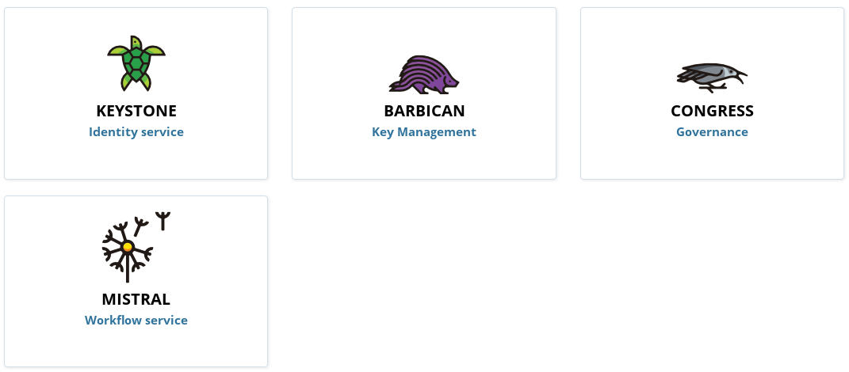
OpenStack Identity Services

Slide 9
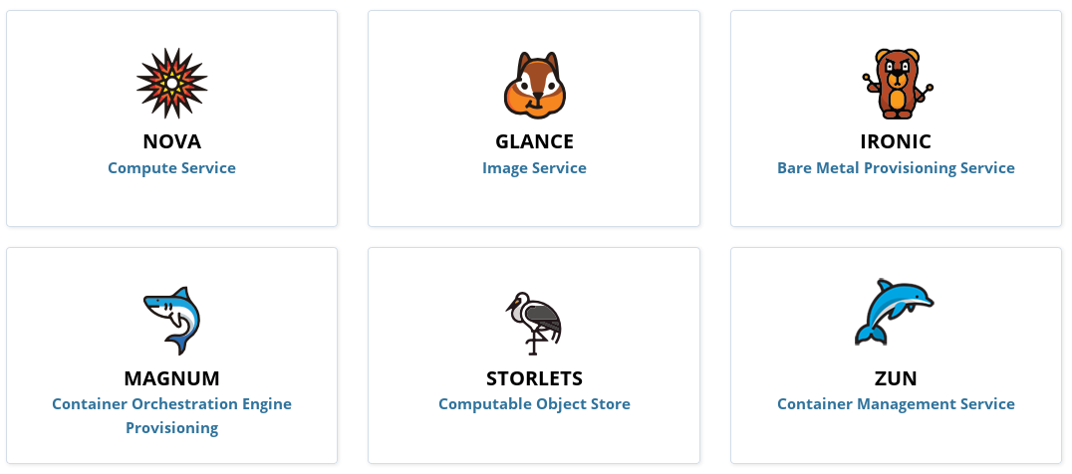
OpenStack Compute Services

Slide 10
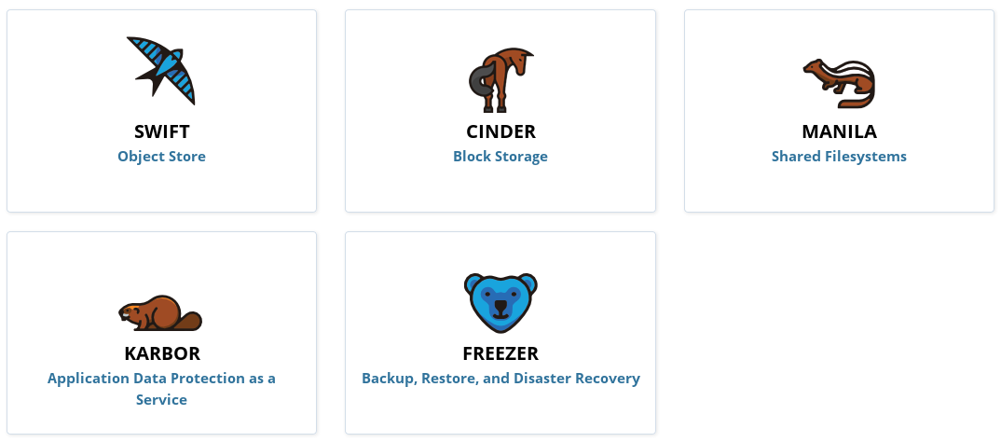
OpenStack Storage Services

Slide 11
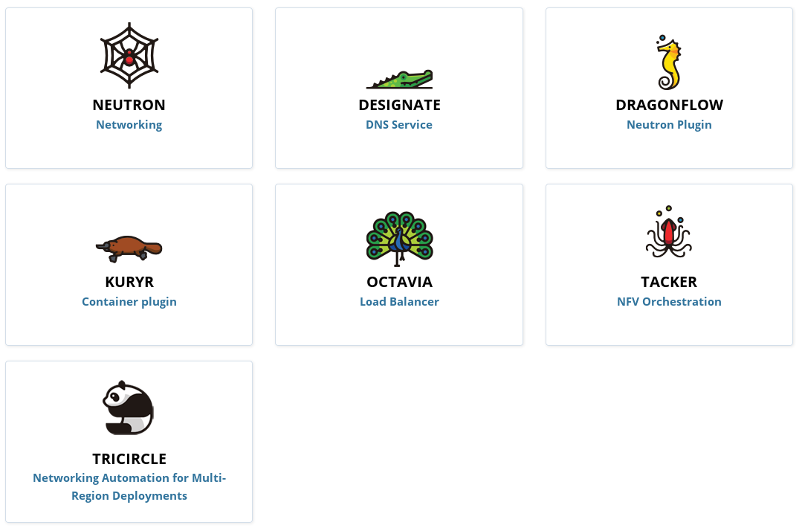
OpenStack Networking Services

Slide 12
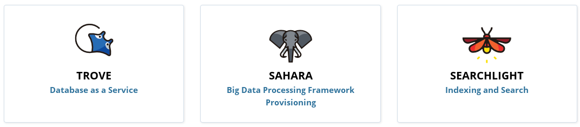
OpenStack Data Services

Slide 13
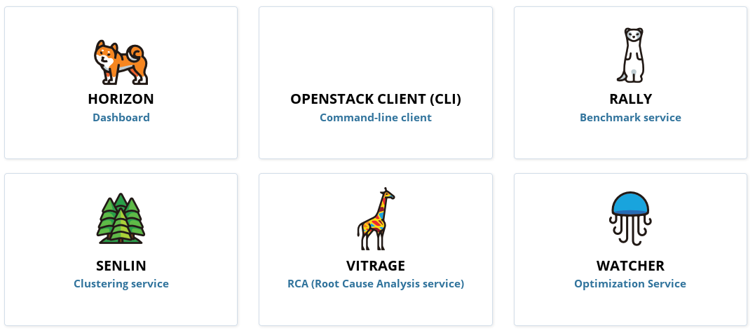
OpenStack Management Services

Slide 14
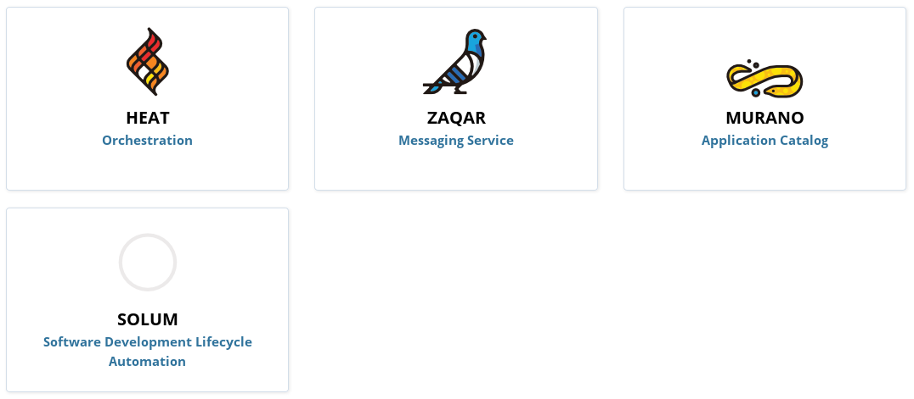
OpenStack Application Services

Slide 15
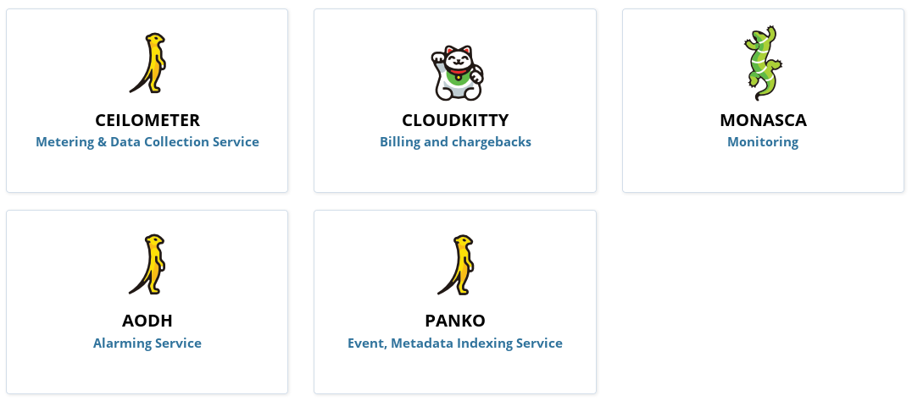
OpenStack Monitoring & Metering

Slide 16
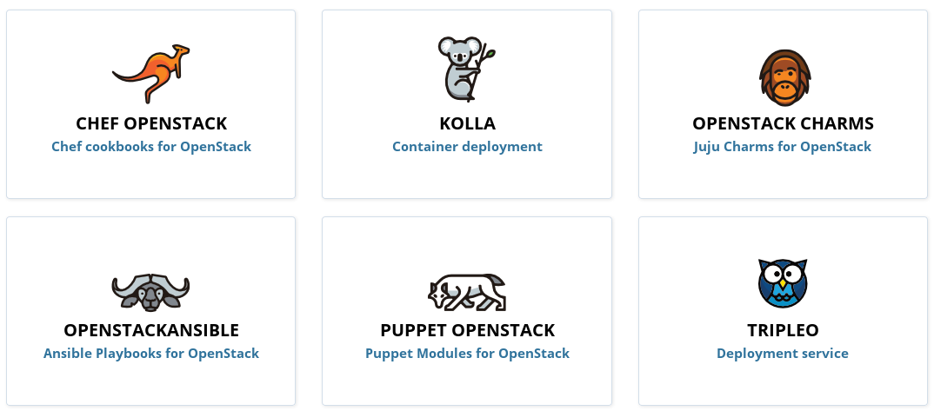
OpenStack Deplyoment Tools

Slide 17
OpenStack Use Cases
Web Applications
Big Data
Ecommerce
Containers
Video Processing and Content Delivery
Telecom and NFV
Enterprise
Scientific Research
HPC/HTC

Slide 18
OpenStack Version
Series | Status | Release Date | EOL
Queens | Under Development
Pike | Stable | 2017-08-30
Ocata | Maintained | 2017-02-22 | 2018-02-26
Newton | Maintained | 2016-10-06 | 2017-10-11

Slide 19



OpenStack Distributions

Slide 20
Distribution Deployment Tools
RHEL/CentOS: Packstack & Triple O: https://www.rdoproject.org
Ubuntu: Conjure-up & Autopilot: https://www.ubuntu.com/cloud/openstack
SUSE/openSUSE: Crowbar: http://crowbar.github.io
Mirantis: Fuel: https://www.fuel-infra.org
Huawei: Compass: http://www.syscompass.org

Slide 21
OpenStack Images
Cirros: http://download.cirros-cloud.net
CentOS: http://cloud.centos.org/centos/
OpenSUSE: http://download.opensuse.org/repositories/Cloud:/Images:/
Ubuntu: http://cloud-images.ubuntu.com
Debian: http://cdimage.debian.org/cdimage/openstack/
Windows Server: https://cloudbase.it/windows-cloud-images/

Slide 22
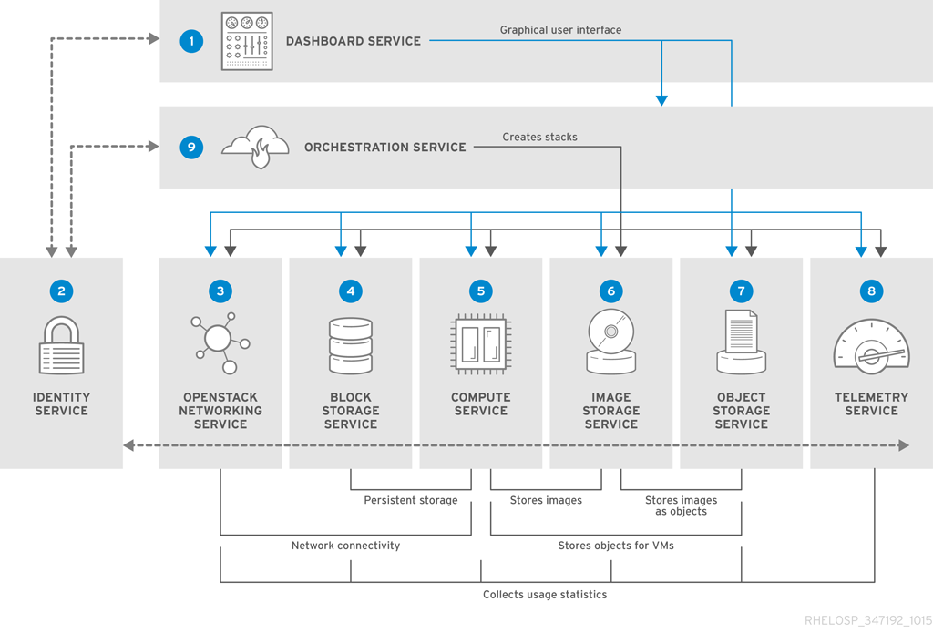
OpenStack Services Diagram

Slide 23
Demo Praktik OpenStack

Slide 24
Kebutuhan Praktikum
Kemampuan administrasi Linux, administrasi jaringan dan administrasi storage
1 VM: CPU 8 cores, RAM 16 GB, HDD 128GB, NIC 2
Sistem operasi: CentOS 7
Skema partisi disk: partisi1 root (/) 100GB xfs, partisi2 swap 8GB, partisi3&4 10GB xfs
Internet

Slide 25



Topologi Praktikum
IPv4 forward
NAT masquerade
INTERNET
vnet1
.1
vnet0
.1
management
10.X0.X0.0/24
Keystone
Glance
Neutron
Nova
Horizon
Heat
Swift
Sahara
gw: .1
.10
eth0
eth1
.10
External: 10.X1.X1.0/24
IP address range of
external subnet: .100 to .199/24 gw: .1

Slide 26
OpenStack Sahara

Slide 27
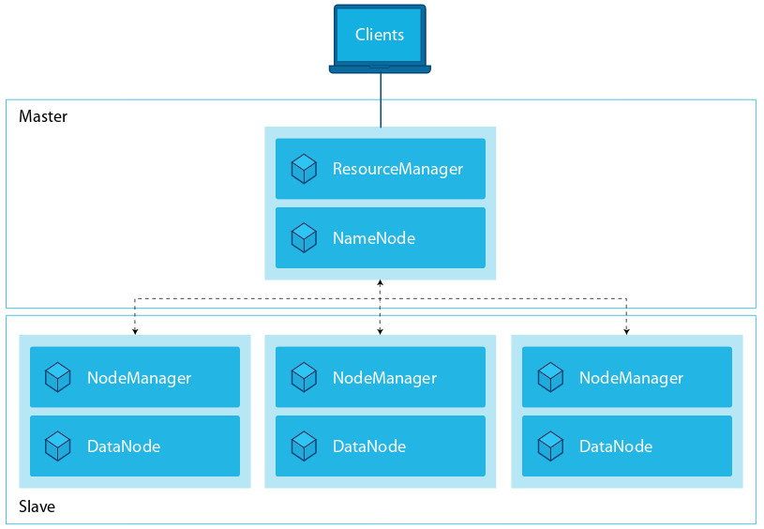
Hadoop High Level Architecture

Slide 28
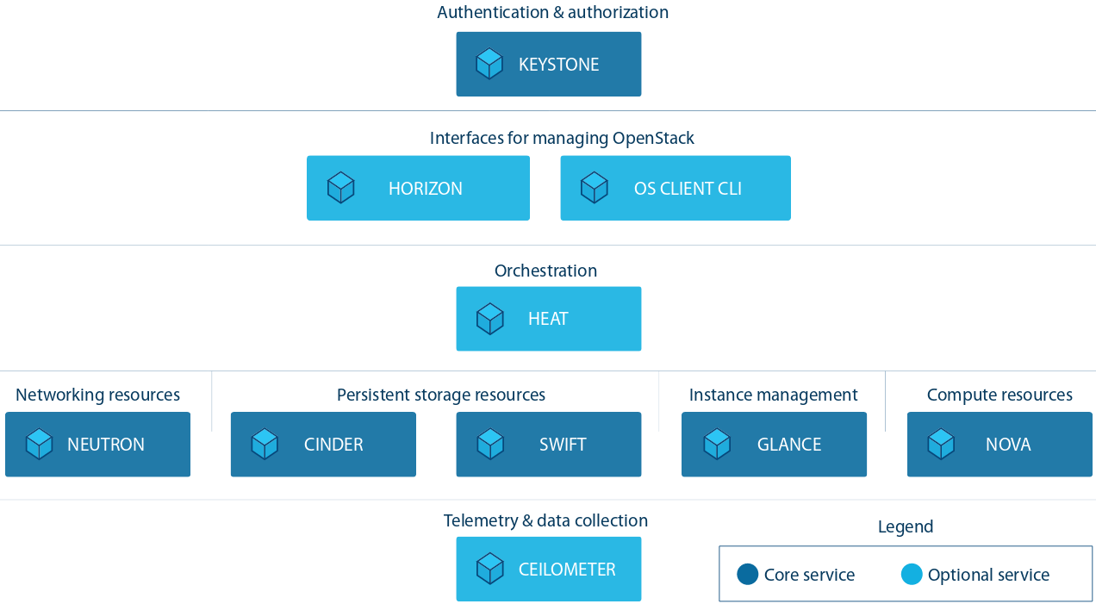
OpenStack Services to support Hadoop

Slide 29
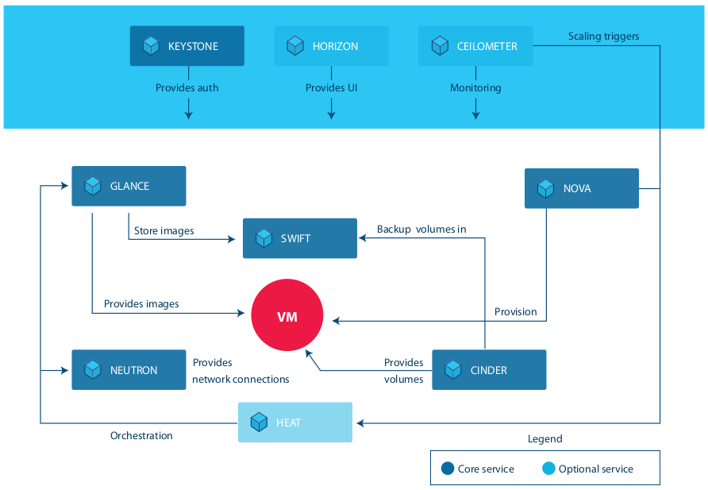
OpenStack Services Interaction

Slide 30
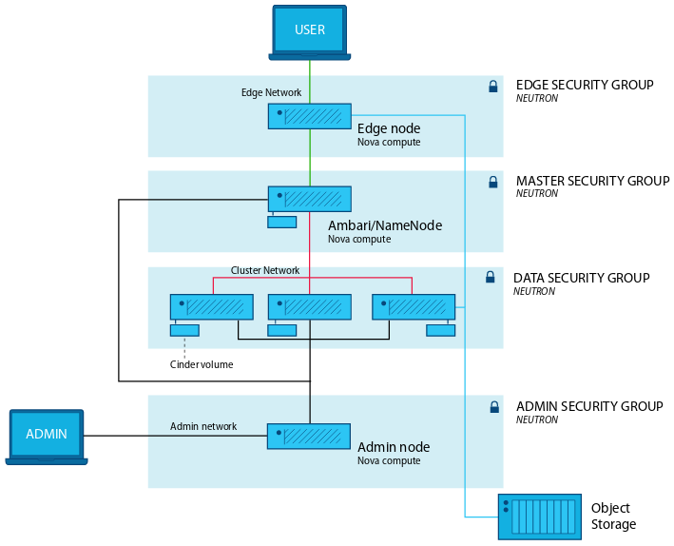
Hadoop Cluster on OpenStack

Slide 31
Sahara Introduction
Provide users with a simple means to provision data processing frameworks (Hadoop, Spark, Storm) clusters by specifying several parameters such as the version, cluster topology, hardware node details and more.
Use cases:
Fast provisioning of data processing clusters on OpenStack for development and quality assurance(QA).
Utilization of unused compute power from a general purpose OpenStack IaaS cloud.
“Analytics as a Service” for ad-hoc or bursty analytic workloads (similar to AWS EMR).

Slide 32
Sahara Key Features
Designed as an OpenStack component.
Managed through a REST API with a user interface(UI) available as part of OpenStack Dashboard.
Support for a variety of data processing frameworks:
Multiple Hadoop vendor distributions.
Apache Spark and Storm.
Pluggable system of Hadoop installation engines.
Integration with vendor specific management tools, such as Apache Ambari and Cloudera Management Console.
Predefined configuration templates with the ability to modify parameters.

Slide 33
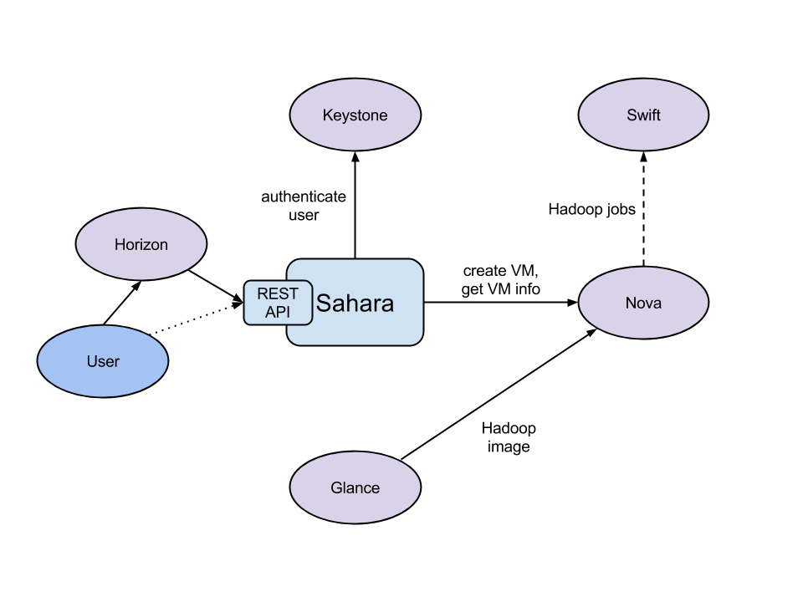
Sahara and Other OpenStack Services

Slide 34
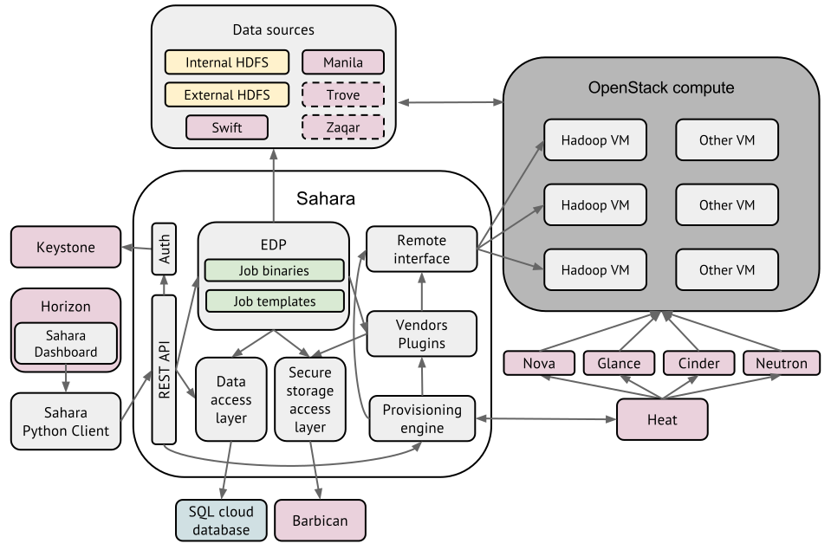
Sahara Architecture

Slide 35
Cluster Provisioning Workflow
Select a Hadoop (or framework) version.
Select a base image with or without pre-installed data processing framework. Download prepared up-to-date images from http://sahara-files.mirantis.com/images/upstream/
Define cluster configuration, including cluster size, topology, and framework parameters (configurable templates are provided).
Provision the cluster; sahara will provision VMs, install and configure the data processing framework.
Perform operations on the cluster; add or remove nodes.
Terminate the cluster when it is no longer needed.

Slide 36
Analitycs as a Service Workflow
Select one of the predefined data processing framework versions.
Configure a job.
Set the limit for the cluster size.
Execute the job.
Get the results of computations (for example, from swift).

Slide 37
Demo Praktik Sahara

Slide 38
Terima Kasih
www.acci.or.id

