Slide 1
TCP/IP
Michaela Blott, Kimon Karras, Kees Vissers
- Xilinx Research, Dec 2014

Slide 2
Agenda
Introduction
Architecture
Interface
Specification
Design flow and testing
Performance measurements
Board support

Slide 3
Introduction

Slide 4
Motivation
TCP/IP is a key component of a networked server (accounts for 80-90% of all traffic)
TCP/IP is a burden on CPUs
  CPU intensive
  Large footprint/high rate of instruction cache misses (160MPKI)
  Frequent interrupts causing stalls in superscalar pipelines x86
Full TCP offload on FPGAs
  Unburdens the CPU
  Enables offloading of many additional functions onto FPGAs for many applications (memcached, encryption, data mining, machine learning)
  However, it is complex.

Slide 5


The Challenges
Connection-oriented protocol
requires keeping state for 1000s sessions
Lookups in 1000s
FSM
State
State
State
State
State
State
TCP/IP
Stream-oriented protocol
Data streams need to be segmented and assembled in packet sizes
Pkt
buffer
State
Acknowledged data transfer
State keeping and packet buffering for each data transfer is required
Interrupt intensive
Various timeouts

Slide 6
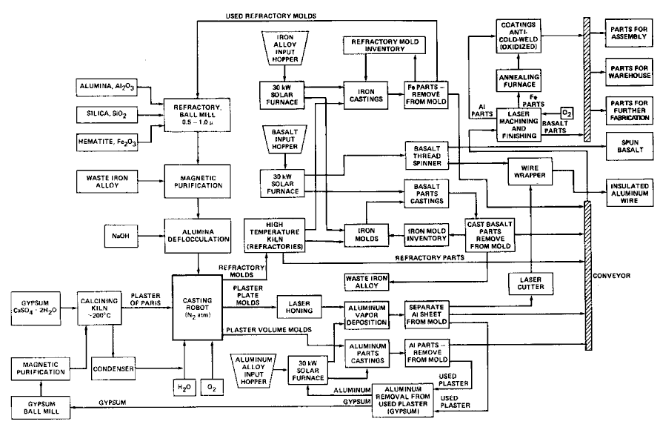

The Challenges
Out-of order processing required
Packet buffer
Congestion control
Complex algorithms to adjust packet size
30years of legacy code
50k lines of code
Most of this becomes extra hard for large number of sessions
(requires different architectures)

Slide 7
Architecture

Slide 8
Stack Architecture
(configurable)
Handling ARP requests and storing MAC-IP tuples
MAC Protocol Parsing
IP checksum verification
IP Protocol Parsing
Split Streams
10Gbps Network interface (10GMAC + PHY)
ARP
IP Input
Handler
IP Output
Handler
ARP
table
...
UOE
TOE
ICMP
UOE
TOE
Any other
protocol
Any other
protocol
Constructing MAC frame
IP checksum computation
MAC Lookup in ARP Table
Merge Streams
ICMP (Ping) server
DHCP
DHCP
DHCP server
Application

Slide 9
TCP Architecture
Pipelining of functionality – Data flow design to achieve linkrate
RX data path
TX data path
RX Engine
TX Engine
Leveraging HLS to reduce development time to an acceptable level
(recode from scratch)
Data
Structures
RX buffer
TX buffer
Application Interface
Careful design of central data structures and flow of information to avoid access conflicts
To support 10K sessions data is buffered in DDR memory (1.3Gbyte)
RX application i/f
TX application i/f

Slide 10
TCP Architecture
RX data path
SmartCam
TX data path
RX Engine
Session lookup
TX Engine
Maps the IP tuples to Session-IDs. Use HashTable instead of CAM
(SmartCAM from PPP)
Keeps Track of used and listening IP port
Stores the state of each session: CLOSED, SYN-RECV, SYN-SENT, ESTABLISHED….
SAR Tables are storing the information of the TCP receive & send window
Propagates Events through the system
Timers, for retransmission, probing, closing
Port Table
State Table
Timers
RX buffer
TX buffer
Event engine
TX SAR table
RX SAR table
RX application i/f
TX application i/f

Slide 11
Interface

Slide 12
TCP/IP– Full control/complexity exposed
listenPortReq(port)
Listening on TCP port
TCP/IP
Application
listenPortRsp(ok)
Notify application about new data
notification(data_avail,len,sid,state)
RX BUFFER
RX
rxDataReq(sid,len)
Application is requesting data from memory
TX BUFFER
rxDataRsp(data,metadata=sid))
Data & metadata is streamed to application
SMARTCAM
openConnReq(ipadr,port)
Open active connection
openConnRsp(sid,ok)
Application streams data & metadata to TCP
10G RX
TX
txDataReq(data,metadata=sid+len)
10G TX
txDataRsp(len)
TCP returns length of data sent
closeConnReq(sid)
Close active connection
closeConnRsp(ok)

Slide 13
UDP– Simple Streaming Interface
UDP
Application
Open port
Open or close UDP port
Port release
RX BUFFER
RX
Port Status
Confirmation
TX BUFFER
rxData,metadata=s+d ports, s+d IPadr
Data & metadata is streamed to application
SMARTCAM
Application streams data & metadata to UDP
10G RX
TX
txData,metadata=s+d ports, s+d IPadr
10G TX

Slide 14
Current Spec

Slide 15
Specification
Features
  Fully functional TCP/IP end point on Alpha Data & VC709 boards
  UDP support
  Basic DHCP Client
  3rd party compliant
  Supports 10K sessions (scalable)
  Basic flow control/congestion management
  10Gbps performance
  Out of order processing up to 4 segments (programmable)
Limitations
  No IP fragmentation
  Various IP and TCP options and flags.
    Are ignored if present
  No IPv6 support

Slide 16

TCP/UDP Offload Resource Use
All results are post-synthesis with Vivado 2014.2
 | Network Interface | Memory Interface | TCP/IP Stack | Total | Available on V7690T
FF | 5581 | 57637 | 28713 | 95873 11.1% | 866400 100%
LUT | 5321 | 43591 | 28706 | 81884 18.9% | 433200 100%
BRAM | 8 | 36 | 441 | 471 32.0% | 1470 100%
Breakdown (TCP/IP)
 | IP Handler | ARP Server | ARP Smart CAM | MAC/IP Encode | ICMP Server | DHCP Client | Session Smart CAM | TOE non-OOO | TOE OOO | UOE
FF | 1119 | 1251 | 1907 | 721 | 1568 | 505 | 2065 | 15504 | 17638 | 1939
LUT | 1036 | 607 | 1653 | 566 | 1573 | 468 | 2112 | 14897 | 18698 | 1993
BRAM | 3 | 6 | 42.5 | 9 | 12 | 0 | 57.5 | 250.5 | 304 | 16

Slide 17
Latency / Line of Code
Latency (1B payload):
  TCP Offload Engine:
    Rx path: 1.1μs
    Tx path: 0.8 μs
  UDP Offload Engine:
    Rx path: 118 ns
    Tx path: 92.4 ns
Line of code:
HLS | IP Handler | ARP Server | MAC/IP Encoder | ICMP Server | TOE non-OOO | TOE OOO | UOE | Total
LoC | 1592 | 462 | 370 | 534 | 5985 | 6441 | 736 | 10142
Notes:
Clean up Mac-ip-encode

Slide 18
Design Flow & Testing

Slide 19
Design Flow
TCP/IP stack
(C++)
Vivado
(simulation + cosimulation)
Wrapper
(top-level module)
IP
(GEMAC, CAM, etc)
Vivado HLS
(synthesis)
Vivado
Vivado Simulation
bitstream

Slide 20
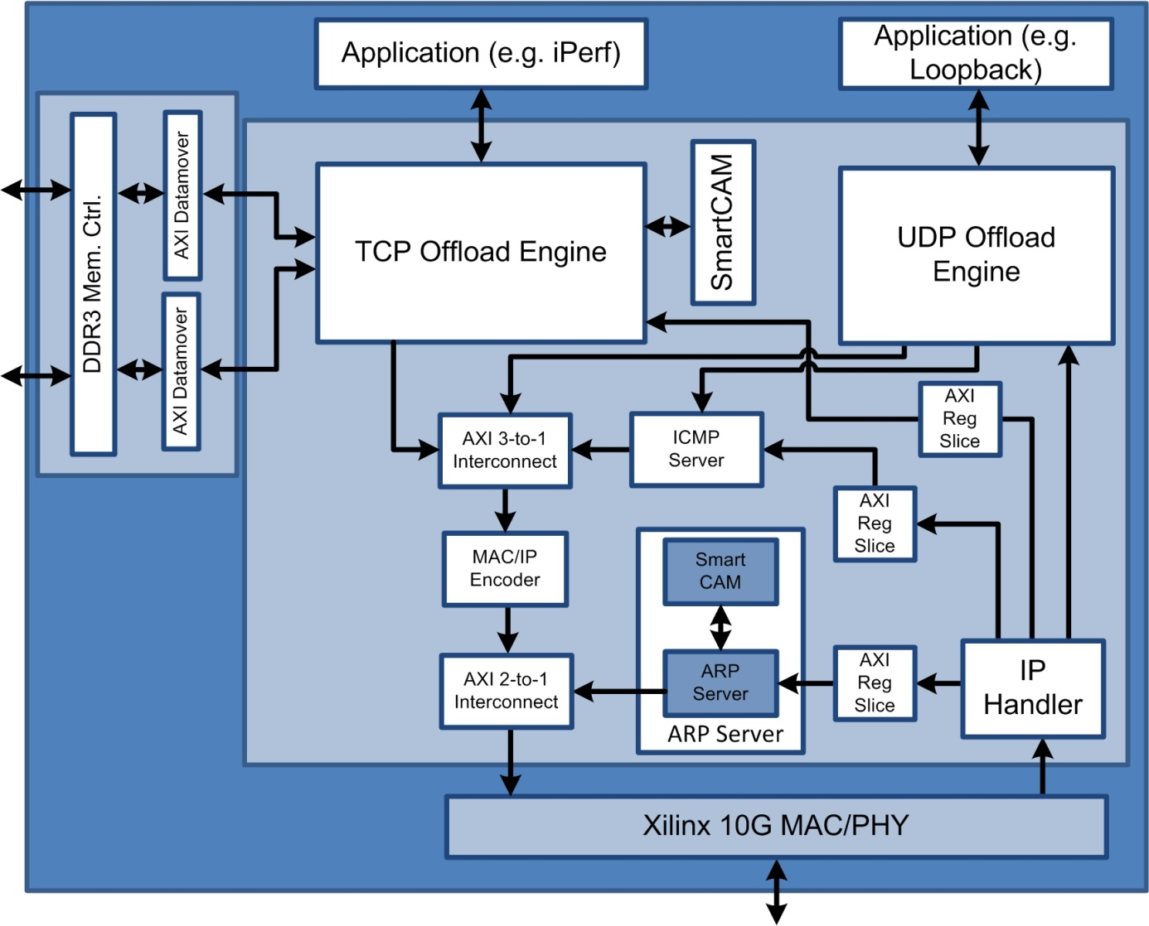

Design Structure

Slide 21
Testing
Disclaimer: Research produced reference design
Simulation
Hardware testing

Slide 22

Simulation
Simulation was performed at 3 different levels
C & C/RTL simulations of all VHLS IP as unit test/subsystems
Additional RTL simulations with handwritten testbenches of interfaces
Demonstration?

Slide 23
Hardware Testing
3 Xilinx test designs
  Echo TOE which we use in conjunction with iperf performance demo
  Web server:
    Used for demo-ing 10k sessions
  Integrated memcached design – used to test memcached in conjunction with standard memcached client (typically lack UDP support)
Systems
  companyX, ETH Zurich, Xilinx

Slide 24
Test Designs
Echo TOE
  Vc709+AD
Webserver TOE
  VC709
companyX TOE
  AD
FPGA
TOE
FPGA
TOE
Web server
FPGA
TOE
companyX

Slide 25
Performance

Slide 26
Performance measurements at Xilinx
System setup with i7 server, chelsio NIC and iperf (8.4Gbps in the lab on application level)
  Reschedule for demo if needed
Spirent testing to commence in 4 weeks once equipment back in the lab
ETH and RTL simulation can show full throughput
I7 server
AlphaData
Chelsio

Slide 27
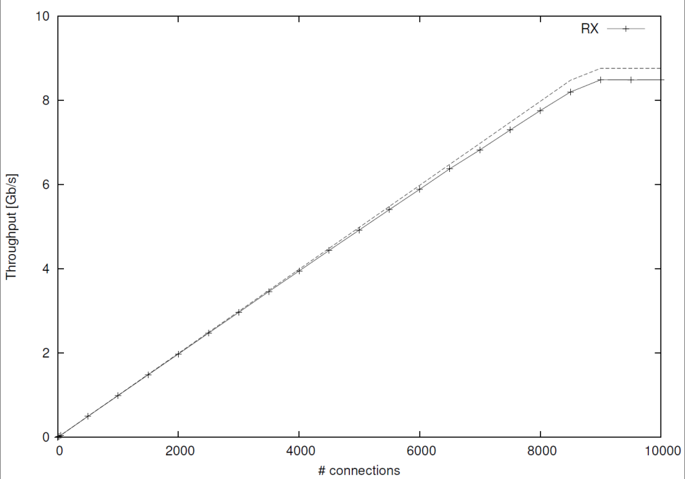
Performance Measurements at ETH
I7 server
intel
switch
VC709
I7 server
intel
Using handcoded test client
Demonstrate maximum TCP throughput in hardware

Slide 28
Board Support

Slide 29
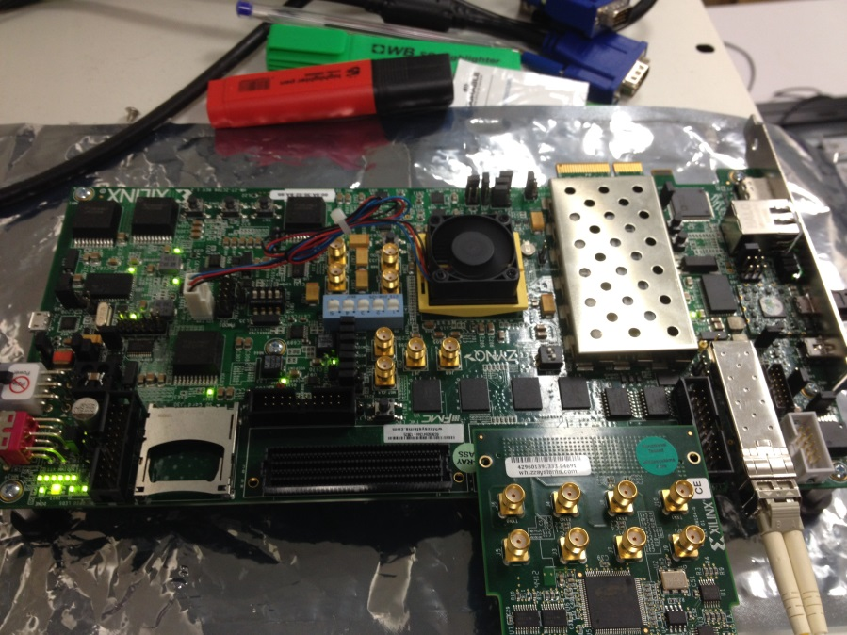
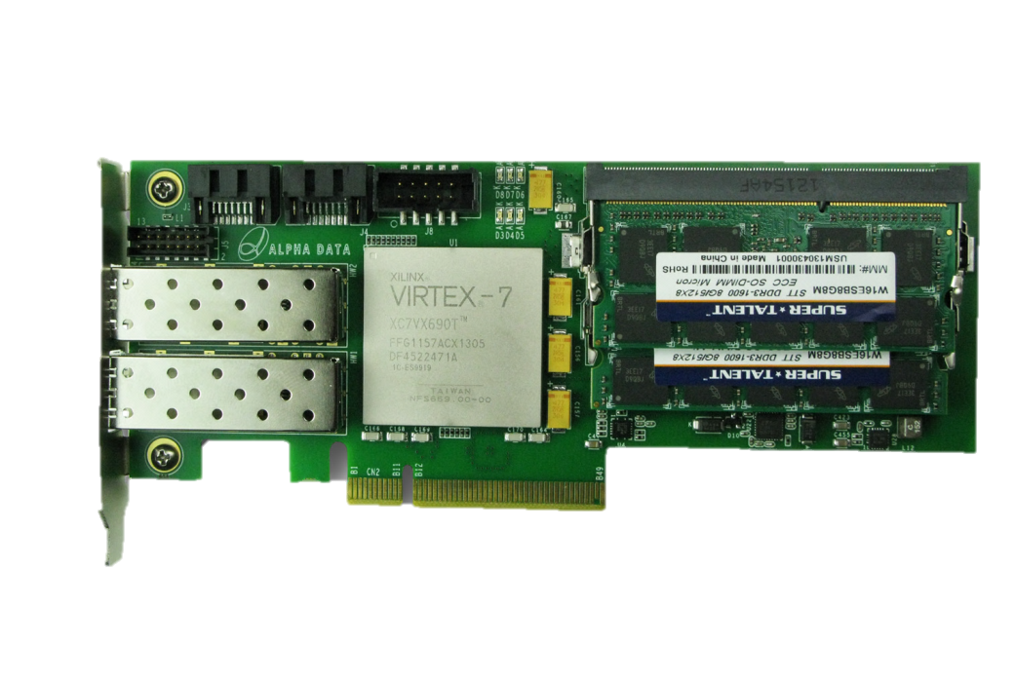
Board Support
VC709
AlphaData
  ADM-PCIE-7V3
2 SATA3
2x 8GB SODIMM
2x 10G SFP+
V7 690T
PCIe Gen3 x8

Slide 30
Backup

Slide 31
Reminder: How does TCP/IP work?
A
SYN
B
SYN ACK
Session
set-up
ACK
Tx: D0..19
Rx: D19
Space: 10bytes
Tx: D0..D4
Data
transfer
No ack?
Rx: D4
Space: 0bytes
Tx: D20..29
Rx: D4
Space: 0bytes
Tx: D20..29
…
Session
Tear down
FIN
…

Slide 32
TCP/IP: Software-Style Interface (API)
Full control over session management and flow control over data streams
Server:
sServer = socket();
bind(sServer, server_addr); listen(sServer);
con = accept(sServer, client_addr);
len = read/write(con, buf, buf_len);
close(con); close(sServer); //conn & socket
Client:
sClient = socket();
connect(sClient, server_addr);
len = write/read(sClient, buf, buf_len);
close(sClient);

Slide 33
Demo

Slide 34


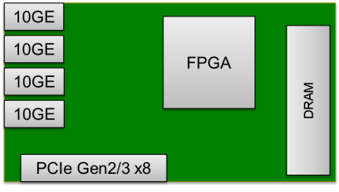
Demo Set-up
running a web browser
connected to FPGA
set-up & tear-down of sessions,
transfers data
Ethernet switch
with 10G uplinks
10G optical cable
1G cable
VC709 TCP/IP prototype with
simple webserver (showing active sessions)
and echo application

Slide 35
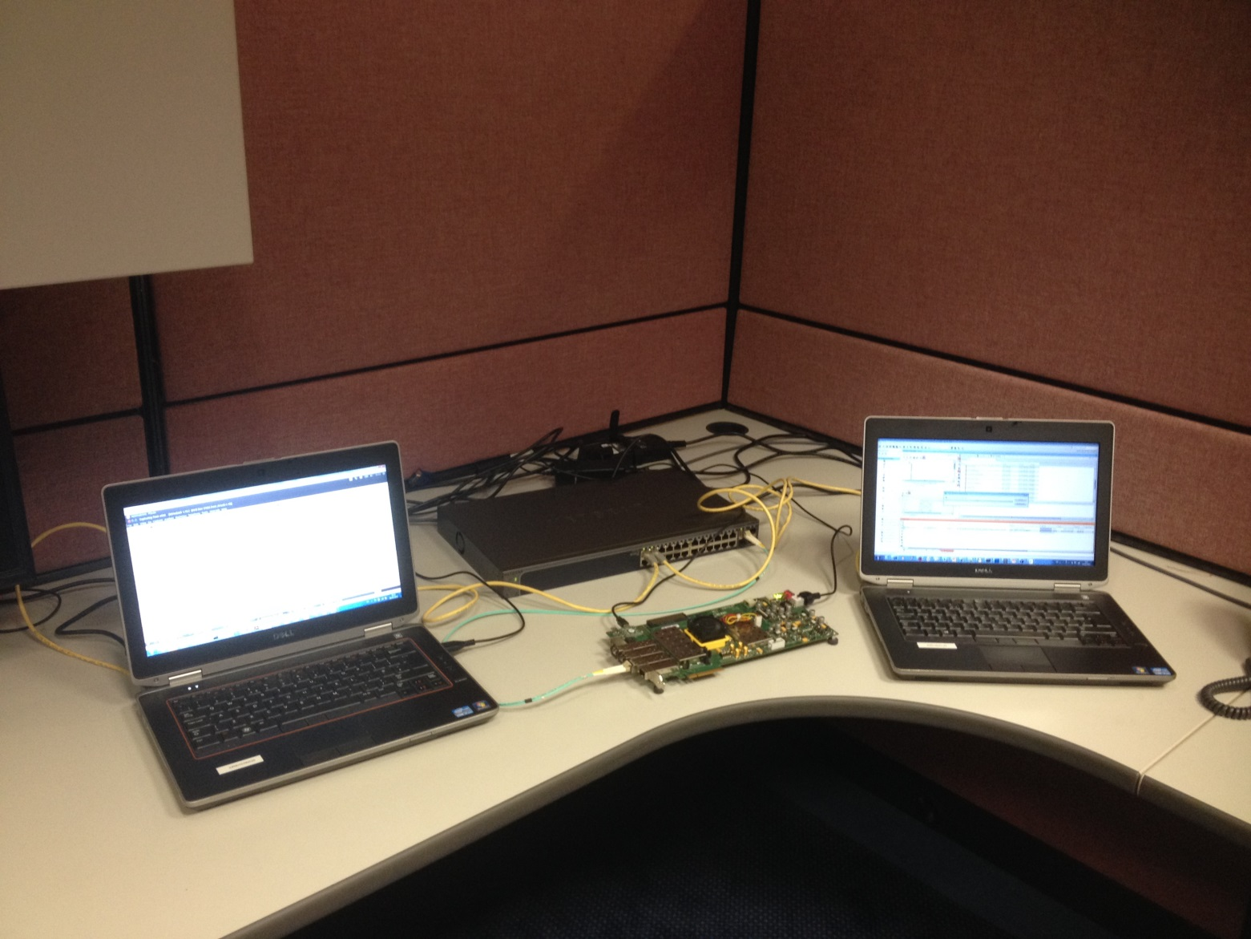
Lab Setup in Reality

Slide 36
Small TCP/IP Demo Video
Notes:
Vid6: power of software: (show maxeler terminal 4 windows, show pwr meter, show spirent test center traffic setup, start traffic (get only 4B keys), show counters, show tx dial, show power meter)

Slide 37
Rx Port Open
TCP Offload Engine IP
User Logic
Rx App
I/F
Port Open Request – appListenPortReq: port to open
Application
To Port Table - Open Port
. . .
From Port Table – Request Status
Port Open Reply –
appListenPortRsp: success or failure

Slide 38
Rx Data Read
Rx Data Present – notification: session ID, IP Address, Port Number, Length of the received segment
Rx App
I/F
Application
Rx Data Request from App – appRxDataReq: session ID & length of the data to be read
To DRAM – Read Cmd
Rx Data Session ID – appRxDataRspMetadata: Session ID
. . .
Rx Packet Data – rxDataRsp: packet data

Slide 39
Tx Session Init
Open Session –
appOpenConnReq: IP Address & Port Number
Tx App
I/F
Application
To Session Lookup – Get Session ID
From Session Lookup – Session ID
To Port Table – Verify state
. . .
Open Session Response – appOpenConnRsp: session ID, success or failure)
From Port Table – Retrieve State

Slide 40
Tx Data Write
Data Sent Request – appTxDataReqMetadata: Session ID
Tx App
I/F
Application
From State Table – Current Session State
Missing: Notification in case of failed request
. . .
To State Table -State Lookup
Application Tx Data – appTxDataReq: Data
To DRAM - DRAM Wr. Cmd
. . .
Memory Wr. Response – appTxDataResp: length of data written
To DRAM - DRAM Wr. Data

