Slide 1



Indian Ocean Dipole, Relative Oceanic Nino Index and Western Indian Ocean Outlook for OND
Laura Harrison and Chris Funk
June 2026

Slide 2
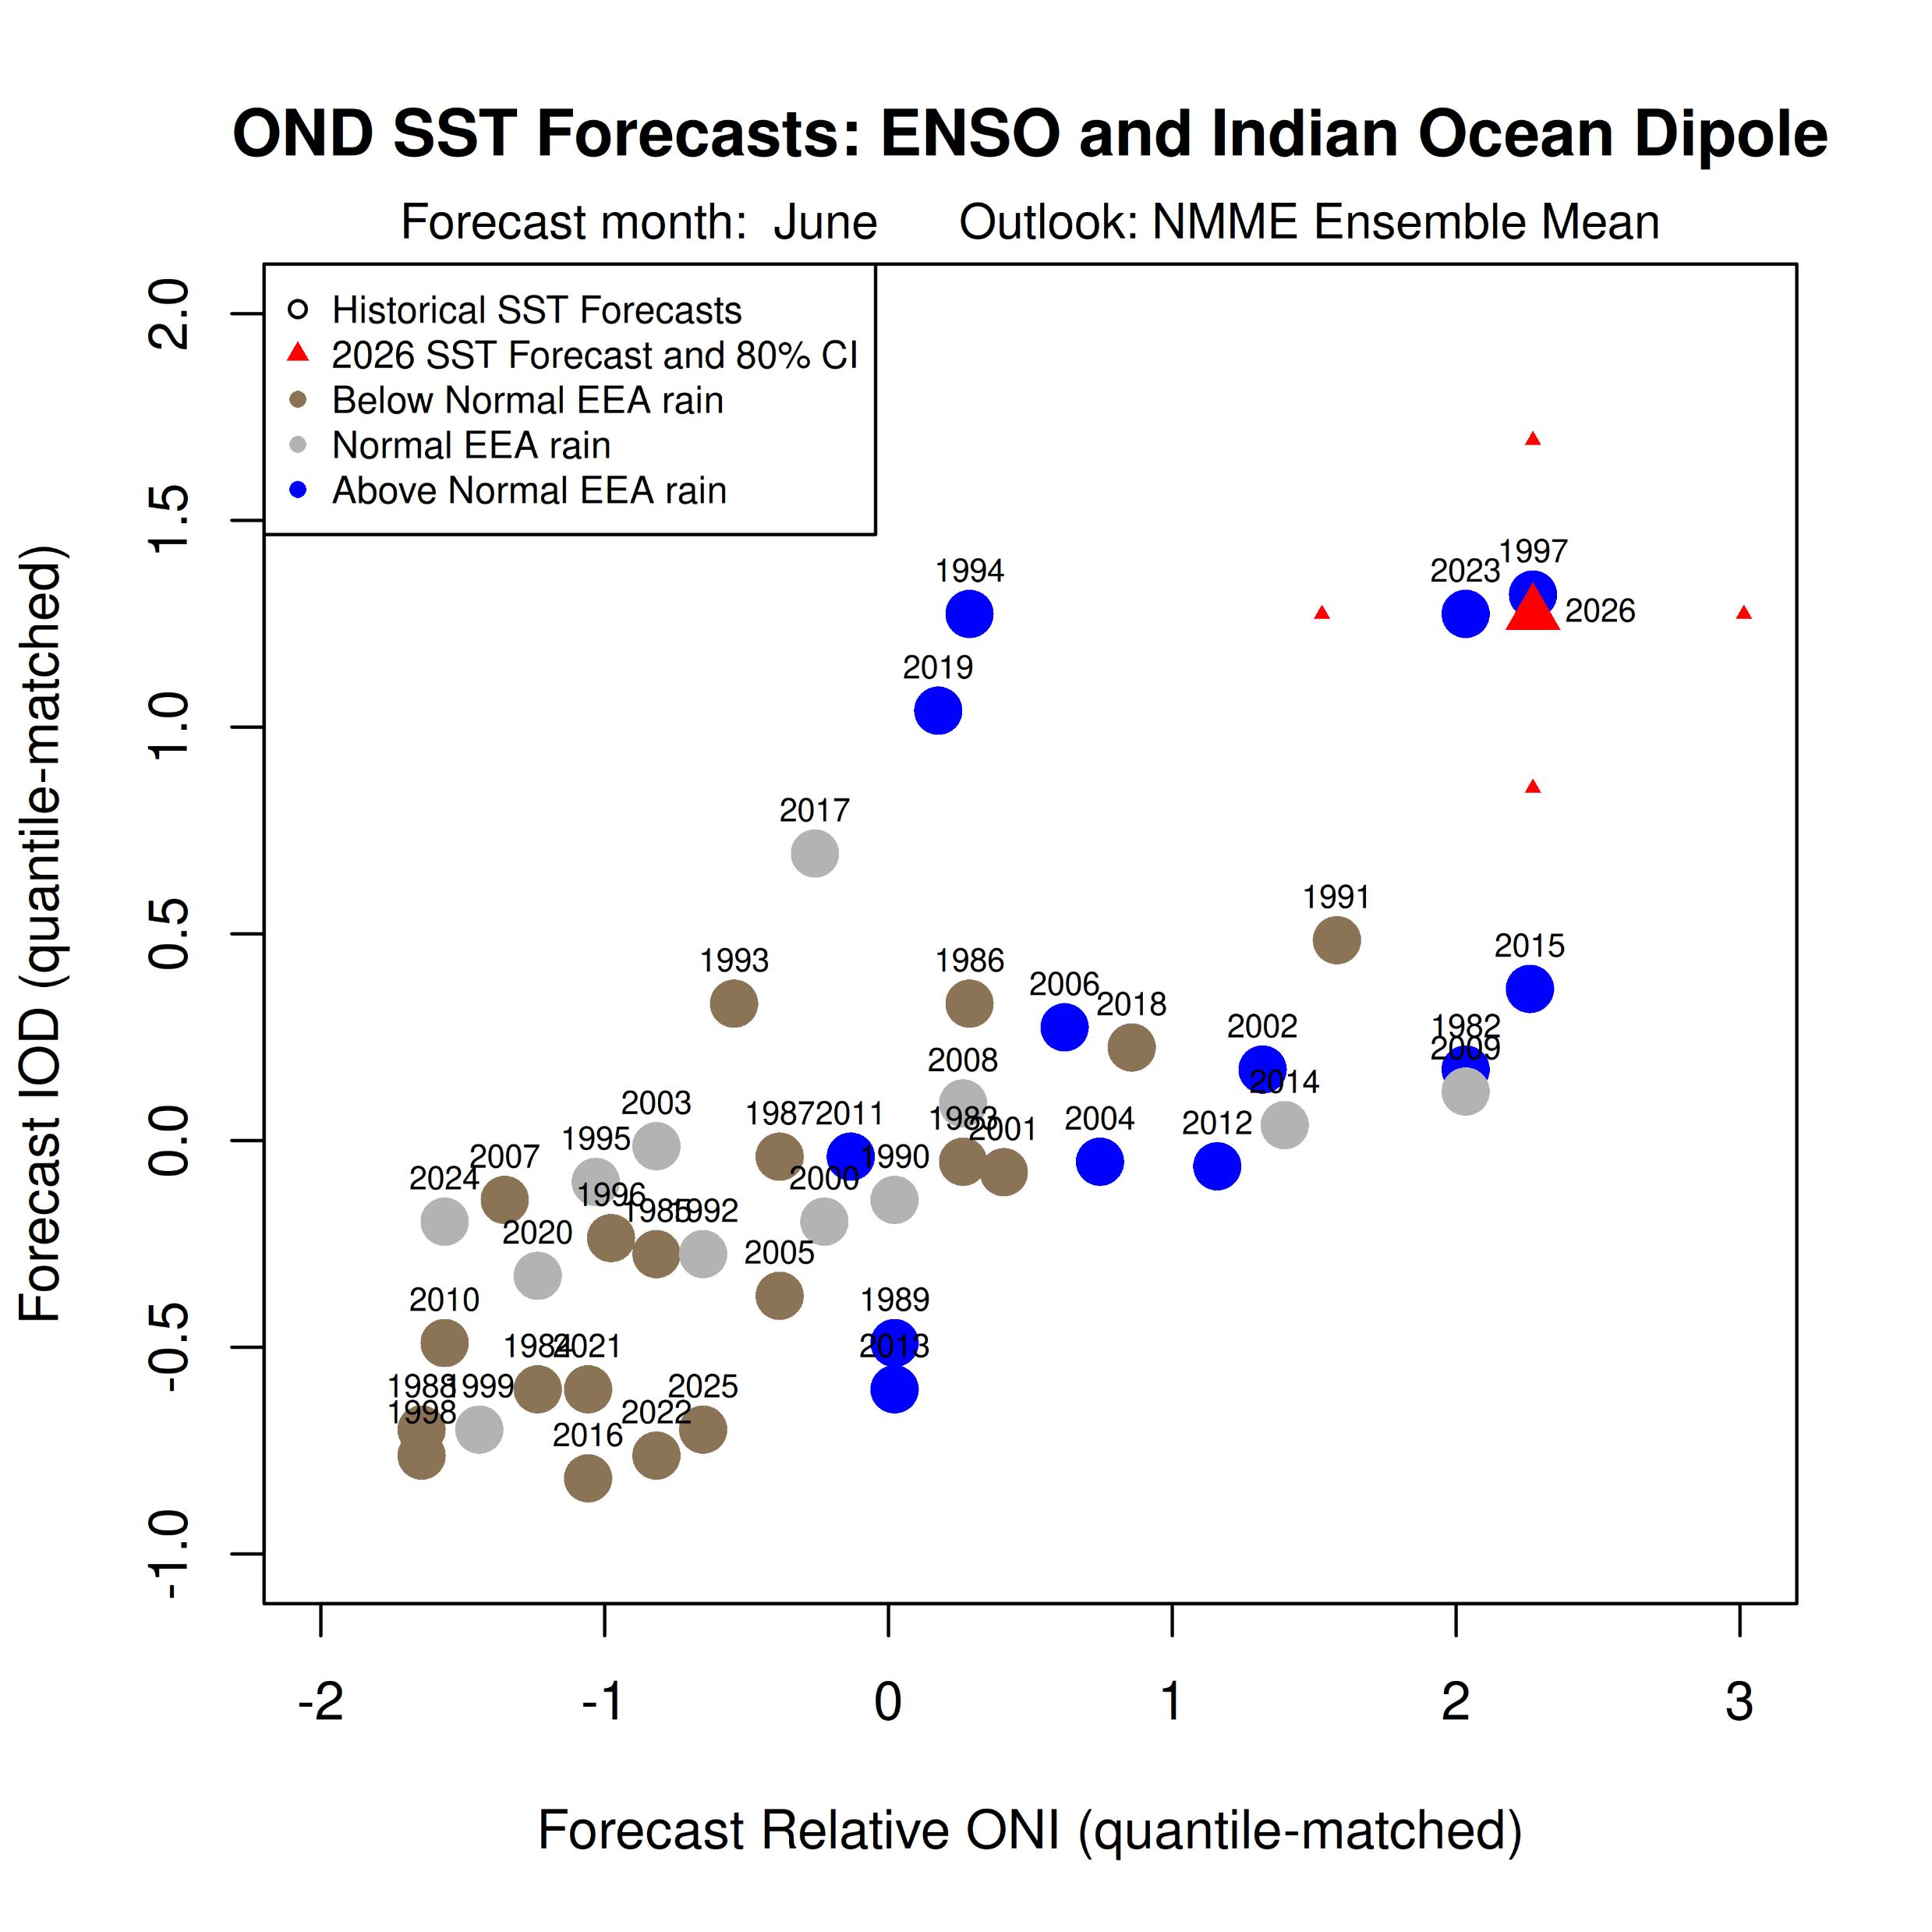
October November December IOD and RONI Forecast Scatterplot
The x and y axes show 1981-2026 OND RONI and IOD forecasts °C.
The current forecast (large red triangle) can be compared to past forecasts for RONI and the IOD index.
An extreme outlook similar to 1997 and 2023 is anticipated. Little triangles around the OND 2026 forecast triangle give us a sense of the zone within which we are pretty sure the forecast values will end up falling within, based on the range of errors from historical forecasts (1991-2020). These small triangle indicate the 80th percent confidence bounds.
The colors of points indicate the rainfall tercile outcomes for the eastern East Africa region, based on CHIRPS3 data and a 1991-2020 baseline.

Slide 3
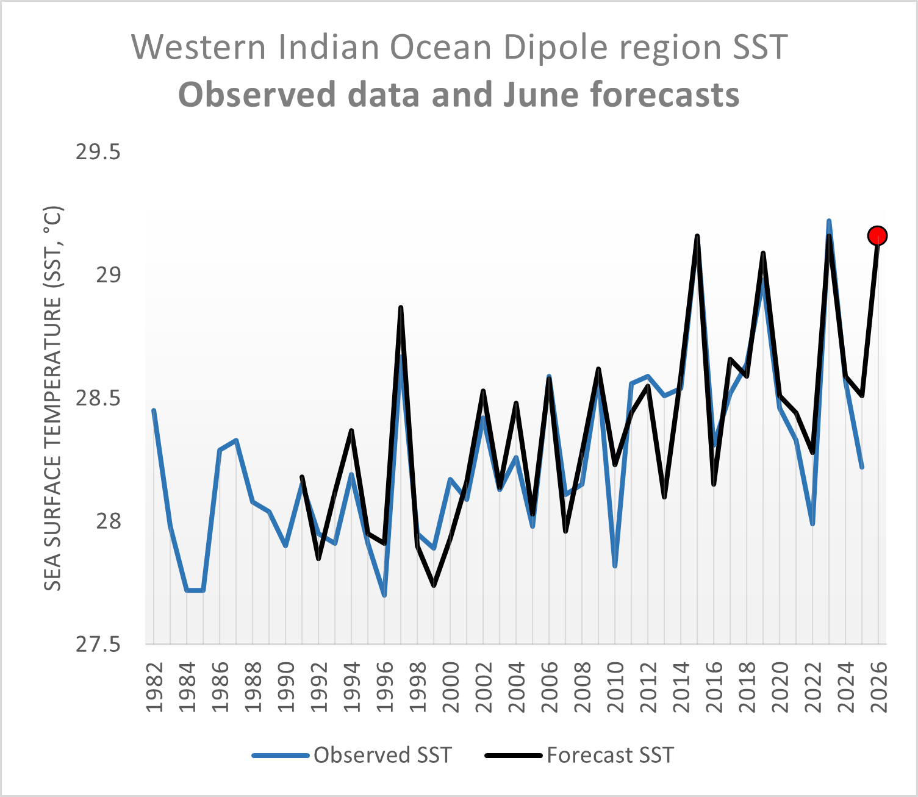
Time series of Western Indian Ocean SST
This figure shows a time series of SST for the western IOD region (i.e. the western part of the IOD).
Similar years of predicted very warm western Indian Ocean SST (1997, 2015, 2019, 2023).
Expected western Indian Ocean SST values are expected to be very warm (>29°C). This sets the stage for very extreme rainfall in eastern East Africa.

Slide 4
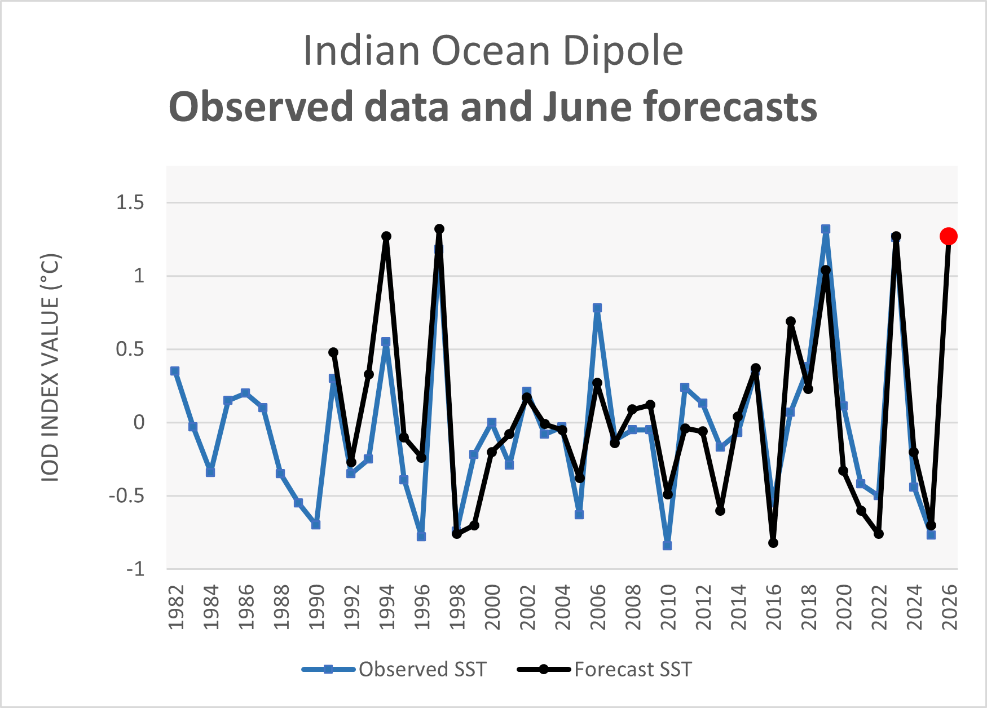
Observed OND IOD Time Series with 2026 Forecast
This figure shows a forecast for a strong positive IOD, as also shown in the scatterplot slide.
In comparison to the above, we can see which of the previously forecast strong positive IOD values involved especially warm western IOD SST (1997, 2015, 2019, 2023).
Meaning enhanced opportunity for lots of rain, due to supporting moisture transports and warm SST enhancing atmospheric moisture and instability.

Slide 5
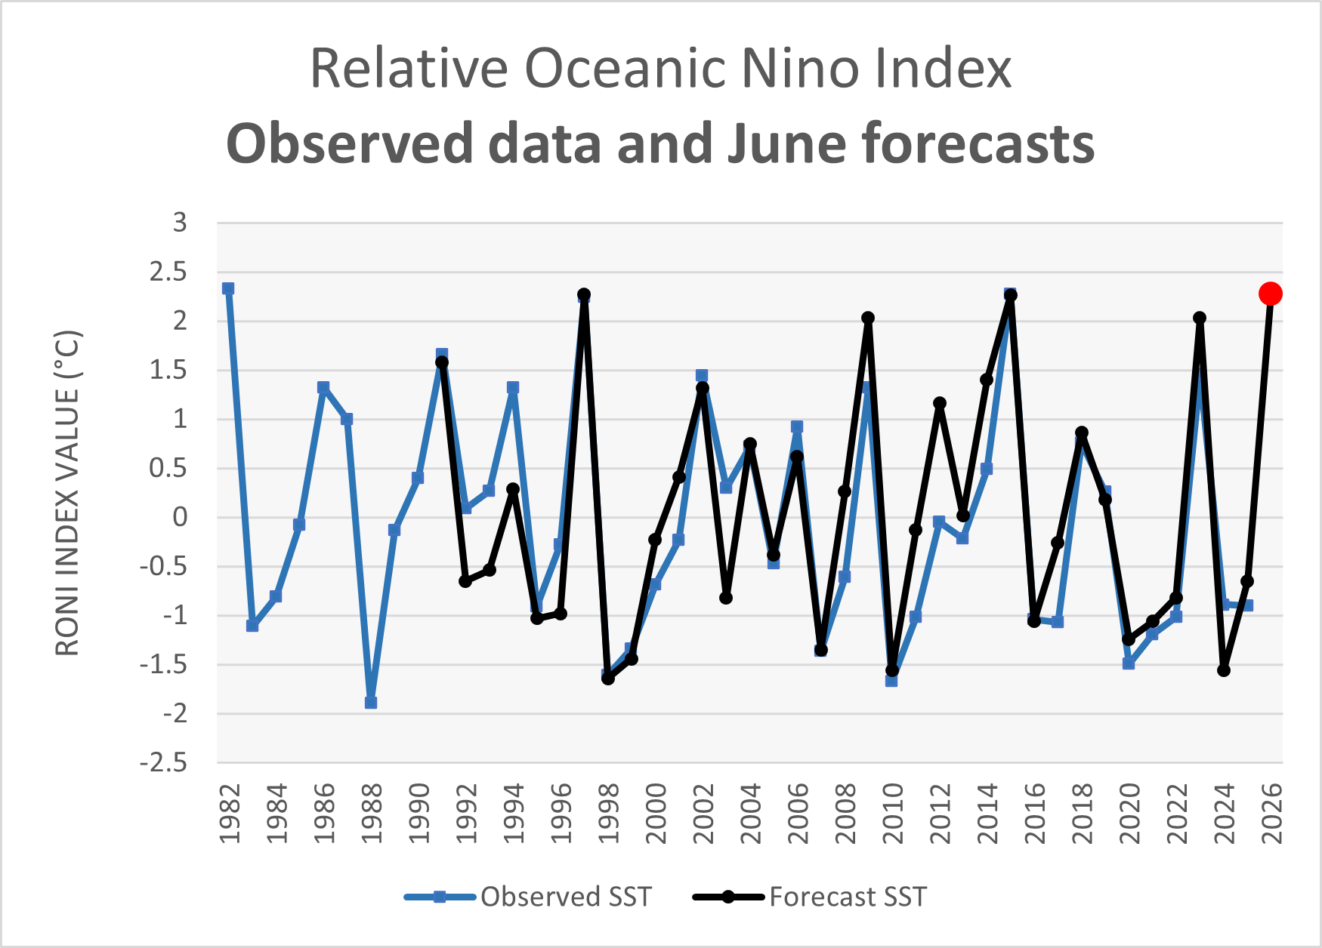
Observed OND RONI Time Series with 2026 Forecast
This figure shows a forecast for a strong El Nino, as also shown in the scatterplot.

Slide 6
Comments
To the forecast values shown here, which are the ensemble mean forecast across 6 NMME models, I applied a quantile-matching bias correction (to the observed SST data). This helps adjust the forecast values a bit to reflect the relationship between past forecasts and observed values. The observed SST data is ERSSTv5. I've employed a 1991-2020 baseline for computations.
It is pretty clear from these that for OND 2026 we are primarily anticipating a special case of strong El Nino and strong positive IOD, with especially warm western Indian Ocean SST.
This analysis identified a small set of standout relevant years: 1997, 2015, 2019, 2023.
Other strong positive IOD or El Nino seasons could also be used as analogs.

