Slide 1

ReliSource
architecture development.
By Alim Ul Karim

Slide 2
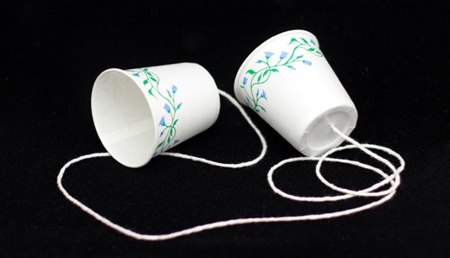
Technology
It’s not the cutting edge ever!

Slide 3
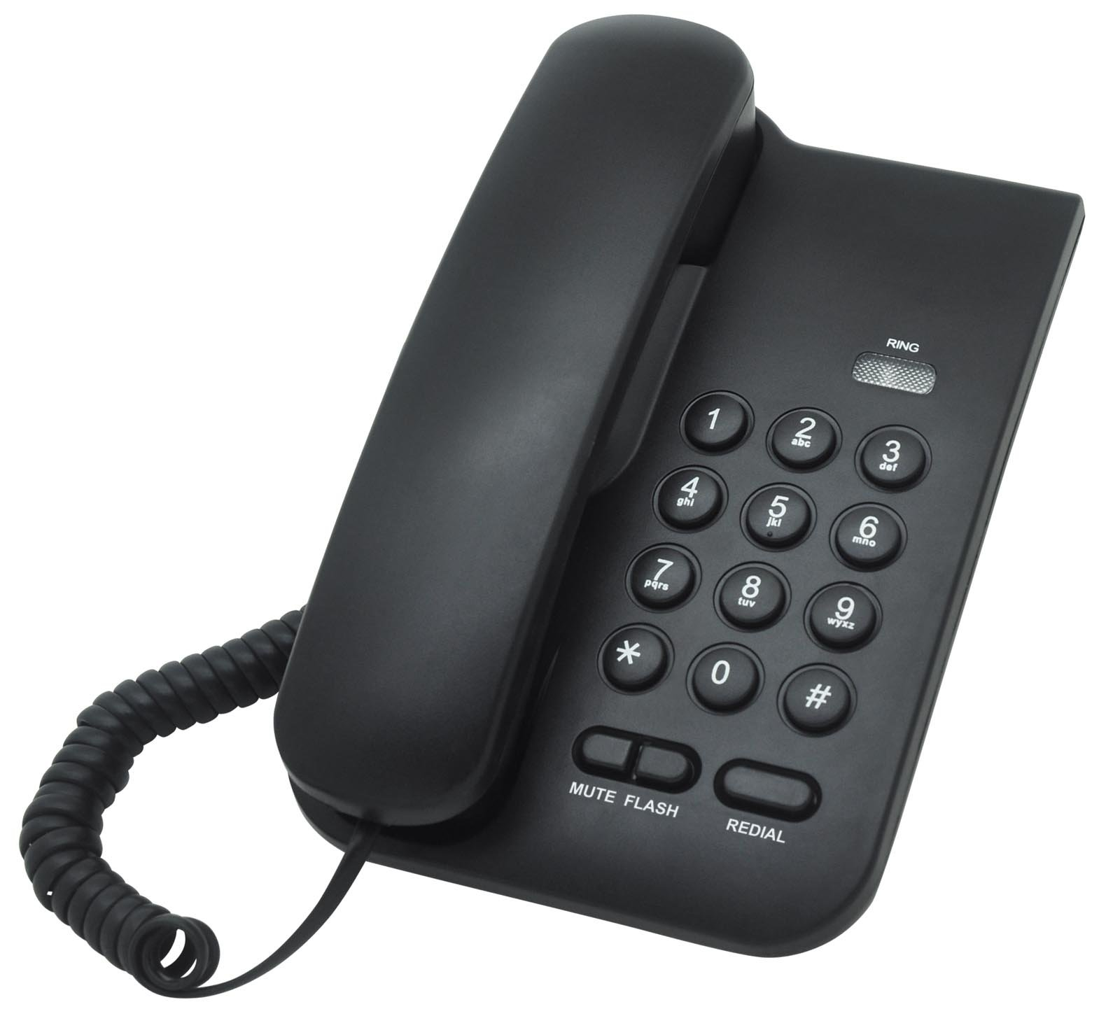
Technology
Seems like modern

Slide 4
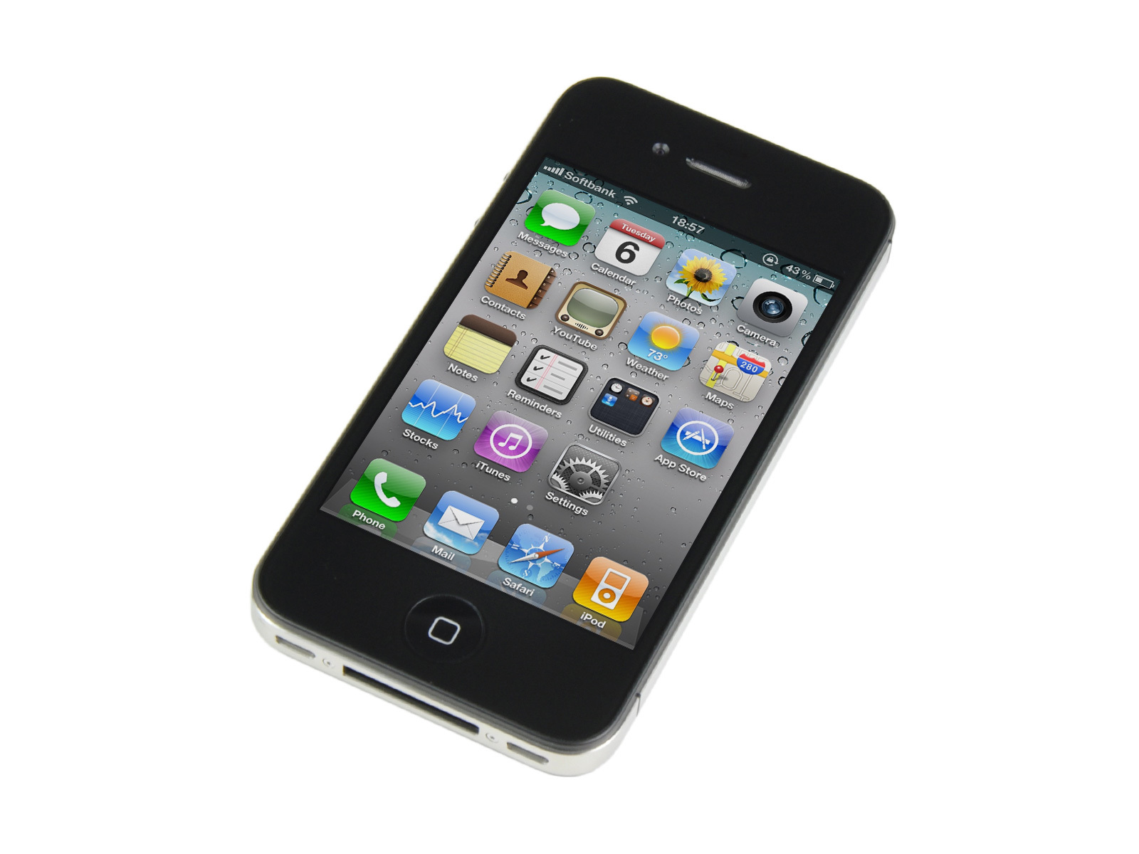
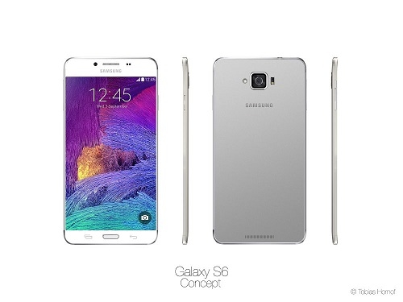
Technology
If we are happy then …

Slide 5
Technology is always a gap.
astray.

Slide 6
Technology is always a gap.

Slide 7
When we are making a system
There are lot of things to consider

Slide 8
One of the most important
UX and UI

Slide 9
Don’t make me think.
Make a system where developers doesn’t have to think much

Slide 10
Don’t make me think.
UX and UI:
Right component for the right work
Focusing area

Slide 11
System Design and Development
Analyzing
System Designing
System Building
Coding
Testing
Production
Maintenance
Thinking area

Slide 12
System Design and Development
Analyzing
System Designing
System Building
Coding
Testing
Production
Maintenance

Slide 13
I started with something and then it became something else. -picaso
Every developer’s time and life is important. I always I think how to make it better and efficient.

Slide 14
A balance between work and life.
Every developer’s time and life is important. I always I think how to make it better and efficient.
Focusing area
After developers are human not machine.

Slide 15
ASP.NET MVC
Controller
Model
View

Slide 16
Developers can work with database in 3 ways.
Code First (by Default)
Code First, Database First, Model First

Slide 17
Code First(Pros)
Portable
Doesn’t need much database logic
Codes fan out everywhere

Slide 18
Code First(Cons)
Need to write a lot of code.
Hard to change data-types in future.
Database doesn’t optimize much.

Slide 19
DB First(Pros)
Write less
Efficient database design
Very much rapid development

Slide 20
DB First(Cons)
Not portable.
Codes doesn’t fan out.
Changing in relationship takes time to sync.

Slide 21
Let’s see some demo in ASP.NET

Slide 22
Let’s see some demo with our project

Slide 23
We did a lot of optimization in Db as well as writing your own code.

Slide 24
Return on Investment
Our main concept of ROI is donation.
It’s an open source system you can download and use it from github.
Maybe in future we will include advertisement concept.

Slide 25
Thank you

Slide 26
Questions ?

