Slide 1
Week of Nov 17 2025

Slide 2
Goals
Submit NACC Request
Complete manuscript draft, including…
  Updated Figure 1 Study Flowchart
  Add GSAMixer and Pascal results
  Edit methods and results to reflect new findings (and final GWAS traits)
  Write Introduction
  Write Discussion
  Add new figure showing correlation of pathway ranks before and after calibration

Slide 3
Completed
Out sick
PascalX ran with null output for two traits (SCZ, BMI)
  Reran with code edit to exclude A1/A2 alleles (not included in calculation anyway)
Updated Fig 1 flowchart
Added Pascal results to Fig 2 FPR calculation
Wrote introduction

Slide 4
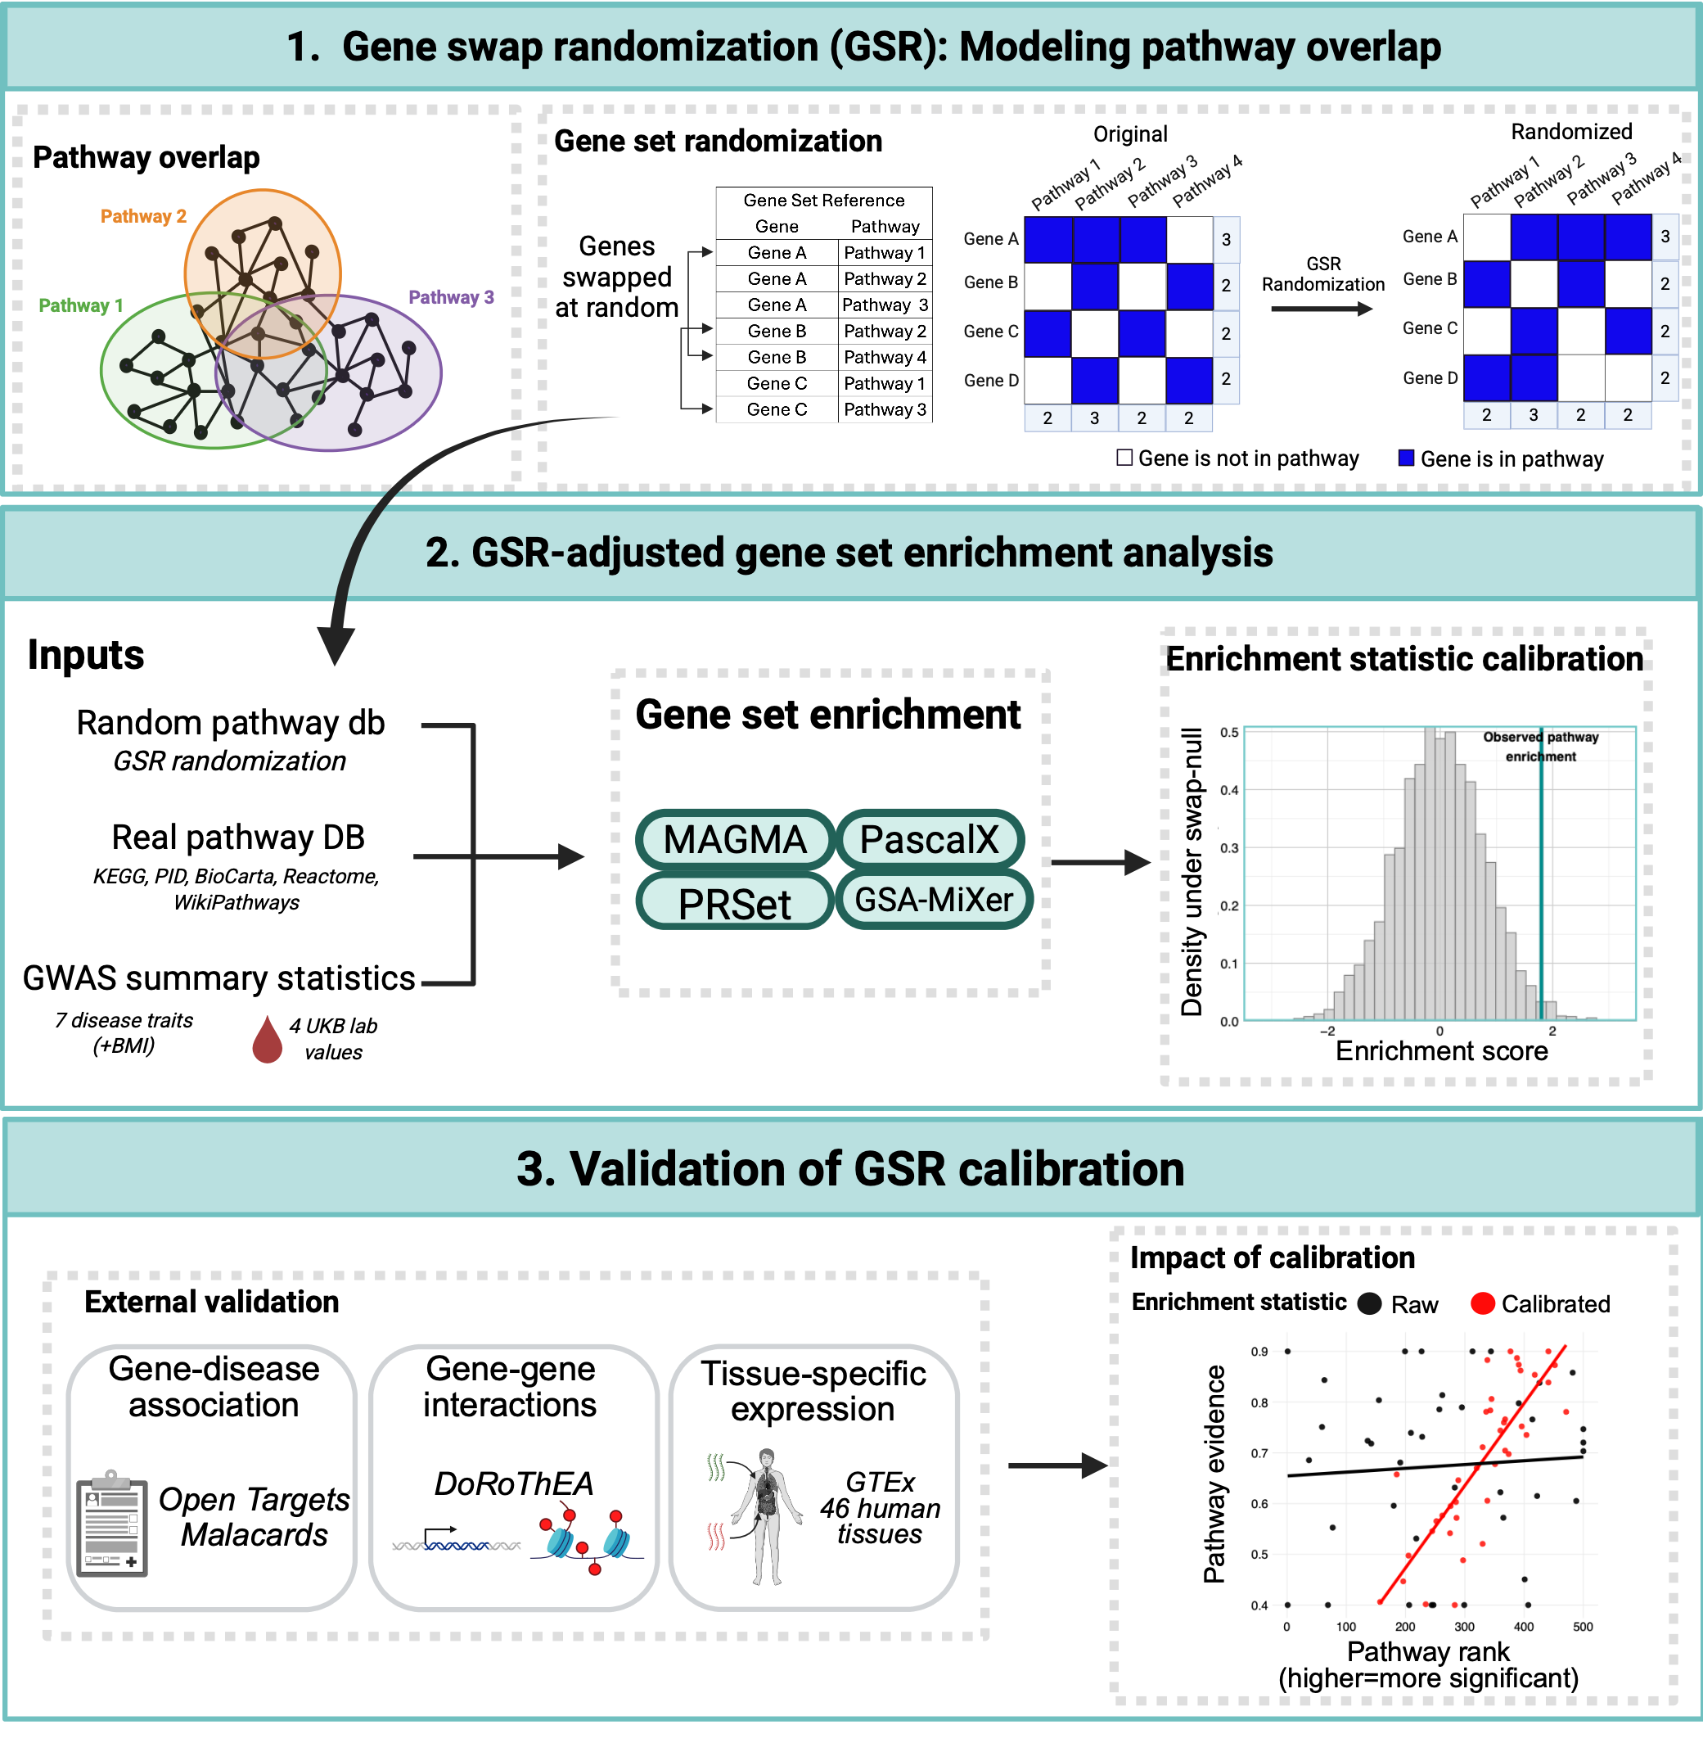
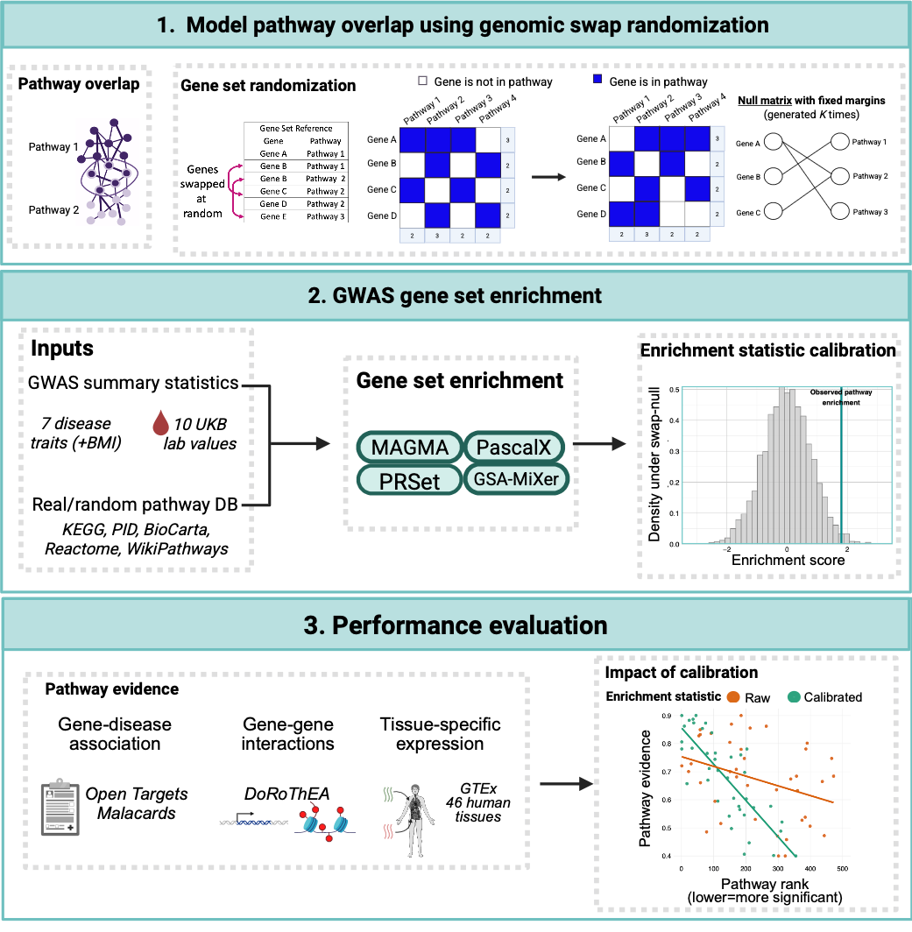
Updated Fig 1 flowchart

Slide 5
Added Pascal results to Fig 2 FPR calculation

