Slide 1
Python Aux
Mehmet Top
Accenture

Slide 2
Python Packaging Systems
What is package manament system ?
Tools which helps people to install and manage software packages like framework and library
Is it language spesific ?
Yes it is.
pip (package manager), package manager for Python
Ruby-Gem, a package manager for the Ruby programming language
Npm (software), a package manager for the Node.js
Composer (software), a package manager for the PHP.

Slide 3
Python package Index & Pip
pip is a package management system used to install and manage software packages written in Python.
The Python Package Index is a repository of software for the Python programming language. There are currently 108895 packages here.
Basic usage;
>> pip install <package_name>
>> pip uninstall <package_name>

Slide 4
What is Flask ?
Flask is a framework for Python based on Werkzeug, Jinja 2 and good intentions.
So what are they ? Werkzeug, Jinja 2
Werkzeug is a WSGI(Web Server Gateway Interface) utility library for Python.
Jinja2 is a modern and designer-friendly templating language for Python
That’s mean, you can develop wep application or services with Flask.
Btw, All of them are under BSD license
You can find and install easily via pip.
>> pip install flask

Slide 5
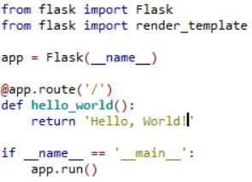
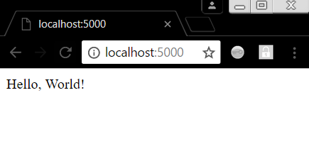

Hello Flask & Web (Displaying message)
Simple and fast...
Import Flask to your project
Create Flask Object
Define your end-point
Return your message
Start Application
And there it is, world’s simplest web-services. With Flask

Slide 6
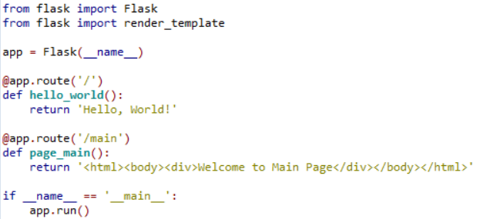
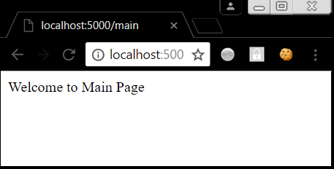
Hello Flask & Web (Displaying HTML)
What about web pages ?
How can i display web pages with Flask?
Well, Let’s try it...

Slide 7
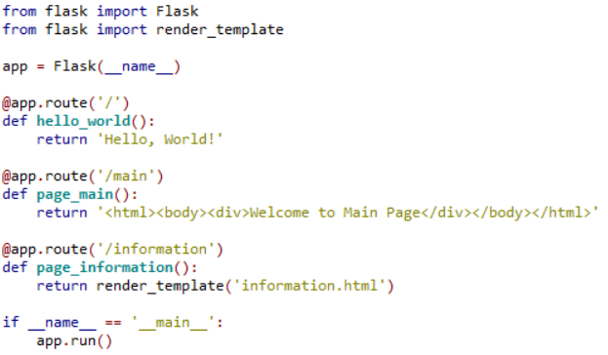
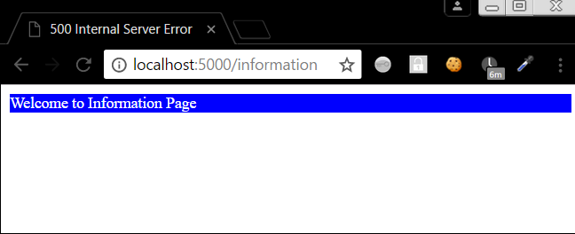
Hello Flask & Web (.html rendering)
How about complex web-sites or application ? We can’t return whole .html files.
Yes you can, but DO NOT !!!
Because we can return .html files thanks to Flask (Render Template)

Slide 8
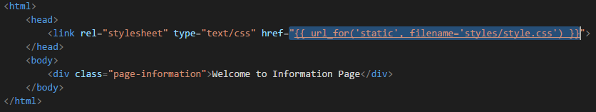
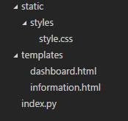

Hello Flask & Web (Adding Style)
Wouw.. Blue background
Let’s look inside of the information.html

Slide 9
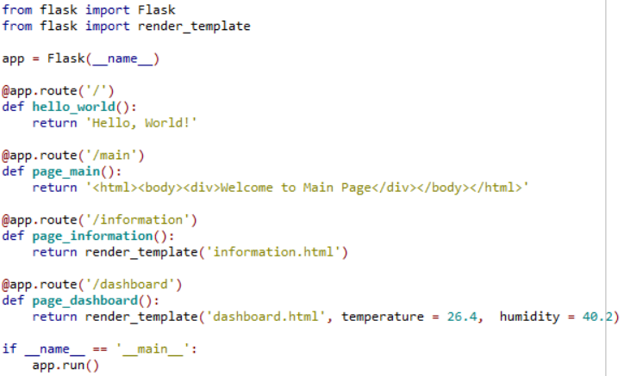
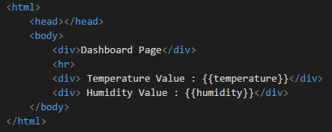
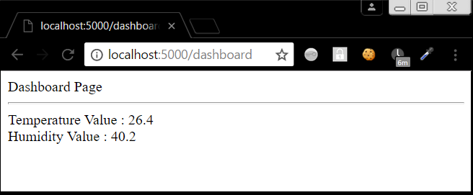
Hello Flask & Web... (Passing Variable)
Ok. These pages are static pages. How can I pass a variable to pages ?

