Slide 1
Why Python ?
Easy to learn
If you can speak in english then you can speak in Python
Interactive shell
Don’t have to compile entire project to try a single command
Garbage Collection
Do not wory about memory leaks like in C/C++
Platform Independent
Everywhere where interpreter is available

Slide 2
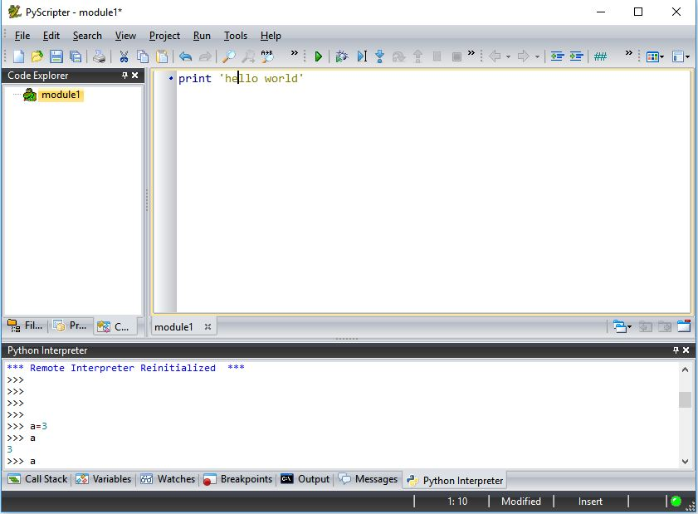
Installation & Running
For Windows:
Download and Install Python 2.7.x
Download and Install PyScripter

Slide 3
Built in Functions
Let’s do it together
print ‘Hello World’
range(0,3)
hex(255)
type()
.... 72 More
- The Python interpreter has a number of functions built into it that are always available.
Variables & Lists
Let’s do it together
No declarations, just assignment
Variable types can change dynamically
Dynamic Arrays (‘Lists’ in python way)
counter = 100 # Integer assignment
miles = 15.2 # Float assignment
name = ‘John’ # String
counter = ‘Re-assigned’
myList = [1 , 2 , 3 ]
otherList = list(5,6,7)
bigList = range(0,100)

Slide 4
Python Syntax
No semicolons
TAB instead of curly braces
Unneccessary spaces cause sytax error

Slide 5
If Statement
Any variable assigned in if statement is available at outside
Don’t forget TAB
Python does not have switch-case statement
Let’s do it together
score = 72
if score >= 90:
grade = 'A'
elif score >= 80:
grade = 'B'
elif score >= 70:
grade = 'C'
elif score >= 60:
grade = 'D'
else:
grade = 'F'
print grade

Slide 6
For Loop
Like if statement, any variable assigned in for loop is available at outside
Let’s do it together
a=5
for i in range(0, 3):
a=a+1
print "Loop value is at %d and a is %d" %(i,a)
a=5
for i in [5, 10, 15]:
a=a+1
print "Loop value is at %d and a is %d" %(i,a)
print "NO tab means that loop scope is finished"

Slide 7
While Loop
Like if statement, any variable assigned in while loop is available at outside
count = 0
while (count < 9):
print 'The count is:' , count
count = count + 1
print "Good bye!"

Slide 8
Functions
def keyword to declare a function
Variables assigned in functions are not available at outside
Parameter types resolved at runtime
Function scope determined with TAB like every scope
Let’s do it together
def multiplier(firstParam, secondParam):
"""This is documentation for our function."""
print 'Multiplier function is running'
return firstParam*secondParam
result = multiplier('Even string! ', 3)
print result

