Slide 1

Elevator Plus New Features

Slide 2
New Features
Key Additions in PDF Setting
Create PO for PM and Other
Reacquisition Of Surplus and damaged inventory
HSN Code in Document of DC, Repair Order - added in tables and pdf
BOM Planning
Upload BOM
Create DC from BOM and Dispatch against BOM

Slide 3
New Features
Monthly date range filter in Monthly Attendance Report
New Searches added.
In Application and web app - in job section added filter of Installation User Type( Sales )
In Application Mark In / Mark Out Functionality -Geo-restriction Rule
Rename of Multiple Fields

Slide 4
New Features
Provided image support for metafield
New Keys addition in PDF Setting
GSTIN Changes
City Dropdown Changes

Slide 5
Key Additions in PDF Setting
Key Addition in Pdf setting - for Module - PO, Trigger - Generated Keys added are - Site Name, Site Address, Job Number, AMC Number And this keys are added in extension also.
In PDF setting - New key is added names - Total Tax Amount - which will include Basic amount + GST amount and this key can be pasted in table in pdf.
Key can be searched in PDF setting.

Slide 6
Key Additions in PDF Setting
Added the Following Keys in the Corresponding PDFs
A. PM Service Report (PM Checklist Report and PM Checklist with Inspection Report) Lift Maker Name Service Time Out
B. Job Handover Letter PM Duration Quantity - to be standard
C. All PM PDFs PM Duration Designation of Executive Job Number

Slide 7
PO and GRN can be generated against PM and Other - two new options are provided
Limitation : Earlier there was only support provided for Job to create PO Solution : Enabled PO for PM and other purchases added in MATL PO/GRN master and also added in info button of PO, info includes -
Firm Name, Site Name, Wing Name, Lift Name

Slide 8
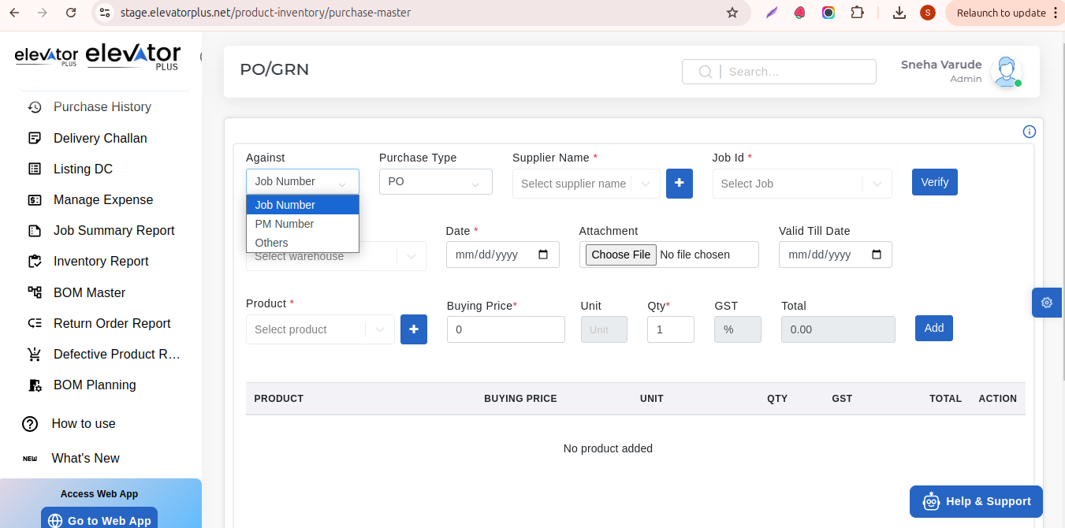
PO and GRN can be generated against PM and Other - two new options are provided

Slide 9
Reacquisition Of Surplus and damaged inventory
Reacquisition of Surplus and damaged inventory - added option of returning surplus ,unused and damaged product
In MATL master added two new reports for returning inventory - Return Inventory report and Defective Product report.
From Return inventory admin will approve or reject return request. Defective product report will have different material status like - Damaged – Not Reusable,
Damaged – Reusable,Incorrect Item Delivered, Surplus (Unused), Incomplete Item, and Other
Damaged – Not Reusable this will not be added in inventory other than this for all status

Slide 10
Reacquisition Of Surplus and damaged inventory
Material will directly get added to inventory of that particular warehouse which was selected at time of creating return inventory order from app.
User access for Return Inventory Report and Defective product report has been given. Admin can access all.

Slide 11
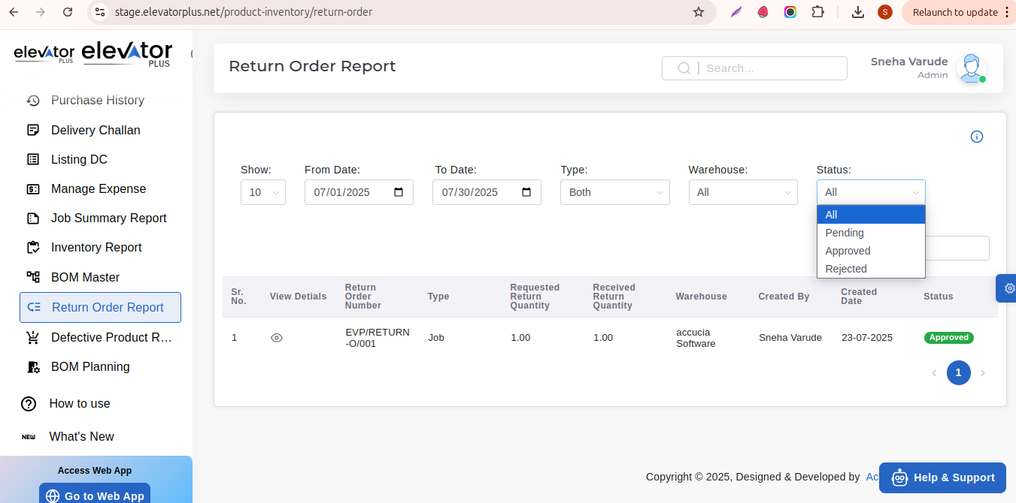

Slide 12
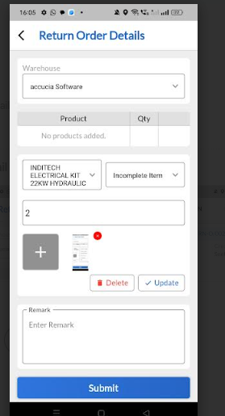
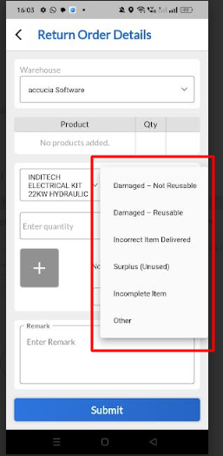
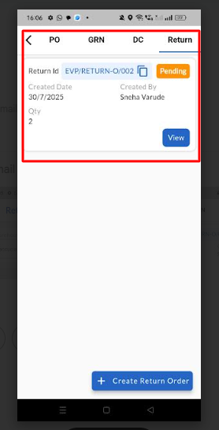

Slide 13
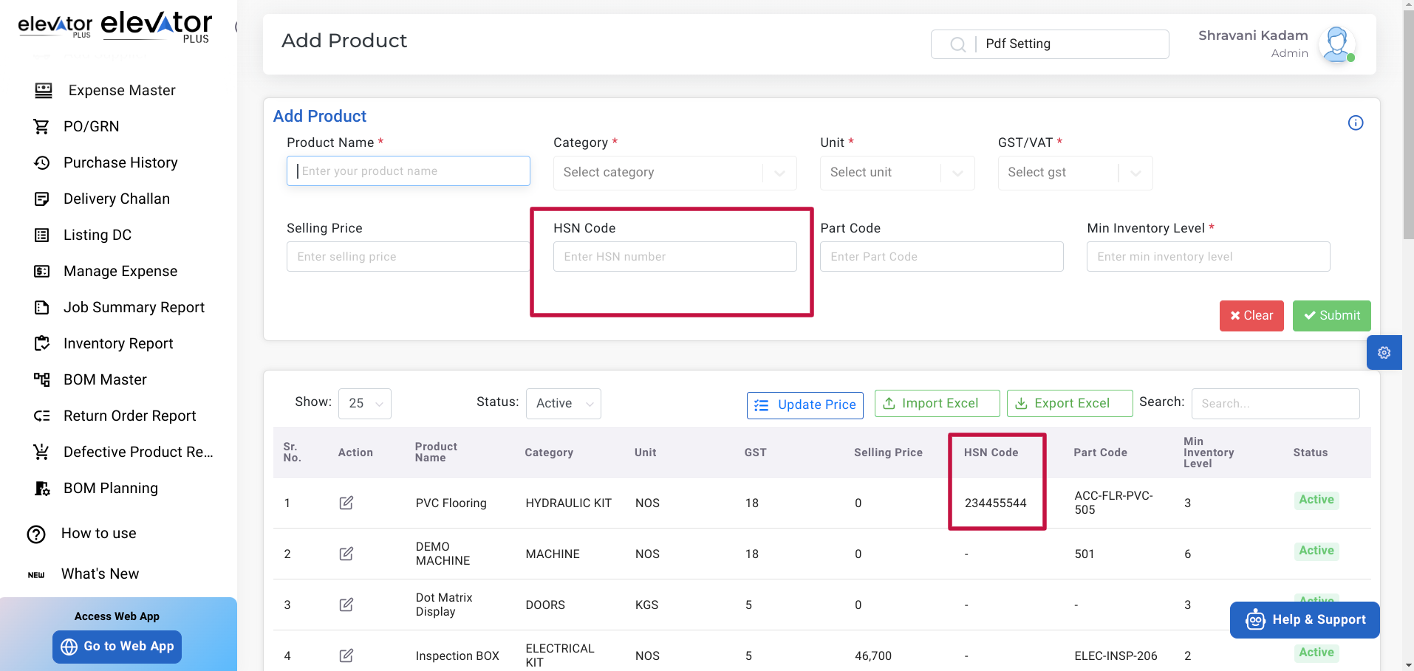
HSN Code in Document of DC, Repair Order - added in and pdf

Slide 14
BOM Planning
BOM planning can be created from Admin panel - new master BOM planning added - From which for a particular Phase and Stage we can add BOM and also download it ,Each BOM plan is associated with a specific job and lift type.
Job Search and Verify button option is provided for BOM, after verifying Site name, Firm Name, Lift Name and Wing Name can be seen , If any BOM exist for that particular job all entries will be displayed below

Slide 15
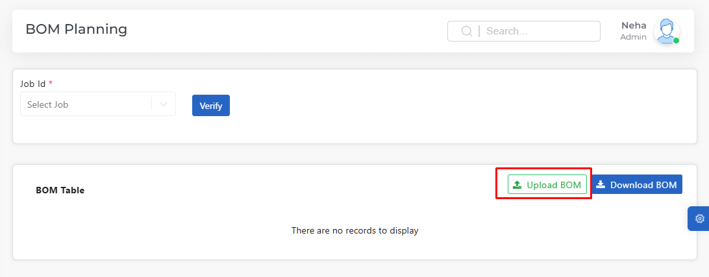

Slide 16
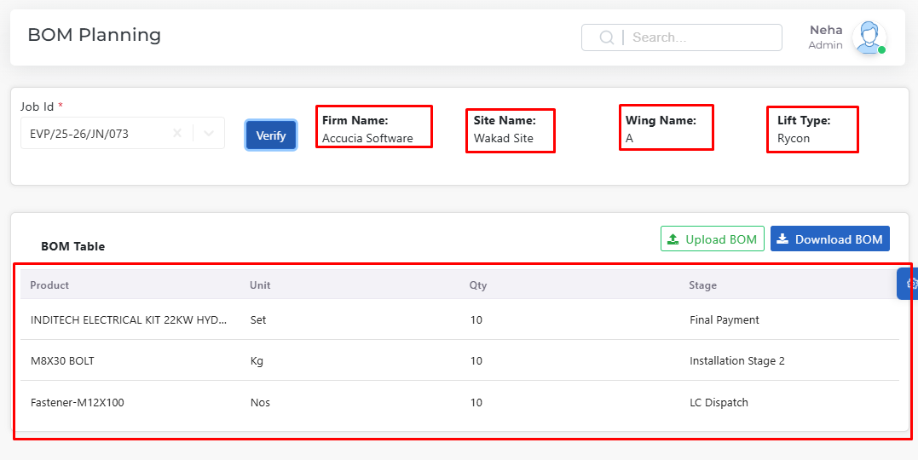

Slide 17
Create DC from BOM and Dispatch against BOM
Create DC - If a DC already exists for the job then it will show the buttons - Create DC from BOM and Dispatch against BOM
Dispatch Against BOM option is provided - includes table - Product Name, Stage, Required Quantity, Dispatch Quantity

Slide 18
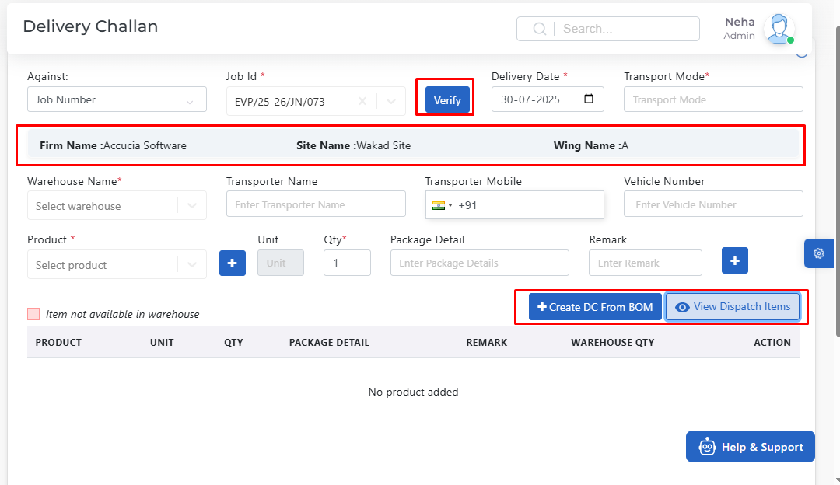

Slide 19
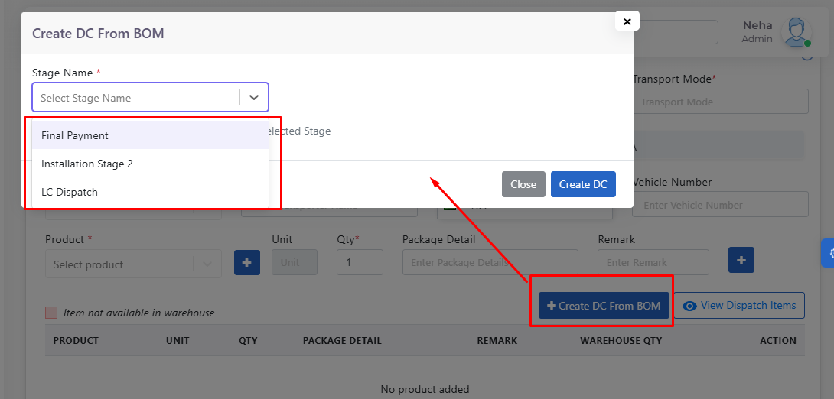

Slide 20
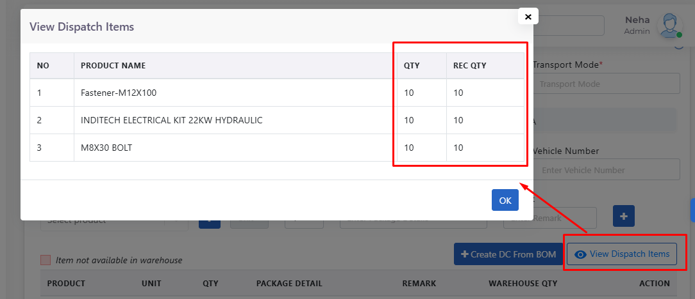

Slide 21
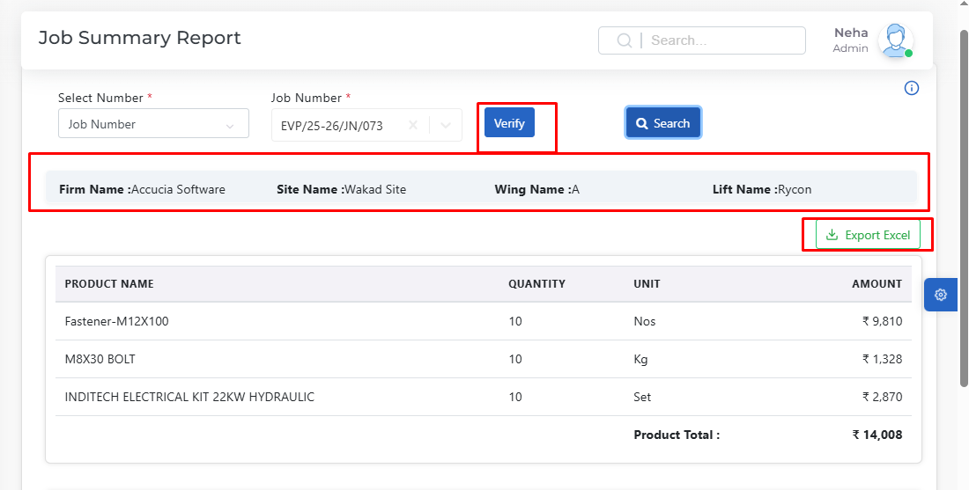

Slide 22
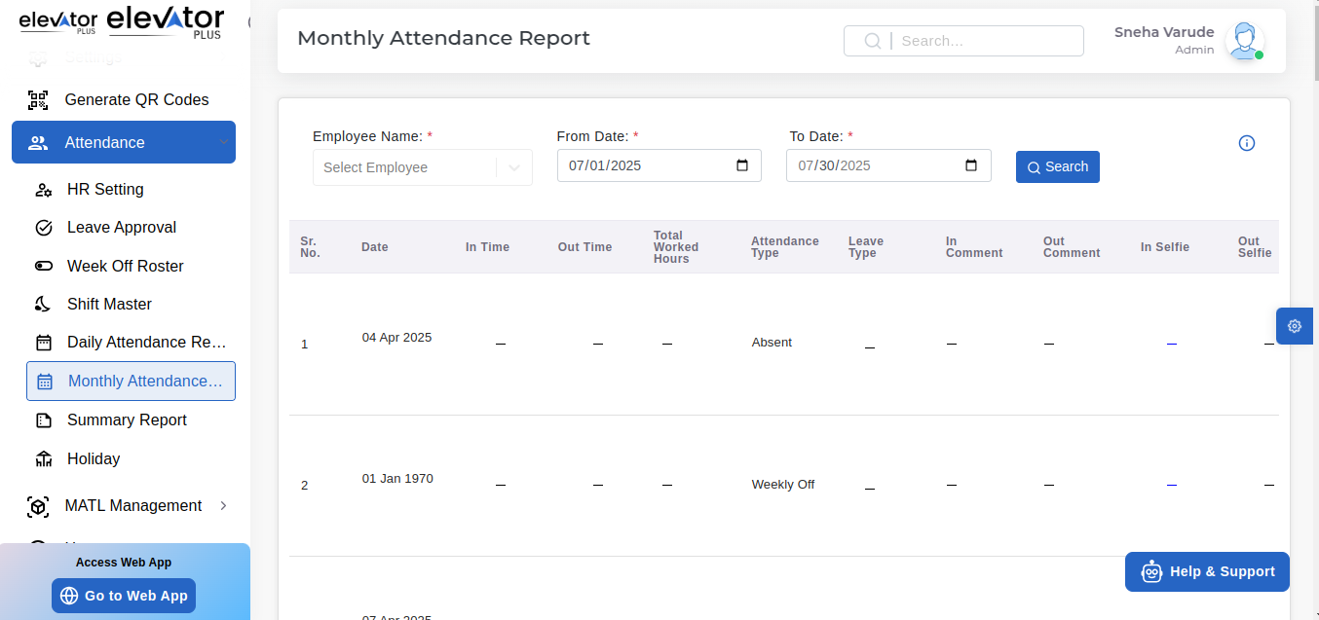
Monthly date range filter in Monthly Attendance Report

Slide 23
In Application Mark In / Mark Out Functionality -Geo-restriction Rule
Mark In/Mark Out actions should be allowed only if the user is physically at the job site location (based on GPS).
Prevent marking in/out from any other (non-authorized) location

Slide 24
Rename of Multiple Fields
In Repair Order Module - i) "Dis" is renamed as "Disc", ii) Added % symbol to discount field. iii) Validation added to discount 0- 100% Jobs Filter UI:
Change label “jobs” to “Jobs” (capitalize first letter) in the Jobs Filter dropdown to maintain consistency.
Renamed “PO/GRN” tab as “Material management” in app as it includes PO, GRN, DC, and Return. Return tab will have create return order button from which we can create return order add product, warehouse, and return quantity - decimal pointer support
From service slot tab removed "Create PM" button and In Pm sale "Create PM" Button rename as " Create PM Quotation.

Slide 25
Provided image support for metafield
Provided image support for metafield - when metafield is added for modules -
Pdf keys will be automatically generated in both extension, doc and also in html and when pasted on pdf metafield images will be shown in pdf

Slide 26
GSTIN Changes And City Dropdown Changes
GSTIN changes - GSTIn will be displayed in both site and firm master - also can be added directly from app also and
City can be directly fetched from site location on map and that particular city is present in admin panel will automatically get fetched directly. Added GSTIN for both site and Firm master and if added in PDF that support is also provided and site GSTIN will be prevailed in all cases.

Slide 27
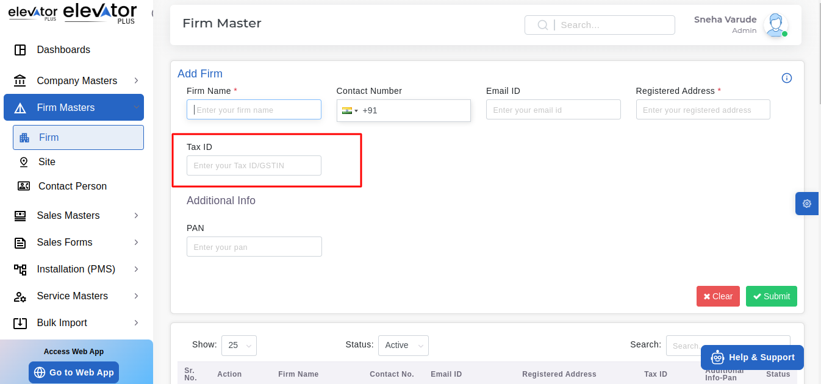
GSTIN Changes And City Dropdown Changes

Slide 28
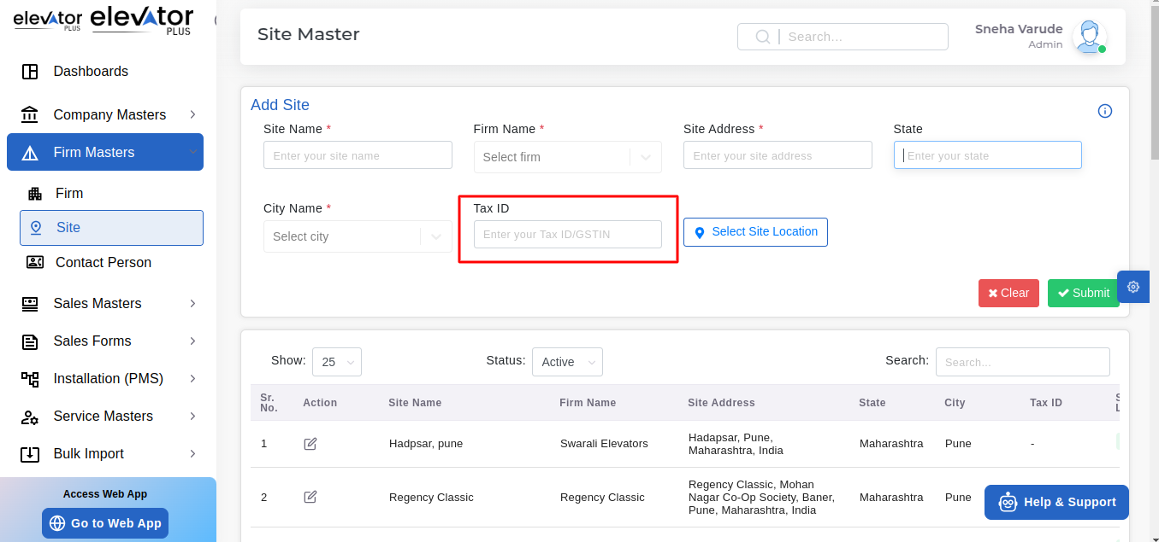
GSTIN Changes And City Dropdown Changes

Slide 29
