Slide 1
ACCUKNOX × VSONE
Zero Trust Security for
Sri Lanka's Banks
One platform to secure code, cloud, workloads, APIs and AI, and to stay audit-ready for CBSL, PDPA and PCI DSS.
Delivered in Sri Lanka by VSONE, AccuKnox's in-country partner for banking, telecom and enterprise.
Banking Security Briefing · 2026

Slide 2
Four forces are squeezing Sri Lanka's banks at once
THE MOMENT

Digital banking has exploded

The regulator has raised the bar
LankaPay, CEFTS and mobile wallets put the sector online. Every new channel, app and API is a new way in.
CBSL Direction No. 16 of 2021 and the PDPA put technology risk on the board, with a senior CISO and a 24x7 SOC.

Attackers moved to run-time

Budgets and talent are thin
The 2025 Cargills Bank ransomware breach hit a live environment. Advanced attacks execute in production.
After the 2022 crisis, teams do more with less, fewer people, tighter forex, a stack of disconnected tools.
Sourced to CBSL, Sri Lanka's PDPA No. 9 of 2022, and regional banking-sector threat reporting.

Slide 3
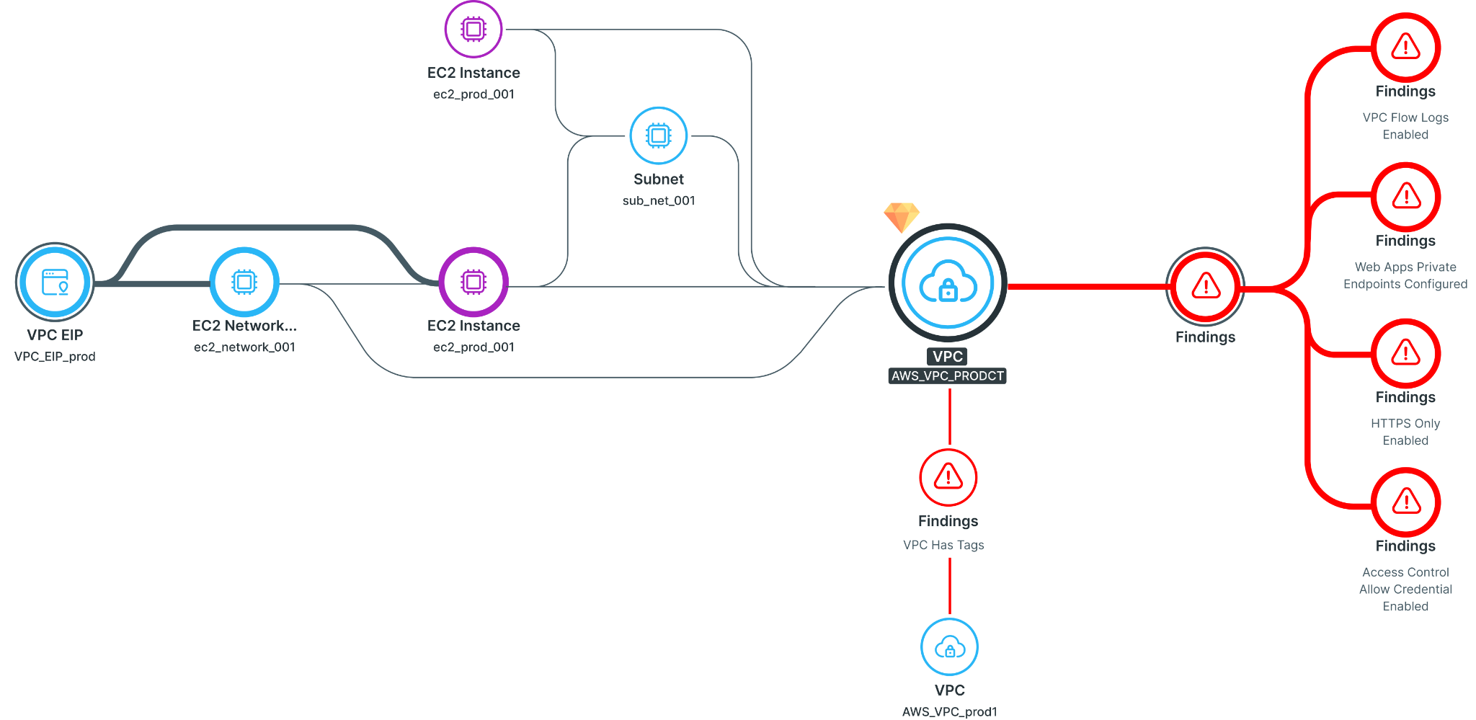
The threat landscape is now a run-time problem
WHY IT MATTERS
4,347
cyber incidents logged by SLCERT in
2024, up from 596 in 2019
1.9 TB
of bank data exfiltrated in the 2025
Cargills Bank ransomware breach
87%
of hybrid environments carry blind
spots public-cloud tools never reach
What hides in the blind spots
▸ Unpatched on-prem servers running core banking, outside cloud tools.
▸ Containers with no run-time rules and shadow workloads.
▸ Over-permissioned identities and secrets sprawled everywhere.
▸ Shadow AI moving customer data before any guardrail fires.
AccuKnox security graph: real attack paths surfaced across cloud, K8s and VMs.

Slide 4
The compliance mandates a Sri Lankan bank must answer to
THE REGULATORY SQUEEZE

CBSL Direction No. 16 of 2021

CBSL Baseline Security Standard

PDPA No. 9 of 2022
Technology Risk & Resilience: board and BIRMC accountability, a senior CISO, a 24x7 SOC, quarterly VAs, annual pen tests, RTO under 4 hours.
The Central Bank's ISO 27000-based control baseline for information-security management across licensed banks.
Data Protection Officers, breach notification to the DPA, and penalties up to LKR 10 million for a first violation.

Incident reporting

PCI DSS 4.0 & SWIFT CSP

AML / CFT (FIU)
CBSL's May 2025 IT & cybersecurity incident circular, plus FinCSIRT and SLCERT coordinated disclosure.
Continuous card-data control validation and annual attestation for cross-border payment infrastructure.
Customer due diligence, suspicious-transaction reporting and six-year record retention under the FTRA.
Six overlapping regimes, each demanding continuous evidence. AccuKnox maps one control set to all of them.

Slide 5
What that leaves the CISO carrying
THE CISO'S REALITY

Tool sprawl

Alert fatigue

Stacked mandates
Separate products for cloud, containers, code, APIs and identity, none of them talking.
Thousands of findings, no context on which are actually exploitable in production.
Direction 16, the Baseline Standard, PDPA and AML rules each demand fresh manual evidence.

Talent drain

On-prem + cloud split

Zero-day exposure
Too few certified engineers, and the crisis pushed skilled staff to jobs overseas.
Core banking on-prem and air-gapped, new services in cloud, two different playbooks.
Build-time scanning misses run-time attacks; the team finds out after the breach.
The result: high cost, thin coverage, and a compliance posture that is hard to prove on demand.

Slide 6
Meet AccuKnox
AI-powered Zero Trust CNAPP · Secure Code to Cognition · brought to Sri Lanka by VSONE

Slide 7
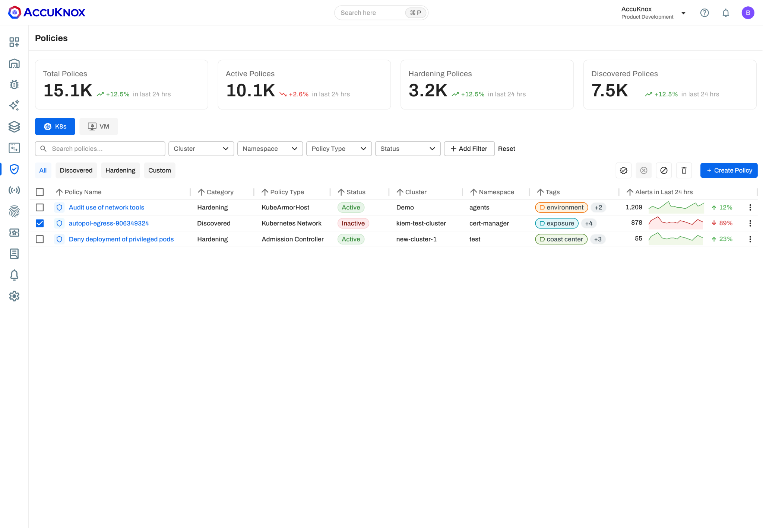
One Zero Trust platform, from code to cloud to AI
WHAT ACCUKNOX IS
Founded in 2020 with Stanford Research Institute. AccuKnox secures public, private, hybrid and air-gapped clouds, plus VMs, Kubernetes, APIs, edge and AI/LLM assets, on one control plane.

Agentless onboarding
Connect and see risk in minutes, no heavy agents.

Run-time, inline defense
eBPF and KubeArmor stop zero-days in production.

Deploy anywhere
SaaS, your cloud, on-prem or fully air-gapped.

GRC included
35+ compliance frameworks and audit trails built in.
AccuKnox console: unified policies across cloud, workloads and clusters.
In Sri Lanka, delivered and supported locally by VSONE, with AccuKnox pre-sales engineering behind every deployment.

Slide 8
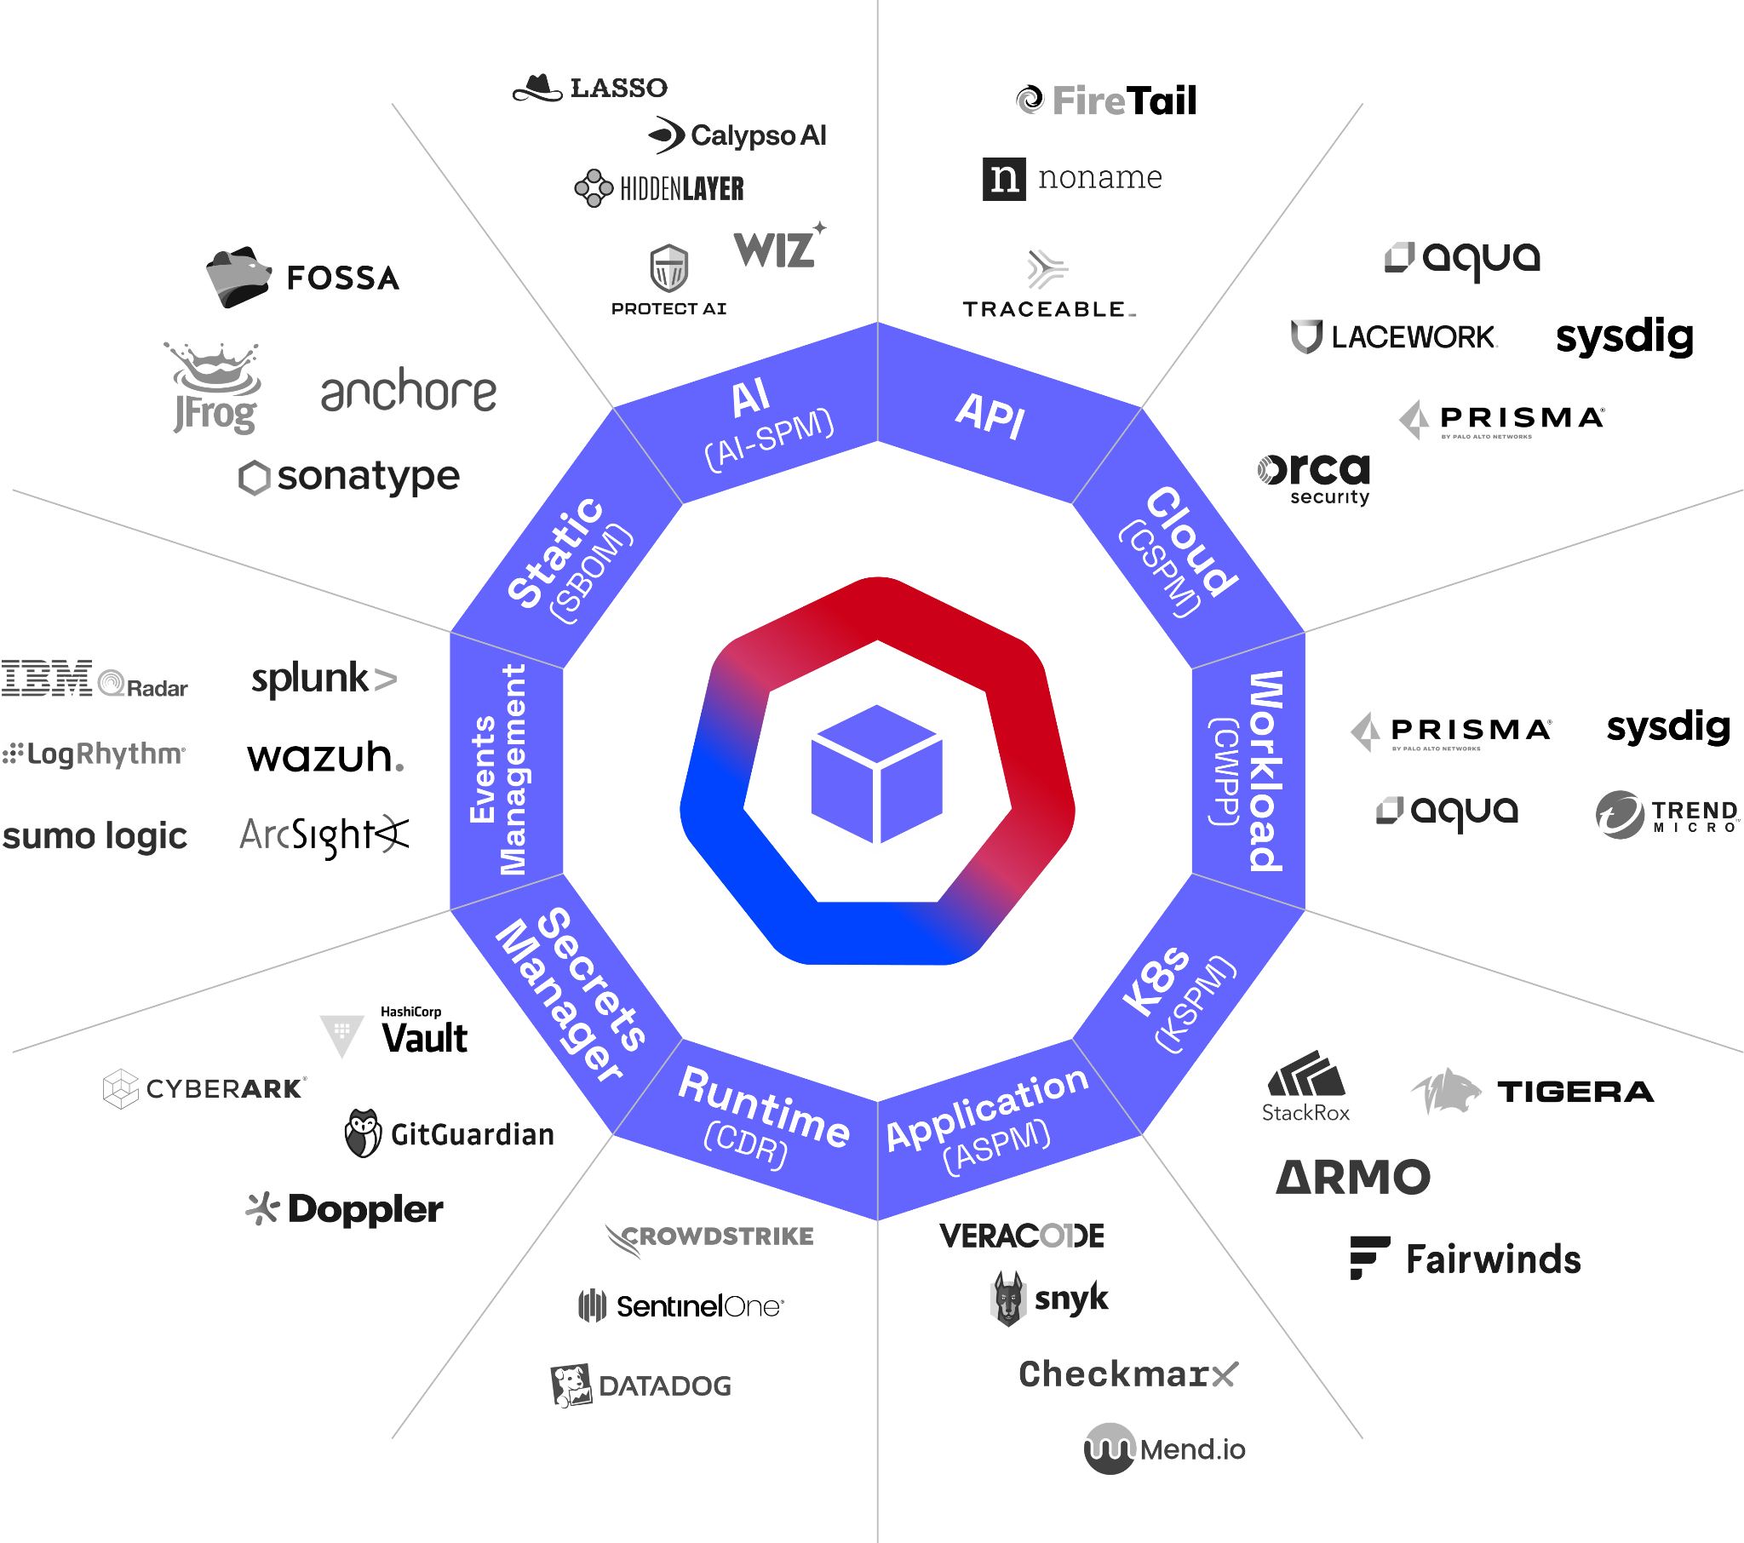
One platform replaces a shelf of point tools
CONSOLIDATE AND SAVE
AccuKnox brings 12+ security domains under one console, cutting licences, integration work and the people-cost of running disconnected tools.
12+
security domains
>50%
cost saving
3→1
vendors
Minutes
to first risk
Replaces Wiz, Prisma, Orca, Aqua, Snyk, Qualys, SentinelOne and more.
12 security domains, one Gen-AI powered CNAPP.

Slide 9
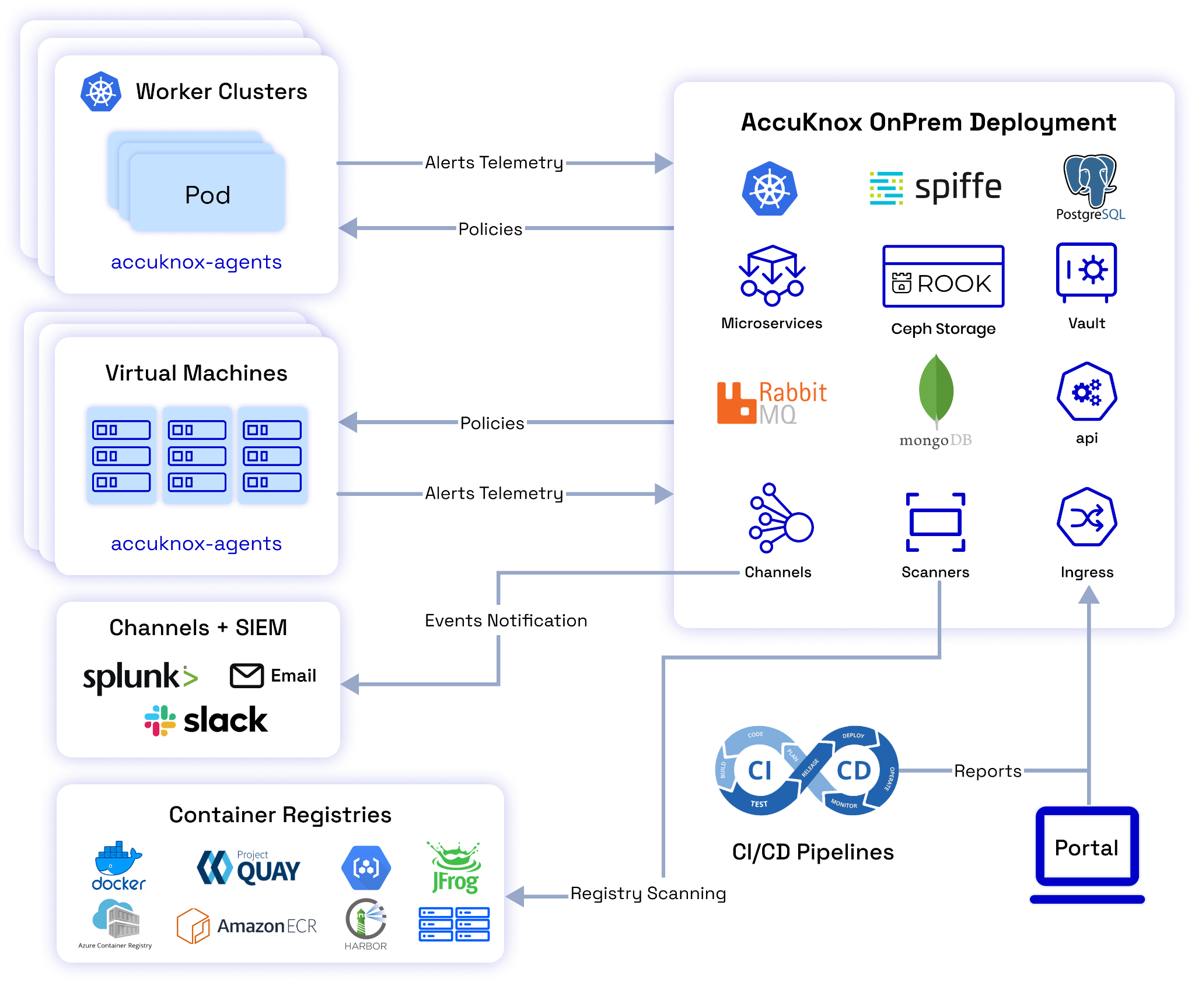
How it works: one control plane over everything
PLATFORM ARCHITECTURE
Secure the full lifecycle, cloud to on-prem to edge:

Agentless collectors
On clusters, VMs and registries stream telemetry to AccuKnox.

One control plane
SaaS or on-prem correlates risk and pushes policy back inline.

Feeds your stack
SIEM (Splunk), email, Slack alerts, plus CI/CD registry scanning.

Slide 10
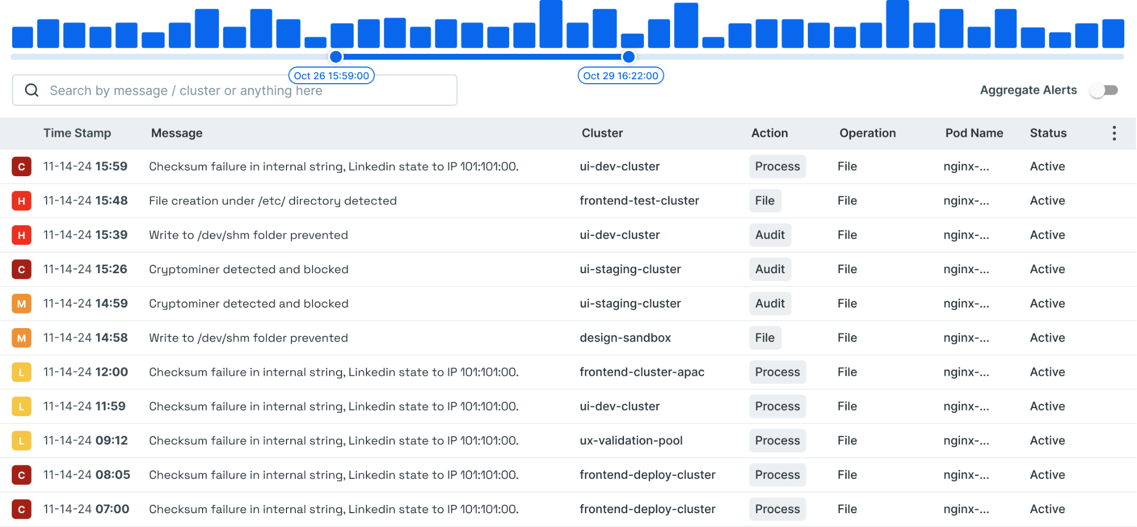
The difference: stop zero-days at run-time, inline
UNIQUE DIFFERENTIATOR
Most tools tell you about an attack after it runs. AccuKnox watches behaviour in production and enforces inline, so a zero-day is blocked as it happens.

1. Observe
Learn each workload's normal process, file, network and API behaviour.

2. Enforce
Block anything off-baseline inline, at the kernel, during the attack.

3. Auto-policy
Generate hardening policy automatically from observed behaviour.
Run-time events and enforcement, live across the estate.

Why a bank should care
Ransomware is contained before it touches core banking. Proven on US DoD 5G and Zero Trust satellite security programs.

Slide 11
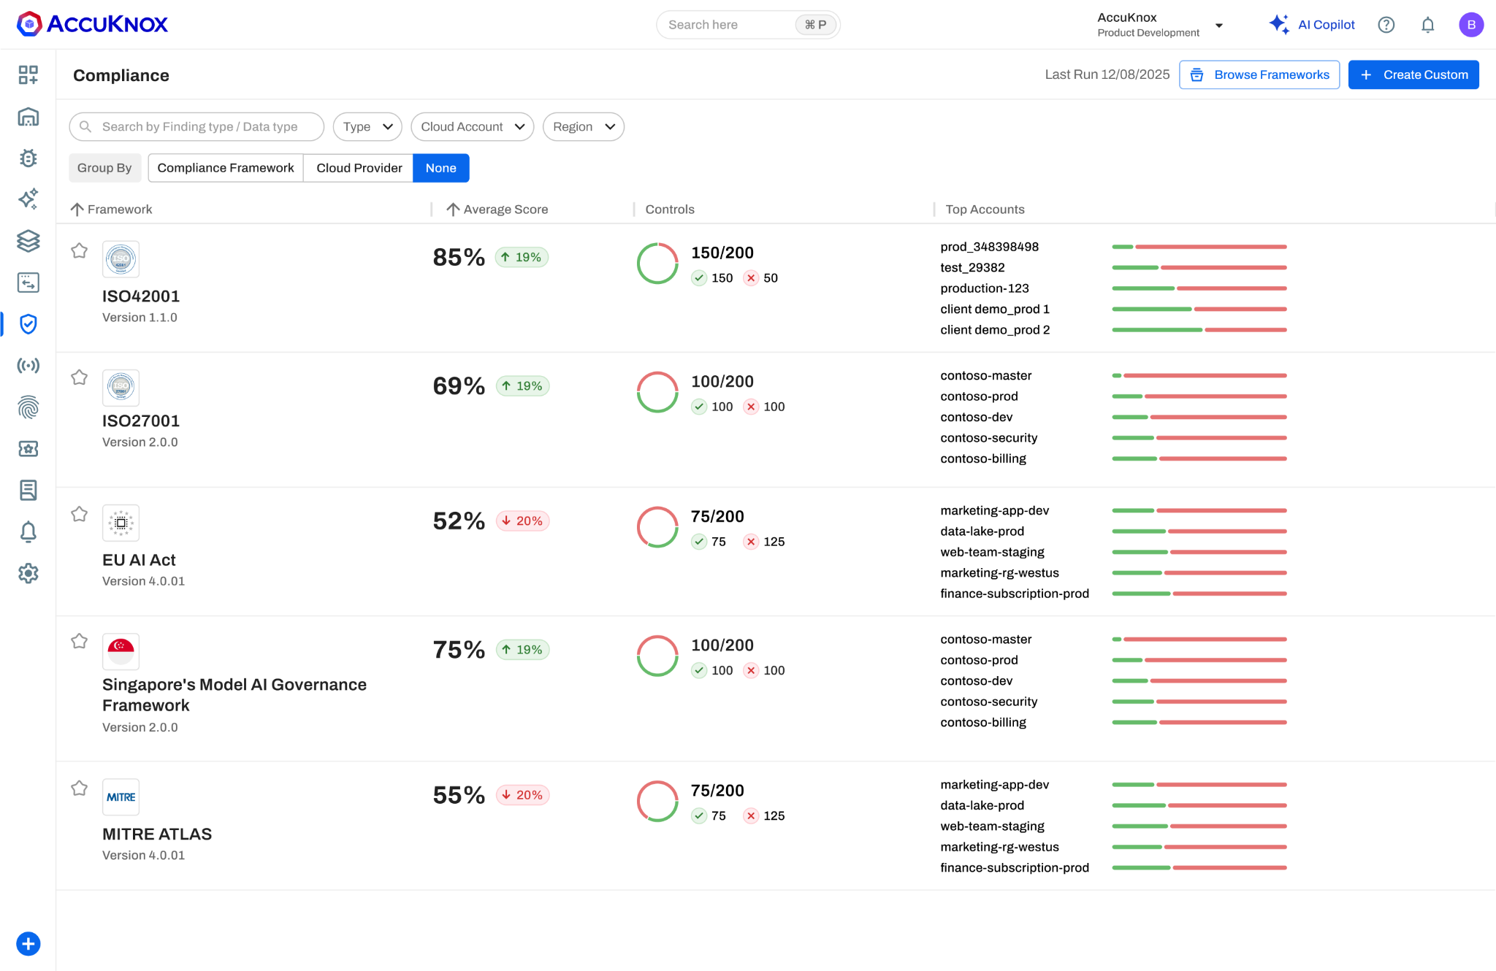
Compliance and GRC, mapped to your mandates
AUDIT-READY BY DESIGN
One set of controls becomes continuous, audit-ready evidence for every framework a Sri Lankan bank reports against, GRC included with the platform.
Mandate | How AccuKnox helps
CBSL Direction 16 of 2021 | Continuous posture, quarterly VA & pen-test evidence
Baseline Standard / ISO 27001 | Pre-built templates, auto-mapped findings, reports
PDPA No. 9 of 2022 | Data discovery (DSPM), residency-aware deployment
PCI DSS 4.0 & SWIFT CSP | Config, workload and access controls validated
Incident reporting (FinCSIRT) | Real-time detection, forensics and audit trail
Live compliance scores: ISO 27001, ISO 42001, EU AI Act, MITRE ATLAS and more.
One control set, evidence for every regime, so audit prep stops being a manual fire drill.

Slide 12
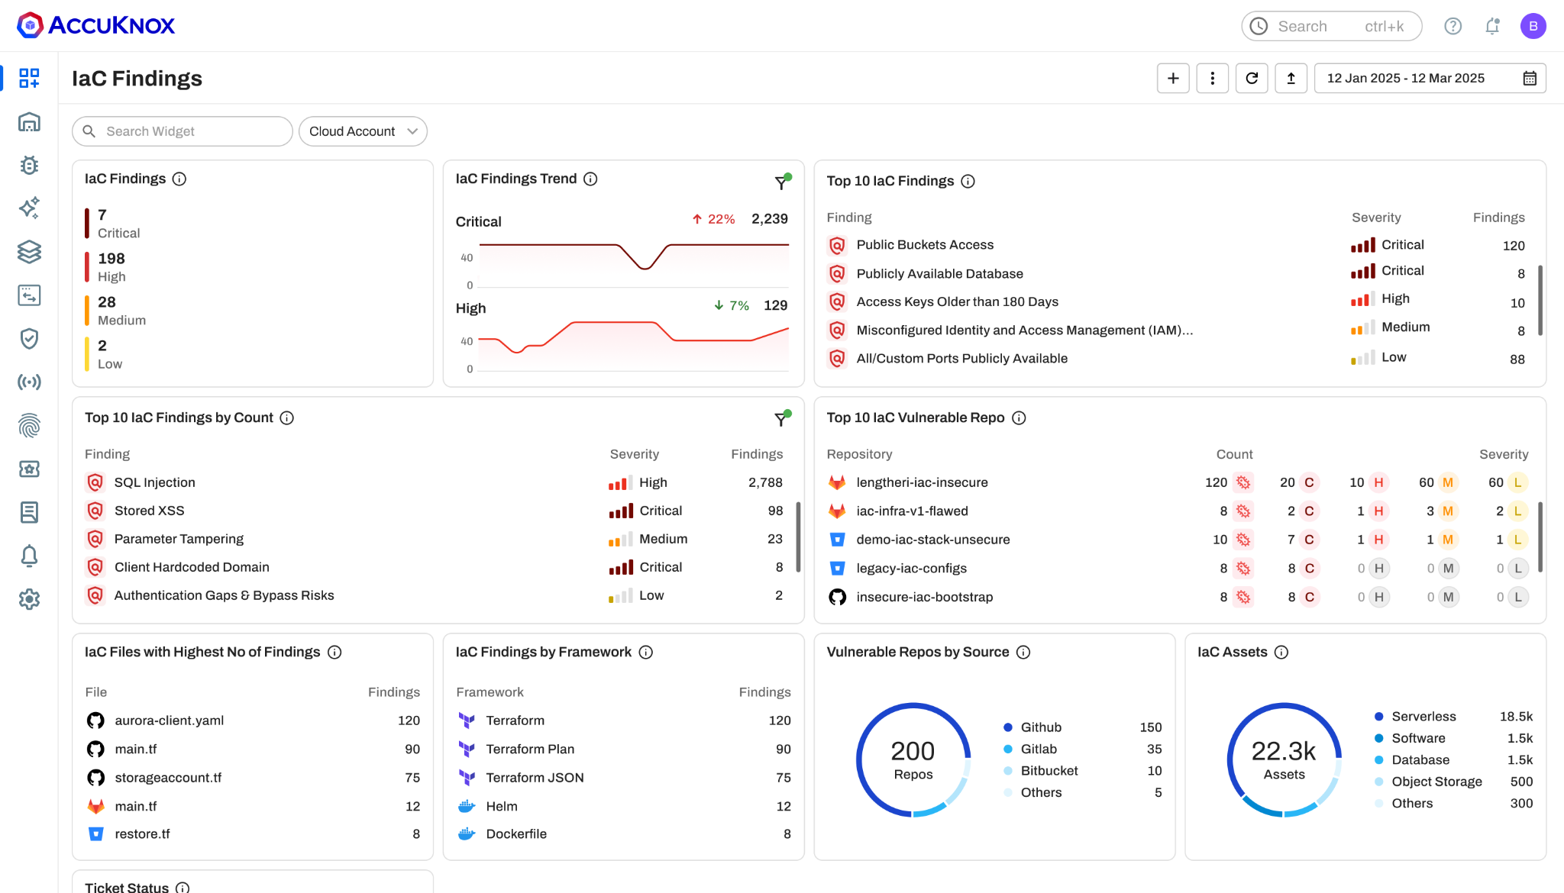
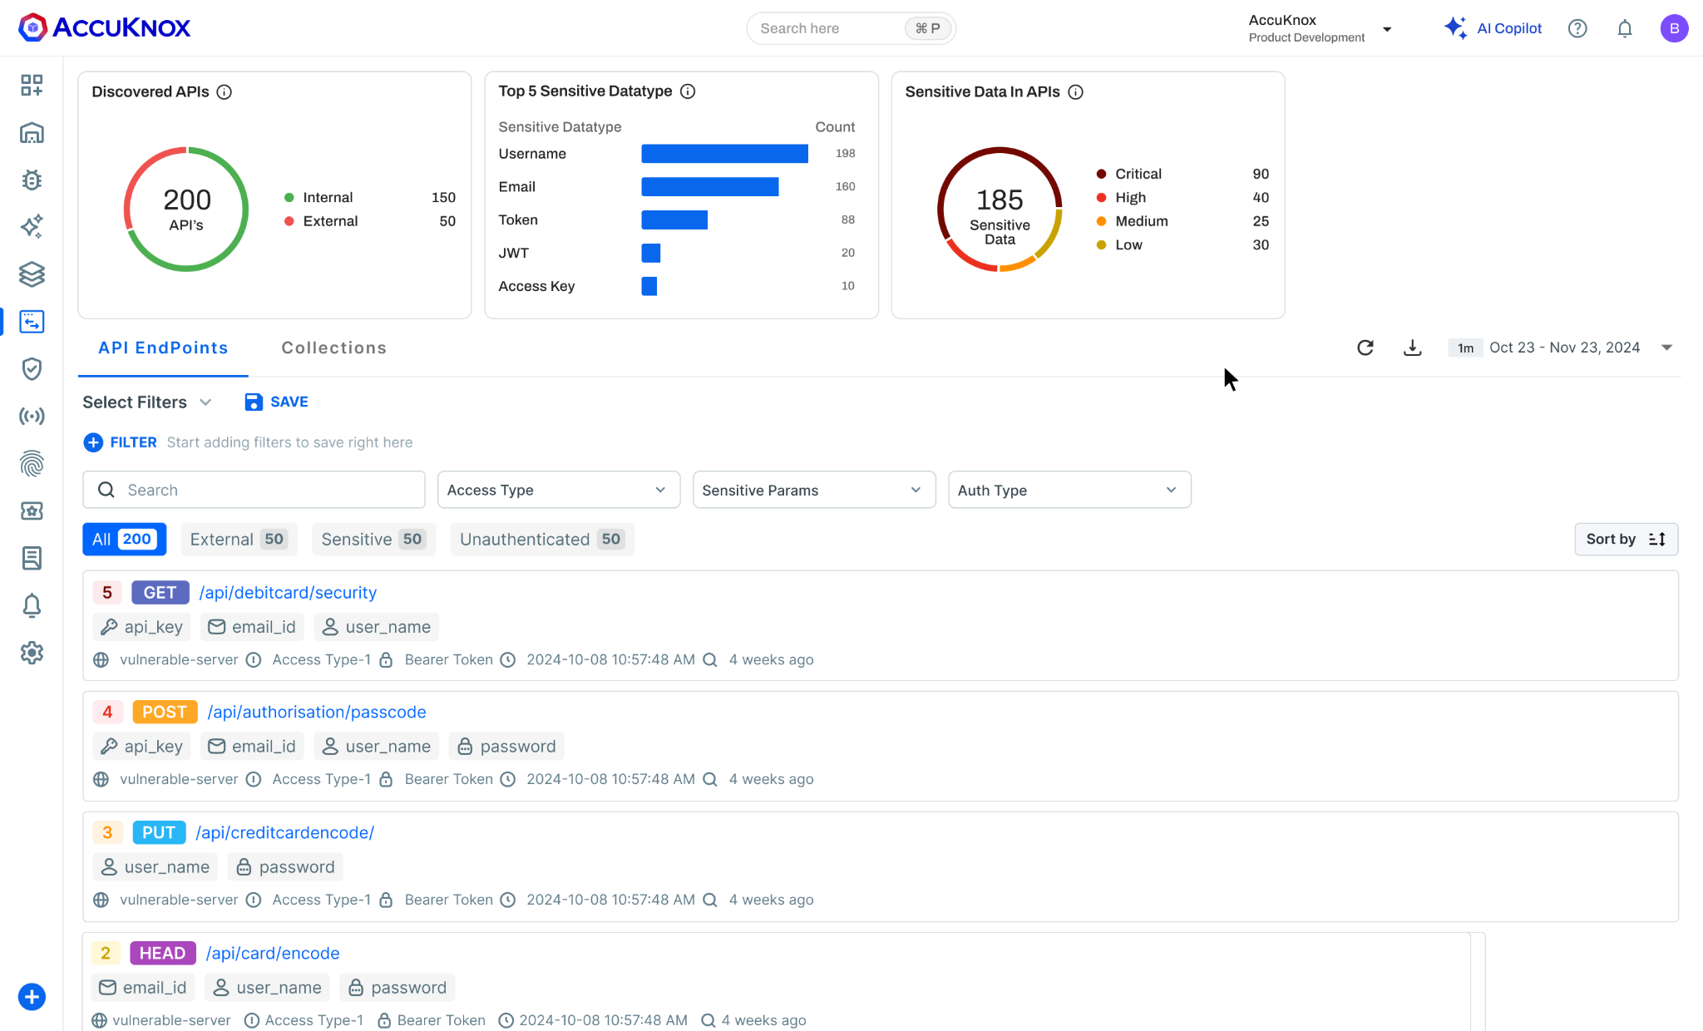
Cloud and workload security
PLATFORM COVERAGE · 1 OF 3

CSPM
Cloud posture: misconfig, attack-path & security graph.

CWPP
Workload protection: eBPF run-time for VMs & containers.

KSPM
Kubernetes posture: CIS benchmarks, cluster hardening.
IaC & misconfiguration findings

CIEM
Cloud identities: permissions graph, over-provision detection.

CDR
Cloud detection & response across cloud, VMs and K8s.

SIEM
Events: high-volume ingestion, code-to-cloud correlation.
Cloud asset & API inventory

Slide 13
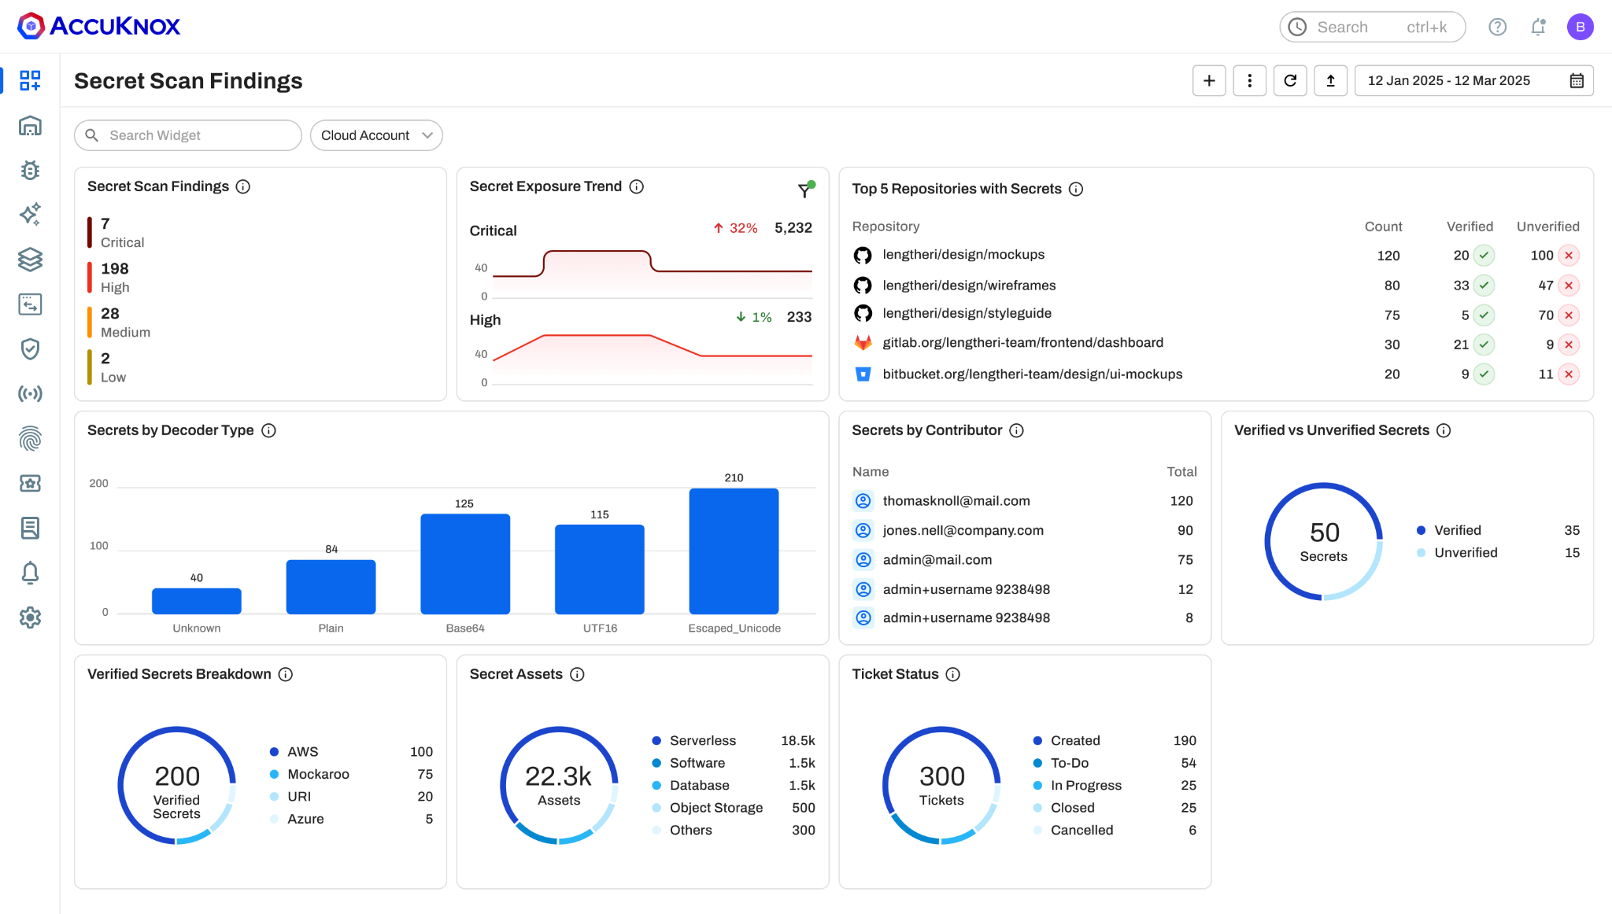
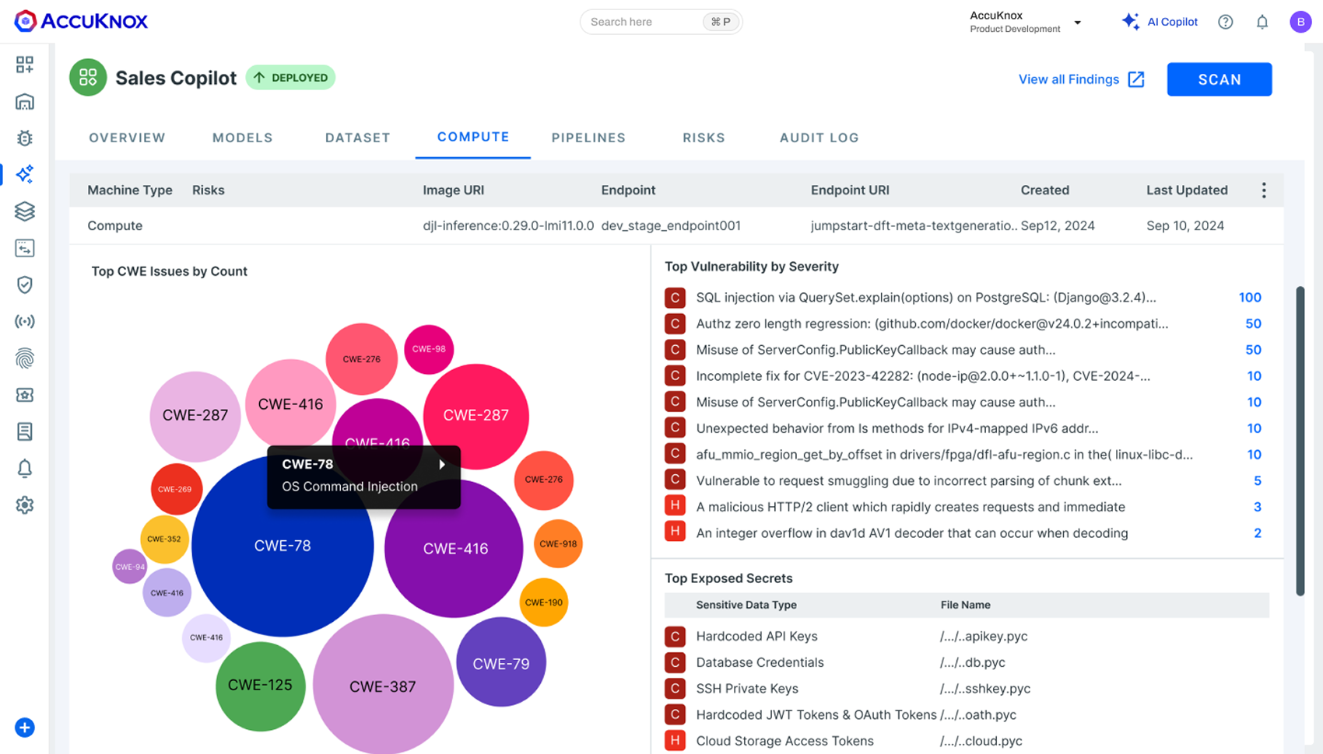
Application, API and data security
PLATFORM COVERAGE · 2 OF 3

ASPM
App posture: SAST, SCA, AI-assisted triage & prioritisation.

DAST
Dynamic testing of web UI and APIs at run-time.

API Security
Discover shadow, orphan & zombie APIs; run-time control.
Secret-scan findings & remediation

SBOM
Live SBOM, dependency drift, licence & vuln mapping.

Secrets
Shift-left scanning, Vault hardening, no hardcoded creds.

DSPM
Discover & classify sensitive data; flag risky access.
Vulnerability prioritisation by severity

Slide 14
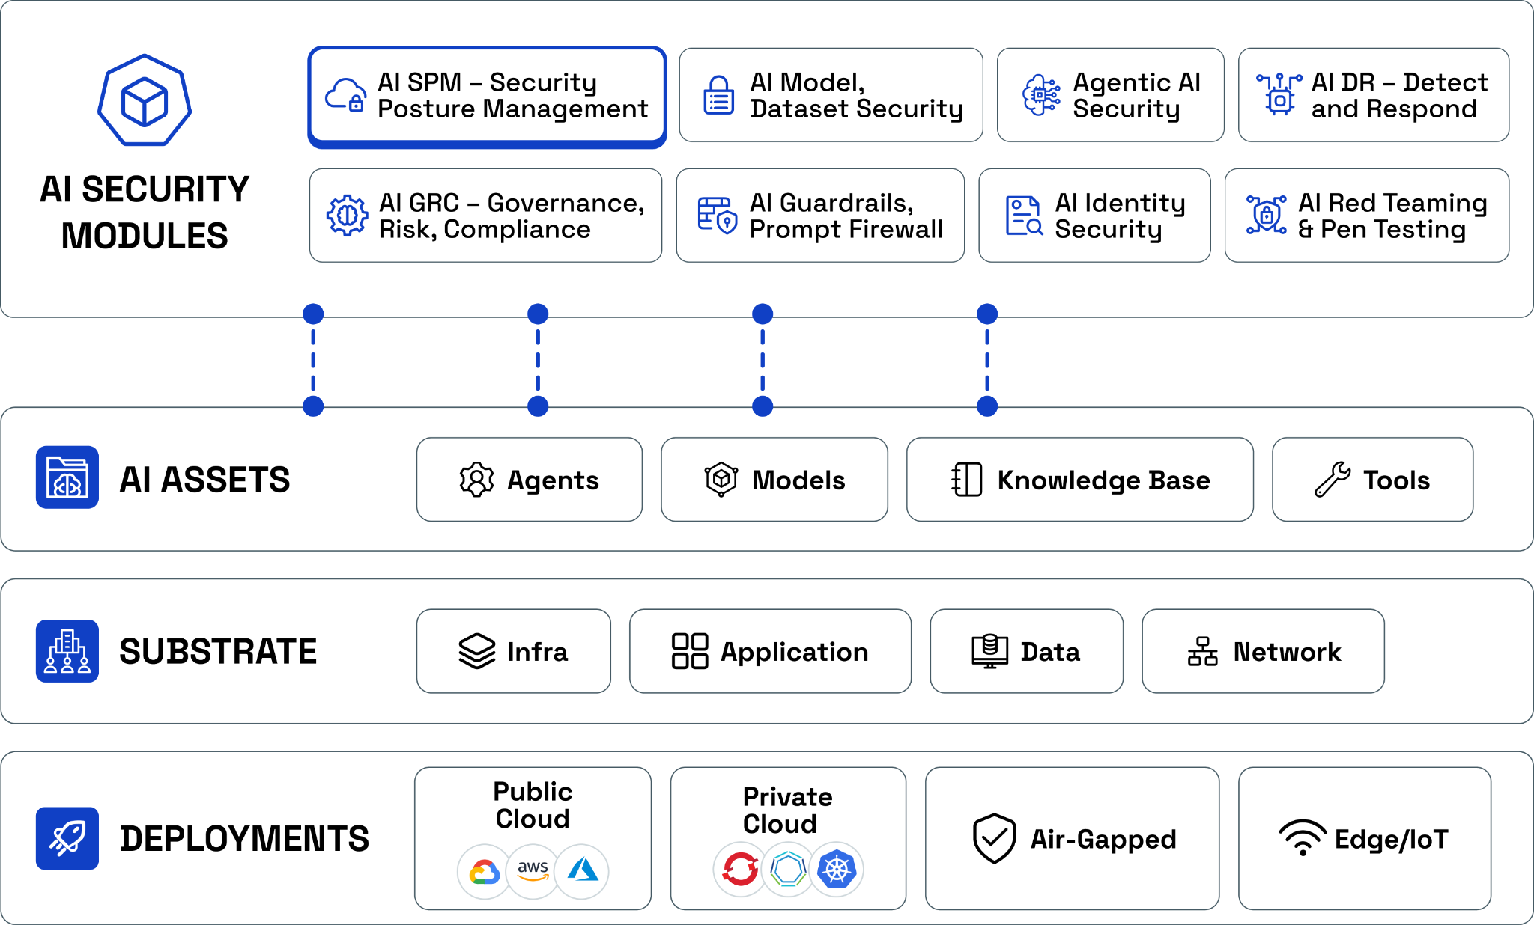
AI security for the next wave of banking
PLATFORM COVERAGE · 3 OF 3
As banks roll out chatbots, copilots and agentic workflows, AccuKnox governs and defends AI the same way it does cloud and code.

AI-SPM
Discover LLMs, ML & agentic apps; score their risk.

Prompt Firewall
Inline guardrails vs. prompt injection & data leaks.

AI Red Teaming
Automated adversarial testing vs. OWASP LLM Top 10.

AI-DR & DSPM
Detect AI threats, stop data leaking to public AI.
Recognised as Agentic AI Security Startup of the Year, 2025.

Slide 15
Deployment models built for a regulated bank
DATA RESIDENCY & CONTROL
Sensitive banking data can stay inside your walls. AccuKnox runs the same platform wherever your data-residency and PDPA obligations require it to live.

AccuKnox SaaS

Your cloud / private

On-prem

Fully air-gapped
Fastest to value, fully managed, for lower-sensitivity workloads.
Runs inside your AWS, Azure, GCP or Oracle tenant, your keys.
Deploy on your own VMs and bare metal for core banking.
No public-internet dependency, for the most sensitive systems.
Same product, same policies, everywhere
Secure cloud-native services and legacy on-prem core banking from one console, without shipping sensitive data outside the country or your control.

Slide 16
Why AccuKnox over point vendors
THE DIFFERENTIATORS

EFFORTLESS

EXTENSIVE

EFFICIENT
Agentless onboarding, protect in minutes.
Broadest AppSec, CloudSec, API & AI security in one.
Runs on every cloud, on-prem and air-gapped.

EFFECTIVE

INNOVATIVE

PARTNER-FIRST
Run-time, inline mitigation of zero-day attacks.
SRI R&D partnership, 10+ Zero Trust patents.
150+ partners; in Sri Lanka, VSONE.
Run-time, inline security across the CNAPP stack
AccuKnox
Wiz
Palo Alto
CrowdStrike
Sysdig
Upwind
✓ Yes
Limited / No
Limited / No
Limited / No
Limited / No
Limited / No
AccuKnox is the only vendor in the set with full private-cloud and air-gapped run-time, inline security.

Slide 17
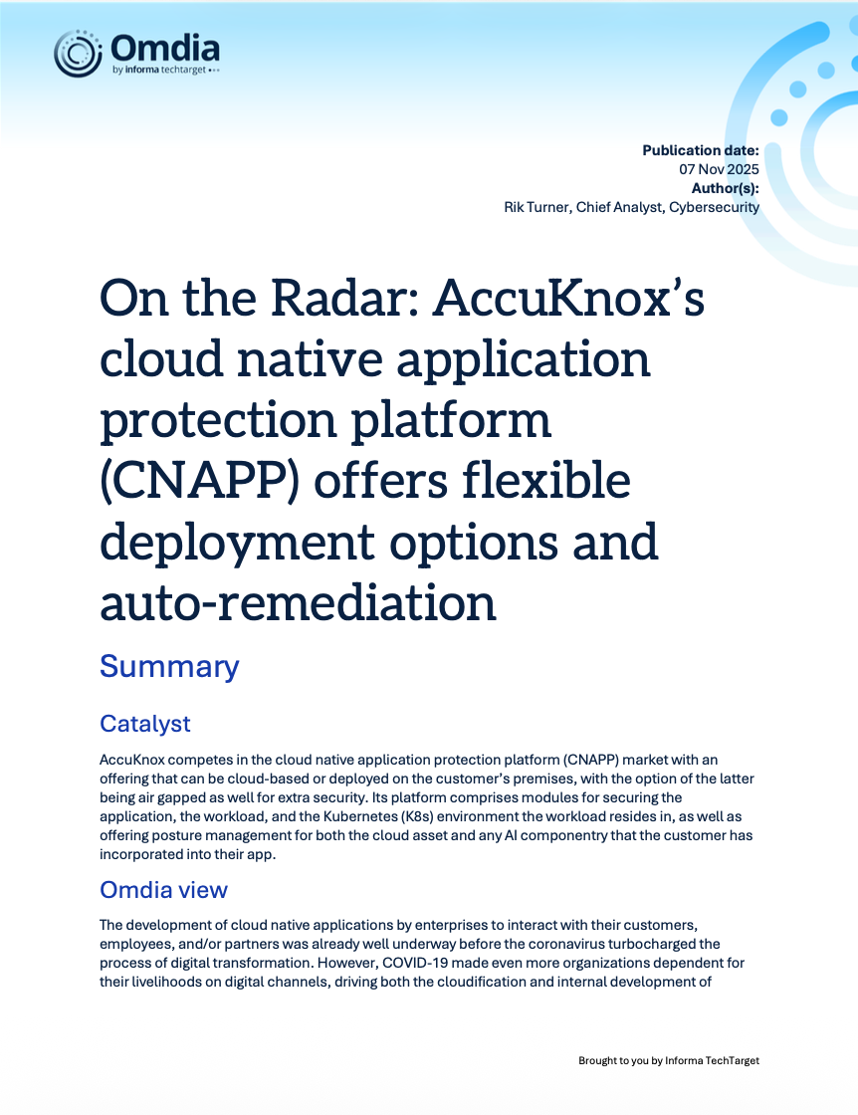
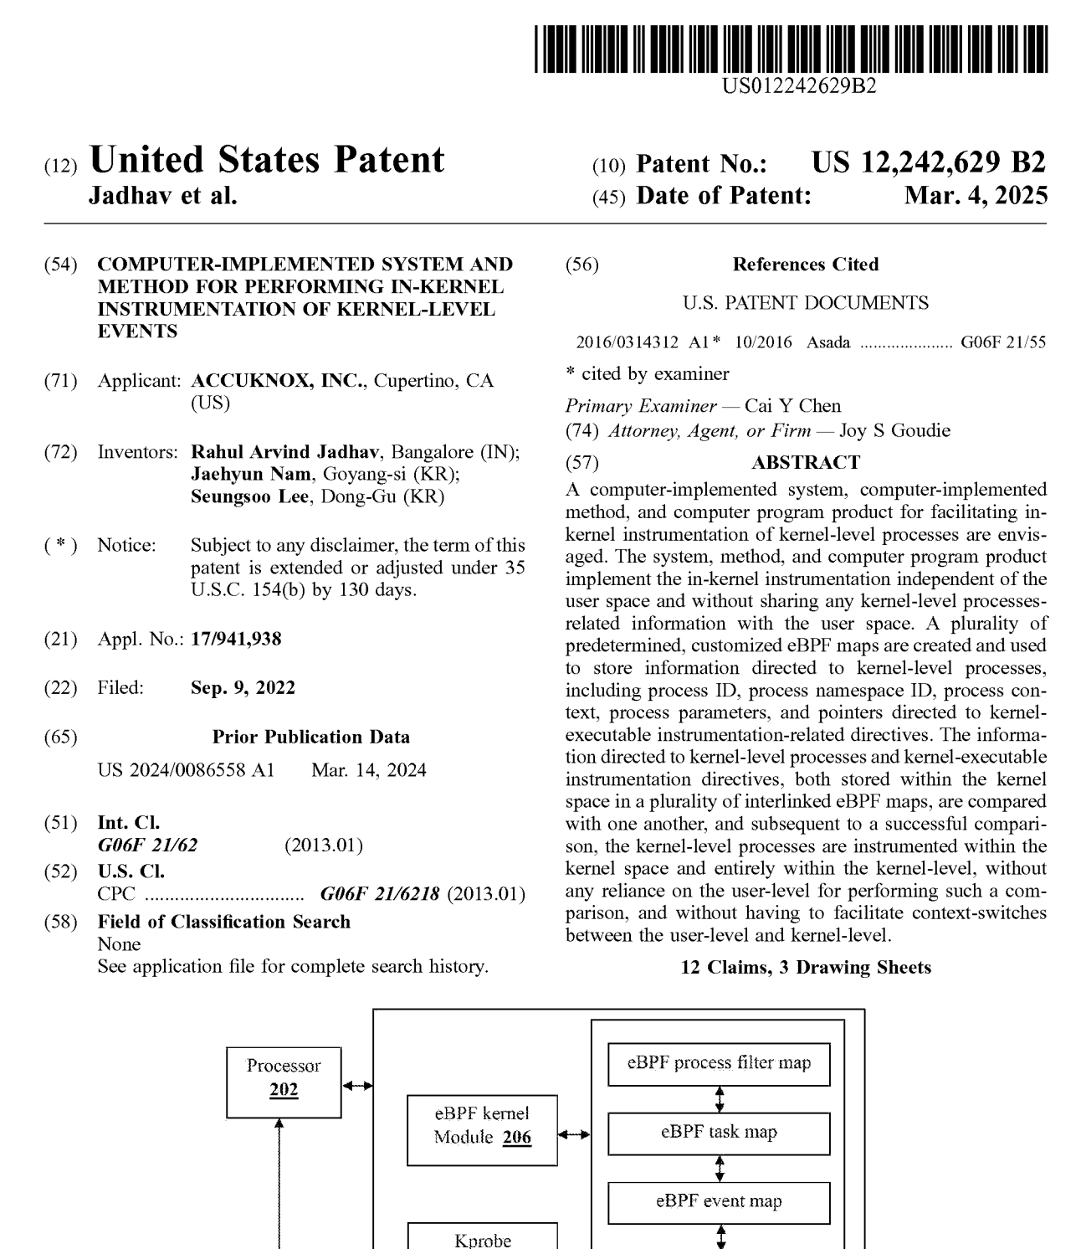
Proof the market already trusts
TRACTION & RECOGNITION
$1.5M
US DoD 5G security
R&D contract
$500K
Zero Trust satellite
security contract
$4.6M
funding for the
Zero Trust platform
150+
partners, 10+
Zero Trust patents
“We evaluated best-in-class vendors and selected AccuKnox for its breadth, ease of deployment, and real-time security against zero-day attacks.”
David Billeter, Cybersecurity Leader, Sonesta International Hotels
Omdia CNAPP report
10+ US patents granted
▸ Aligned to Gartner's CNAPP Market Guide and OWASP Cloud-Native Top 10.
▸ Trusted by regulated enterprises including IDT Telecom and SupportLogic (45% less engineering overhead).

Slide 18
ACCUKNOX × VSONE
Let's secure your bank,
from first commit to live production.
Start with a scoped proof of value on your own environment. See AccuKnox find real risk in your cloud, workloads and code within days, not months.

Discovery call

Proof of value

Roll out
Map your estate, mandates and priorities with VSONE and AccuKnox.
Agentless onboarding, first findings in your environment fast.
Phase across cloud, on-prem and air-gapped with local support.
VSONE (Colombo) · AccuKnox pre-sales engineering · support@accuknox.com · accuknox.com

