Slide 1
DAST
Find live vulnerabilities before attackers do. Continuous, authenticated, automation-driven web app testing.
*Confidential - Limited Distribution Under NDA

Slide 2
Outline
1
Problem Statements
2
OWASP Top 10:2025 Coverage
3
Business Impacts & Industry Insights
4
AccuKnox DAST Components & Roadmap
5
Scan Types & Engine
6
Architecture & Deployment
7
UI/UX Journey — Configuration to Findings
8
Rules Engine, Ticketing, Ask AI & Scheduling
*Confidential - Limited Distribution Under NDA

Slide 3




Problem Statements
DAST
What does DAST solve?
Live XSS, SQLi, CSRF in production
Missing Security Headers (CSP, HSTS, XFO)
Sensitive Data in Responses (PII, PHI)
Unauthenticated areas crawled, auth areas missed
Public + internal apps — same coverage gap
Insecure Cookies
No HttpOnly / SameSite
Shadow Endpoints
Forgotten Dev/Stage URLs
Open Redirects / SSRF
DORA Compliance
GDPR Compliance
HIPAA Compliance
PCI-DSS Compliance
Broken Authentication
OWASP Compliance
*Confidential - Limited Distribution Under NDA

Slide 4
OWASP Top 10:2025
A01:2025
Broken Access Control
A10:2025
Server-Side Request Forgery
COVERED
COVERED
A05:2025
Security Misconfiguration
A07:2025
Authentication Failures
COVERED
COVERED
A03:2025
Injection
COVERED

Slide 5
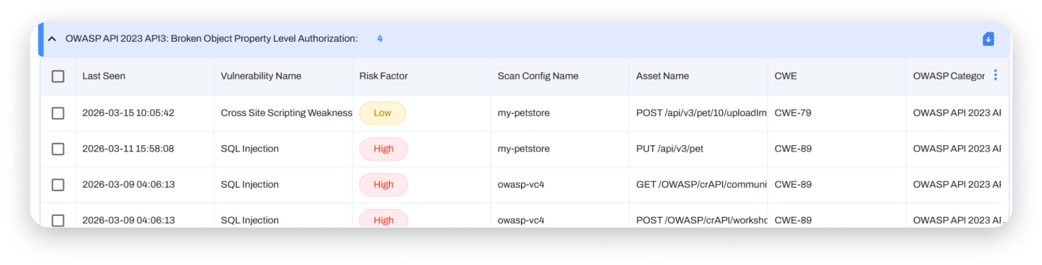
OWASP Top 10:2025
A01:2025
Broken Access Control
AccuKnox Coverage
COVERED
Forced Browsing — DAST attempts auth-only URLs without credentials to detect missing access controls.
IDOR — Object identifier tampering in URLs and JSON bodies.
Access control failures let users act outside intended permissions — unauthorized disclosure, modification, or destruction of data.
Bypassing access control checks by modifying the URL (parameter tampering), internal application state, or the HTML page.
Viewing or editing another user's account by changing its unique identifier (insecure direct object references).
Elevation of privilege — acting as a user without being logged in, or gaining admin rights.
CORS misconfiguration allowing API/web access from unauthorized origins.
Force browsing to authenticated pages as an unauthenticated user.

Slide 6
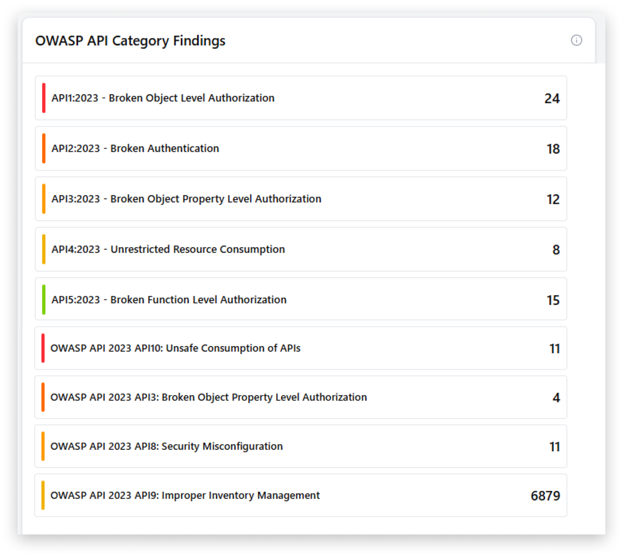
OWASP Top 10:2025
A05:2025
Security Misconfiguration
AccuKnox Coverage
COVERED
Missing security headers (CSP, X-Frame-Options, X-Content-Type-Options, HSTS) flagged on every endpoint.
Security misconfiguration is when a system, application, or cloud service is set up incorrectly from a security perspective.
Missing security hardening across the application stack — default settings, debug modes, sample apps left enabled.
Unnecessary features installed (open ports, debug endpoints, sample pages, default accounts).
Default accounts and passwords still enabled and unchanged.
Error handling reveals stack traces or overly informative messages.
Latest security features disabled or not configured securely after upgrades.
Security headers absent or set to insecure values — no CSP, HSTS, or X-Frame-Options.

Slide 7
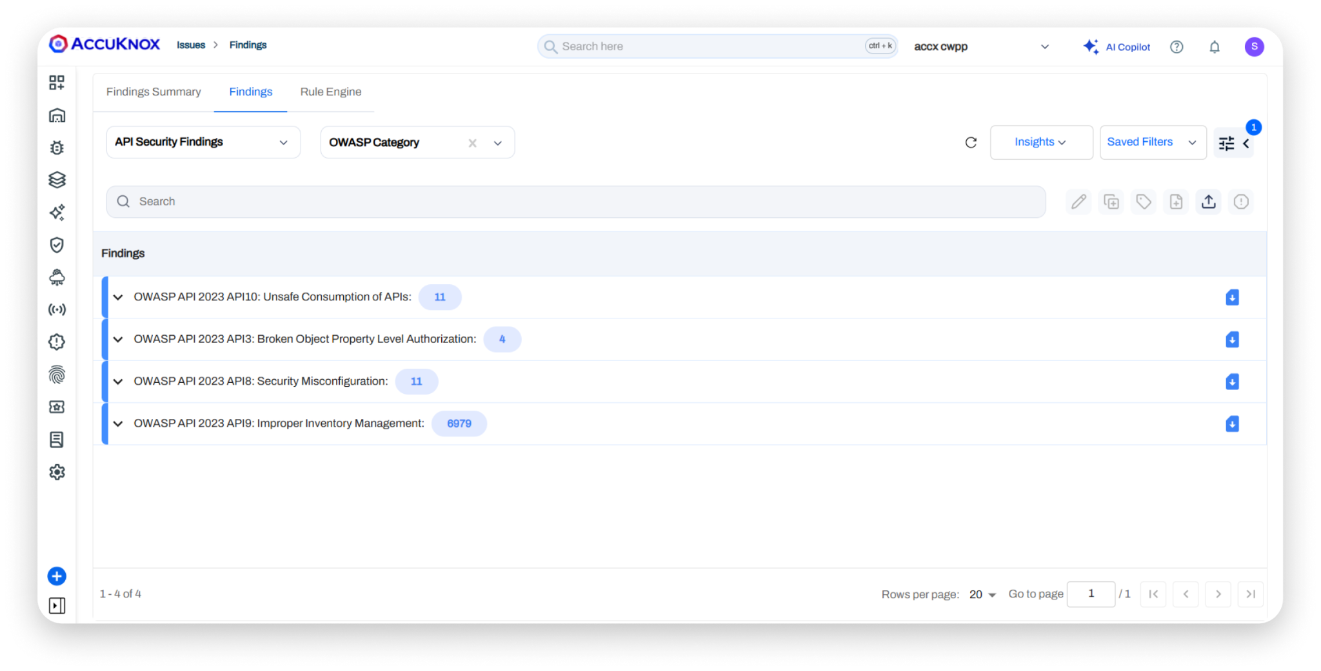
OWASP Top 10:2025
A03:2025
Injection
AccuKnox Coverage
COVERED
SQL Injection, NoSQL Injection, OS Command Injection — hundreds of payload variants tested per parameter.
An injection vulnerability is an application flaw that lets untrusted user input reach an interpreter and execute unintended commands.
User-supplied data not validated, filtered, or sanitized.
Dynamic queries or non-parameterized calls used directly in the interpreter.
Unsanitized data used in ORM search parameters to extract sensitive records.
Hostile data concatenated into SQL or shell commands at runtime.
DAST sends real attack payloads against every discovered parameter to confirm exploitability.

Slide 8
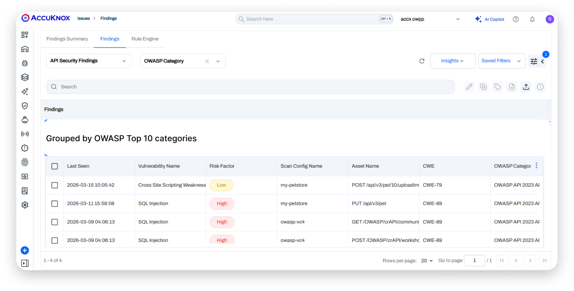
OWASP Top 10:2025
A10:2025
Server-Side Request Forgery
AccuKnox Coverage
COVERED
Server-Side Request Forgery (SSRF) detected via callback-based out-of-band testing.
SSRF flaws occur when an app fetches a remote resource without validating the user-supplied URL.
Attackers coerce the application to send crafted requests to internal or unintended destinations.
Bypasses network controls (VPCs, firewalls) by abusing trusted server-side traffic.
Common targets: cloud metadata endpoints (169.254.169.254), internal admin panels, databases.
DAST runs out-of-band callbacks to confirm exploitability with zero false positives.

Slide 9
OWASP Top 10:2025
A07:2025
Authentication Failures
AccuKnox Coverage
COVERED
Weak Authentication — DAST tests for missing rate limits on login, session fixation, weak password reset.
Authenticated scans validate session state through Logged-In / Logged-Out / Fallback indicators.
Authentication failures let attackers impersonate legitimate users.
Permits credential stuffing or brute force without lockout.
Permits default, weak, or well-known passwords like 'Password1' or 'admin/admin'.
Allows weak or ineffective credential recovery flows.
Uses plain text, encrypted, or weakly hashed passwords.
Missing or ineffective multi-factor authentication.
Exposes session identifiers in the URL or reuses session IDs after login.

Slide 10

Business Impacts
Apps at Risk
Avg Breach Cost
70%+ web apps carry at least one critical vuln (Imperva, 2024).
$4.88M average breach cost — web apps top initial vector (IBM, 2024).
DAST Market
Verizon DBIR
$5.1B DAST market by 2028 — ~14% CAGR (MarketsAndMarkets).
39% of breaches via web app attacks (Verizon DBIR, 2024).
Equifax Breach
Equifax 2017: unpatched Struts exposed 147M, $1.4B in costs.
*Confidential - Limited Distribution Under NDA

Slide 11
AccuKnox DAST Components
Component | Focus Area | Key Functions
API Discovery | Visibility & Inventory | Identify shadow, zombie, and exposed APIs
Runtime Monitoring | Behavioral Security | Detect anomalies in traffic and API usage
Access Policy Control | Identity & Authorization | Enforce RBAC and policy-as-code for API access
Threat Detection | Attack Prevention | Block injection, scraping, and broken object-level authorisation
Compliance Reporting | Audit Readiness | 🏁Align with SOC 2, PCI-DSS, and HIPAA standards
🏁 Roadmap
*Confidential - Limited Distribution Under NDA

Slide 12
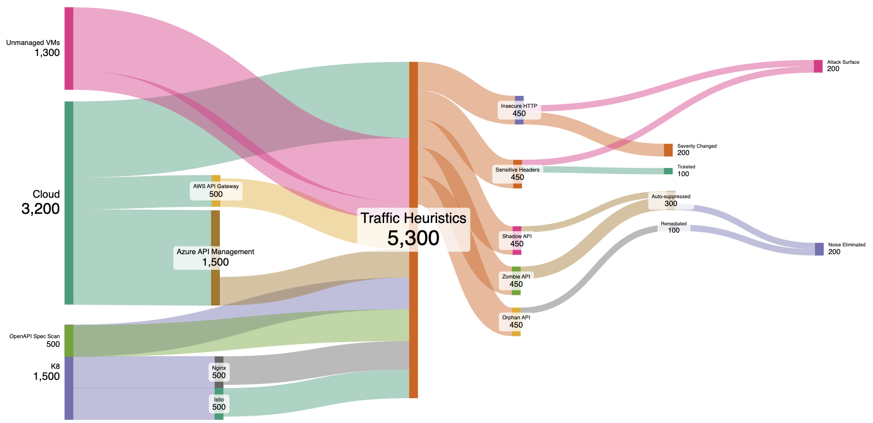
AccuKnox Differentiator — Noise vs Value Flow
CNAPP Platform Insights to triage DAST findings
Exploitable Web Vulns
DAST with CNAPP
Reachability filtering eliminates non-exploitable findings
Runtime context confirms which inputs see real traffic
Asset inventory ties findings to owning service / team
Auto-deduped across Baseline, Standard, Extended scans
Same finding never tickets twice across SAST + DAST
Severity reweighted by business impact
Compliance frameworks auto-mapped (PCI, HIPAA, OWASP)
*Confidential - Limited Distribution Under NDA

Slide 13

How AccuKnox DAST is different/better
Component |  | Vendor A | Vendor B
API Discovery & Cataloging | ✅ | ✅ | ✅
Runtime Monitoring | ✅ | ✅ | ✅
Access Policy Control | ✅ | ⚠ | ⚠
Shadow, Orphan, Zombie APIs | ✅ | ✅ | ✅
On-prem, Air-gapped Installation | ✅ | ❌ | ❌
Multi Vector Visibility {Process, File, Network, API } | ✅ | ❌ | ❌
*Confidential - Limited Distribution Under NDA

Slide 14

DAST Scan Profiles
DAST Scan Profiles
Pick the right scan for each stage — every commit, nightly, pre-release, or quarterly audit
Baseline Scan
Scan Targets
Passive only — no payloads, safe for production
Baseline Scan
Public Web
Crawl
Spider + AJAX
Duration
marketing, landing
Active Scan
Disabled
2 - 5 min
DAST Engine
Authenticated
Standard Scan
admin panels, SPAs
Spider + AJAX Crawler
Passive Header Audit
Active Payload Testing
Active scan — SQLi, XSS, CSRF, Path Traversal (Dev CICD)
Standard Scan
Internal
Crawl
Spider + AJAX
Duration
VPN-only services
ZAP-based • Auth-aware
Active Scan
Dev CICD
15 - 30 min
APIs
Extended / Comprehensive
REST / GraphQL
Findings
Maximum coverage — deep crawl, every payload class
Extended / Comprehensive
Severity • CWE • Compliance • Evidence
Crawl
Deep Spider
Duration
Active Scan
Dev Full
60 - 180 min

Slide 15
Use-Cases & Approach Mapping
Use-Case | AccuKnox Approach
API Inventory Discovery and cataloging Identify shadow/zombie APIs Identify internal/external accesses | ✔ Discovery Engine uses the abstraction provided by underlying platform (such as k8s) to discover the service to service communication and identify the API accesses attempted.
Traffic Capture/Inspection For empirical analysis Compliance requirement | ✔ Traffic metadata is maintained in the Accuknox data pipeline for empirical analysis.
Shadow, Orphan APIs, Zombie APIs | APIs not part of the spec. APIs in the spec never seen in use.
Deployment modes | Collectors {K8s and non-K8s, API Connectors}
Supported API Connectors | Nginx, Nginx Ingress Controller, Istio, AWS API Gateway, Azure APIM
OWASP Web & API Attacks Protection | Traffic signatures can be used to identify API attacks.
Auto Upgrade to secure connections | Manage service identities and upgrade to secure connections for APIs.
Brute force authn attempts | Identify brute force authentication attempts
Sensitive Data Exposure Identification | Detect for sensitive data patterns in API responses. Customizable sensitive data expression
API Static scanning | Scan the swagger or openapi specs
Rate Limiting & Throttling | Ensure that the valid users don’t overuse their permissions
API Spec Generation from Traffic | Automatically get OpenAPI spec from the observed / collected traffic
*Confidential - Limited Distribution Under NDA

Slide 16
UI/UX Journey
*Confidential - Limited Distribution Under NDA

Slide 17
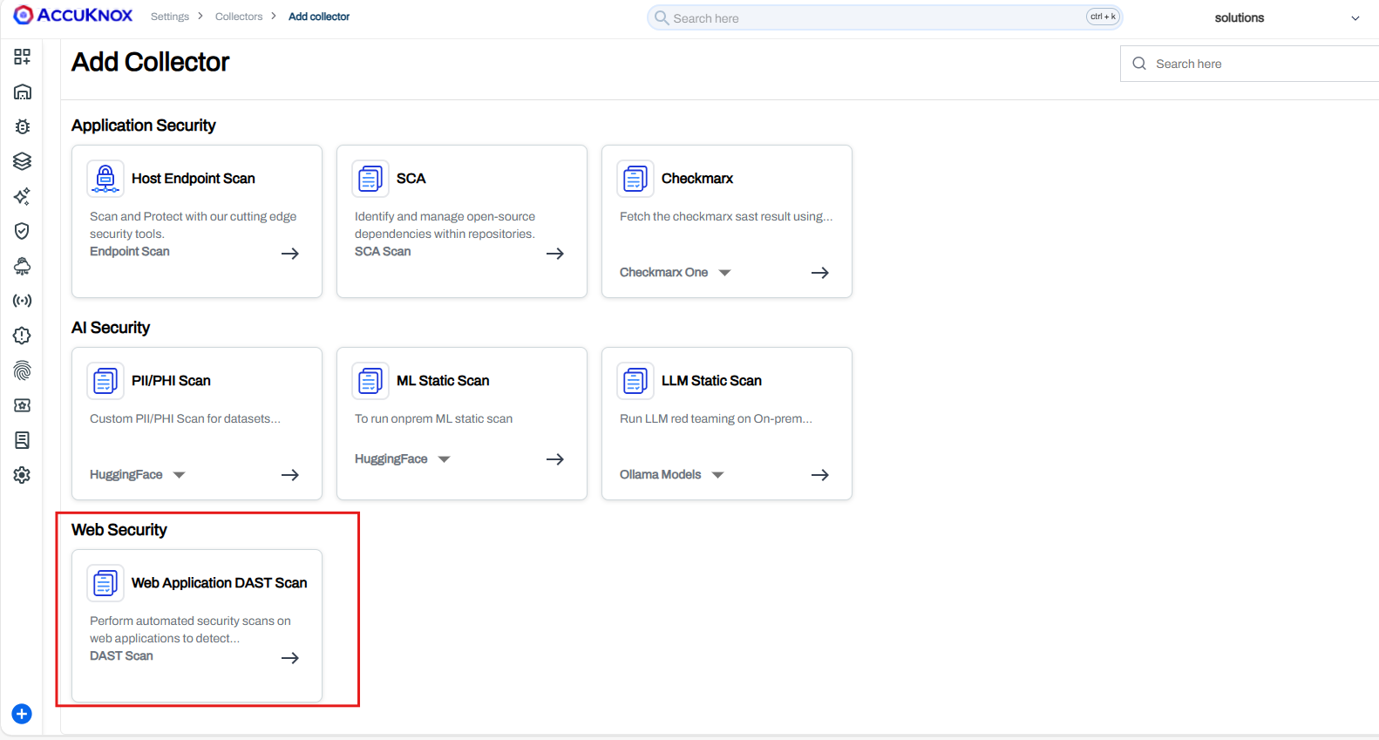
Add Collector — Web Application DAST Scan
*Confidential - Limited Distribution Under NDA

Slide 18
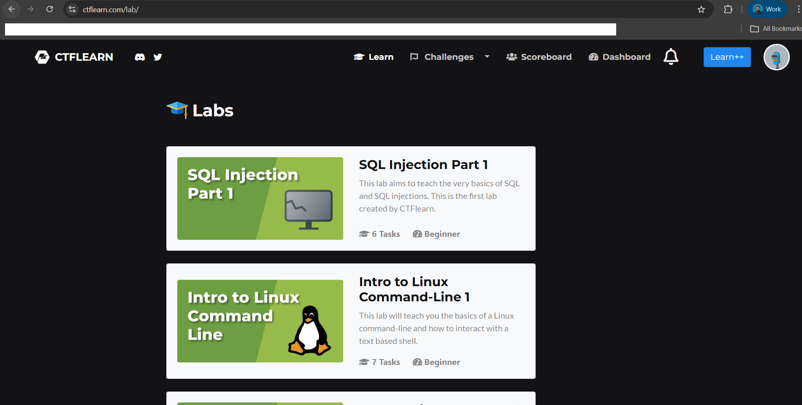
Scan Configuration — No-Auth Mode
*Confidential - Limited Distribution Under NDA

Slide 19
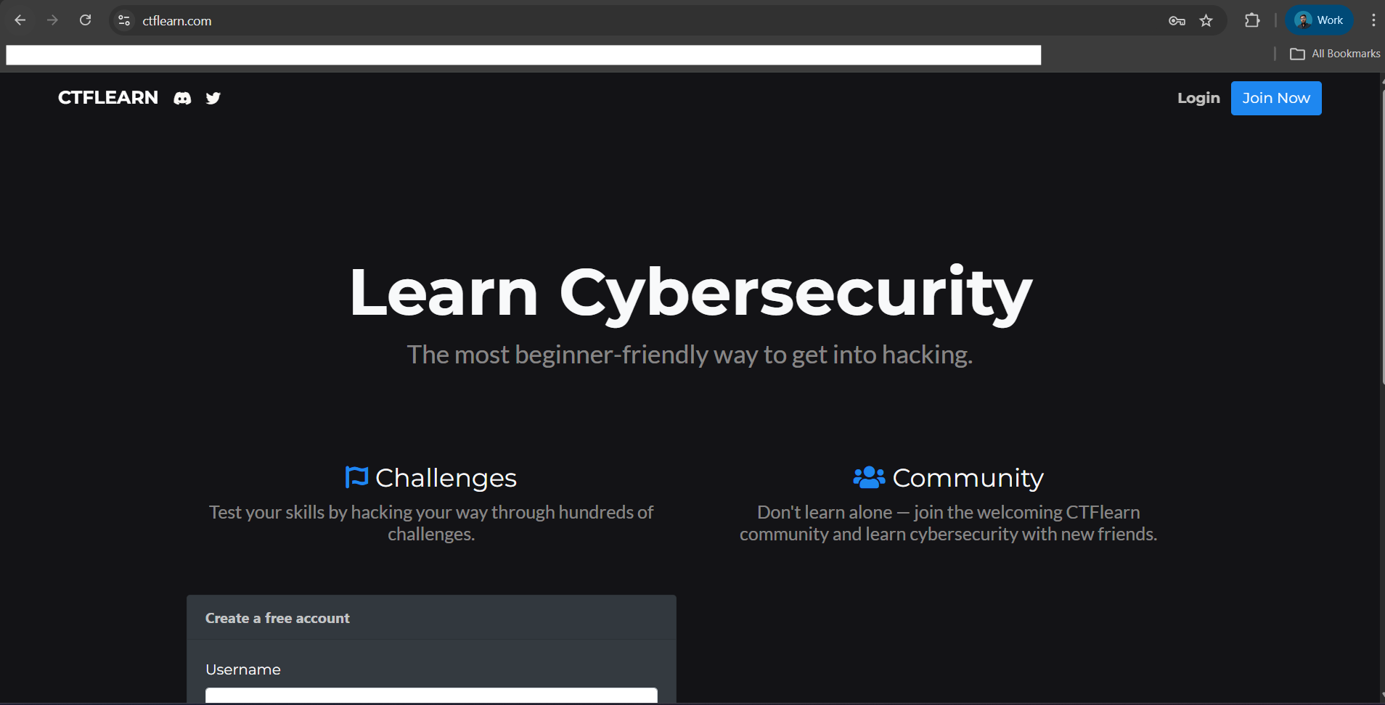
Authenticated Scan — Login URL & Credentials
*Confidential - Limited Distribution Under NDA

Slide 20
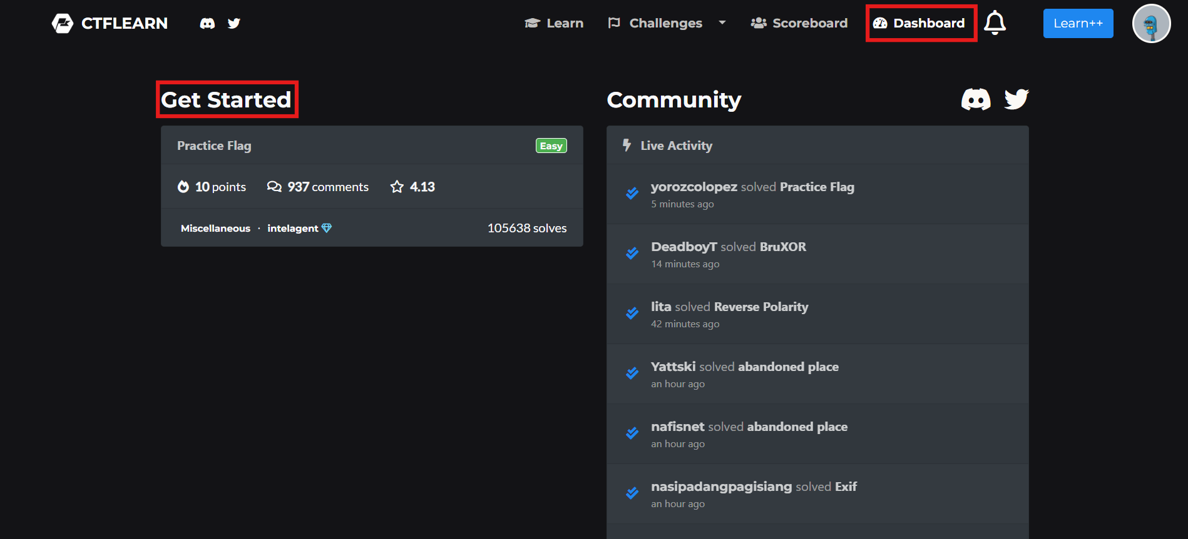
Session Indicators — Logged-In / Logged-Out / Fallback
*Confidential - Limited Distribution Under NDA

Slide 21
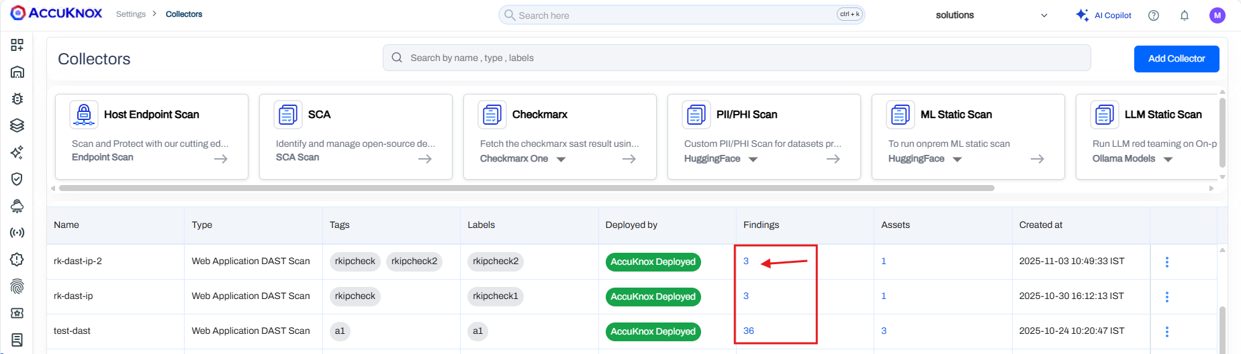
Scan Triggered — Status & Progress
*Confidential - Limited Distribution Under NDA

Slide 22
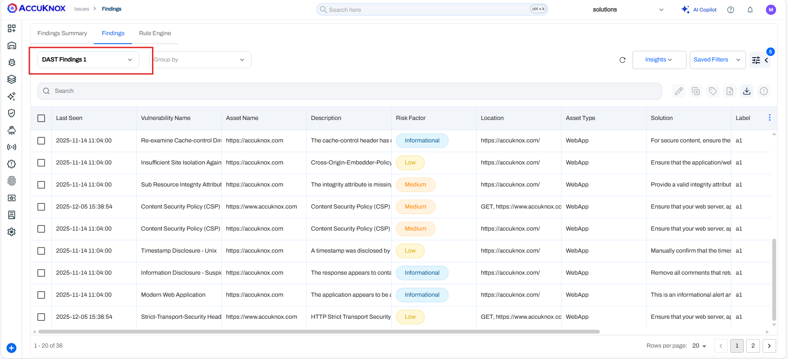
Findings — Severity, Evidence & Remediation
*Confidential - Limited Distribution Under NDA

Slide 23
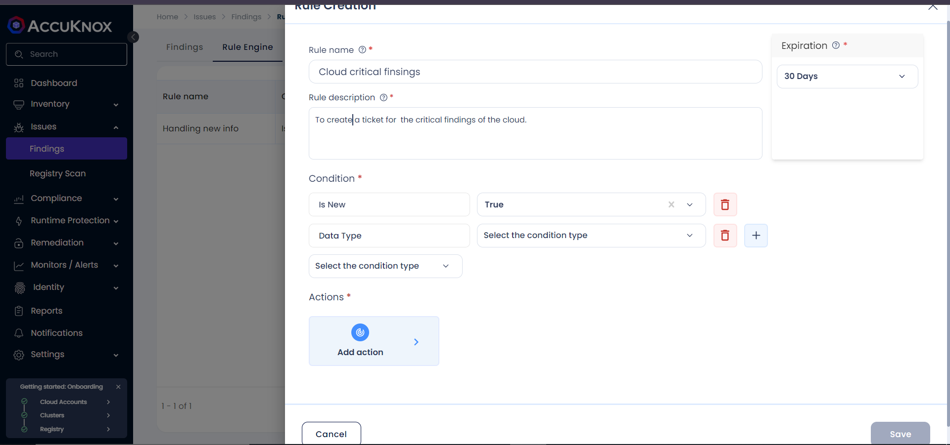
Rules Engine — Automate Findings Triage
*Confidential - Limited Distribution Under NDA

Slide 24
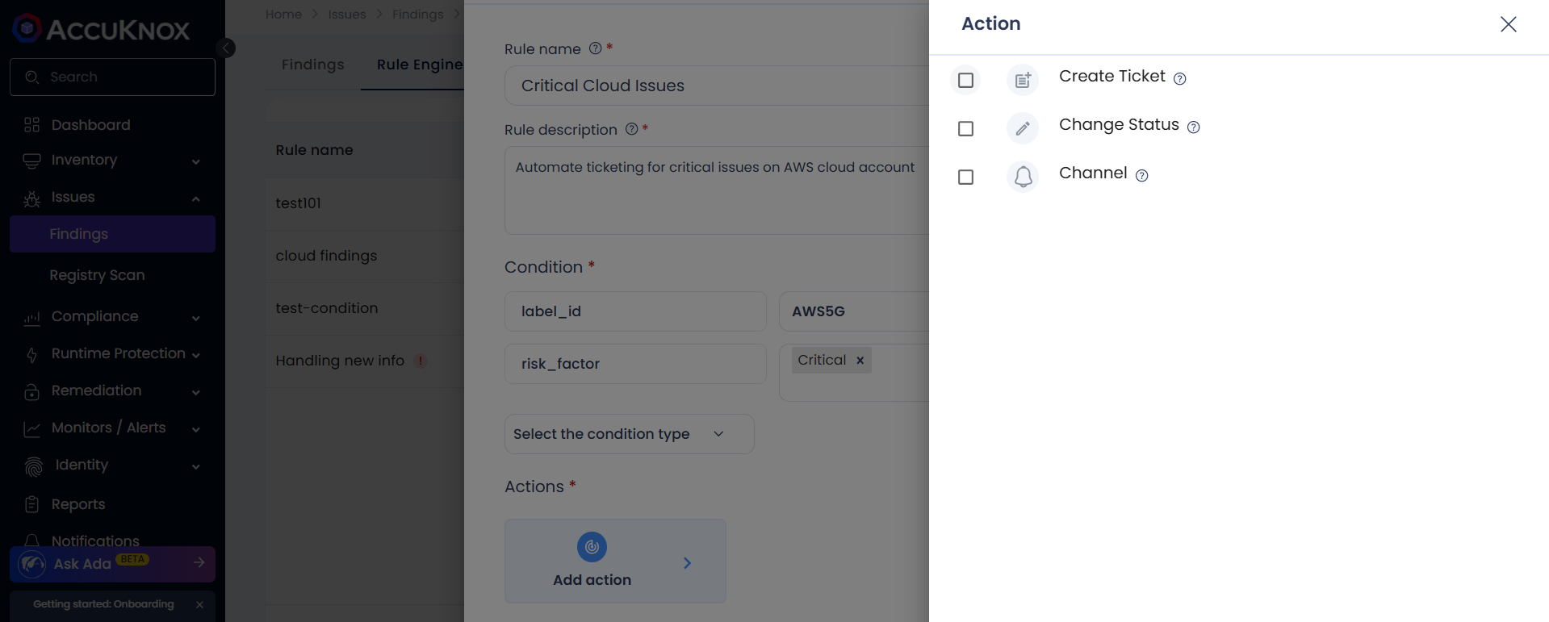
Rules Engine — Create Ticket Action
*Confidential - Limited Distribution Under NDA

Slide 25
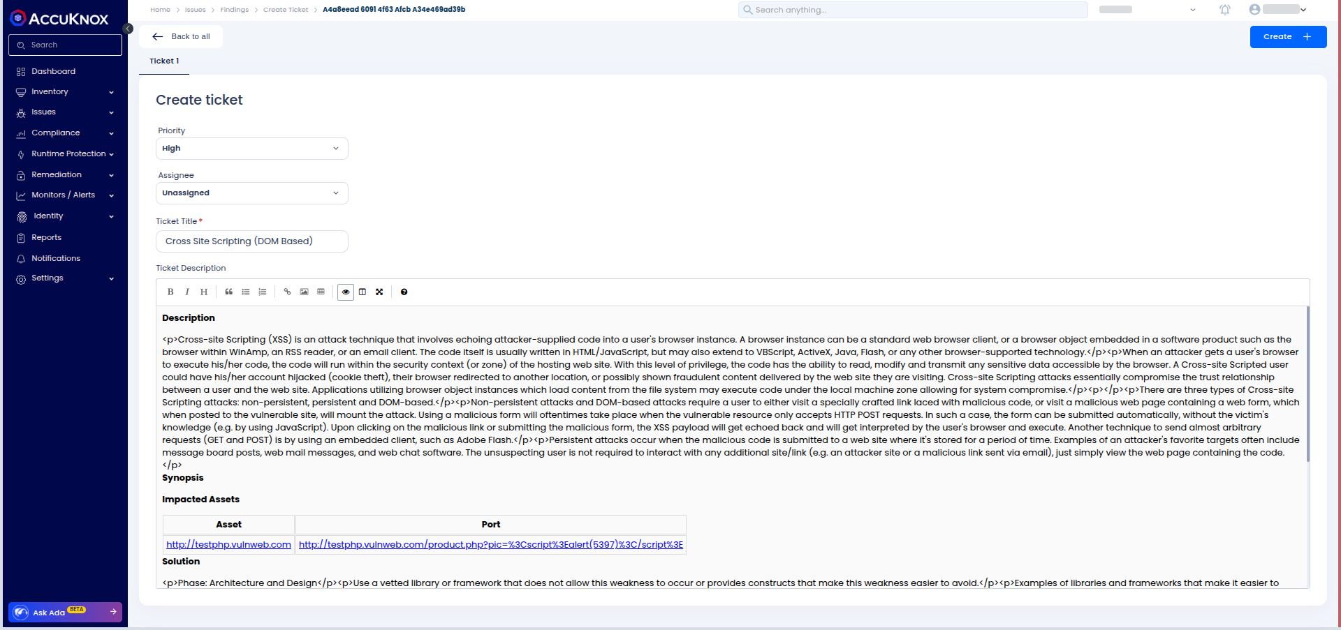
Ticketing — Auto-Create Jira / ServiceNow Tickets
*Confidential - Limited Distribution Under NDA

Slide 26
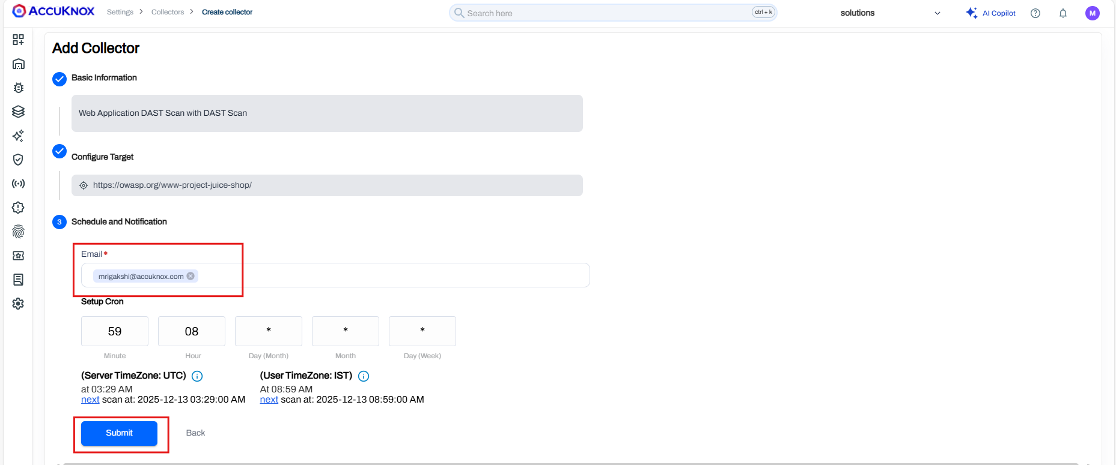
Scheduling — Recurring DAST Scans
*Confidential - Limited Distribution Under NDA

Slide 27
Ask AI — GenAI Co-Pilot for DAST Triage
Natural-Language Triage
Ask 'Why is this XSS exploitable?' and AI Copilot replies with attack path, evidence, CWE, and fix.
Bulk Action Suggestions
Highlight 50 findings, ask 'Which can I deprioritize?' — Copilot ranks by reachability + business impact.
Auto-Generated Remediation
Get sanitized code snippets, framework-specific WAF rules, and CSP/HSTS header values to paste in.
OWASP / CWE Explainer
One-click summary of any CWE-79 / CWE-89 / CWE-918 finding in plain language for non-security teams.
Custom Rule Builder
Describe a rule in English ('open Jira for any High DAST finding on prod label') — Copilot writes the JSON.
Audit-Ready Reports
Generate PCI-DSS / HIPAA / SOC2 summaries from filtered findings, exported to PDF or shared as a link.
*Confidential - Limited Distribution Under NDA

Slide 28


Next Steps…
1
Onboard Targets
Add web app URLs and labels via Settings → Collectors. No agent install required.
Authenticated Scans
Session-aware crawler reaches admin panels and protected APIs.
1
2
Configure Auth & Scope
Provide login URL, credentials, include/exclude paths, and session indicators.
2
OWASP Top 10 Coverage
Active payload library mapped to A01 … A10 with evidence.
3
Pick Scan Type
Baseline for CI/CD, Standard nightly, Extended pre-release, Comprehensive for audits.
3
CI/CD Native
GitHub Action, GitLab template, Jenkins plug-in — fail builds on critical findings.
DAST Journey
AccuKnox Advantage
4
4
Triage in Findings
Filter by severity, CWE, or OWASP category. Auto-create Jira tickets via Rules Engine.
Rules Engine + Ticketing
Auto-create Jira/ServiceNow tickets when finding matches rule.
5
5
Verify & Re-Scan
Schedule recurring scans and confirm fixes close out tickets automatically.
Ask AI + Schedule
GenAI triage co-pilot + recurring schedules — zero manual upkeep.
*Confidential - Limited Distribution Under NDA

Slide 29
SEE US IN ACTION
support@accuknox.com
*Confidential - Limited Distribution Under NDA

