Slide 1
VM Security Use Cases (RHEL)
May 2026

Slide 2
Outline
1
VM EDR Lifecycle
2
Attack Scenarios
3
VM Security overview
4
Deployment Models Continuous Compliance
5
Appendix
6
Q&A

Slide 3
VM EDR Lifecycle
Module I
Module II
Module III
VM Vulnerability Scanning Missing patches Known CVEs Misconfigurations Weak services and exposed ports Outdated OS/packages Compliance gaps VM Compliance STIGs CIS SOC2 | VM Malware Scanning Ransomware, trojans, spyware, cryptominers, persistence mechanisms, malicious binaries and scripts. | VM Runtime Hardening Enforces best practices VM Runtime Behaviour Detection monitors behavior, detects attacks, blocks malicious actions, enforces zero-trust policies.

Slide 4
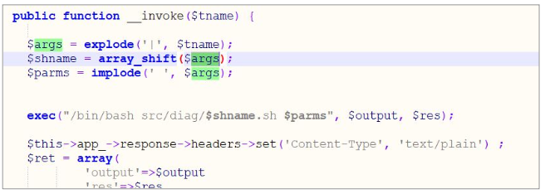
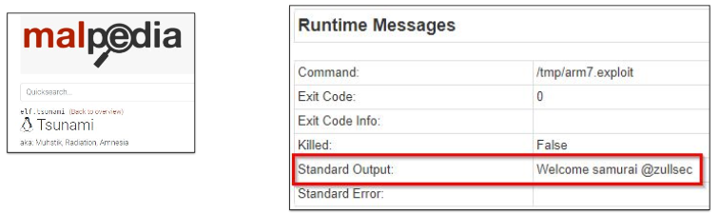
Attack Scenarios Example
Remote Code Execution
Remote code execution vulnerability on a server
Can be exploited to run and execute any set of commands separated by “;”
Known Malware
Install and execute known “Tsunami” malware
Variants of Mirai Botnet

Slide 5
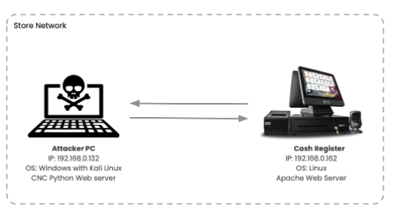
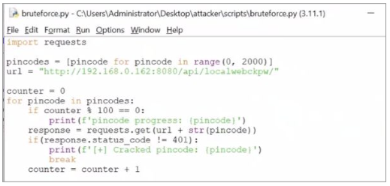
Attack Scenarios Example
Brute Force
Brute force attack uses trial-and-error to guess login credentials.

Slide 6
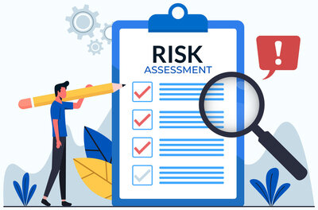
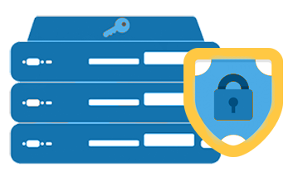

Module 1: VM/Bare-metal Security Overview
VM/Bare-Metal Risk Assessment
STIGs based risk assessment
Security Hardening
Hardening the OS, file system
Application hardening for workloads operating on hosts
Host based Process whitelisting
Cryptomining Protection
File Integrity Monitoring/Prevention
Securing containers on VM/Bare-Metal
VM/Bare-Metal Forensics
Application behavior analysis/forensics
Anomaly Detection

Slide 7
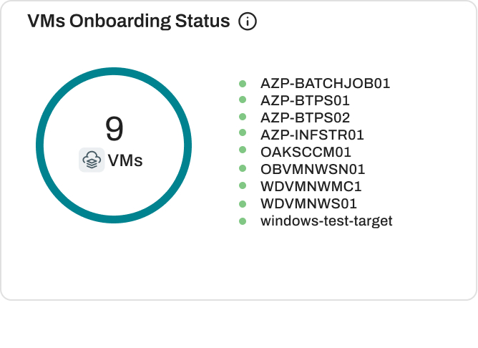
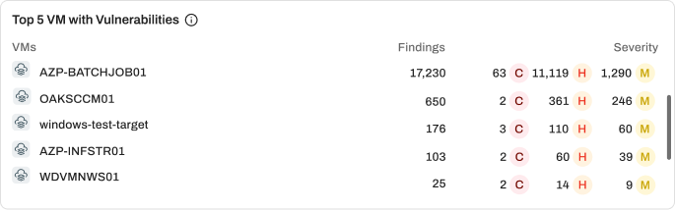
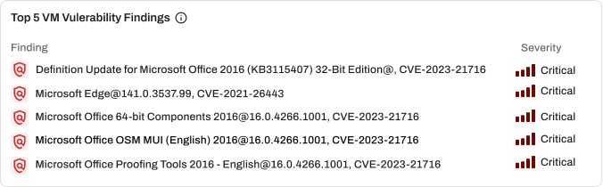
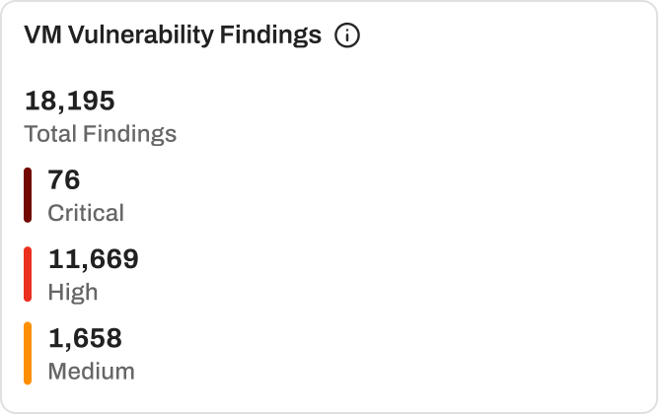
Module 1 : VM Vulnerability Findings Insights

Slide 8
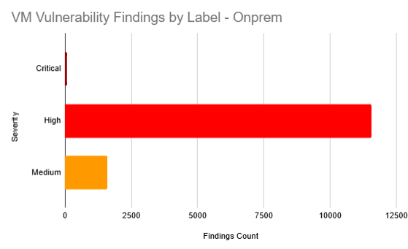
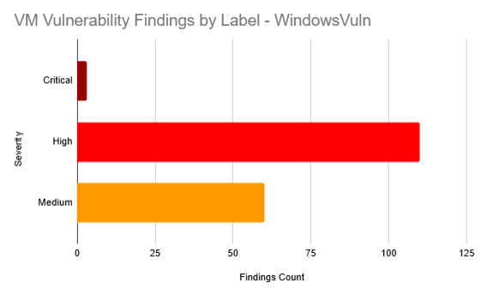
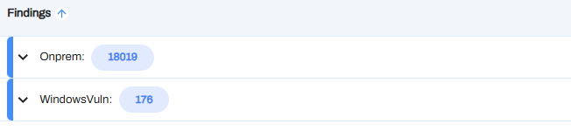
Module 1 : VM Vulnerability Findings by Label
Data Composition: The Overall findings (18195) - On-Prem (18019)
Primary Risk Source: The On-Prem label is the primary driver of risk, accounting for ~99% of the total vulnerability volume and 96% of all Critical issues.
Critical Breakdown: There are 76 Critical vulnerabilities in total; 73 are located in the On-Prem environment, while only 3 are associated with the Windows vulnerability set.
Severity Concentration: High Severity is the dominant category across both environments (11,669 total)

Slide 9
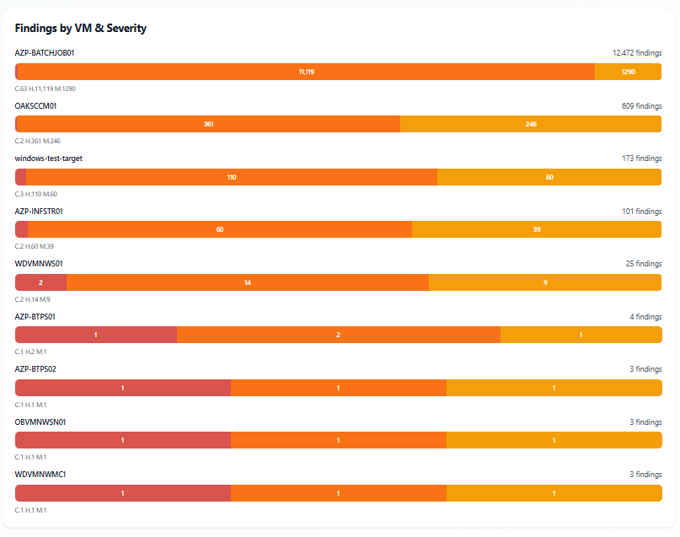
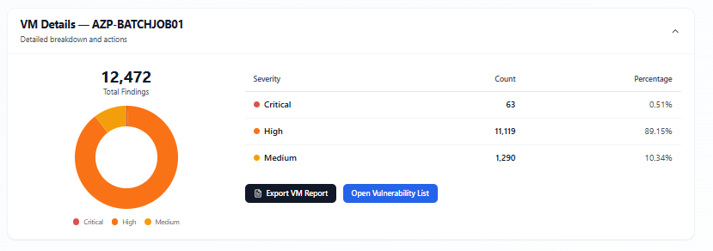
Module 1 : VM Vulnerability by Severity

Slide 10
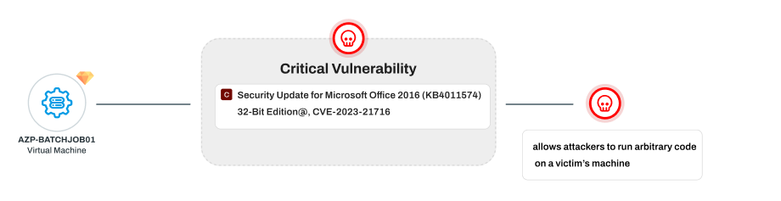
Module 1: Critical Vulnerability on VM
Critical Remote Code Execution (RCE) Risk - CVE-2023-21716 allows attackers to run arbitrary code on a victim’s machine using a specially crafted malicious RTF file. Just opening or previewing the file in Word or Outlook can trigger the exploit.
Heap Corruption in Word's RTF Parser - The vulnerability exists due to a heap corruption bug in Word’s RTF parsing engine. A malformed font table in an RTF document causes memory corruption — enabling full system compromise if exploited.
Update KB4011574 Fixes the Vulnerability- The security update patches the RTF parsing flaw in Office 2016 (32-bit), preventing exploitation. Without this patch, the system remains vulnerable to malware delivery, privilege escalation, and complete takeover.

Slide 11
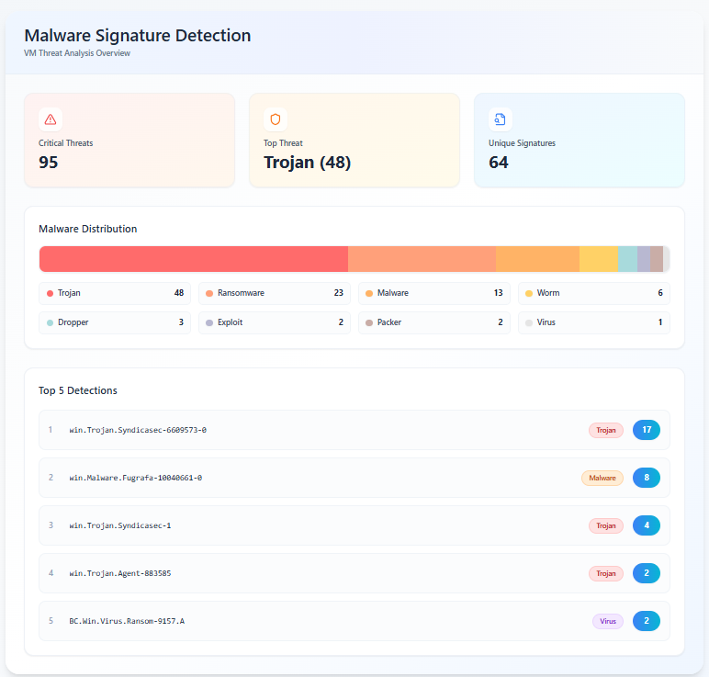
Module 2: VM Malware Detection
Syndicasec and Fugrafa are the most active families, showing multiple variants and repeated detections.
Ransomware presence is high, with 18+ variants including WannaCryptor, Maze, Locky, and Petya-based strains.
Exploit-driven activity detected (CVE-2017-0147, DCOM), indicating attempts at lateral movement and targeting unpatched systems.
Multi-stage and obfuscated malware observed through droppers and packed payloads, suggesting evasion-focused attacks.
Mix of modern and legacy threats (Emotet, Zusy, Blaster worms) highlights a broad and diverse attack surface.

Slide 12
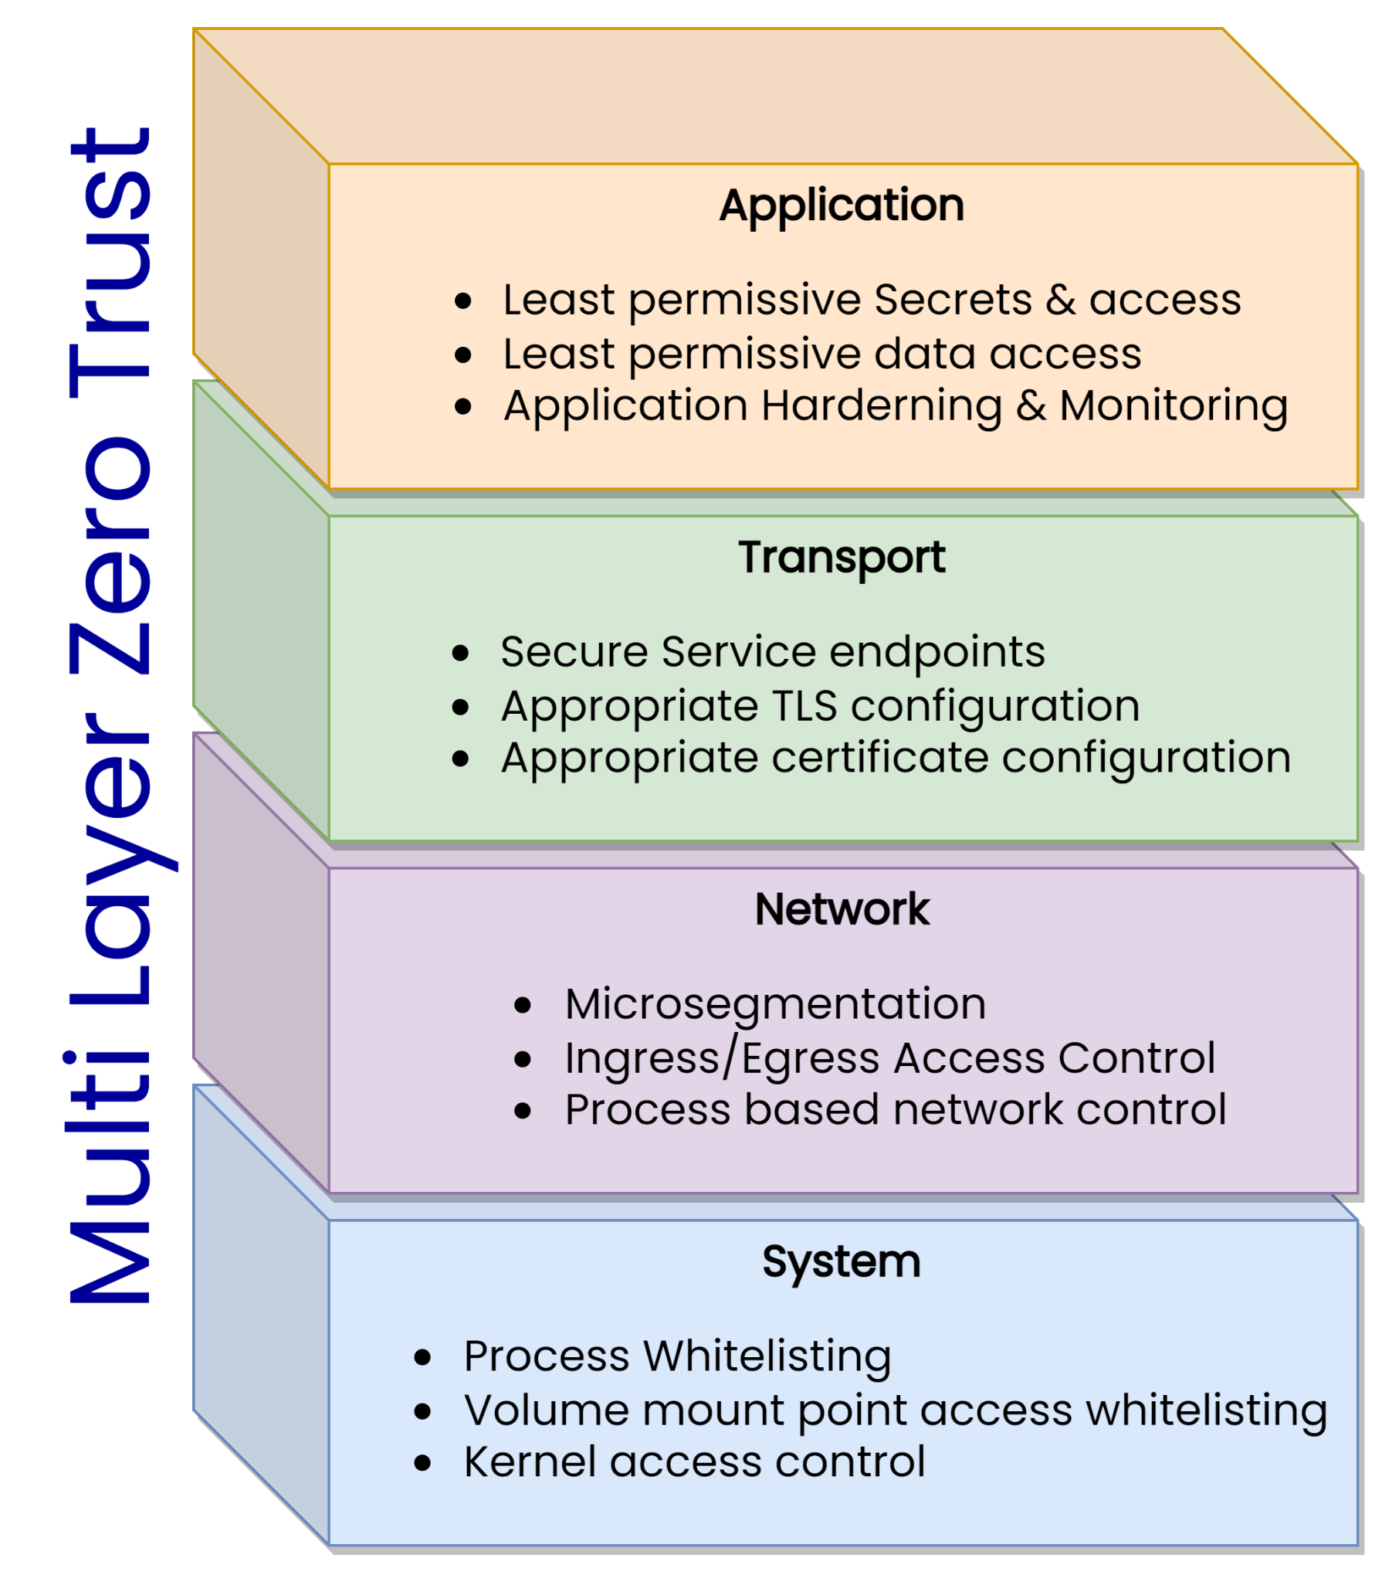
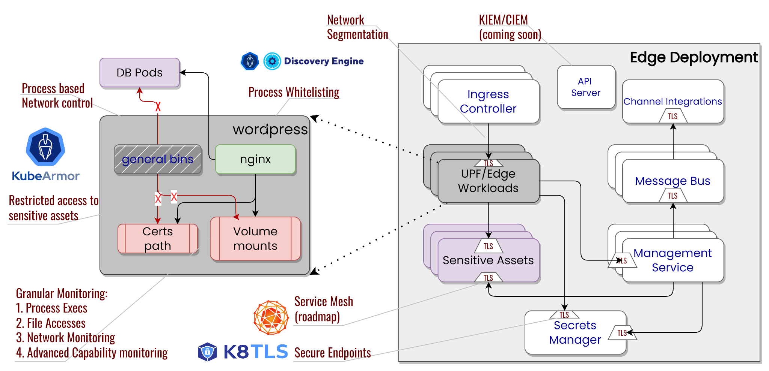
Module 3: Zero Trust for VMs
Auto Generated Least Permissive Policy out-of- the-box:
Fine-tuned least permissive security policies based on default posture of the application
Ability to enforce least permissive posture in Default-deny or Audit mode on workload
Enforce Zero Trust in a automated Lifecycle
Ability to detect dynamic change in App Behavior
Ability to segment traffic via network microsegmentation
Ability to enforce Recommended MITRE, NIST based Hardening Policy

Slide 13
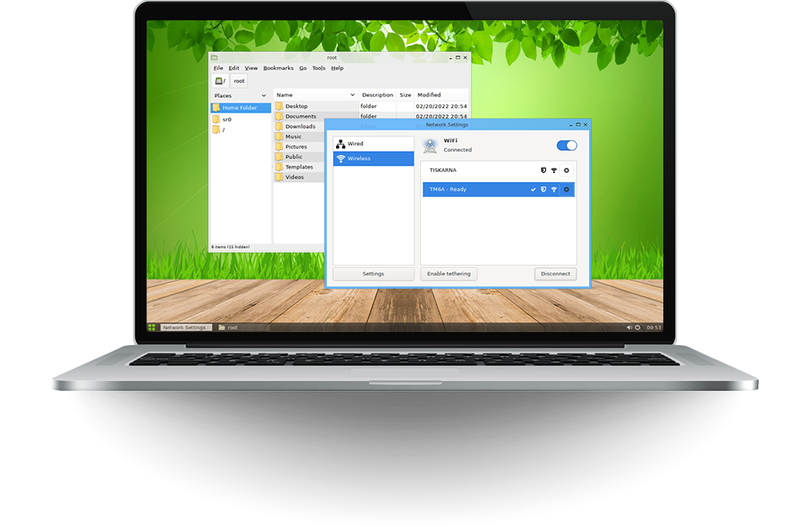


POC Deployment
.. N devices --
Kubearmor enforcer
summary-engine
vm-adapter
Management Portal
Desktop App
AccuKnox EDR
RMQ
Feeder-Service
SIA / PEA
AccuKnox Security Portal
Management
VM CP

Slide 14





Module 3: Top EDR Attacks at Runtime
 | Attack Vectors | How AccuKnox prevents them
 | Living-off-the-Land (LotL) Attacks: Attackers use legitimate, built-in system tools (e.g., PowerShell, WMI, PsExec) to perform malicious actions. Because these tools are trusted by the system, EDRs may not immediately flag them as malicious. | Accuknox proprietary algorithms generate system profile for each system to ensure that no irregular action can be performed on the system based on zero trust principles. This ensures that malicious activities are prevented before that they can start
 | Fileless Malware: These attacks operate entirely in memory (RAM) and do not write files to the disk, leaving a minimal footprint that traditional antivirus solutions often miss. They frequently leverage scripting languages like PowerShell or JavaScript. | Accuknox provides security policies and presets for fileless execution to prevent/audit such behavior. When using strict security mode is applied on the system or a sub-component of the system only authorized parties can interact with the protected asset
 | Ransomware 2.0 (Double Extortion): Modern ransomware goes beyond just encrypting data; attackers steal sensitive data before encryption to blackmail organizations, ensuring they can demand payment even if the system is restored. | Accuknox offer both malware scanning and asset protection via various policies such as: File Integrity Protection Policy Protect credentials/tokens Policy
 | EDR Disablement/Evasion: Sophisticated threats actively attempt to detect the presence of EDR agents and disable, blind, or bypass them using evasion techniques like obfuscation or API unhooking. | Accuknox enforces zero trust policies/principles to ensure that the protected assets can be only accessed by legitimate parties. Accuknox rely on inline policy enforcement techniques to ensure that evasion techniques has no impact on the security enforcement of the protected asset
 | Identity-Based Attacks: Utilizing stolen, compromised, or brute-forced credentials to login as a legitimate user, making the malicious activity appear authorized. | Accuknox provides two types of policies to protect against these attacks: Discovered policies that protected tokens/certificate from illegitimate access and ensure only authorized parties/systems gain access Hardening policies that protect known sensitive informations on a system

Slide 15

Linux Endpoint Security
Least permissive application enforcement
Only allow whitelisted processes to execute
Prevent Remote command injection
Malware/Crypto Mining protection
File Integrity Protection
Protected Network access to only whitelisted processes
Protect Sensitive Data assets by allowing access only to known processes
Threat Model the POS app and create custom protection policies.

Slide 16
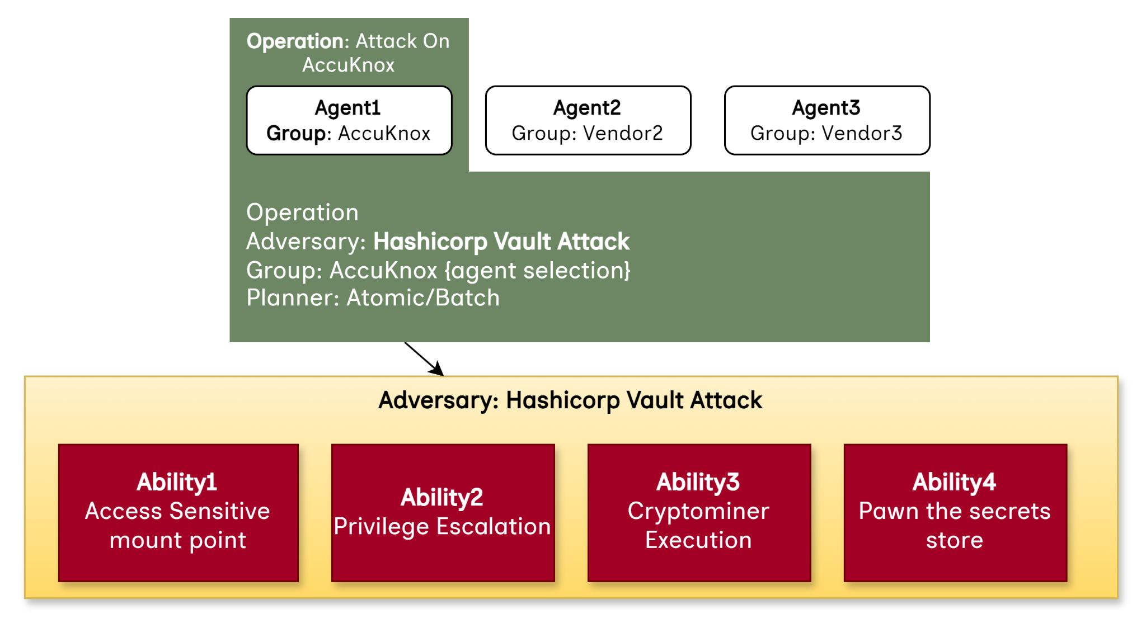
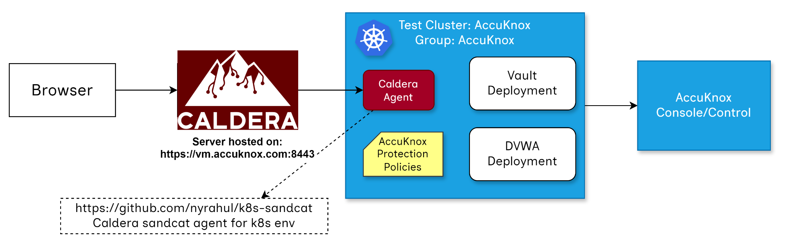
Adversarial Simulation Tool: MITRE Caldera
Agent: Agent performing an attack
Ability: Attack use-case
Adversary: Group of Abilities
Operation: Attack Operation
Ref:
MITRE Caldera: Learning the terminology
https://github.com/nyrahul/k8s-sandcat

Slide 17
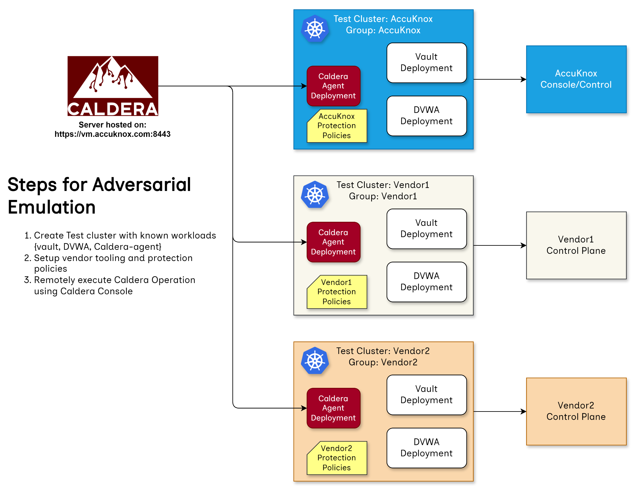
Adversarial Simulation across multiple vendors

Slide 18
Detailed Demo for MITRE Caldera
https://app.storylane.io/share/2ybs00khhlmk

Slide 19
Appendix

Slide 20
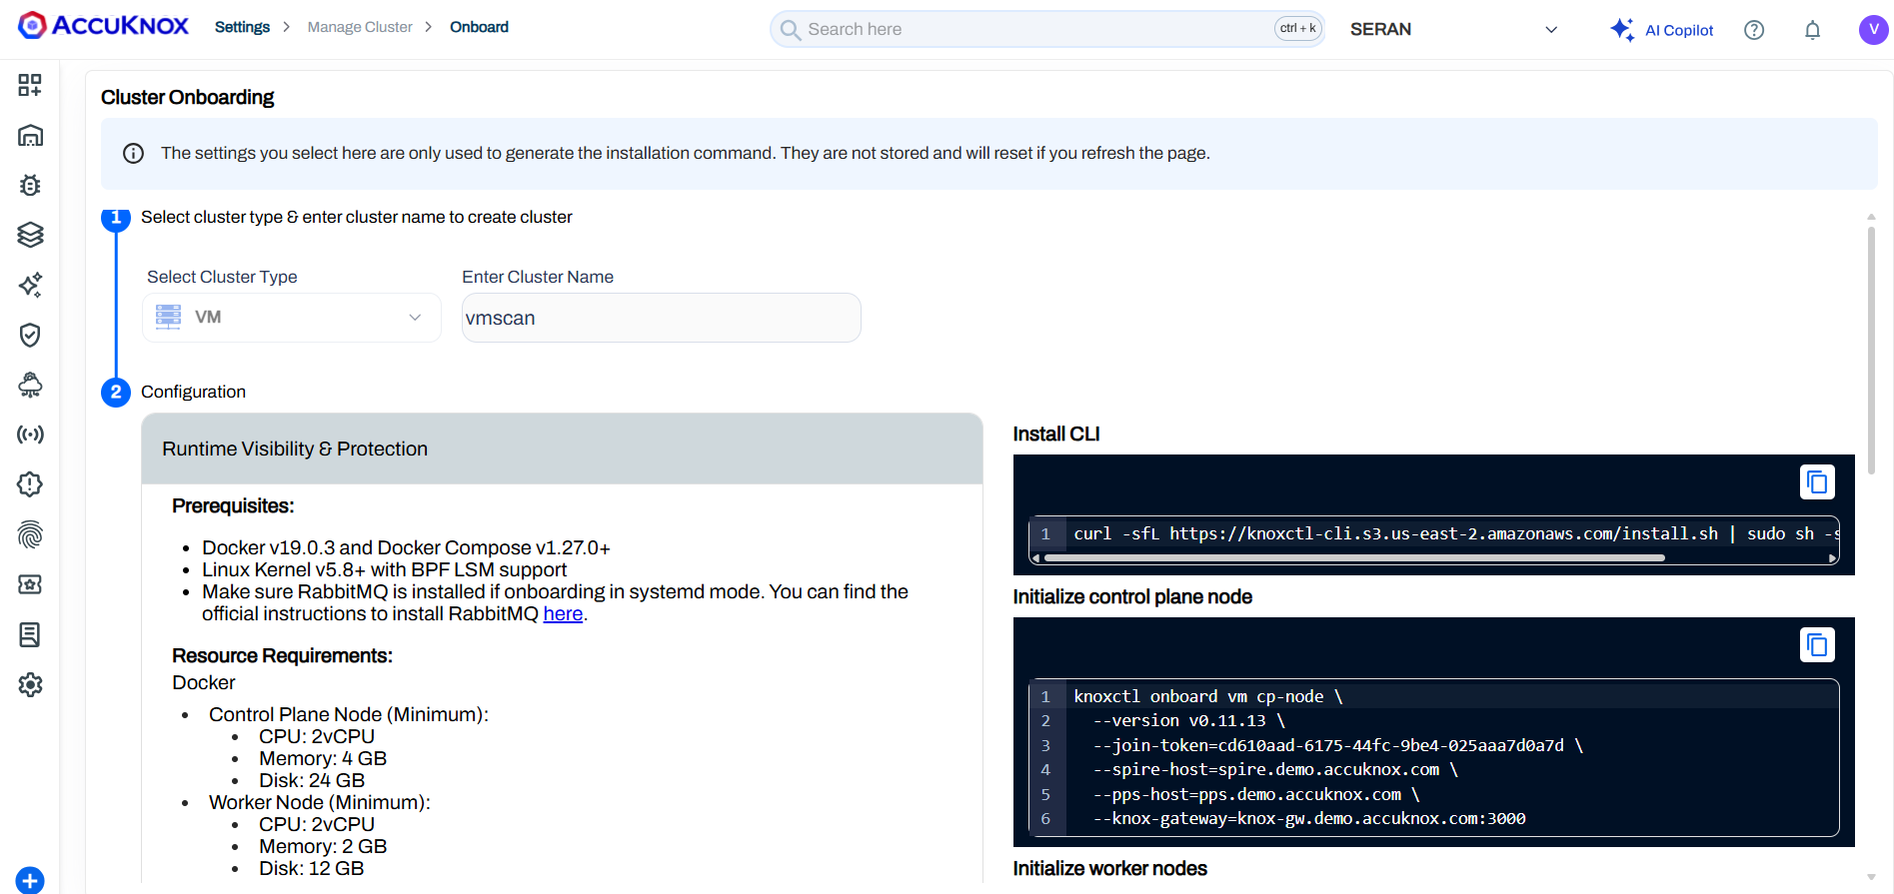
VM Onboarding
Navigate to Settings → Manage Cluster and click on Onboard Now
Select cluster type as VM, enter Name and Save. Verify prerequisites and install the agents via the commands on screen

Slide 21
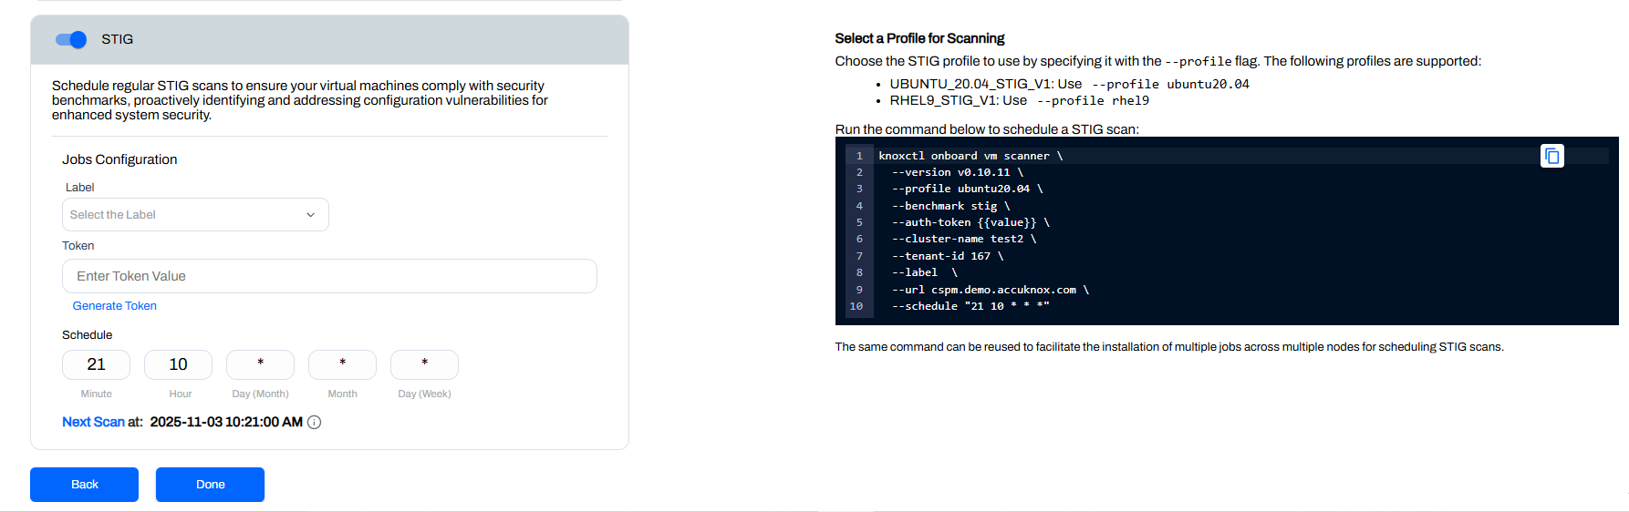
VM Onboarding
STIG scan can also be enabled to ensure that virtual machine comply with security benchmark practices.

Slide 22
VM Scanning
vagrant ssh

Slide 23
Vulnerability Scanning and Malware Scanning
Prerequisites
Root or sudo access to the Linux VM
Outbound internet connectivity to cspm.accuknox.com
CURL installed on the VM
A valid AccuKnox Tenant ID and API Token

Slide 24
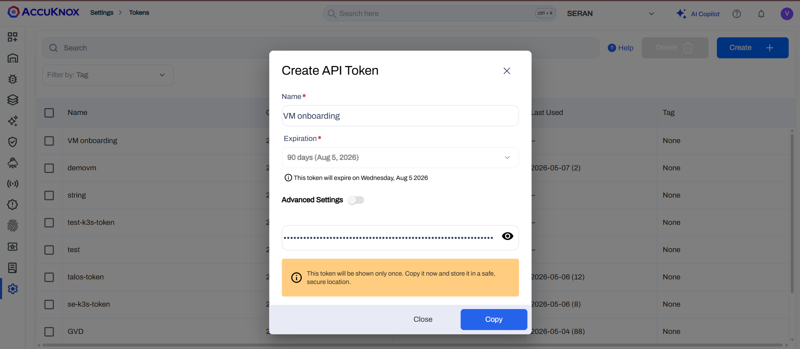
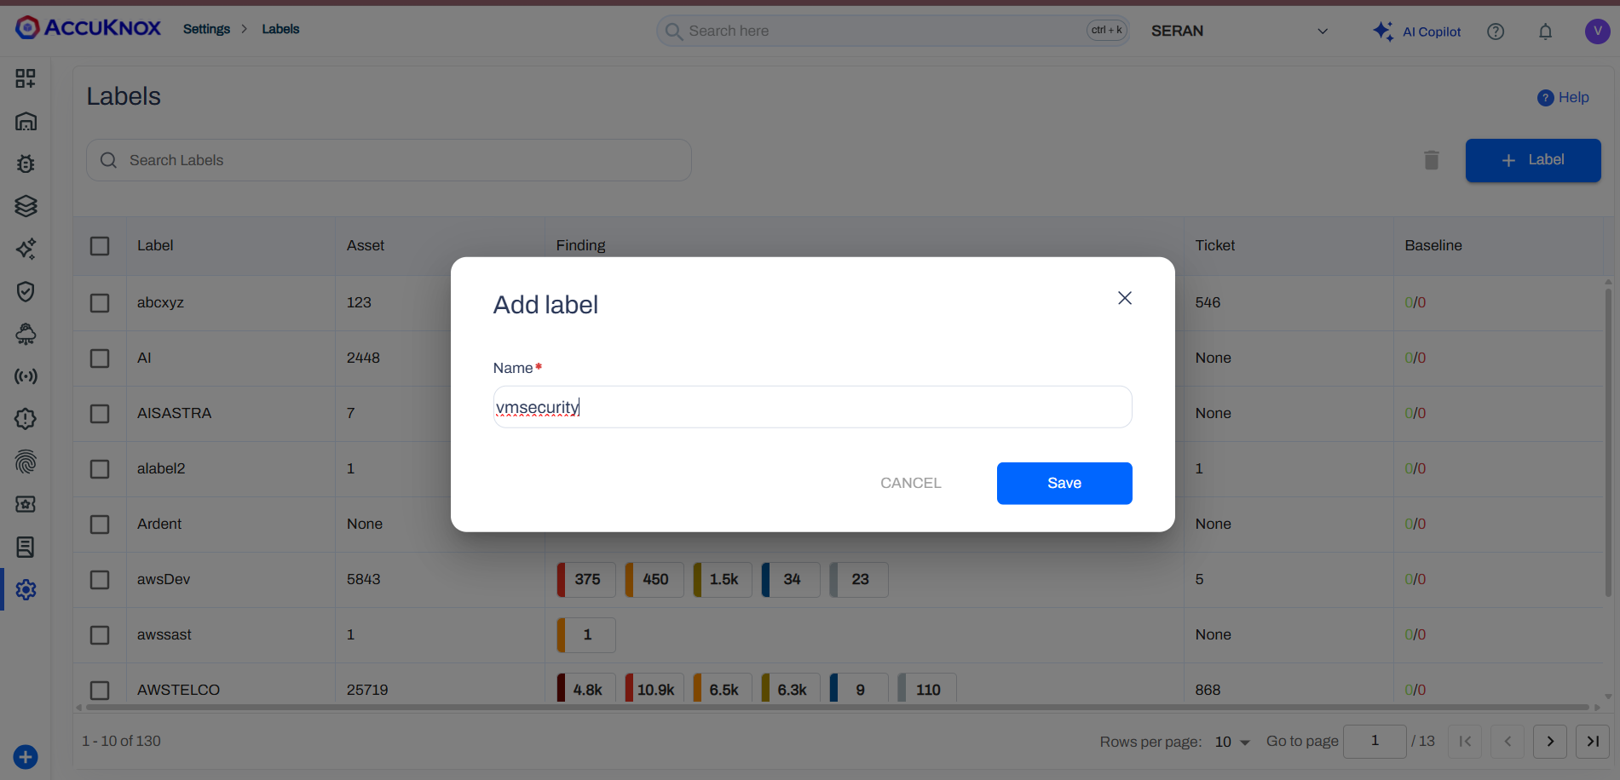
Configuration Detail
Artifact API Token: Generate this under Settings > Tokens in the AccuKnox dashboard.
Artifact Label: Create a label under Settings > Labels to identify this VM.
The installation script creates a systemd service (omni.service) and a daily systemd timer (omni.timer).

Slide 25
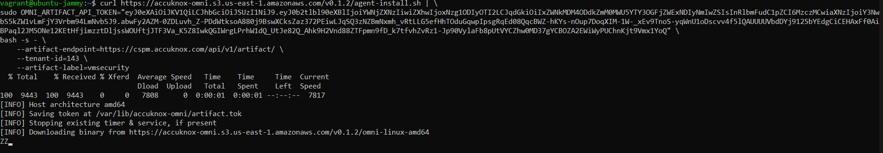
Installation
Run the Installation Script
Run the following command to download and install the agent. Replace <REDACTED> with your actual Artifact API Token and CHANGEME with your desired label for vulnerability as well as malware scanning. For malware you need to enable it as by default it is set to false
curl https://accuknox-omni.s3.us-east-1.amazonaws.com/v0.1.2/agent-install.sh | \
OMNI_ARTIFACT_API_TOKEN="<REDACTED>" \bash -s - \
--artifact-endpoint=https://cspm.accuknox.com/api/v1/artifact/ \
--tenant-id=142 \
--artifact-label=CHANGEME
--export OMNI_SKIP_MALWARE_SCAN=false
For malware you need to enable it as by default it is set to false

Slide 26
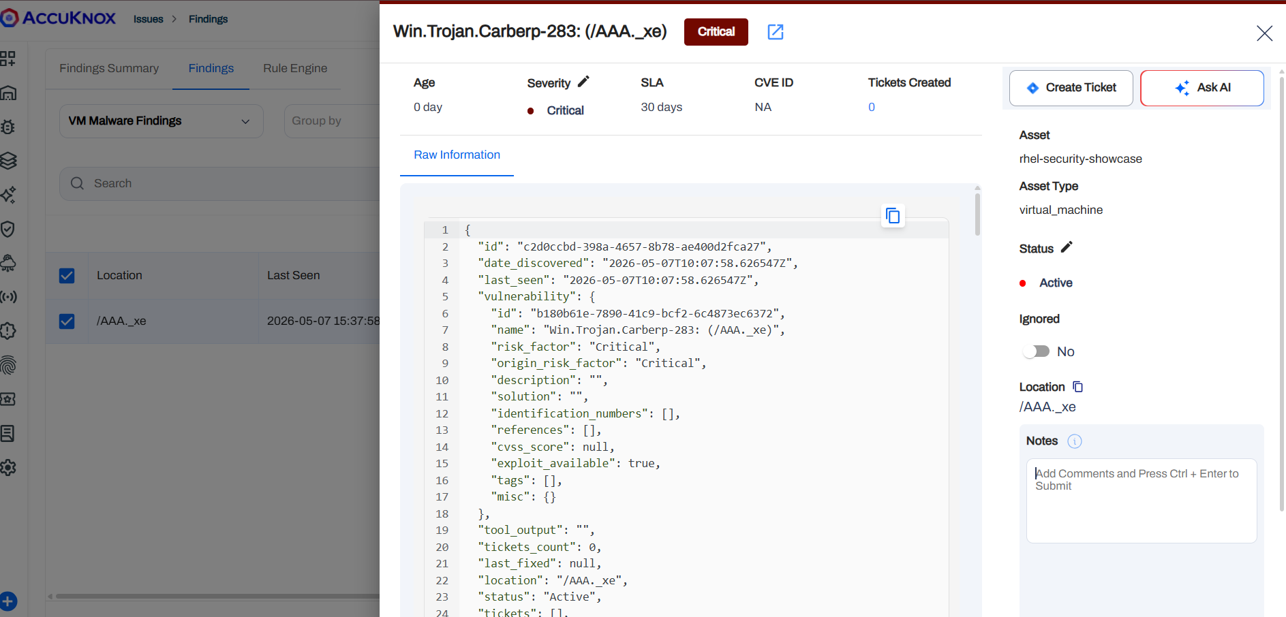
Findings (Malware Findings)
This finding identifies a critical banking Trojan on your RHEL asset, found at /AAA._xe, designed to steal credentials and grant remote system control. The high entropy (7.82) and the presence of a Windows executable on a Linux host indicate a highly suspicious, likely encrypted, cross-platform threat.

Slide 27
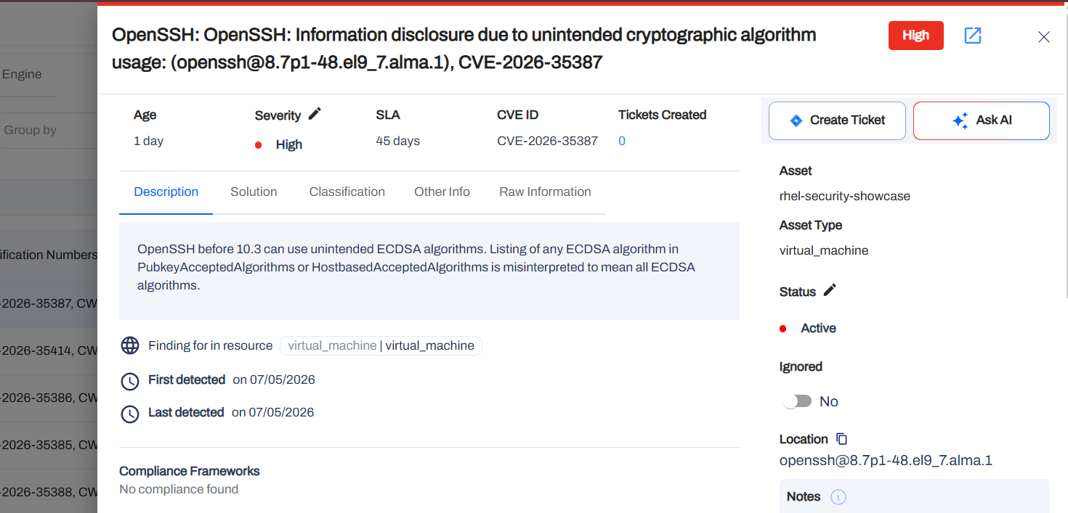
Findings (Vulnerability Scan Findings)
This finding highlights a High severity vulnerability (CVE-2026-35387) where OpenSSH incorrectly enables all ECDSA algorithms if any single one is listed in the configuration. This flaw can lead to unintended cryptographic algorithm usage and potential information disclosure on your rhel-security-showcase asset.

Slide 28
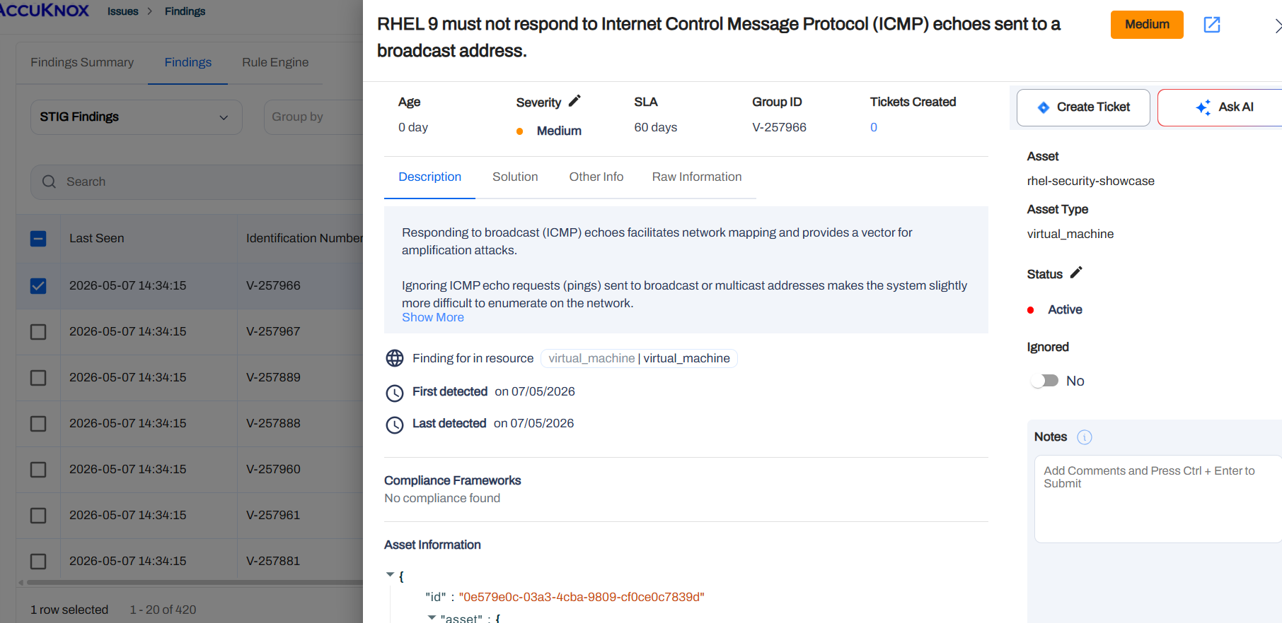
Finding (DISA STIG Findings)
This finding (V-257966) identifies that your RHEL 9 system is configured to respond to ICMP broadcast requests, which can be exploited for network mapping and "Smurf" amplification attacks. To mitigate this, you must set net.ipv4.icmp_echo_ignore_broadcasts to 1 in your sysctl configuration.

Slide 29
VM Security Use cases

Slide 30
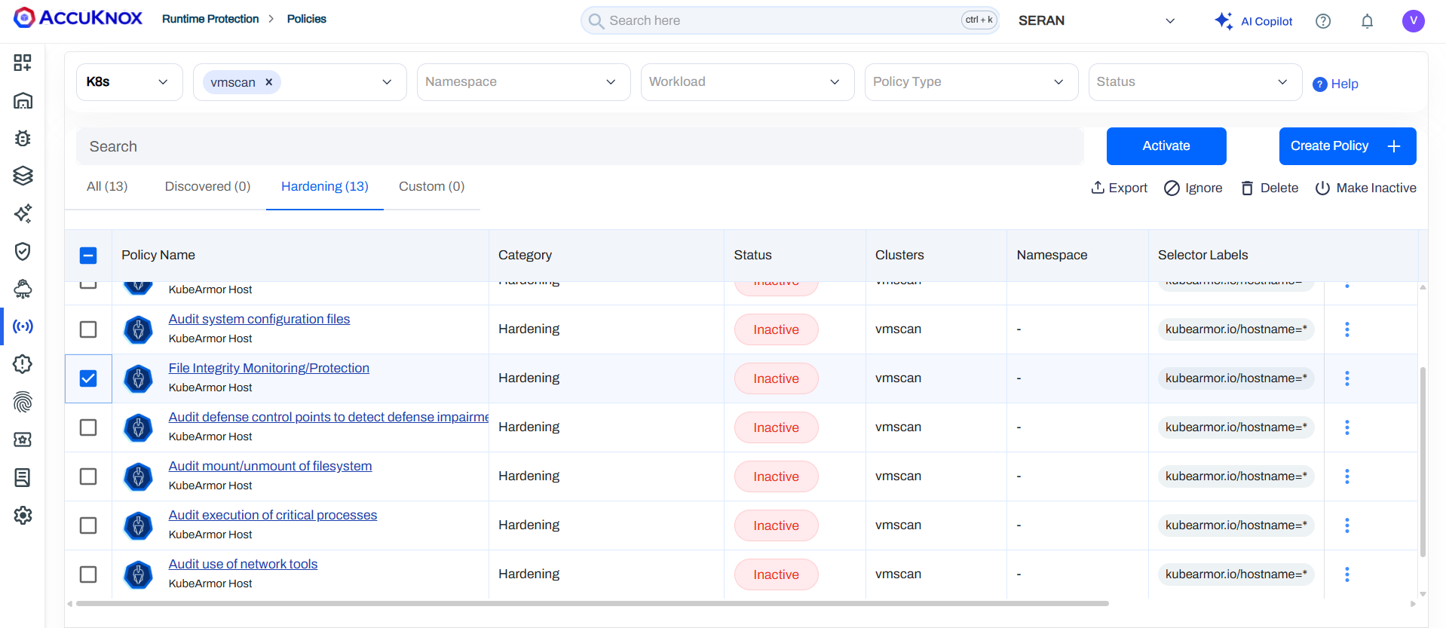
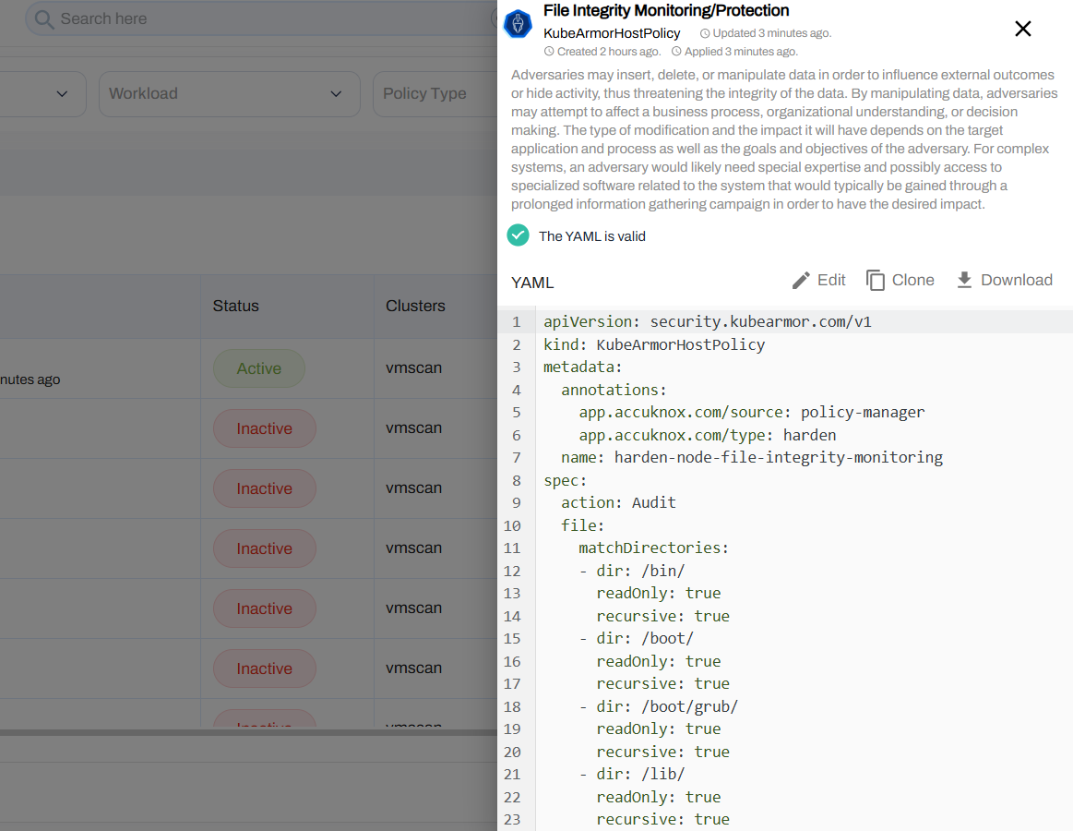
VM Hardening - File Integrity Monitoring
Navigate to runtime protection > policies > select your vm and apply set of hardening policies like Audit Use of network tools to to identify active connections, listening ports, and running services Actions can be set to audit, block, monitor .

Slide 31
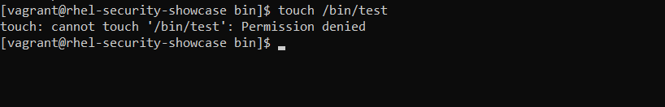
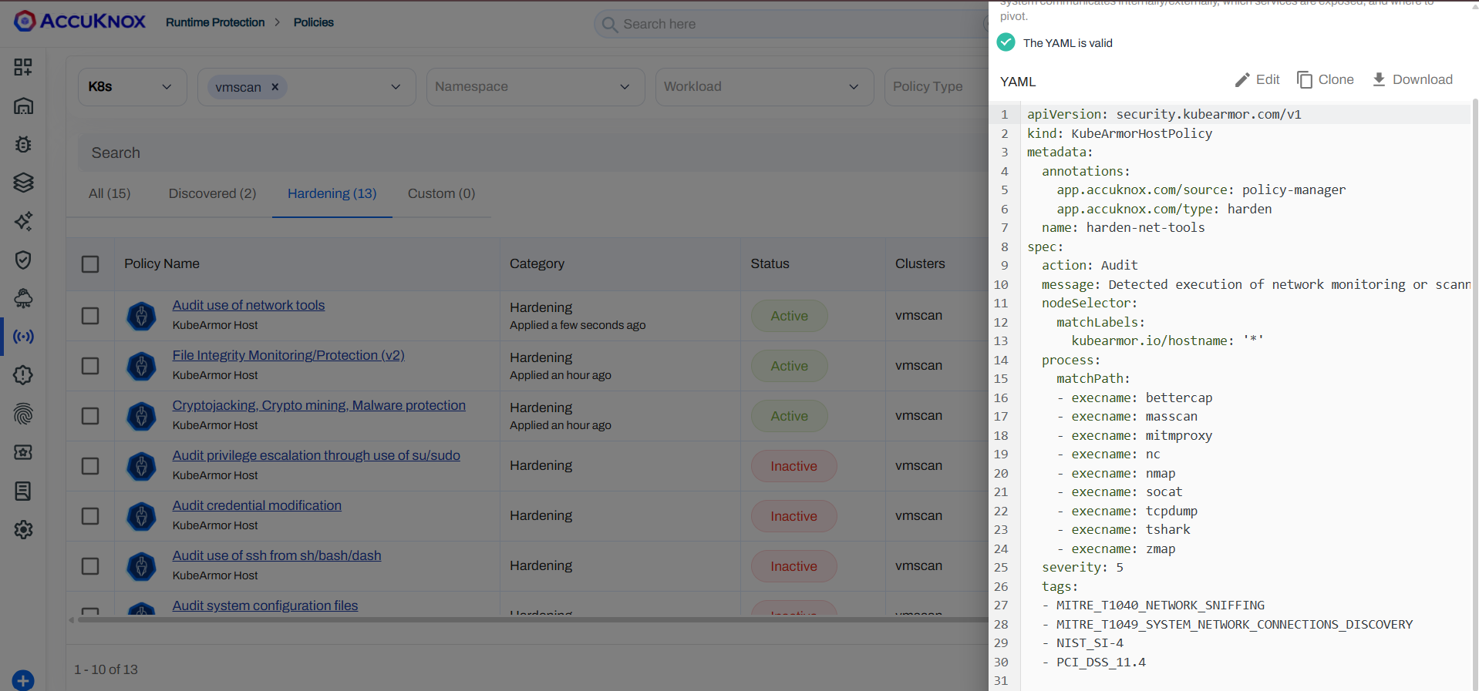
VM Hardening - File Integrity Monitoring
Navigate to runtime protection > policies > select your vm and apply set of hardening policies like Audit Use of network tools to to identify active connections, listening ports, and running services Actions can be set to audit, block, monitor .

Slide 32
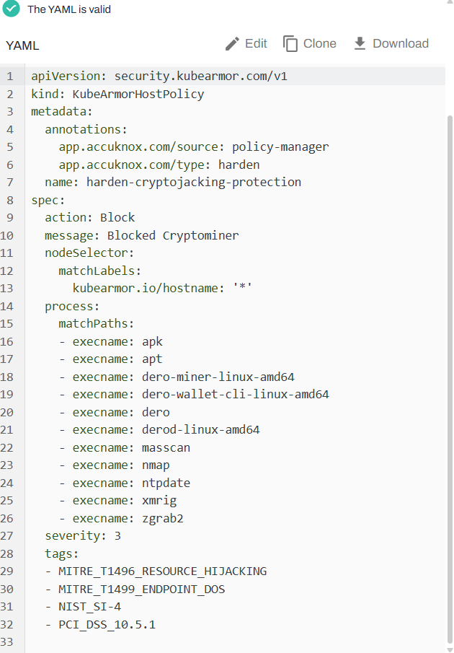

VM Hardening - Prevent Crypto Miners Execution
Deny execution of known cryptominers and prevent execution of binaries from tmp, prevent tampering of sensitive files to protect against Cryptojacking attacks
Upload and Activate this policy to protect against cryptojacking
Prevents attackers from downloading or installing new tools to stay hidden.
Blocks network scanning tools. This prevents an attacker from using your VM as a "jump box" to scan the rest of your internal network for more victims.

Slide 33
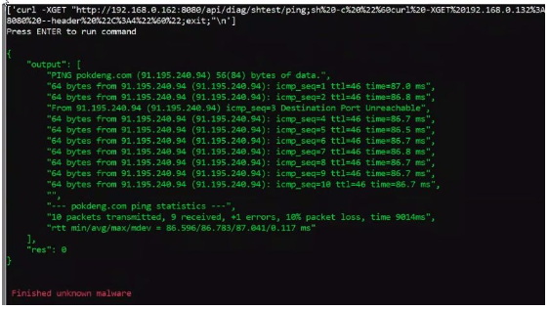

Example
Unknown Malware
Install and execute unknown malware with “legitimate” signature
Unknown malware connects to malicious domain pokdeng.com
Pok Deng is a Thai gambling card game
Unknown Malware successfully runs
Remote code vulnerability execution via shell injection
Malware communicates with malicious domain pokdeng.com

Slide 34
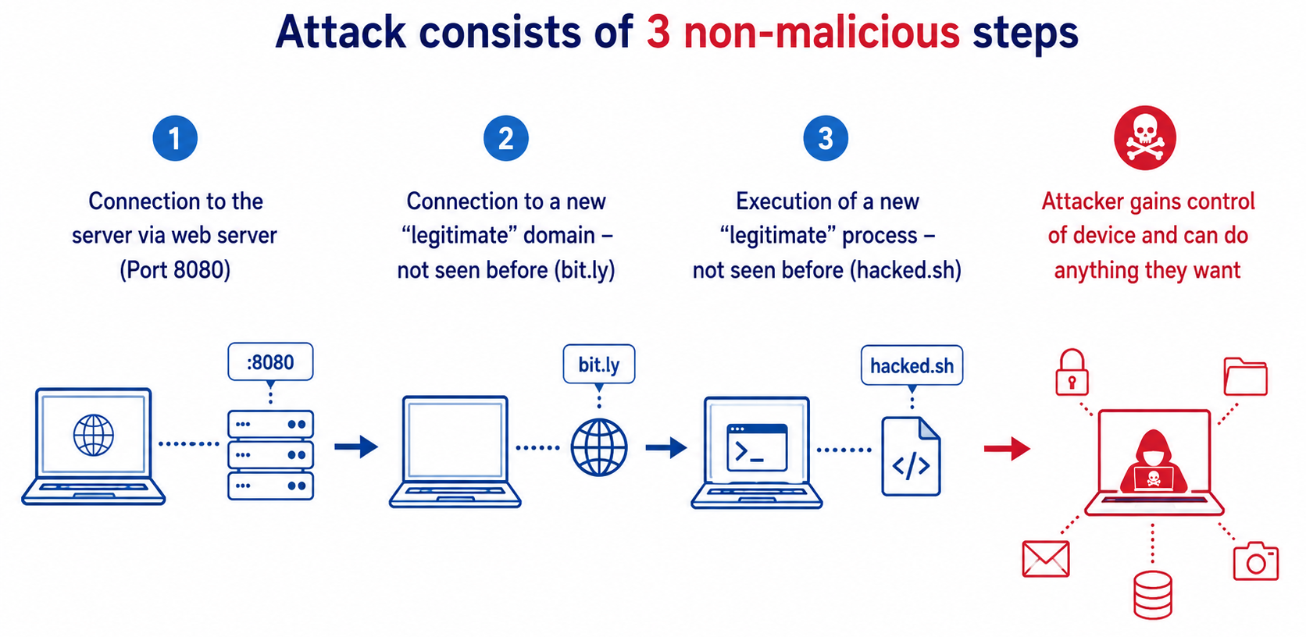
Example of Multi Stage Exploit

Slide 35

Cryptojacking/Malware Protection
Not just detection but prevention of cryptomining attacks
VM/Bare-metal based miners
Container based miners
No dependency on machine learning algorithms
Use of ML has high runtime performance impact
Heuristics used
No execution allowed from world-writable folders such as /tmp/
Binary execution whitelisted from specific paths and runtime writes not allowed to those paths
Detection of well-known miners such as xmrig, dero
Ref: https://www.accuknox.com/blog/cryptojacking-threat-prevention

Slide 36

Process/Host based Microsegmentation
Process based Network control
Allowing specific processes to use specific network primitives
Ensure that only whitelisted applications can use network
Process based Sensitive asset control
Allow specific processes access to specific file system paths
Not even root would be allowed access without access policy
For detailed use-cases refer doc

Slide 37

Ransomware Protection for Assets on Endpoints
Protect sensitive assets that are mounted on the system
KubeArmor based inline mitigation for unauthorized access
Inline mitigation ensures attackers cannot execute code on the targets
Examples
Protect app configuration containing sensitive tokens
Zero Trust access for sensitive volume mounts
Example use-case (applicable for VM deployment as well)

Slide 38
Requirements
Evaluate container security solution by emulating consistent attacks
Codify the attack scenarios and auto-deploy the attack vectors and payload
Consistent reporting
Whether attack was successful?
Ability to view what happened if attack was successful or not

Slide 39
Adversarial Simulation Tool: MITRE Caldera
Agent: Agent performing an attack
Ability: Attack use-case
Adversary: Group of Abilities
Operation: Attack Operation
Ref:
MITRE Caldera: Learning the terminology
https://github.com/nyrahul/k8s-sandcat
Notes:
https://caldera.readthedocs.io/en/2.8.0/Learning-the-terminology.html

Slide 40
Adversarial Simulation Across Multiple Vendors

Slide 41
Detailed Demo for MITRE Caldera
https://app.storylane.io/share/2ybs00khhlmk

Slide 42
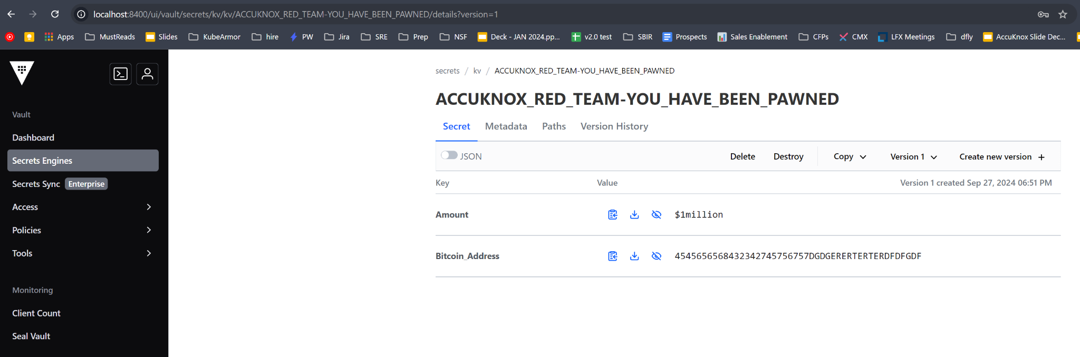
Attack Simulated for Vault in Caldera
Pawning Vault Secrets Store

Slide 43
Other Attacks Simulated in MITRE Caldera
Cryptominer execution
Attacker downloads and invokes xmrig in Vault
Access Sensitive Mount point
Attacker access /vault/ volume point that has all the secrets
Download accessory tooling
Attacker leverages apk toolkit
Privilege Escalation
Attacker uses su-exec for privilege escalation

Slide 44
Summary
Adversarial simulation
Check the impact of adversarial simulation before and after the protection policies are in place.
Out of box agents and MITRE Caldera abilities provided by AccuKnox Red Team
Consistent verification of security engines across multiple vendors

Slide 45
POC Steps
Use-case | Description | Success Criteria
Protection: File Integrity Protection | Do not allow new bins to be injected in system bin folders | Injection of bin in sys folder should be blocked.
Protection: Protect credentials/tokens | Protect root certs, trusted cert bundles Protect other in creds (/etc/) | Injection of new root cert should be blocked. Change in /etc/passwd should be blocked.
Protection: Network access | Only allow allow listed processes to do network communication | Unknown processes network connection should be blocked.
Monitoring: Process execution | Spawning of new processes should be monitored. | New process execution should reflect in process behavior
Monitoring: Any accesses to key folders | Identify and audit accesses to sensitive data/file system paths | Audit events when any accesses happen to sensitive file paths
Monitoring: Network access | Network accesses should be audited. | Ingress, Egress connections should be audited and IP Addresses should be reported. Get me all the IP addresses this NRS connected to
Monitoring: Reduce alert deluge | Only report executions outside of allow list. For e.g., if a process execution for /usr/bin/php is whitelisted then there should not be any alert. | Execution of allow listed process, file should not result in alerts/events.

Slide 46
Handling Scale Concerns
AccuKnox agents resource usage
300 MB RAM, 1/5th of one CPU core
Telemetry events
Process execution reporting
Network connections reporting
File Access reporting for sensitive paths
Blocked actions, Policy violations reporting
Deployment Automation
Deploy agents + policies
Managing POC upgrades
AccuKnox will not allow OS/app upgrades when strict security is enabled

Slide 47
Next Steps
POC Steps
Details of Linux POS
Details of Linux Image/distribution used
High level application details
Check: What kind of Network traffic do we expect to be shipped?
Do we have continuous network connection?
Do we need whitelisted access telemetry?
How would you like to handle alerts/telemetry?
Deployment Model?
AccuKnox Device Test Report
Policy test report
Resource test report
App behavior test report

Slide 48
SEE US IN ACTION
support@accuknox.com

