Slide 1

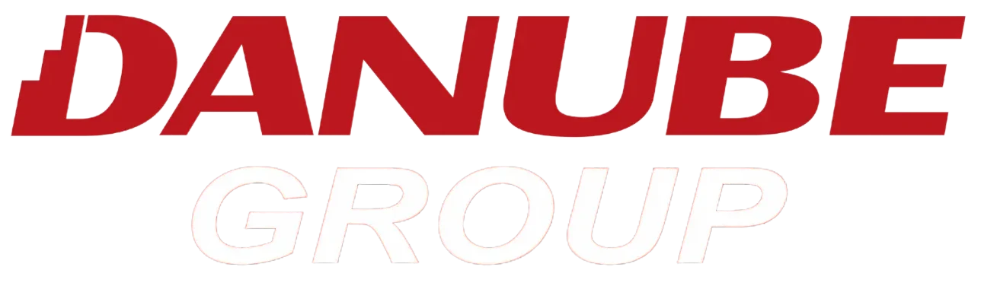
[ Presentation Title ]
[ Date ]

Slide 2
Outline
1
Platform Overview
2
Overall POC Execution Status
3
Top 3 Business Use Cases for Danube
4
AccuKnox Product Roadmap

Slide 3






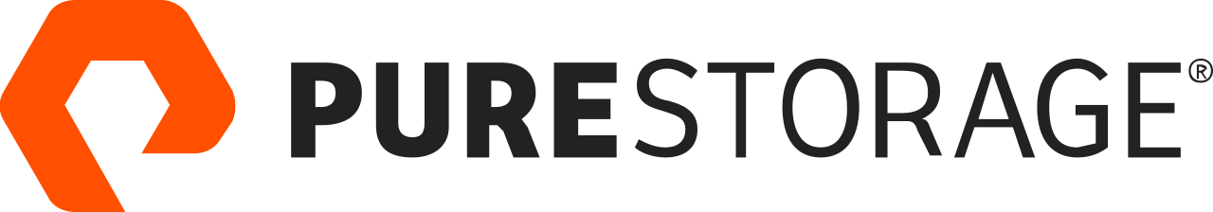


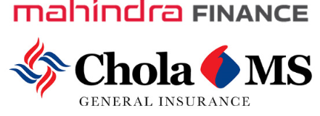


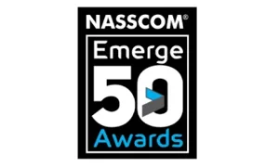

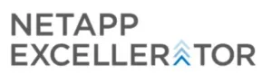


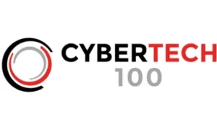


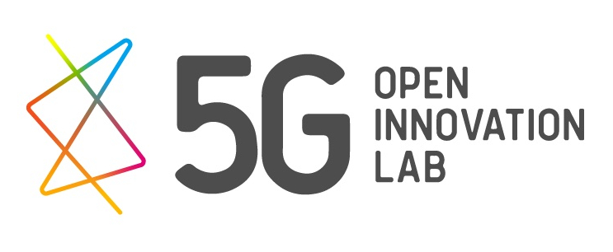
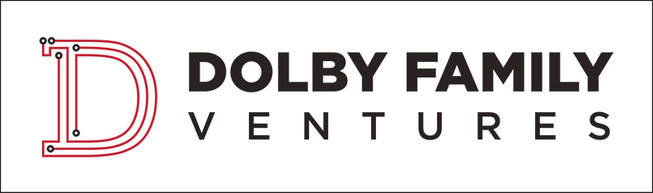

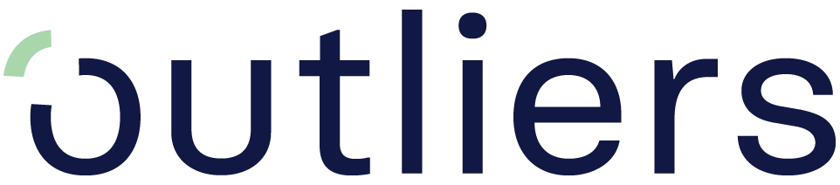
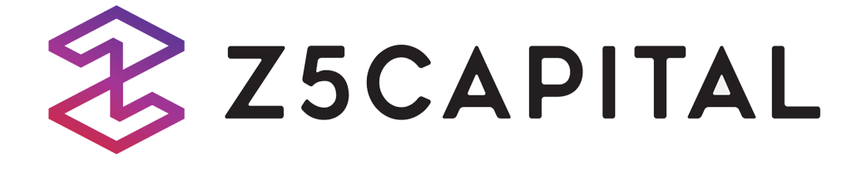

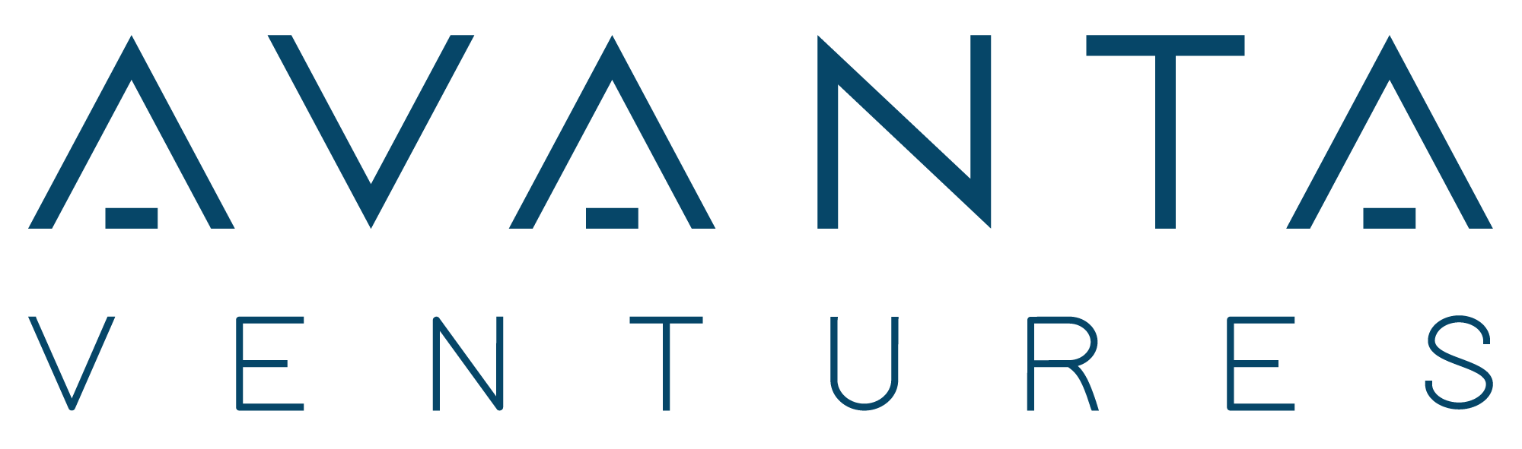

About AccuKnox
Founded in Aug 2020 in partnership with Stanford Research Institute(SRI). AccuKnox provides AI powered Zero Trust CNAPP (Cloud Native Application Protection Platform) that secures Public, Private, Hybrid Clouds, Edge/IoT, API, 5G and AI/LLM assets.
10+
2M+
5
$15m
PATENTS
DOWNLOADS
BOOKS PUBLISHED
SEED FUNDING
Registered with United States Patent & Trademark Office
1,000+
From top investment firms including SRI International, NationalGrid Partners
On different aspects of Zero Trust Security
Open Source led industry initiatives
Education, Evangelism, Industry thought leadership
FEATURED CUSTOMERS
AWARDS & RECOGNITIONS
AGENTIC AI SECURITY STARTUP OF THE YEAR 2025
INVESTORS

Slide 4
AccuKnox Platform
AI Security
AI-SPM
AI-DR
PROMPT FIREWALL
RED TEAMING
PEN TESTING
DSPM*
GRC*
AGENTIC SECURITY*
AI Infrastructure Discovery - LLMs , MLs, Agentic Applications
Risk Disovery across hybrid AI infrastructure
AI Compliance
Region specific LLM Deployment Enforcement
Sensitive Data Risk Alerts
Public AI Asset Auto-Remediation
Prevention of Data Loss (DLP)
Runtime AI Policy Enforcement
Real-Time Prompt Monitoring
Policy Violation Detection
Model Integrity Monitoring
AI Lifecycle Security
AI Pipeline Visibility and Protection
Adaptive Threat Testing-Dynamic Red Teaming
Model Vulnerability Testing
AI Attack Simulation
AI Attack Surface Discovery
AI Exploit Simulation
Multi-Cloud Data Discovery
Unauthorized and Sensitive Data Access Detection
Privileged User Risk Monitoring
Agentless Compliance Discovery across 34+ Compliance
Supports Compliance for Multi-Cloud CSPs (AWS, AZURE, GCP, Oracle)
Discovery of Agentic AI Application on Hybrid AI Infrastructure
Sandboxing Applications based on the real time behaviour
Cloud Native Application Protection Platform (CNAPP)
CSPM
CWPP
CDR
KSPM
KIEM
GRC
CIEM*
Asset Inventory Visibility
Drift Detection & Remediation
Zero Trust Policy Enforcement
Compliance & Audit
Benchmarks
Least Permissive Posture Assessment
Securing Secrets Manager
Container & VM Enforcement
Runtime Threat Detection
Automatic Remediation of Public Exposures
Real-Time Cloud Misconfiguration Detection
Unauthorized Access and Geo-AnomaIy Detection
Runtime Drift and Policy Enforcement
Fast Incident Response
Cluster Misconfiguration Detection
CIS K8s Benchmark Findings
K8s Identity & Entitlement Management (KIEM)
Pod & Network Security Monitoring
RBAC Relationship Mapping
Kubernetes Access and Identitiy Governance
RBAC Drift Detection
Excessive & Least Privilege Detection and Enforcement
Detections of dangling service accounts
Agentless Compliance Posture Discovery
STIG, CIS Compliance for VMs
SOC2, CIS and Cluster Misconfigurations for Kubernetes Cluster
Unified Multi-CIoud Entitlement Visibility
Cross-Cloud Identity and Permission Correlation
Consistent Multi-Cloud CIEM Controls
Centralized Risk Detection and Prioritization
Single Control Plane for Identity Risk
APP SECURITY (ASPM)
API SECURITY
SBOM SECURITY
SECURING SECRETS
SIEM
CTEM*
Static Application Security Testing (SAST)
Dynamic Application Security Testing (DAST)
Secret Scans
IaC Scans
Software Bill of Materials (SBOM)
API Discovery and Inventory
Access Control and Enforcement
Discover Shadow APIs, Rogue APIs, Orphan APIs
OWASP Top 10
Rate limiting
Static API Security testing
"Shift Left" Security in CI/CD
Software Supply Chain Visibility
Dependancy Drift Detection
Multi-Format SBOM Ingestion
Audit-Ready SBOM Reporting
LIve SBOM Generation
Hardcoded Credential Scanning
Dynamic Secret Generation
Runtime Secrets Hardening
Centralized Log Management
Alert Fatigue Reduction
Audit Readiness
Continuous Threat Exposure Management
Adversarial Emulation and Validation
Policy Enforcement & Remediation (CDR)
Real-Time Threat Detection
GRC – 35+ Compliance Templates (POC, SOC2, NIST, ISO, GDPR, HIPAA, CIS, MITRE)
All Public Clouds. All Private Clouds. Clients may use one or more of these modules.

Slide 5
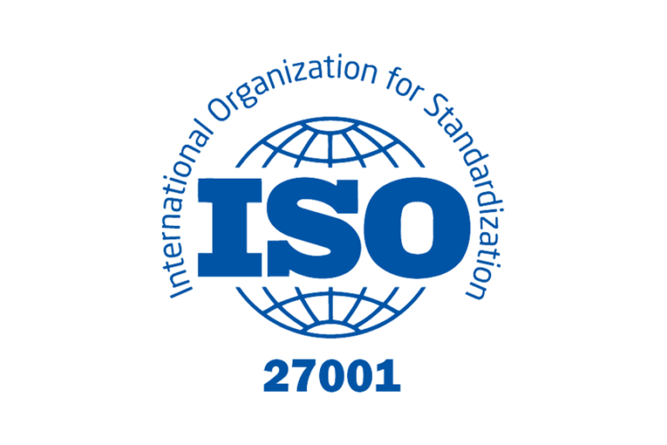








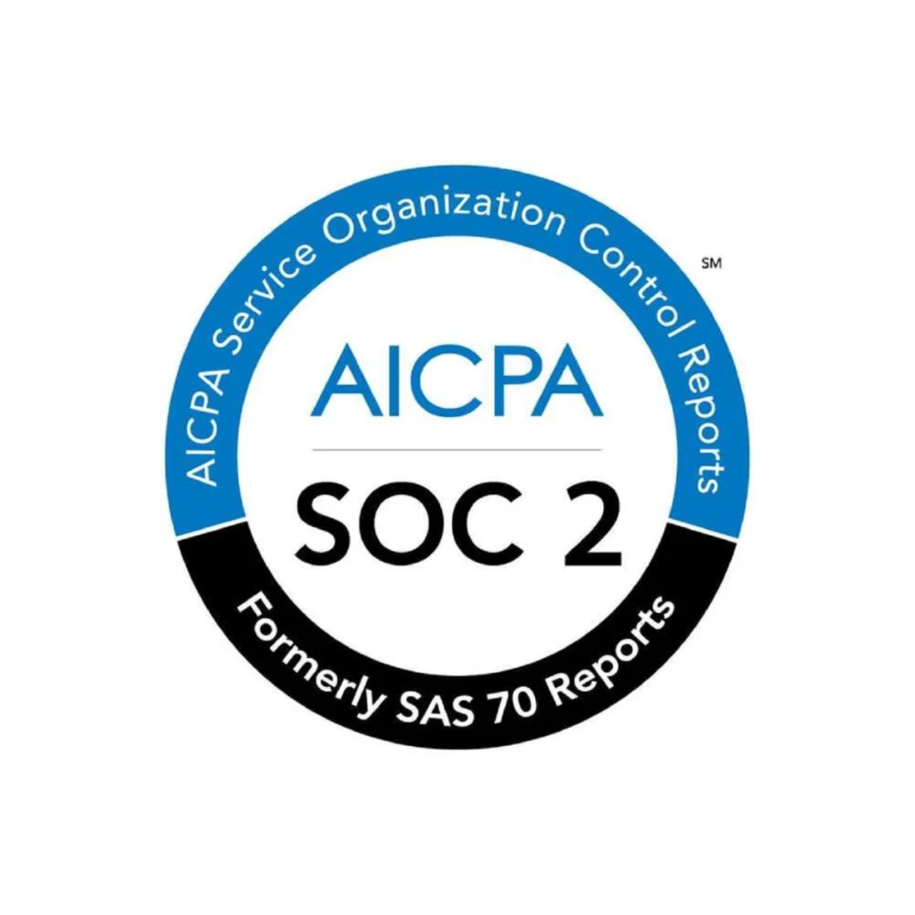

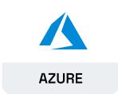

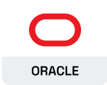
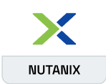
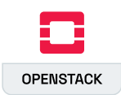
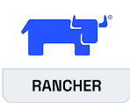
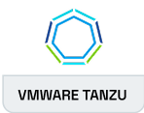

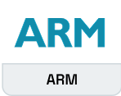
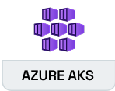
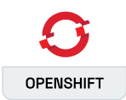
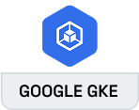
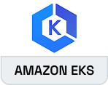
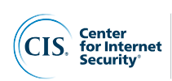



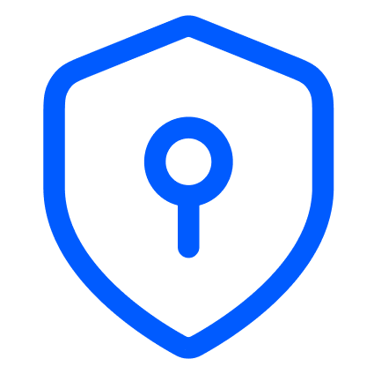

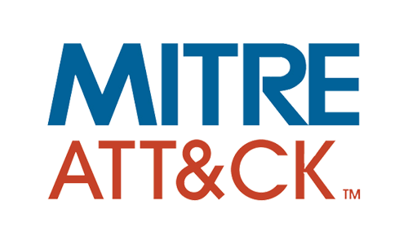


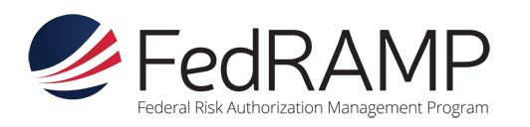
AccuKnox Code to Cognition Solution CNAPP
AccuKnox Code to Cognition Solution CNAPP
AppSec
CloudSec CNAPP
API Sec
AI Sec
[Cloud Native Application Protection Platform]
CSPM
ASPM
KSPM
CWPP
KIEM
CDR
AI SEC
API SEC
Public Cloud
Private Cloud
Edge / IoT
ASK AI
SIEM
CIEM
Compliance
Ticketing
Conversational Interface -DevSecOps meets ChatGPT
End-to-End Threat Intelligence
Support for 35+standards
Continues Threat Exposure Management
Unified Issue Tracking & Remediation
‹#›

Slide 6
[ Client ]: Before vs After
BEFORE ACCUKNOX
AFTER ACCUKNOX
✗ Manual CIS compliance audits taking weeks
Automated CIS compliance, 90% less effort
✗ No visibility into unified cloud security vulnerabilities
Real-time vulnerability detection across AWS, GCP, Oracle, Azure
✗ Delayed risk prioritisation across application lifecycle
Faster prioritisation and remediation across application lifecycle
✗ Siloed security tools with no unified view
Unified multi-level defense with single console
AccuKnox delivers automated, prevention-first security that transforms Danube Group’s compliance & threat posture.

Slide 7
POC Execution Status
01
Cloud Security Posture Management (CSPM)
Onboarded: 13 cloud accounts
Azure, AWS, GCP & Oracle
Overall Findings: 1.8k
02
Repository Scanning
Onboarded: Bitbucket Repository Scans done: SAST, Secret, SCA
Overall Findings: 1.7k
03
DAST Scanning
Onboarded: 3 Websites
DanubeHome, Promotion beta, Dabstore
Overall Findings: 1.2k
04
Container Registry Scan
Onboarded: Google Artifact Registry
us-central1
Overall Findings: 900+
Detailed POC report link: [Report]

Slide 8
[ Client ] - Business Use Cases
[ Headline ]
1,658
Cloud Findings
(Azure + GCP)
12,157
Based on AccuKnox Proof-of-Concept Security Assessment
Cloud Assets
Under Monitoring
79%
01
Cloud Exposure & Compliance Risk
02
Application & Data Privacy Risk
GCP Compliance
(CIS Benchmark v3.0)
03
Supply Chain & Container Vulnerabilities
37
Critical Container
CVEs Detected

Slide 9
Business Case 01 · [ Title ]
AccuKnox scanned 13 cloud accounts across Azure, AWS, Oracle and GCP uncovering 1,658 misconfigurations, compliance gaps, and publicly exposed critical resources.
High-Severity: Open Ports & No Bastion Host
1,658
NSG DANGRP-AZ-PROD-NSG-FG-TRUST exposes ALL ports to the internet. RDP (3389) and SSH (22) are publicly reachable. No Azure Bastion Host found across 10 subscriptions any internet-connected VM is a direct entry point.
Total Cloud Findings
Azure (1,449) + GCP (209)
Key Vault Secrets Traversing the Public Internet
99%
DANGRP-AZ-PROD-KEYVAULT has no private endpoint configured. Secrets, keys, and certificates are accessible outside the VNet perimeter. VM Encryption at Host is also missing, cached data is unprotected at the physical host level.
Azure Compliance
ISO 27001 · NIST · SOC 2 maintained
GCP Compliance: 50% SOC3— Audit Logs Disabled
50%
GCP project scores just 50% for SOC3-Audit logging, flow logs, bucket logging, and OS login are all disabled. This blind spot means malicious activity in GCP goes completely undetected and unattributable.
GCP SOC3 Compliance Score (gap to close)
Business Impact
Open RDP/SSH ports, unprotected Key Vaults, and a GCP compliance gap create direct exposure to credential theft, regulatory fines (UAE PDPL, GDPR), and audit failure.

Slide 10
Business Case 02 · [ Title ]
DAST scanning of dbmstore.com and SAST + secret scanning of the Danube Magento repository reveal live vulnerabilities exposing customer PII and hardcoded credentials.
823
5
1,691
Broken Access Control
OWASP A01 — Top-ranked DAST category
Hardcoded Secrets
in Git OAuth2, PLAIN tokens committed
SAST Issues in
Danube Marketplace Magento repo
Code Repository Scan & Vulnerabilities
Missing CSP Headers + No CSRF Tokens on All Endpoints
Content Security Policy headers are absent across all 5 top-traffic endpoints — enabling XSS and script injection. Anti-CSRF tokens are missing on all state-changing forms, allowing attackers to trick authenticated users into executing unintended actions (password changes, order manipulation).
The code repository scan identified multiple security issues, including unsafe dynamic code execution, insecure input handling, potential ReDoS vulnerabilities, exposed API keys, unpinned Docker sources and frontend security weaknesses such as insecure DOM manipulation and insufficient sanitization, which may lead to XSS and code execution risks.
Business Impact
Live PII exposure on dbmstore.com, hardcoded OAuth2 tokens in Git, and 823 broken access control findings, the data breach risk is active, not theoretical.

Slide 11
Business Case 03 · [ Title ]
AccuKnox found 915 vulnerabilities across 9 GCP container images and critical CVEs in open-source packages powering the Danube Marketplace — including active code injection risks.
SCA — Critical Open-Source Package CVEs
37
Critical CVEs in
Container Images
CVE-2025-68121 (crypto/tls), CVE-2026-25896 (fast-xml-parser), prototype pollution — all active in GCP Artifact Registry
CVE-2026-40176 composer/composer@2.8.9
Command Injection via Perforce Repo — arbitrary shell commands execute during dependency installation. Full system takeover risk during CI/CD.
262
High-Severity CVEs
Across 9 Running Images
Incorrect cert validation (CVE-2026-27137), axios SSRF via NO_PROXY bypass — all scanned in prod GCP registry
GHSA-27qh-8cxx-2cr5 aws-sdk-php@3.344.5
CloudFront Policy Injection via special characters — attackers bypass signed URL access controls and gain unauthorized CDN content access.
915
Total Container
Vulnerabilities Found
CVE-2025-64500 symfony/http-foundation@6.4.22
Critical: 37 · High: 262 · Medium: 470 · Low: 86 | 0 images failed to scan — 100% coverage achieved
Security bypass via improper PATH_INFO handling — allows attackers to circumvent access control rules on the '/' prefix in the Symfony framework.
Business Impact
Unpatched critical CVEs in production containers + command injection in Composer = supply chain compromise and arbitrary code execution in the Danube Marketplace build pipeline.

Slide 12























































Platform Utilization (as per POC done)
ASPM
(AppSec)
CSPM
(CloudSec)
CWPP
(Workload Sec)
KSPM
(Kubernetes Sec)
AI-SPM
(AI Security)
Static Application Security Testing (SAST)
Cloud Asset & Inventory Visibility
Least Permissive Posture Assessment
Cluster Misconfiguration Detection
AI Detection & Response (AI-DR)
Dynamic Application Security Testing (DAST)
Drift Detection & Remediation
Prompt Firewall
Securing Secrets Manager
CIS K8s Benchmark Findings
K8s Identity & Entitlement Management (KIEM)
AI Runtime App Security
Secret Scans
Zero Trust Policy Enforcement
Container & VM Enforcement
Runtime Threat Detection
Model & Dataset Security
IaC Scans
Pod & Network Security Monitoring
Compliance & Audit
Benchmarks
LLM Red Teaming
Software Bill of Materials (SBOM) 🏁
AI-Compliance
Software Composition Analysis (SCA)
Onboarded during POC
Container Image Scanning
Not Onboarded Yet
Platform-Wide Support
Compliance
35+ Frameworks: SOC2, PCI DSS, etc.
CDR
Cloud Detection & Response
API Security
AI Copilot
SIEM
Security Information

Slide 13
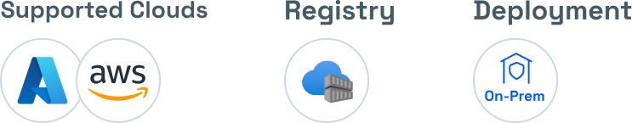
[ Customer ] - Case Study
Top UAE Bank Achieves Continuous Cloud Compliance on Azure
Outcomes
Detected 300+ unique vulnerabilities across 6 Azure subscriptions — zero disruption to banking operations.
Achieved continuous CIS, PCI, and SOC 2 Type II compliance via automated CSPM monitoring.
Closed the AKS runtime security gap with live threat detection across production workloads.
Eliminated ACR image blind spots by scanning containers before production deployment.
Consolidated cloud, container, and runtime security into a single AccuKnox Managed OnPrem deployment — reducing toolchain complexity across a regulated environment.
Achieves 300+ Vulnerabilities Detected Across 6 Azure Subscriptions

Slide 14
AccuKnox Differentiated Capabilities

Slide 15
Better Coverage
Features | Palo Alto | WIZ | Sysdig | Crowdstrike | Tigera | Isovalent | SONRAI | SNYK | AccuKnox
On-Prem Air-Gapped CNAPP Deployment (Vulnerability Mgmt. & Container Security) | ⚠ Supports Runtime Protection in On-Prem but don’t support Vuln Mgmt. | ❌ | ⚠ Supports Runtime Protection in On-Prem but don’t support Vuln Mgmt. | ❌ | ⚠ Supports Runtime Protection in On-Prem but don’t support Vuln Mgmt. | ❌ | ❌ | ❌ | ✅Supports both Runtime protection and Vuln mgt. In On-prem air-gapped deployment model
CNCF Opensource led | ❌ | ❌ | ✅ | ❌ | ✅ | ✅ | ❌ | ❌ | ✅ AccuKnox built, now opensource, Runtime Security engine ~ KubeArmor
ASPM & SDLC Security | IaC, SCA, CI/CD Security, Supply chain sec, Secrets Scanning | ✅ | IaC, SCA & CI/CD Security | Acquired Bionic.IaC, SCA, SAST, CI/CD Security, | ❌ Only container image scanning | ❌ | ❌ Provides only Approval mechanisms | ✅ Snyk Apprisk + Helios + Gemini Code Assist SAST, DAST, SCA, SBOM, IaC, CI/CD Security | ✅IaC, SAST, DAST, SCA, SBOM Secrets Scanning, CI/CD Security with AskAda
In-Line/ Proactive Remediation | Supports in-line mitigation however requires changes to the runC binary (intrusive) | ❌ | ❌ | ❌ | ❌ | ❌ | ❌ | ❌ | ✅Patented Technology based on Opensource Foundation

Slide 16
Better Coverage
Features | Palo Alto | WIZ | Sysdig | Crowdstrike | Tigera | Isovalent | SONRAI | SNYK | AccuKnox
Continuous Diagnostic and Mitigation | ✅ | ✅ | ✅ | ✅ | ❌ | ✅ | ❌ | ❌ | ✅
Vulnerability Prioritization | ✅ Contextual Risk based Prioritization | ✅ | ✅With CheckMarX | ✅Falcon Spotlight’s ExPRT.AI prioritization model | ❌ | ❌ | ✅ Age, Exploit, CVSS score | DeeCode AI for SAST ✅ | ✅ AccuRisk™
30+ Compliance Framework Support | ✅ | ✅ | ✅ | ❌ | ❌ Only k8s | ❌ Only k8s | ⚠ Less Compliance Support | ⚠ Less Compliance Support | ✅Multi-Cloud and Containers
IaC Scanning | ✅ | ✅ | ✅ | ✅ | ❌ | ❌ | ❌ | ✅ | ✅
Admission Controller | ✅ | ✅ | ✅ | ✅ | ✅ | ❌ | ❌ | ❌ | ✅

Slide 17
Better Coverage
Features | Palo Alto | WIZ | Sysdig | Crowdstrike | Tigera | Isovalent | SONRAI | SNYK | AccuKnox
KIEM (Kubernetes Identity and Entitlement Management) | ❌ | ❌ | ❌ | ❌ | ❌ | ❌ | ❌ | ❌ | ✅ Security Graph
GenAI Powered Security Chatbot | ✅ | ✅ | ✅ | ✅ | ❌ | ❌ | ❌ | ❌ | ✅ AskAda
Auto-Discovery of Zero Trust Policies | ✅ | ❌ | ✅ | ❌ | ✅ | ✅ | ❌ | ❌ | ✅ Default Posture & Best Practices
Container Drift Detection | ✅ | ❌ | ✅ | ❌ | ❌ | ✅ | ❌ | ❌ | ✅ Detection & Prevention of Drift
LLM/ML or AI workload Security | ✅ | ✅ | ✅ | ✅ | ❌ | ❌ | ❌ | ❌ | ✅ Secure ML and LLM workloads
5G Edge & IoT Security | ✅ | ❌ | ❌ Edge security support | ❌ IoT Security support | ❌ | ❌ IoT\Edge support | ❌ | ❌ | ✅ Unique 5G/Edge Security

Slide 18
SEE US IN ACTION
support@accuknox.com

