Slide 1







Slide 2






DL Compiler

Slide 3
High-level IR
Graph Optimizations
Operator Fusion
Layout Conversion
Low-level IR
Hardware Intrinsic Mapping
Memory Allocation
Memory Latency Hiding
Loop Optimization
Parallelization

Slide 4
Target
LLVM
GPU CUDA/OpenCL/ Metal…
Accelerator Backends
CPU x86/ARM…

Slide 5
DL Model
DL Compiler
High-level IR
Graph Optimizations
Operator Fusion
Layout Conversion
Low-level IR
Hardware Intrinsic Mapping
Memory Allocation
Memory Latency Hiding
Loop Optimization
Parallelization
Target
LLVM
GPU CUDA/OpenCL/ Metal…
Accelerator Backends
CPU x86/ARM…

Slide 6
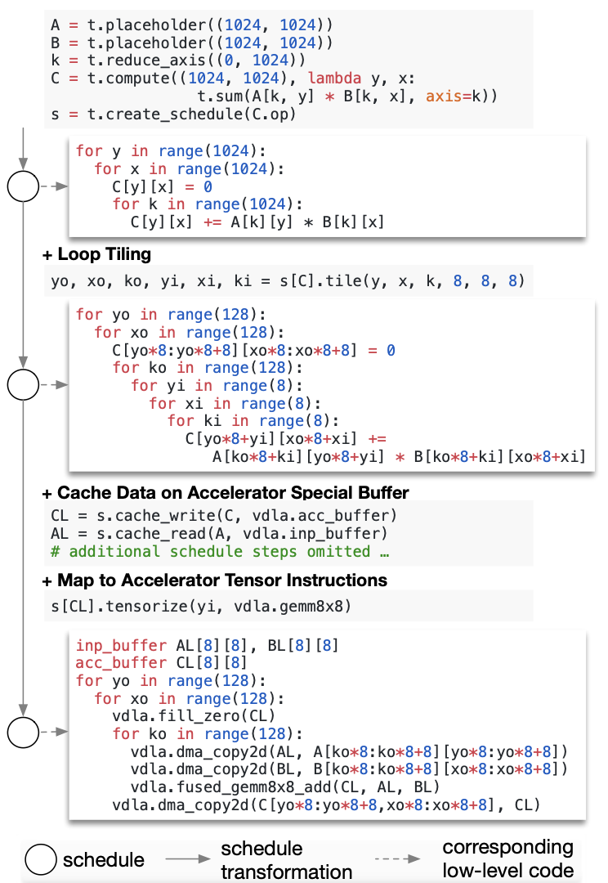
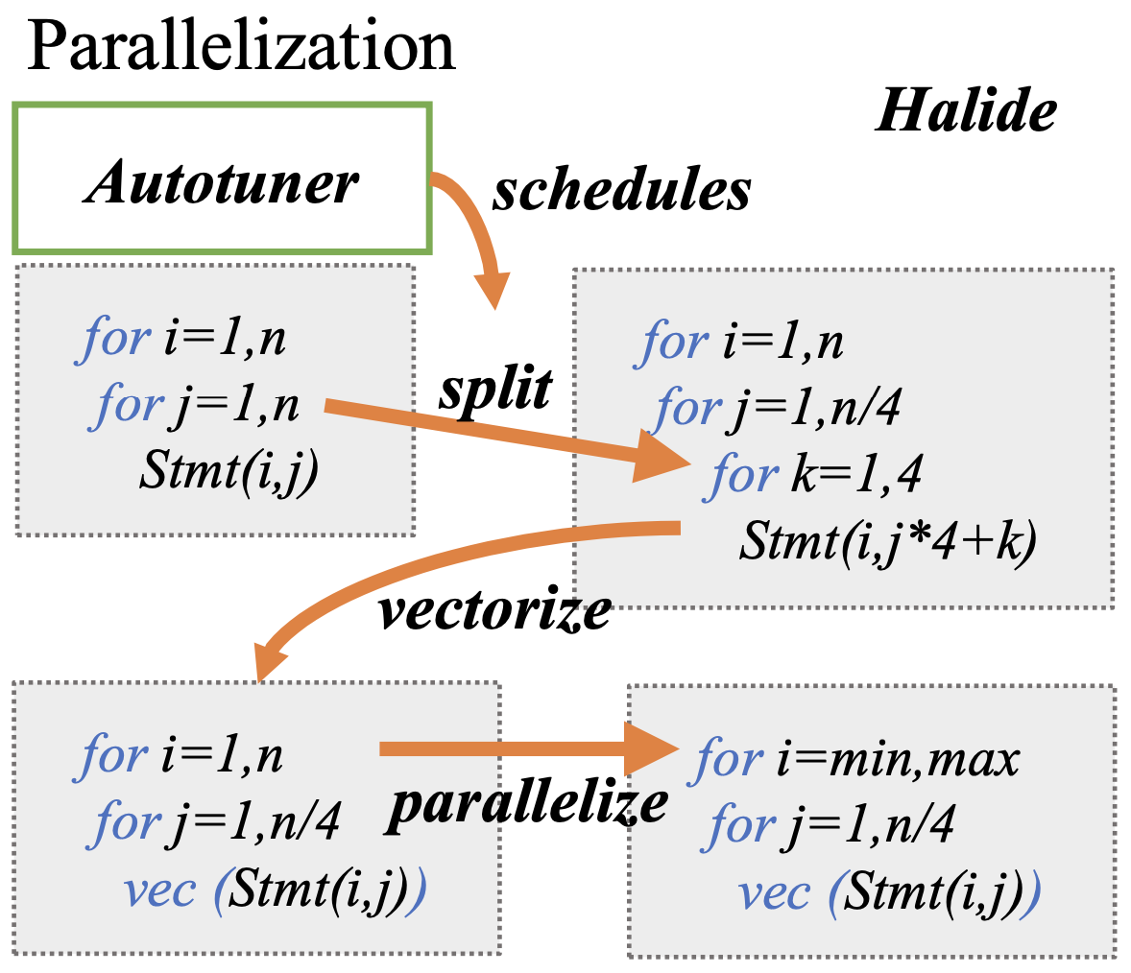

Slide 7
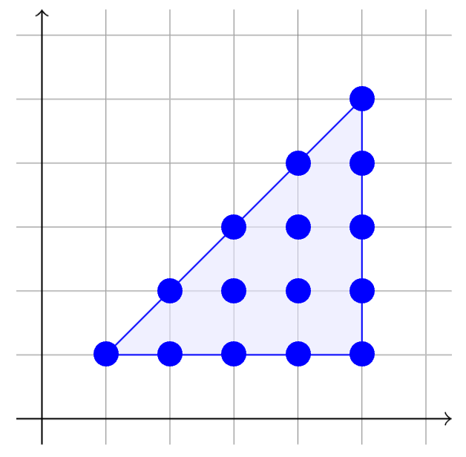
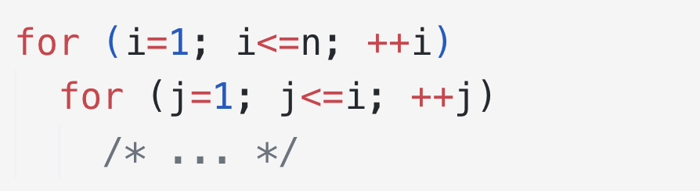

Slide 8
