Slide 1

“Am I tall enough?” what are the chances you’ll go pro out of an American college, in men's indoor volleyball.
Aaron Dierkes

Slide 2
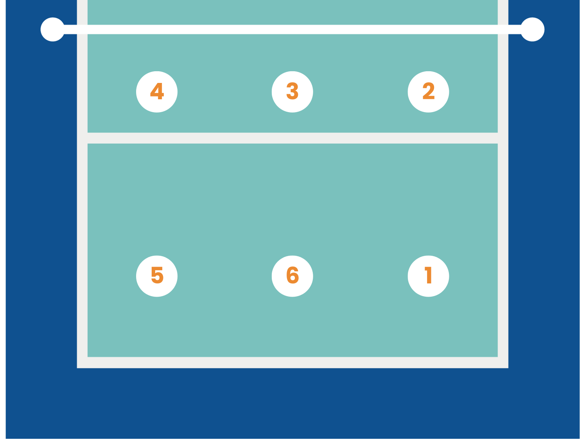
Volleyball background
6 Positions
Professional clubs are everywhere but the U.S.
Fewer than 2% of NCAA athletes go pro.
Opportunity/ impact
Players have little indication of where they should go to college for their position to have the highest chance of going pro out of college.
Could help players know which colleges to focus on for their position.
Could potentially save coaches and scouts time when looking for players.

Slide 3
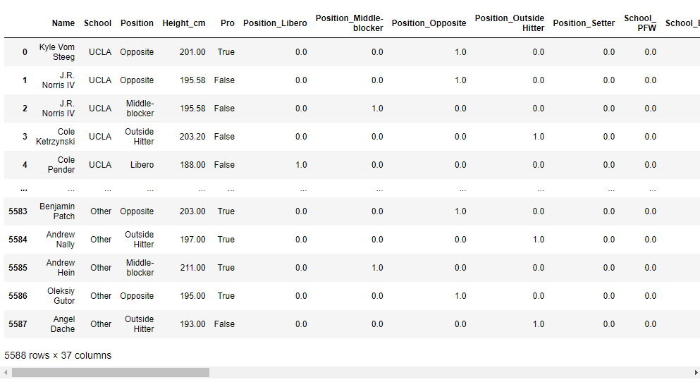
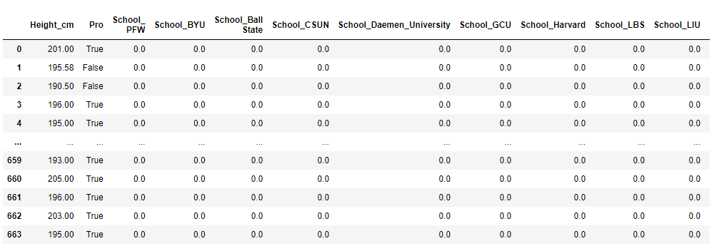
Data Set
I removed columns where I had to impute data because they we’re impacting the quality of the models.
After running tests on the data frame above I realized I had to split the data frame further into individual positions.
I was left with 5 different data frames to run ML models on using height and what school they played for as the features.

Slide 4
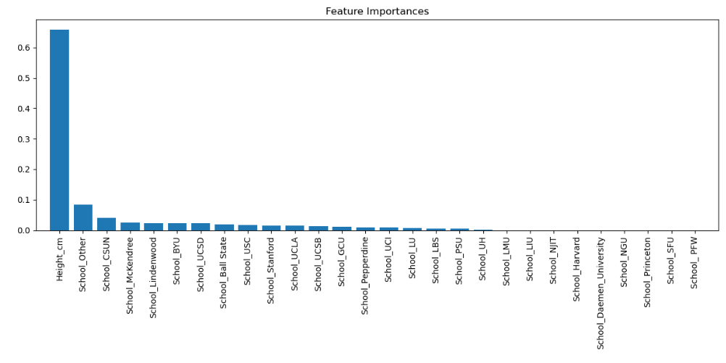
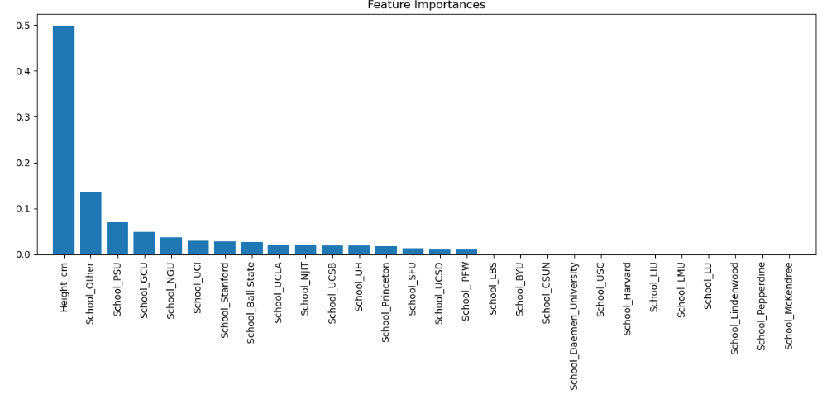
Key insights from modeling.
Middle Blocker
Libero
Height was the most important feature, but it varied by position.
For libero height wasn’t as important in comparison.
Important take away from observing the models were, each position has a different school as its third most important feature, which has made me start to think that certain schools could potentially train professional level talent for different positions better than others.

Slide 5
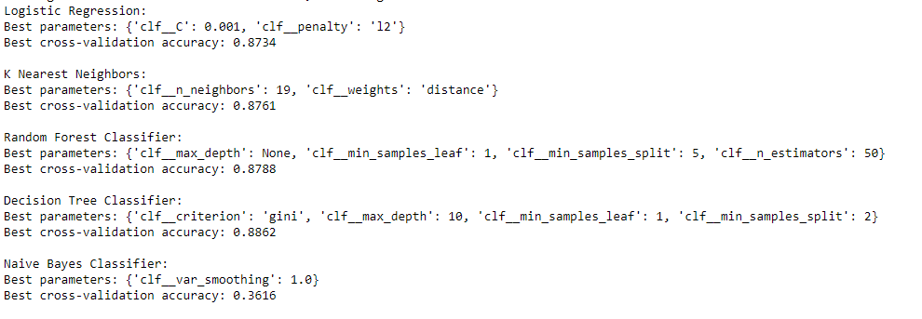
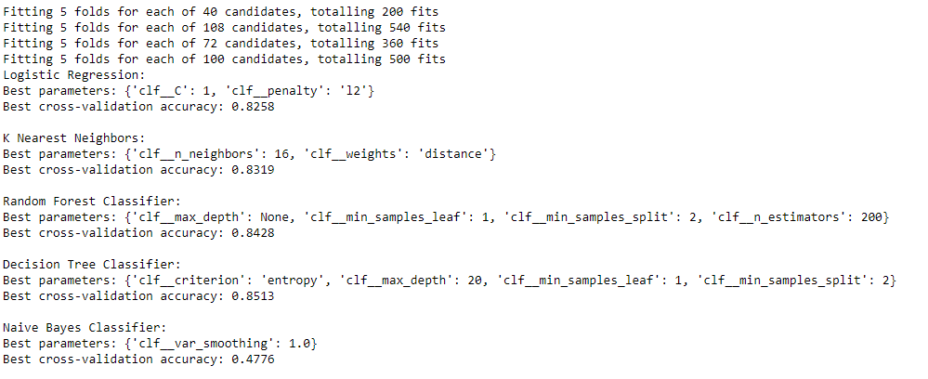


Model comparison and interpretation
Outside hitter
Middle Blocker
Decision tree classifiers ended up being the best model to use for almost every position. The accuracy increased roughly 1 - 3% more than baseline for each position.
Was able to predict trues in the confusion matrix without guess not pro every single time like the other models did.
Random forest
Decision tree

Slide 6
Next steps for product
The goal is to create a web app. I want the user to select what position they play, what school they play for and then input their height.
The response should be a pro or not pro answer with a percentage accuracy.

