Slide 1

Chance to go pro in men’s indoor volleyball If you’re from the usa
Aaron Dierkes

Slide 2
Volleyball background
Problem/opportunity
Men’s indoor volleyball has 6 positions: outside 1, outside 2, middle, setter, opposite, and libero.
The progression for volleyball players that take the sport seriously is, play club growing up, play in high school, try and be recruited for an NCAA college, be a top player in the NCAA, try to play professionally overseas.
4% of high school players play in the NCAA and 2% become professionals.
All the professional clubs in the world exist outside of the US. There are “professional teams’ in the US but the league started in 2020 and you don’t get paid. For this project we will consider them not pro.
Players have no metric to check to determine their chances to go pro.
Rely on coaches to guide them into positions.
I see an opportunity to create something that will give you a realistic answer based on genetics and scalable to include things like awards, clubs played growing up, and where you're from.
This will help players see if they need to train harder to overcome genetic differences that may decrease their odds.

Slide 3
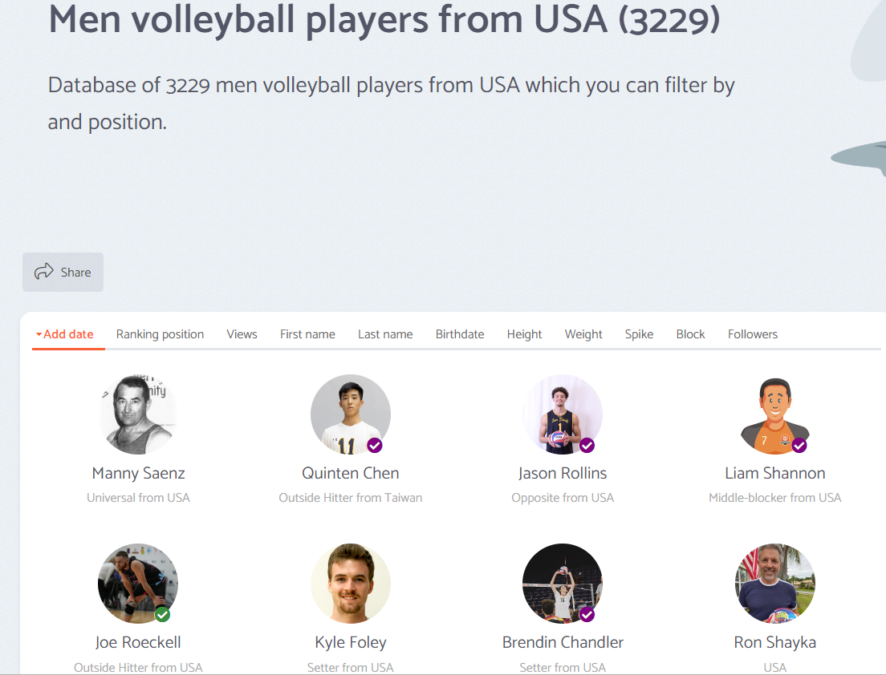
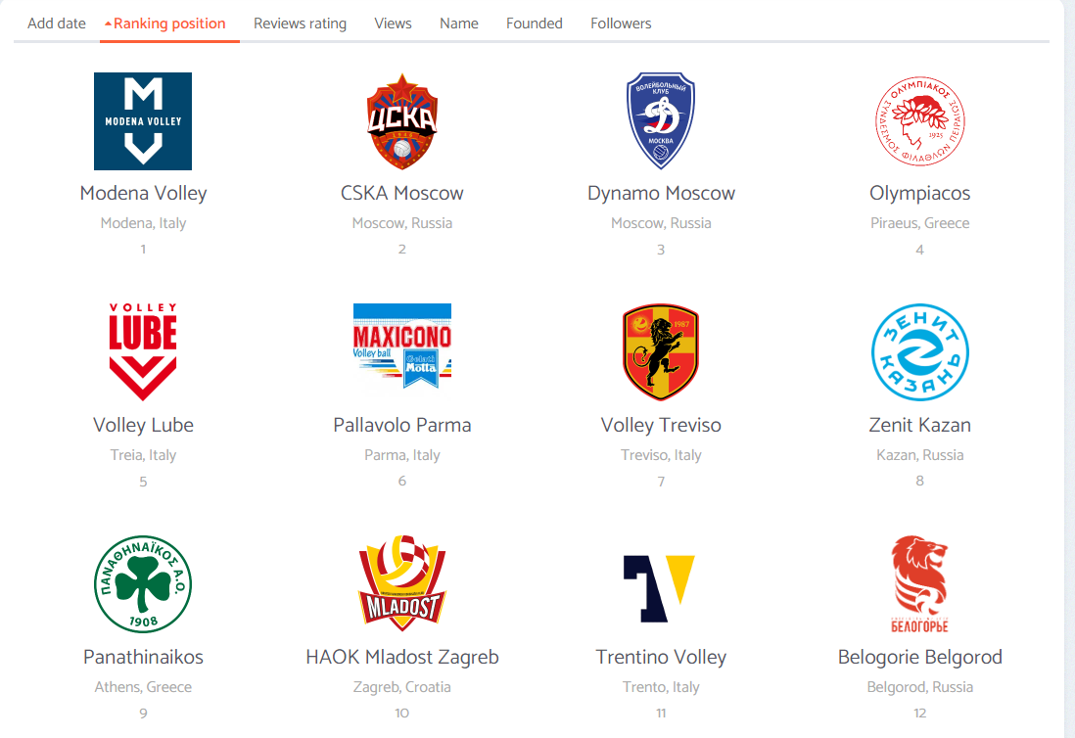
Proposed vision TO TACKLE THE PROBLEM
My plan is to use all the US player data from the volleybox website.
Compare the US players club information to the list of clubs on the website to get an accurate assessment of US players playing actual professional volleyball.
Get the full roster data from the previous 14ish years or more if available of NCAA D1 schools and add all the data together on names to see who went pro out of college and who didn’t.
I’ll then be able to do some EDA to see average heights by position for pro teams, dominant hands per position, vertical jump per position, etc which will help me create a model that will help predict the outcome, going pro.

Slide 4
Potential impact
This model would help players determine what they’re lacking by position compared to the pros and help motivate them to work harder or help them make the decision to switch to another sport if they think they’ll have a better shot going pro elsewhere.
This model would also help coaches and scouts determine whether a player shows potential based on the results of the model.
Could potentially save coaches and scouts time when looking for players.
Could potentially save players time and money associated with playing club and training.

Slide 5
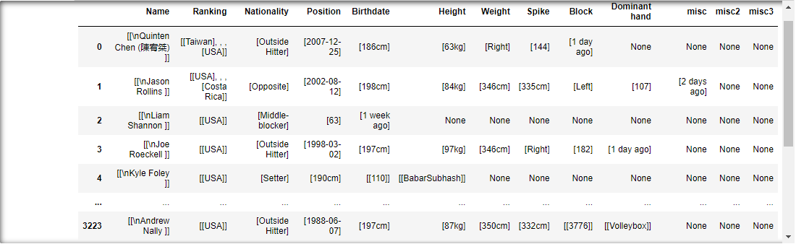
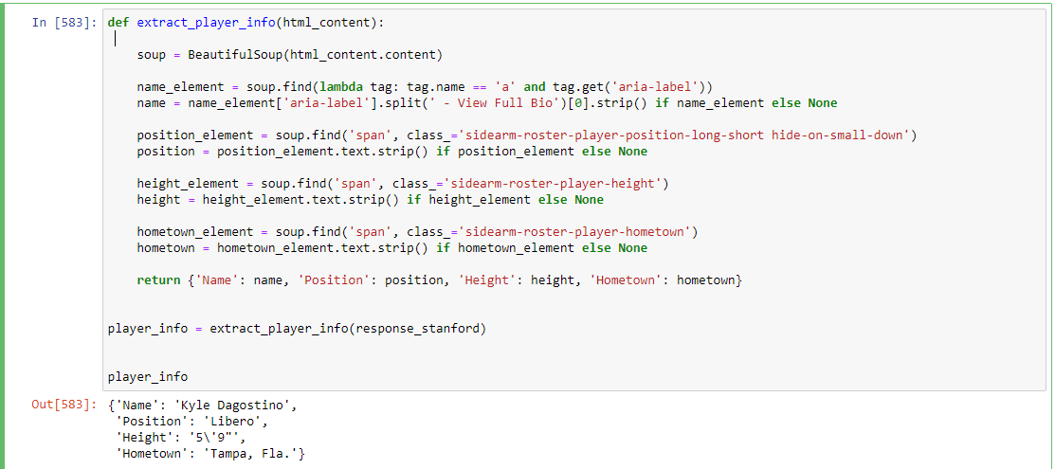
The data set
The data I can get will ultimately provide me with all of the necessary features for a baseline model
My ‘y’ is whether or not they play for a professional club which I can determine from extracting the information from volleybox.
My ‘X’ or features are all available in the data sets I’ll be scraping.
Name, Rank, Nationality, Position, Birthdate, Height, Weight, Spike, Block, Dominant hand, Hometown, Club.
The opportunity to scale this model by adding additional features is there.
This is uncleaned data pulled from the volleybox players page
This is the work in progress for extracting data from one of the rosters I’ll be using data from

Slide 6
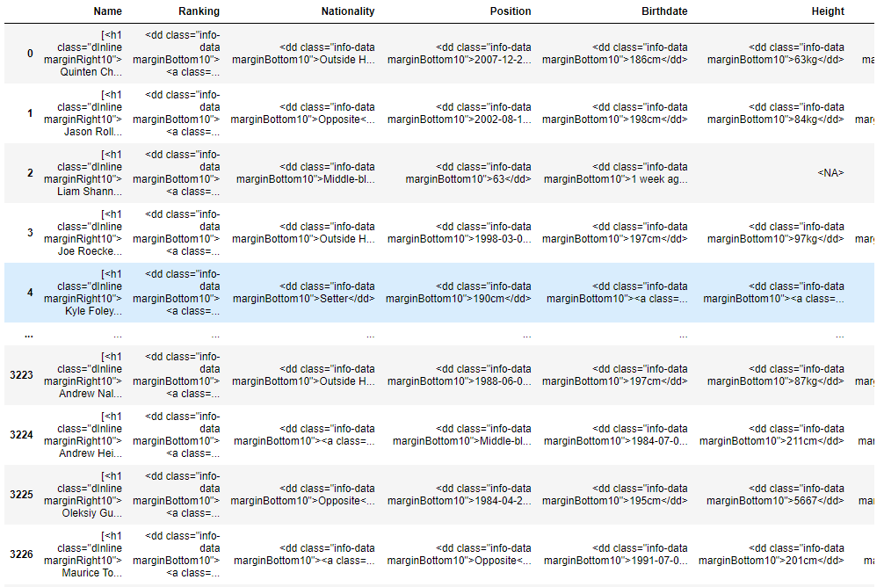
This is what it looks like when I convert it into a string and try to extract and put the values into the correct columns
Essentially the data sets I'm going to collect are going to require a lot of cleaning and a lot of soup.findall() to get what I need for web scraping.

Slide 7
Next steps
The most important thing for me to focus on right now is web scraping and consolidating all the roster data from the D1 schools.
There’s 59 D1 programs with men’s volleyball so I need to web scrape as much as possible.
After I need to clean it all up and combine them all together into one data set.
I should be able to convert most of the data I’ve collected into numerical data so I believe that using linear regression will be my best bet.

