Slide 1
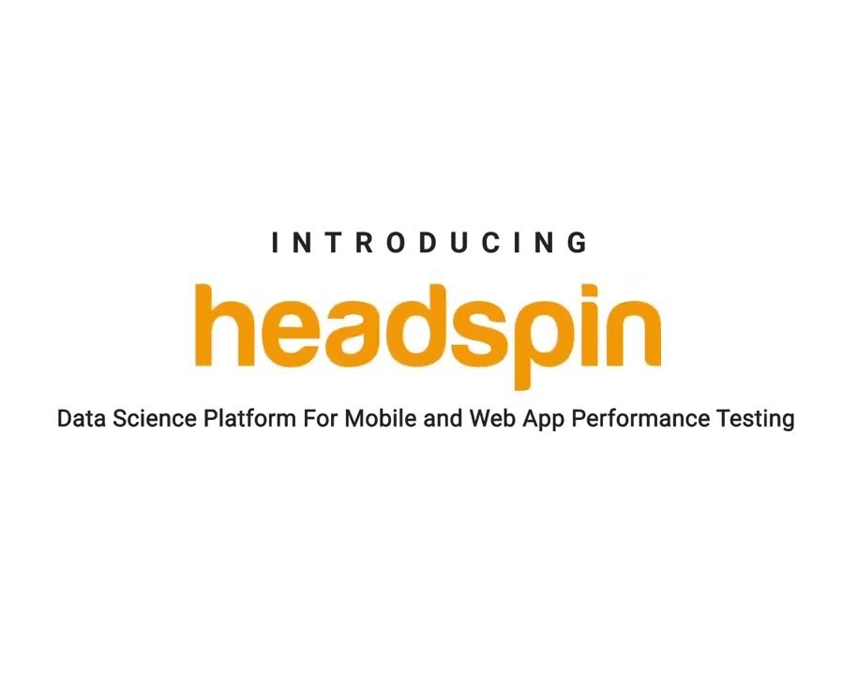
HeadSpin Monitoring Tool
Presented By
Prateek Malviya
Harisha Kandru
Avanish Chandra

Slide 2
Introduction to HeadSpin
HeadSpin makes automated and manual testing easier through AI-driven data science insights. It offers solutions across four core areas:
Headspin is a performance management tool that provides insights into your app’s performance.

Slide 3
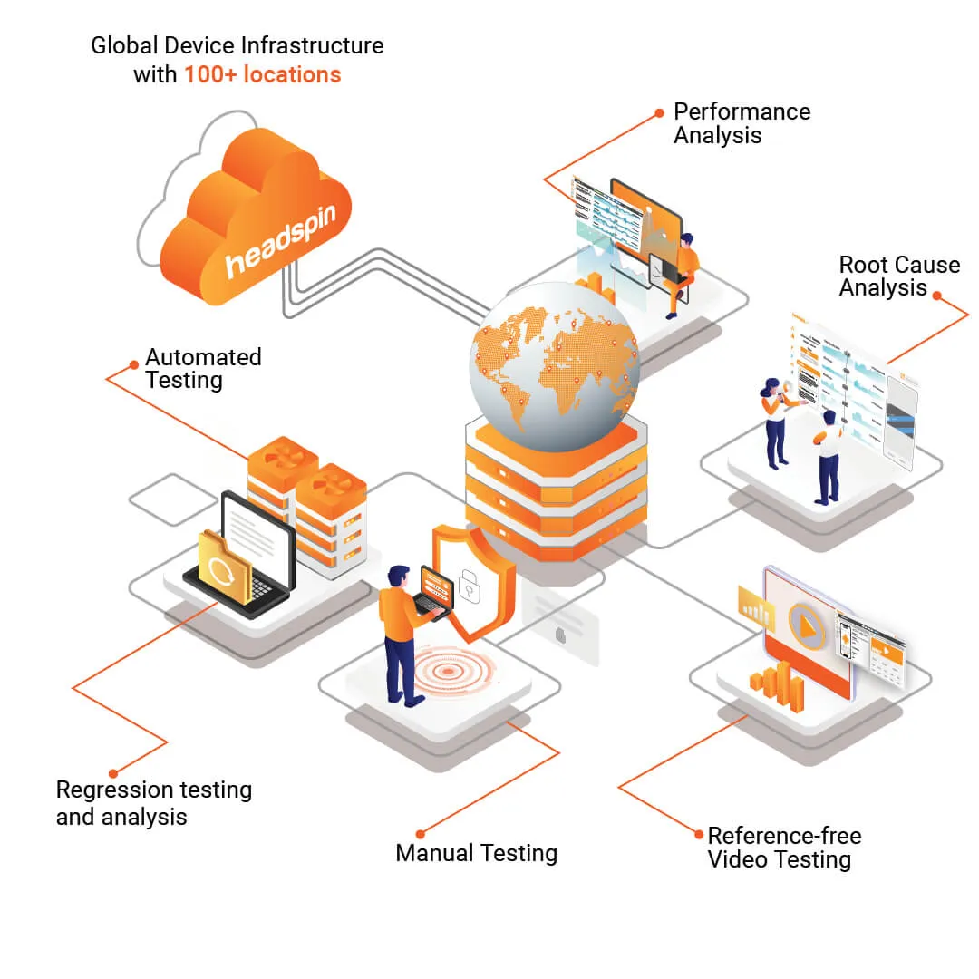
Core Solutions provided by HeadSpin
Mobile app testing
Cross-browser testing
Experience monitoring
Functional performance analysis solutions

Slide 4
Add-On Features and Capabilities of HeadSpin
Audio Visual Platform: One platform for all your media testing.
Create Your Own Lab (CYOL): Utilize your own device infrastructure with HeadSpin.
NimbleApp Code Profiling: Enables secure scale-up of remote test efforts
NimbleApp Code Profiling: Enables secure scale-up of remote test efforts

Slide 5
How HeadSpin Improves App Performance
Real SIM-enabled devices, worldwide locations, and unlimited usage minutes
Actionable regression and aggregation insights
Browser testing workbench with real devices and browsers
Support for automation frameworks (Appium, Selenium)
Audio/video QoE monitoring
Code profiling for performance optimization

Slide 6

HeadSpin Features:
Real SIM-enabled devices
Worldwide locations
Unlimited usage minutes
In-depth data and insights
Secure, scalable API
Actionable regression and aggregation insights
Browser testing workbench with real devices
Device logs, screenshots, and video recording
Support for automation frameworks
Audio/video QoE monitoring
Code profiling

Slide 7
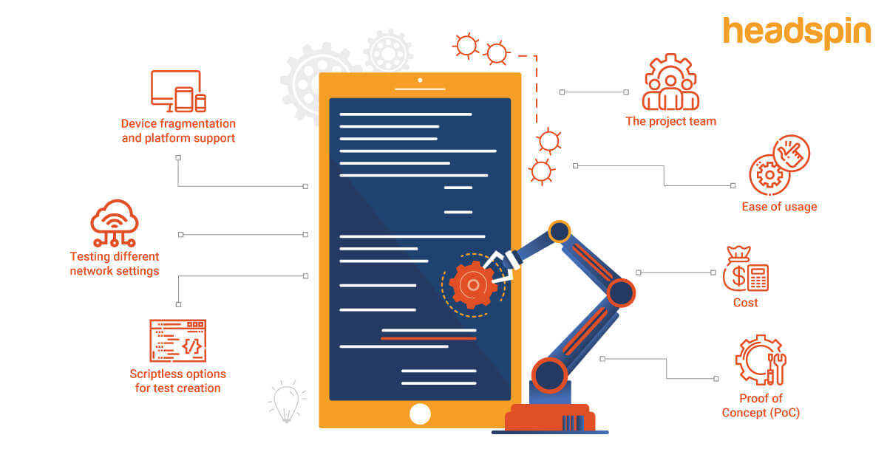
Benefits of Using HeadSpin
Increased ROI: HeadSpin helps you increase your ROI by providing insights into your app’s performance.
Faster Time-to-Test: HeadSpin helps you test your app faster. With HeadSpin, you can quickly test your app on any device at any time.
Easy to Use: HeadSpin is easy to use. Simply sign up for a free account and connect your app. Once you’re connected, HeadSpin will start collecting data and provide insights into your app’s performance.
Seamless Integration: HeadSpin integrates seamlessly into CI/CD workflows, making it easy to get started with performance testing pre- and post-release.

Slide 8
USE CASE
Manual and Automated Device Testing
Different App Version
Audio/Video/Different Operating System
Network Connectivity
Location
Device Types
Recommended & Analysis of Network Traffic
Performance Bottlenecks
Metrics on Outbound Connections

Slide 9

Application Scenarios
HeadSpin finds application in various scenarios. It is used during the app development phase to test and optimize performance. Quality assurance teams employ HeadSpin to identify and resolve issues before app release.
Product managers utilize HeadSpin to gain insights into user behavior, enabling them to make informed decisions about app enhancements. Organizations that prioritize delivering high-quality mobile apps benefit from HeadSpin's capabilities.

Slide 10
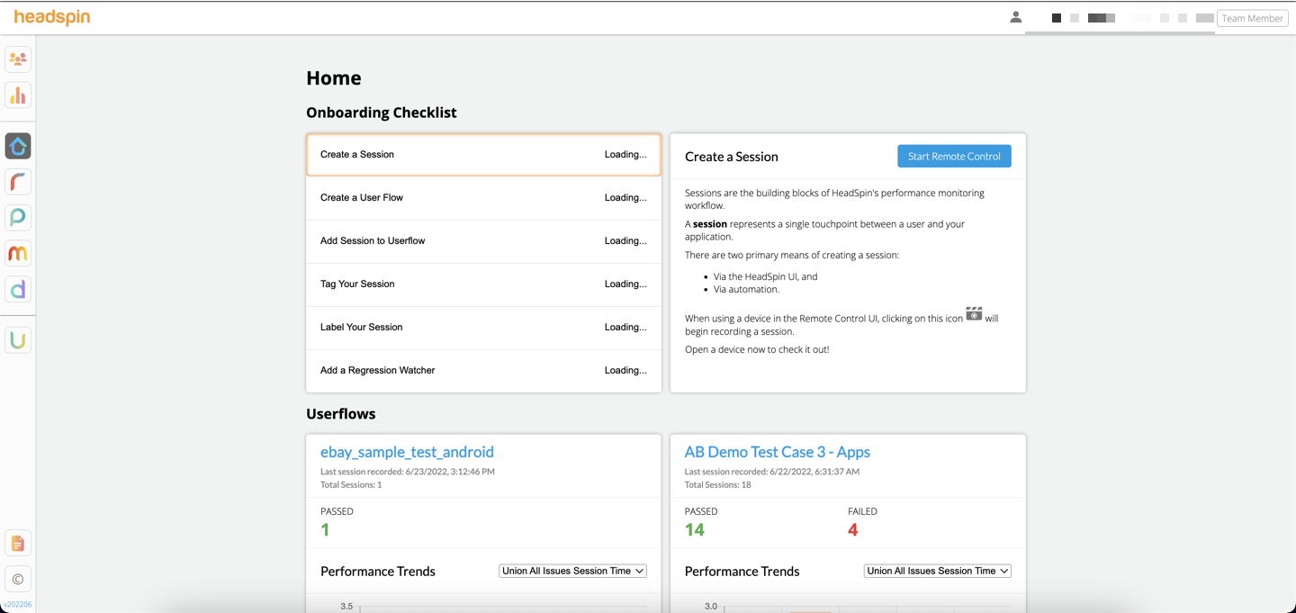
Dashboard

Slide 11

Conclusion
With HeadSpin, you can test on real devices in real user conditions, get actionable insights with detailed reports, and automate the performance testing process.
HeadSpin is a powerful tool that can help you get deeper insights into your app’s performance. It is easy to use and will help you improve your app’s quality and user experience

Slide 12
TNANK YOU

