Slide 1

Splunk
Presented By
Avanish Chandra

Slide 2
Agenda
Background and Founding
Purpose and Use Cases
Features and Capabilities
Impact and Adoption
Conclusion

Slide 3
A Brief History of
Splunk was co-founded by Rob Das and Eric Swan in 2003 to address the challenges faced by companies in examining and understanding their information caves.
The name "Splunk" is derived from the word "spelunking," which means exploring caves, symbolizing the exploration of log files and data.
Splunk was introduced as a search engine for log files, allowing users to easily search, analyze, and gain insights from the vast amounts of machine-generated data stored in their system infrastructure.
The primary goal of Splunk was to provide a comprehensive solution for managing and extracting value from machine data, which was complex, unstructured, and difficult to analyze manually.
By processing and extracting relevant information from machine data, Splunk enables users to identify issues, troubleshoot problems, and gain actionable insights.
Splunk's effectiveness in handling big data and its ability to create visualizations and dashboards for data analysis contributed to its increasing popularity in the analytics domain.

Slide 4
Overview of
Splunk is a powerful engine for searching, investigating, monitoring, troubleshooting, alerting, and reporting on machine-generated data.
It is widely used in today's data-driven world.
Splunk can be considered as the "Google for machine-generated data."

Slide 5
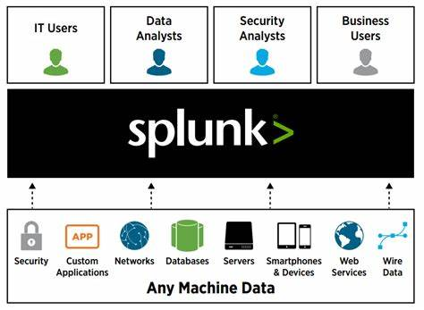
What is
Make machine data accessible, usable & valuable

Slide 6
What is Splunk used for: The Machine Data Challenge
Splunk is a software platform used for processing and analyzing machine-generated data.
Machine data refers to the complex, unstructured logs and data generated by various systems and devices.
Splunk helps in understanding and analyzing machine data, which is otherwise difficult to interpret manually.
It processes and extracts relevant information from machine data, making it easier to locate and identify problems or issues.
Splunk is particularly useful for SysAdmins who need to troubleshoot hardware or system failures by analyzing machine data.
Splunk can handle large amounts of data, making it suitable for big data analytics.
Data analysts often use Splunk to analyze and visualize big data by creating dashboards.
Splunk has gained popularity in the big data domain due to its ability to store, process, and analyze vast amounts of data effectively.

Slide 7
Components of Splunk
Splunk is made up of 3 primary components namely
Splunk Forwarder
Splunk Indexer
Splunk Search Head

Slide 8

Overview Components of Splunk
Splunk Forwarder:
Splunk Forwarder is mainly related to for data forwarding. It collects the logs and sends them further to the indexer. We can install multiple such forwarders in array of machines and forward the log data to a Splunk Indexer for processing and storage. Splunk forwarder are of 2 types as under –
Universal Forwarder – Is used to forward raw data without any prior treatment or processing. This type is much faster with minimal resource requirement on the host. One caveat is that it results in huge quantities of data sent to the indexer.
Heavy Forwarder – It is responsible for parsing and indexing at the source, on the host machine. The benefit is that only the parsed events are sent to the indexer.
Splunk Indexer:
It is primarily related to Parsing and Indexing the data. Indexer indexes and stores the data coming from the forwarder. The Splunk instance changes the incoming data into events and then stores it in indexes in order to perform search operations efficiently.
Following file types are created by indexer and separated into directories called buckets:
Compressed raw data
Indexes pointing towards raw data (.TSIDX files)
Metadata files
We may set up a cluster of indexers with replication in order to avoid data loss.
Search Head:
Search Head basically a GUI used for searching, analyzing and reporting. It renders the UI for users for them to interact with Splunk. It allows users to search and then query Splunk data and interfaces with help of indexers in order to gain access to the specific data which was requested.

Slide 9
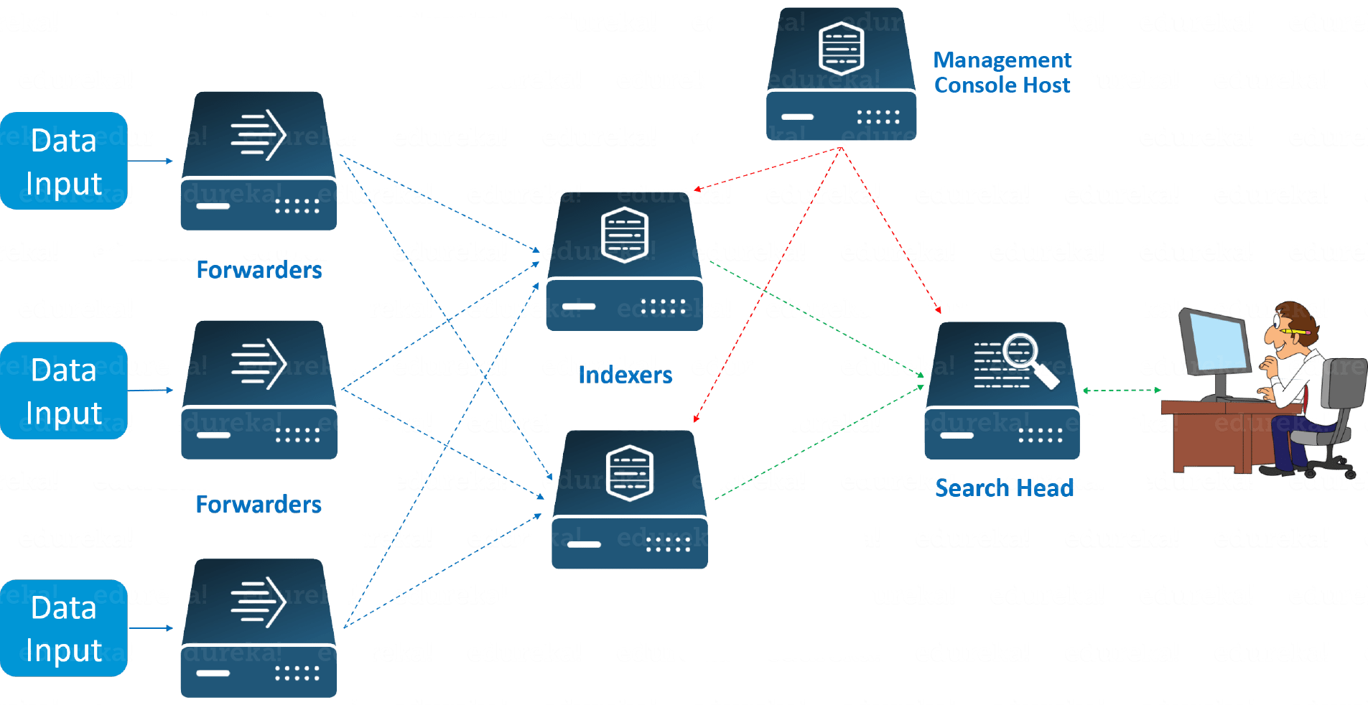
Splunk Components Architecture
Look at the above image to understand the end to end working of Splunk. The images shows a few remote Forwarders that send the data to the Indexers. Based on the data present in the Indexer, you can use the Search Head to perform functions like searching, analyzing, visualizing and creating knowledge objects for Operational Intelligence. Z
The Management Console Host acts as a centralized configuration manager responsible for distributing configurations, app updates and content updates to the Deployment Clients. The Deployment Clients are Forwarders, Indexers and Search Heads.

Slide 10

Features of Splunk
Real-time data processing
Support for various data formats (CSV, JSON, etc.)
Powerful search and investigation capabilities
Troubleshooting and performance improvement
Monitoring business metrics
Visualization and analysis through dashboards
IT system performance analysis
Integration of Artificial Intelligence

Slide 11
Splunk Dashboard
Splunk Dashboards contain data visualization displays such as tables, charts, lists, and maps.
Users can build and edit dashboards using the Splunk Web dashboard editor.
Steps for building a dashboard:
Add content (searches, reports, panels)
Design the user interface
Add interactivity (optional)
Customize the dashboard
Build and edit using Splunk Web Dashboard Editor

Slide 12
Splunk Dashboard Customization
Choose between Absolute and Grid layout options in Dashboard Studio to customize the placement and arrangement of visualizations on your dashboard. Absolute layout allows for precise positioning and layering, while Grid layout provides alignment and automatic resizing for quick and tidy dashboards.
Modify chart colors using Dashboard Studio's native capabilities. You can adjust colors through the UI or in the source code. Specify HEX colors or select from predefined color palettes for Single Value, Table, and custom Choropleth SVGs. For other visualizations like area charts or bar charts, you can define colors in the source code, either as a palette or for individual fields.
Incorporate images and GIFs into your dashboard with Dashboard Studio's Absolute layout. Upload images directly or use image URLs. Adjust the scale of background images and utilize additional images for corporate logos or animated elements.
Enhance your dashboard with text boxes, available in Dashboard Studio's Absolute layout. Text boxes can be used to provide static information or contextual details about the dashboard.
Use shapes and lines in Dashboard Studio's Absolute layout to add visual elements, group objects, create layers between visualizations and the background, and establish connections between objects. Shapes and lines can enhance the aesthetics and organization of your dashboard.

Slide 13
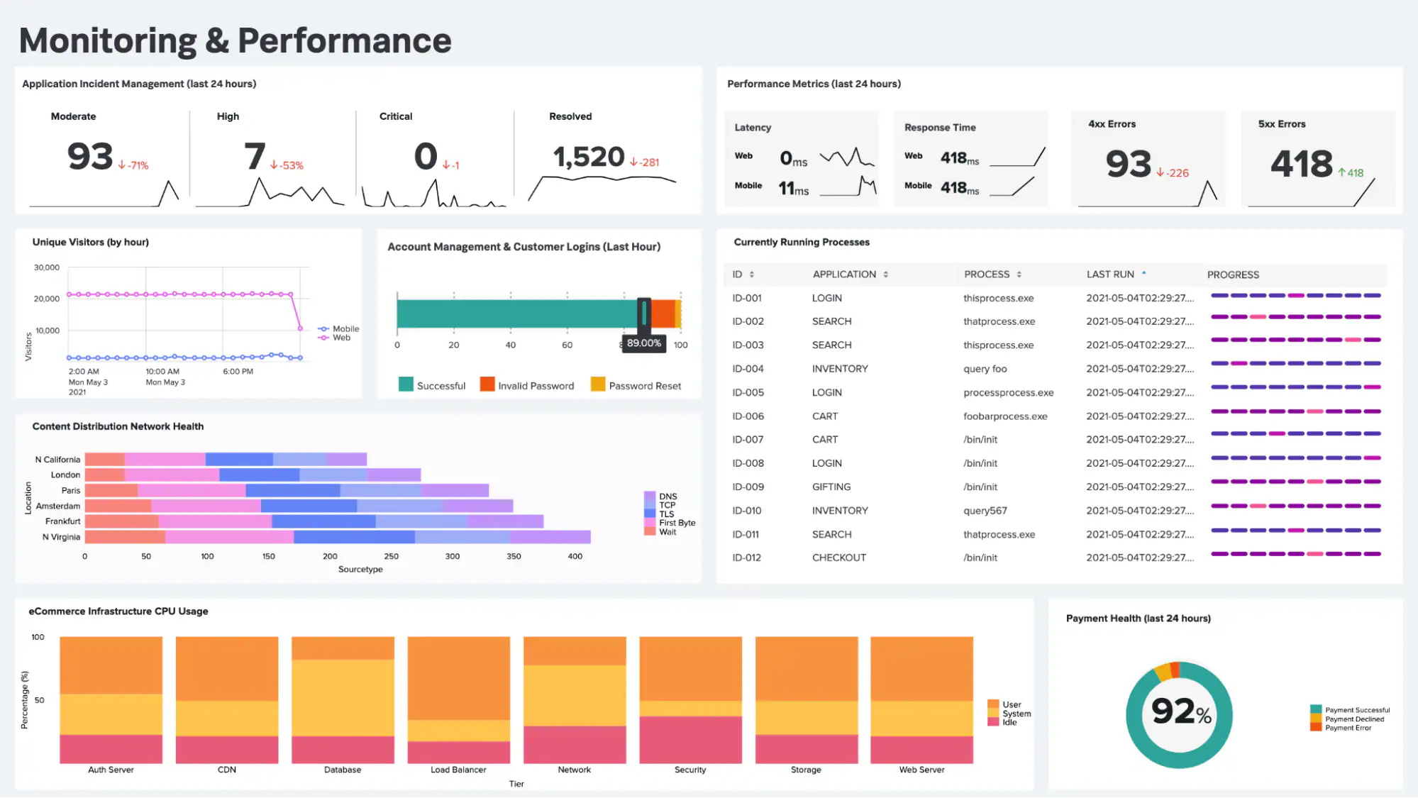
Splunk Customized Dashboard

Slide 14
Conclusion
Splunk is a powerful software platform designed to process and analyze machine-generated data, providing valuable insights and troubleshooting capabilities.
Co-founded in 2003, Splunk was created to address the challenges faced by companies in understanding and leveraging their information caves.
With its search engine for log files, Splunk offers a comprehensive solution for navigating complex and unstructured machine data.
Over the years, Splunk has gained widespread adoption, becoming a go-to tool for data analysts and sysadmins in various industries, empowering them to make informed decisions and drive innovation.

Slide 15
Thank You

