Slide 1
VICAV 3.0
A Research Environment for Variational Linguists

Slide 2
Preliminiaries
VICAV
is a website to support researchers in variational linguistics,
has a focus on digital language resources for spoken Arabic varieties and
is being conducted as a cooperation between the University of Vienna and the Austrian Academy of Sciences.
https://vicav.acdh.oeaw.ac.at/

Slide 3
Perspectives
Linguistic research
Teaching
Text technology
Standards
Openness

Slide 4
Language Resources
Bibliography
Language profiles
Feature lists
(Annotated) sample texts
(Corpora)
Dictionaries (!= glossaries)
(Grammatical descriptions, papers)

Slide 5
Language Resources
Paratexts (Documentation)
VICAV Encoding Guidelines
VLE Guide
Arabic Research Tools
Learning Materials

Slide 6
Requirements
Web-based application
Standards-based
User-friendly

Slide 7
Design Principles
Dual approach
Visualisation on maps
Random access through menus/queries

Slide 8
Structure
Visualisation of data on
an active map (locators)
in fixed panels (text)

Slide 9
Technologies
X-Technologies
HTML
JS (jQuery, Leaflet)
CSS
BaseX
ZOTERO
VLE
& Tools

Slide 10
Technologies
BaseX (Pro)
Easy to install and deploy
Fast
Can deal with large amounts of data
Rest interface
BaseX (Contra)
Less flexible when querying mixed content
& Tools

Slide 11
Technologies
TEI
All Texts
Dictionary module
Zotero RDF
(De-facto) Standards

Slide 12
workflows
Word templates → TEI (XML) → BaseX
Texts

Slide 13
workflows
Oxygen → BaseX
BaseX → REST (xQuery+ XSLT) → HTML
BaseX → REST (xQuery+ XSLT) → TEI
BaseX → REST (xQuery+ XSLT) → RDF
Paratexts

Slide 14
workflows
VLE
… produces XML (TEI-P5)
Lexical Data

Slide 15
workflows
Currently
Word → XML → TEI → BaseX
Future
Webforms → BaseX
Profiles | Sample Texts | Features

Slide 16
workflows
ZOTERO → BaseX
Zotero /zoʊˈtɛroʊ/ is a free and open-source reference management software to manage bibliographic data and related research materials
Bibliographical Data

Slide 17
workflows
ZOTERO (Contra)
slow, inflexible wrt schema
ZOTERO (Pro)
Web-based
Collaborative
Large community
Well-established
API (JSON)
Bibliographical Data

Slide 18
workflows
ZOTOSCOPE
… applies the VICAV taxonomy
Bibliographical Data

Slide 19
Features
Everything is TEI !!!
Citability via URLs
Cross Dictionary Query

Slide 20
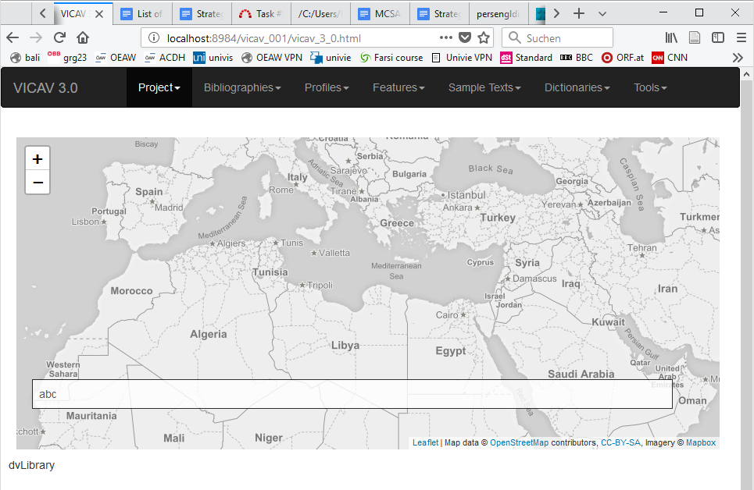
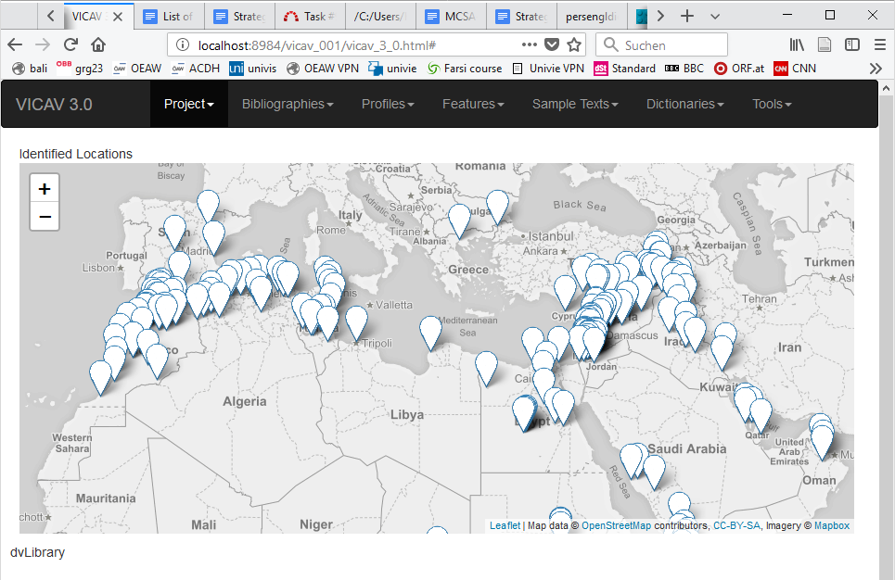
First Attempts

Slide 21
First Attempts

Slide 22
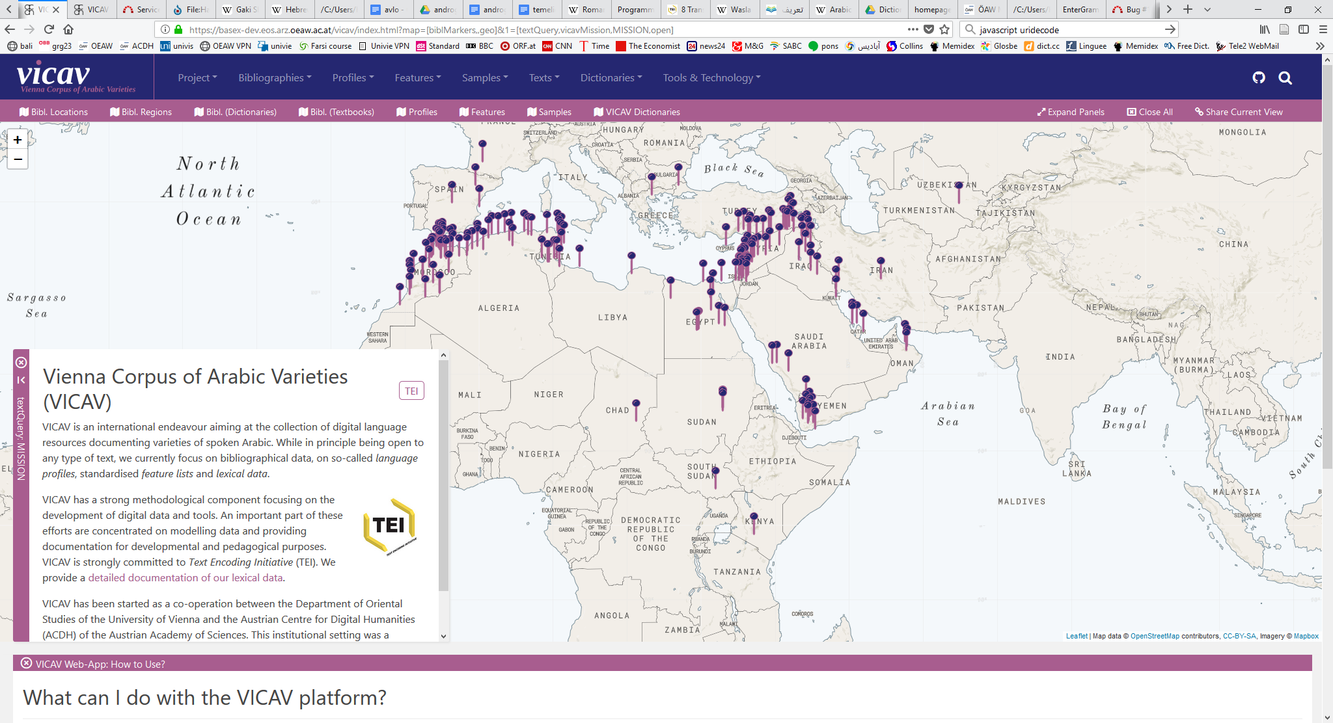
Current Look
Notes:
VIVAC is about LRs and most of the actions you can perform in the menus will lead the user to LRs, either by putting them on the map, or by displaying other visualisations of the data

Slide 23
Future
??? Contribute via web-form ???
Searchable interface for text queries
BaseX vs. Noske

Slide 24
Credits
Asil Cetin
Dario Kampkaspar
Barbara Krautgartner
Daniel Schopper
Omar Siam
Technical team

Slide 25
Credits
https://vicav.acdh.oeaw.ac.at/vicav/index.html#map=[biblMarkers,,geo]&1=[textQuery,vicavContributors,CONTRIBUTORS,open]
Researchers / Data curators

Slide 26
Děkuji za pozornost!
Thank you for your attention!
Danke für Ihre Aufmerksamkeit!
Merci pour votre attention!
感谢您的聆听!
Dank u voor uw aandacht!
Gracias por su atención
Ngiyabonga ukulalela kwenu!
Grazie per l’attenzione!
Спасибо за внимание!
Asante sana kwa kunisikiliza!
!وشكرا لكم على اهتمامكم

