Slide 1
Statistical analysis

Slide 2
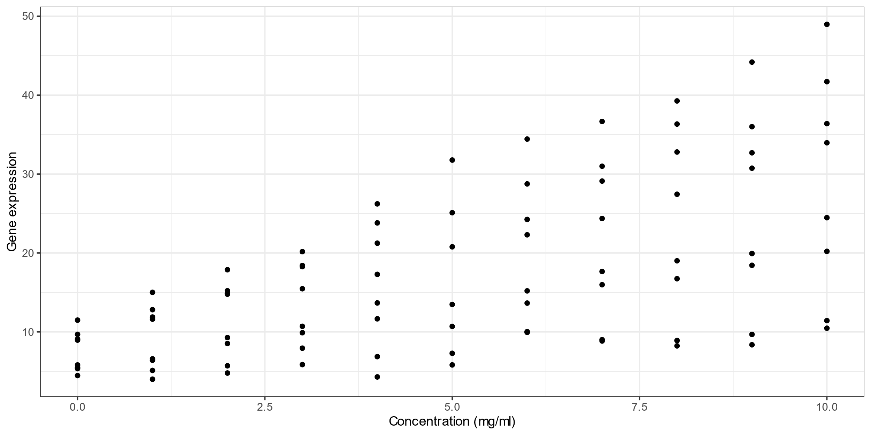
Concentration vs gene expression
Notes:
A plot of concentration of growth factor (on the x axis) vs gene expression (on the y axis), showing that as concentration increases, gene expression appears to also increase.

Slide 3
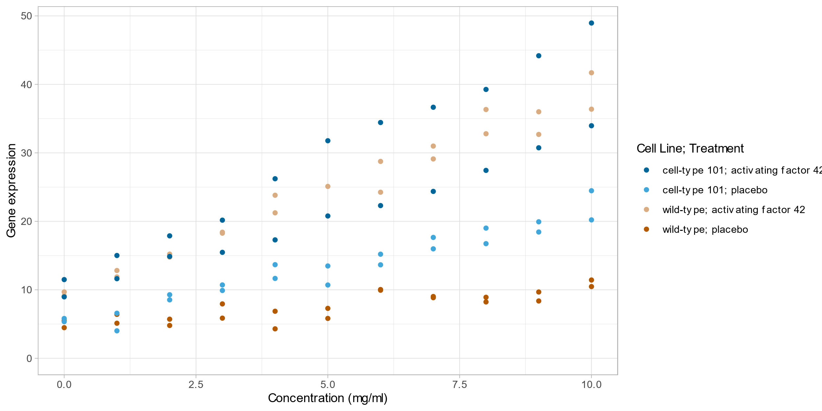
Concentration vs gene expression (coloured by cell line and treatment)
Notes:
The plot of concentration versus gene expression, coloured by cell line and treatment.

Slide 4
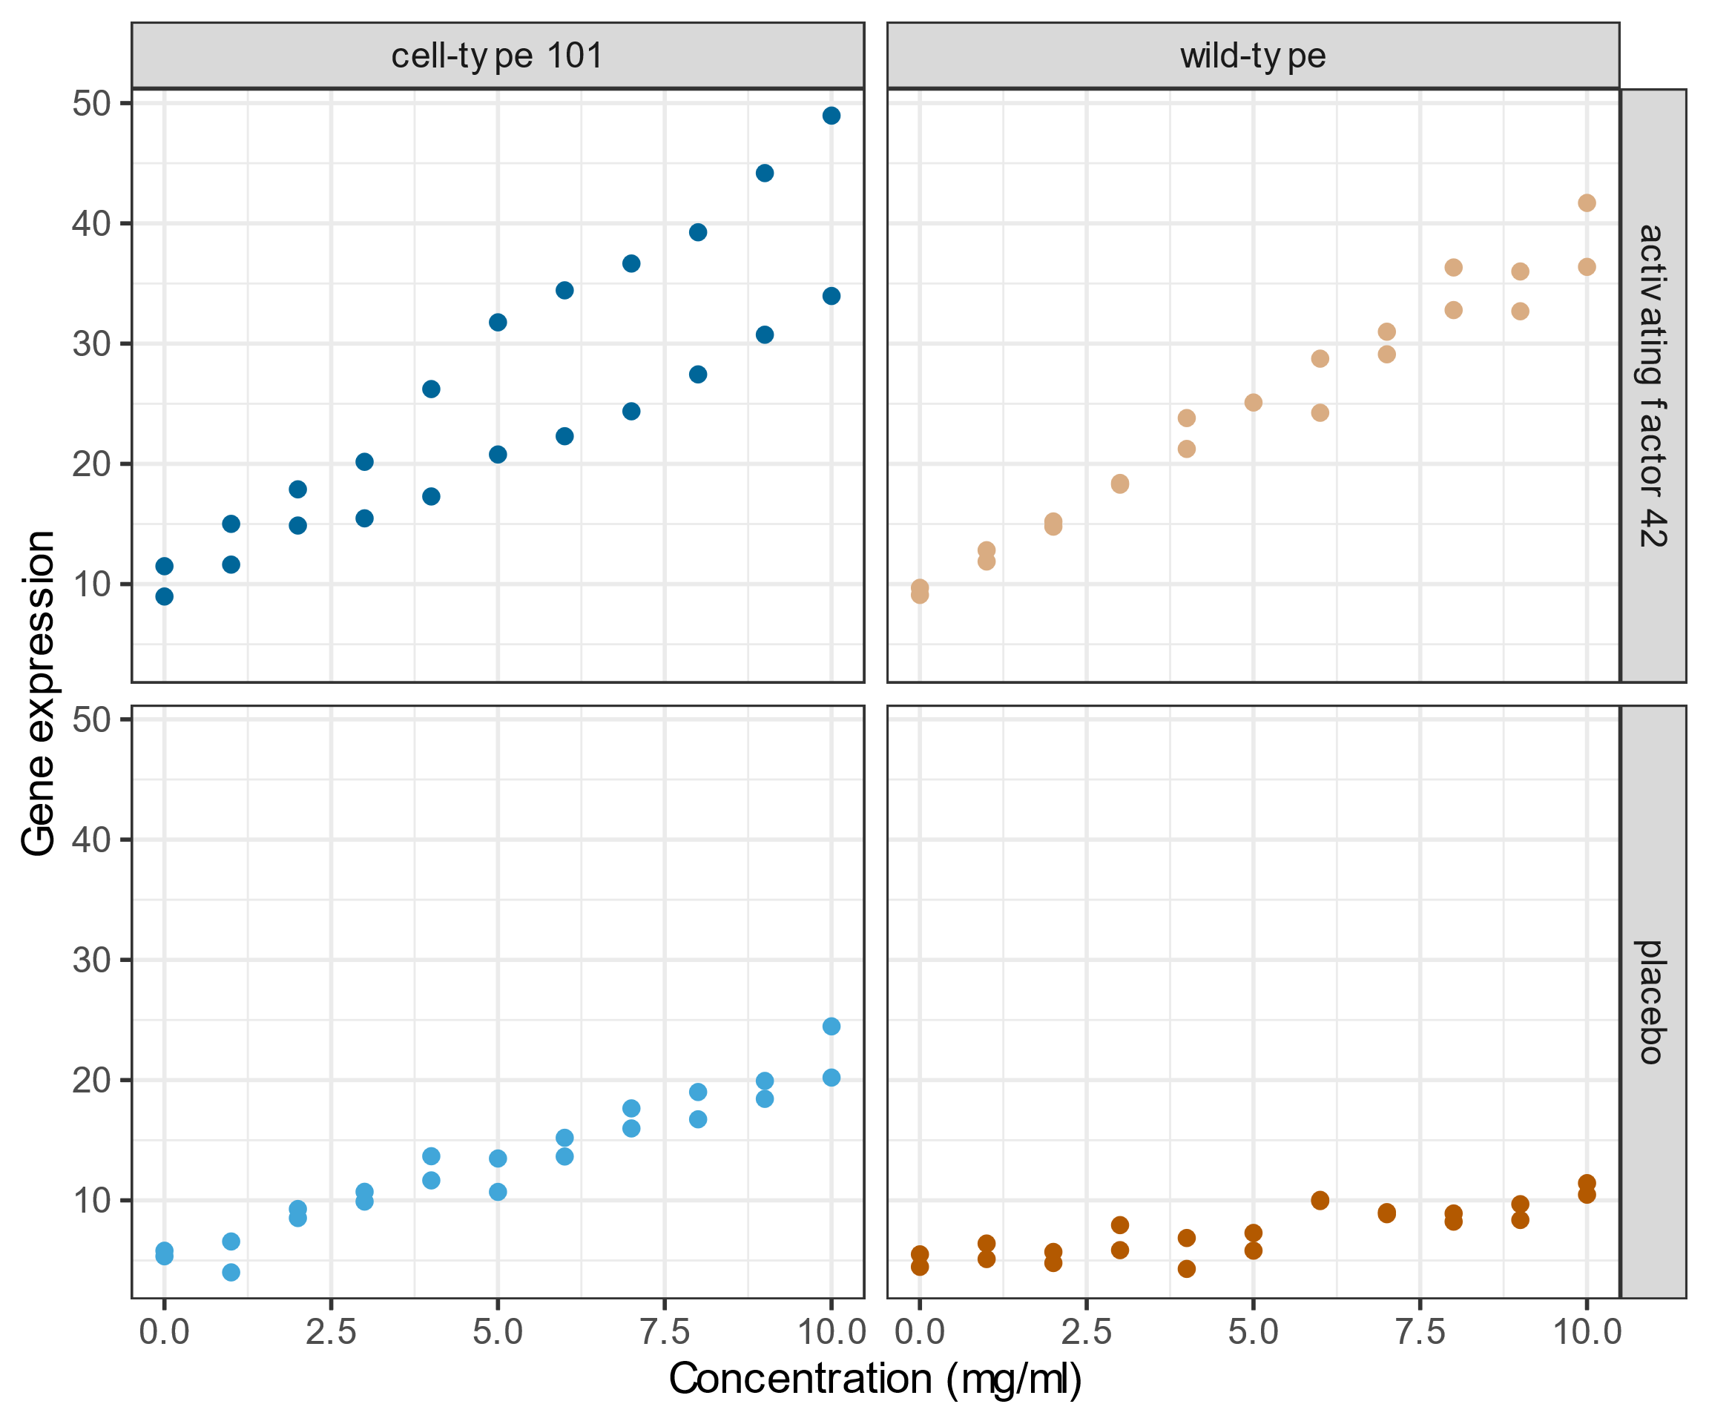
Concentration vs gene expression (grouped by cell line and treatment)
Notes:
The plot of concentration versus gene expression coloured according to cell line and treatment group, split into separate subplots. A three-way mixed ANOVA conducted upon this data indicates that there is a statistically significant interaction effect between cell line, treatment and concentration (F(10,30)=2.244, p = 0.0043).

Slide 5
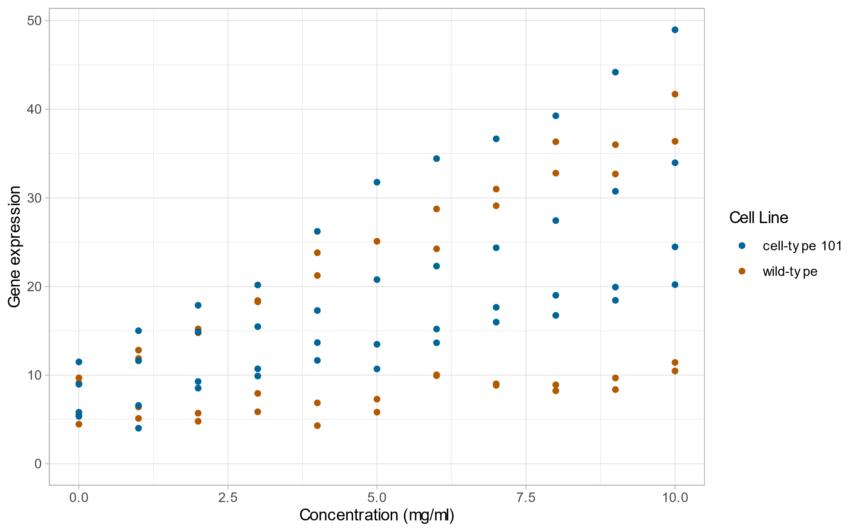
Concentration vs gene expression (coloured by cell line)
Notes:
A plot of cell line (wild-type or cell-type 101; on the x axis) versus gene expression (on the y axis), coloured by cell line. This plot shows that whilst the cell-type 101 cell line may increase the gene expression (compared to the wild-type cell line), it is not the only factor.

Slide 6
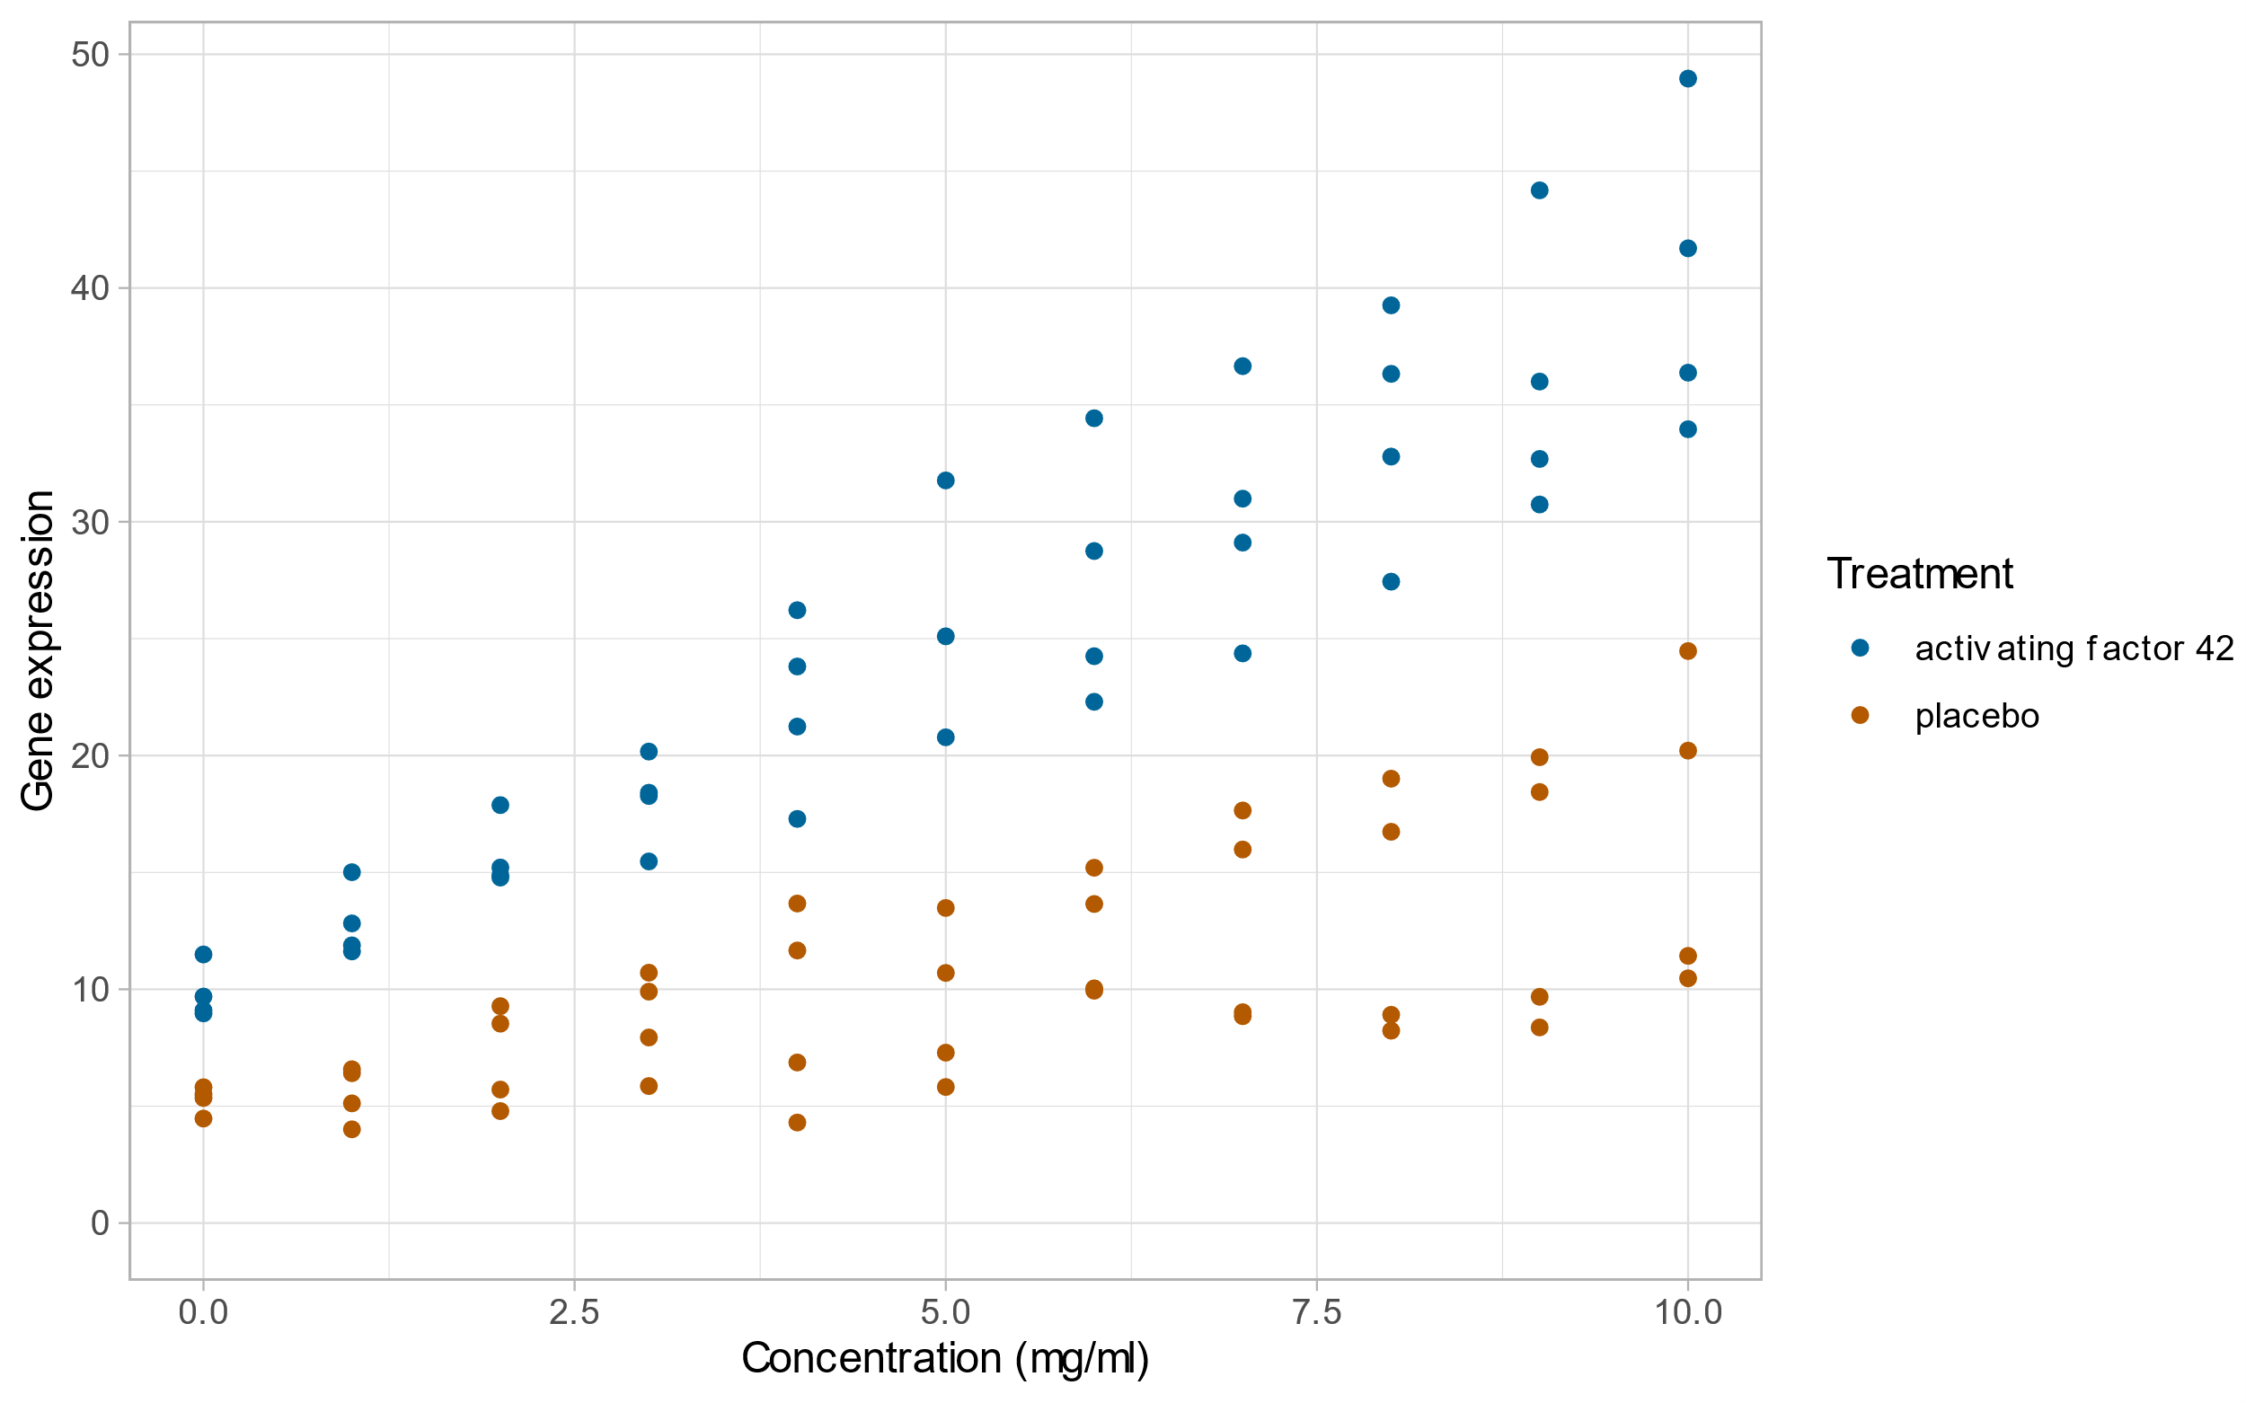
Concentration vs gene expression (coloured by treatment)
Notes:
A plot of concentration (on the x axis) versus gene expression (on the y axis), coloured by treatment type. This plot shows that there appears to be an increase in gene expression for the activating factor 42 treatment over the placebo treatment, which is confirmed by the post-hoc testing.

Slide 7
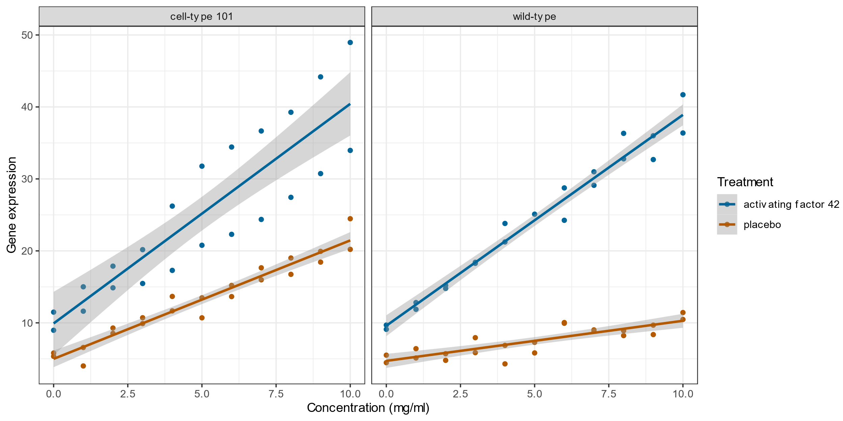
Concentration vs gene expression (grouped by cell line, coloured by treatment)
Notes:
A plot of concentration versus gene expression, with treatment type indicated by colour and each cell line in a separate sub-plot.
On these plots are shown models of gene expression as a function of concentration, for each treatment and cell line.

Slide 8
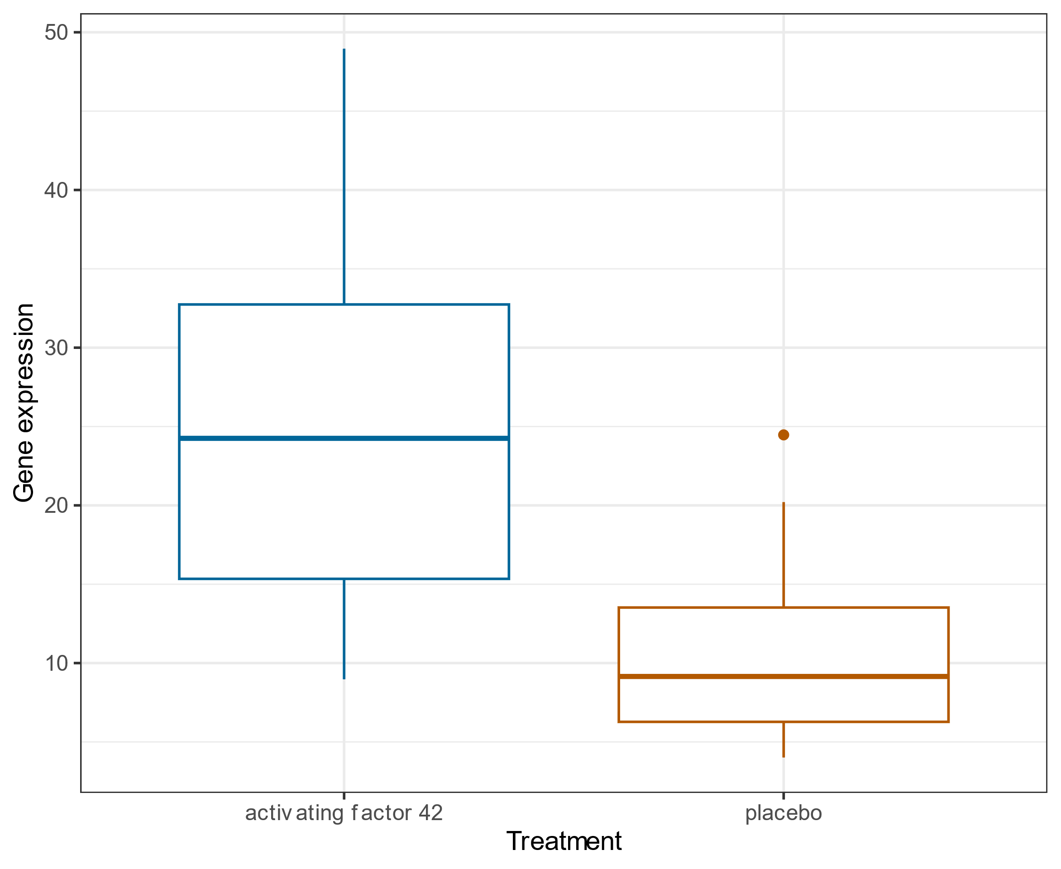
Treatment vs gene expression
Notes:
A boxplot of treatment (placebo or activating factor 42) on the x axis versus gene expression on the y axis, showing that there appears to be greater gene expression for the activating factor than for the placebo.

Slide 9
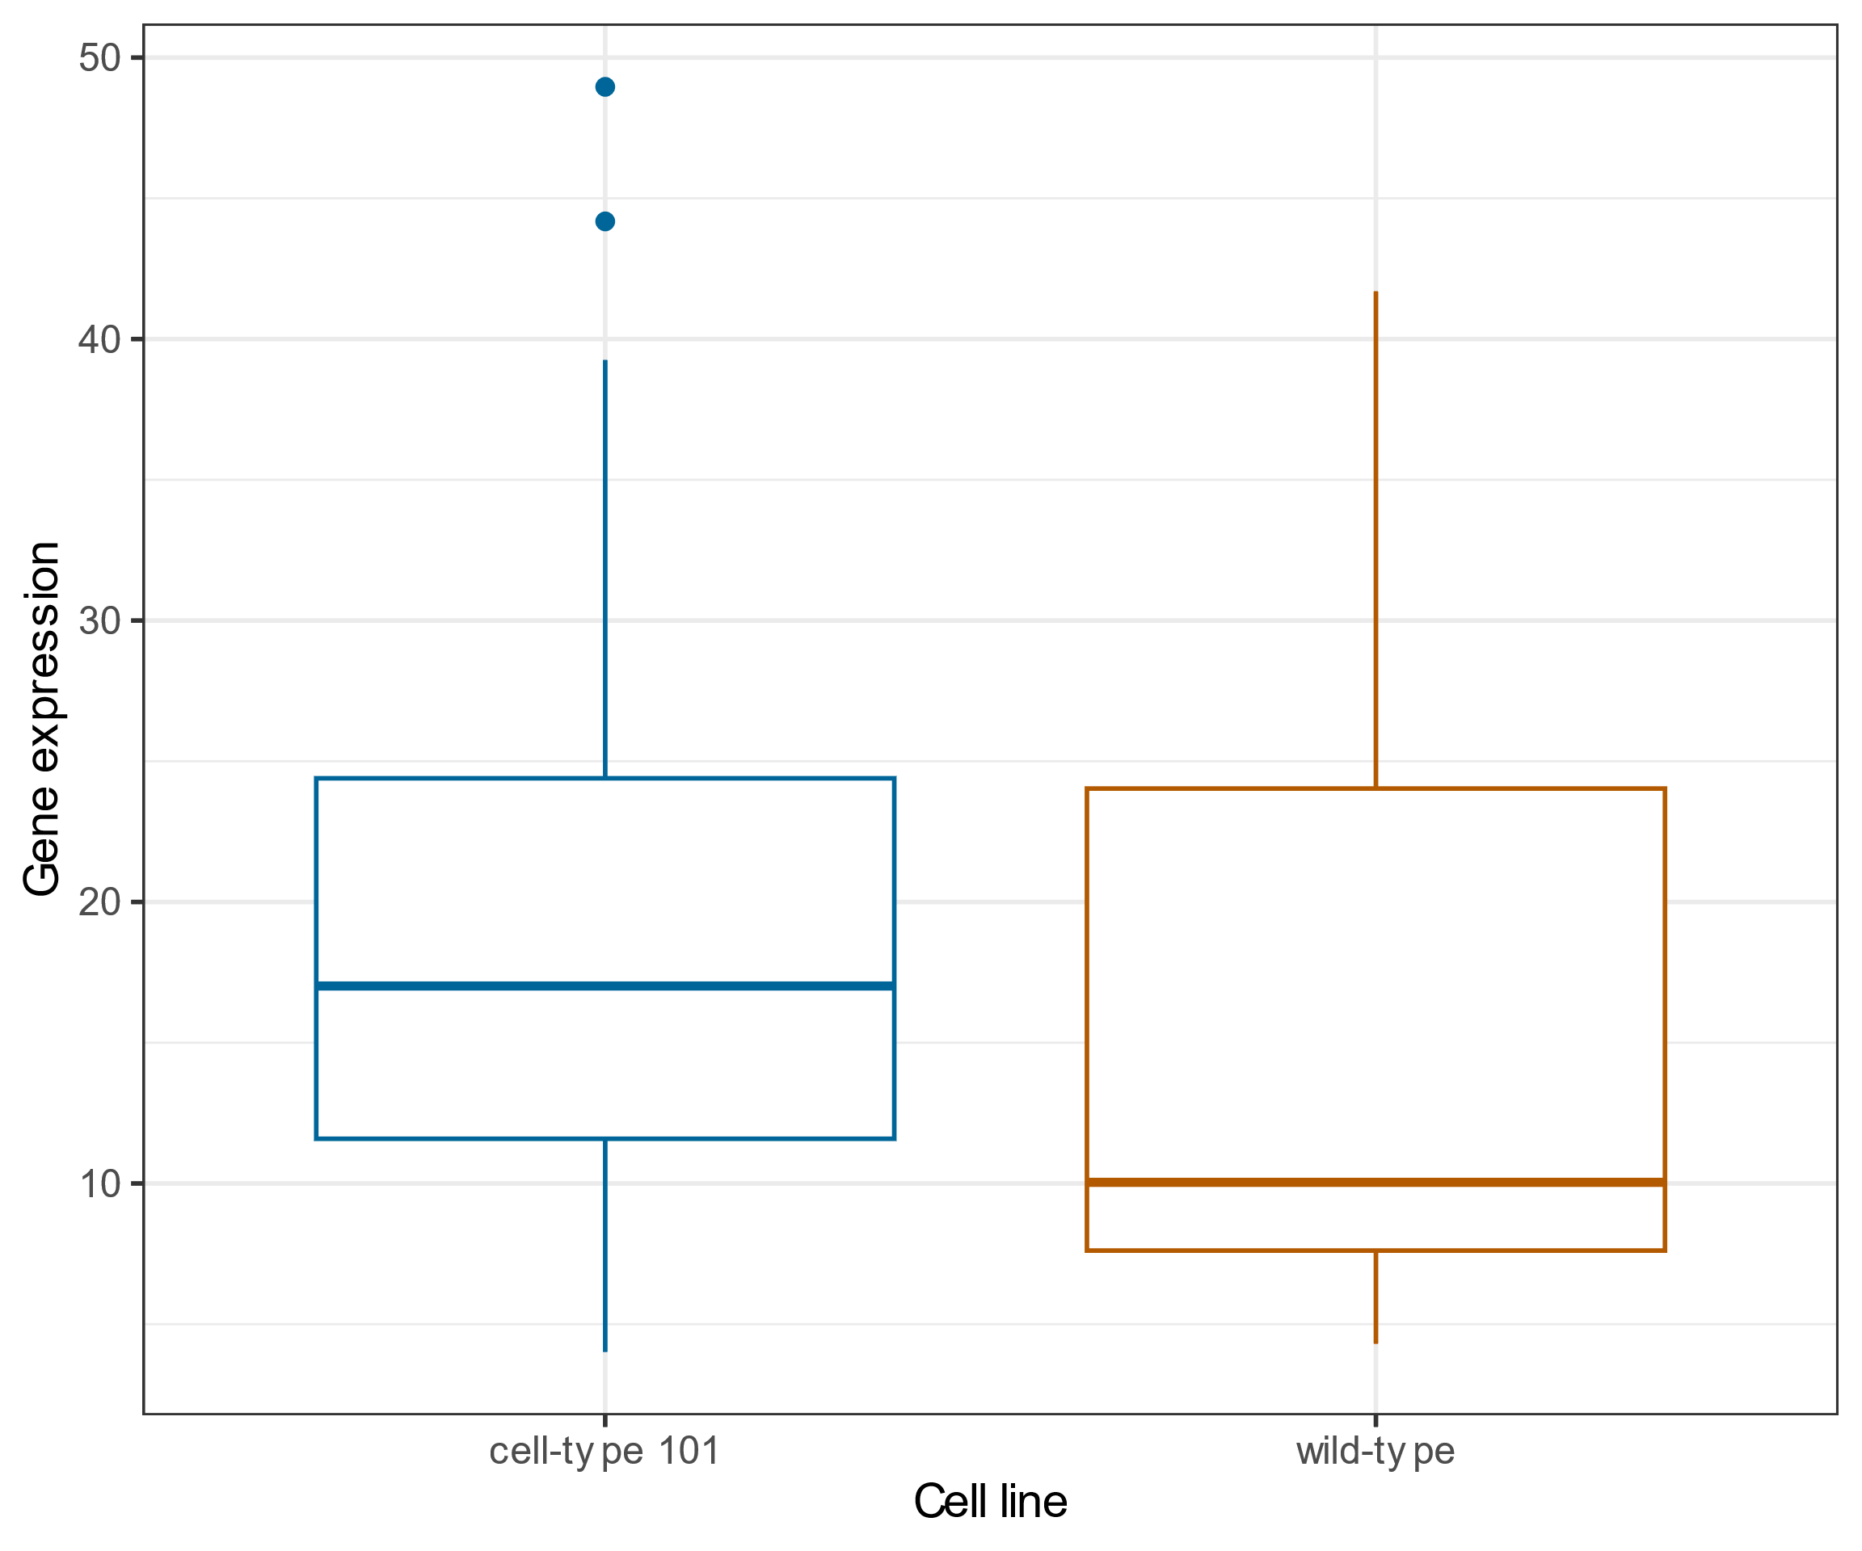
Cell line vs gene expression
Notes:
A boxplot of cell line (wild-type or cell-type 101) on the x axis versus gene expression on the y axis.

