Slide 1



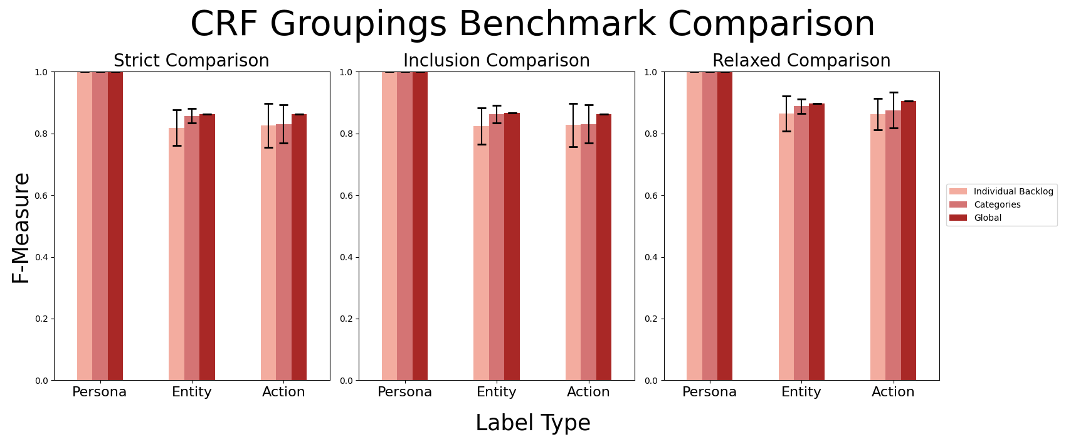
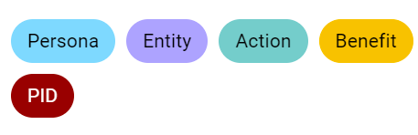

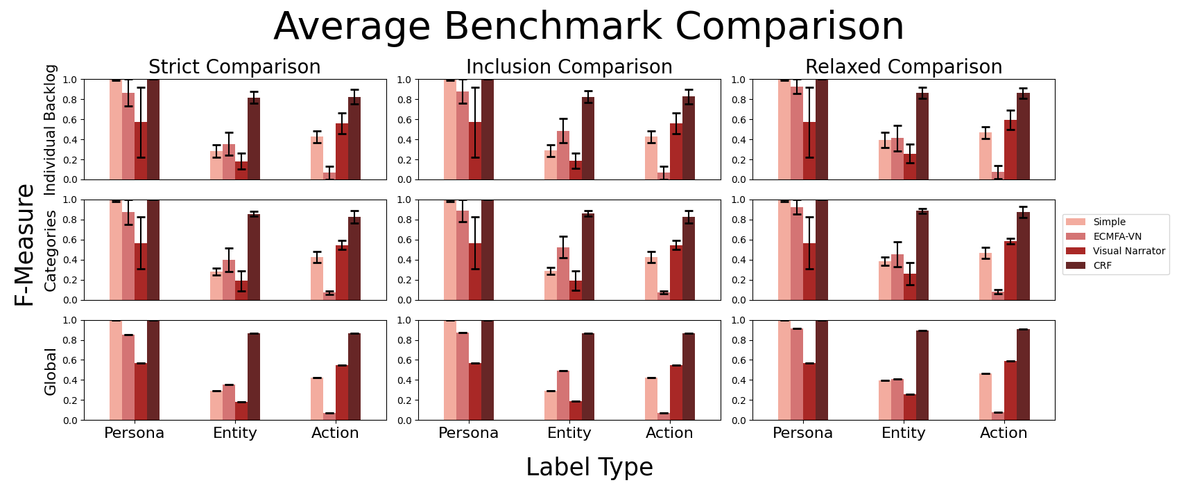
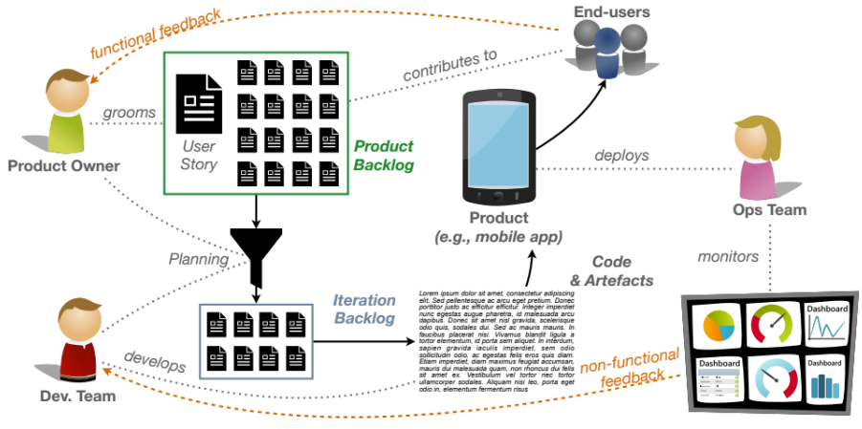
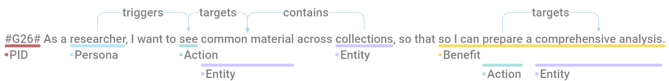
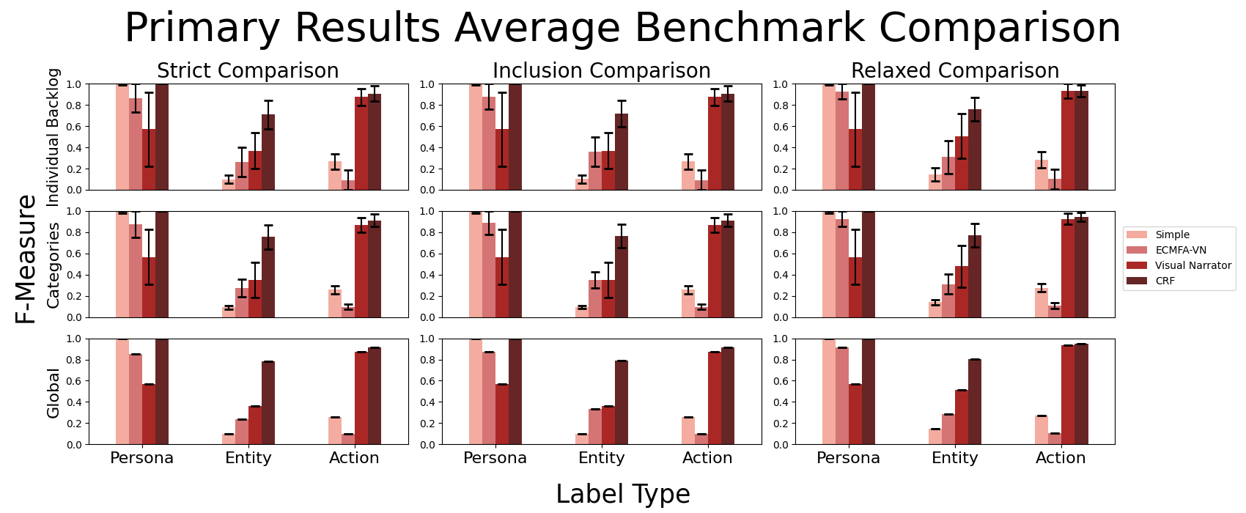

Comparing the Accuracy of Natural Language Processing (NLP) Tools’ Annotations of User Stories
Sathurshan Arulmohan¹, Sebastien Mosser PhD¹, Marie-Jean Meurs PhD²
¹ Department of Computing and Software, McMaster University, Hamilton, Canada. ² Department of Computer Science, Université du Québec à Montréal, Montreal, Canada.
Agile Software Development
Agile Software Development consists of a feedback loop, Fig 1, [1] Product owner receives feedback from end-users and converts it into user stories to store in the product backlog Developers (Dev) team uses feedback from the operations (Ops) team and from user stories in the product backlog to improve the product The problem is that the product backlog does not yet provide immediate feedback to Dev. team [1] Slows down the feedback loop Overlapping or similar feedback may not be considered at once An approach uses NLP tools to automatically extract valuable information from user stories to shorten the feedback loop [1]
Annotations
Benchmark (Baseline Annotations) Each story was manually annotated on Doccano [4] Ensures that a benchmark exists for comparing the accuracy of NLP tools’ annotations Annotations include: Labels: : Project ID : The main person of the story : An action done by the Persona or an Entity : Word(s) that represents an element : The outcome of the primary action Note: Qualifiers such as adjectives are included in Action and Entity annotations Relations (between two labels): : relation of a Persona triggering an Action : relation of Action targeting an Entity : relation of an Entity containing another Entity Actions and Entities are further categorized Primary: Main Action/Entity of the story Secondary: All other Action/Entity in the story NLP Annotations Simple NLP: Developed a very simple annotation tool that depends on a dictionary of words Used to determine if other NLP tools are redundant ECMFA-VN: Annotations of stories were already given Visual Narrator: Blackbox tool that outputs only primary annotations [5] CRF: An updated version of sklearn-crfsuite that learns from a pre-annotated training set of stories Relies on pre-set features and parameters that affect its learning
Results
Different groupings of the training sets showed no significant changes to the F-Measure Groups of small training sets sometimes performed worse than using one global training set ECMFA-VN does not annotate Actions well Visual Narrator annotates Primary Actions well but falls when annotating Personas and Entities CRF annotates Actions, Entities, and Primary Entities better than all the other NLP tools CRF can almost annotate all Personas and Primary Actions in a given set
Figure 3: Comparing the CRF results of different groupings of the training set
Figure 4: Annotation benchmark comparison results using a set that contains 20% of
the user stories in the dataset.
Figure 2: Example annotation from backlog g16-racdam.
Figure 1: Agile software development feedback loop for a product. [1]
Objectives
Evaluate the accuracy of current NLP tools’ annotations of user stories Compare the accuracy of all NLP tool’s annotations using a benchmark Manually annotate each user story Implement a new NLP tool (CRF [2]) that will be more accurate at annotating than the current NLP tools
Figure 5: Primary annotation benchmark comparison results using the same set of
user stories as Fig 4.
User Stories
The only publicly available and reusable dataset is published by Dalpiaz [1],[3] Consist of 22 backlogs with 1670 unique valid user stories Each user story contains a similar format [1]: “<PID>, As a <Persona>, I want to <perform action on entities>, so that <benefit>.” Note: some user stories are poorly written and may not have any entities or a benefit.
Comparing Modes
Three modes of comparison Strict: Must EXACTLY match baseline annotations Inclusion: Baseline results are part of NLP’s results Relaxed: Qualifiers within annotations are ignored
Conclusions
CRF annotates user stories well compared to existing NLP tools Still has room for further improvement Train CRF using one global training set Provides a more generalized learning outcome so that CRF can be scalable and used on other datasets ECMFA-VN and Visual Narrator’s calculations are redundant in most cases
Example Comparison Results
Baseline Annotation | NLP Tool Annotation | Strict Comparison | Inclusion Comparison | Relaxed Comparison
Dataset | datasets | Fail | Pass | Fail
Many datasets | datasets | Fail | Fail | Pass
User’s dataset | [User, datasets] | Fail | Fail | Fail
dataset | Dataset | Pass | Pass | Pass
Future Work
Evaluate CRF performance with different ratios of training and testing set sizes Optimize CRF parameters Adjust CRF features to generalize learning outcomes Evaluate CRF trained models on new datasets Fully automate python scripts Improve CRF’s relation annotations using syntactic trees and proximity matching Identify Contains and secondary relations Evaluate the accuracy of NLP tools’ relation annotations with the benchmark
References
[1] S. Mosser, C. Pulgar, V. Reinhar, “Modelling Agile Backlogs as Composable Artifacts to support Developers and Product Owners”, Journal of Object Technology, Volume 21, no. 3, July 2022, pp. 3:1-15, doi:10.5381/jot.2022.21.3.a3. [2] S. Mosser, “ace-sklearn-crfsuite: Scikit-learn inspired API for CRFsuite.” https://github.com/ace-design/ace-sklearn-crfsuite [accessed July 29, 2022] [3] F. Dalpiaz, “Requirements data sets (user stories)”, Mendeley Data, V1, July 2018, doi: 10.17632/7zbk8zsd8y.1 [accessed May 02, 2022] [4] H. Nakayama et al., “Doccano: Open source annotation tool for machine learning practitioners.” https://github.com/doccano/doccano [accessed May 00, 2022] [5] MJ Robeer, S.Mosser, et al. “Visual Narrator” https://github.com/MarcelRobeer/VisualNarrator [accessed May 02, 2022] [6] P. Qi, Y. Zhang, Y. Zhang, J. Bolton, C.D. Manning. ”Stanza: A Python Natural Language Processing Toolkit for Many Human Languages.” 2020. https:// stanfordnlp.github.io/stanza/. [accessed June 10, 2022]
Sathurshan Arulmohan
Undergraduate Software Engineering
McMaster University, Department of Computing and Software, Faculty of Engineering
Email: arulmohs@mcmaster.ca

