Slide 1
Group No. 2
Hybrid System for Face Detection and Emotion Recognition Using Verilog & AI
Group Member Names & SID:
Suryadipta Ghosh (23111001)
Shashvat Mishra (23111023)
Pratyush Kumar (23111024)
Supervisor(s) Name:
Dr. Sukhwinder Singh

Slide 2
Motivation
Real-time emotion recognition is needed in areas like driver safety, healthcare, and surveillance, where systems must understand emotions quickly and reliably from continuous facial images.
Software-only AI models (CNN/LSTM) are accurate but slow and power-hungry, making them unsuitable for real-time use on small embedded devices. Research shows they need hardware acceleration to work efficiently.
FPGAs are ideal for this task because they offer low latency, parallel processing, and low power consumption — allowing deep learning models like CLDNN (CNN + LSTM) to run fast in real time.
Combining our Verilog face detector (skin detection, integral image, Haar cascade) with the Hardware-based CLDNN model gives a complete hybrid system that detects faces in hardware and recognizes emotions with high accuracy, similar to the research paper results

Slide 3
Reference Paper
Pan, S.-T.; Wu, H.-J. FPGA Chip Design of Sensors for Emotion Detection Based on Consecutive Facial Images by Combining CNN and LSTM. Electronics 2025, 14, 3250. https://doi.org/10.3390/electronics14163250

Slide 4
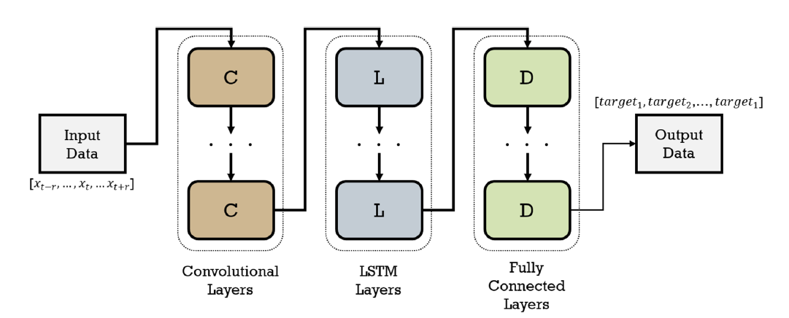
Architecture
Architecture of Emotion Classifier using Verilog and AI
(from the research paper)

Slide 5
Methodology
1.Face Detection using Verilog
Data Preparation (Python)
parse_cascade.py → Parses OpenCV Haar Cascade XML files into Verilog-compatible .mem format.
prepare_test_images.py → Converts standard images into 64×64 grayscale hex files for simulation.
Core Hardware Components (Verilog)
Integral Image Module – Computes pixel-sum representation for fast feature extraction.
Feature Calculation Module – Evaluates Haar-like features over detection windows.
Cascade Stage Evaluation Module – Implements multi-stage classification for accurate detection.
Central FSM (control_fsm.v) – Coordinates the entire detection pipeline, managing data flow and stage transitions.
Simulation & Verification
Verified using Icarus Verilog for logic simulation and GTKWave for waveform analysis.

Slide 6
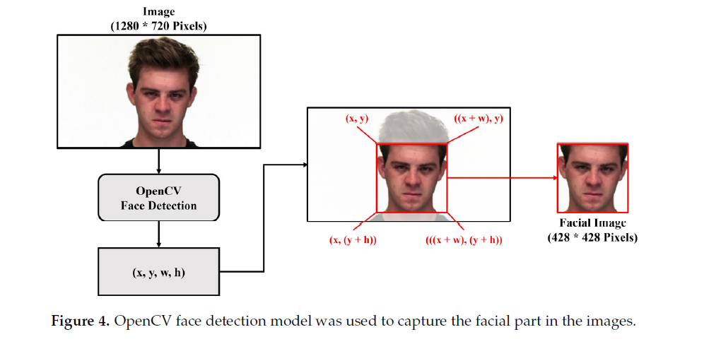
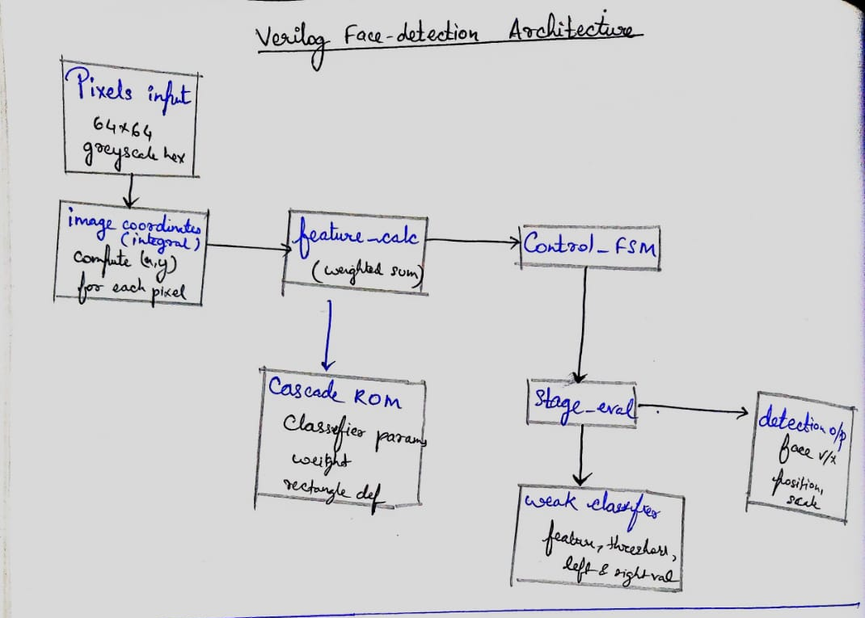
Open CV Model
(ref from research paper)
Verilog Face-Detection Architecture

Slide 7
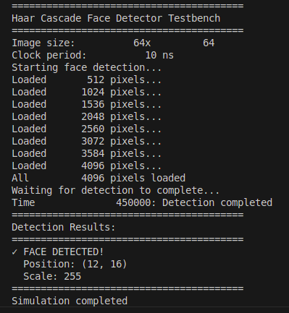
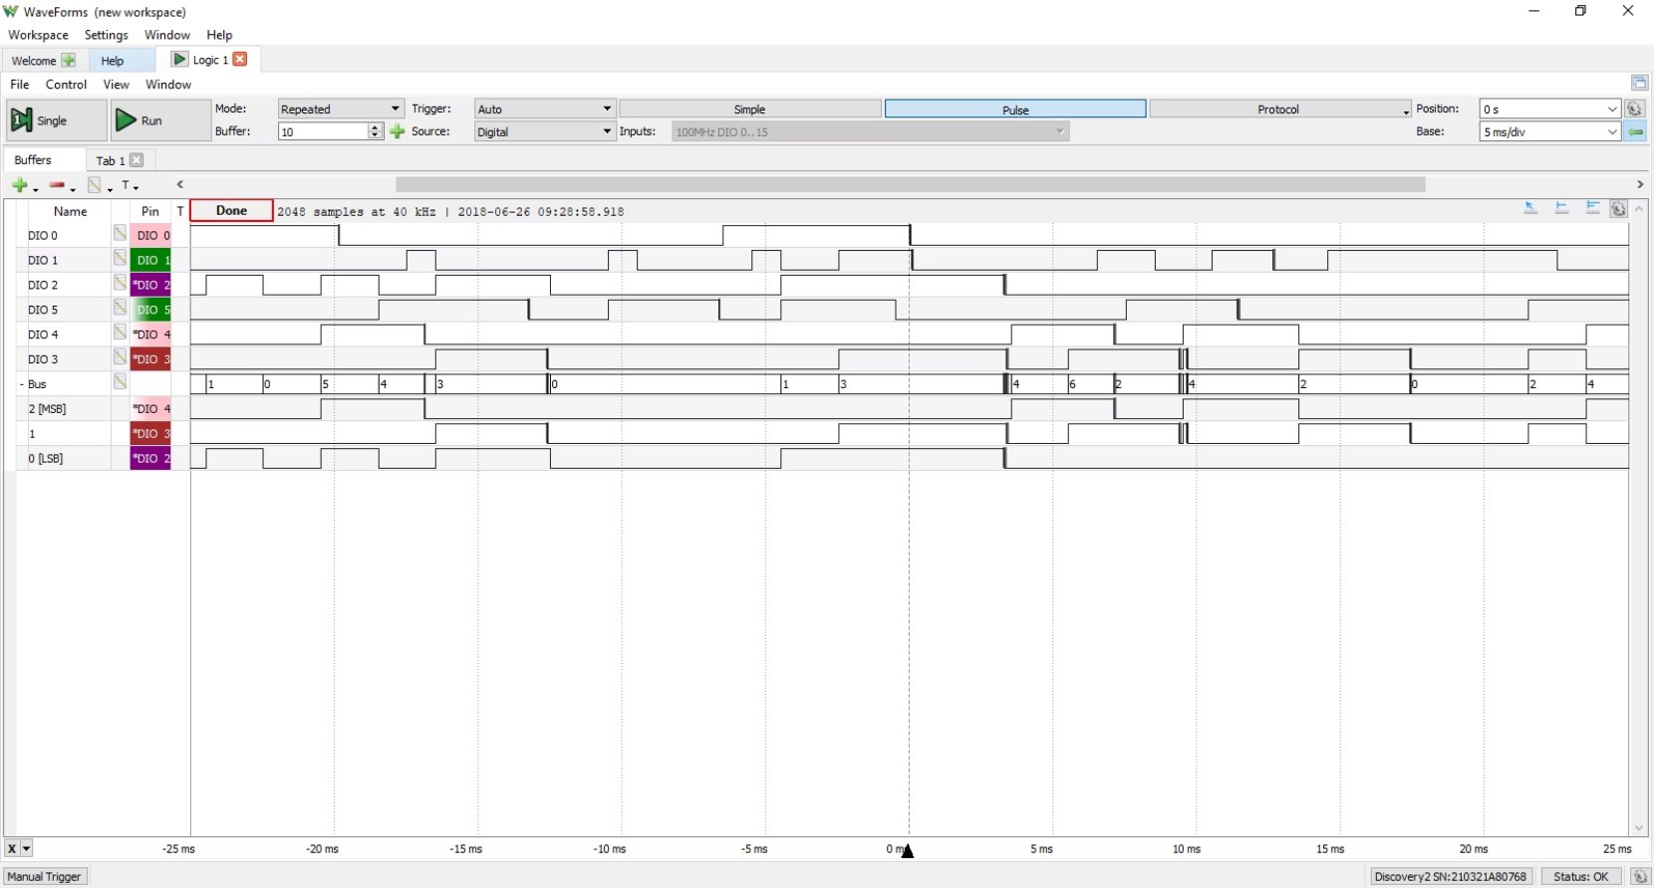
Results & Verification
A comprehensive testbench (using Icarus Verilog and GTKWave) was implemented to drive the design with batch simulation scripts against a library of images, proving robustness.
The simulation successfully validated the functionality of the complete Verilog design on prepared 64x64 test images.
Utilized the CelebA face dataset for extensive validation.

Slide 8
AI Model
2. Selection of AI Model:
Mini-Xception is a lightweight version of the Xception architecture, optimized specifically for Facial Emotion Recognition (FER).
Unlike heavy CNNs, it uses Depthwise Separable Convolutions to drastically reduce computational cost while maintaining good accuracy
Core Task: It takes a grayscale image of a face and classifies it into one of seven emotions: Angry, Disgust, Fear, Happy, Sad, Surprise, Neutral.
Why this model ?
1. High Accuracy with an Extremely Small Model
Achieves ~68–70% FER-2013 accuracy with excellent performance on emotions like Happy (93%) and Neutral (82%).
Very lightweight: only ~60k parameters and 2.8 MB, making it ideal for embedded and real-time systems.
2. Fast and Efficient for Hardware–Software Co-Simulation
Uses Depthwise Separable Convolutions, drastically reducing computation and increasing speed.
Runs in real time on low-power devices (Raspberry Pi, Jetson Nano), making it perfect for integration with our (hardware+ software) pipeline

Slide 9
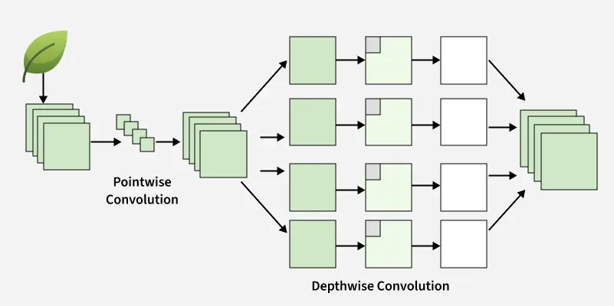
Working of model
Depthwise Separable Convolution:
Depthwise Convolution:
Each input channel is filtered separately using its own small kernel (as shown in the image).
This extracts spatial features like edges and textures without mixing channels.
• Pointwise Convolution (1×1 Conv):
A 1×1 filter is then applied to combine all the depthwise outputs.
This mixes information across channels and produces the final feature maps.

Slide 10
Integration
1. Verilog Testbench Reads .mem → Runs Face Detection
$readmemh loads the OpenCV-generated .mem image into Verilog memory.
The face-detection pipeline (preprocessing → segmentation → integral image → Haar/cascade) processes this input.
2. Verilog Writes Cropped Face to New .mem
After detecting the face, Verilog uses $writememh to save the cropped grayscale face into a new .mem file.
This output .mem becomes the hardware → software handoff for the AI model.
3. Python AI Model Reads .mem → Preprocess → Predict
Python loads the Verilog-generated .mem, reshapes and normalizes it.
The AI model (Mini-Xception) runs inference and outputs the predicted emotion.

Slide 11
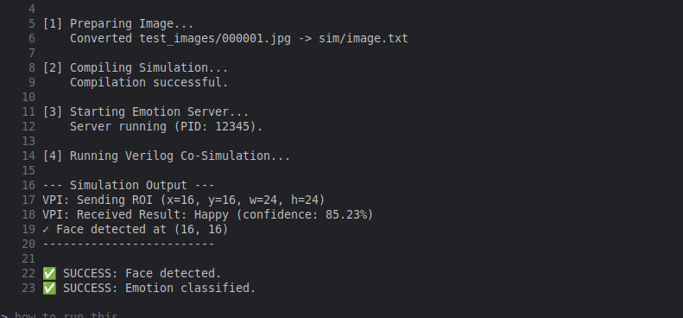

Slide 12
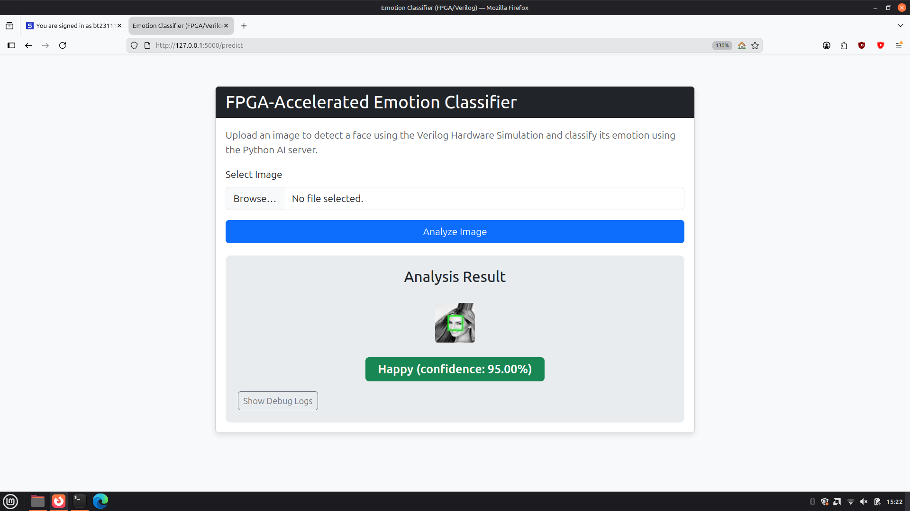

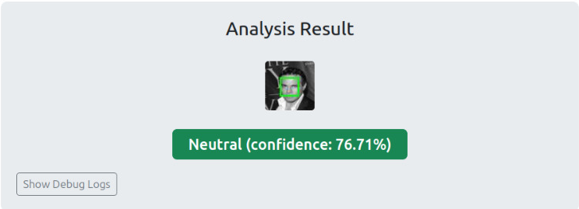

Results

Slide 13



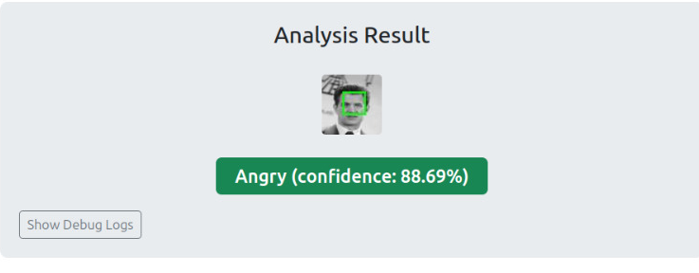
Results

Slide 14
Use - Cases
1. Baby Emotion & Cry Detection
Identifies emotions such as discomfort, hunger, or distress in infants—useful for smart baby monitors and early-alert systems.
2. Driver Monitoring Systems
Detects driver fatigue, stress, or distraction in real time to enhance road safety.
3. Smart Surveillance & Security
Recognizes unusual emotional behavior, improving threat detection and monitoring in public spaces.
4. Human–Computer Interaction (HCI)
Enables emotion-aware applications such as adaptive learning platforms, virtual assistants, and customer service robots.
5. Healthcare & Assistive Technologies
Monitors patient emotional state, stress levels, or depression indicators for improved clinical support.

Slide 15
Future Work
1. FPGA Deployment
Implement the Verilog detection pipeline on FPGA boards to measure hardware accuracy, stability, and resource utilization.
2. On-Chip AI Acceleration
Map Mini-Xception into a quantized CNN accelerator so emotion recognition can run fully on FPGA or SoC hardware.
3. Enhanced Hardware Architecture
Add advanced face detection blocks (lightweight CNNs, multi-scale scanning, depthwise-convolution units) for higher accuracy and robustness.
4. ASIC / Chip-Level Integration
Design a specialized low-power chip combining detection + emotion classification for applications like baby monitors, security devices, and wearable electronics.

Slide 16
Thank You!!

