Slide 1
MINI PROJECT No. 3
ResNet을 이용한 전이 학습
강의 : 산업인공지능개론
학과 : 산업인공지능학과
학번 : 2021254011
성명 : 방창현

Slide 2
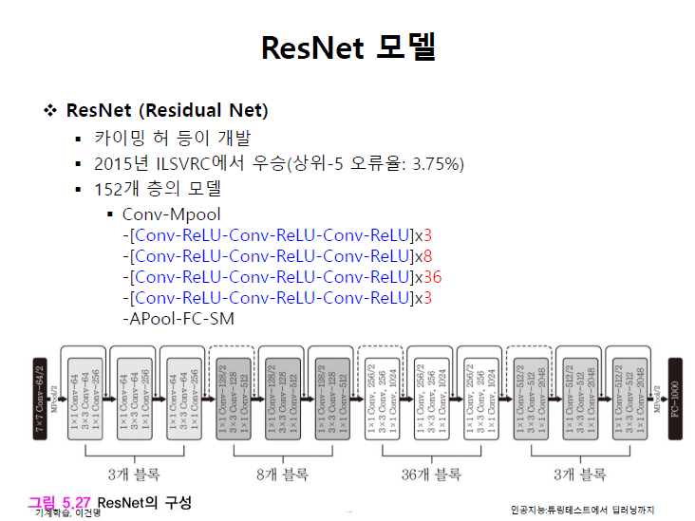
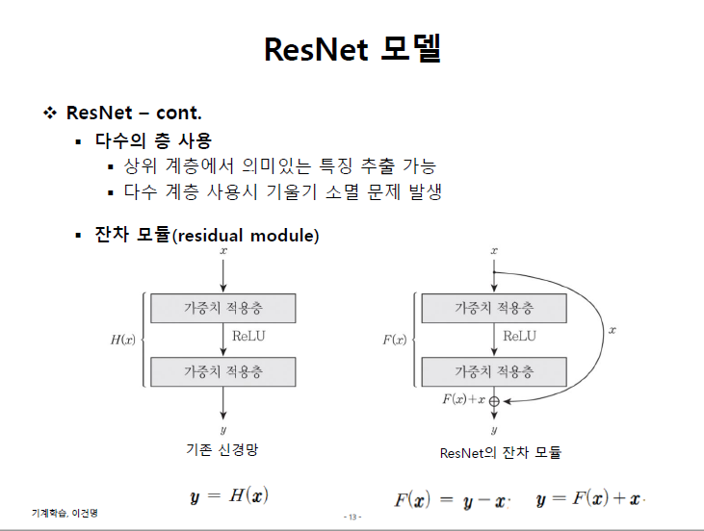
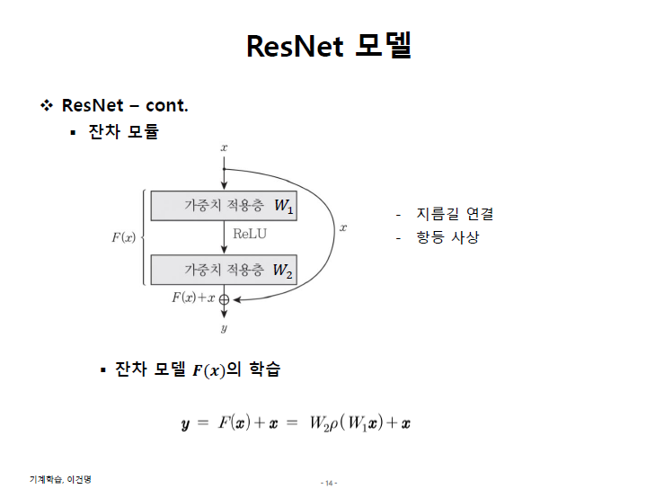
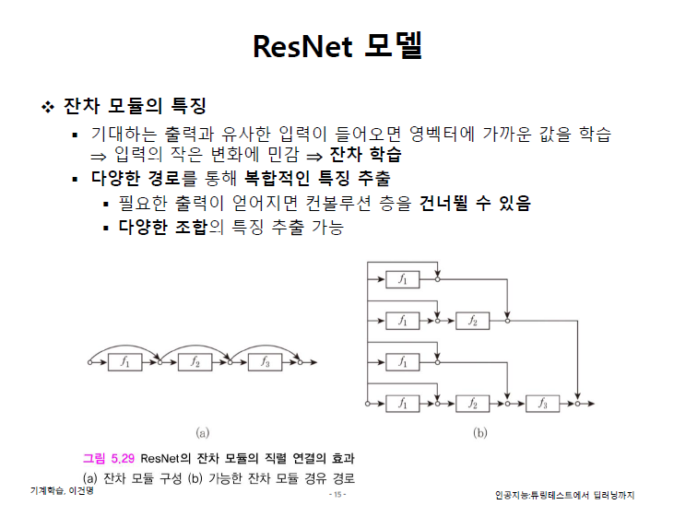
1. ResNet 모델 (물체인식 CNN모델)
(1)
(2)
(3)
(4)

Slide 3
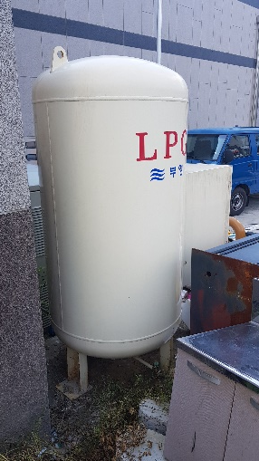
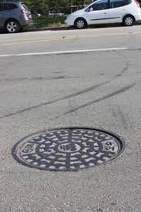
2. 학습 데이터
명칭 | 이미지 | train | val | 설명
가스통 |  | 133장 | 30장 | 충청북도 규제 자유 특구 혁신 사업 육성 실증 및 기술개발 사업 중 가스 안전제어 서비스 개발에 참여하고 있음. 가스시설물의 안전유무를 판단하기 위해서 건물주변의 가스통들을 인식하고 기울기, 이동, 온도 등의 측정하여 위험 유무를 판단함. 이에 가스통 이미지들을 수집.
맨홀 |  | 130장 | 20장 | 가스통 주변의 시설물 중에 맨홀 위치를 파악하고 지도 내 표시.

Slide 4
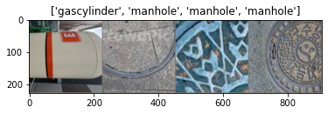
3. imshow

Slide 5






3. visualize_model(model_ft)
Epoch 0/24
----------
train Loss:0.3154 Acc:0.8175
val Loss:0.0024 Acc:1.0000
Epoch 1/24
----------
train Loss:0.1923 Acc:0.9316
val Loss:0.0026 Acc:1.0000
Epoch 2/24
----------
train Loss:0.1774 Acc:0.9430
val Loss:0.0018 Acc:1.0000
Epoch 3/24
----------
train Loss:0.1512 Acc:0.9278
val Loss:0.0037 Acc:1.0000
Epoch 4/24
----------
train Loss:0.1953 Acc:0.9316
val Loss:0.0037 Acc:1.0000
Epoch 5/24
----------
train Loss:0.1799 Acc:0.9316
val Loss:0.0274 Acc:1.0000
Epoch 6/24
----------
train Loss:0.3209 Acc:0.9049
val Loss:0.0015 Acc:1.0000
Epoch 7/24
----------
train Loss:0.2089 Acc:0.9163
val Loss:0.0027 Acc:1.0000
Epoch 8/24
----------
train Loss:0.1134 Acc:0.9696
val Loss:0.0022 Acc:1.0000
Epoch 9/24
----------
train Loss:0.1533 Acc:0.9544
val Loss:0.0025 Acc:1.0000
Epoch 10/24
----------
train Loss:0.2259 Acc:0.9087
val Loss:0.0025 Acc:1.0000
Epoch 11/24
----------
train Loss:0.2110 Acc:0.9278
val Loss:0.0023 Acc:1.0000
Epoch 12/24
----------
train Loss:0.1703 Acc:0.9354
val Loss:0.0029 Acc:1.0000
Epoch 13/24
----------
train Loss:0.2075 Acc:0.9163
val Loss:0.0021 Acc:1.0000
Epoch 14/24
----------
train Loss:0.2043 Acc:0.8973
val Loss:0.0049 Acc:1.0000
Epoch 15/24
----------
train Loss:0.2030 Acc:0.9202
val Loss:0.0025 Acc:1.0000
Epoch 16/24
----------
train Loss:0.1495 Acc:0.9468
val Loss:0.0044 Acc:1.0000
Epoch 17/24
----------
train Loss:0.1071 Acc:0.9658
val Loss:0.0022 Acc:1.0000
Epoch 18/24
----------
train Loss:0.1987 Acc:0.9163
val Loss:0.0027 Acc:1.0000
Epoch 19/24
----------
train Loss:0.1276 Acc:0.9468
val Loss:0.0018 Acc:1.0000
Epoch 20/24
----------
train Loss:0.1494 Acc:0.9354
val Loss:0.0048 Acc:1.0000
Epoch 21/24
----------
train Loss:0.1705 Acc:0.9430
val Loss:0.0029 Acc:1.0000
Epoch 22/24
----------
train Loss:0.1787 Acc:0.9316
val Loss:0.0023 Acc:1.0000
Epoch 23/24
----------
train Loss:0.1341 Acc:0.9430
val Loss:0.0029 Acc:1.0000
Epoch 24/24
----------
train Loss:0.1541 Acc:0.9506
val Loss:0.0018 Acc:1.0000
Training complete in 26m 11s
Best val Acc: 1.000000

Slide 6





4. visualize_model(model_conv)
Epoch 0/24
----------
train Loss:0.3869 Acc:0.8099
val Loss:0.0115 Acc:1.0000
Epoch 1/24
----------
train Loss:0.3036 Acc:0.8897
val Loss:0.0144 Acc:1.0000
Epoch 2/24
----------
train Loss:0.2771 Acc:0.8631
val Loss:0.0078 Acc:1.0000
Epoch 3/24
----------
train Loss:0.2585 Acc:0.8935
val Loss:0.0041 Acc:1.0000
Epoch 4/24
----------
train Loss:0.2386 Acc:0.8935
val Loss:0.0037 Acc:1.0000
Epoch 5/24
----------
train Loss:0.2840 Acc:0.8897
val Loss:0.0037 Acc:1.0000
Epoch 6/24
----------
train Loss:0.1892 Acc:0.9202
val Loss:0.0033 Acc:1.0000
Epoch 7/24
----------
train Loss:0.2607 Acc:0.8783
val Loss:0.0049 Acc:1.0000
Epoch 8/24
----------
train Loss:0.2346 Acc:0.8973
val Loss:0.0031 Acc:1.0000
Epoch 9/24
----------
train Loss:0.1911 Acc:0.9087
val Loss:0.0029 Acc:1.0000
Epoch 10/24
----------
train Loss:0.1023 Acc:0.9658
val Loss:0.0038 Acc:1.0000
Epoch 11/24
----------
train Loss:0.2047 Acc:0.9163
val Loss:0.0042 Acc:1.0000
Epoch 12/24
----------
train Loss:0.1593 Acc:0.9392
val Loss:0.0039 Acc:1.0000
Epoch 13/24
----------
train Loss:0.1224 Acc:0.9430
val Loss:0.0043 Acc:1.0000
Epoch 14/24
----------
train Loss:0.1945 Acc:0.9163
val Loss:0.0028 Acc:1.0000
Epoch 15/24
----------
train Loss:0.2015 Acc:0.9125
val Loss:0.0054 Acc:1.0000
Epoch 16/24
----------
train Loss:0.1340 Acc:0.9544
val Loss:0.0034 Acc:1.0000
Epoch 17/24
----------
train Loss:0.1752 Acc:0.9240
val Loss:0.0041 Acc:1.0000
Epoch 18/24
----------
train Loss:0.1578 Acc:0.9316
val Loss:0.0032 Acc:1.0000
Epoch 19/24
----------
train Loss:0.1541 Acc:0.9354
val Loss:0.0042 Acc:1.0000
Epoch 20/24
----------
train Loss:0.1841 Acc:0.9202
val Loss:0.0044 Acc:1.0000
Epoch 21/24
----------
train Loss:0.1694 Acc:0.9240
val Loss:0.0038 Acc:1.0000
Epoch 22/24
----------
train Loss:0.2292 Acc:0.8973
val Loss:0.0048 Acc:1.0000
Epoch 23/24
----------
train Loss:0.2256 Acc:0.8859
val Loss:0.0035 Acc:1.0000
Epoch 24/24
----------
train Loss:0.1582 Acc:0.9392
val Loss:0.0040 Acc:1.0000
Training complete in 13m 42s
Best val Acc: 1.000000

