Slide 1
Write detailed user stories for a.) a new dog to sign up for the app and b.) a dog to be able to become friends with another dog (for instance, a dog could make a friend request, and another dog could accept it, and so on) Think of at least one original story to add to the DogChat app. List any new views for DogChat that your new user stories require.

Slide 2
Story 1: A new dog to sign up for the app
User can sign up for a new profile
Option to input name and upload a profile picture
User can input interests, birthday, and other relevant information
User can confirm information and create profile

Slide 3
Story 2: A dog to be able to become friends with another dog
Search bar at the top of the page where a user can search the names of other users on the app
User can click request button request to become friends with another dog on the other dog’s profile
Other dog has a friend requests page where they have the option to accept or deny friend requests

Slide 4
Story 3: A dog can choose if they want their post to be visible to the public or to friends only
When making a post, there is a dropdown where a user can toggle their privacy settings
Option to update the privacy settings of past posts.

Slide 5
Views:
Sign up page
Friend request page
Post page

Slide 6

DogChat
Sign Up
Login
Sign Up
Upload a profile photo: Upload a cover photo:
Name: Teddy
Birthday: 03/03/2019
Location: Brooklyn, NY
Interests: Playing fetch, getting belly rubs
Breed: Yorkshire Terrier
Sign Up

Slide 7


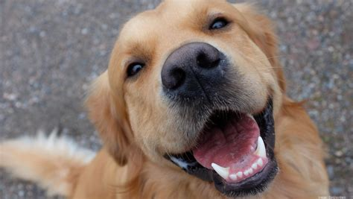
DogChat
Mr. Scruffles
Logout
Mr. Scruffles
Lives in Bronx, NY
Is a Golden Retriever
Is 3 Years Old
Request Friend

Slide 8



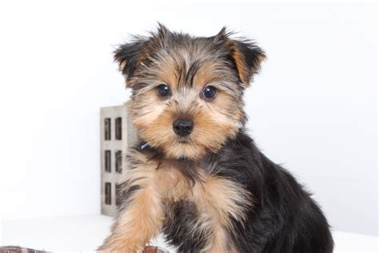
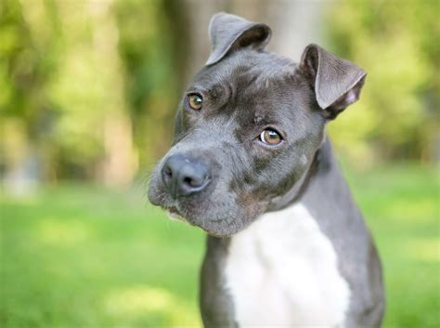
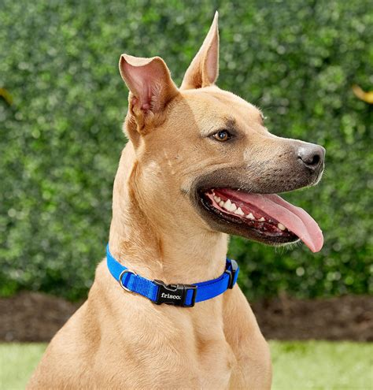
DogChat
Logout
Friend Requests
Teddy
Roosevelt
Bingo
Accept
Decline
Accept
Decline
Accept
Decline

Slide 9



DogChat
Logout
New post
Public
I could really go for some bacon right about now
Post
My Feed
Just played fetch!
Just watched my owner pick up my poop!
Went to the store for some new treats!

