Slide 1
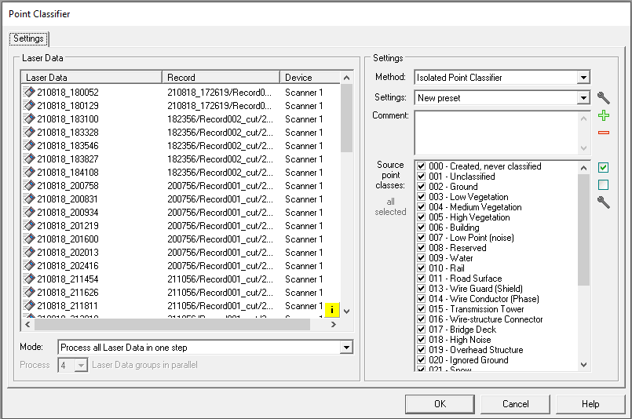
POINT CLASSIFIER – ISOLATED POINT FILTER
Complete the tasks as per the data processing wizard. Prior to running the RiPrecision - remove the isolated points
Open a new VIEW by selecting “ADD”
Add a new View – Select View Type (eg. Reflectance, scaled) <OK>. A new blank View opens.
Drag and drop a single record (or the whole RECORDS folder) into the window. Best to do single in tis case.
View Inspector (right side of screen) will populate with those strips loaded.
Go to TOOLS menu and select Point Classifier.
METHOD: Choose Isolated Point Classifier (“Ground” and “Building and Vegetation” require separate license)
The goal of this method is to find points that have no or just a few neighboring points within a certain radius (noise points).
Parameters:
Search radius R [m] , Maximum neighbor count N_max , Target class.
Algorithm: Each point p of the point cloud is examined:
Define sphere S=S(p,R) of radius R centered at p
Determine number N of neighboring points q (q not equal p) inside S
If N <= N_max, then classify p as "isolated point" (i.e. move it to class C)
R must be a positive value. N_max must be a non-negative value.

Slide 2
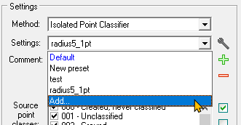
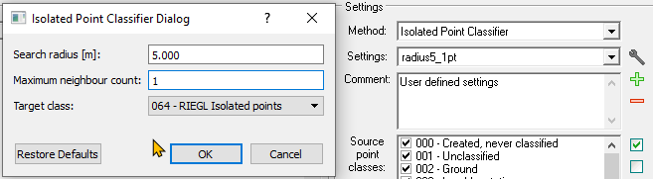
POINT CLASSIFIER – ISOLATED POINT FILTER con’t
Choose Settings: Default are not able to be changed.
If Default settings do not work “Add” (green plus sign) choose a name……
Select new search radius and neighbor count/ Leave Target class as “Riegl Isolated Points” <ok>
MODE: “process all data in one step”
Select ALL Source Point Classes
<OK> and classification will begin.

Slide 3
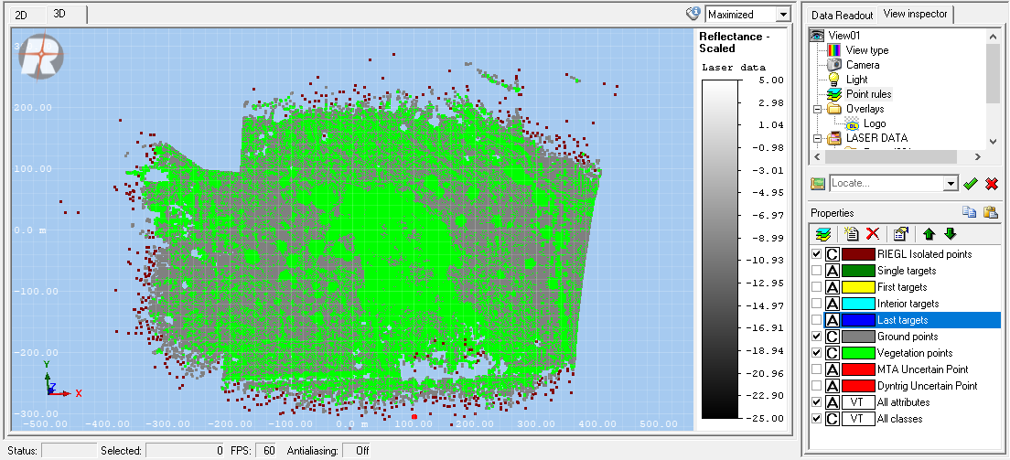
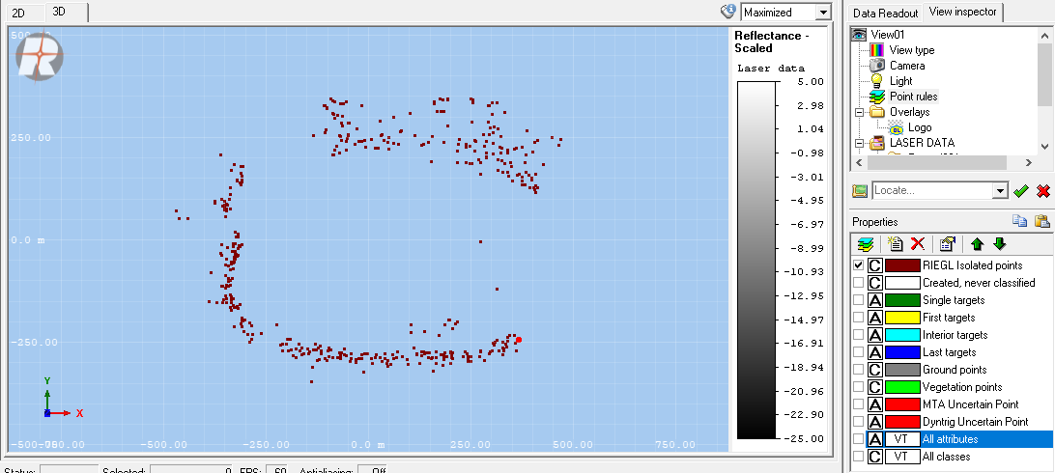
The view will go blank while processing. When complete click VIEW from PROJECT window (left side) and the View Inspector window from right side will populate.
Highlight point rules and the properties window will populate
Then double click the “VIEW” in the View Inspector window and the main display will show the data.
Right click the POINT RULES and select “create rules from point scans”
ALL layers will show including the Isolated point rules.
Uncheck all except isolated points to view separately
If NOT happy with results…delete View (BEFORE YOU DELETE PTS) from left side project window and change settings and repeat steps
Any modifications completed on the data will be permanent. Once you delete points they are gone. (reprocess will reinstate)

Slide 4

If happy with results right click in the main display or choose from the top window icon ribbon and choose “selection mode” from menu
Fence the points and they will highlight in YELLOW
Now UNSELECT the selection mode using the ICON in the top bar (STAR with ARROW) **important**
Now you can use the RED X to delete the isolated points. (YOU CANNOT DELETE WHILE IN SELECTION MODE)…OR
Right click VIEW in project window and Delete. Data strip will be saved with in the project.

Slide 6
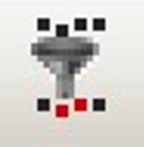
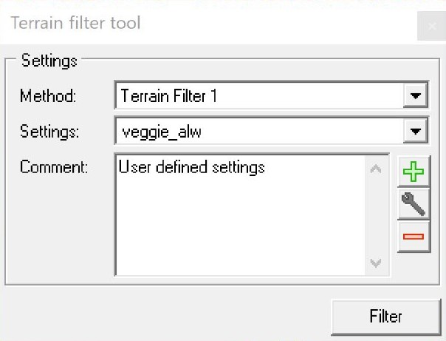
TERRAIN FILTER - RiProcess
Complete the tasks as per the data processing wizard. Remove isolated points and run RiPrecision.
Add a new View – Select View Type (eg. Height,scaled) <OK>. A new blank View opens.
Drag and drop a single record or the whole folder into the window.
View inspector (right side of screen) will populate with those strips loaded.
Default is 2D – switch to 3D. click in screen and classification menu icons appear at top
Choose terrain filter tool method is the Terrain Filter1: choose settings:
Vegetation and Car Noise are locked and not editable. Click the wrench to view the settings
To add a new filter with different settings click the green plus and enter values.
Adjust the parameters based on the following:

Slide 7
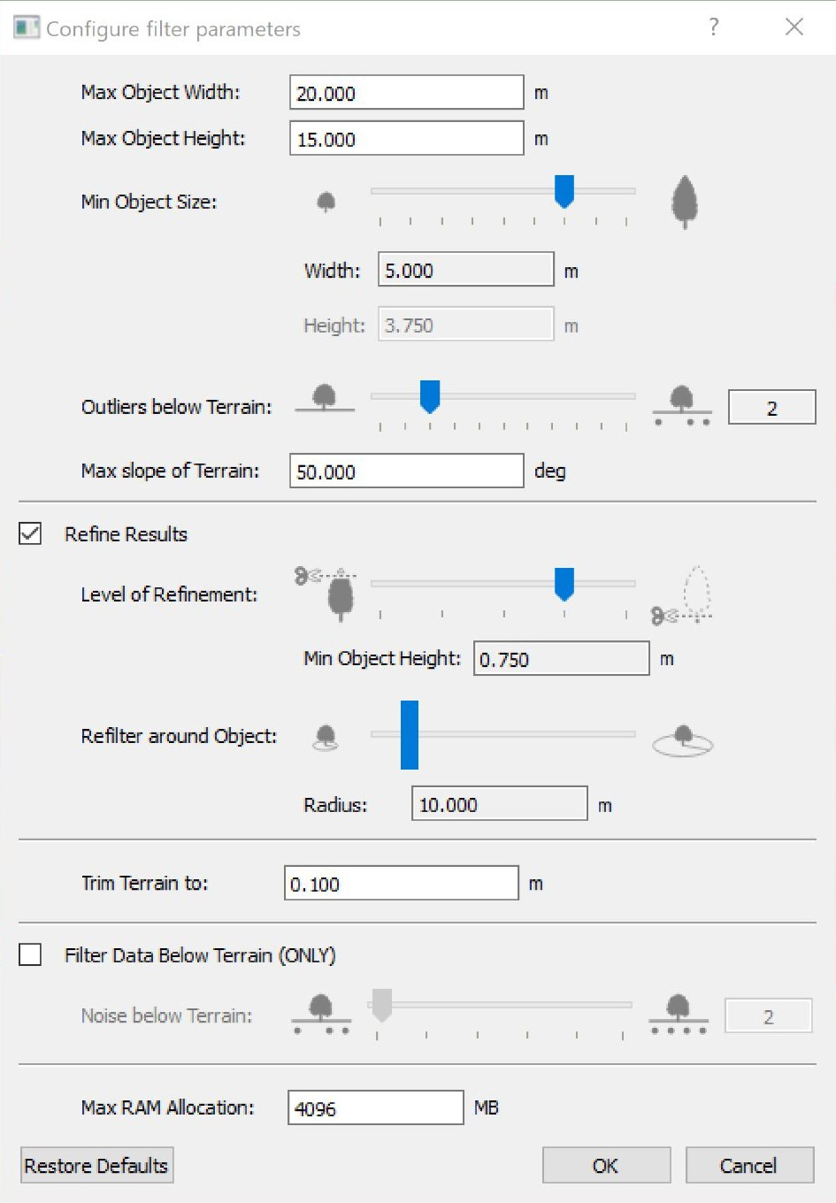
TERRAIN FILTER – RiProcess con’t
Max Object Width: Solid objects (i.e. being not penetrable by the laser scan) up to this width can be considered by the filter. Whether they are actually filtered, depends on the value of 'Max. Object Height'.
Max Object Height: A solid object taller than this value is filtered if its width does not exceed the value 'Max. Object Width'.
Min Object Size: This parameter determines how detailed the filter works. Depending on its value, more or less levels of details (LoDs) are considered. The parameters 'Width' and 'Height', which correspond to the finest LoD, are calculated. Solid objects smaller than 'Width' are filtered if they are taller than 'Height'.
Outliers below Terrain: This parameter allows to consider outliers below the terrain. The more of them are expected in the data, the higher its value should be selected.
Max slope of Terrain: This parameter specifies the slope of the terrain, up to which the filter shall be applied. A value of 90° means that the filter is applied everywhere, whereas a value of < 90° prevents steep areas from being filtered.
Refine results: This option is recommended for filtering objects, whose width decreases with height (e.g. a crawler crane). If selected, a second filter step is carried out in order to filter lower parts of objects that have been omitted by the first filter step. In this second filter step, only areas are considered, which are close to areas where off-terrain points have already been found by the first step.
Level of Refinement: This parameter determines the height tolerance used for the refinement filter step. The height-width ratio of filterable objects is more or less reduced compared to the first filter step. The lower the value is specified, the lower objects can be filtered (given the same object width).
Refilter around Object: Use this parameter to specify the areas for the refinement filter step. The larger the value is specified, the larger the neighborhood around the previously filtered area is selected.
Trim Terrain to: In a final step, points outside a vertical tolerance band above and below the terrain are considered as outliers and classified as off-terrain points. For this parameter, a value equal or smaller than 'Min. Object Height' is recommended.
Filter data below Terrain (ONLY): This option may be used for removing artifacts below the terrain (e.g. mirrored surfaces due to reflection on water surfaces).
Noise below Terrain: If the option 'Filter data below Terrain only' is used, this parameter replaces the parameter 'Outliers below Terrain'. It has the same meaning than the latter one, but higher values may be specified.
Max RAM Allocation: Maximum size of memory in megabytes being used. Based on this size, the number of points fitting in the memory is estimated. If this point number is exceeded, a temporary file on the disk is used for swapping data, which significantly slows down the process.

Slide 8
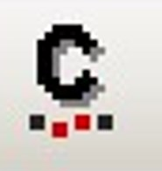
TERRAIN FILTER con’t
Once set save the new settings and choose “filter”.
Results will show in the view window and appear as YELLOW (these points are selected)(colors can be modified in Tools>Options>4.Visualizations>4.8 View Tools)
Open the classification tool and choose the Point Class desired eg: #5 high vegetation
Choose apply and the properties window populates with layers. Vegetation points now have a check mark and point color now matches property window color.
Right click “Point Rules” and select ”Create Point Rules from Scans”
Now you can deselect Vegetation and use the selection mode (either polygon or fence) to select all the GROUND. They will go yellow - with classification tool still open choose the most appropriate class eg #2 Ground hit apply.
Right click “Point Rules” and select ”Create Point Rules from Scans”
Now you have vegetation and ground classified. If you want to export – turn off all layers not wanted and right click data export data is at bottom of list. This will take you through the normal export windows.
IF the menu does not appear make sure the selection mode is turned OFF. Try again.
**NOTE** once you load strips into a view window and manipulate it only the data in the window is modified. Original strips listed under RECORDS are not modified. If some thing is incorrect delete view window and open another and load same strips(s) in again and redo.
NOTE: If you only want use terrain tool on one small area of a strip then open Selection Mode and choose area with polygon. The area will become highlighted, Run terrain filter then open classification tool and pick a suitable class

