Slide 1

ONTARIO SCHOOL RESEARCH PROJECT
Amy Dryden, Alessandro Mori, Khemaka Oo, Arti Bhatia

Slide 2
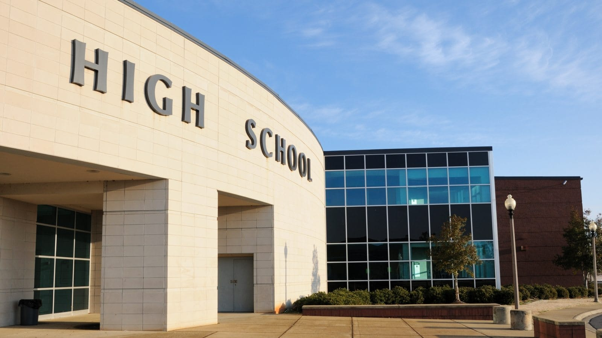
Our Goal
We wanted to research how potential life decisions that youth take regarding their educational careers.
We decided to geographical look at specially Ontario and schools within this province.

Slide 3
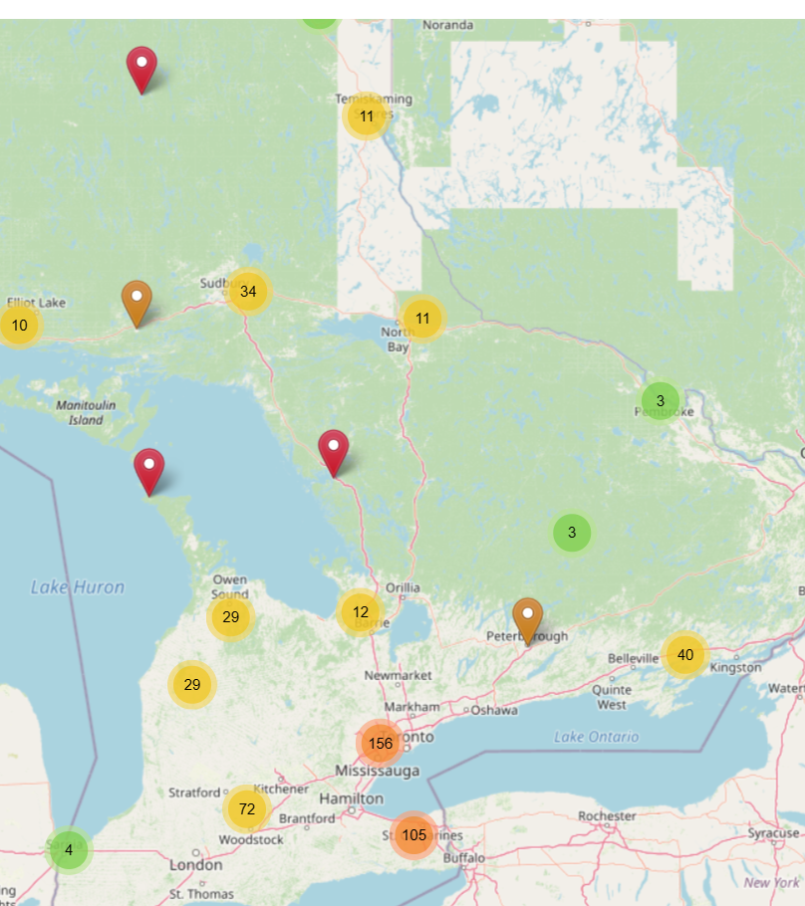
MAps
Streetmap showing Elementary and Secondary School markers.

Slide 4
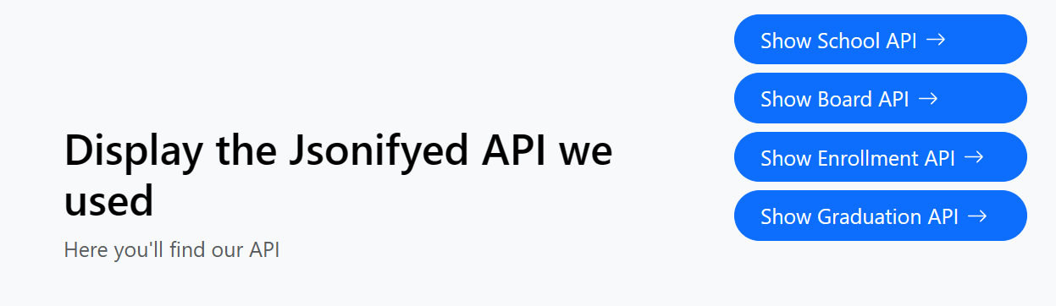
Jsonifyed data
We created 4 APIs related to Ontario School Data.
Most data sources related to Ontario Schools were collected from government databases.

Slide 5

Enrollment and Graduation Rates in Ontario have been high within the last 4-5 years.

Slide 6
Enrollment rates

Slide 7
Graduation rates

Slide 8
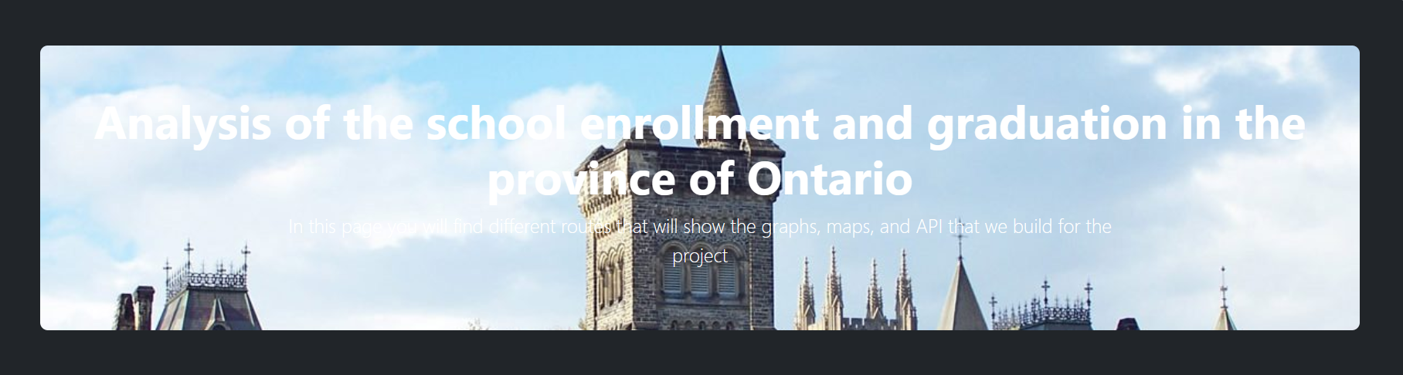
HTML webpage LINK
Let us demonstrate by giving you a quick tour of our webpage.

