Slide 1
CAPSTONE PROJECT • STATUS UPDATE
Online Retail
$24.9M
Performance Review
revenue analyzed
9 charts
Sales, customers, and seasonality across 2009-2011
across 24 months of data
PREPARED BY
George | Capstone Analytics
May 2026

Slide 2
EXECUTIVE SUMMARY
What the data is telling us
$24.9M
92%
$1.85M
30.5%
Total revenue (Dec 2009 – Dec 2011)
Revenue from United Kingdom
Peak month (Nov 2011, holiday lift)
Loyal customers (6+ orders)
HIGHLIGHTS
Strong holiday seasonality. Revenue more than doubles from quiet months (Feb) to peak months (Nov), with a clear two-year ramp into the autumn buying season.
UK is the home market — by a wide margin.
International revenue is concentrated in just a handful of European countries; everything outside the EU is a rounding error today.
A small group of customers drives a disproportionate share of revenue.
Top 2 customers alone account for ~$1.4M, and 30%+ are repeat buyers — a signal that retention efforts pay off.
Online Retail Capstone • Status Update
2 / 8

Slide 3
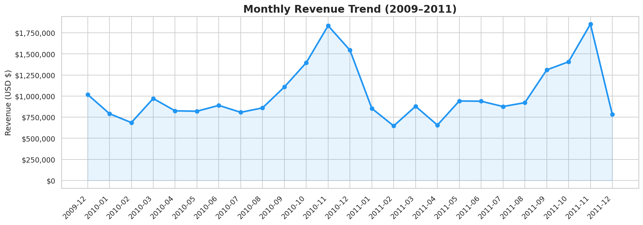
REVENUE TREND
Two strong holiday peaks, otherwise steady baseline
KEY INSIGHTS
Nov 2010: $1.83M
Nov 2011: $1.85M
Holiday lift is consistent year over year and gives us a reliable forecast anchor.
September through November is the demand ramp — staff and inventory should be planned around it.
Online Retail Capstone • Status Update
3 / 8

Slide 4
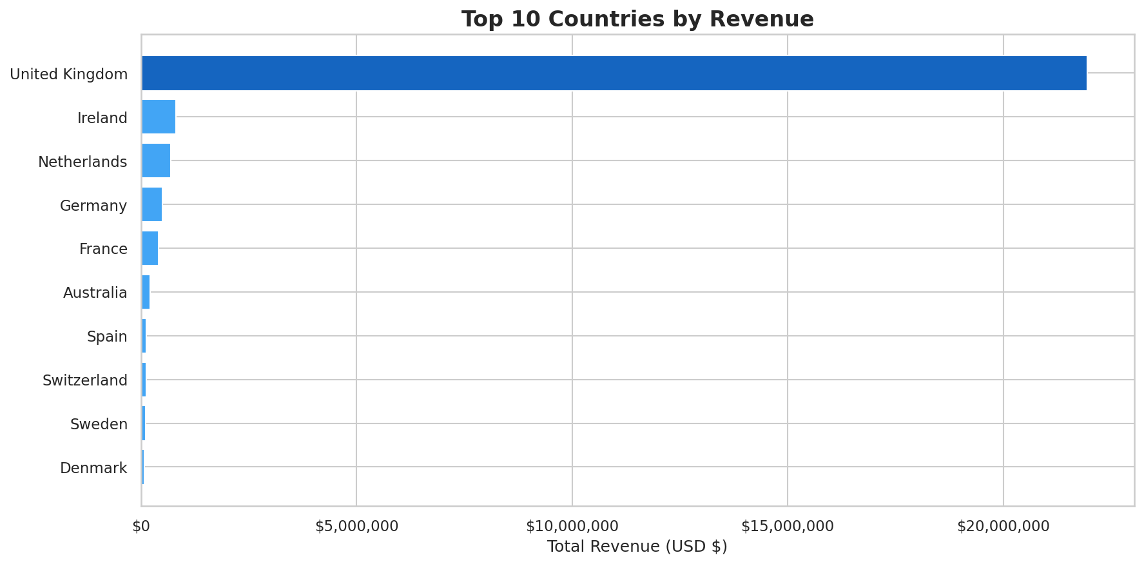
GEOGRAPHIC MIX
The UK is the business — Europe is the next frontier
92%
of revenue is UK-based
5
European countries make up the bulk of intl
<1%
share for markets outside Europe
Online Retail Capstone • Status Update
4 / 8

Slide 5
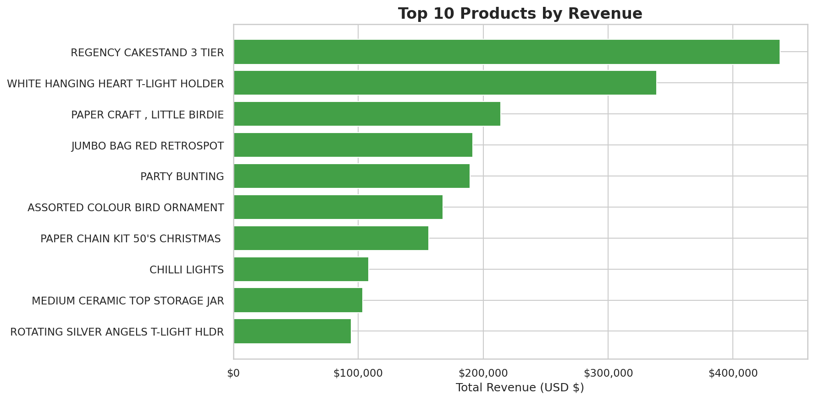
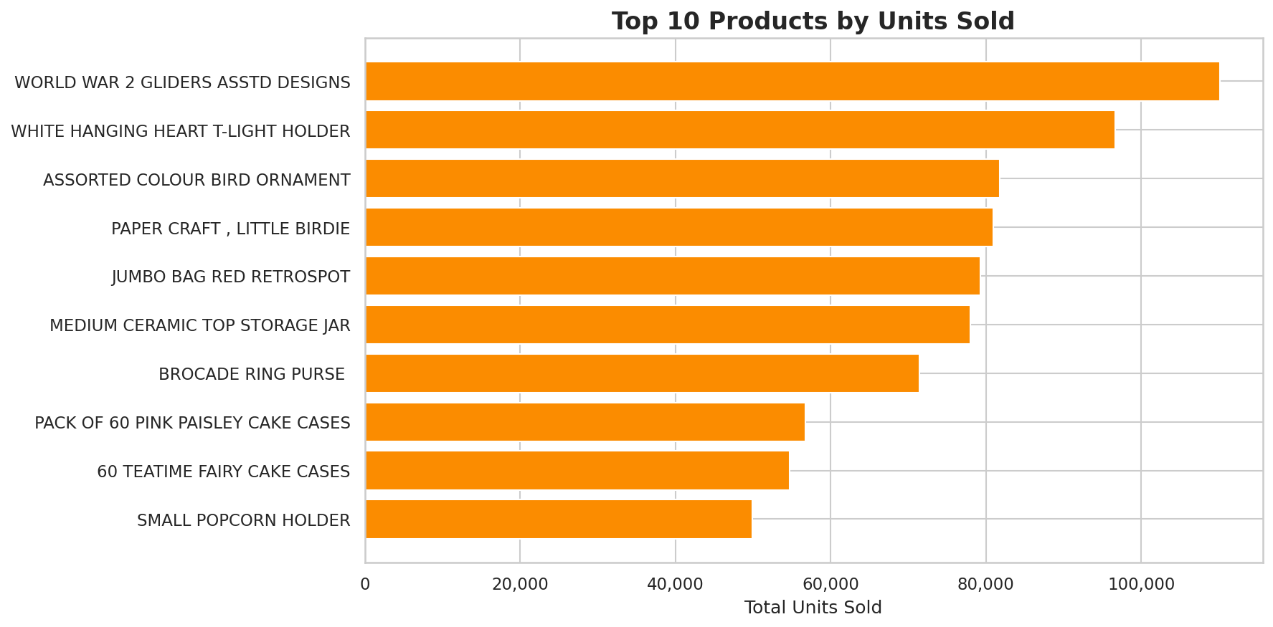
PRODUCT MIX
Best sellers by money — and by volume — aren't the same
Top 10 by Revenue
Top 10 by Units Sold
TAKEAWAY Regency Cakestand is the revenue king ($430K) but the WW2 Gliders move the most units (~110K) — different merchandising plays for each.
Online Retail Capstone • Status Update
5 / 8

Slide 6
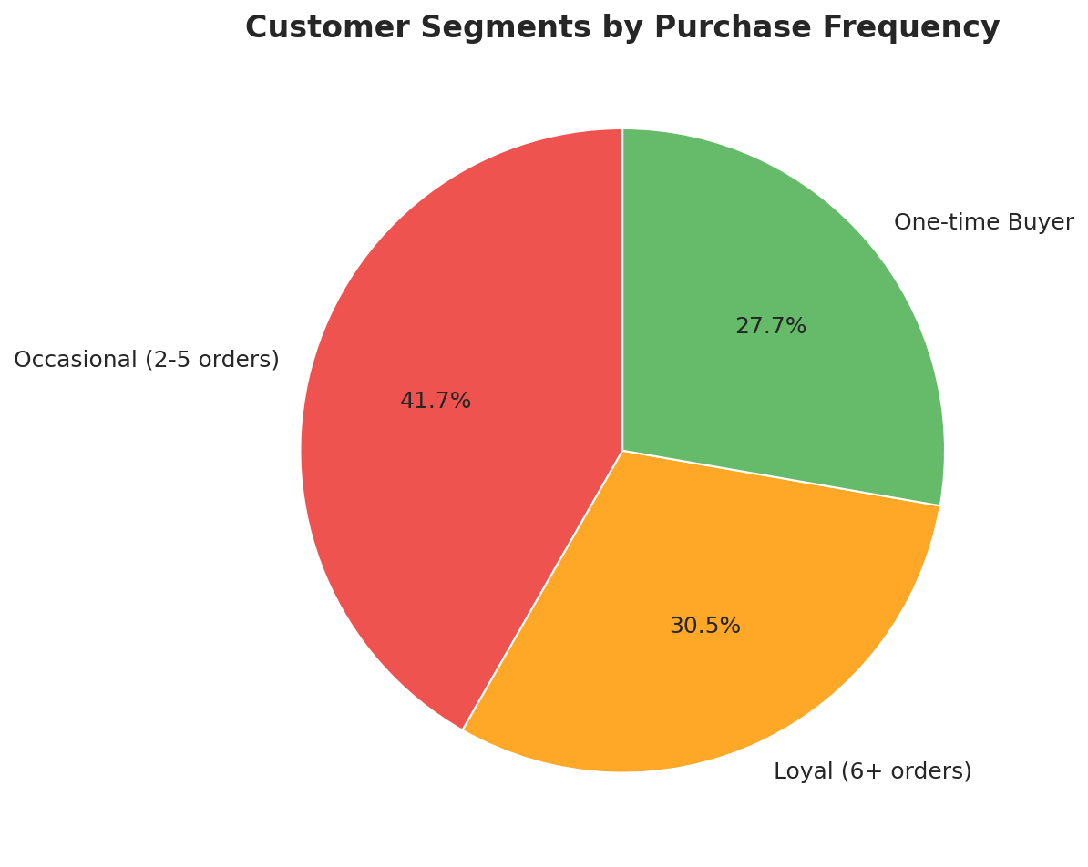
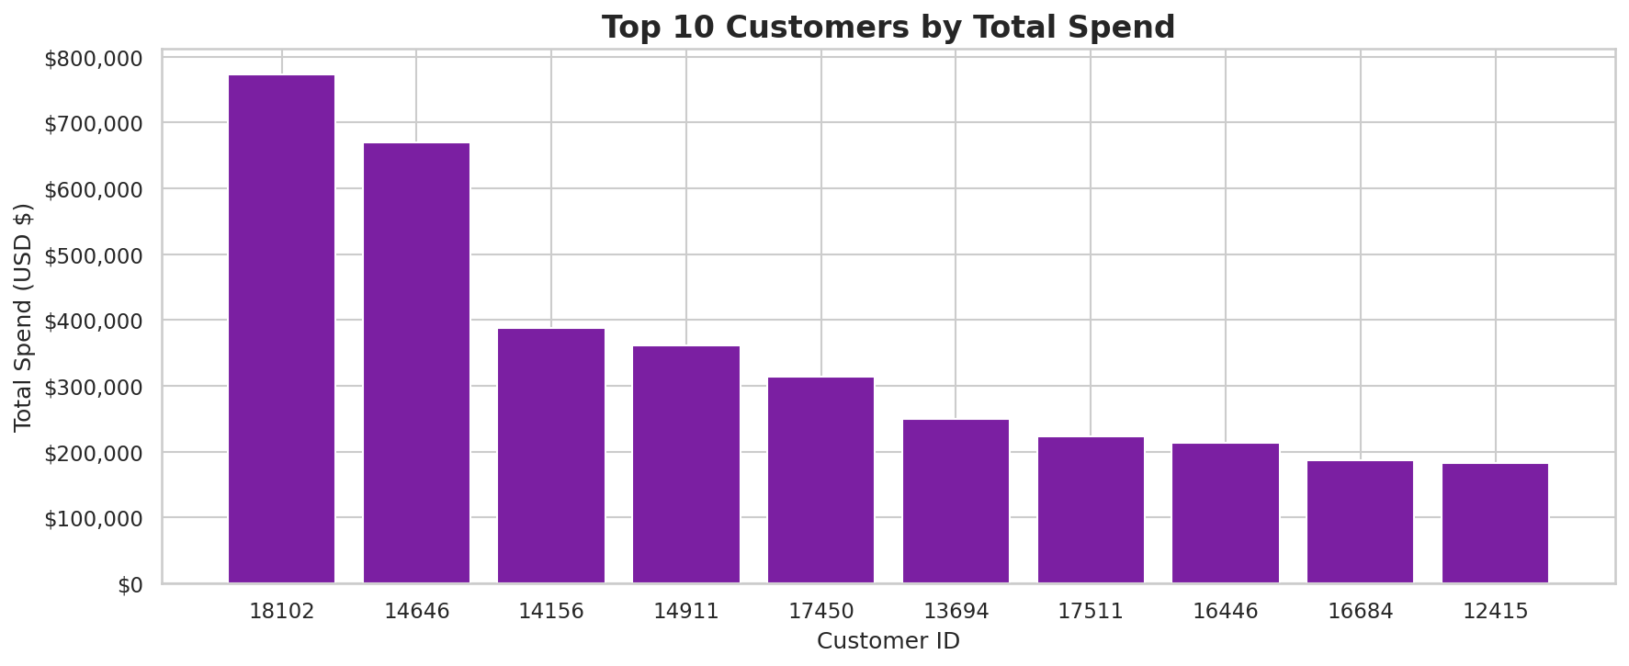
CUSTOMERS
Repeat buyers carry the business
Customer Mix by Order Frequency
Top 10 Customers by Spend
TAKEAWAY Loyal + Occasional buyers are 72% of the base. The top 2 customers alone spend ~$1.4M — a small B2B reseller cohort worth a dedicated account program.
Online Retail Capstone • Status Update
6 / 8

Slide 7
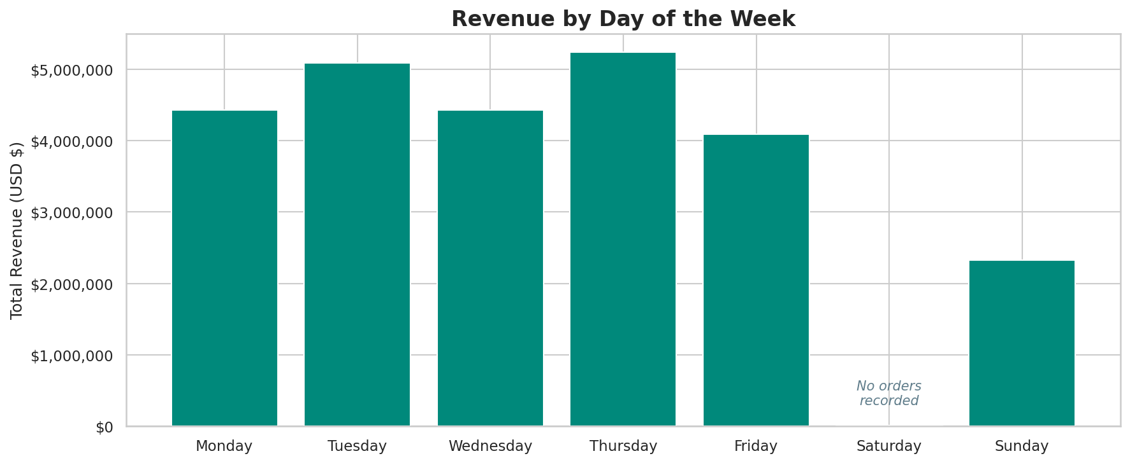
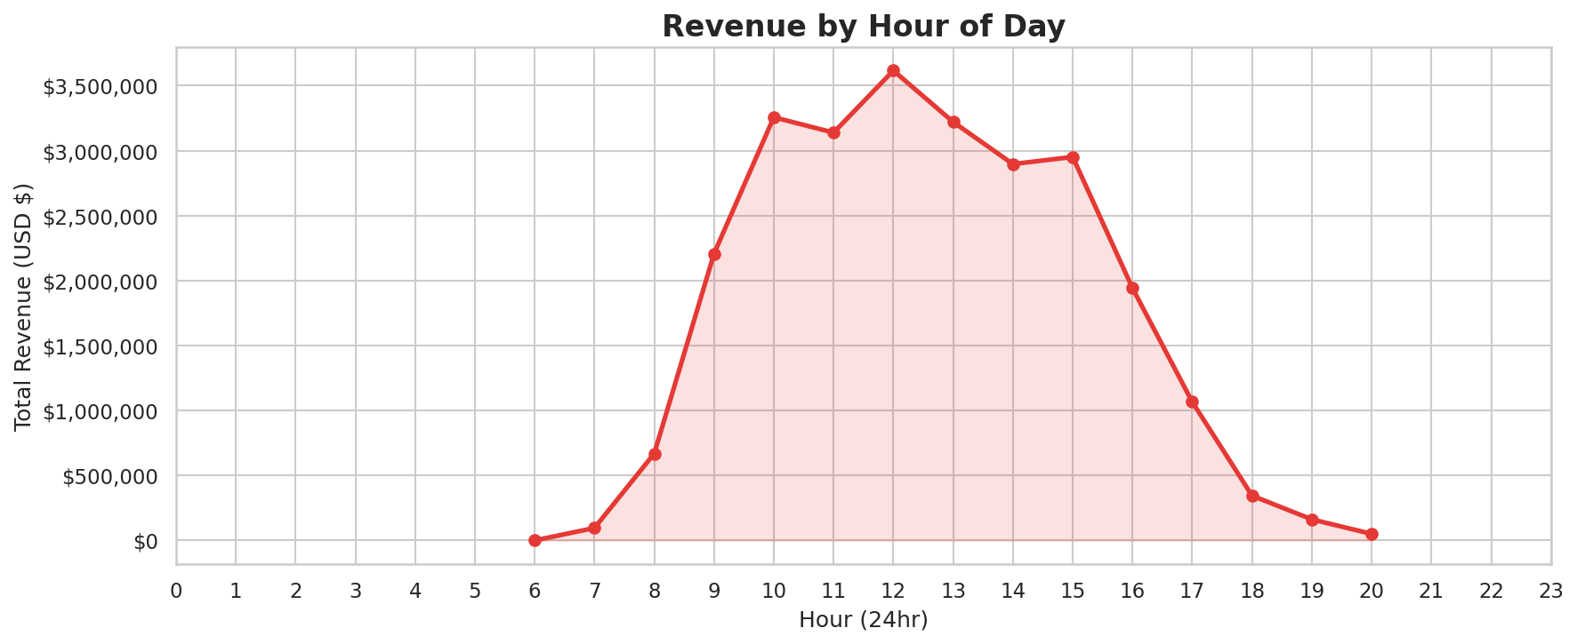
ORDER PATTERNS
B2B-style buying rhythm: midweek mornings
Revenue by Day of the Week
Revenue by Hour of Day
TAKEAWAY Tue-Thu drives the week; Saturday is dead. Demand peaks 10am–3pm — staff support, ads, and email sends should be timed accordingly.
Online Retail Capstone • Status Update
7 / 8

Slide 8
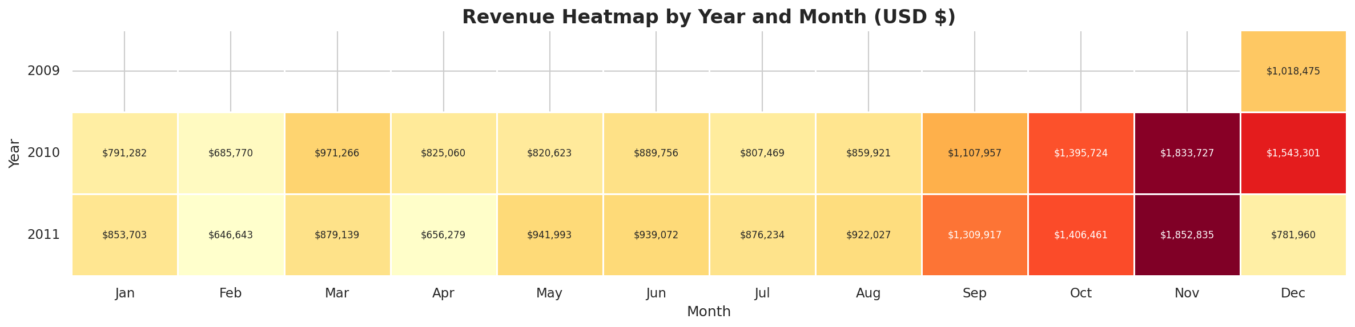
RECOMMENDATIONS • WHAT'S NEXT
Three plays for the next quarter
1
Double down on Q4
Build a dedicated Sept–Nov campaign plan. The lift is reliable; the question is how much we can amplify it.
2
Grow the EU 5
Ireland, Netherlands, Germany, France, Australia already convert. Localized ads + EU shipping promos can compound.
3
VIP the top 2%
A named-account program for the top spenders (likely small resellers). Personal outreach + early access to new SKUs.
Revenue heatmap — November is the moment every year.
Online Retail Capstone • Status Update
8 / 8

