Slide 1
Python
Hands on
Baseado nos materiais
Henning Schulzrinne
Guido van Rossum (Criador do Python)
https://gvanrossum.github.io

Slide 2
Roteiro
Apresentar
  Revisar conceitos de Python
Hands on
  Projeto HUB

Slide 3
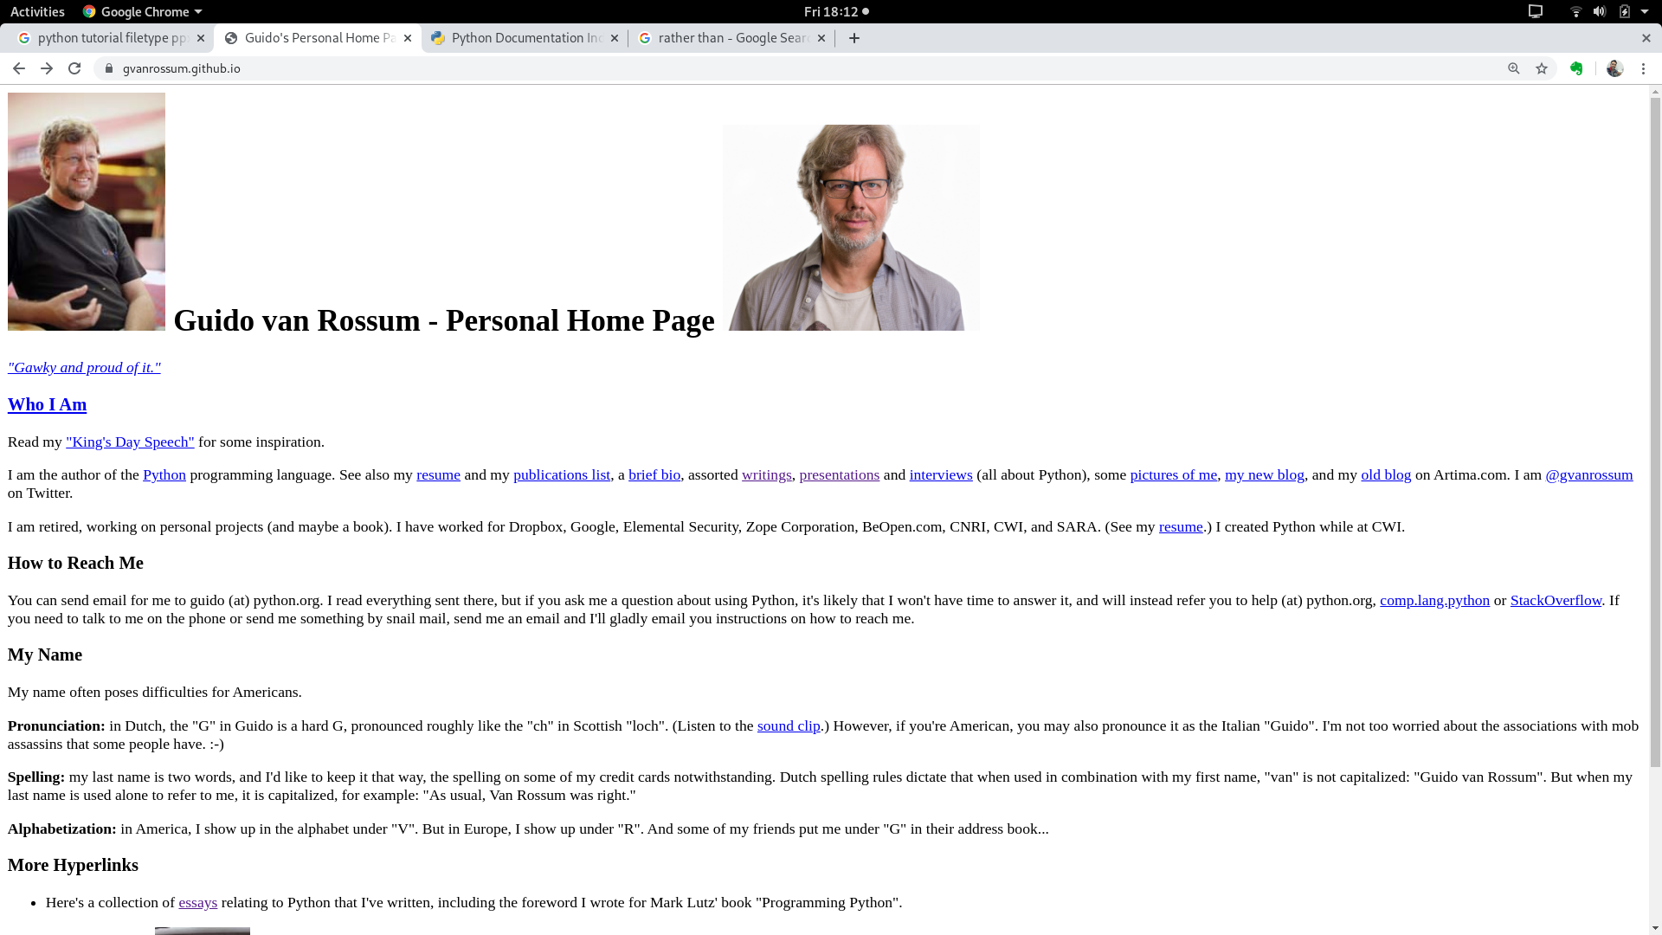

Slide 4
Introdução
Linguagem de script (scripting/extension)
  origina-se ~1991
Herança: teaching language (ABC)
  Tcl: shell
  perl: string (regex) processing
Linguagem Orientada a Objetos
  add-on (OOTcl)

Slide 5
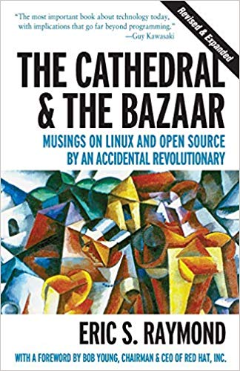
“A educação em Ciência da Computação não pode tornar ninguém um especialista em programação assim como estudar pincéis e pigmentos não pode criar um pintor especialista”
https://www.freecodecamp.org/news/what-programming-language-should-i-learn-first-19a33b0a467d/

Slide 6

http://tiny.cc/3kgpgz

Slide 7

http://tiny.cc/6igpgz

Slide 8
Python Filosofia
Coerencia
  Not hard to read
  Write
  Maintain
Poderosa – Mineração de dados e IA
Escopo
  Rápido desenvolvimento
Objetos
Integração
  Sistemas Hibridos

Slide 9
Python Features (1/2)
no compiling or linking | rapid development cycle
no type declarations | simpler, shorter, more flexible
automatic memory management | garbage collection
high-level data types and operations | fast development
object-oriented programming | code structuring and reuse, C++
embedding and extending in C | mixed language systems
classes, modules, exceptions | "programming-in-the-large" support
dynamic loading of C modules | simplified extensions, smaller binaries
dynamic reloading of C modules | programs can be modified without stopping
Lutz, Programming Python

Slide 10
Python Features (2/2)
Lutz, Programming Python
universal "first-class" object model | fewer restrictions and rules
run-time program construction | handles unforeseen needs, end-user coding
interactive, dynamic nature | incremental development and testing
access to interpreter information | metaprogramming, introspective objects
wide portability | cross-platform programming without ports
compilation to portable byte-code | execution speed, protecting source code
built-in interfaces to external services | system tools, GUIs, persistence, databases, etc.

Slide 11
Python
Envolve elementos das seguintes linguagens
  C++, Modula-3 (modules), ABC, Icon (slicing)
Familiariadade com
  Perl, Tcl, Scheme, REXX, BASIC dialects

Slide 12
Uso do Python
Ferramentas de Shell Scripts
  system admin tools
  command line programs (Programas de Linha de Comando)
RAD - Rapid App Prototyping/Development
Linguagem Baseada em Módulos
GUI
Acesso a Bando de Dados
Programação distribuída
Scripts para Internet

Slide 13
Por que não usar o Python
Existem muitas linguagens de scripts
Não é eficiente quanto o C
  Porque não ???

Slide 14
Using python
/usr/local/bin/python
  #! /usr/bin/env python
interactive use
Python 1.6 (#1, Sep 24 2000, 20:40:45) [GCC 2.95.1 19990816 (release)] on sunos5
Copyright (c) 1995-2000 Corporation for National Research Initiatives.
All Rights Reserved.
Copyright (c) 1991-1995 Stichting Mathematisch Centrum, Amsterdam.
All Rights Reserved.
>>>
python –c command [arg] ...
python –i script
  read script first, then interactive

Slide 15
Python structure
módulos: como Python ou C
  extensions
  import, top-level via from, reload
declaração
  control flow
  Criação de objetos
  Indentação ao invés {}
objetos
  TUDO É UM OBJETO
  Automaticamente reciclado quando não é mais usado

Slide 16
First example
#!/usr/local/bin/python
# import systems module
import sys
marker = '::::::'
for name in sys.argv[1:]:
input = open(name, 'r')
print marker + name
print input.read()

Slide 17
Basic operations
Atribuição (assignment):
  size = 40
  a = b = c = 3
Númeroos
  integer, float
  complex numbers: 1j+3, abs(z)
Strings
  'hello world', 'it\'s hot'
  "bye world"
  continuation via \ or use """ long text """"

Slide 18
String operations
concatenação + ou com neighbors
  word = 'Help' + x
  word = 'Help' 'a'
Subindice de strings
  'Hello'[2] → 'l'
  slice: 'Hello'[1:2] → 'el'
  word[-1] → last character
  len(word) → 5
  immutable: cannot assign to subscript

Slide 19
Lists
Listas podem ser heterogêneas
  a = ['spam', 'eggs', 100, 1234, 2*2]
Listas podem ser indexadas
  a[0] → spam
  a[:2] → ['spam', 'eggs']
Listas podem ser manipuladas
  a[2] = a[2] + 23
  a[0:2] = [1,12]
  a[0:0] = []
  len(a) → 5

Slide 20
Basic programming
a,b = 0, 1
# non-zero = true
while b < 10:
# formatted output, without \n
print b,
# multiple assignment
a,b = b, a+b

Slide 21
Control flow: if
x = int(raw_input("Please enter #:"))
if x < 0:
x = 0
print 'Negative changed to zero'
elif x == 0:
print 'Zero'
elif x == 1:
print 'Single'
else:
print 'More'
ATENÇÃO – NÃO TEM SWITH...CASE

Slide 22
Control flow: for
a = ['cat', 'window', 'defenestrate']
for x in a:
print x, len(x)
no arithmetic progression, but
  range(10) → [0, 1, 2, 3, 4, 5, 6, 7, 8, 9]
  for i in range(len(a)):
  print i, a[i]
Não modifica a sequencia interna

Slide 23
For em Python e C
0
Bingo!
---
---
---
3
---
---
---
6
---
---
---
9
---
---
---
12
---
---
---
15
Bingo!
---
---
---
18
---
---
In Python:
for i in range(20):
if i%3 == 0:
print i
if i%5 == 0:
print "Bingo!"
print "---"
In C:
for (i = 0; i < 20; i++)
{
if (i%3 == 0) {
printf("%d\n", i);
if (i%5 == 0) {
printf("Bingo!\n"); }
}
printf("---\n");
}

Slide 24
Loops: break, continue, else
break, continue como em C
else pode ser usado em loops exaustão
for n in range(2,10):
for x in range(2,n):
if n % x == 0:
print n, 'equals', x, '*', n/x
break
else:
# loop fell through without finding a factor
print n, 'is prime'

Slide 25
Do nothing
Passa e não faz nada
  pass does nothing
syntactic filler
while 1:
pass

Slide 26
Definição de Funções
def fib(n):
"""Print a Fibonacci series up to n."""
a, b = 0, 1
while b < n:
print b,
a, b = b, a+b
>>> fib(2000)
Primeira linha é um docstring
Procura variáveis locais, depois globais
Requer atribuição de variáveis globais

Slide 27
Functions: default argument values
def ask_ok(prompt, retries=4, complaint='Yes or no, please!'):
while 1:
ok = raw_input(prompt)
if ok in ('y', 'ye', 'yes'): return 1
if ok in ('n', 'no'): return 0
retries = retries - 1
if retries < 0: raise IOError, 'refusenik error'
print complaint
>>> ask_ok('Really?')

Slide 28
Keyword arguments
Último argumento como keywords
def parrot(voltage, state='a stiff', action='voom', type='Norwegian blue'):
print "-- This parrot wouldn't", action,
print "if you put", voltage, "Volts through it."
print "Lovely plumage, the ", type
print "-- It's", state, "!"
parrot(1000)
parrot(action='VOOOM', voltage=100000)

Slide 29
Lambda forms
Funções anonimas
  anonymous functions
  def make_incrementor(n):
  return lambda x: x + n
  f = make_incrementor(42)
  f(0)
  f(1)

Slide 30
Métodos de List
append(x)
extend(L)
  append all items in list (like Tcl lappend)
insert(i,x)
remove(x)
pop([i]), pop()
  create stack (FIFO), or queue (LIFO) → pop(0)
index(x)
  return the index for value x

Slide 31
List methods
count(x)
  how many times x appears in list
sort()
  sort items in place
reverse()
  reverse list

Slide 32
Programação Funcional
filter(function, sequence)
  def f(x): return x%2 != 0 and x%3
  filter(f, range(2,25))
map(function, sequence)
  call function for each item
  return list of return values
reduce(function, sequence)
  return a single value
  call binary function on the first two items
  then on the result and next item
  iterate

Slide 33
List comprehensions (2.0)
Create lists without map(), filter(), lambda
= expression followed by for clause + zero or more for or of clauses
>>> vec = [2,4,6]
>>> [3*x for x in vec]
[6, 12, 18]
>>> [{x: x**2} for x in vec}
[{2: 4}, {4: 16}, {6: 36}]

Slide 34
List comprehensions
Produto Vetorial cross products:
>>> vec1 = [2,4,6]
>>> vec2 = [4,3,-9]
>>> [x*y for x in vec1 for y in vec2]
[8,6,-18, 16,12,-36, 24,18,-54]
>>> [x+y for x in vec1 and y in vec2]
[6,5,-7,8,7,-5,10,9,-3]
>>> [vec1[i]*vec2[i] for i in range(len(vec1))]
[8,12,-54]

Slide 35
List comprehensions
can also use if:
>>> [3*x for x in vec if x > 3]
[12, 18]
>>> [3*x for x in vec if x < 2]
[]

Slide 36
del – removindo itens
remove by index, not value
remove slices from list (rather than by assigning an empty list)
>>> a = [-1,1,66.6,333,333,1234.5]
>>> del a[0]
>>> a
[1,66.6,333,333,1234.5]
>>> del a[2:4]
>>> a
[1,66.6,1234.5]

Slide 37
Tuples/Sequences
lists, strings, tuples: examples of sequence type
tuple = values separated by commas
>>> t = 123, 543, 'bar'
>>> t[0]
123
>>> t
(123, 543, 'bar')

Slide 38
Tuples
Tuples podem ser aninhadas
>>> u = t, (1,2)
>>> u
((123, 542, 'bar'), (1,2))
Tipos de estrutudas:
  (x,y) coordinates
  database records
como strings, immutable → can't assign to individual items

Slide 39
Tuples
Empty tuples: ()
>>> empty = ()
>>> len(empty)
0
one item → trailing comma
>>> singleton = 'foo',

Slide 40
Tuples
Abrir elementos
  unpacking → distribute elements across variables
>>> t = 123, 543, 'bar'
>>> x, y, z = t
>>> x
123
packing always creates tuple
unpacking works for any sequence

Slide 41
Dicionários
Dictionaries
Como Tcl/awk
  indexed by keys
  keys are any immutable type: e.g., tuples
  but not lists (mutable!)
uses 'key: value' notation
>>> tel = {'hgs' : 7042, 'lennox': 7018}
>>> tel['cs'] = 7000
>>> tel

Slide 42
Dictionaries
Não tem ordem particular
Remoção de elementos com del
>>> del tel['foo']
keys() method → unsorted list of keys
>>> tel.keys()
['cs', 'lennox', 'hgs']
use has_key() checar existência
>>> tel.has_key('foo')
0

Slide 43
Condições
can check for sequence membership with is and is not:
  >>> if (4 in vec):
  ... print '4 is'
chained comparisons: a less than b AND b equals c:
  a < b == c
and and or are short-circuit operators:
  evaluated from left to right
  stop evaluation as soon as outcome clear

Slide 44
Condições
Can assign comparison to variable:
  >>> s1,s2,s3='', 'foo', 'bar'
  >>> non_null = s1 or s2 or s3
  >>> non_null
  foo
Unlike C, no assignment within expression

Slide 45
Comparing sequences
unlike C, can compare sequences (lists, tuples, ...)
lexicographical comparison:
  compare first; if different → outcome
  continue recursively
  subsequences are smaller
  strings use ASCII comparison
  can compare objects of different type, but by type name (list < string < tuple)

Slide 46
Comparing sequences
(1,2,3) < (1,2,4)
[1,2,3] < [1,2,4]
'ABC' < 'C' < 'Pascal' < 'Python'
(1,2,3) == (1.0,2.0,3.0)
(1,2) < (1,2,-1)

Slide 47
Modules
Coleçoes de funções, classes...
Definição pode ser importada
[nome_do_modulo] + .py
e.g., create module fibo.py
def fib(n): # write Fib. series up to n
...
def fib2(n): # return Fib. series up to n

Slide 48
Modules
Importe o modulo:
  import fibo
Use modules via "name space":
  >>> fibo.fib(1000)
  >>> fibo.__name__
  'fibo'
can give it a local name:
  >>> fib = fibo.fib
  >>> fib(500)

Slide 49
Modules
Funções + Definições globais
Executado apenas se o módulo for importado
Módulos podem ter campos privados
Evite nomes de classes globais
Acessível como module.globalname
Pode ser importado:
  >>> from fibo import fib, fib2
  >>> fib(500)
Pode ser importado todas definições
  >>> from fibo import *

Slide 50
Module search path
Busca no diretório local
Lista de diretórios em PYTHONPATH environment variable
Uso da instalação padrão, e.g., .:/usr/local/lib/python
uses sys.path
  >>> import sys
  >>> sys.path
  ['', 'C:\\PROGRA~1\\Python2.2', 'C:\\Program Files\\Python2.2\\DLLs', 'C:\\Program Files\\Python2.2\\lib', 'C:\\Program Files\\Python2.2\\lib\\lib-tk', 'C:\\Program Files\\Python2.2', 'C:\\Program Files\\Python2.2\\lib\\site-packages']

Slide 51
Compiled Python files
include byte-compiled version of module if there exists fibo.pyc in same directory as fibo.py
only if creation time of fibo.pyc matches fibo.py
automatically write compiled file, if possible
platform independent
doesn't run any faster, but loads faster
can have only .pyc file → hide source

Slide 52
Standard modules
system-dependent list
always sys module
  >>> import sys
  >>> sys.p1
  '>>> '
  >>> sys.p2
  '... '
  >>> sys.path.append('/some/directory')

Slide 53
Module listing
use dir() for each module
  >>> dir(fibo)
  ['___name___', 'fib', 'fib2']
  >>> dir(sys)
  ['__displayhook__', '__doc__', '__excepthook__', '__name__', '__stderr__', '__st
  din__', '__stdout__', '_getframe', 'argv', 'builtin_module_names', 'byteorder',
  'copyright', 'displayhook', 'dllhandle', 'exc_info', 'exc_type', 'excepthook', '
  exec_prefix', 'executable', 'exit', 'getdefaultencoding', 'getrecursionlimit', '
  getrefcount', 'hexversion', 'last_type', 'last_value', 'maxint', 'maxunicode', '
  modules', 'path', 'platform', 'prefix', 'ps1', 'ps2', 'setcheckinterval', 'setpr
  ofile', 'setrecursionlimit', 'settrace', 'stderr', 'stdin', 'stdout', 'version',
  'version_info', 'warnoptions', 'winver']

Slide 54
Classes
Mistura de C++ e Modula-3
Permite herânça multipla
Classes derivadas podem sobrescrever qualquer método de sua classe base
Métodos podem chamar métodos da classe base com o mesmo nome
Objetos tem campos privados
C++ terms:
  Todas as classe são publicas
  all member functions are virtual
  no constructors or destructors (not needed)

Slide 55
Classes
Classes são objetos
built-in types cannot be used as base classes by user
Operadores artiméticos podem ser sobrescritos para serem redefinidos
  Como C++
  Diferente de Java

Slide 56
Definição de Classe
class ClassName:
<statement-1>
...
<statement-N>
must be executed
can be executed conditionally (see Tcl)
creates new namespace

Slide 57
Namespaces
mapping from name to object:
  built-in names (abs())
  global names in module
  local names in function invocation
attributes = any following a dot
  z.real, z.imag
attributes read-only or writable
  module attributes are writeable

Slide 58
Namespaces
scope = textual region of Python program where a namespace is directly accessible (without dot)
  innermost scope (first) = local names
  middle scope = current module's global names
  outermost scope (last) = built-in names
assignments always affect innermost scope
  don't copy, just create name bindings to objects
global indicates name is in global scope

Slide 59
Class objects
obj.name references (plus module!):
  class MyClass:
  "A simple example class"
  i = 123
  def f(self):
  return 'hello world'
  >>> MyClass.i
  123
MyClass.f is method object

Slide 60
Class objects
class instantiation:
  >>> x = MyClass()
  >>> x.f()
  'hello world'
Cria novas instancias
  note x = MyClass vs. x = MyClass()
___init__() special method for initialization of object
  def __init__(self,realpart,imagpart):
  self.r = realpart
  self.i = imagpart

Slide 61
Instancias
Referências de atributos
data attributes (C++/Java data members)
  created dynamically
  x.counter = 1
  while x.counter < 10:
  x.counter = x.counter * 2
  print x.counter
  del x.counter

Slide 62
Métodos
Chamado imediatamente:
  x.f()
can be referenced:
  xf = x.f
  while 1:
  print xf()
object is passed as first argument of function → 'self'
  x.f() é igual MyClass.f(x)

Slide 63
Notes on classes
Data attributes override method attributes with the same name
no real hiding → not usable to implement pure abstract data types
clients (users) of an object can add data attributes
first argument of method usually called self
  'self' has no special meaning (cf. Java)

Slide 64
Another example
bag.py
  class Bag:
  def __init__(self):
  self.data = []
  def add(self, x):
  self.data.append(x)
  def addtwice(self,x):
  self.add(x)
  self.add(x)

Slide 65
Another example, cont'd.
invoke:
  >>> from bag import *
  >>> l = Bag()
  >>> l.add('first')
  >>> l.add('second')
  >>> l.data
  ['first', 'second']

Slide 66
Herançca
Inheritance
class DerivedClassName(BaseClassName)
<statement-1>
...
<statement-N>
search class attribute, descending chain of base classes
may override methods in the base class
call directly via BaseClassName.method

Slide 67
Herança Multipla
Multiple inheritance
class DerivedClass(Base1,Base2,Base3):
<statement>
depth-first, left-to-right
problem: class derived from two classes with a common base class

Slide 68
Campos Privados
Não tem real suporte
__var is replaced by _classname_var
Previne de modificações acidentais, mas não é confiável

Slide 69
~ C structs
Parecido com Structs do C:
  class Employee:
  pass
  john = Employee()
  john.name = 'John Doe'
  john.dept = 'CS'
  john.salary = 1000

Slide 70
Exceptions
syntax (parsing) errors
while 1 print 'Hello World'
File "<stdin>", line 1
while 1 print 'Hello World'
^
SyntaxError: invalid syntax
exceptions
  run-time errors
  e.g., ZeroDivisionError, NameError, TypeError

Slide 71
Capturando...
Handling exceptions
while 1:
try:
x = int(raw_input("Please enter a number: "))
break
except ValueError:
print "Not a valid number"
Primeiro, executa try clause
  if no exception, skip except clause
  If exception, skip rest of try clause and use except clause
  if no matching exception, attempt outer try statement

Slide 72
Handling exceptions
try.py
import sys
for arg in sys.argv[1:]:
try:
f = open(arg, 'r')
except IOError:
print 'cannot open', arg
else:
print arg, 'lines:', len(f.readlines())
f.close
e.g., as python try.py *.py

Slide 73
Language comparison
 |  | Tcl | Perl | Python | JavaScript | Visual Basic
Speed | development | ✓ | ✓ | ✓ | ✓ | ✓
 | regexp | ✓ | ✓ | ✓
breadth | extensible | ✓ |  | ✓ |  | ✓
 | embeddable | ✓ |  | ✓
 | easy GUI | ✓ |  | ✓ (Tk) |  | ✓
 | net/web | ✓ | ✓ | ✓ | ✓ | ✓
enterprise | cross-platform | ✓ | ✓ | ✓ | ✓
 | I18N | ✓ |  | ✓ | ✓ | ✓
 | thread-safe | ✓ |  | ✓ |  | ✓
 | database access | ✓ | ✓ | ✓ | ✓ | ✓

Slide 74
Requests via HTTP
pip install requests
import requests
r =requests.get('https://xkcd.com/1906/')
r.status_code
r.headers
r.text

Slide 75
Requests com Payloads HTTP
pip install requests
import requests
ploads = {'things':2,'total':25}
r = requests.get('https://httpbin.org/get',params=ploads)
print(r.text)
print(r.url)

Slide 76
Post com Payloads HTTP
pip install requests
import requests
pload = {'username':'Olivia','password':'123'}
r = requests.post('https://httpbin.org/post',data = pload)
print(r.text)

Slide 77
Post com Payloads HTTP
pip install requests
import requests
pload = {'username':'olivia','password':'123'}
r = requests.post('https://httpbin.org/post',data = pload)
print(r.json())

Slide 78
Post com Payloads HTTP
pip install requests
import requests
pload = {'username':'olivia','password':'123'}
r = requests.post('https://httpbin.org/post',data = pload)
r_dictionary= r.json()
print(r_dictionary['form'])

Slide 79
Hands on
Projeto HUB

Slide 80
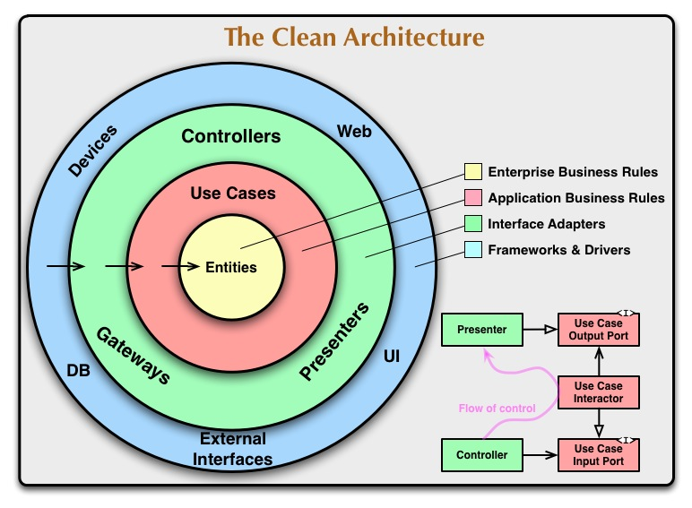

Slide 81
Projeto HUB (POO)
Passos
Criar arquitetura clean code
Criar módulos necessários
Criar classe para leitura da API do ML
  Usar APIs e Postman (sugestão)
Criar classe para leitura de parâmetros via CMD
Preparar estrutura do projeto features
USE
→ https://developers.mercadolivre.com.br/pt_br/api-docs-pt-br

Slide 82
