Slide 1
Verification and Validation Activities for Embedded Systems
A Feasibility Study on a Reading Technique for SysML Models
Erik Aceiro Antonio
erik_antonio@dc.ufscar.br
Rafael Rovina
rovina@dc.ufscar.br
Sandra Fabbri
sfabbri@dc.ufscar.br
LaPES – Laboratory of Research on Software Engineering
Computing Department – UFSCar – Brazil
Notes:
In this slide you can talk about the title of the paper and the authors involved in this research paper. In addition, you can talk about some of points such as:
- This paper is part of a doctorate research;
- This paper describe in particular, a Family of Reading Technique (RTs) for detect defects in SysML and Simulink;
- Finally, this RTs aims detect defects in Embedded Systems contexts and other related areas that involves SysML and Simulink models,
in particular you show that RTs can detect 72% of defects in that models.

Slide 2
Guidelines
Introduction
  Motivations for Quality Control in Models
Background
  Systematic Mapping for V&V Activities
A Family of RTs for SysML/Simulink Models (RTSS)
  SYSMOD with RTSS
  Characteristics of RTSS
The Feasibility Study
Conclusions
Notes:
So, in this part of this presentation, you can talk about five points that are: cite the points and talk about them. For example:
The first point, is a introduction, in this topic you can tell that showed the motivations for quality control in models, in particular, SysML and Simulink models
The second point is a background, in this topic you talk about a Systematic Mapping carried out to explore opportunities research gaps related to Verification and Validation Activities
The third point involves a family of RTs. In this topic, you can talk about how it were structured, in particular, these RTs were organized through by the SYSMOD modelling process.
RTSS is a new acronym to refer my RTs, RTSS – Reading Techniques for SysML and Simulink Models.

Slide 3
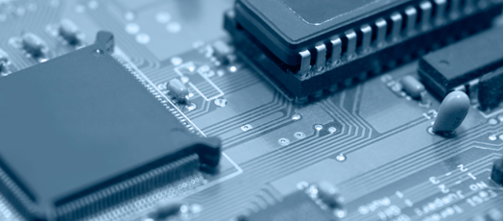
Embedded Systems (ES)
ES are a central ingredient of technical products;
They requires strict definition of functional and non-functional requirements:
  Time constraints (real-time);
  Reliability; and
  Accurate requirements definition.
http://www.embedded.fraunhofer.de/en.html
Notes:
In this slide, you can start talking about this points:
Embedded systems are a central ingredient of technical products, e.g., in transportation, medical technology, or automation technology. Usually they are also interconnected and increasingly open (e.g., towards the Internet). Embedded systems can be found in control devices, in networks of control devices, in networks of control devices in a system (such as an airplane), and in systems, including integration into a system’s operating environment. The latter are also called “Cyber-Physical Systems”. This definition, was extracted from the link http://www.embedded.fraunhofer.de/en.html
So, ES requires strict definitions for requirements, functional and non-functions
In this context, the Embedded Systems Engineering aims to explore techniques and strategies largely used in the traditional software engineering to promote quality in the embedded systems development

Slide 4
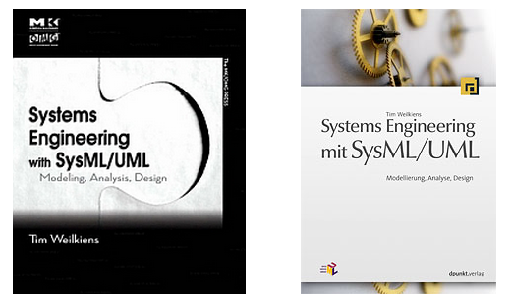
Embedded Systems and Models
To provide improvements in modelling for ES several approaches have been proposed, such as:
  Unified Modeling Language (UML) and extensions RT and MARTE; and
  SysML;
  System Modelling (SYSMOD)
http://sysmod.system-modeling.com/
Notes:
In this slide, you can start talking about this points:
1) Some improvements in the literature, in special, highlights the SysML and SYSMOD process

Slide 5
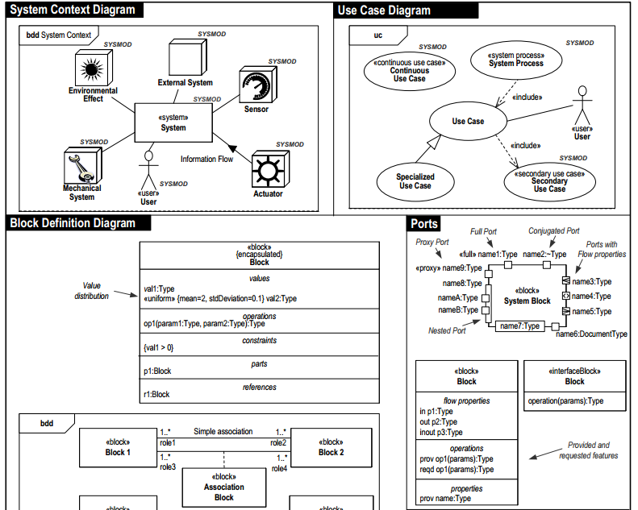
SYSMOD (1/3)
SYSMOD is a top-down
process that uses the
artifacts of the SysML
language
http://model-based-systems-engineering.com/
Notes:
In this slide, you can start talking about this points:

Slide 6
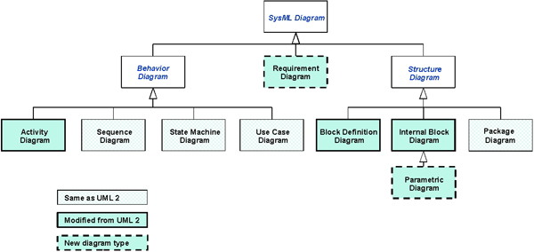
SYSMOD and SysML (2/3)
SYSMOD process use several artifacts from SysML languages
Notes:
In this slide, you can start talking about this points:
Talk about the diagrams used in SysML such as Requirement Diagrams (REQs), Activity Diagram, Block Definition Diagrams and etc..
For example, the Requirement Diagram specify Functional and Non-Functional requirements using blocks and others importants syntax and semantics existents in SysML;
This diagrams are modeled through by guidelines provides in SYSMOD process

Slide 7
SYSMOD and SysML (3/3)
Despite the SYSMOD provide guidelines for modeling in SysML, it don’t have control quality points.
Notes:
In this slide, you can start talking about this points:

Slide 8
Research Gap in V&V Activities
To provide a round map about V&V Activities for Embedded Systems a Systematic Research (SM) was performed;
The aim of the SM was identify researches gap in the context Embedded Systems; and
The SM was performed, depicting V&V activities, modeling techniques and resources used
Notes:
In this slide, you can start talking about this points:

Slide 9
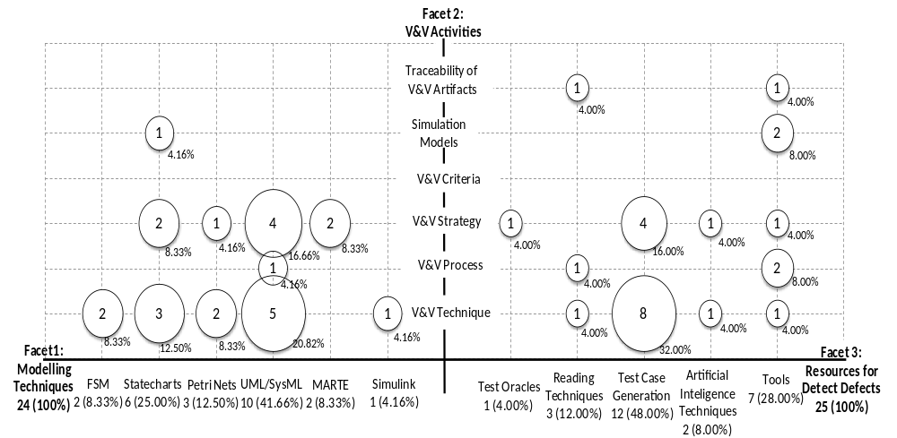
Systematic Mapping for V&V Activities
Notes:
In this slide, you can start talking about this points:
Figure 1 maps the 49 studies according to these facets. Observe from these 49 studies that 24 are related to facet (1) and facet (2); and 25 are related to facet (3) and facet (2). Hence, for example, there is one study that addresses both the categories: Reading Techniques and V&V Process; there are 8 studies that address Test Case Generation and V&V techniques. Also, it is important to notice that the same study can be included in more than one relationship.

Slide 10
Systematic Mapping for V&V Activities
Denger, C., Ciolkowski, M., 2003. High Quality Statecharts through Tailored,
Perspective-Based Inspections, in: EUROMICRO Conference.
IEEE Computer Society, Los Alamitos, CA, USA, p. 316.
Notes:
In this slide, you can start talking about this points:
In “RED”, you can see that according to SM performed, was obtained only 12% of studies involving RTs for Embedded Systems. Aiming to exemplify the initiatives that are being conducted, this study refers to the static activity of inspection. Denger and Ciolkowski (2003) propose a Reading technique for inspecting Statecharts models inspired on Perspective Based Reading (PBR) (Basili et al., 1996).
However, this study doesn’t explore UML/SysML and another artifacts used by SysML.

Slide 11
A Family of RTs for SysML Models and Simulink Models
Due to the importance V&V Activities for quality in software development, in particular, for SYSMOD and SysML/Simulink diagrams, was defined a family of Reading Techniques (RTs) using the SYSMOD process as reference.
Notes:
In this slide, you can start talking about this points:

Slide 12
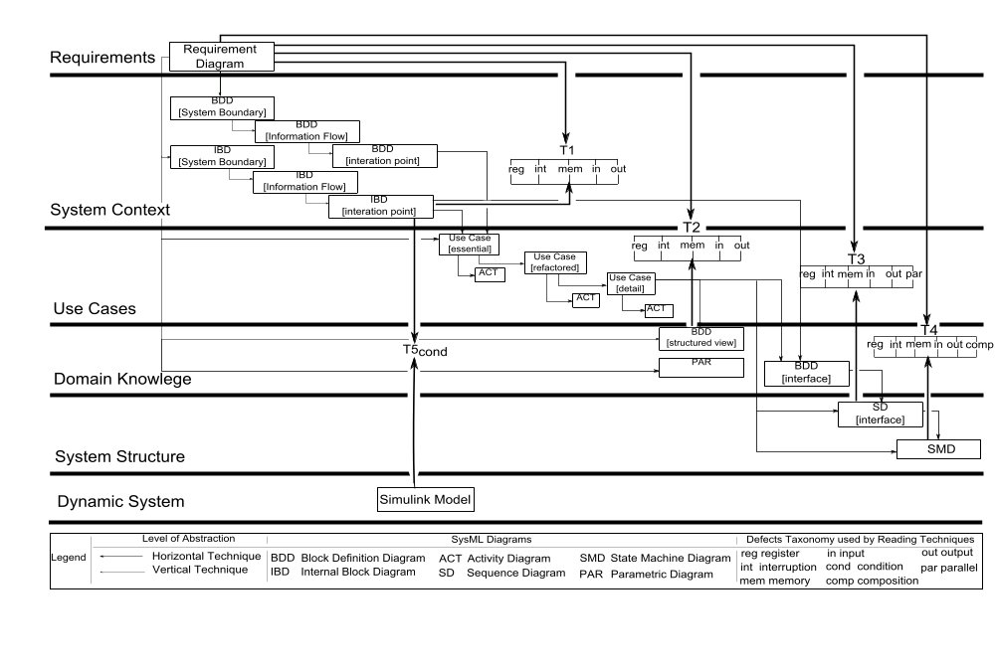
RTSS in SYSMOD
Notes:
In this slide, you can talk some specific points of RTSS in SYSMOD
This figure highlights the phases of this process: Requirements, System Context, Use Cases, Domain Knowledge, System Structure and Dynamic System. Each SYSMOD phase defines the SysML diagrams necessary for the specification of the embedded system. For example, in the Requirements phase, the system requirements are specified into a Requirements Diagram (REQ), and in the System Context phase, system requirements are detailed in Internal Block Diagram (IBD) and Block Definition Diagrams (BDD). The reading techniques have been established between pairs of diagrams where the information of one diagram is used to build the other one.
As an example, T1 technique is applied to the pair of diagrams: Requirements Diagram (REQ) and Internal Block Diagram (IBD) (Figure 2). According to the nomenclature used by Travassos, Shull and Carver (2000) for UML, we named vertical reading technique the one that uses the Requirements Diagram and horizontal reading technique the ones that do not involve the Requirements Diagram.

Slide 13
Characteristics of RTSS
RTSS verify if the transcription of information from one diagram to another diagram is correct using four fonts of defects:
  Taxonomy is based on the Std1044 IEEE-2009;
    provides a taxonomy of defects
  International Certification UL-98;
    provides commons terms associated with ES certification
  International Certification DO178C;
    provides commons terms associated with Aircraft certification
  Syntactic/Semantic properties of SysML language
    provides terms associated with SysML language
Notes:
In this slide, you can start talking about this points:

Slide 14
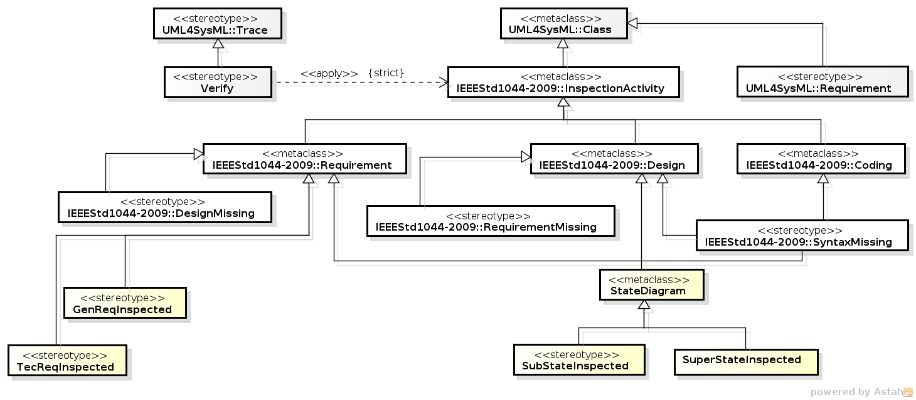
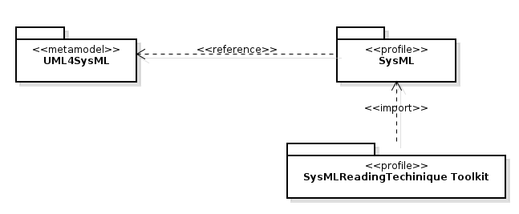
Characteristics of RTSS
The RTSS use a set of stereotypes to annotate the artifacts along to the inspection activity:
  The stereotypes were created to performed inspection in SysML and Simulink models;
  This stereotypes were created through by the extension of SysML profile.
Notes:
In this slide, you can start talking about this points:

Slide 15
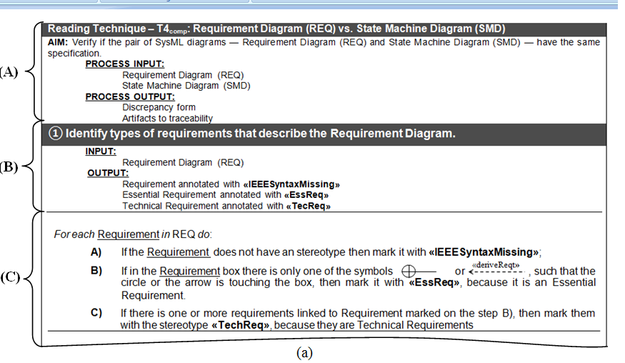
RTSS – T4_{comp}(text)

Slide 16
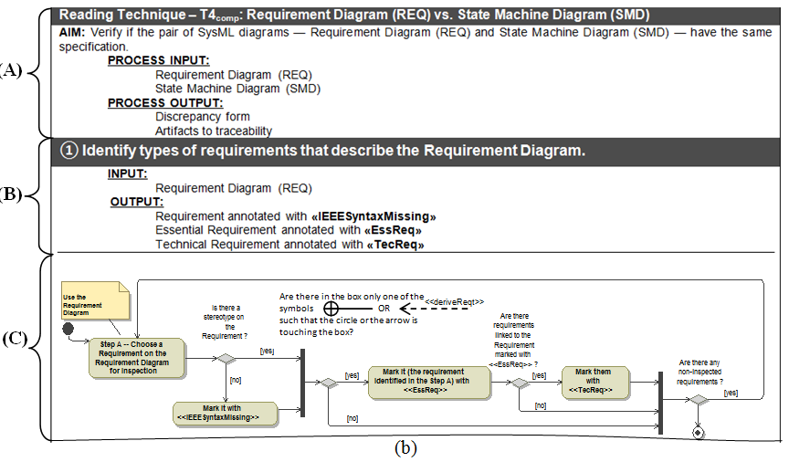
RTSS – T4_{comp}(flowchart)

Slide 17
The Feasibility Study (1/3)
The study was based on the main steps suggested by the Wohlin’s experimental process. So two main questions were proposed:
(Q1) The main question aimed to evaluate if the Reading Technique T4_{comp} is feasible to be used to inspect SysML models in terms of effectiveness and efficiency;
(Q2) The secondary question aimed to evaluate if the format the technique is written (Text or Flowchart) can interfere on the performance for identifying defects (effectiveness and efficiency).
Notes:
In this slide, you can start talking about this points:

Slide 18
The Feasibility Study (2/3)
The GQM was structured as depicted below:
Analyze the Reading Technique T4_{comp}
For the purpose of evaluation
With respect to effectiveness and efficiency
From the point of view of the developer
In the context of undergraduate students

Slide 19
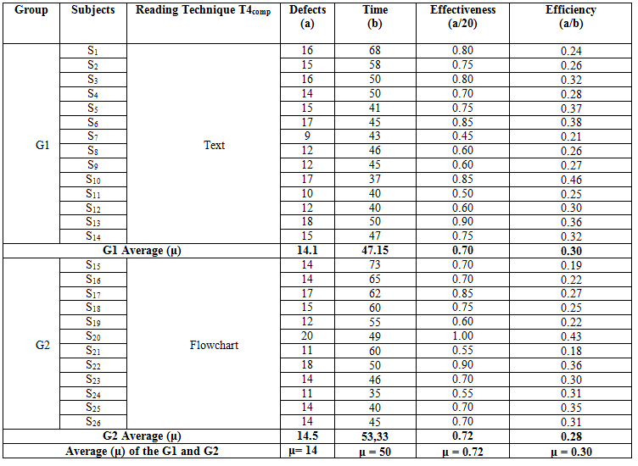
The Feasibility Study (3/3)
Notes:
This a summarization

Slide 20
Research Question Q1 (1/2)
To answer the research question Q1

Slide 21
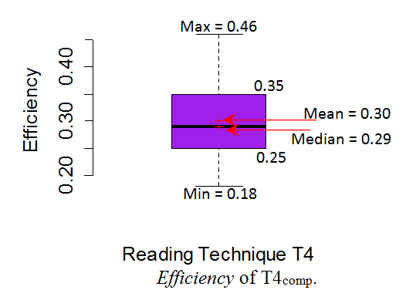
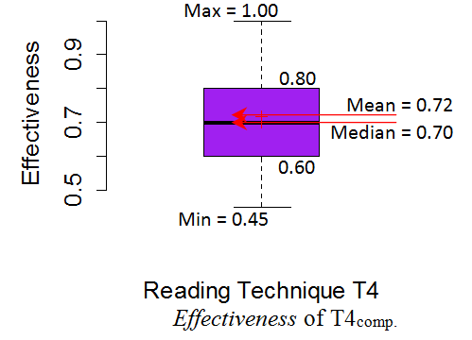
Research Question Q1 (2/2)
(*) According to the hypotheses defined the Reading Technique T4_{comp} is feasible to be used to inspect SysML models in terms of effectiveness and efficiency
Notes:
In this slide, you can start talking about this points:
According to Figure 4 the following regions can be observed:
(i) the first region corresponding to the first quartile, which represents 25% of data, where (0.45 ≤ effectiveness< 0.60);
(ii) the second region corresponding to the second and third quartiles, which represents 50% of data, where (0.60 ≤ effectiveness ≤ 0.80); and (iii) the third region corresponding to the fourth quartile, which represents the greatest 25% of data, where (0.80 <effectiveness ≤ 1.00). From second region it can be observed that one half of subjects have got at least 50% of effectiveness.
As the mean and median were very close — 0.72 and 0.70, respectively, we can consider that the data distribution is symmetric, i.e., the effectiveness data has a normal distribution. In relation to efficiency (Figure 5), the data can be interpreted in a similar way. It is important to notice that at least at least 50% of subjects detected from 0.25 to 0.35 defects per minutes, on the other hand, them have spent from 46 up to 48 minutes to conclude the inspection

Slide 22
Research Question Q2 (1/2)
To answer the research question Q2
To answer the research question Q2

Slide 23
Research Question Q2 (2/2)
Applying F-test statistic test, both failed to reveal a significant effect for the G1 (p = 0.9853) and G2 group (p = 0.8290);
Therefore, we can say that there is no significant difference in applying T4 in text format or flowchart format.
Notes:
In this slide, you can start talking about this points:
According to Figure 4 the following regions can be observed:
(i) the first region corresponding to the first quartile, which represents 25% of data, where (0.45 ≤ effectiveness< 0.60);
(ii) the second region corresponding to the second and third quartiles, which represents 50% of data, where (0.60 ≤ effectiveness ≤ 0.80); and (iii) the third region corresponding to the fourth quartile, which represents the greatest 25% of data, where (0.80 <effectiveness ≤ 1.00). From second region it can be observed that one half of subjects have got at least 50% of effectiveness.
As the mean and median were very close — 0.72 and 0.70, respectively, we can consider that the data distribution is symmetric, i.e., the effectiveness data has a normal distribution. In relation to efficiency (Figure 5), the data can be interpreted in a similar way. It is important to notice that at least at least 50% of subjects detected from 0.25 to 0.35 defects per minutes, on the other hand, them have spent from 46 up to 48 minutes to conclude the inspection

Slide 24
Conclusions and Future works
A family of RTs (RTSS) has been proposed from the feasibility study carried out;
This work described the contribution of a reading technique (T4_{comp}) for detecting defects in SysML models;
The results indicated that more than 70% of the defects were identified by at least 50% of the subjects;
Feasibility study allowed that there is no difference in the effectiveness and efficiency for defects identification, independently of the format used (text or flowchart).
Other RTs were defined in a similar way and nowadays other experimental studies are being conducted to evaluate the other techniques;

Slide 25

Erik Aceiro Antonio
erik_antonio@dc.ufscar.br
Rafael Rovina
rovina@dc.ufscar.br
Sandra Fabbri
sfabbri@dc.ufscar.br
LaPES – Laboratory of Research on Software Engineering
Computing Department – UFSCar – Brazil

