Slide 1
GameFace
Lim Jun Ming, Kennedy Tadhg, Yeong Wee Ping
Group 12

Slide 2
Team Members
Wee Ping
Jun Ming
Tadhg
Project Motivation
Minimum Viable Product
High Level Tasks
Existing Works
Datasets
System Design
Algorithms and Models
System Setup
Deliverables

Slide 3
What Are We Trying to Solve?
People living with different physical disabilities need to buy expensive third party peripherals in order to control their computers and enjoy video games.
We aim to develop a vision system which will allow Human-Computer Interaction (HCI) in a fun and affordable way, using human gesture and pose recognition.

Slide 4
MVP
A vision system that interacts with a simple retro Tetris game that allows user to control commands using different head postures through a webcam.
C:\> Simple Webcam
C:\> Facial Landmark Detection
C:\> Play Classic Tetris Game

Slide 5
What Are The Tasks?
Detection
Tracking
Classification
Action
Face Detection
Facial Landmark Detection
Real Time Face Landmark Tracking
Face Posture Estimation
Output Command to Computer

Slide 6
Are There Projects We Could Learn From?
References
Challenges
Fast Facial Landmark Detection and Application: Survey ^{[1]}
High latency, delayed response
Head Pose Estimation in Computer Vision: Survey ^{[2]}
Balance between Model accuracy and complexity
Head Pose Estimation with Hopenet ^{[3]}

Slide 7
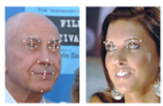
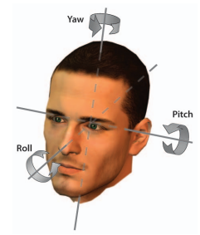
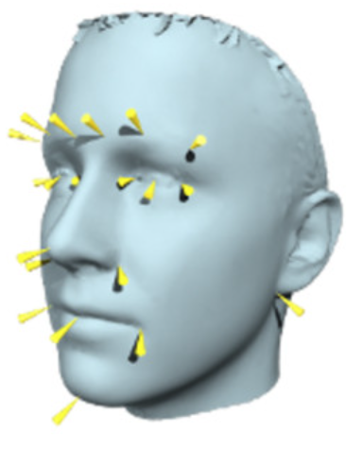
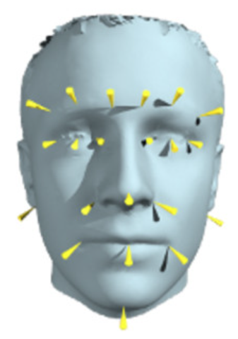
What Are The Datasets?
LFPW
AFLW
Pandora
Labelled Face Part in the Wild:
1,432 images with 29 landmark point location files
Annotated Facial Landmarks in the Wild:
25,993 images with 21 landmarks point per image
Specifically created for Head Center Localization and Head Pose Estimation, with ground truth expressed in 70 yaw, 100 pitch and 125 roll angles

Slide 8
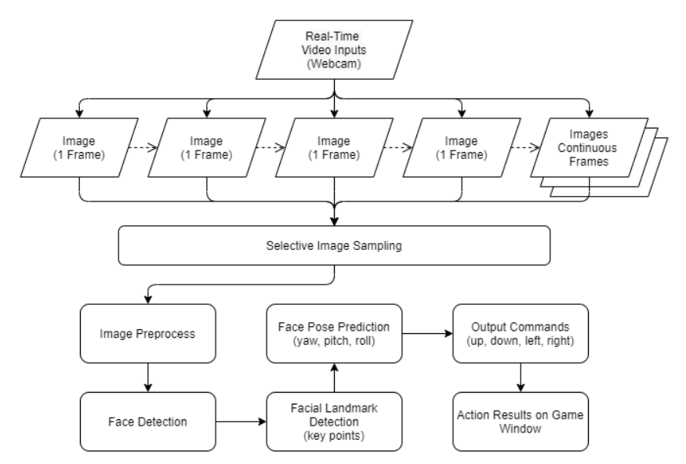
How Do We Design The System?

Slide 9
What Are The Algorithms and Models?
Facial Landmarks
Dlib
OpenFace
Face Detection
Face Pose
Viola-Jones Face Detection
OpenCV Caffe Model
Rule based estimation
Hopenet
Area of Focus
Notes:
Verbal mention of how we plan to train 1 model ourselves
How we try to improve detection speed via sampling?

Slide 10
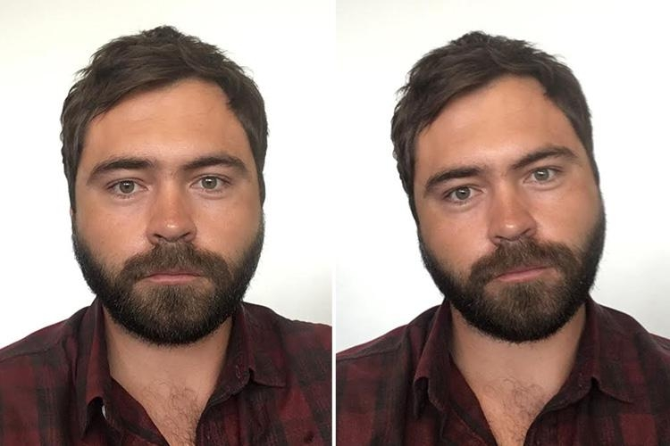
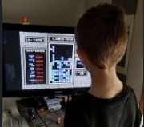
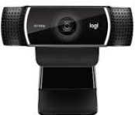
How Do We Start Having Fun?
Technical Metrics
Business Metrics
SETUP
The key metrics here will be the speed and accuracy of the model
Neutral
Left
This will be the usability of the system for those with physical disabilities

Slide 11
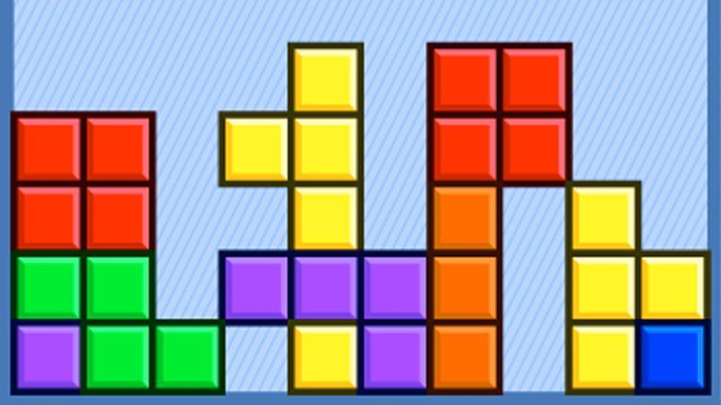
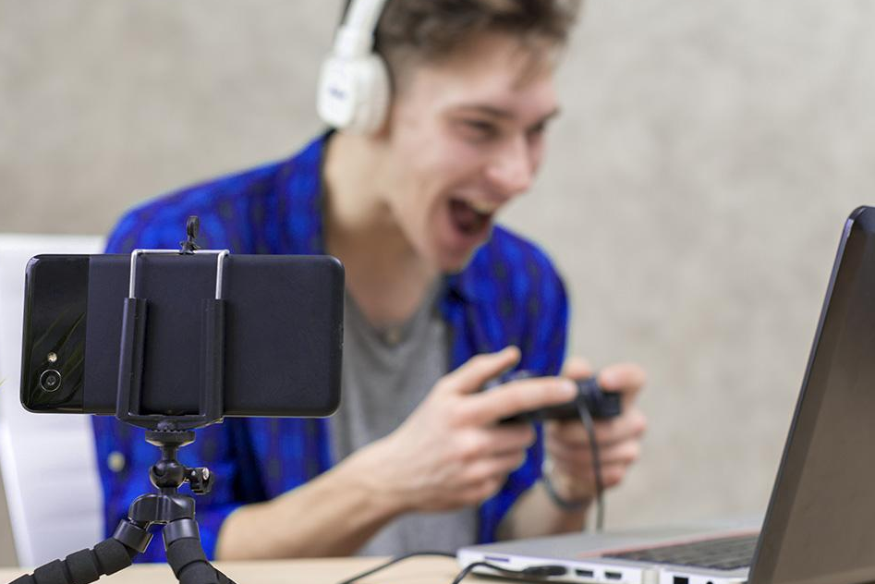
What We Will Deliver!
A vision system that is able to predict face pose using image input from a webcam.
Convert face pose information to commands and send them to the game control using Auto GUI

Slide 12
RESOURCES
PAPERS & LITERATURE
[1] https://arxiv.org/abs/2101.10808
[2] http://cvrr.ucsd.edu/publications/2009/MurphyChutorian_Trivedi_PAMI09.pdf
[3] https://towardsdatascience.com/head-pose-estimation-with-hopenet-5e62ace254d5

Slide 13

Q & A
Does anyone have any questions?

