Slide 1

“ElderGuard” Suspicious Text Messages Detector for the Elderly
Elder
Guard
Lim Jun Ming - A0231523U
Mediana - A0231458E
Yeong Wee Ping - A0231533R

Slide 2


Project Objectives and Scope
Objectives:
Scope:
Target: Senior Citizen
Input: SMS Text Messages
Platform: Android Phone
Language: English
Output to user: / (symbols for ease of understanding)
Building an application that can help to protect vulnerable elderly from being scammed or cheated. Our application will detect text messages that may be fraudulent in nature, for examples spam messages, fraudulent messages or messages that contains malicious or phishing URLs.
Categories | Classification Output
Phishing URL | Phishing / Non-Phishing
Malicious URL | Malicious / Non-Malicious
Spam Text | Ham / Spam

Slide 3
Data and Methodology
Dataset
Phishing and Non-Phishing URL
Feature Extraction
Lexical Features
Bag-Of-Word
Word Embeddings
PRS Data Modelling & Evaluation
Deployment
Android App
Malicious and Non-Malicious URL
Spam and Normal Text Messages
Flask on Heroku
Supervised
Deep Learning
Ensembles / Hybrid ML
Notes:
Phishing Dataset
OpenPhish.com
Kaggle - https://www.kaggle.com/taruntiwarihp/phishing-site-urls/download
Malicious URL
https://www.kaggle.com/antonyj453/urldataset/download
UCI Machine Learning Repository - https://archive.ics.uci.edu/ml/datasets/sms+spam+collection#

Slide 4



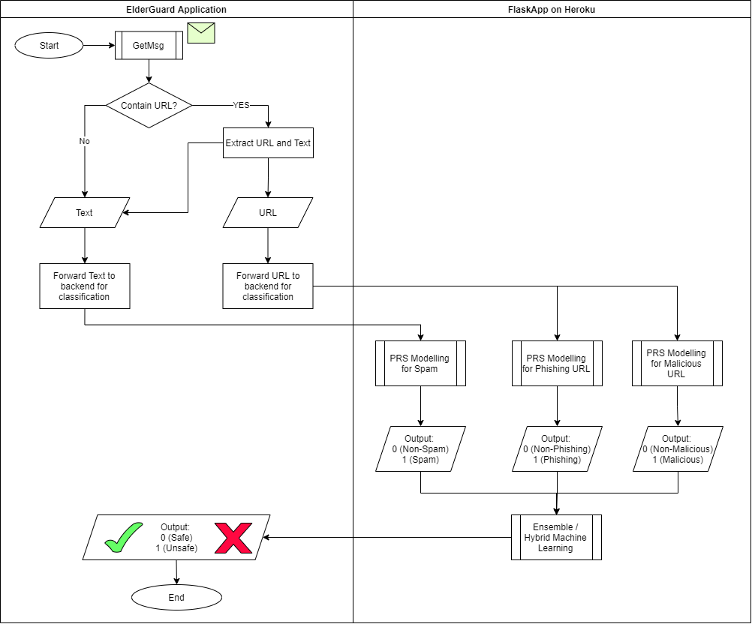

ElderGuard Apps Process Workflow

Slide 5
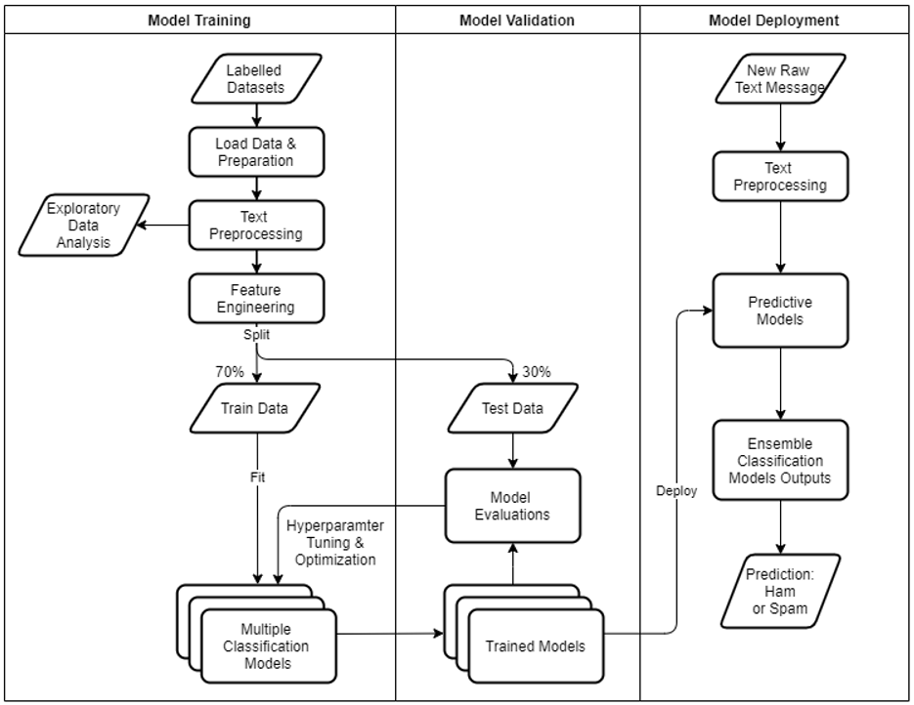
Technical Workflow for Spam Text Classification

Slide 6

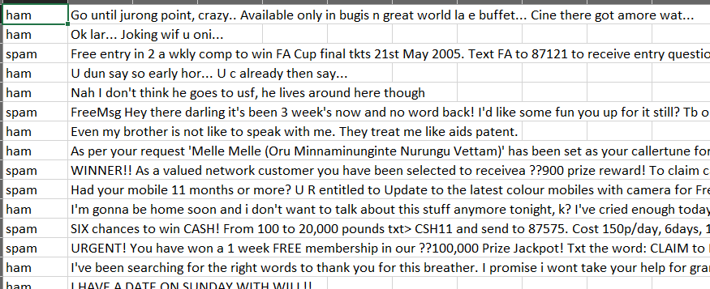
Spam Text Classification
Dataset for Model Training
SMS Collection Data Set (UCI Machine Learning Repository)
https://archive.ics.uci.edu/ml/datasets/sms+spam+collection#
Kaggle SMS data set
https://www.kaggle.com/uds5501/sms-dataset
Labelled dataset in csv form:

Slide 7

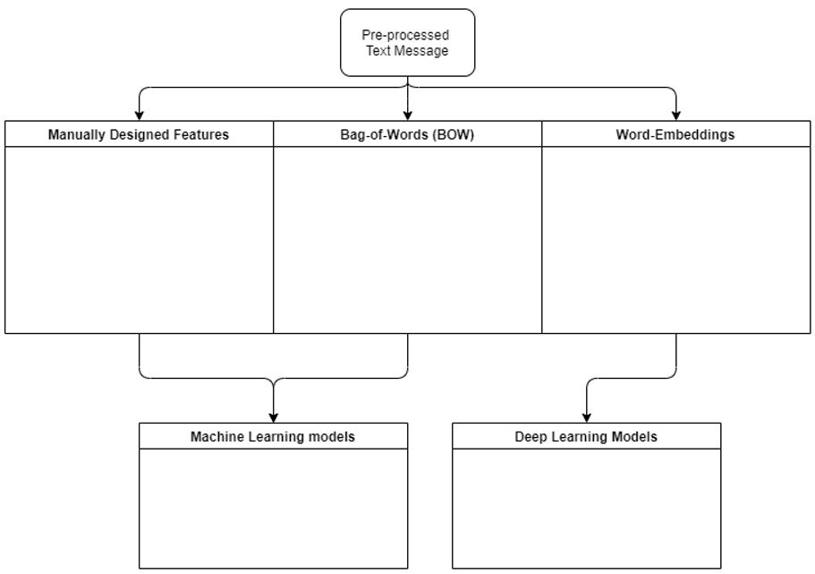
Spam Text Classification
Feature Engineering & Classification Models
Count of math symbols
(‘+’ , ‘-’ , ‘/’ , ‘^’ , …)
Count of special symbols
(‘!’ , ‘@’, ‘$’, ‘~’, ….)
Count of fully uppercased words
Count of common spam words
Phone/SMS number indicator
Number of words
CountVectorizer
TfIdf Vectorizer
Vectorization based on vocabulary word index
Word embeddings trained based on dataset (Tensorflow)
Pre-trained word embeddings (GloVe)
Logistic Regression
Random Forest
Support Vector Machine (SVM)
AdaBoost
Multilayer Perceptron (MLP) NN
CNN
LSTM
Notes:
Jeffrey Pennington, Richard Socher, and Christopher D. Manning. 2014. https://nlp.stanford.edu/projects/glove/

Slide 8

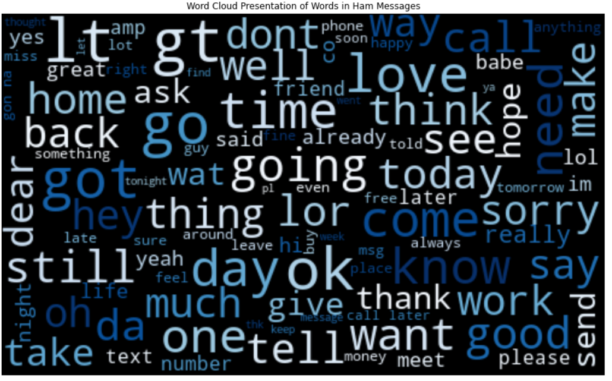
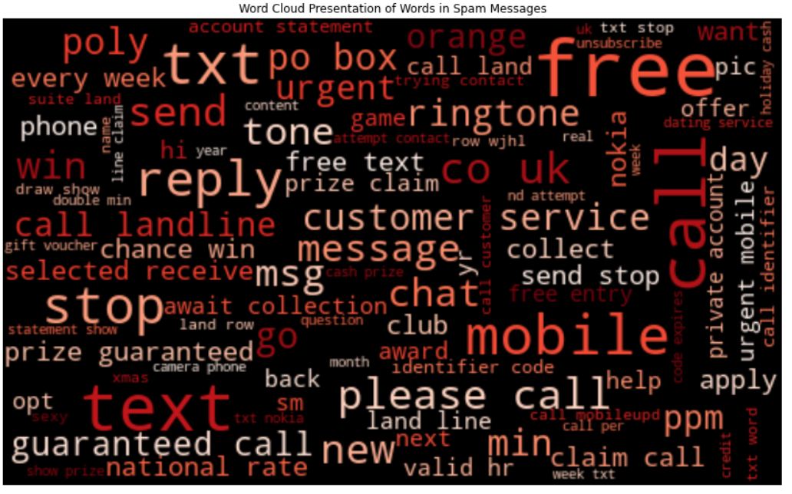
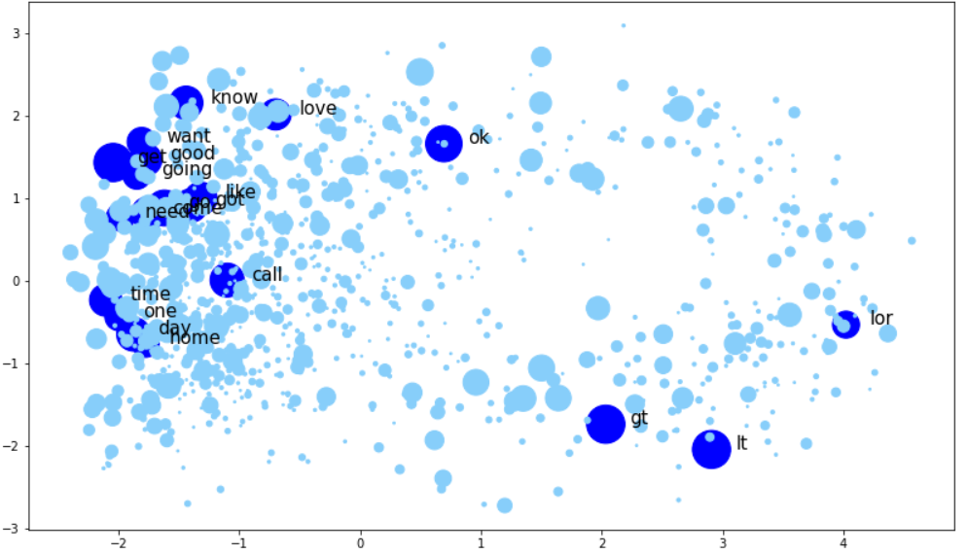
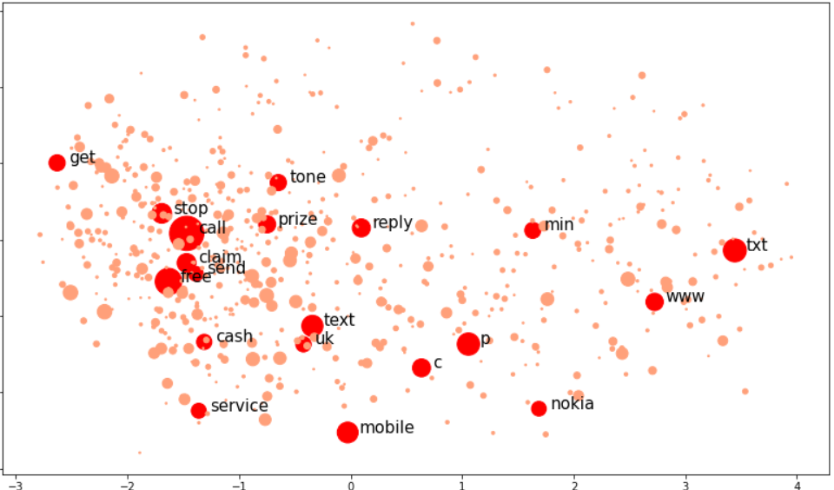
Spam Text Classification
Data Exploration & Visualization
Ham Messages Common Words¹
Spam Messages Common Words¹
2D Visualization of Word Embeddings²
For Common Words in Ham Messages
2D Visualization of Word Embeddings²
For Common Words in Spam Messages
¹ Figures are generated using python library – WordCloud.
² Diagrams are generated by using word embeddings with dimension reduced to 2D using PCA.

Slide 9
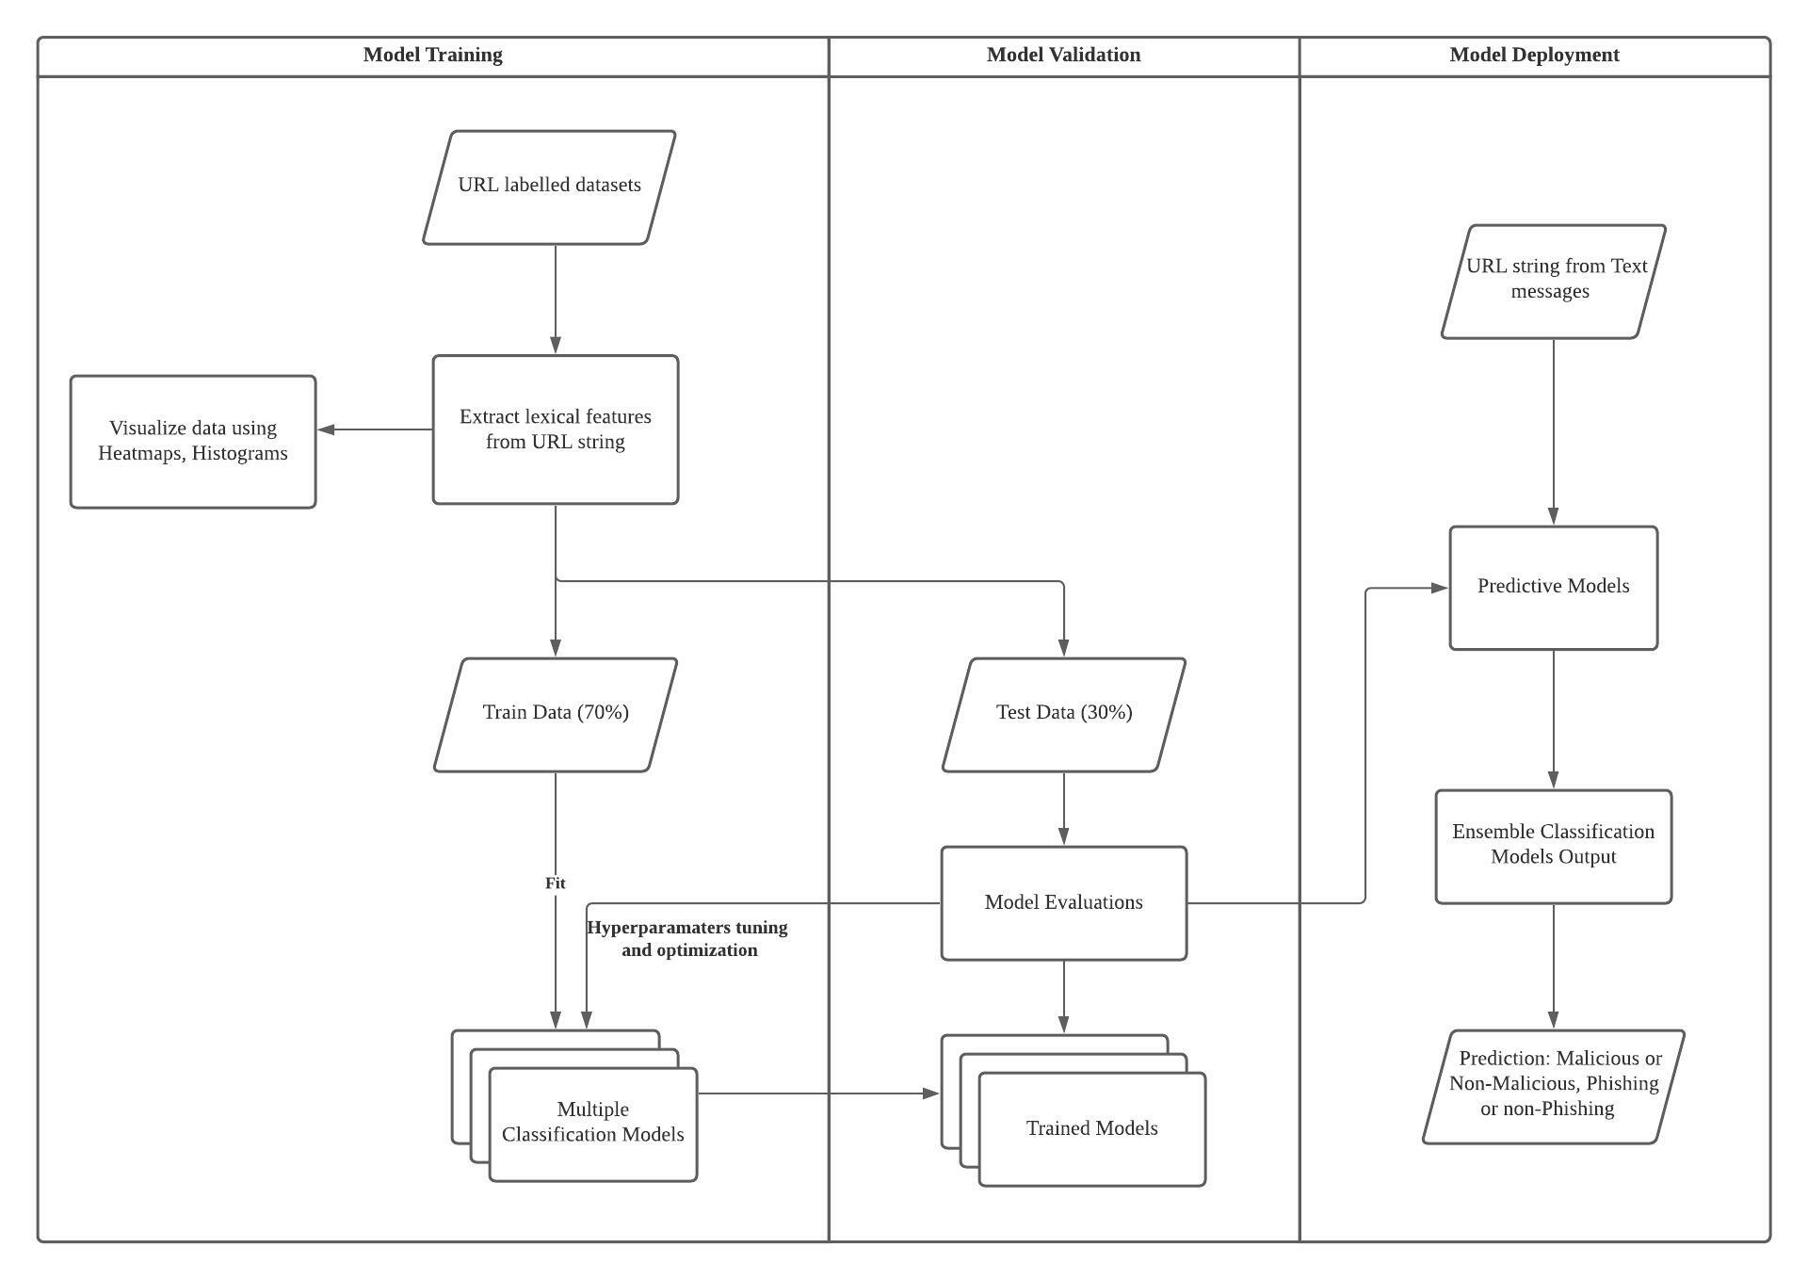
Technical Workflow for URL Classification

Slide 10
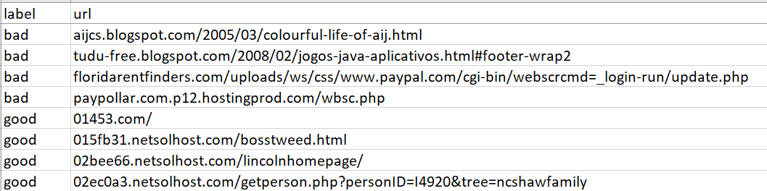
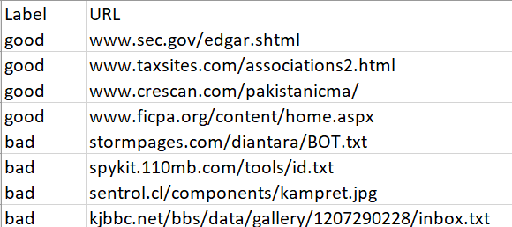
URL Classification
Dataset for Model Training
Malicious URL datasets
https://www.kaggle.com/antonyj453/urldataset/download
Phishing URL datasets
https://www.kaggle.com/taruntiwarihp/phishing-site-urls/download
OpenPhish.com
Labelled dataset in csv form:
Malicious
Phishing

Slide 11
URL Classification
Feature Engineering based on URL Lexical Features
& Classification Models
TLD
First Directory
http://hostname.net/firstdirectory/install.php?www=19320;cre=mu&gr@pid
Hostname
Path
URL
Lexicon Length | Lexicon Count | Binary Features
Length of URL Length of Hostname Length of Path Length of First Directory Length of Top Level Domain (TLD) | Count of ‘-’ Count of ‘@’ Count of ‘?’ Count of ‘%’ Count of ‘.’ Count of ‘=’ Count of ‘http’ Count of ‘www’ Count of Digits Count of Letters Count of Number of Directories | Use of IP address, or not Use of Shortening URL, or not
Machine Learning Models
- Logistic Regression - KNN - Decision Trees - AdaBoost - Random Forest - Multinomial Naïve Bayes

Slide 12



Project Status Overview
Tasks Breakdown | Progress | Next Pipeline
Research and literature review |  | Completed
Spam classification model |  | Continue Deep Learning models
Phishing & Malicious URL classification model |  | Continue explore other ML and Deep Learning models
Backend server using Flask/Heroku |  | Develop backend server to host our classification models for prediction tasks
Android App development |  | Develop App interface to present decision to user

Slide 13
Thank you

Slide 14
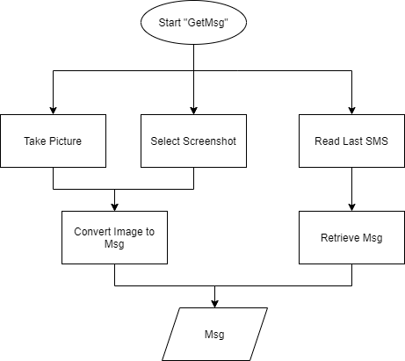
GetMsg Function
3 ways to obtain msg

Slide 15
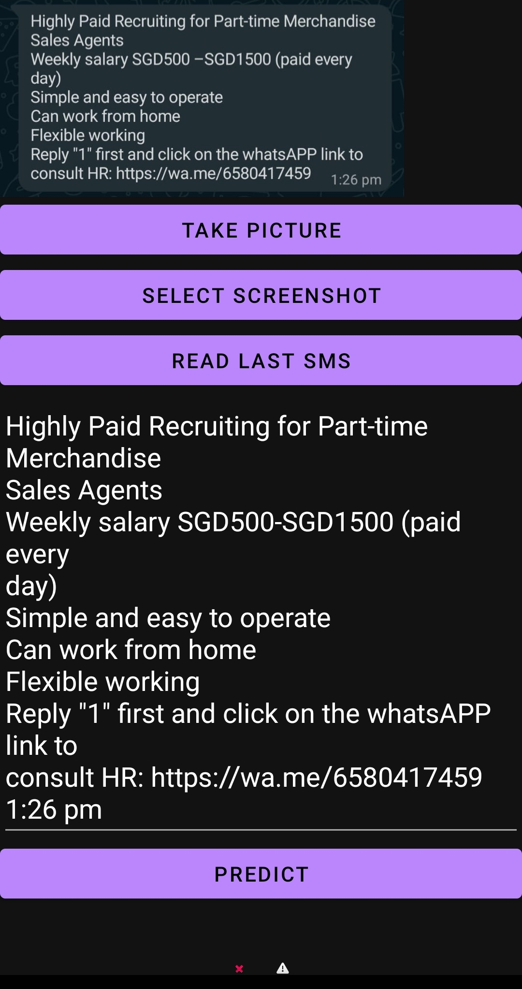
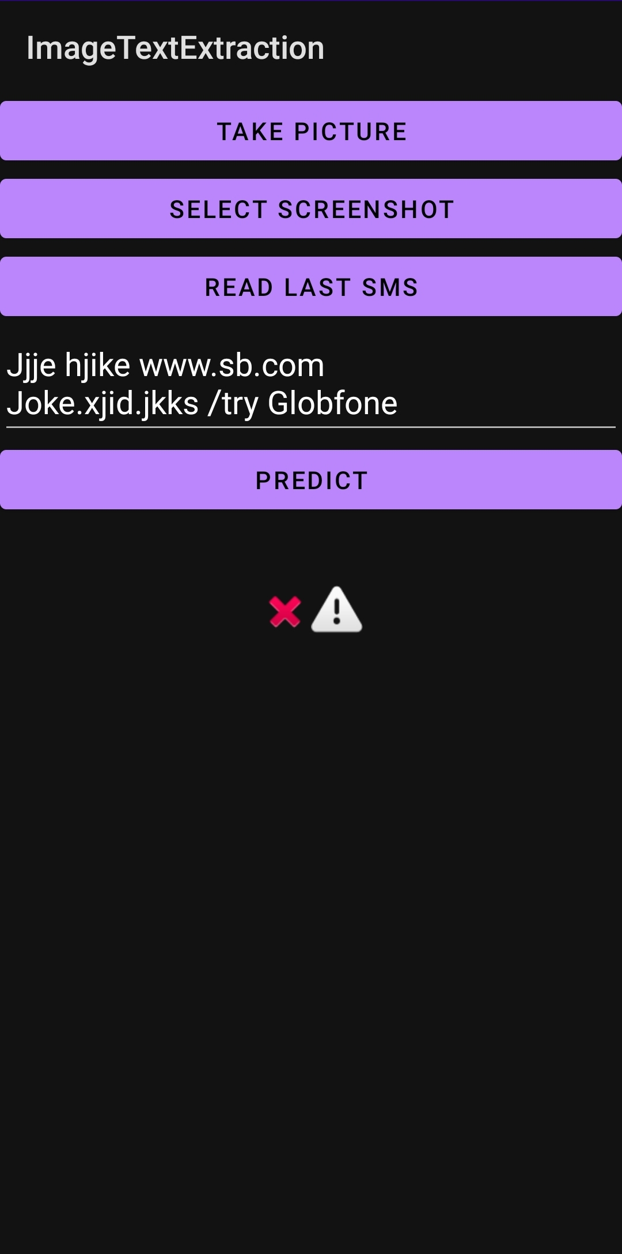
ElderGuard App (beta)
Using Screenshot – Convert Image to Text
Read Latest SMS Received

Slide 16
Model Accuracy Comparison (Phishing URL) To be continued..
Lexical Features (Manual Extraction)
Model | *Accuracy Score (Test Dataset)
Random Forest | 92%
Decision Tree | 89%
KNN | 86%
AdaBoost | 84%
Logistic Regression | 78%
Multinomial Naïve Bayes | 64%
CountVectorizer
Model | *Accuracy Score (Test Dataset)
Logistic Regression | 96%
Decision Tree | 96%
KNN | 93%
AdaBoost
Random Forest
Multinomial Naïve Bayes
* Baseline – without optimization and tuning

Slide 17
Model Accuracy Comparison (Malicious URL) To be continued..
Lexical Features (Manual Extraction)
Model | *Accuracy Score (Test Dataset)
Random Forest | 90%
Decision Tree | 89%
AdaBoost | 85%
Logistic Regression | 84%
* Baseline – without optimization and tuning

Slide 18
Spam Text Detection Model Evaluation
Machine Learning Models | Accuracy Score (Test Dataset)
Support Vector Machine (SVM) | 98.4%
Naïve Bayes | 98.1%
Logistic Regression | 97.9%
Random Forest | 97.4%
AdaBoost | 98.0%
K-Nearest Neighbors

Slide 19
CountVectorizer - Example
Data Point | Tokenized Text
1 | [‘I’, ‘ate’, ‘an’, ‘apple’, ‘yesterday’]
2 | [‘I’, ‘ate’, ‘an’, ‘apple’, ‘this’, ‘morning’]
3 | [‘I’, ‘ate’, ‘an, ‘orange’, ‘yesterday’]
4 | [‘he’, ‘ate’, ‘an’, ‘orange’, ‘this’, ‘morning’]
Count Vectorization
Data Point | ‘I’ | ‘ate’ | ‘an’ | ‘apple’ | ‘orange’ | ‘yesterday’ | ‘this’ | ‘morning | ‘he’
1 | 1 | 1 | 1 | 1 | 0 | 1 | 0 | 0 | 0
2 | 1 | 1 | 1 | 1 | 0 | 0 | 1 | 1 | 0
3 | 1 | 1 | 1 | 0 | 1 | 1 | 0 | 0 | 0
4 | 0 | 1 | 1 | 0 | 1 | 0 | 1 | 1 | 1

Slide 20
Vectorization Based on Vocabulary Word Index - Example
Tokenized Text = [‘He’, ‘likes’, ‘to’, ‘travel’]
Vectorization
Word Index Dictionary:
{ ‘he’ : 1,
‘to’ : 2,
….
‘travel’ : 50,
….
‘likes’ : 105
…. }
‘He’ | ‘Likes’ | ‘to’ | ‘travel’
1 | 105 | 2 | 50
Vocabulary
& Index
Word
Index

