Slide 1
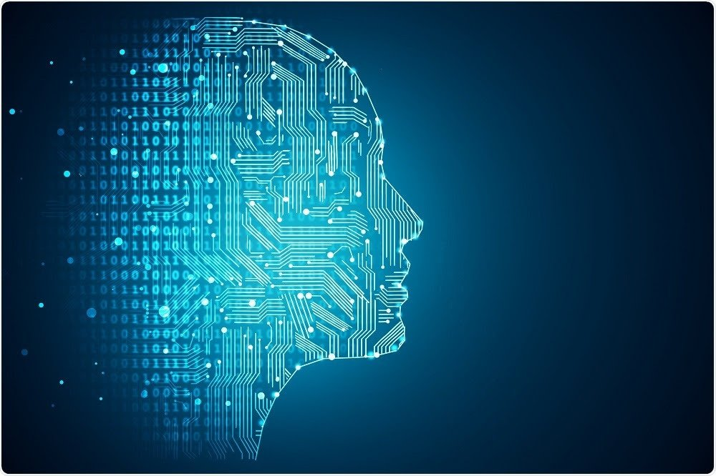
INDUSTRIAL TRAINING
ON
PYTHON WITH
ARTIFICIAL INTELLIGENCE
By Amisha Kalra & Anurag
CSE/16/107-108

Slide 2
ACKNOWLEDGEMENT
It gives me great pleasure to present my presentation report . I owe my gratitude to teacher of HP, for their constant support and guidance throughout the training of python with artificial intelligence .

Slide 3
INTRODUCTION
Company Introduction :
I have completed my industrial training from Kyrion associated with HPE CoC certification from 18 June 2018 to 27 July 2018.
TECHNOLOGIES:
I used the python for making the project in artificial intelligence and I used different libraries likes:-
Opencv , numpy .

Slide 4
Content
1. Introduction
About Company
About Project
About python
About artificial intelligence
About Technology
2. Outputs
3. Advantages
4. Disadvantages
5. Future scope of artificial intelligence
6. Conclusion

Slide 5
About artificial intelligence:
According to the father of artificial intelligence, john McCarthy it is: - Artificial = “man made things”
Intelligence =“ by their knowledge ”
“ It is the study of how to make computer do the things which at present human can do better.”
Parts of artificial intelligence :
Image Recognition .
Voice Recognition .
Neural networking .
Robotics etc .

Slide 6
Artificial intelligence
Weak AI strong AI
(Narrow AI)
What my project is based on ?
Image processing
handwritten Digits Recognition .
Software used
JetBrains PyCharm Community Edition 2018.1.4 x64

Slide 7
IMPORTANCE OF AI
Where ever it is cost feasible to use in order to either perform more efficiently than a human being or else where it is too dangerous to send a human being, or when its return is not possible. Or the job is too stressful. Also Google has basic A.I. It can recognize if you meant to type something different. Such as if you type dog breads it says did you mean dog breeds even though the 2 words are spelled correctly.
Do the computational work for us
Get physical work done by manifesting itself into robots
Work tirelessly towards afforestation & abundant renewable energy
Make shelters & grow foods for us in the hinterland/arid regions
Lastly liberate us from doing jobs for a livelihood & show more humanity to other fellow humans & beings, this is for the future generations but we need to work for that goal

Slide 8
ABOUT THE PROJECT
Learning Characters
The OCRchie recognition algorithm relies on a set of learned characters and their properties. It compares the characters in the scanned image file to the characters in this learned set.Generating the learned set is quite simple. It requires that an image file with the desired characters in the desired font be created, and a text file representing the characters in this image file. If a character such as pi, has a multicharacter translation, angled brackets should be placed around the translation .
Once the learned set has been read in from the image file and its properties recognized, it can be written out to a "learn" file. This file stores the properties of the learned characters in abbreviated form, eliminating the need for retaining the images of the learned characters, and can be read in very quickly.

Slide 9
Language used
About python :
python is a basic programming language, Easy to use .
Fully object oriented.
General purpose high level language.
It can work on ?
console based applications, desktop based apps , mobile apps etc .
applications by using python?
youtube ,Dropbox , Instagram.
.

Slide 10
SOFTWARE USED:
-JetBrains PyCharm Community Edition 2018.1.4 x64
-python 3.6
HARDWARE USED
-1 GB RAM minimum, 2 GB RAM recommended
-1024x768 minimum screen resolution.
.

Slide 11
LIBRARIES
Numpy:
Numpy is a highly optimized library for numerical operations. It gives a MATLAB-style syntax. All the OpenCV array structures are converted to-and-from Numpy arrays. So whatever operations you can do in Numpy, you can combine it with OpenCV, which increases number of weapons in your arsenal. Besides that, several other libraries like SciPy, Matplotlib which supports Numpy can be used with this.
Open cv:
OpenCV (Open Source Computer Vision Library) is an open source computer vision and machine learning software library. OpenCV was built to provide a common infrastructure for computer vision applications and to accelerate the use of machine perception in the commercial products. Being a BSD-licensed product, OpenCV makes it easy for businesses to utilize and modify the code.

Slide 12
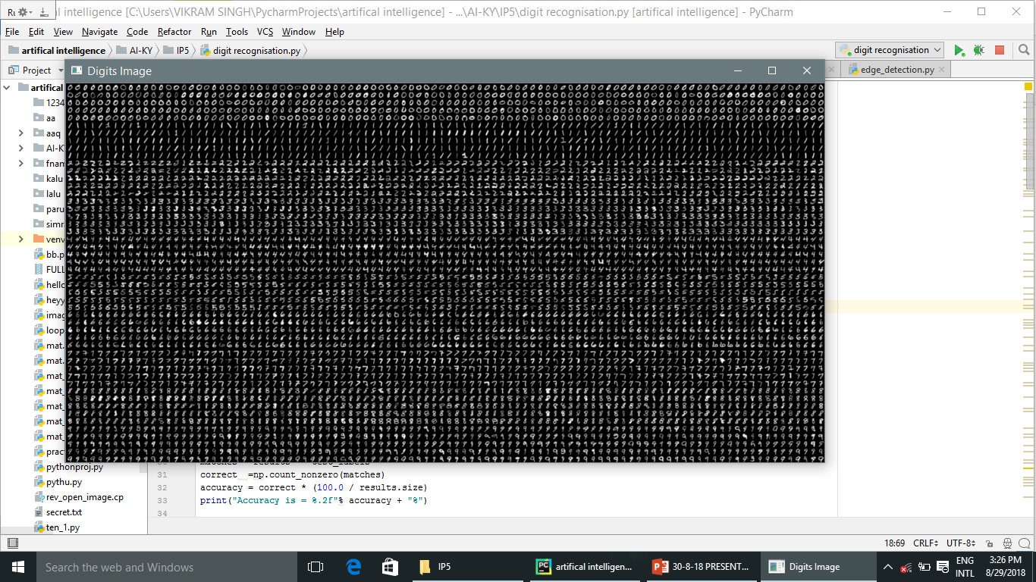
Previously stored data set

Slide 13
STEPS :
Conversion of original image to gray scale
Blurring the grey image
Edge detection
Applying contours
Pattern recognition

Slide 14
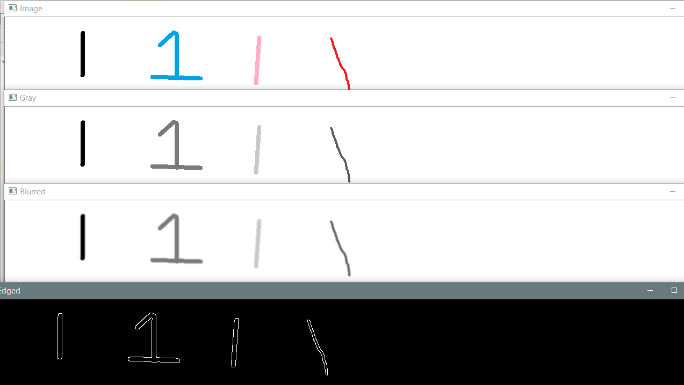

Slide 15
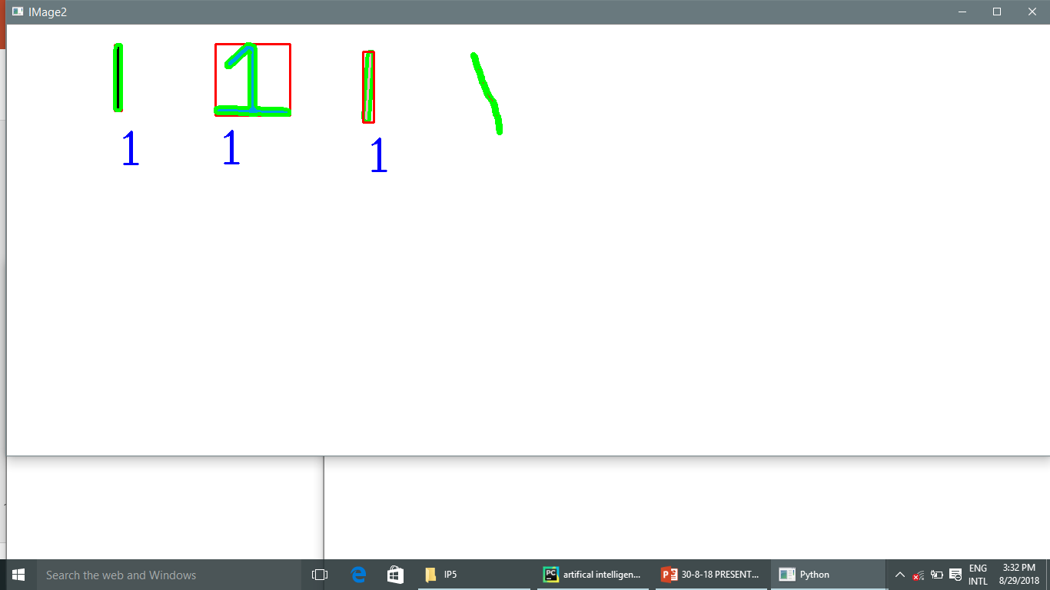
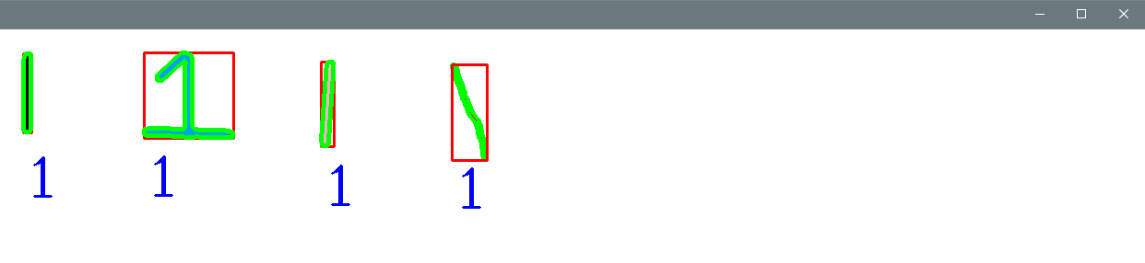

Slide 16
IMPORTANCE OF PATTERN RECOGNITION
Pattern recognition forms the basis of learning and action for all living things in nature.Patterns are all around us - from human fingerprints, zebra crossings, warm current flows in oceans to the beautiful arrangement of a rose bud.
The importance of Pattern Recognition can be traced from its needs in daily life- pattern recognition plays an important role: reading texts, identifying people, retrieving objects, or finding the way in a city. Once patterns are established, learned from some examples or from a teacher, we are able to classify new objects or phenomena into a class of known patterns.
Pattern Recognition is important because it is a need that appears in many practical problems. We as humans do this very well, but getting a computer to do the same is complicated.

Slide 17
ADVANTAGES
Faster searches
Reduced errors
More storage space
Readily available
Efficient management
Security
1

Slide 18
LIMITATIONS
Loads of data set is required
Data set can be inefficient
only reads horizontally
Case sensitive
Alignment must be taken care of
Logics of coder must be strong
High cost investment is requuired
1

Slide 19
FUTURE SCOPE
The future of artificial intelligence is very vast because :
All the work will done by robots in future .
A lot of application is working on AI .
In ai machine demonstrate certain aspects of human intelligence like learning,understanding etc
On AI research is still working.

Slide 20
CONCLUSION
It was a great experience. I learnt a lot of things from
The faculty of Kyroin . I worked on image processing
during my industrial training.
Thank you !!

