Slide 1
ML Classifiers on PIMA Dataset
Ahsen Nazir

Slide 2
Problems
limited number of labeled data
and also, the presence of outliers (or missing values) in the diabetes datasets.

Slide 3
Objective
To design a robust framework for diabetes prediction where,
the outlier rejection
filling the missing values
data standardization
feature selection
can be handled along with ensembling of multiple ML classifiers.

Slide 4
ML Models
K-fold crossvalidation, and different Machine Learning (ML) classifiers
k-nearest Neighbour,
Decision Trees,
Random Forest,
AdaBoost,
Naive Bayes,
XGBoost

Slide 5
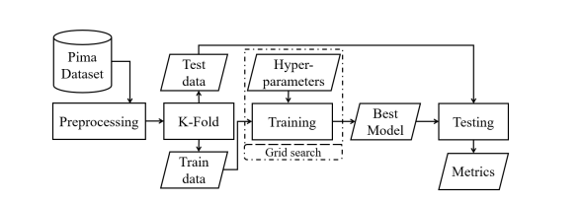

Slide 6
Dataset
768 female diabetic patients from the Pima Indian population near Phoenix, Arizona.
268 diabetic patients (positive) and 500 non-diabetic patients (negative) with eight different attributes.

Slide 7
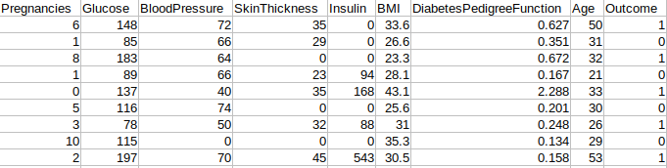
Shape of dataset

Slide 8
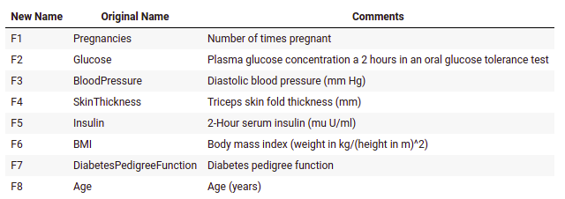
Metadata

Slide 9

Preprocessing (Outlier rejection)
Calculate the interquartile range for the data.
Multiply the interquartile range (IQR) by 1.5 (a constant used to discern outliers).
Add 1.5 x (IQR) to the third quartile. Any number greater than this is a suspected outlier.
Subtract 1.5 x (IQR) from the first quartile. Any number less than this is a suspected outlier.
1.5 controls the sensitivity of the range and hence the decision rule. A bigger scale would make the outlier(s) to be considered as data point(s) while a smaller one would make some of the data point(s) to be perceived as outlier(s).

Slide 10

Preprocessing (Handle Missing values)
The missing or null values were imputed by the mean values of the attributes rather than dropping.
The imputation with the mean is beneficial as it imputes the continuous data without introducing outliers

Slide 11

Preprocessing (Standardization)
The standardization or Z-score normalization is the technique to rescale the attributes for achieving standard normal distribution
This reduces skewness.

Slide 12
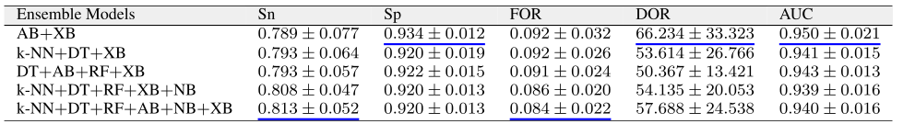

Slide 13
Results
KNN | DT | RF | AB | NB | XB
0.926+/-0.022 | 0.911+/-0.007 | 0.939+/-0.019 | 0.94+/-0.018 | 0.879+/-0.025 | 0.946+/-0.02

Slide 14
BloodPressure prediction
Swap BloodPressure with the target label
Categorize the BP
Diastolic blood pressure
0 for low (BP <= 80)
1 for high (BP > 80)
Data
Total records - 636
Low - 504
High - 132

Slide 15
Glucose prediction
Swap Glucose with the target label
Categorize the Glucose
oral glucose tolerance test
0 for low (Glucose <= 140)
1 for high (Glucose > 140)
Data
Total records - 636
Low - 499
High - 137

Slide 16
Evaluation Metric
StratifiedKFold was used for cross-validation (splits = 5)
Mean of folds using:
F1 Score
AUCs

Slide 17

Results

Slide 18
Multi-class

Slide 19
BloodPressure prediction
Swap BloodPressure with the target label
Categorize the BP
Diastolic blood pressure
0 for low (BP <= 60)
1 for normal (60 < BP < 85)
2 for high (BP >= 80)
Data
Total records - 636
Low - 107
Normal - 362
High - 167

Slide 20
Glucose prediction
Swap Glucose with the target label
Categorize the Glucose
oral glucose tolerance test
0 for low (Glucose <= 70)
1 for normal (70 < Glucose < 125)
2 for high (Glucose > 125)
Data
Total records - 636
Low - 10
Normal - 232
High - 394

Slide 21
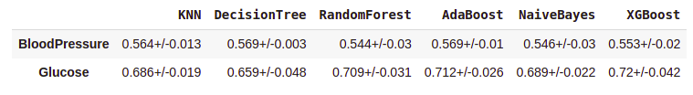
Multi-class
Results

Slide 22
Multi-class (w/ dim reduction)

Slide 23
BloodPressure prediction
Target
BloodPressure
Technique
PCA
Components
8

Slide 24
Glucose prediction
Target
Glucose
Technique
PCA
Components
6

Slide 25
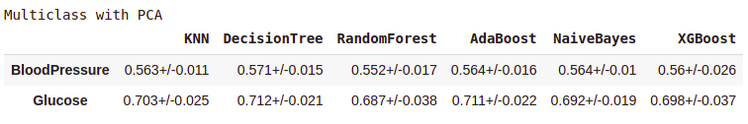
Results

Slide 26
Glucose prediction (Binary)
Swap Glucose with the target label
Categorize the Glucose
oral glucose tolerance test
0 for normal (Glucose < 125)
1 for prediabetes (Glucose >= 125)
Data
Total records - 636
Normal - 417
Prediabetes - 219

Slide 27
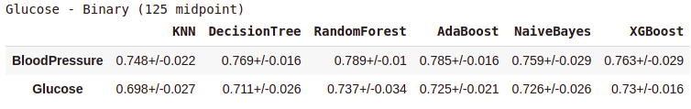
Results

Slide 28
Data Augmentation Multi Targets

Slide 29
BloodPressure prediction
Technique
SMOTE
Value counts (before)
0 (107)
1 (362)
2 (167)
Value counts (after)
0 (362)
1 (362)
2 (362)

Slide 30
Glucose prediction
Technique
SMOTE
Value counts (before)
0 (10)
1 (232)
2 (394)
Value counts (after)
0 (394)
1 (394)
2 (394)

Slide 31
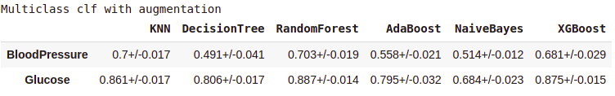
Results

Slide 32
Data Augmentation Binary Targets

Slide 33
BloodPressure prediction
Technique
SMOTE
Value counts (before)
0 (504)
1 (132)
Value counts (after)
0 (504)
1 (504)

Slide 34
Glucose prediction
Technique
SMOTE
Value counts (before)
0 (499)
1 (137)
Value counts (after)
0 (499)
1 (499)

Slide 35
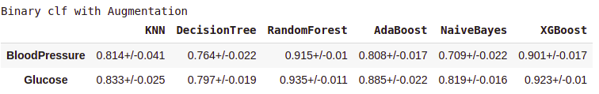
Results

