Slide 1
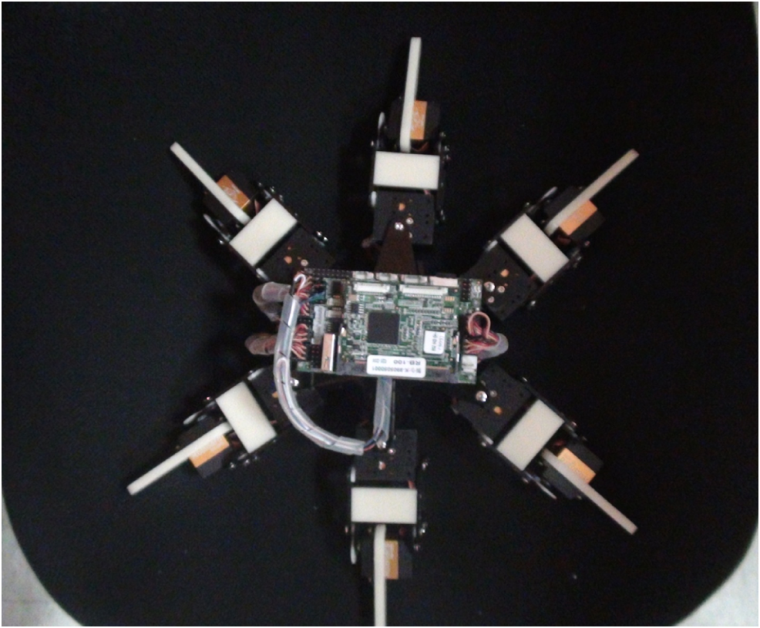

Diagram
S1
S2
S3
S22
S23
S24
S5
S6
S7
forward
S10
S11
S12
S14
S15
S16
S17
S18
S19

Slide 2
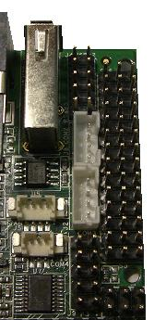
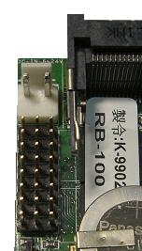
PWM 24ch
S16
S15
S14
S13
S12
S11
S10
S9
S8
S7
S5
S4
S3
S2
S1
S24
S23
S22
S21
S20
S19
S18
S17

