Slide 1

Container Technology Docker
Benj & Dänu, Bern, 3. September 2021

Slide 2
Container Technology Docker
Agenda
1. | Introduction to Containers
1.1. | What is a Container?
1.2. | Examples of Use
1.3. | Chances and Challenges
2. | Techlab

Slide 3

What is a Container?
Introduction to Containers

Slide 4
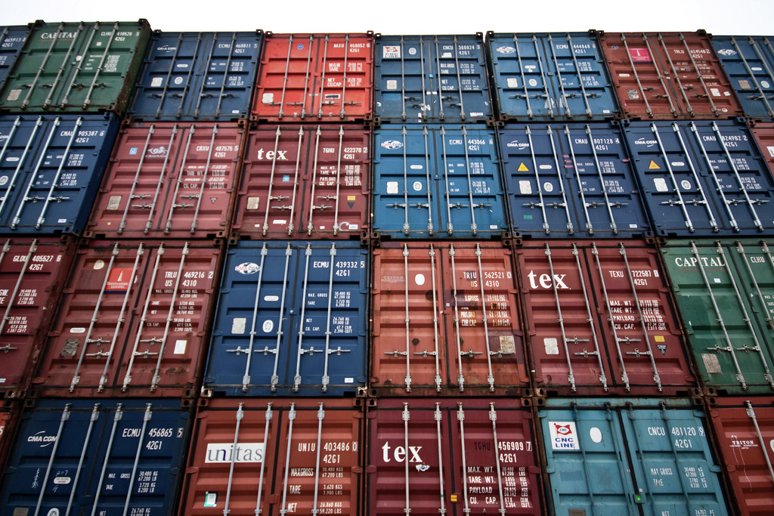
©Håkan Dahlström
Source: https://www.flickr.com/photos/dahlstroms/3144199355

Slide 5
Developments in IT
What is a Container?
1995

Slide 6
Developments in IT
What is a Container?
1995
Today

Slide 7
Plethora of Combinations
What is a Container?
Website
.NET
Java
Front-end
Queue
Batch
DB
Large number of services
Interaction between services
Large number of environments
Fast and easy migration
Pre Prod
Local
UAT
Prod
Pre Prod
Dev

Slide 8
Matrix from Hell
What is a Container?
 | Dev PC | Dev | Test | Prod | Cloud | Customer server | ...
Website | ? | ? | ? | ? | ? | ? | ?
Frontend | ? | ? | ? | ? | ? | ? | ?
Web-Service | ? | ? | ? | ? | ? | ? | ?
Database | ? | ? | ? | ? | ? | ? | ?
Queue | ? | ? | ? | ? | ? | ? | ?
Application | ? | ? | ? | ? | ? | ? | ?

Slide 9
Goods Traffic before 1960
What is a Container?

Slide 10
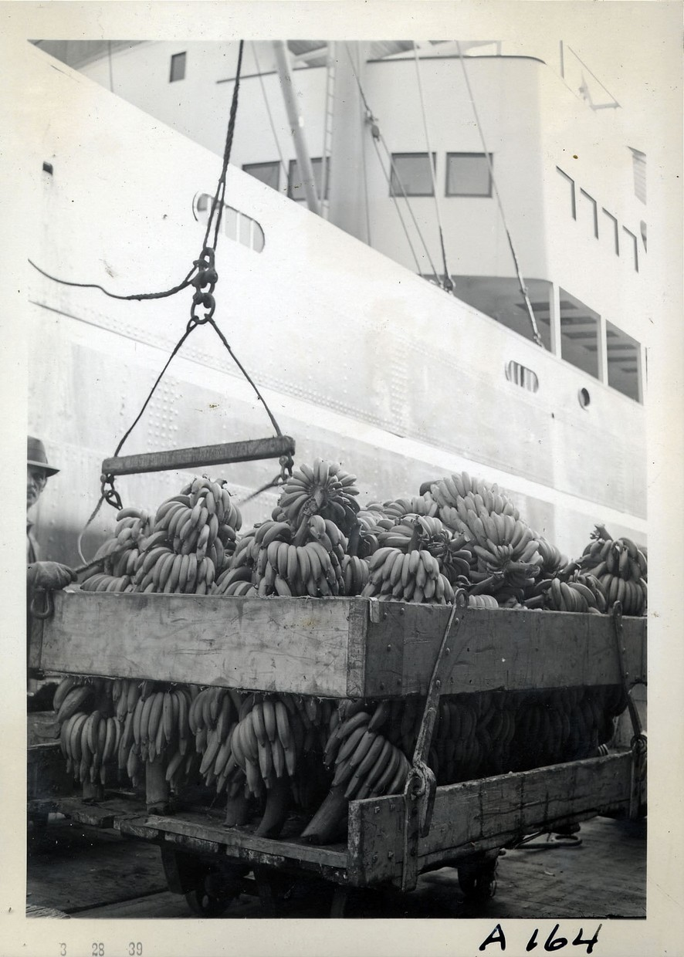
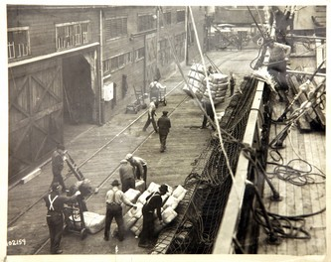
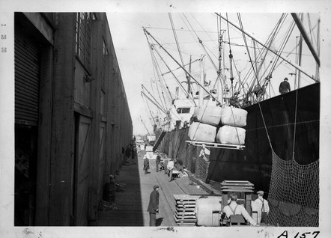

Slide 11






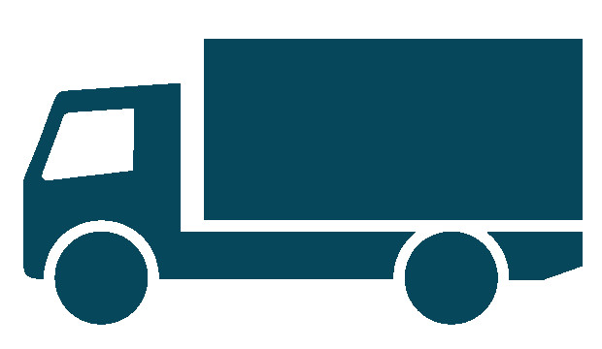


Plethora of Combinations
What is a Container?
Large number of goods
Interaction between goods
Large number of routes
Fast and smooth transport
Pre Prod

Slide 12
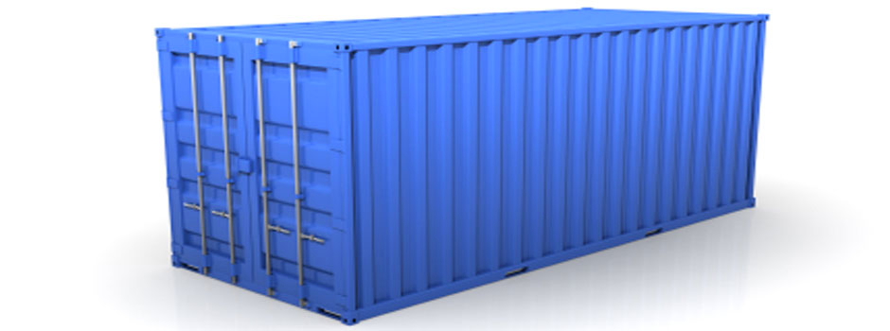
Solution
What is a Container?
Large number of goods
Interaction between goods
Large number of routes
Fast and smooth transport
Pre Prod

Slide 13
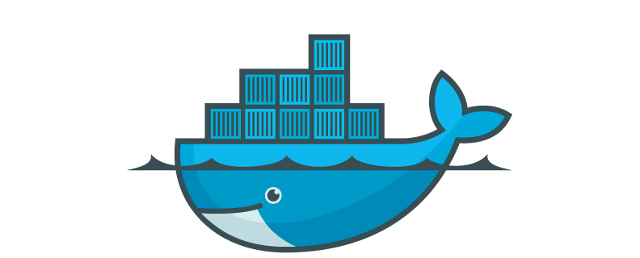
Application in Containers
What is a Container?
Website
.NET
Java
Front-end
Queue
Batch
DB
Large number of services
Interaction between services
Large number of environments
Fast and easy migration
Local
UAT
Prod
Pre Prod
Dev

Slide 14

Matrix Reloaded
What is a Container?
 | Dev PC | Dev | Test | Prod | Cloud | Customer server | ...
Website
Frontend
Web-Service
Database
Queue
Application

Slide 15
Purpose
What is a Container?
Standardized mechanism for building, deploying and operating applications
Isolation of applications
Clear definition of interfaces between application and platform
Potential to unifiy workflows
Dev and test environments analog to production

Slide 16
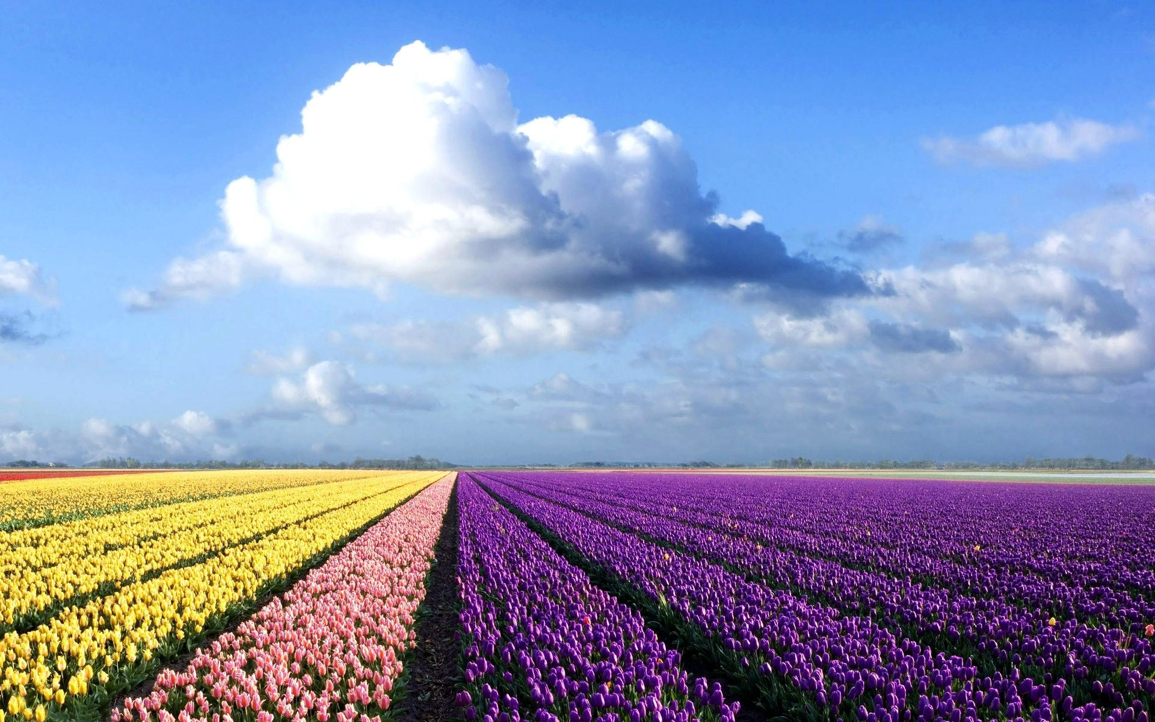

Slide 17
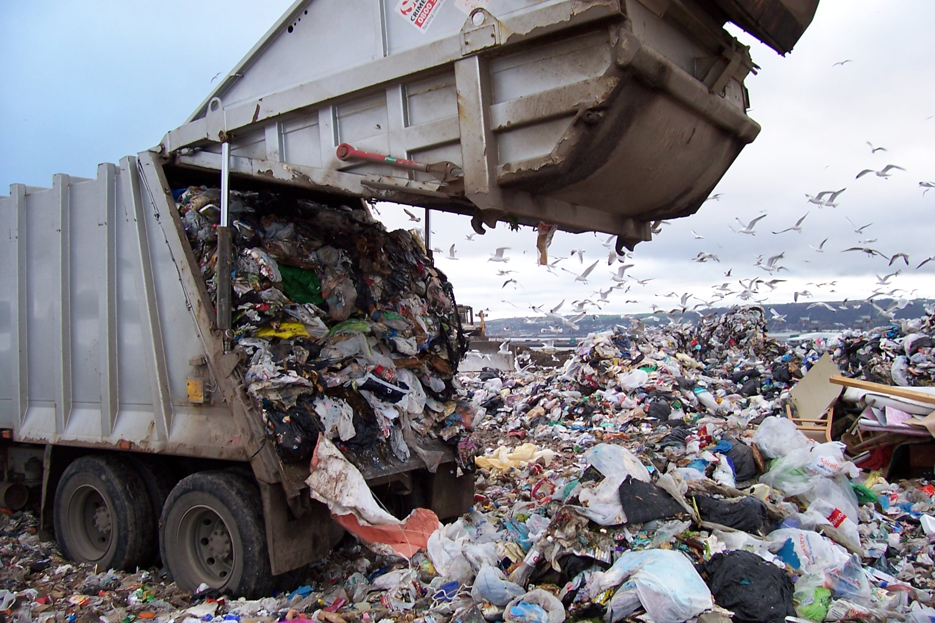

Slide 18
Hello World Docker Example
What is a Container?
docker run fedora-minimal /bin/echo "Hello world"

Slide 19
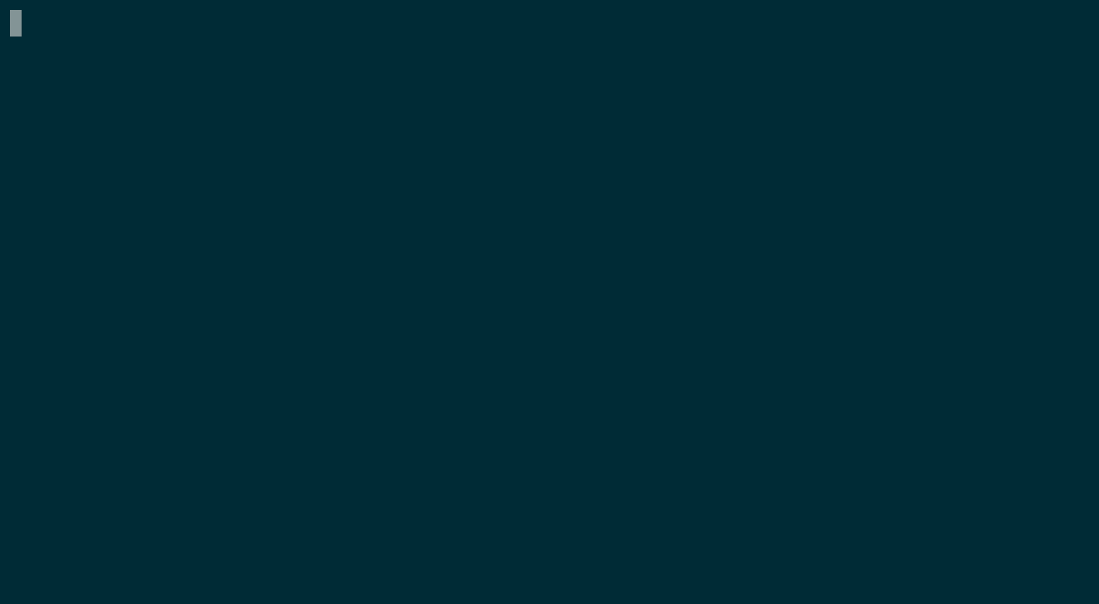

Slide 20
What happend in the background?
What is a Container?
Container start
Allocation of filesystem
Mount of a read/write filesystem layer
Attachment of networking layer
Execution of `echo` command
Output to my console
Container stop

Slide 21
<1s
What is a Container?

Slide 22
What is a Container?

Slide 23
Nothing new!
LXC, VServer, Free BSD Jails, Google...
What is a Container?

Slide 24
Virtualization vs. Containerization
What is a Container?
app
app
lib
lib
app
app
os
os
lib
lib
Hypervisor
os
os
Hardware
Hardware

Slide 25
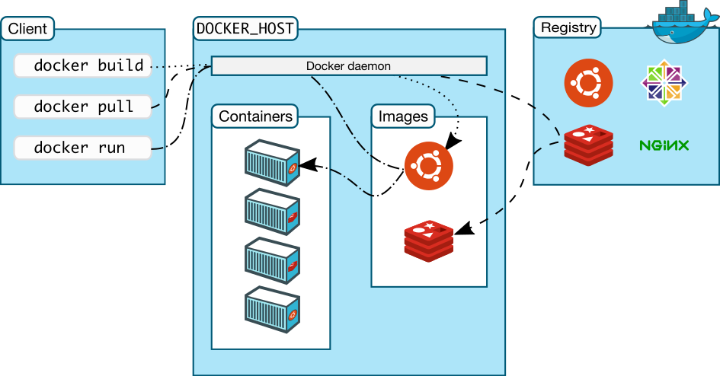
Docker Architecture
What is a Container?

Slide 26
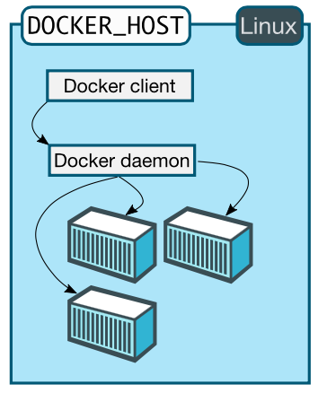
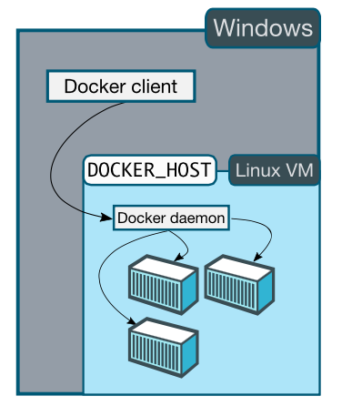
Docker Architecture on Windows
What is a Container?

Slide 27
Docker Hub
What is a Container?
Public registry
Lots of (official) container images
Build platform for your own images
Auto build and integration into GitHub
...

Slide 28
Behind the scenes
What is a Container?
Docker is implemented in GO
Namespaces (visibility)
Control Groups (resources)
Union File System

Slide 29
What is a Container?
Runtime FS
read-write
application.war + config
Wildfly
Dockerfile
read-only
Java
Ubuntu
Guest Kernel

Slide 30
Container Concepts
What is a Container?
Containers are immutable
Update a container by replacing it
  applies to applications and system patches
No local filesystem for data
Persistent storage

Slide 31
Dockerfile (1)
What is a Container?
FROM centos7
MAINTAINER Thomas Philipona <philipona@puzzle.ch>
EXPOSE 8080
# Install Java
RUN INSTALL_PKGS="tar unzip bc which lsof java-1.8.0-openjdk java-1.8.0-openjdk-devel" && \
yum install -y $INSTALL_PKGS && \
yum clean all -y

Slide 32
Dockerfile (2)
What is a Container?
...
USER 1001
# Add application source to image
ADD . /opt/app-root/src/
# build application and copy to correct location
RUN sh /opt/app-root/src/gradlew build && \
cp -a /opt/app-root/src/build/libs/springboots2idemo*.jar \
/opt/app-root/application.jar

Slide 33
Dockerfile (2)
What is a Container?
...
CMD ["java", "-Xmx64m", "-Xss1024k", "-jar",
"/opt/app-root/application.jar"]

Slide 34
Dockerfile Best Practices (1/2)
What is a Container?
Containers should be stateless, state should only exist in mounted volumes
One process per container
Keep number of layers small
Use a .dockerignore file
Log to stdout → let platform handle aggregation and rotation

Slide 35
Dockerfile Best Practices (2/2)
What is a Container?
Only use trusted base images
Automatic rebuild → security patches
Sort multiline arguments:
RUN apt-get update && apt-get install -y \
bzr \
cvs \
git \
mercurial \
subversion

Slide 36
Examples of Use
Introduction to Containers

Slide 37
LaTex Rendering
Examples of Use
Installation of a LaTex rendering infrastructure can be a pain (depending on
OS)…
Put it into a container!
Standardization, traceability, installation documentation, fast
docker run pdflatex -output-directory output /input.tex

Slide 38
Build infrastructure
Examples of Use
Java, JavaScript, Ruby on Rails, Node, …
Build tools in different versions for varying projects have to be installed...
Put it in a container (-:
Define the exact development environment for each application.
Reusable, fast, isolated.

Slide 39
Java EE application with WildFly
Examples of Use
Add your .war file and configuration into the image and let's go!
FROM jboss/wildfly
ADD app-web.war /opt/jboss/wildfly/standalone/deployments/
ADD standalone.xml /opt/jboss/wildfly/standalone/configuration/

Slide 40
And so on...
Examples of Use

Slide 41
Chances and Challenges
Introduction to Containers

Slide 42
Advantages
Chances and Challenges
Lightweight and fast
Standardized
Easy to use and extend
Large community
Lots of available images
"Works on my machine" was yesterday

Slide 43
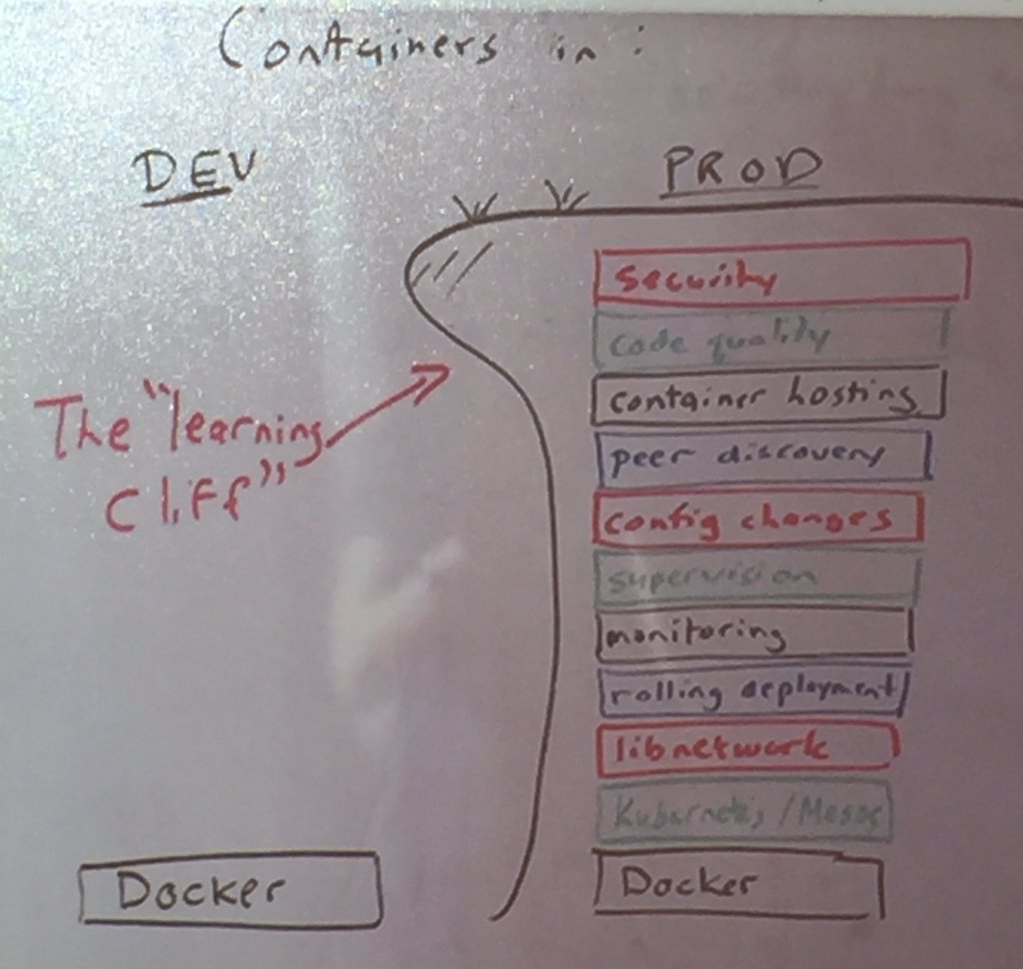
Chances and Challenges

Slide 44
Challenges: Security
Chances and Challenges
"Over 30% of Official Images in Docker Hub Contain High Priority Security Vulnerabilities":
ShellShock (Bash)
Heartbleed (OpenSSL)
Poodle (OpenSSL)
...
Source: http://www.banyanops.com/blog/analyzing-docker-hub/
May 2015: Jayanth Gummaraju, Tarun Desikan and Yoshio Turner

Slide 45
Challenges: Security
Chances and Challenges
Treat processes as if they were running on the host
Do not let processes run as root
Only open necessary ports
Sources: https://opensource.com/business/14/7/docker-security-selinux
http://www.pro-linux.de/news/1/22315/docker-erh%C3%B6ht-die-sicherheit.html

Slide 46
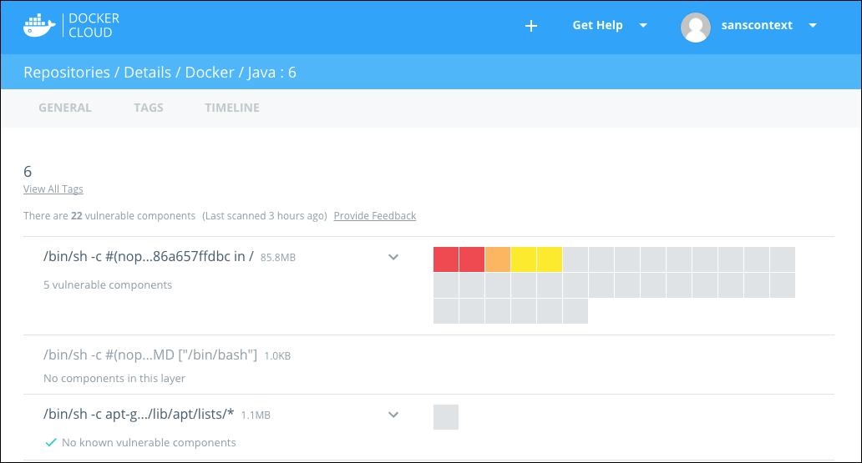
Docker Security Scanning
Chances and Challenges

Slide 47
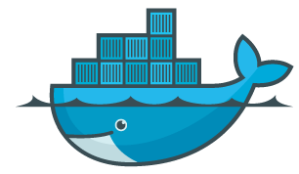
Challenges: Operations
Chances and Challenges
Storage
Lifecycle
Containers & Infrastrucuture
Backup
Monitoring
Network
Log Server
Databases
Jenkins
Mail Server

Slide 48
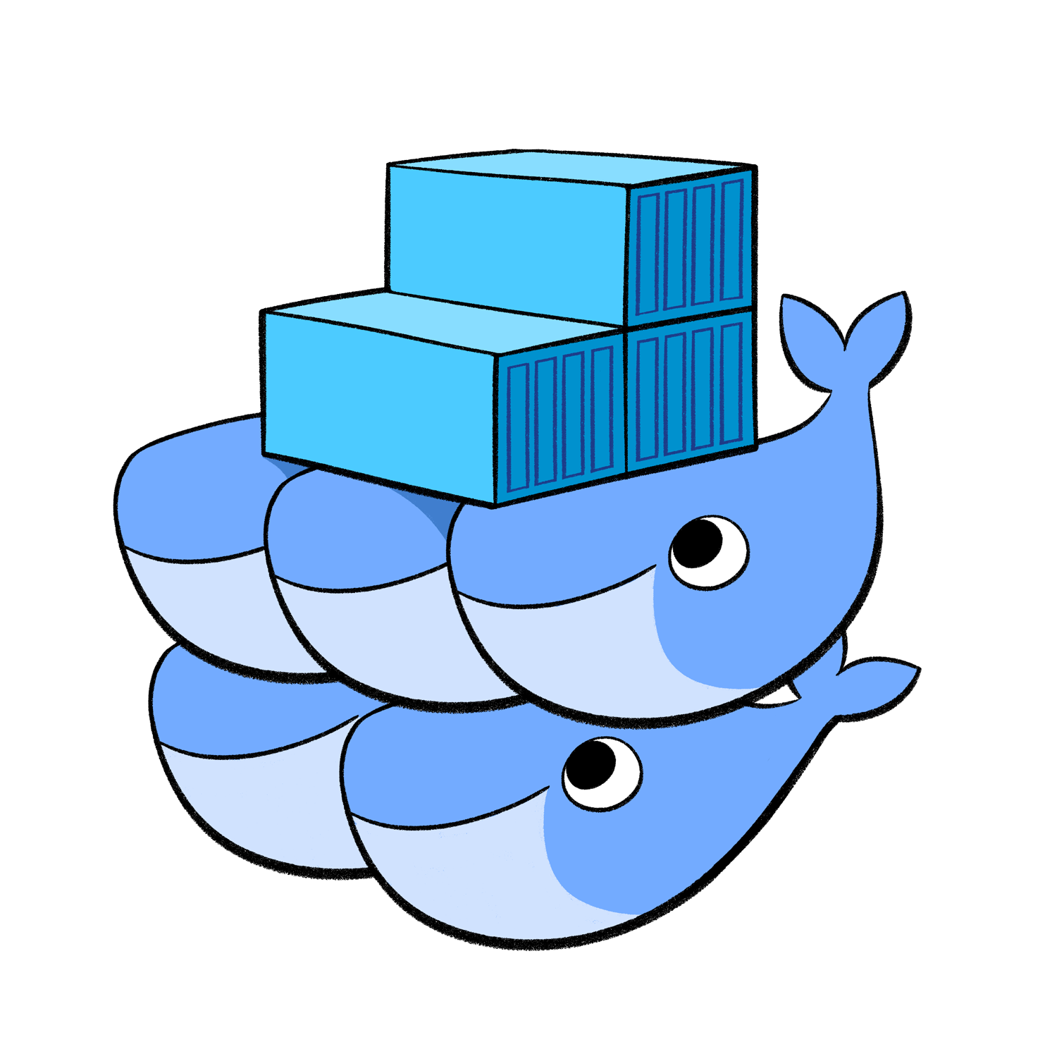
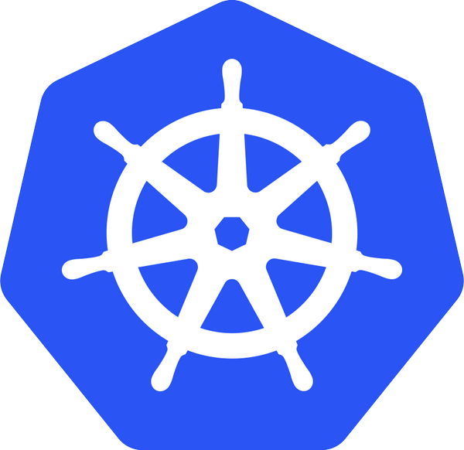



Deployment and Orchestration
Chances and Challenges

Slide 49


