Slide 1
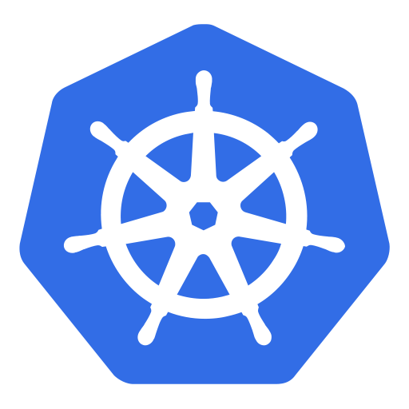
Kubernetes (k8s)

Slide 2
Ku.b.e.r.n.e.t.e.s (k8s)
Greek for "governor", "helmsman" or "captain")

Slide 3
Agenda
What is Kubernetes?
Kubernetes Concepts
Hands on Lab
Kubernetes – Architecture

Slide 4
Kubernetes – What is it?
1

Slide 5



Kubernetes – What is it?
Kubernetes is a powerful open-source system, initially developed by Google, for managing containerized applications in a clustered environment. It aims to provide better ways of managing related, distributed components and services across varied infrastructure.
Notes:
Opensource Projekt, entwickelt und betrieben von google

Slide 6
History
Founded by Google: Joe Beda, Brendan Burns and Craig McLucki
Development and design are heavily influenced by Google's Borg system.
Original codename for Kubernetes within Google was Project Seven of Nine, the « friendlier » Borg
Kubernetes v1.0 was released on July 21, 2015.
Google partnered with the Linux Foundation to form the Cloud Native Computing Foundation (CNCF)

Slide 7
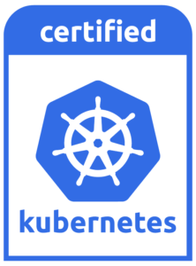



Certified Kubernetes
Consistency users want consistency when interacting with any installation of Kubernetes.
Timely Updates vendors need to provide the latest version of Kubernetes yearly or more frequently, so you can be sure that you’ll always have access to the latest features the community has been working hard to deliver.
Confirmability any end user can confirm that their distribution or platform remains conformant by running the identical open source conformance application (Sonobuoy) that was used to certify.
https://www.cncf.io/certification/software-conformance/

Slide 8
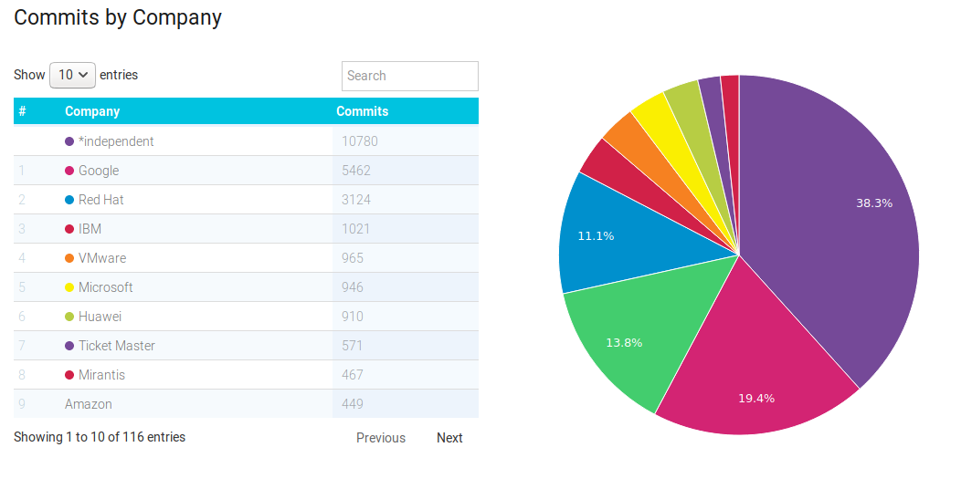
Kubernetes Community Contributions
https://www.stackalytics.com/?release=all&project_type=kubernetes-group&metric=commits

Slide 9

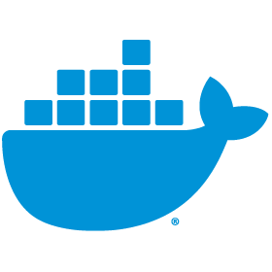
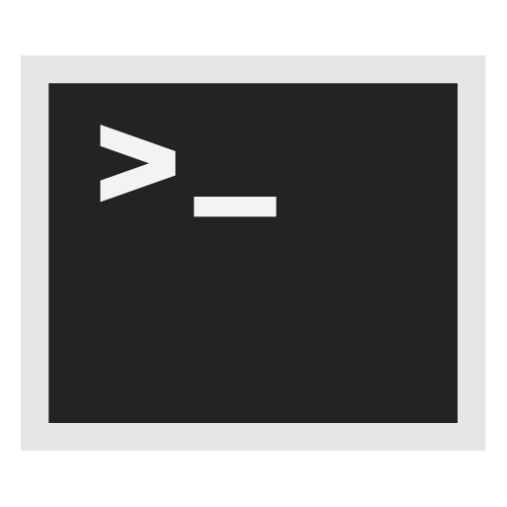
Kubernetes – What is it?
Kubernetes, at its basic level, is a system for running and coordinating containerized applications across a cluster of machines. It is a platform designed to completely manage the life cycle of containerized applications and services using methods that provide predictability, scalability, and high availability.
Notes:
Automatisiert das einrichten, betreiben und skalieren von Containerumgebungen

Slide 10
Kubernetes – Concepts
2

Slide 11
Kubernetes Objects

Slide 12
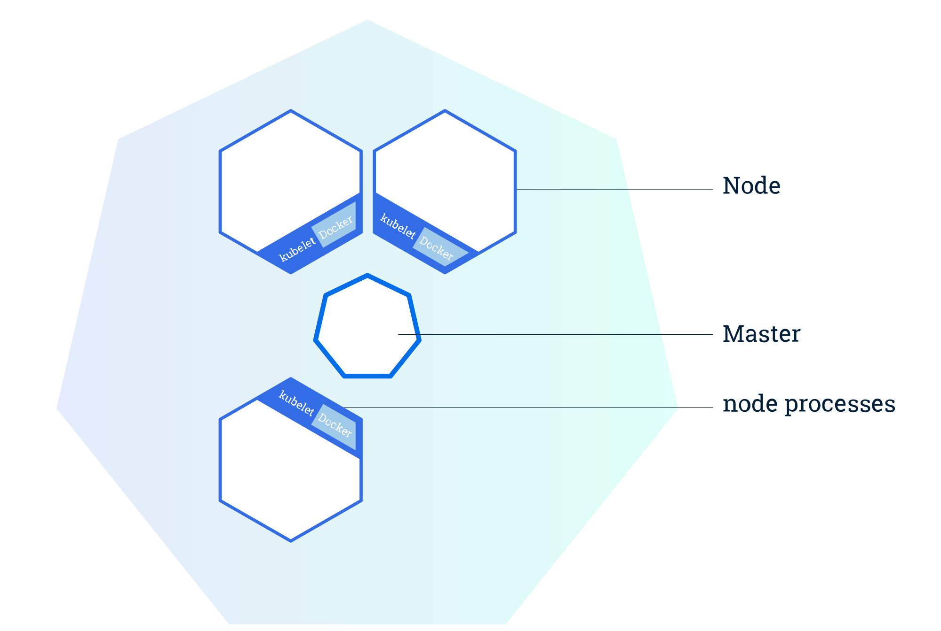
Cluster
© 2018 The Kubernetes Authors | Documentation Distributed under CC BY 4.0
Notes:
Besteht aus zwei Komponenten : Master und Nodes
Master API
kubectl
etcd

Slide 13
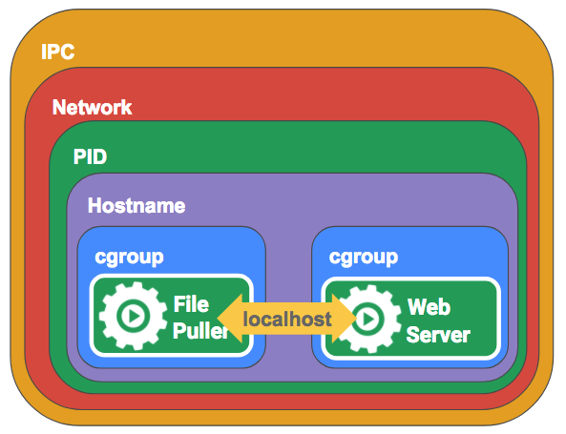
Kubernetes Objects
Pod is the smallest deployable unit on a Node. It’s a group of containers which must run together. Quite often, but not necessarily, a Pod usually contains one container. https://kubernetes.io/docs/concepts/workloads/pods/pod-overview/
Volume is essentially a directory accessible to all containers running in a Pod. https://kubernetes.io/docs/concepts/storage/volumes/

Slide 14
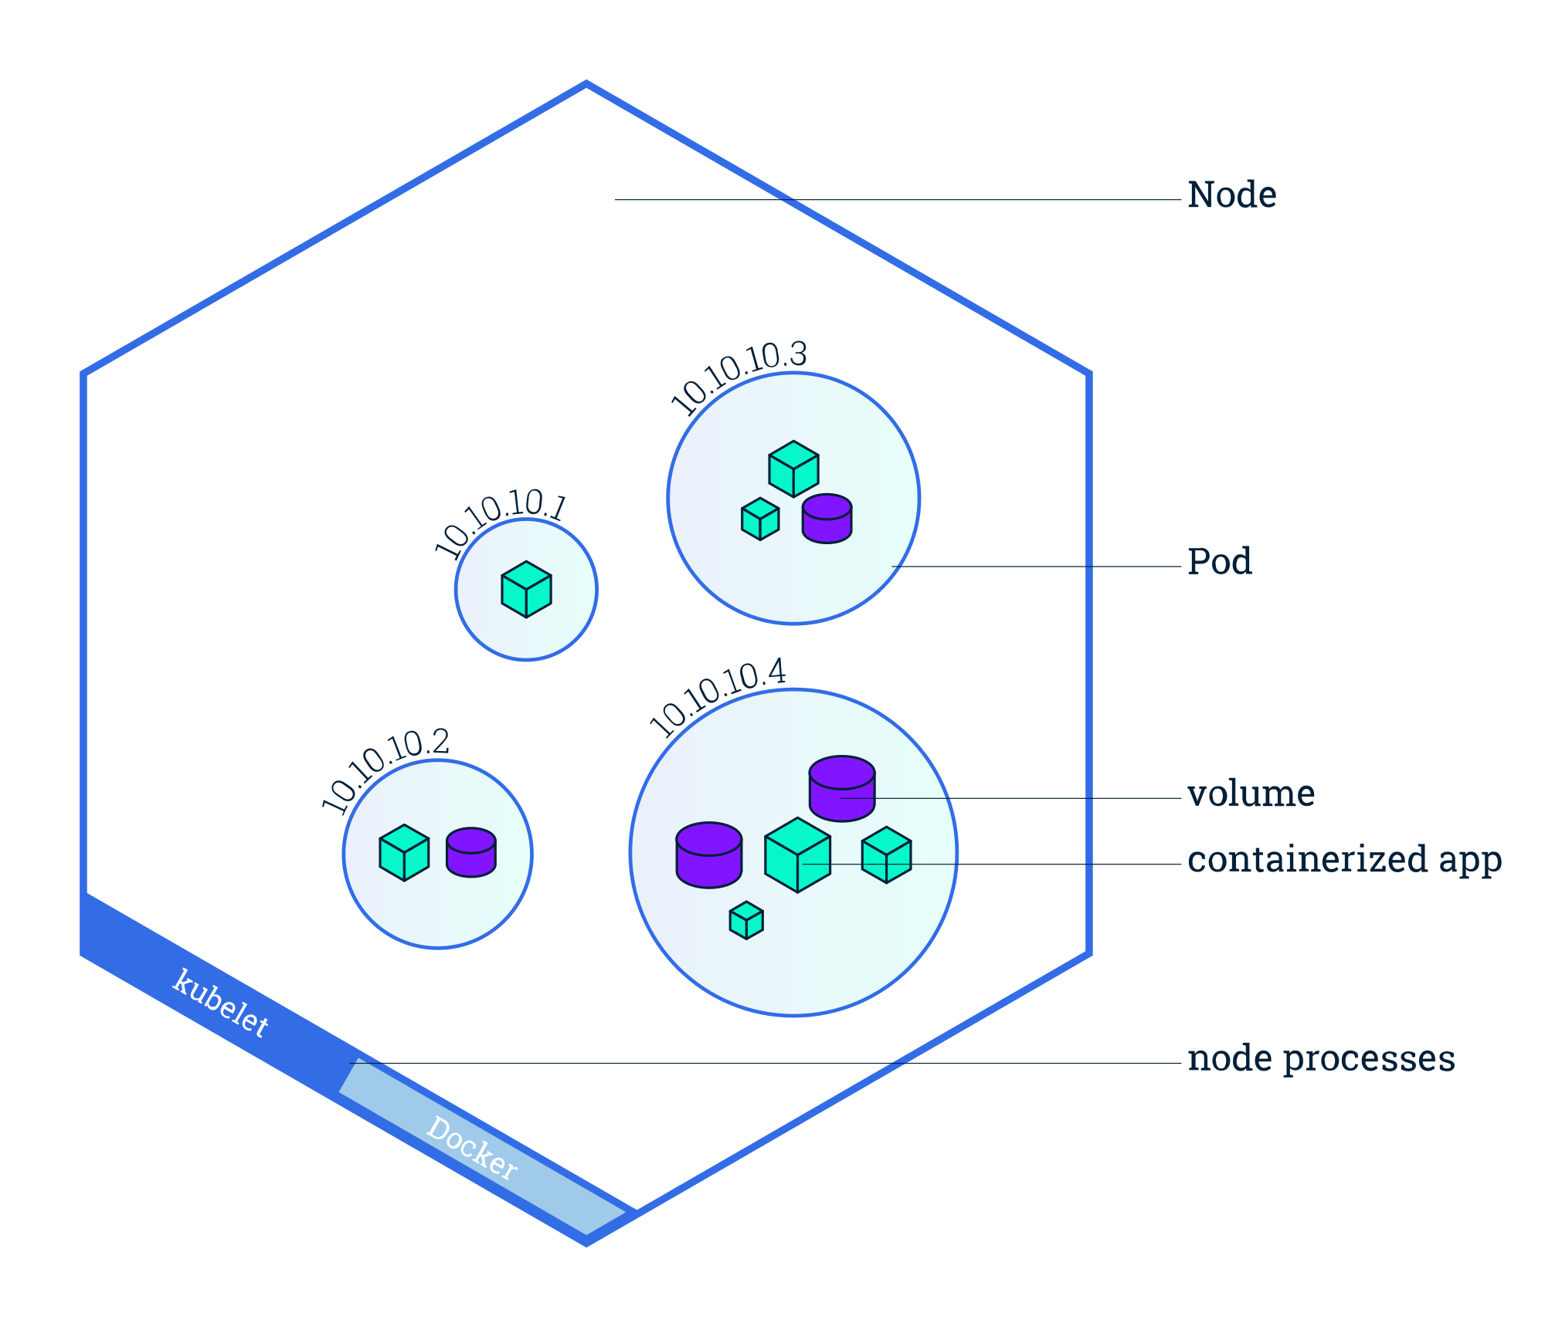
Pods
© 2018 The Kubernetes Authors | Documentation Distributed under CC BY 4.0
Notes:
Besteht aus zwei Komponenten : Master und Kubernetes/Worker Node(s) (Minion(s))

Slide 15
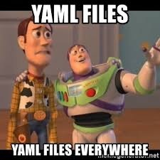
Pods
apiVersion: v1
kind: Pod
metadata:
name: nginx
labels:
name: nginx
spec:
containers:
- name: nginx
image: nginx

Slide 16
Kubernetes Objects
apiVersion: apps/v1
kind: ReplicaSet
metadata:
name: frontend
labels:
app: guestbook
tier: frontend
spec:
replicas: 3
selector:
matchLabels:
tier: frontend
template:
metadata:
labels :
tier: frontend
spec:
containers:
- name: nginx
image: nginx
Replication Set is an object that defines a pod template and control parameters to scale identical replicas of a pod horizontally by increasing or decreasing the number of running copies.
https://kubernetes.io/docs/concepts/workloads/controllers/replicaset/

Slide 17
Kubernetes Objects
apiVersion: apps/v1
kind: Deployment
metadata:
name: frontend
labels:
app: guestbook
tier: frontend
spec:
replicas: 3
strategy:
type: RollingUpdate
selector:
matchLabels:
tier: frontend
template:
metadata:
labels :
tier: frontend
spec:
containers:
- name: nginx
image: nginx
Deployments are one of the most common workloads to directly create and manage. Deployments use replication sets as a building block, adding flexible life cycle management functionality to the mix.
https://kubernetes.io/docs/concepts/workloads/controllers/deployment/

Slide 18
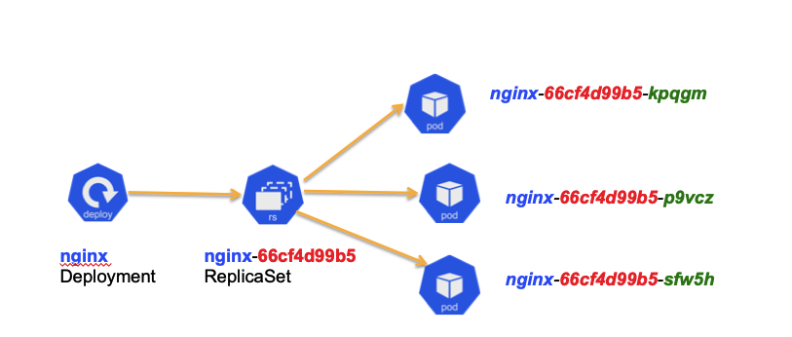
Deployments & Replication Set

Slide 19
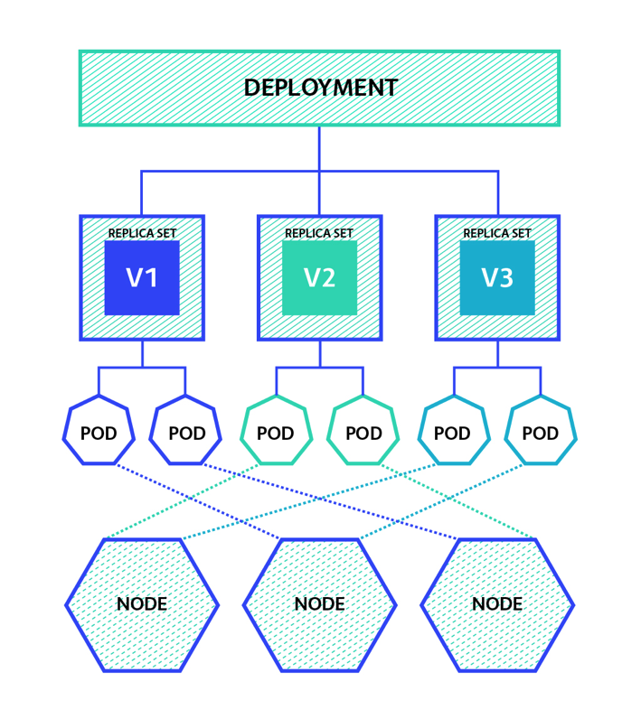
Deployments & Replication Set

Slide 20
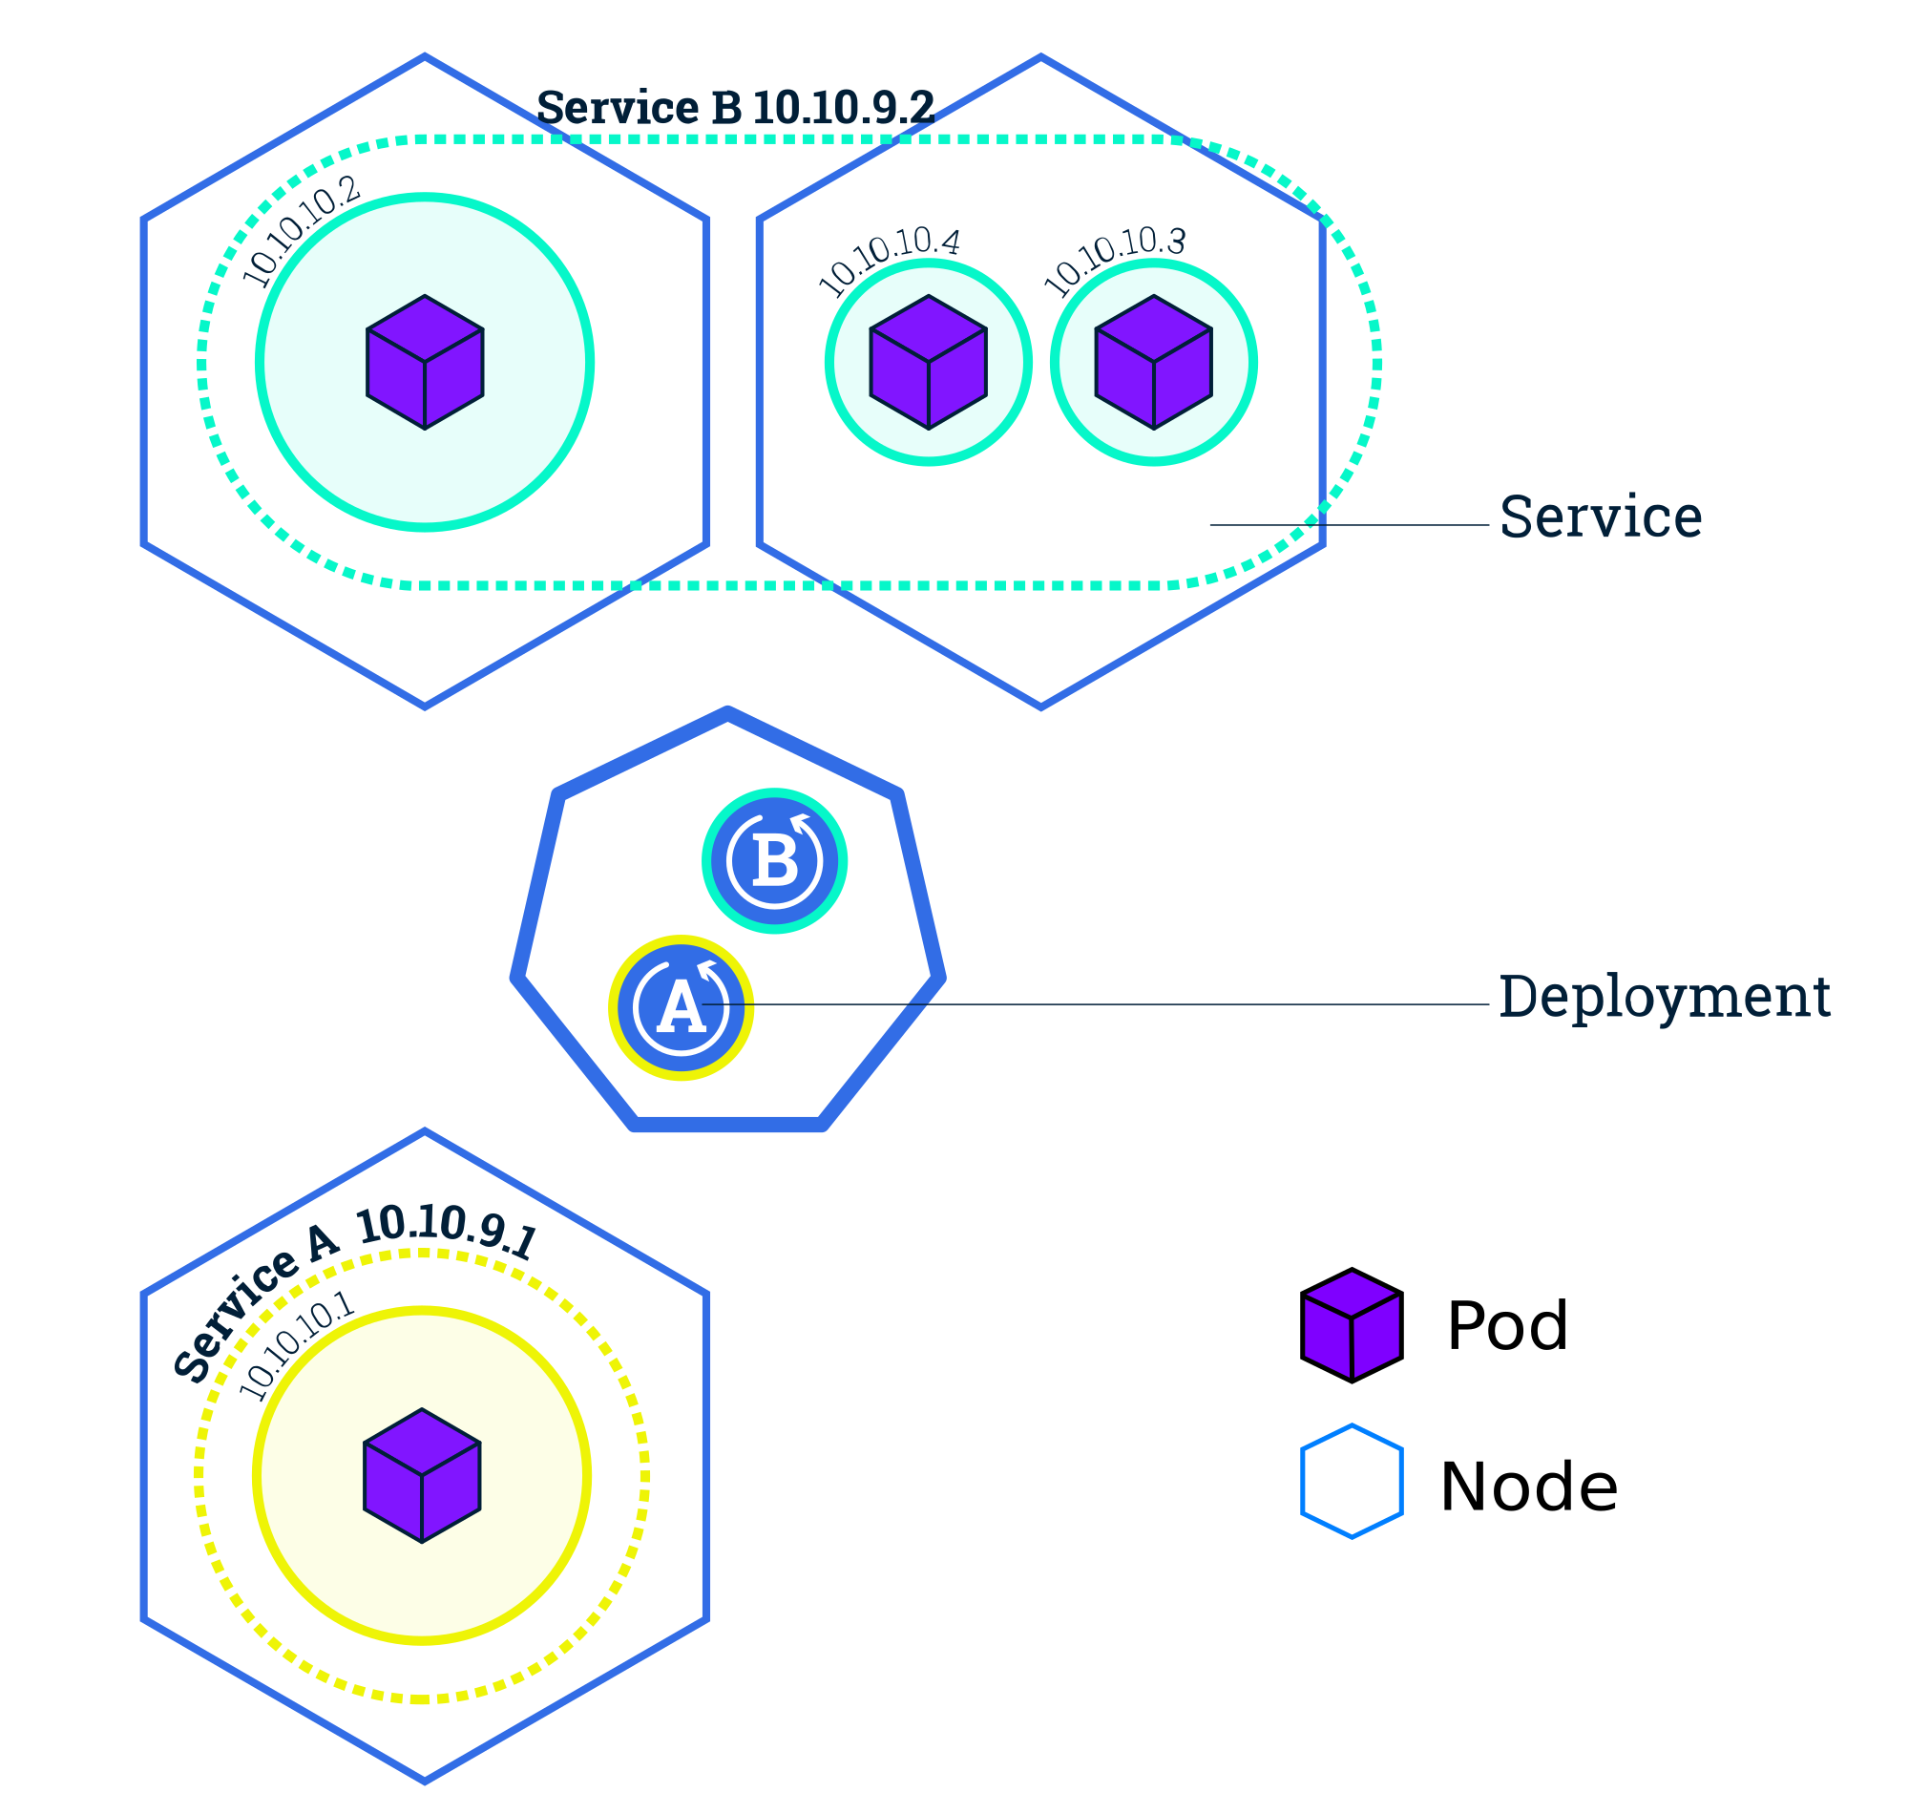
Kubernetes Objects
Service is used to define a logical set of Pods and related policies used to access them. https://kubernetes.io/docs/concepts/services-networking/service/

Slide 21
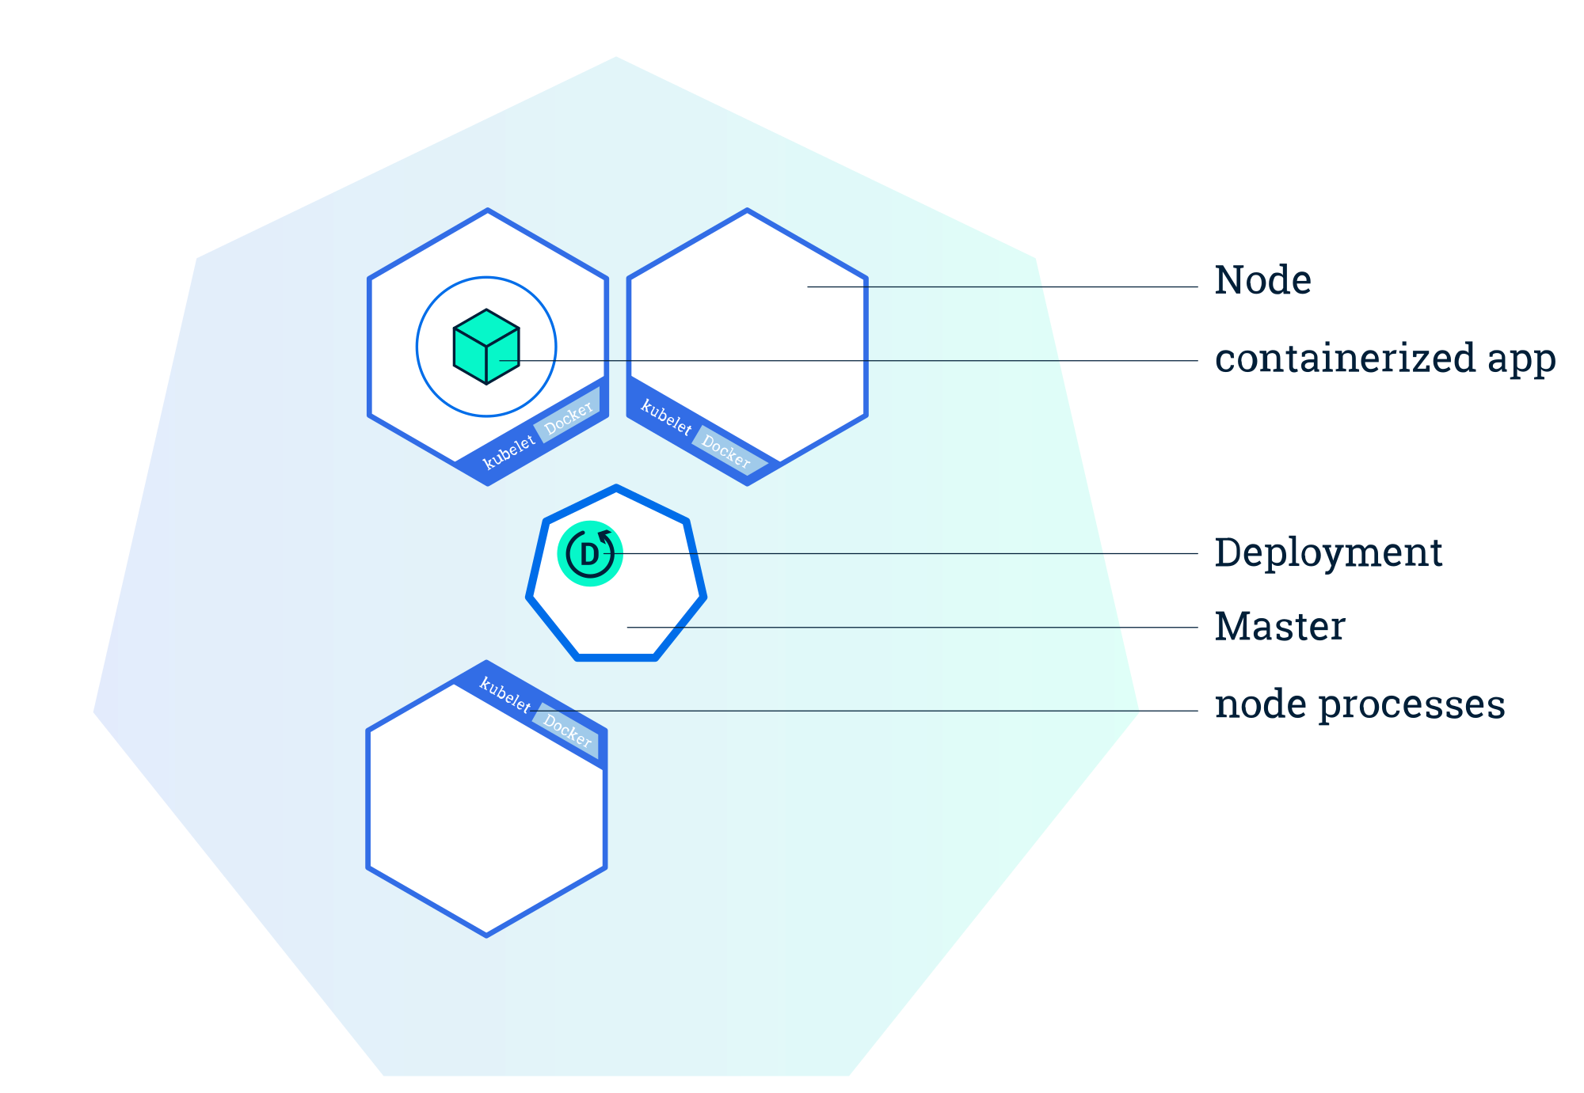
Deploy an app
© 2018 The Kubernetes Authors | Documentation Distributed under CC BY 4.0
Notes:
Besteht aus zwei Komponenten : Master und Kubernetes/Worker Node(s) (Minion(s))

Slide 22
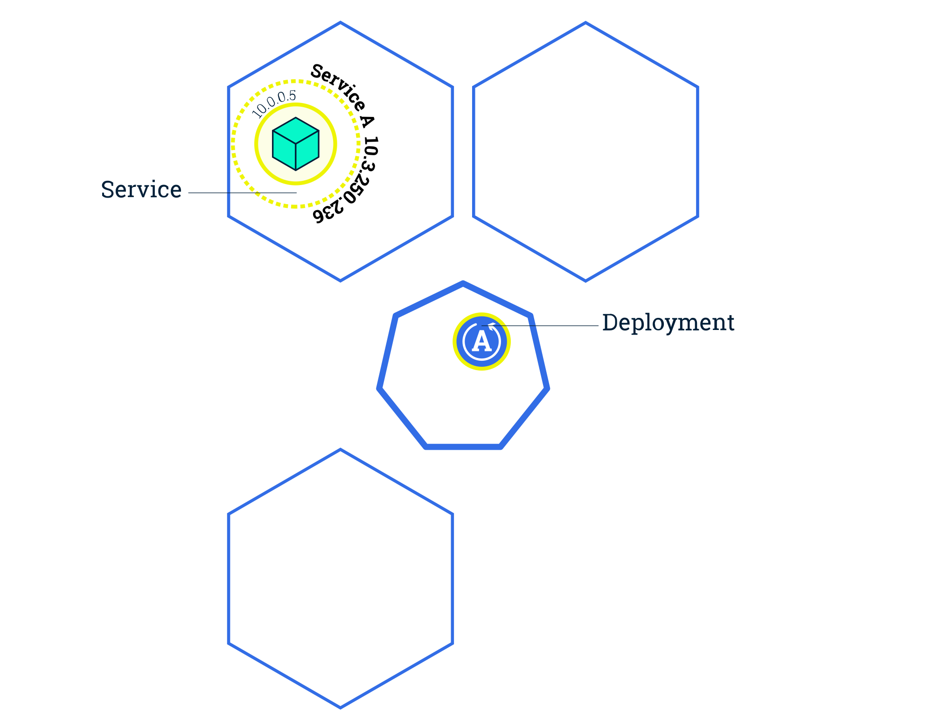
Scaling
© 2018 The Kubernetes Authors | Documentation Distributed under CC BY 4.0
Notes:
Besteht aus zwei Komponenten : Master und Kubernetes/Worker Node(s) (Minion(s))

Slide 23
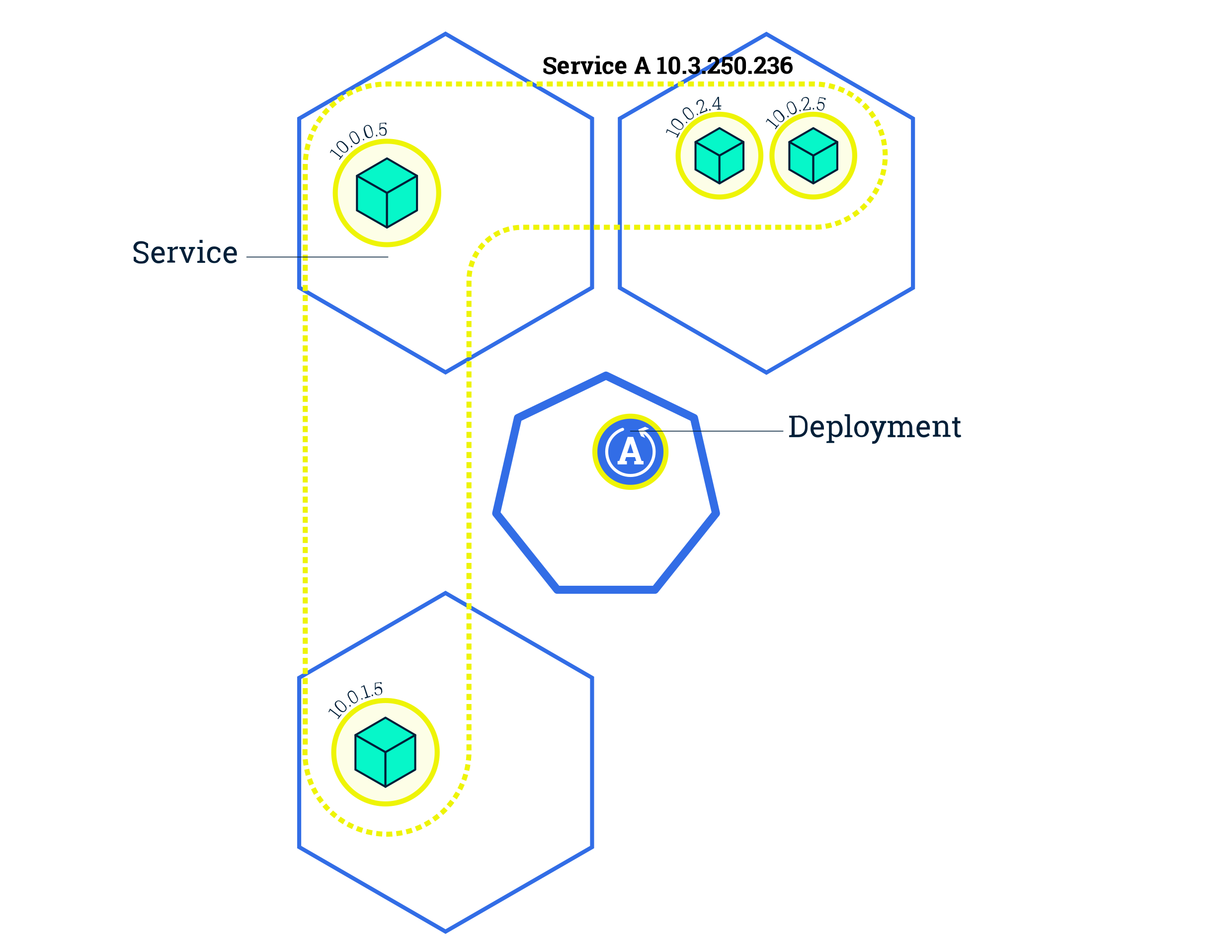
Scaling
© 2018 The Kubernetes Authors | Documentation Distributed under CC BY 4.0
Notes:
Besteht aus zwei Komponenten : Master und Kubernetes/Worker Node(s) (Minion(s))

Slide 24
Kubernetes Objects
Namespaces are virtual clusters backed by the physical cluster. https://kubernetes.io/docs/concepts/overview/working-with-objects/namespaces/
Namespaces are intended for use in environments with many users spread across multiple teams, or projects.
Namespaces provide a scope for names. Names of resources need to be unique within a namespace, but not across namespaces. Namespaces can not be nested inside one another and each Kubernetes resource can only be in one namespace.
Namespaces are a way to divide cluster resources between multiple users (via resource quota).

Slide 25
Communication

Slide 26
Kubernetes – Communication
Highly-coupled container to container communication
Pod to pod communication
Pod to service communication
External to service communication

Slide 27

Kubernetes – Network Model
All containers can communicate with each other without NAT
All nodes can communicate with containers without NAT
The IP address a container sees for itself is the same address everyone else sees
https://kubernetes.io/docs/concepts/cluster-administration/networking/#the-kubernetes-network-model

Slide 28
Perstistent Storage

Slide 29
Persistent Storage
A PersistentVolume (PV) is a piece of storage in the cluster that has been provisioned by an administrator or dynamically provisioned using Storage Classes. It is a resource in the cluster just like a node is a cluster resource. PVs are volume plugins like Volumes, but have a lifecycle independent of any individual pod that uses the PV. This API object captures the details of the implementation of the storage, be that NFS, iSCSI, or a cloud-provider-specific storage system.
A PersistentVolumeClaim (PVC) is a request for storage by a user. It is similar to a pod. Pods consume node resources and PVCs consume PV resources. Pods can request specific levels of resources (CPU and Memory). Claims can request specific size and access modes (e.g., can be mounted once read/write or many times read-only).
https://kubernetes.io/docs/concepts/storage/persistent-volumes/

Slide 30
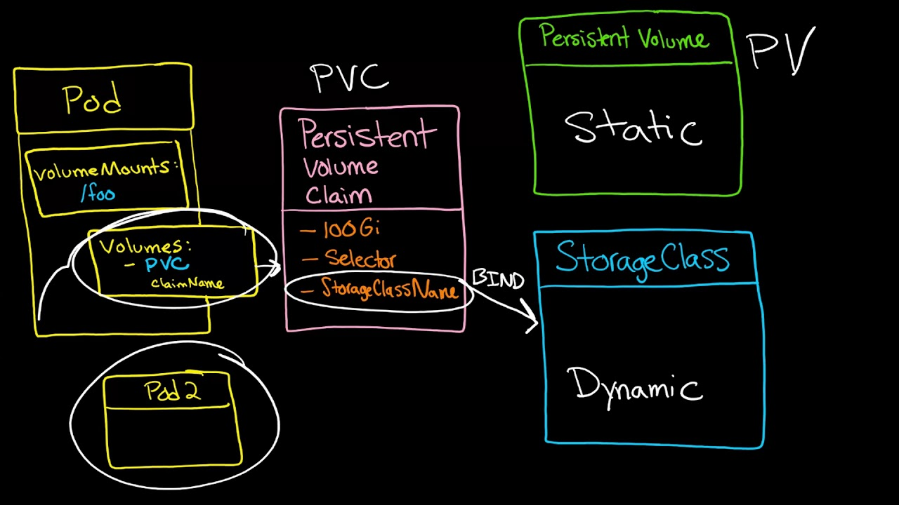
Persistent Storage

Slide 31


Persistent storage example
https://app.kube.puzzle.ch
10.0.0.1
10.0.0.2
10.0.0.3
Persistent
Storage
10.0.0.4
Notes:
Via Route im Netz verfügbar
Loadbalancing auf Pods
oc scale dc app --replicas=3
Verbunden über transparentes Software Defined Network (SDN)
Projekt-Setup als JSON exportier- / importierbar

Slide 32

Persistent storage example
https://app.kube.puzzle.ch
10.0.0.1
10.0.0.2
10.0.0.3
Persistent
Storage
10.0.0.4

Slide 33
Persistent storage example
https://app.kube.puzzle.ch
10.0.0.1
10.0.0.2
10.0.0.3
Persistent
Storage
10.0.0.4
Notes:
Pod wird neu gestartet
Gleiche Adresse
Persistent Volume wandert mit

Slide 34
Hands On Lab
3

Slide 35
Hand on Lab
URLs
https://github.com/puzzle/kubernetes-techlab/tree/rancherversion
https://github.com/puzzle/kubernetes-techlab/archive/rancherversion.zip https://rancher.puzzle.ch
Access Information
Username : (will be given by your teacher)
Password : (will be given by your teacher)
Project : techlab

Slide 36
Kubernetes – Architecture
4

Slide 37
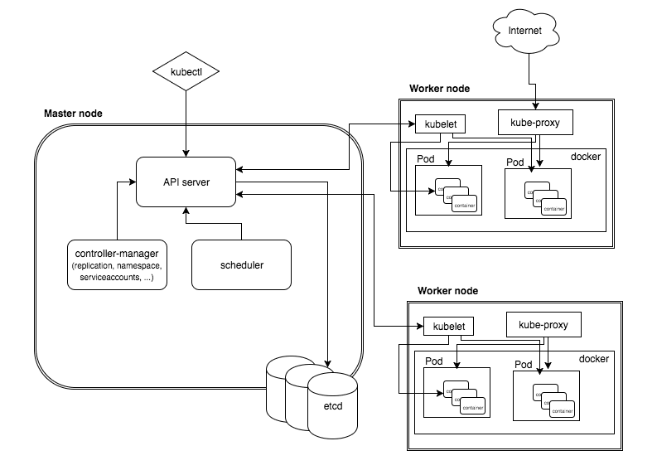
High Level Architecture

Slide 38
Master Node
The master node is responsible for the management of Kubernetes cluster. This is the entry point of all administrative tasks. The master node is the one taking care of orchestrating the worker nodes, where the actual services are running.

Slide 39
Master Node – Components - 1
API Server
The API server is the entry points for all the REST commands used to control the cluster. It processes the REST requests, validates them, and executes the bound business logic. The result state has to be persisted somewhere, and that brings us to the next component of the master node.
Etcd storage
etcd is a simple, distributed, consistent key-value store. It provides a REST API for CRUD operations as well as an interface to register watchers on specific nodes, which enables a reliable way to notify the rest of the cluster about configuration changes.

Slide 40
Master Node – Components - 2
scheduler
The deployment of configured pods and services onto the nodes happens thanks to the scheduler component.
The scheduler has the information regarding resources available on the members of the cluster, as well as the ones required for the configured service to run and hence is able to decide where to deploy a specific service.
controller-manager
A controller uses apiserver to watch the shared state of the cluster and makes corrective changes to the current state to change it to the desired one.
An example of such a controller is the Replication controller, which takes care of the number of pods in the system. The replication factor is configured by the user, and it's the controller’s responsibility to recreate a failed pod or remove an extra-scheduled one.

Slide 41
Worker Node
The pods are run here, so the worker node contains all the necessary services to manage the networking between the containers, communicate with the master node, and assign resources to the containers scheduled.

Slide 42
Worker Node – Components - 1
Docker
Docker runs on each of the worker nodes, and runs the configured pods. It takes care of downloading the images and starting the containers.
kubelet
kubelet gets the configuration of a pod from the apiserver and ensures that the described containers are up and running. This is the worker service that’s responsible for communicating with the master node.
It also communicates with etcd, to get information about services and write the details about newly created ones.

Slide 43
Worker Node – Components - 2
kube-proxy
kube-proxy acts as a network proxy and a load balancer for a service on a single worker node. It takes care of the network routing for TCP and UDP packets.
kubectl
And the final bit – a command line tool to communicate with the API service and send commands to the master node.

Slide 44

Thank you!

