Slide 1
Quarkus Basics
Training

Slide 2



Nice to meet you
Raffael Hertle
Senior Software Engineer
hertle@puzzle.ch
Max Burri
Senior Software Engineer
burri@puzzle.ch
Stephan Girod
Senior Software Engineer
girod@puzzle.ch
Stephan Girod
Senior Software Engineer
girod@puzzle.ch

Slide 3
One Team
Notes:
Puzzle ITC
Picture before pandemic
Opensource company headquarter in berne
140 Members
Software Engineering, System Engineering, UX
Cloud native centered, container kubernetes engineering, linux engineering

Slide 4

https://www.menti.com/yrj5e8s1io

Slide 5
Agenda - Day 1
Microservices architecture
Quarkus introduction
MicroProfile specification
RESTful microservices with Quarkus

Slide 6
Agenda - Day 2
8 fallacies of distributed computing
Cloud patterns
Continuous integration and delivery
Event driven architecture and messaging
Observability – Metrics and Tracing
Writing your own Quarkus extension

Slide 7
Day 1

Slide 8
Agenda - Day 1
Microservices architecture
Quarkus introduction
MicroProfile specification
RESTful microservices with Quarkus

Slide 9
Microservices
What are microservices
Why and when to use them
Advantages / Disadvantages
Approach to migrate
Notes:
Talked a lot about microservices
- What are microservices?
- Why and when to use them?
- Pitfalls from our experiences
- Approach to migration (strangler pattern)

Slide 10

Monolithic Architecture
Notes:
Monolith
UNESCO heritage site house Saudi Arabia
This is monolithic architecture (literally)
Try to replace or relocate kitchen in this thing – good luck

Slide 11
Monolithic Architecture
Single code-base
Single unit deployable
Independent from other applications
All domains or business processes in one application
Notes:
Software system held as a single codebase
Delivered and deployed as a single unit
Lifecycle of all units is connected.
If one piece wants to change, the entire system needs to be rolled out
Self contained application, mostly independent from other systems
Can perform all tasks of a needed process

Slide 12
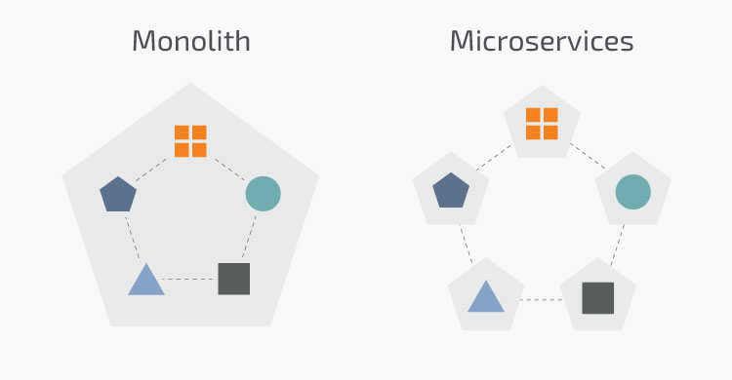
Microservices Architecture
Notes:
Microservices architecture
Monolithic house before
Split seperate domains into seperate services
Kitchen, Recreational space, bedroom single services
Independent from each other

Slide 13
Microservices Architecture
Small autonomous applications
Independent life cycles
Microservice for single responsibility / domain
Loosely coupled
Code base per domain / business process
Notes:
Hard to define
Small autonomous applications
Independent life cycles
Single service for single responsibility / domain
Loosens coupling
Code base per domain / business process

Slide 14
Microservices Architecture
When to choose which architecture?
Notes:
When to choose architecture

Slide 15
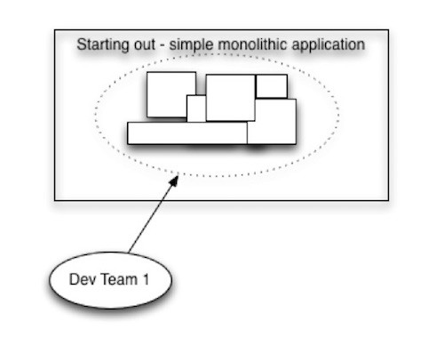
New Application
Notes:
New application development starts
Start developing as a monolith by a single team
Similar to our project, small scope, small team

Slide 16
Advantages of monoliths
Simple architecture
Everything is local
High productivity
Limited attack vectors
Easy testing
Performance matches requirements
Notes:
Advantages of monolithic architecture:
- Everything local, held in the same codebase
- High productivity, all components inhouse
- Less open structure, less attack vectors
- Easy testable, not many external dependencies
- Performance and requirements match

Slide 17
Advantages of monoliths
Team
Dedicated team
Independent releasing
Features can be released fast
No dependencies to other teams
Devs have strong application knowledge
Notes:
Also advantages for the team:
- Dedicated team for a single application
- Productivity bigger => faster feature release
- No dependencies to other teams
- Development team has knowledge over entire application

Slide 18

But then...
Application is a big success
Users increase
Traffic increases dramatically
New features
Dev team grows

Slide 19
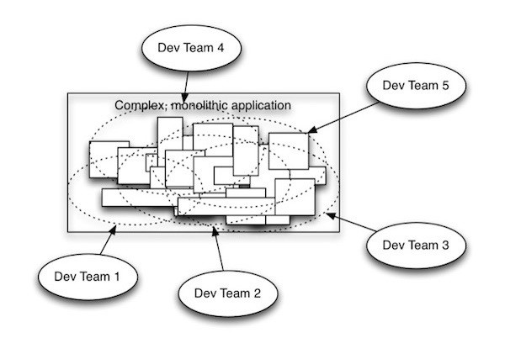
Application and complexity grows
Image source: linkedin.com
Notes:
Suddenly without you realizing your application looks like this…
The well-structured monolith became the big ball of mud you didn’t want him to become

Slide 20
Disadvantages of monoliths
Complex architecture
Architectural changes are difficult
Impact of code change are hard to estimate
Keeping up code quality needs extra effort
Newer technologies are hard to pickup
Notes:
Disadvantages:
- Architectural changes become almost impossible in this situation
- Code changes could impact the entire application
- Keeping up the quality brings a lot of effort
- Upgrading or updating to newer technologies will be very hard

Slide 21
Disadvantages of monoliths (cont.)
Team
Teams need to be coordinated
Code changes may collide
Release planning required
Feature freeze and test cycles
Devs have limited knowledge
Productivity drops
Notes:
Disadvantages for teams:
- Coordination overhead
- Coworking with more teams will end in collisions
- Feature release gets complex and needs structured plannings
- This leads to feature freezes and longer cycles
- Suddenly devs do not know the entire application anymore
- Productivity drops all of a sudden

Slide 22
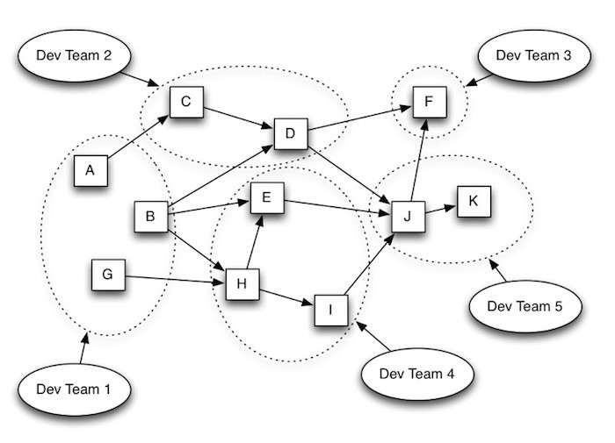
Ok, now what?
Notes:
What could you possibly do?
Microservices.

Slide 23
Advantages of microservices
Architecture
Independent modules
Defined boundaries (APIs, Events)
Loosely coupled (if done right)
Polyglot (what best fits the task)
Notes:
Look at advantages of microservices
- Independent modules can become independent services
- Boundaries / APIs get well defined
- Loosens coupling of entire system
- Teams could choose their preferred stack => polyglot

Slide 24
Advantages of microservices
Team
Teams work independently
Need to agree to defined boundaries
Independent within their microservice
Easier onboarding due limited scope
Notes:
For the teams:
- Teams can work independently
- Agreement on defined boundaries (contracts)
- Bigger knowledge of their defined scopes
- Brings faster onboarding for newer members

Slide 25
Advantages of microservices
Deployment and Runtime
Deploy independently
Easier scaling of single components
Bugs may be local only
Notes:
Deployment and Runtime:
- Microservices can and should be deployed independently
- Scaling of single components becomes possible
- Bugs may not affect entire system

Slide 26
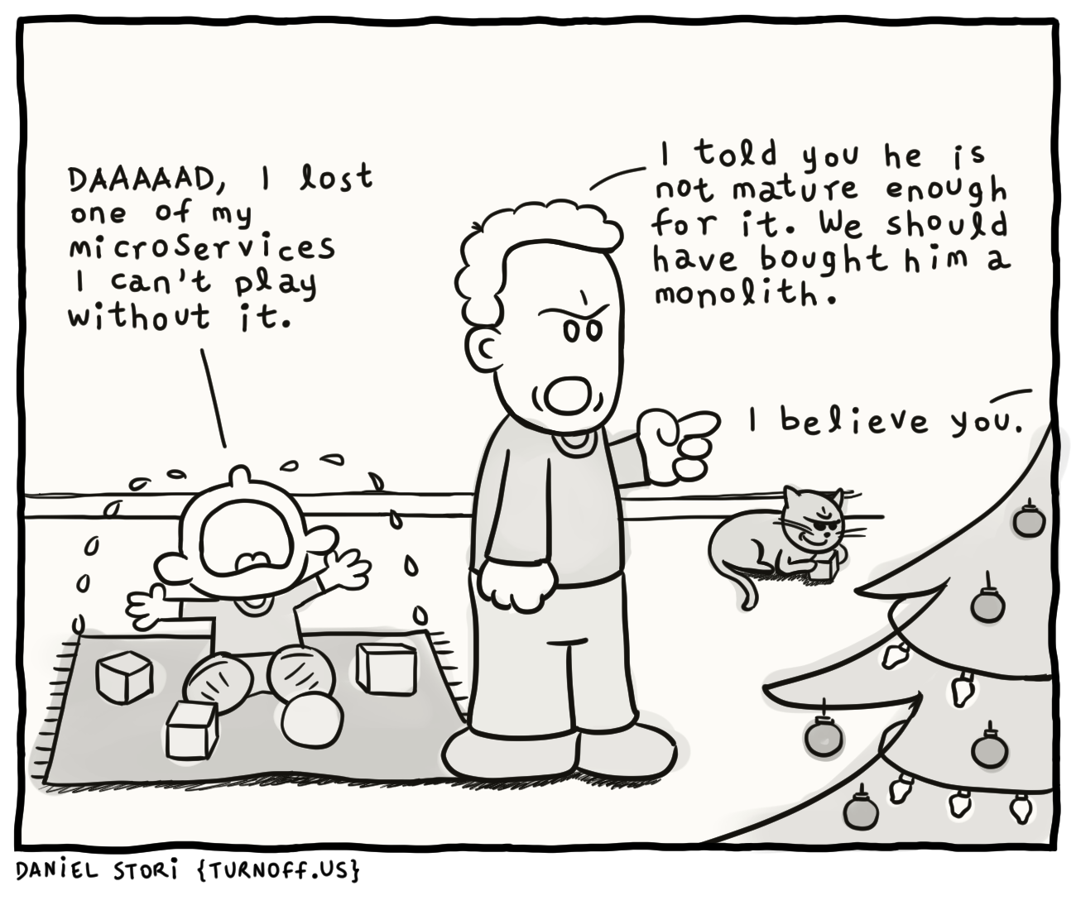
But ...
Image source: turnoff.us
Notes:
But then there is always also a downside...

Slide 27
Disadvantages of microservices
Architecture
Everything is local does not hold anymore
Data is distributed, no foreign keys across boundaries
Keeping data consistent needs extra effort
Communication and error handling needs extra effort
Changing the agreed boundaries may be hard
Notes:
Disadvantages:
- Everything local not true anymore
- Distributed data brings extra pains with it, foreign keys over boundaries
- Holding consistency becomes very hard
- More distribution brings more communication
- Boundaries and their contracts cannot be changed easily

Slide 28
Disadvantages of microservices (cont.)
Deployment and Runtime
Harder troubleshooting with multiple instances
Root cause detection can be hard
More attack vectors
Notes:
Deployments and runtime:
- Troubleshooting with scaled and distributed system becomes hard
- Finding the root of all evil may be difficult
- More distributed systems bring more attack vectors to the system

Slide 29
Short Recap
Microservices
Lead to modularity
Developers are enforced to respect boundaries
Enable teams to work and release independently
Can be replaced as long as boundary is untouched
But they introduce technical complexity
Notes:
Recap:
- Do not follow any hype trains blindly
- Choose your architecture and adapt over time
- Microservices bring modularity
- Also bring contracts for boundaries with them
- Teams may work more independent
- But they introduce a lot of technical complexity

Slide 30
Microservices Architecture
How to migrate from monolithic application?
Notes:
Most commonly monolithic approach chosen, then adapted to new requirements
How to migrate?

Slide 31
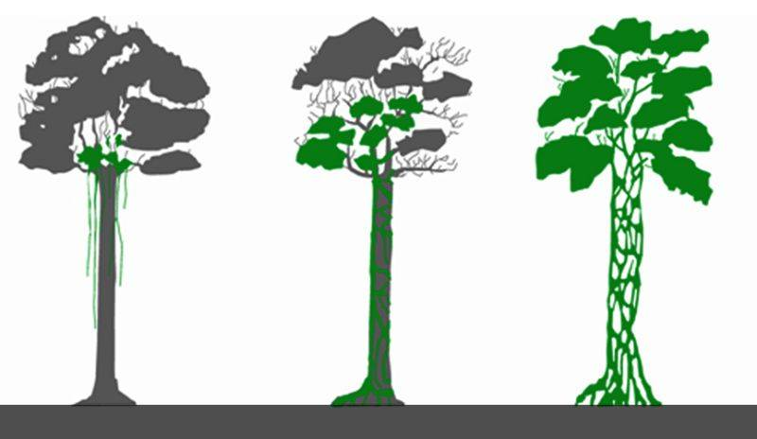
Strangler pattern
Notes:
- Strangler fig subtropical plant
- Starts growing from top of tree to bottom
- After time original tree dies and strangler lives on
- Nice real life analogy to refactoring

Slide 32
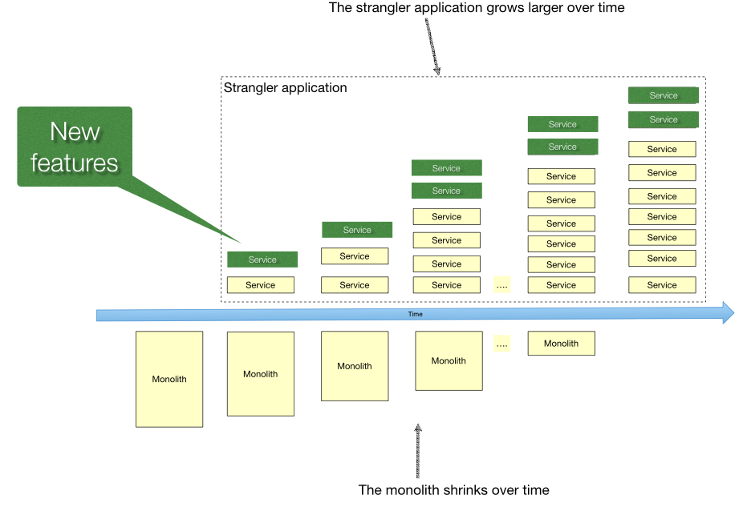
Strangler pattern
Notes:
- Transition part for part
- Created strangler applications (microservices)
- Refactored parts to microservices until old application was redundant
- Important here: Find nice cuts to extract from old application

Slide 33
Agenda - Day 1
Microservices architecture
Quarkus introduction
MicroProfile specification
RESTful microservices with Quarkus

Slide 34
What is Quarkus?
«Full-stack, Kubernetes-native Java framework made for JVM and native compilation», Red Hat
«Toolkit and Framework for writing Java, Kotlin and Scala applications», Peter Palaga 2020
«Build time augmentation Toolkit», Peter Palaga 2021
Notes:
Quarkus ist ein K8 native java stack.
Subatomic - sehr klein und leichtgewichtig
Supersonic - schnell mit unschlagbarer Startzeit
Opensource Framework und Toolkit für verschiedene Programmiersprachen
Toolkit - Quarkus vertritt keine Meinung wie Apps geschrieben werden sollen...
D.h. Programming Models und Frameworks sind an Quarkus-Extension ausgelagert...

Slide 35
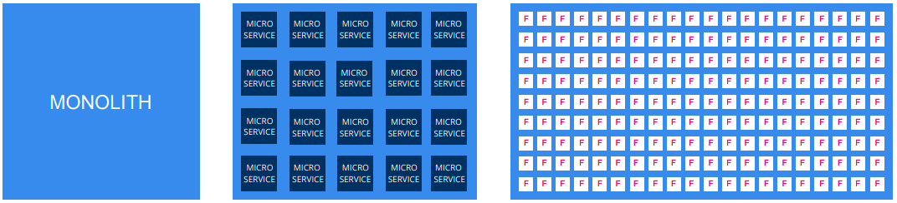
Why Quarkus?
1 monolith → 20 Microservices → 200 functions
Big → Small
Long living → short living
Image source: Red Hat
Notes:
Heute nicht mehr nur ein ArchitekturModel
- Quarkus addressiert die Evolution des traditionellen Java-Stacks und supported alle Paradigmen
Egal ob grosser Monolith welcher langlebig ist
Zu MicroServices
Zu Funktionen – Serverless/Funktion as a Service

Slide 36
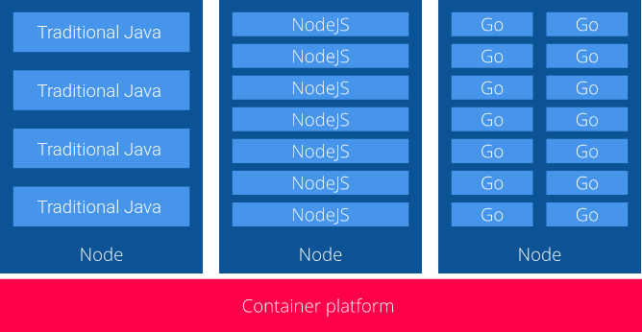
Why Quarkus? – Java and containers
Startup overhead
Resource overhead
Image source: Red Hat
Notes:
Traditionelle Java Container im Vergleich
- grossen Memory-Anforderung
- Ressourcen overhead
- Startup overhead
Quarkus ist designed für Container-First Philosophy

Slide 37
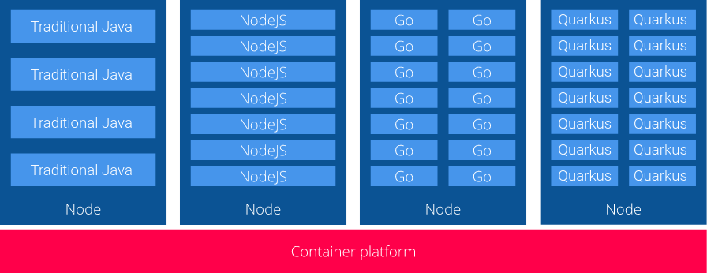
Why Quarkus?
Optimizing Java for containers
Enabling Java to become an effective platform for serverless, cloud and Kubernetes environments
Image source: Red Hat
Notes:
Container First:
- Small size on disk -> Small container images
- Fast boot time -> Instant scale up
- Low memory footprint -> More containers with the same RAM
Quarkus Ziel - Java zur führenden Platform in Kubernetes und Serverless-Umgebungen zu machen

Slide 38
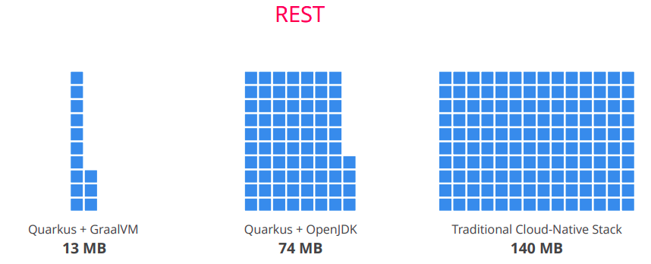
Show me numbers!
Image source: Red Hat
Notes:
Memory Verbrauch REST APP
Native
vs. Quarkus mit OpenJDK (Hotspot)
vs. Java Traditional Cloud-Native Stack

Slide 39
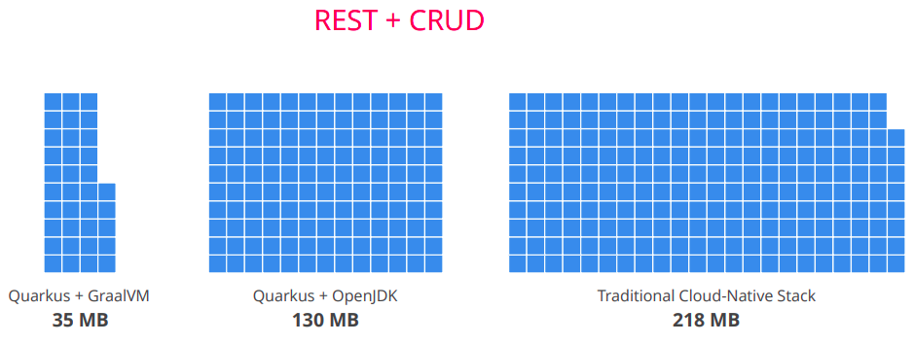
Show me numbers!
Image source: Red Hat
Notes:
Memory REST und CRUD

Slide 40
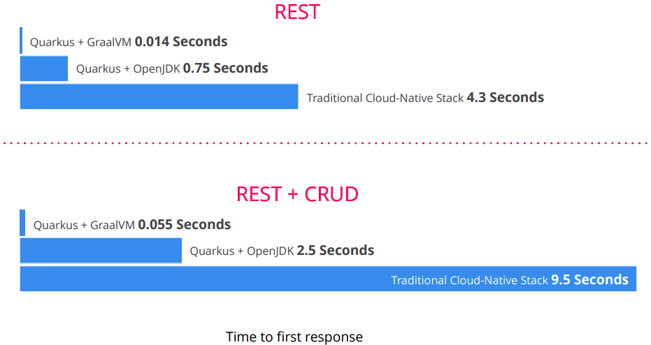
Show me numbers!
Image source: Red Hat

Slide 41
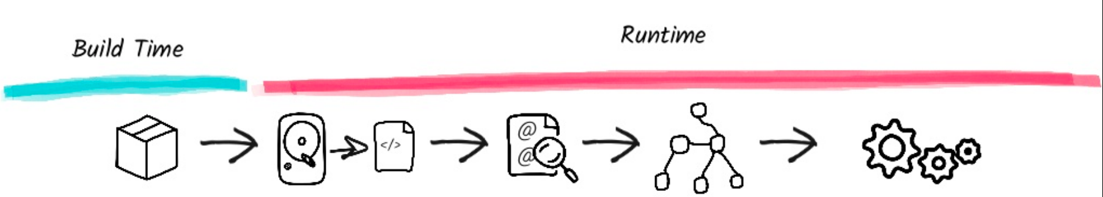
How a framework starts
Package Application
(maven, gradle, ...)
Image source: Red Hat
Notes:
Build-Time (CICD Pipeline) -> Compile and package
Runtime -> App führt den packetierten Code aus der Build-Phase im Runtime-Environment aus

Slide 42
How a framework starts
Load config files
(parse it, ...)
Image source: Red Hat
Notes:
Detail geschieht während des Bootstrappings der App folgendes:
- Configfiles laden und parsen

Slide 43
How a framework starts
Scan classpath for annotations
(load classes, enable/disable features, ...)
Image source: Red Hat
Notes:
Classpath-Scanning nach Annotations -> Klassen laden -> Featurs enablen/disablen

Slide 44
How a framework starts
Build its model of the world
Image source: Red Hat
Notes:
CDI (Context und DependencyInjection), Indexierung, Caching...

Slide 45
How a framework starts
Start Application
(threads, pools, ...)
Image source: Red Hat
Notes:
Das ganze Prozedere braucht Zeit
- höhere Startup-Time
- mehr Memory, da viele Klassen unnötigerweise geladen werden....

Slide 46
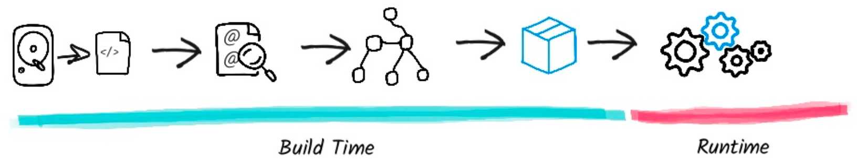
How Quarkus does it
Image source: Red Hat
Notes:
- Grossteil der Config in Bytecode compiliert
- Annotations zu Funktionsaufrufen umgewandelt
- CDI Beans builden
- Reflections and Proxy Verhalten analysiert und in Bytecode umgewandelt
Je mehr in der Build-Phase erledigt werden kann, desto kleiner wird die APP sein und desto schneller wird sie laden.

Slide 47
Traditional vs Quarkus
Traditional
Many classes only run during boot
  Xml parsers, annotation lookup, …
  Later unused and occupy memory
Quarkus
Built time approach
As much work as possible during build
Built time augmentation
  Extensions
Output: recorded wiring bytecode
Notes:
Quarkus optimiert das Executable soweit möglich

Slide 48
Quarkus Build
«The end result of a Quarkus build should be just enough bytecode to start the services that your application requires»
Edson Yanaga, Red Hat
Notes:
So klein wie möglich aber ja nicht kleiner

Slide 49
Configuration phases
Quarkus needs to make decisions at build time
Different config phases
  Build time
  Build and runtime fixed
  Bootstrap
  Run Time
Notes:
Durch die vorgelagerten Tätigkeiten zur Build-Zeit unterscheidet Quarkus verschiedene Configurations-Phasen.
Das bedeutet, dass nicht alle Properties zu jeder Zeit verändert werden können.
- Build Time: Alles was Build betrifft
- Build and Runtime Fixed: - nur read-only zur Laufzeit
- Bootstrap: Wird quasi als Runtime-Init ausgeführt, d.h. vor anderen RuntimeStep.
Kann auch für externe Configloads wie zb. mit Consul
- RunTime: Zur Laufzeit in allen Modes

Slide 50
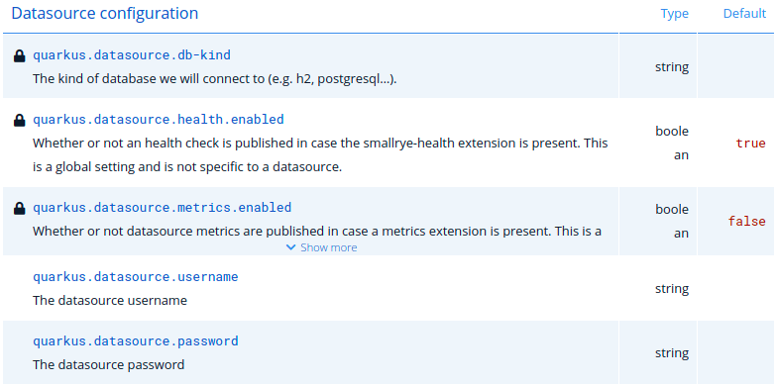
Configuration phases
Not all properties may be changed at runtime
Some properties will need a rebuild
Check «All Configuration Options» of Quarkus
Notes:
Configs Options sind auf quarkus.io ersichtlich.

Slide 51
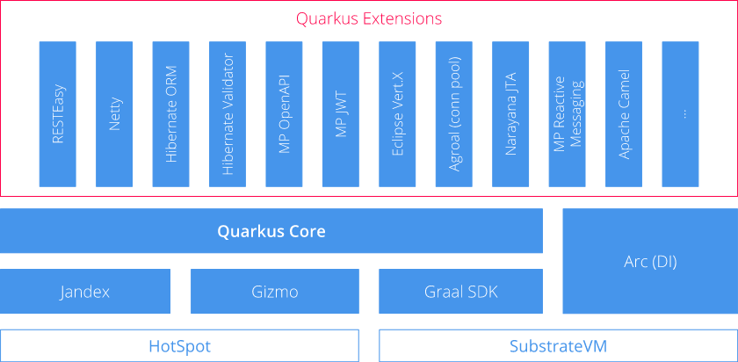
Quarkus structure
Image source: Red Hat
Notes:
Extensions – Alle JavaEE, JPA, CRUD, ect. Alles an Security, Integration, Automation...
Core – Dev Goodies, Komplette Logik zur Erstellung der Container, Layering,
Jandex – Indexierungs- und Annotation Resolver,
- Index zum BuildZeitpunkt erstellt und während Runtime genutzt
Gizmo – Bytecode Generierung
GraalSDK - Native Code Generierung
Arc - DependencyInjection

Slide 52


Quarkus modes
Application
code
Quarkus
Maven / Gradle plugin
enhanced code
JVM
Native executable
Notes:
App mit Quarkus-Tooling gebaut (Mvn/GradlePlugin)
Zu AppCode werden Klassen auf Code-Analyse basis erstellt
- Bootstrap-Sequenz
- Config für GraalVM
Resultat ist ByteCode → HotspotJVM
Oder → GraalVM Native-Compiler → platformspez. Native-Executable
JVM Mode: Faster Compilation - larger Memory footprint and slower startup
Native Mode: Slow Compilation - minimal Memory footprint and fast startup
Develop with JVM and then native
Hotspot - Just-in-time compilation - OpenJDK Standart
GraalVM - Graal JIT Compiler (ersetzt Hostspots)
+ Unterstützt zusätzlich ahead-of-time compilation
+ multilanguage support
SubstrateVM - Native executable (only one facet of GraalVM)

Slide 53
Downside of GraalVM
Closed world assumption
  Everything has to be known at build-time
No dynamic classloading
No native VM Interfaces (JVM tool Interface, Java Management Extensions JMX)
No agents (Profilers, Traceing, …)
No Java debugger
  Native debugger GDB
https://www.graalvm.org/22.1/reference-manual/native-image/Limitations/
Notes:
- ClosedWorldassumption - Jeder LaufzeitCode zum Buildzeitpunkt bekannt
-> dafür sehr effektive Statische Analyse + Eliminierung von DeadCode, - ergo kleinen Footprint + tiefen MemoryConsumption
- NoDynamicClassloading - d.h. JARs, WARs, etc können nicht zur Laufzeit deployed werden. Traditional ServletContainer nicht 1:1 in GraalVM verwendedbar, ausser beides (Container und App) wird zusammen Compiliert... so ist aller Code zur BuildZeit bekannt.
- Standart Debugging und Monitoring Intefaces sind nicht verfügbar, diese sind zur Überwachung von Compilation und unter der Voraussetzung dass ByteCode zur Runtime vorhanden ist, erstellt worden.
Dies ist in den Nativen Executables nicht der Fall. Alternative: GDB oder VTune

Slide 54
Downside of GraalVM
Require Registration
  Reflection limited (@RegisterForReflection, reflection-config.json)
  Dynamic Proxies (Proxy Config files)
  Resources (resources-config.json)
Static Inits
  Bytecode recorded at build time
  Stored in executable
  No file handles, sockets, threads
https://www.graalvm.org/22.1/reference-manual/native-image/Limitations/
Notes:
- Require Registration
Reflections, Dyn. Proxies, JNI, Serialization etc. vorgängig registriert oder konfiguriert werden.
Mit dynamische Pfaden wird der Compiler hintergangen. Compiler analysiert Code über Executionpaths und evaluiert, welche Methoden erreichbar sind und welche nicht.
- Static Inits
Class Initializers werden defaultmässig einmalig zur BuildZeit aufgerufen- ergibt zur Laufzeit weniger Aufrufzeit und einsparen des Memoryspace
Ursprünglich GraalVM default, heute Quarkus Default
Zur Buildzeit wird ein Snapshot des Heaps erstellt, dieser wird danach wieder in die Laufzeit kopiert.
Class Initializers welche FileHandles, Sockets, Threads verwenden müssen speziell markiert werden, da dies zur Laufzeit ansonsten nicht funktioniert.

Slide 55
Extensions and standards
Extend Quarkus framework with custom functionality
Standards
Java EE (Servlet, JAX-RS, CDI, JPA, Bean Validation, ...)
MicroProfile (Health, Metrics, Rest Client, Fault-Tolerance, …)
Spring (Web, Boot, Data, Scheduled,...)
Databases & Tooling
PostgreSQL, MySQL, MariaDB, MS SQL Server, H2, MongoDB, Neo4j, Flyway, Liquibase …
3rdParty libraries and frameworks
Netty, Vert.x, Apache Camel, Caffein, Keycloak, Elasticsearch, Infinispan, Debezium, ...
Notes:
- Quarkus -> Standard JavaEE
- Sehr guter MicroProfile support
- Teils Support für Spring via CompatibilityLayers, d.h. die SpringAnnotations werden in die JavaEE oder Microprofile Gegenstücke übersetzt. (Es gibt keinen SpringContext, welcher "under-the-hood" läuft.)
Standart-Fällen ok sonst naja, Support beim Wechsel von Spring -> Quarkus…
- Alle Major-Database werden unterstützt, sogar Oracle.

Slide 56
Extensions and standards
Quarkus Core Repository
github.com/quarkusio (~150 extensions)
Independent sources
github.com/apache/camel-quarkus
github.com/datastax/cassandra-quarkus
github.com/debezium/debezium-quarkus-outbox
...
Quarkiverse: Incubator & Community extensions
logging-json, cxf, github-api, freemarker, google-cloud-services, …
code.quarkus.io provides a big list of extensions
Notes:
Woher kommen diese Extensions?
1. Primär aus dem Quarkus-Core-Repo - beinhaltet die JavaEE-Standards, Database-Drivers, MicroProfile usw.
2. Unabhängige Projekte die nicht direkt von Redhat kontrolliert werden.
3. Quarkiverse: Incubator/hosting für Community extensions
Komplette List unter (code.quarkus.io)[code.quarkus.io] ersichtlich. Ähnlich zu Spring.Initializor..

Slide 57
Developer Joy
Easy to start & fast bootstrap
mvn io.quarkus:quarkus-maven-plugin:1.13.3.Final:create \
-DprojectGroupId=ch.puzzle.quarkustechlab \
-DprojectArtifactId=dev-demo \
-DclassName="ch.puzzle.quarkustechlab.GreetingResource" \
-Dpath="/hello"
cd dev-demo
mvn compile quarkus:dev
curl localhost:8080/hello
Hello RESTEasy

Slide 58
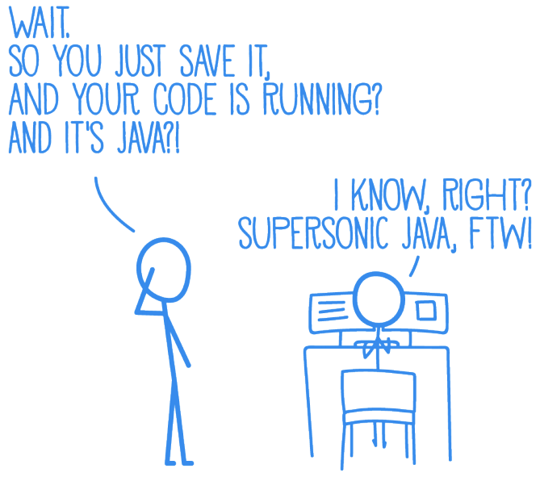
Developer Joy
Live Reload
mvn compile quarkus:dev
curl localhost:8080/hello
Hello RESTEasy
sed -i -e 's/RESTEasy/Quarkus/g' \
.../GreetingResource.java \
&& curl localhost:8080/hello
Hello Quarkus
-> Hot replace total time: 0.256s
Image source: Red Hat
Notes:
LiveReload wie bei Frontend-Entwicklung
- Hot Deployment mit Background-Compilation
Neuer Request triggert
- Workspace-Scan
- Compilation
- Redeploy
Kein echtes HotReplacement –> superfast restart
- Continuos Testing!
- Intial Run all tests
- Reload nur betroffene Tests

Slide 59
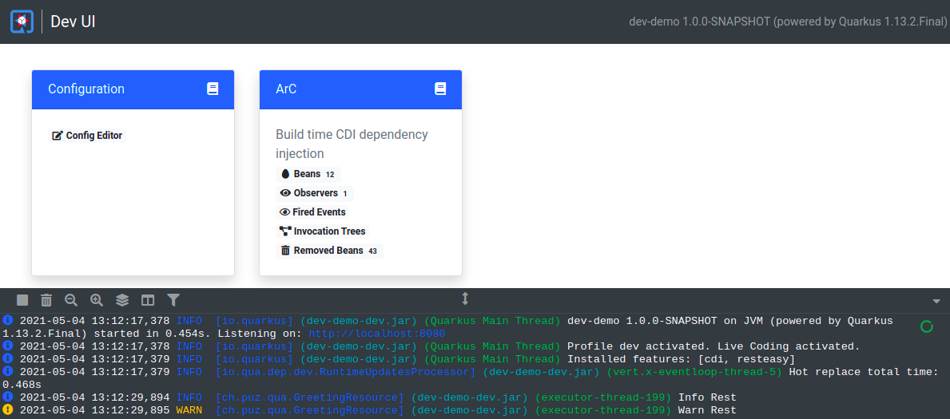
Developer Joy – Dev UI
Url: http://localhost:8080/q/dev
Notes:
Zeigt alle Extensions in a Box
- BuildSteps mit Execution Chart
- Configuration editor
- Dependency Graph als D3-Animation
- Removed Beans usw.

Slide 60
Developer Joy - DevServices
Spins up required services
  Most common Databases, Kafka, OIDC (Keycloak)
  Enabled when testing or running in dev mode
  Zero configuration required
  Quarkus uses TestContainers (docker required)
  For Kafka Services Quarkus uses Redpanda (Kafka API compatible → ~1sec startup time)
How do we get this?
  Add relevant extension (database type, kafka or OIDC)
  Do not configure a database url, kafka.bootstrap.servers or auth-server-url for dev profile
→ Quarkus does the magic for you
Notes:
Ohne Aufwand – DB oder Kafka
- keine Konfig nötig
- Testcontainer
- State geht bei Reload verloren

Slide 61
Developer Joy – Quarkus CLI Tooling
Quarkus CLI (Currently preview)
  Replacement for maven or gradle commands
  Create, add extensions, build and start application
  Installation using jbang (See CLI-Tooling Guide)
$ quarkus create app ch.puzzle.quarkustechlab:quarkus-cli-tooling-demo
…
$ quarkus extension list --installable --search postgres
Current Quarkus extensions installable:
quarkus-rest-client
$ quarkus extension add quarkus-rest-client
[SUCCESS] ✅ Extension io.quarkus:quarkus-rest-client has been installed
$ quarkus dev

Slide 62
Developer Joy
Fast start (easy bootstrap)
Live reload
Easy Configuration
Documentation & Guides
Development UI
  Change configurations, Console log, Extension Integration
DevServices
Quarkus CLI
Notes:
Quarkus isoliert den DEV fast komplett von der GraalVM-Komplexität. Die ganze Config kommt out-of-the-box mit Quarkus.

Slide 63
Agenda - Day 1
Microservices architecture
Quarkus introduction
MicroProfile specification
RESTful microservices with Quarkus

Slide 64

What is MicroProfile?
«MicroProfile is an open-source community specification for Enterprise Java microservices», microprofile.io
«A community of individuals, organizations, and vendors collaborating within an open source Eclipse Foundation Working Group to bring microservices to the Enterprise Java community», microprofile.io
Notes:
- Open Source specifications for java microservices
- not standards but living specifications
- community members include Oracle, IBM, Payara, Red Hat but also the e.g. IJUG (Interessenverbund der Java User Groups)

Slide 65
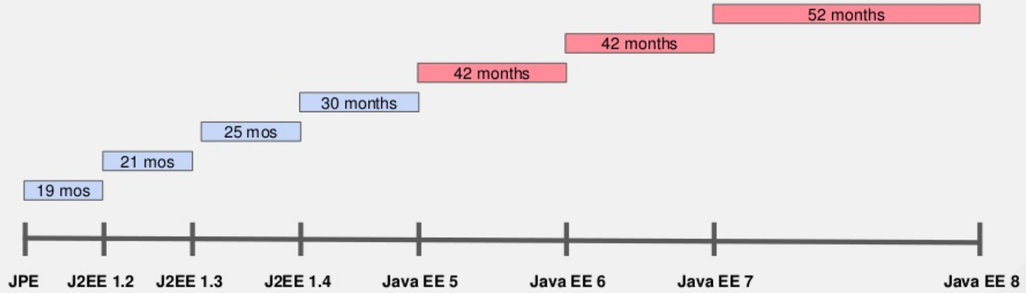
Why MicroProfile?
Image source: Red Hat
Notes:
- Long release cicles for j2ee and jee/ jakarte ee standards
JEE 5 in 2006
JEE 6 in 2009
JEE 7 in 2013
JEE 8 in 2017
- jee has a quite a large scope
- fast changes in towards microservices required new specifications
Why Microprofile?

Slide 66
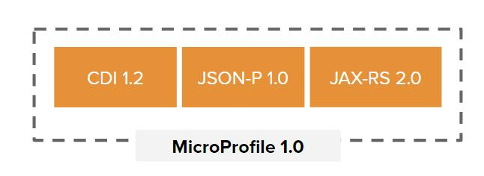
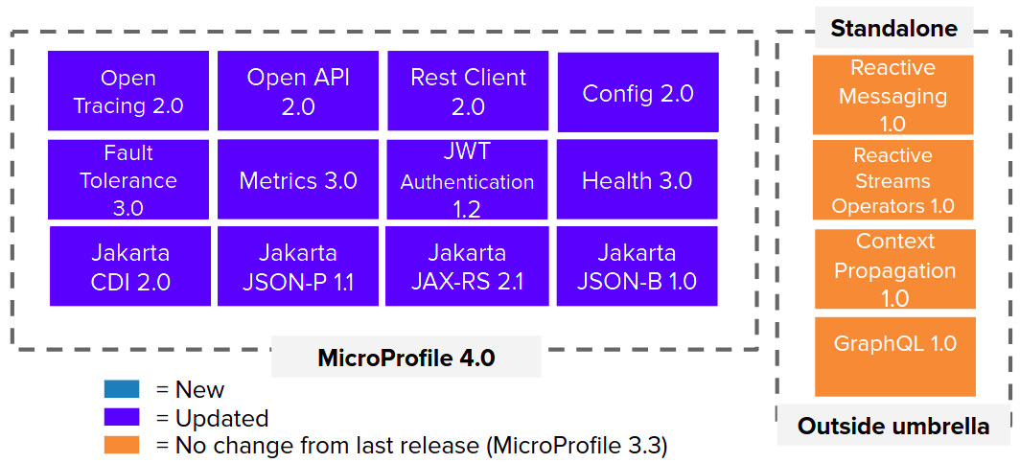
MicroProfile 1.0 ...
September 2016
December 2020
11 releases

Slide 67
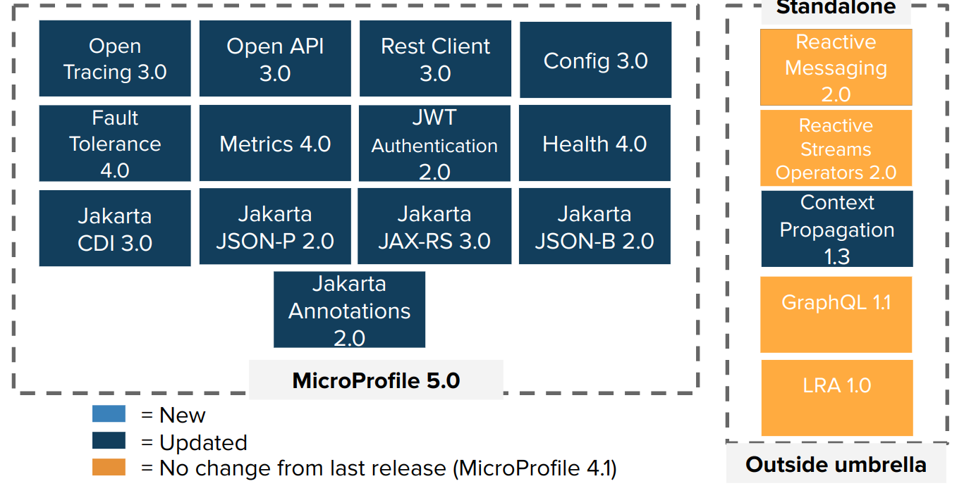
MicroProfile 5.0 (Current MP)
Image source: microprofile.io
Notes:
Last release exactly one year ago
Latest release only updates, no new specs
Standalone: Community specs, not officially under the microprofile umbrella
Last year only one release → specifications became quite stable (?)

Slide 68
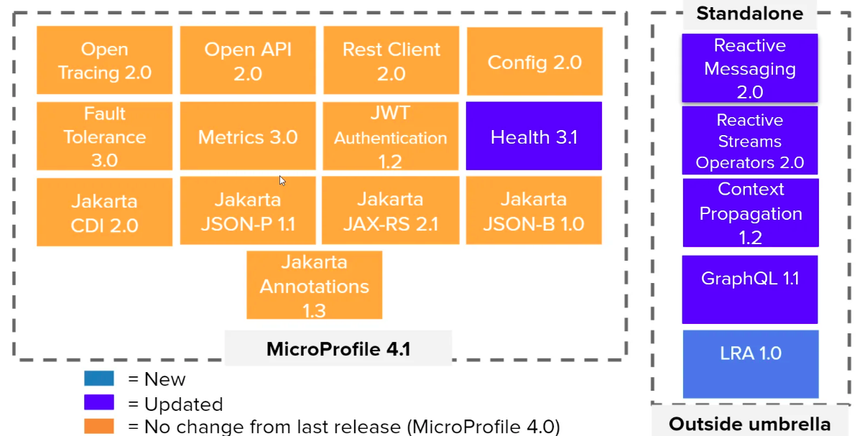
MicroProfile Configuration
Easy and flexible way for application config
Extendable (write your own config provider)
Order (highest priority first)
  System properties
  Environment variables
  File named .env in working directory
  File application.properties placed in $PWD/config
  File application.properties (from src/main/resources)
  File META-INF/microprofile-config.properties
Details about configuration? -> MP Config 3.0
Notes:
- Configure your application with properties.
- property files or system properties or environment variables
- system properties always win – then environment variables
- you can also define your own custom property sources. Like yaml files or you could probably also get configuration from a database (?)

Slide 69
MicroProfile Configuration
Injection @ConfigProperty
@ConfigProperty(name = "greeting.suffix", defaultValue="!")
String suffix;
Programatically
ConfigProvider.getConfig().getValue("greeting.suffix", String.class);
With config class (New SmallRye Config)
With config class (Quarkus Deprecated)
@ConfigMapping(prefix = "greeting")
public interface GreetingConfiguration {
@WithDefault(defaultValue = "!")
String getSuffix();
}
@ConfigProperties(prefix = "greeting")
public interface GreetingConfiguration {
@ConfigProperty(defaultValue = "!")
String getSuffix();
}
Notes:
- set class properties with annotations
- or read it programatically
- or define configuration classes
You see, microprofile specs and quarkus itself changes… as everything

Slide 70
MicroProfile Configuration
Quarkus supports profiles (default: dev, test, prod)
  Easy extenable with adding a new %{profile}
Read from «quarkus-profile» system property or «QUARKUS_PROFILE» env variable
Syntax: %{profile}.config.key → %dev.quarkus.log.level
Support for application-{profile}.properties → application-dev.properties
application.properties
quarkus.log.level=info
%dev.quarkus.log.level=debug
%test.quarkus.datasource.driver = org.h2.Driver
Using a specific profile
mvn -Dquarkus-profile=staging compile quarkus:dev
Access profile programmatically
ProfileManager.getActiveProfile();
Notes:
- mp config also supports profile – like spring boot
- define specific configs with a prefix (new to me) or in seperate files
- specify profile via environment variables

Slide 71
MicroProfile Configuration
Env Variable Mapping Rules – e.g. «com.ACME.size»
Exact match: com.ACME.size
Replace special chars with «_»: com_ACME_size
Uppercase version: COM_ACME_SIZE
Property | Environment variable override
myservice-api/mp-rest/url=abc | MYSERVICE_API_MP_REST_URL=xy
myservice-api/mp-rest/url=${MY_ENV:abc} | MY_ENV=xy
quarkus.log.category."org.my".level=INFO * | QUARKUS_LOG_CATEGORY__ORG_MY__LEVEL=DEBUG
my.quarkus.property | MY_QUARKUS_PROPERTY
* must be defined
Notes:
- some characters are not supported by certain operating systems, especially the dot… «.»
- replace special characters with an underscore for env. Vars
- exact match wins over replaced/ uppercase matches

Slide 72
MicroProfile Rest Client
Make typesafe calls to Rest APIs
Defined as Java Interface
Details about configuration? →Rest Client 3.0
@RegisterRestClient(configKey="my-client")
public interface MyServiceClient {
@GET
@Path("/greet")
Response greet();
}
application.properties
my-client/mp-rest/url=https://my-greeting-service/rest
my-client/mp-rest/readTimeout=xy
my-client/mp-rest/connectTimeout=5000
my-client/mp-rest/proxyAddresses=xy (MP 4.0)
Notes:
- make rest calls to other systems has never been easies
- define an interface and a method
- annotate method with the http method an the path
- configure endpoint in properties
- proxyAdresses is needed if you are behind a proxy
(you will probably know if you need that…)

Slide 73
MicroProfile Rest Client
Example:
Add Custom Headers → @ClientHeaderParam
Use Interceptors and filters → @RegisterProvider
@RegisterRestClient(configKey="my-client")
@ClientHeaderParam(name="CustomHeader", value="value1")
@RegisterProvider(AuthorizationRequestFilter.class)
public interface MyServiceClient {
@POST
@Path("/user")
@ClientHeaderParam(name="X-Request-ID", value="{generateRequestId}")
Response postUser();
default String generateRequestId() {
return UUID.randomUUID().toString();
}
}
Notes:
- add custom headers – to all or just specifc requests.
- Authorization headers.

Slide 74
MicroProfile Metrics
Add monitoring endpoint /metrics
  OpenMetrics (text/plain), JSON (application/json)
Expose metrics from application
There is a shift of MP Metrics to Micrometer!
Details about configuration? → MP Metrics 4.0
​@Counted(name = "processing-counter", absolute = true, tags={"tag1=value1"})
@Timed(name = "processTimer", description = "execution time", unit = MetricUnits.MILLISECONDS)
​public void processMessage() { }
Notes:
- metrics – not health!
- endpoint /metrics
Example:
- how often ist the method called
- how long does ist take…
Quarkus now uses micrometer instead of the metrics microprofile

Slide 75
MicroProfile Health
Validate status and availability of application
Machine to machine M2M focused
  Replace unhealthy instances with new health instances
  Monitored by container platforms
Provides «Liveness» and «Readiness» endpoint /health
Details about configuration? → MP Health 4.0
​@ApplicationScoped
@Liveness
@Readiness
public class MyCheck implements HealthCheck {
public HealthCheckResponse call() {
[...]
}
}
Notes:
- check if your application is alive and can handle requests
- liveness and readyness probes
- new endpoint /health
- custom checks possible...

Slide 76
MicroProfile Fault Tolerance
Toolkit for resilient applications
  Timeout, Retry, Fallback, Circuit Breaker, Bulkhead
Designed to separate execution logic from execution
Details about configuration? → MP Fault Tolerance 4.0
​public interface MyServiceClient {
@GET
@Path("/greet")
// timeout is 400ms
@Timeout(400)
// 0 – 400ms delay, max 10
​ @Retry(delay = 400, maxDuration= 3200, jitter= 400, maxRetries = 10)
// Specify fallback handler class
@Fallback(GreetingStringFallbackHandler.class)
// Scenario: Success, Failure, Success, Success, Failure, CurcuitBreakerOpenException
@CircuitBreaker(successThreshold = 10, requestVolumeThreshold = 4, failureRatio=0.5, delay = 1000)
// maximum 10 concurrent requests allowed
@Bulkhead(10)
Response greet();
}
Notes:
- if something goes wrong – for example in your rest client
- specify timeouts, retries, fallbacks, circuit breakes and more
- allows to separate business logic from execution

Slide 77
MicroProfile Tracing
Trace request flow across service boundaries
  Support for JDBC, Kafka or MongoDB available
Focused on easy instrumentation of services
Rest endpoints are automatically traced
  Tracing further classes or methods with @Traced
Details about configuration? → MP OpenTracing 3.0
​@Traced
@ApplicationScoped
public class GreetingService {
public String sayHello() {
return "hello";
}
}
Notes:
- trace the execution flow through your system – from your rest resources to the database and back again…
- detailed information about errors and execution times

Slide 78
CDI – Quarkus ArC
Quarkus ArC (build time oriented DI) is based on CDI 3.0
ArC does not fully implement CDI Spec
  Some CDI features are runtime constructs
  Not Supported (… there are more!):
    CDI Portable extensions
    @ConversationScope (other scopes are supported)
    Specializations
    usage of beans.xml
See «Supported Features» and «Limitations» of Quarkus ArC
Notes:
MP CDI == JEE CDI
But Quarkus CDI != MP CDI
Based on, but not a full implementation – some things are not supported
Some specialities

Slide 79
Quarkus ArC - Instantiation
Beans are initialized lazy
At injection (pseudo-scope @Dependent, @Singleton)
At first use – uses a client proxy (other scopes)
Eager Instantiation:
​@ApplicationScoped
public class GreetingService {
void startup(@Observes StartupEvent event) {}
}
​@Startup
@ApplicationScoped
public class GreetingService {
}
Notes:
Usually – beans are lazy initialized
For eager ininitialization at startup provide a startup method or annatation with @Startup

Slide 80
Quarkus ArC - Modifiers
Use package private modifier to avoid reflection
compatibility for native mode
e.g. field injection, observer methods, ...
​@ApplicationScoped
public class GreetingService {
@Inject
Greeter greeter;
void onMessage(@Observes StartupEvent event) {}
}
​@ApplicationScoped
public class GreetingService {
private final Greeter greeter;
GreetingService(Greeter greeter) {
this.greeter = greeter;
}
}
​@Inject
void setDeps(Dictionary dic, LocalizationService locService) {}
Notes:
Quarkus encourages to use private package modifiers, not private! This is to avoid using reflection (not possible for native builds)
Constructor injection (without annotations) and default (empty) constructor – make the property private

Slide 81
Quarkus ArC - DefaultBean
Declare @DefaultBean
Easily overridable
IfBuildProfile or UnlessBuildProfile, IfBuildProperty
​@Dependent
public class MyService {
@Produces
@IfBuildProperty(name = "real.service.enabled", stringValue = "true")
public MyService realService() {
return new MyRealService();
}
@Produces
@DefaultBean
public MyService dummyService() {
return new MyDummyService();
}
}
Notes:
Provide defaultbean for defaults… e.g. in your extension
If any other bean is produced somewhere – the default bean is dropped and the other bean is used...

Slide 82

SmallRye
«APIs and implementations tailored for Cloud development, including but not limited to, Eclipse MicroProfile», smallrye.io
Implementation currently used by:
Quarkus
WildFly
Thorntail
Open Liberty
Notes:
Smallrye is an implementor of microprofile specs
- implementions are used by various application servers and platforms

Slide 83
Resources
Eclipse MicroProfile Developer Resources
https://projects.eclipse.org/projects/technology.microprofile/developer
MicroProfile Specifications available at Github (e.g. Reactive Messaging):
https://github.com/eclipse/microprofile-reactive-messaging
SmallRye MicroProfile Implementation Documentation:
https://smallrye.io/docs/index/index/index.html
SmallRye Reactive Messaging Documentation:
https://smallrye.io/smallrye-reactive-messaging
MicroProfile 4.0 Release Presentation:
https://drive.google.com/drive/folders/1zqIzegskeYUCualDek3Wq4Sle9qW-_eY
Quarkus Dependency Injection
https://quarkus.io/blog/quarkus-dependency-injection/

Slide 84
Agenda - Day 1
Microservices architecture
Quarkus introduction
MicroProfile specification
RESTful microservices with Quarkus

Slide 85
RESTful microservices with Quarkus
Build two microservices with a RESTful endpoint and a RESTful client
Data Producer
Implement RESTful endpoint /data with JSON data
Produce random SensorMeasurement
Data Consumer
Consumes SensorMeasurement from producers REST endpoint /data
Implement RESTful client for /data endpoint
Hint: use the quarkus dev mode while developing. Enjoy.

Slide 86
RESTful microservices with Quarkus
Add resiliency with MicroProfile fault-tolerance to our microservices
Add some random errors
Slow down the producing of the SensorMeasurement
How can the Data Consumer be more resilient to errors on the producer?
Try fault-tolerance features retry and timeout

Slide 87
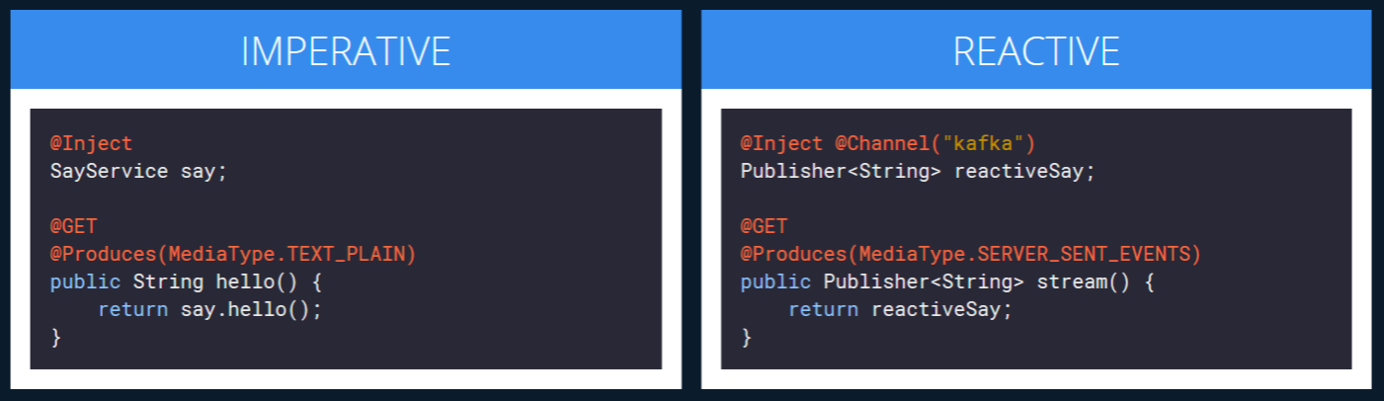
RESTful microservices with Quarkus
Implement microservices in a reactive way
Stream the data with ServerSentEvents
Use Reactive JDBC for database calls
Image source: quarkus.io

Slide 88
Agenda - Day 1
Microservices architecture
Quarkus introduction
MicroProfile specification
RESTful microservices with Quarkus
Building docker containers

Slide 89
Quarkus structure
Image source: Red Hat

Slide 90
Building Docker containers
Application
code
Quarkus
Maven / Gradle plugin
enhanced code
JVM
Native executable

Slide 91
Day 2

Slide 92
Agenda - Day 2
8 fallacies of distributed computing
Cloud patterns
Continuous integration and delivery
Event driven architecture and messaging
Observability – Metrics and Tracing
Writing your own Quarkus extension

Slide 93
Questions Day 1?

Slide 94
Agenda - Day 2
8 fallacies of distributed computing
Cloud patterns
Continuous integration and delivery
Event driven architecture and messaging
Observability – Metrics and Tracing
Writing your own Quarkus extension
Notes:
Fallacies: Trugschlüsse
You think that something is true – but usually its not true – or at least not always...

Slide 95
8 fallacies of distributed computing
The network is reliable
Latency is zero
Bandwidth is infinite
The network is secure
Topology doesn't change
There is one administrator
Transport cost is zero
The network is homogeneous.
Notes:
L. Peter Deutsch drafted the first 7 fallacies in 1994,
8th added by James Gosling in 1997.
We wont discuss all of them now

Slide 96
1. The network is reliable
Service A
Service B
X
X
Problem: The network is not reliable. Requests will fail.
Options: Automatic Retries, Message Queues, Timeouts, Circuit-Breaker
Notes:
Retries
Idempotence needed if response fails

Slide 97
Error Handling #1 - REST
Order
Stock
Local
Transaction
Local
Transaction
create
X1
reserve articles
X2
retry?
?

Slide 98
Error Handling #2 - Events
Management
event
Student 72
21
…
t4
72
Zoé
t3
81
…
t2
72
Zoe
t1
Zoe
X
retry
Notes:
Events... write zoe (t1) – and fix typo afterwards in t3 … other messages in queue
What to do if t1 fails for some reason…?

Slide 99
Error Handling #2 - Events
Management
event
Student 72
21
…
t4
72
Zoé
t3
81
…
t2
72
Zoe
t1
Zoe
failed
X
retry
72
Zoe
t1
Notes:
- t1 failed… but the messages are still processed from the queue

Slide 100
Error Handling #2 - Events
Management
event
Student 72
21
…
t4
72
Zoé
t3
81
…
t2
72
Zoe
t1
OK
failed
retry?
retry
72
Zoe
t1
Notes:
Maybe just retry… and it everything might be ok...

Slide 101
Error Handling #2 - Events
Management
event
Student 72
21
…
t4
72
Zoé
t3
81
…
t2
72
Zoe
t1
retry
72
Zoe
t1
Notes:
Events are getting processed. T1 is still waiting...

Slide 102
Error Handling #2 - Events
Management
event
Student 72
21
…
t4
72
Zoé
t3
81
…
t2
72
Zoe
t1
Zoé
72
Zoé
t3
retry
72
Zoe
t1
Notes:
Now – t3 completed – but t1 is still waiting.

Slide 103
Error Handling #2 - Events
Management
event
Student 72
21
…
t4
72
Zoé
t3
81
…
t2
72
Zoe
t1
72
Zoé
t3
retry?
retry
72
Zoe
t1
Notes:
Should we still retry?
Changes would be overwritten…

Slide 104
Error Handling #2 - Events
Management
event
Student 72
21
…
t4
72
Zoé
t3
81
…
t2
72
Zoe
t1
72
Zoé
t3
retry
retry?
72
Zoe
t1
Can ignore event
Name change
T1 < T3 → Drop
Order does not matter
Coffee order
→ Just retry/apply
Order matters
Bank account (overdraft penalty)
T3 → retry behind T1
Notes:
It depends…
- Ignore it…
- retry is ok if order does not matter
- if order matters retry t3 after t1...

Slide 105
Error Handling #2 - Events
Management
event
Student 72
21
…
t4
72
Zoé
t3
81
…
t2
72
Zoe
t1
delay
retry
retry?
72
Zoé
t3
72
Zoe
t1
Can ignore event
Name change
T1 < T3 → Drop
Order does not matter
Coffee order
→ Just retry/apply
Order matters
Bank account (overdraft penalty)
T3 → retry behind T1
Notes:
Delay t3 and wait for t1 to complete successfully

Slide 106
Data Consistency - Transactions
Order
Stock
Local
Transaction
Local
Transaction
create
reserve articles
ok
X
failed
Notes:
Order reserved in stock sucessfully – but local transaction failes in order service.
How does the stock service know? What should happen now

Slide 107
Data Consistency - Transactions
Global/Distributed Transaction
Order
Stock
Local
Transaction
Local
Transaction
create
reserve articles
ok
X
failed
Notes:
Usage of global, distributed transactions
Saga pattern
Later in this presentation

Slide 108
2. Latency is zero
Component A
Component B
Local in-memory call
Service A
Service B
remote access call
Problem: Network calls are orders of magnitude slower than in-memory calls
Options: Caching, Bulk Requests, Availability Zones
Notes:
Cache data if possible
Bring Back All the Data You Might Need
Beware of N+1 Select problem
Lazy loading triggers database calls.
Move the Data Closer to the Clients – Availability Zones

Slide 109
Select N+1 Problem
Management
Client
Get users
User
1
Get all orders for users
Order
1
...
n
Notes:
N+1 problems are bad for databases… but far worse when doing REST

Slide 110
3. Bandwidth is infinite
Service A
Service B
Problem: Bandwidth and also amount of connections is not infinite
Options: Small payloads, Optimized data formats, DTOs, Throttling
Notes:
While bandwidth has increased significantly over the past few decades, it is not infinite.

Slide 111
Bandwidth
Shop
Wishlist
Product[]
(500kb)
Wishlist
Wishlists is called 2000 times per second
Traffic: 2000 * 500kb = 1gb
Wishlist renders name only (200 bytes)
Traffic required: 2000 * 200 bytes = 400kb
- Table
- Chair
- Mousepad
Notes:
Example: Lets consider a wish-list. The Wishlist has a product link. Sending the product with all information 500kb and you only need the name (200bytes). If the Wish-list is called 2000 times a second youll end up with 1GB transfered instead of 400kb.
Fetching objects and calling toList may load the whole database in memory oder send over the wire. Use ORM Correctly – projections.
Use Limited DTOs for network transfer. Also to hide local or internal information.

Slide 112
5. Topology does not change
Service A
Service B⁰
Service B¹
Problem: Topology changes constantly. Service die and restart.
Options: Rely on DNS, No IP hardcoding, Service Discovery
Notes:
Rely on DNS instead of Ips
If not possible use service discovery
Assume that servers die and startup frequently.
Treat that every server is replaceable
Chaos engineering (netflix)

Slide 113



Pets vs. Cattle
Traditional Applications
(Pets)
Cloud Native Applications
(Cattle)
Sticky
LB
Sticky
LB
stateful
stateless
Dora
Lotta
Cow
ghcs
Cow
xklm
Cow
sqpt
Cow
qpts
Notes:
Pets
- They are unique, lovingly and hand raised
- When they get ill, you nurse them back
Cattle
- Numbered
- When they get ill, you get another one

Slide 114
Agenda - Day 2
8 fallacies of distributed computing
Cloud patterns
Continuous integration and delivery
Event driven architecture and messaging
Observability – Metrics and Tracing
Writing your own Quarkus extension

Slide 115
Cloud patterns
The Twelve-Factor App
Design for Failure (Retry, Timeout, Circuitbreaker)
Microservice Communication
Orchestration vs. Choreography
Event Driven Architecture
Transaction management
Notes:
Cloud patterns
Guidelines or helpers for architecture
12 factor application manifesto

Slide 116
12 factor application
«The Twelve-Factor App methodology is a methodology for building software-as-a-service applications. These best practices are designed to enable applications to be built with portability and resilience when deployed to the web.[1]»
Hofmann, Michael; Schnabel, Erin; Stanley, Katherine (13 March 2017). Microservices Best Practices for Java. IBM Redbooks. pp. 2–3. ISBN 9780738442273.
Notes:
Hopefully most know this
General proposition how to handle things in the cloud
12 factors – 12 guidelines
Look at most important ones

Slide 117
12 factor application
I. Codebase - One codebase tracked in revision control, many deploys
II. Dependencies - Explicitly declare and isolate dependencies
III. Config - Store config in the environment
IV. Backing services - Treat backing services as attached resources
V. Build, release, run - Strictly separate build and run stages
VI. Processes - Execute the app as one or more stateless processes
VII. Port binding - Export services via port binding
VIII. Concurrency - Scale out via the process model
IX. Disposability - Maximize robustness with fast startup and graceful shutdown
X. Dev/prod parity - Keep development, staging, and production as similar as possible
XI. Logs - Treat logs as event streams
XII. Admin processes - Run admin/management tasks as one-off processes
Notes:
Entire 12 factors as reference
Will take a look at 6 of them in particular

Slide 118
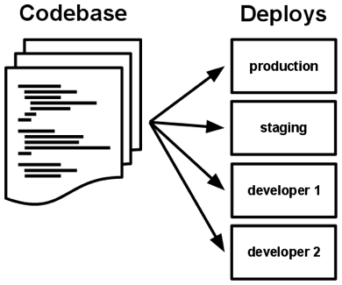
I. Codebase
One codebase for a single deployed service
Each microservice might have seperated codebase
One codebase many deployments
Deployments should differ in config
Notes:
Codebase
Most basic thing: use version control
Git
Codebase for single deployable – independent life cycles
Deploy the same codebase to many environments – dev, integration, prod
Track versions of code

Slide 119
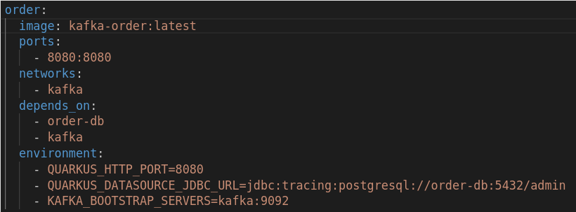
III. Config
Seperation of config from code
Environment variables define deployments
Modern frameworks support this approach
Notes:
Config management
Strict seperation from config to code
Code handles business, config parameterizes service
Use environment variables to override configuration
Makes environments dynamic
Modern frameworks support approach

Slide 120
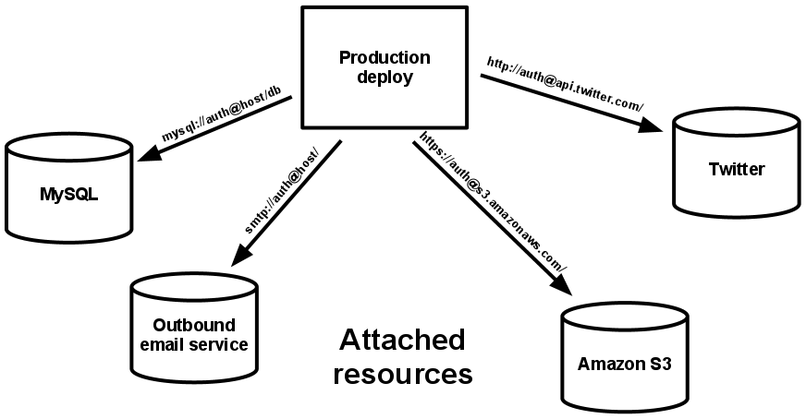
IV. Backing services
Make backing services (Databases, message brokers, etc) attachable resource
Loosely coupled even with third party services
Attach and detach or substitute with ease
Notes:
Modern applications use backing services
Databases, message brokers, tracer etc as attachable resource
Parameterize APIs in config
Loosens coupling drasticly
Attach and detach or substitute depending on configuration

Slide 121
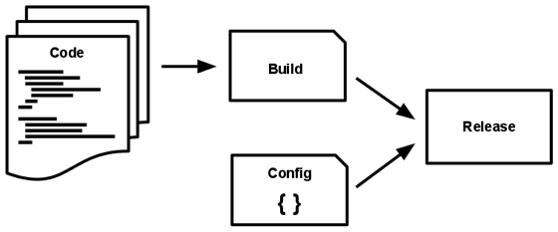
V. Build, release, run
Transform codebase into deploy with three stages
Use the same artifact (Docker image) for all environments
Use a single pipeline to track all steps
Notes:
Build, release, run
Not only for OPS team important, Devops culture
Stage to transform code into deployable
Best practices:
- User same artifact (image) for all environments
- Automated pipeline to build, test, release

Slide 122
V. Build
Use automated pipelines to build and test codebase
Create single deployable for all deployment environments
Prepare your deployable to be parameterized for each deployment
Notes:
Build (Closest to developer)
Use pipelines to build artifacts
Test your code and run tests in pipeline
Create a single deployable for all environments
Prepare deployable with parameterizable config

Slide 123
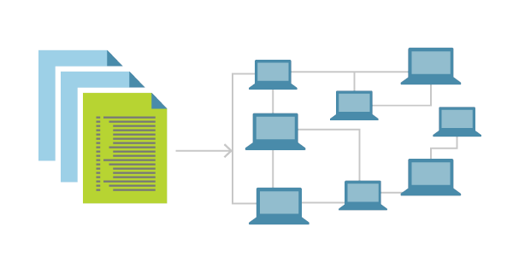
V. Release
Deliver the parameterizable deployable to environment
Use environment variables to fill parameters to your needs
Release fast and often
Best practice: Infrastructure as code
Notes:
Release
Deliver the deployable to infrastructure
Fill parameters depending on environment
Release fast and often => fail early
Best practice:
Infrastructure as code (different repo)
Git Ops

Slide 124
V. Run
Delivered deployable should run on each environment
Tag and track deployed applications via build or release ids
Notes:
Run
Delivered deployable should run in different environments
Tag and track deployed applications on each environment via build-ids
Use observability to track health

Slide 125
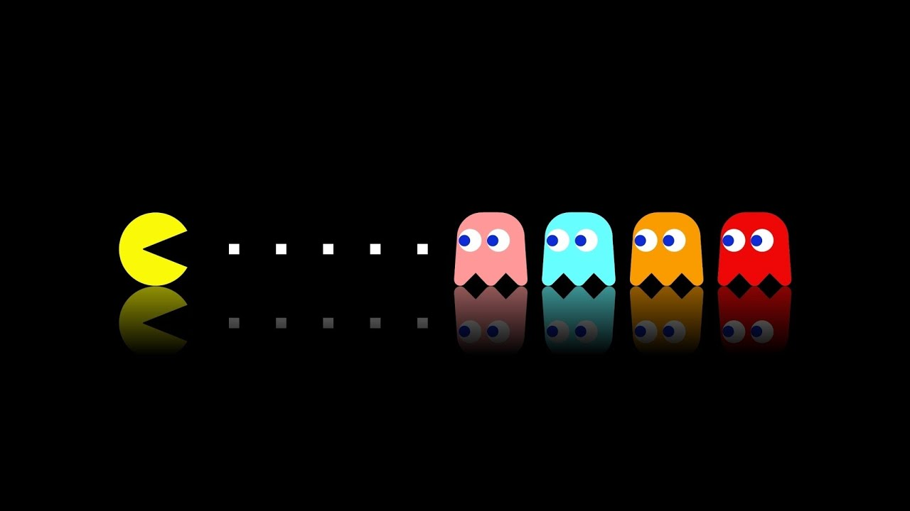
IX. Disposability
Scalable applications should have low startup times
Stopped and started with low cost
Robustness against sudden death
Notes:
Small services should scale
Requires fast startup times
Should stop as fast
Should be robust against sudden death
Then they will be easily scalable

Slide 126
X. Dev/Prod parity
Environments (dev/prod) should use same deployable
As similar as possible
Difference in environment variables preferably via code
Tests will have meaning
Notes:
Since we use the same deployable, Dev / Prod very close
Should be as similar as possible
Differ in environment variables
Then tests will have meaning

Slide 127
Cloud patterns
The Twelve-Factor App
Design for Failure (Retry, Timeout, Circuitbreaker)
Microservice Communication
Orchestration vs. Choreography
Event Driven Architecture
Transaction management
Notes:
Design for failure
Specially in Software systems

Slide 128
Design for failure
Microservices need a lot of communication
Communication brings external coupling
External coupling will vulnerable to failure
Use patterns to create robustness
Notes:
Design for failure
Think ahead, services will eventually fail
More distribution = > more communication
More communication => more external coupling
We can use patterns to create robustness

Slide 129
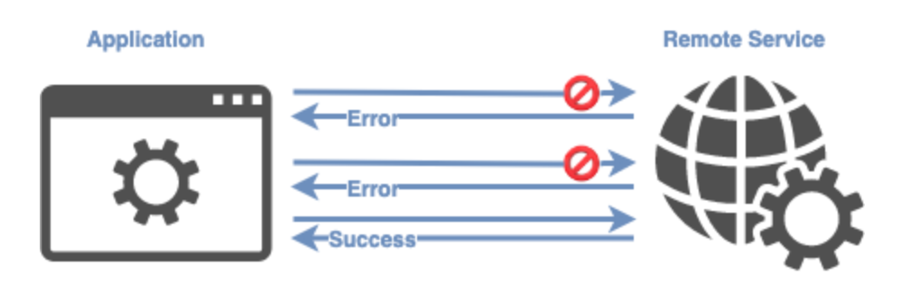
Retry
Microservice A calls a remote service B
B is not available (can and will happen)
Call from Microservice A will be retried after a short delay and will hopefully succeed
Notes:
Retry Mechanism
Scenario: Service A calls remote service B
B not available
Instead of just failing and crashing,
A retries after a defined delay for a defined amount

Slide 130
Timeout
Microservice A calls a remote service B
B experiences a lot of load and has longer response time
A defines a timeout period to wait until the remote call will be dismissed
Careful with combining retries and timeouts
Notes:
Timeout:
Same scenario: Service A calls Service B
B has huge load => longer response time
A defines a timeout to wait until call fails
Can be helpful if calls tend to have undefinable response time
CARE with combining retries and timeouts
What can happen?

Slide 131
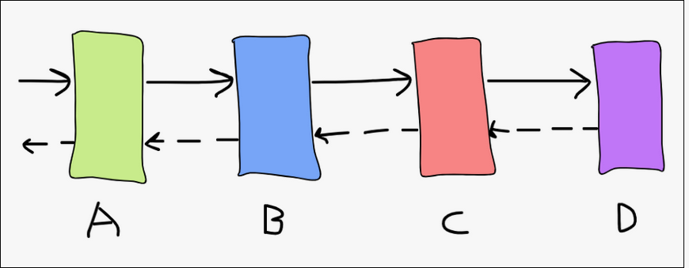
Retry storms
Number of retries = 3
A calls B, B calls C, C calls D
D responses with 100% errors
B will face 300% load, C 900% load, D 2700% load
Notes:
Retry storms
Scenario: 4 services, defined 3 retries
Service A calls B, B calls C and C calls D
Chained workflow, rest calls, all retries defined
For some reason D responses with 100% error rate
See the problem?
B will triple in load, C factor 9, D factor 27

Slide 132
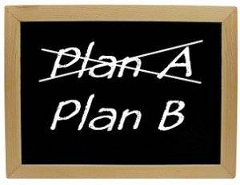
Fallback
Fallbacks can be defined when alternatives are available
Whenever a remote source fails, repeat on fallback
Example: Use last cached result instead of new query
Careful compromise between robustness and vulnerability and loss of consistency
Notes:
Fallbacks:
Defined alternatives for a failing machanism
Whenever remote service fails, we define fallback mechanism
Very useful with last cached results
Instead of new query, use last result
Create compromise, robustness vs vulnerability or loss of consistency
Fallback might not be up-to-date or give same result

Slide 133
Circuit Breaker
Real world analogy to electrical circuit breaker
Resources that fail often in a defined period of time will open a circuit breaker
Continue operation without failure cascading through entire system
Notes:
Circuit Breaker
Insteresting mechanism, Real world analogy to electrical circuit breaker
General idea: Resources that fail, fail multiple times
If the fail, take fallback for defined time, then try again
With circuit breaker, operation can continue without failure cascade through system

Slide 134
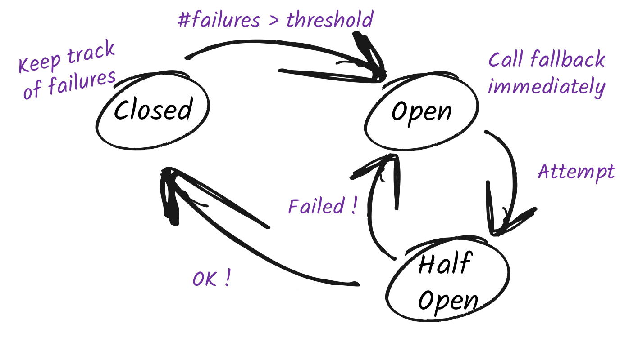
Circuit Breaker
Failures will trigger circuit breaker to open
If circuit breaker is open, calls will fail immediately, fallback will handle
After succession, circuit breaker will be half open and retry
If request succeeds circuit breaker will close and operation will continue normally
Notes:
How does it work
Failures will be tracked, if number failures bigger than threshold, circuit breaker opens
At this point all operations go straight to fallback
Circuit Breaker will attempt to use resource again, if it succeeds, state to half-open
If it continues to work then the circuit breaker will close again and operation will continue normally

Slide 135
Cloud patterns
The Twelve-Factor App
Design for Failure (Retry, Timeout, Circuitbreaker)
Microservice Communication
Orchestration vs. Choreography
Event Driven Architecture
Transaction management

Slide 136
Microservice Communication
Microservice heavily reliant on communication
More distribution brings more communication
Synchronous / Asynchronous protocols
Notes:
Distributed Systems will need a lot of communication
A lot of problems arise with communication
Choosing protocol is important
Communication can be synchronous or asynchronous

Slide 137
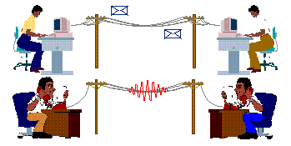
Synchronous vs Asynchronous
Synchronous – Telegraph
Asynchronous - Email
Notes:
Good real world analogy in communication
Synchronous – Telegraph. You had to wait until parnter is ready, then communicate, and receive answer.
Asynchronous – Email. Invention of email helped us a lot. You can give bad news to people without facing them.
Asynchronous, can send whenever I want
Infrastructure (Mail Server) must be available

Slide 138

Synchronous communication
Well known
Easy implemented
Hard to scale
Notes:
Synchronous communication protocols
Well known. HTTPS example
Easily implemented. REST service available for everyone
Hard to scale in general

Slide 139
Synchronous: REST (HTTP)
REST communication simple and efficient
Transition from monolithic approach easy
Fault tolerance patterns widely supported
Brings tighter coupling
Blocking operations
Notes:
Example REST over HTTP
Simple and efficient
Transition from monolithic application very easy, replace all communication with rest calls
Fault tolerance patterns easily implemented, and supported
Tight coupling, services must be here to communicate
Blocking operations

Slide 140
Asynchronous: Messaging
Loose coupling
Non-blocking operations
Simple to scale
Responsibility shift to broker
Notes:
Asynchronous Messaging (example AMQP)
Loosens coupling
Services no need to know each other, simply the broker (postal service)
Communication becomes non-blocking instead of blocking
Simple to scale, broker does all the work
Immense responsibility shift, from services to broker, which does all the delivery and balancing

Slide 141
Cloud patterns
The Twelve-Factor App
Design for Failure (Retry, Timeout, Circuitbreaker)
Microservice Communication
Orchestration vs. Choreography
Event Driven Architecture
Transaction management

Slide 142
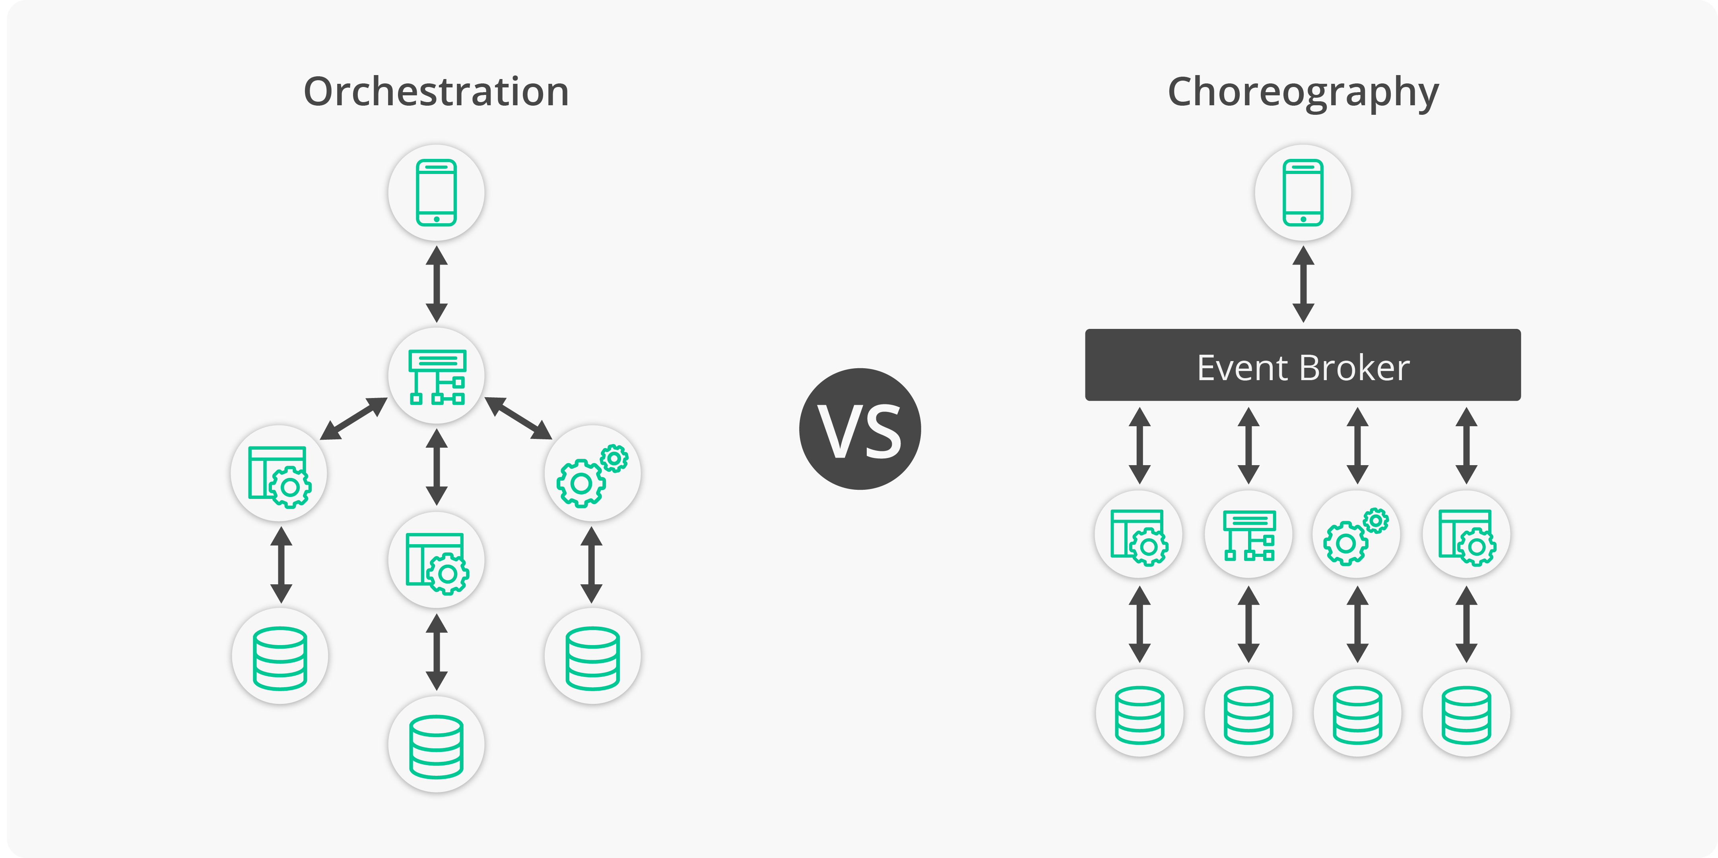
Orchestration vs. Choreography
Different approach for communication
Responsibility question
Notes:
Communication question:
- Who knows how to control workflow
- Responsibility shift
- Difference maybe in size and complexity of workflow

Slide 143
Choreography
Each part knows it’s responsibility
Microservice knows the workflow
Notes:
Choreography
- Each Microservice knows it›s part in the entire workflow
- Microservice has to know workflow
- Listen to previous step
- Call or message to next step
Example:
Money collecting:
Situation, restaurant eating with a friend. Split bill. You pay, your friend pays you back.
This problem will get more complex with more friends

Slide 144
Orchestration
Central orchestrator has responsibility
Controls general workflow within the system
Notes:
In this scenario orchestrator microservice knows and controls the workflow
He holds the responsibility of orchestrating the flow in the system
Scenario from before: Eating restaurant with the entire office, money collecting becomes harder and inefficient if everyone has to do it by themselves. Central manager will do the payments.

Slide 145
Cloud patterns
The Twelve-Factor App
Design for Failure (Retry, Timeout, Circuitbreaker)
Microservice Communication
Orchestration vs. Choreography
Event Driven Architecture
Transaction management

Slide 146
Event Driven Architecture
Design tends to be imperative
Creates coupling direct between services
Services need to know their communication partner
Notes:
Design tend to be imperative
We think in an imperative way
Imperative flows create coupling
Example

Slide 147
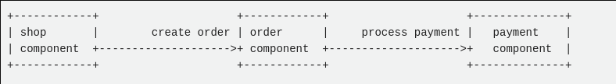
Event Driven Architecture
Notes:
Example: Web shop
User creates order in webshop, order created in order microservice
Order service triggers payment to finalize
Communication will only work when all parties are available
Components need to know each other => creates coupling

Slide 148
Event Driven Architecture
Take a look from another perspective
Call from Shop to Order can be viewed as an event
Workflow becomes reactive instead of imperative
Central broker takes responsibility for delivering events
Single source of truth in event bus
Notes:
Take a step back from this approach
Look at it differently
Call from Shop to order can be viewed as event
Suddenly workflow is reactive instead of imperative
Message broker (Postal service) takes responsibility for delivering messages or events
The message bus becomes single source of truth

Slide 149
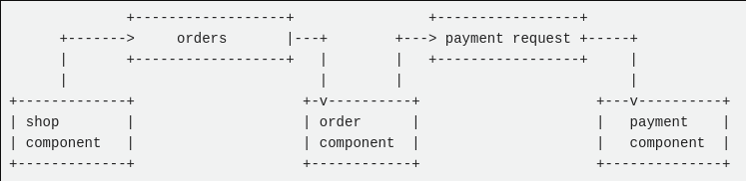
Event Driven Architecture
Notes:
Event driven approach
Shop does not imperatively trigger order service
Shop emits event to «orders» topic. Order component subscribes to «orders» topic and gets notified by broker whenever event passes through.
All services only need to know broker, loosens coupling between the services

Slide 150
Transaction management
What are distributed transaction?
Patterns for distributed transactions
Saga pattern

Slide 151
Transaction management
Decentralization from workflow generates problem
ACID (atomicity, consistency, isolation, durability)
Several patterns how to manage transactions
Best practice: Database per service

Slide 152
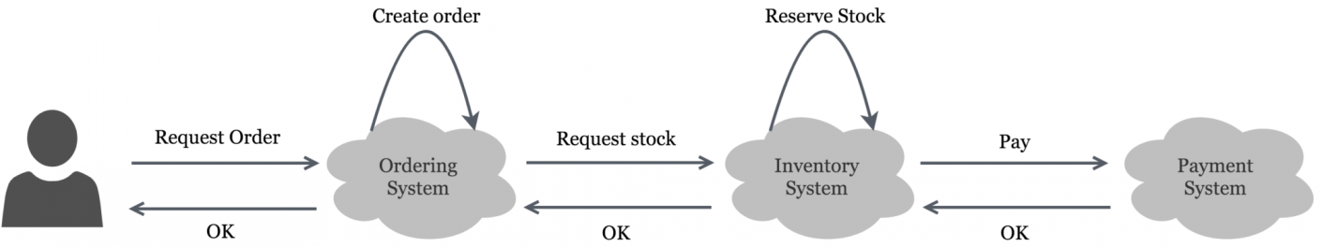
Transaction management
Notes:
Example Order Scenario:
Orchestrated approach, every microservice knows what to do. Can be asynchronous or synchronous.
This is the happy path.
What happens when we fail? What happens to our data?

Slide 153
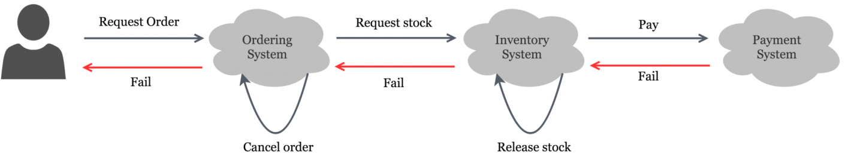
Transaction management
Notes:
Example Order Scenario:
Payment fails due to any reason
Answer comes back and every service does its own rollback or compensation
Every part in the system knows what to do.
Heavily reliant on the single services to know what they do.
Fallacy of distributed system – Network reliability through processes
See any problems? Think about it

Slide 154
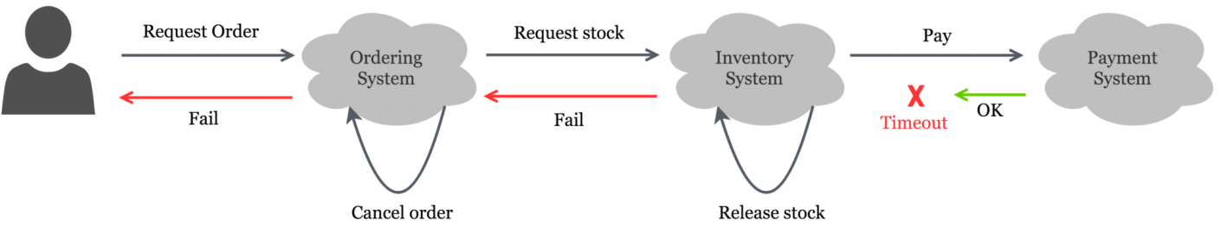
Transaction management
Notes:
Error due to hazard.
Response takes longer, inventory recognizes failure, starts compensation
Compensation goes through
Invalid system state. Payment was processed, Inventory and Order were cancelled.
We need a solution for distributed transactions

Slide 155
Saga Pattern
Global distributed transactions as series of local ACID transactions
Compensations as rollback mechanism
Global state depends of local transaction executions
Orchestration / Choreography

Slide 156
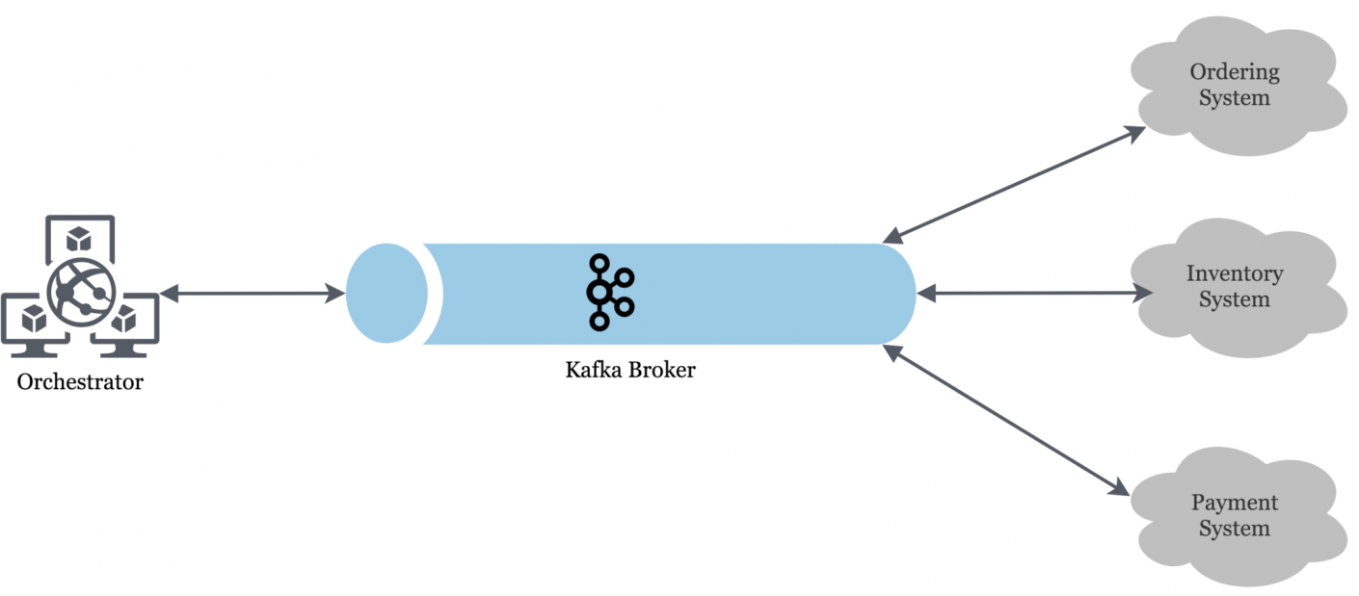
Saga Pattern
Notes:
Orchestrated example
Orchestrator sends event to create order request, create inventory request, and payment request.
Transaction will be completed if and only if all components will confirm transaction.
Services will reply with confirmation if everything was going after plan

Slide 157
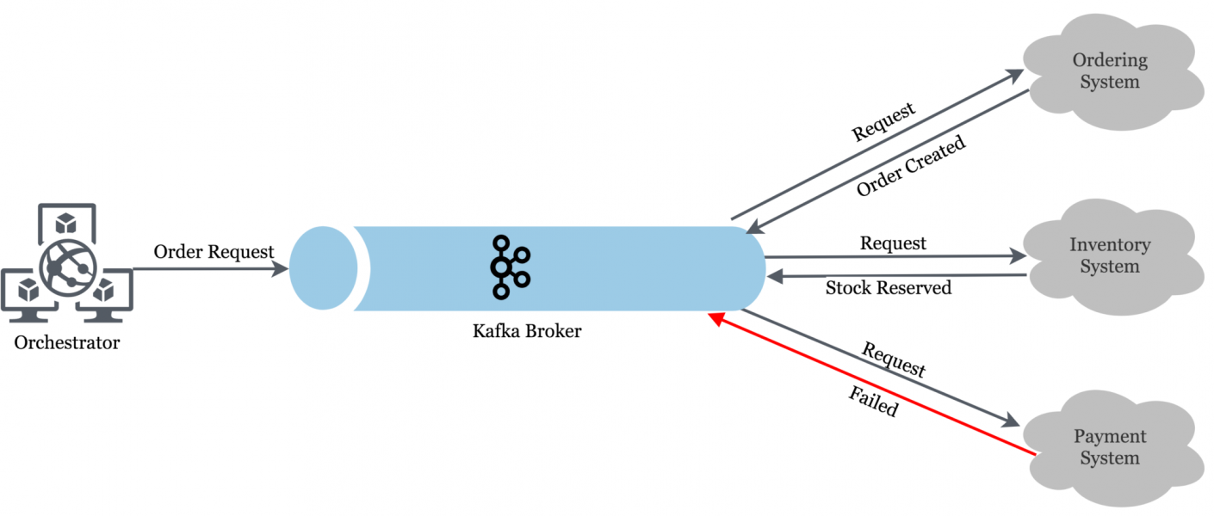
Saga Pattern
Notes:
Same scenario as before: Payment fails
Order service sent confirmation,
Inventory system sent confirmation
2 of 3 services confirmed, transaction still in progress in the orchestrator
Payment fails. Now every action has to be reverted in the system. This is called compensation.

Slide 158
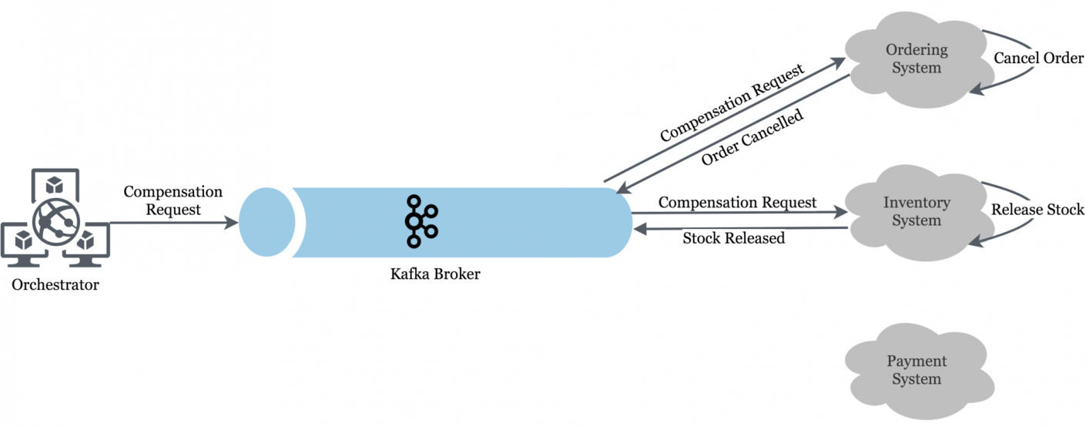
Saga Pattern
Notes:
The orchestrator now sends compensation requests to both the order and inventory service
They will confirm the compensation and the transaction was rolled back.
System is now back to original state.
When and how dot the events get emitted? Whenever the service calls the database?

Slide 159
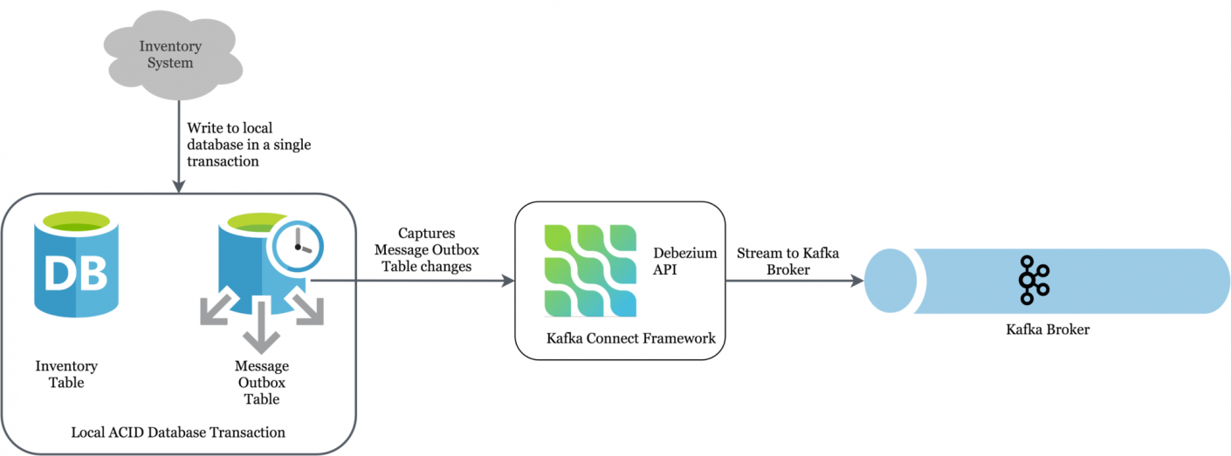
Transactional outbox pattern
Database operations will atomically inserted to outbox table in the same transaction
Outbox table will then produce events to publish transactions
Notes:
Transactional outbox pattern or data change capture pattern
General problem: Writing to database and emit event not atomic.
So it will be separated, every database change will in the same local transaction be captured in outbox table
Connected service will read table and emit events to the broker
Connected service may also stream database log instead of outbox table

Slide 160
Agenda - Day 2
8 fallacies of distributed computing
Cloud patterns
Continuous integration and delivery
Event driven architecture and messaging
Observability – Metrics and Tracing
Writing your own Quarkus extension

Slide 161
Deployment automation
DevOps culture
Applications can be rolled out independently
Continuous Integration and Delivery is crucial
Build and Deploy often
Automate as much as possible
Notes:
Deployment automation:
DevOps culture (what, why, how?)
Build seperated services, roll them out seperately
CICD / DevOps helps a lot
Fail fast and often / Build and deploy
Automate as much as possible

Slide 162

DevOps
Notes:
Hype / Buzzword
But very practical if taken seriously
Neat quality of life enhancements in daily business
But what is DevOps?

Slide 163
DevOps
«DevOps is the combination of cultural philosophies, practices, and tools that increases an organization’s ability to deliver applications and services at high velocity: evolving and improving products at a faster pace than organizations using traditional software development and infrastructure management processes.»
https://aws.amazon.com/devops/what-is-devops/
Notes:
Definition from Amazon AWS:
Take few seconds to read

Slide 164
DevOps
«DevOps is the combination of cultural philosophies, practices, and tools that increases an organization’s ability to deliver applications and services at high velocity: evolving and improving products at a faster pace than organizations using traditional software development and infrastructure management processes.»
https://aws.amazon.com/devops/what-is-devops/
Notes:
Keywords for me:
- Cultural philosophies
- Practices
- Tools
- Brings faster pace
Sounds neat, why not?
Understand the base scenario first

Slide 165
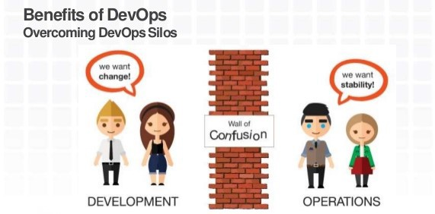
DevOps
Notes:
Long time ago in a distant land
Devs and Ops lived seperatly
Between their reals wall of confusion
Devs did not know what ops did
Ops had no clue about implementation
What happened?

Slide 166
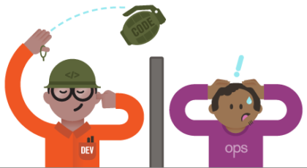
DevOps - Before
Classical split Devs and Ops
Dev develops application
Application thrown over fence
Ops should operate unknown application
Big knowledge gap
Notes:
Dev developed application
After build, thrown like a handgranade to Ops
Ops should then operate unknown application
Big gap between their two worlds
Exagurated a bit

Slide 167
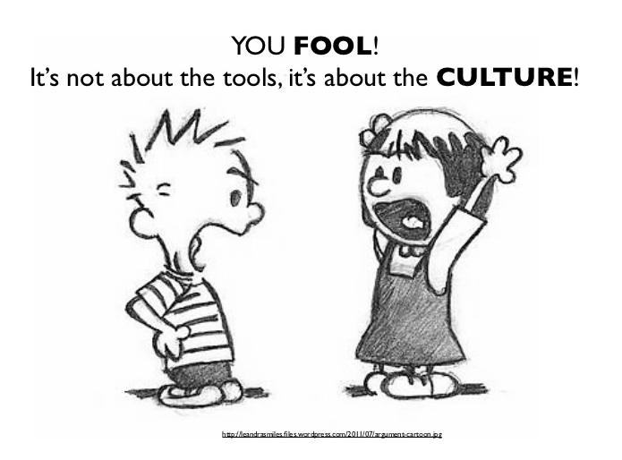
DevOps culture
Tear down wall of confusion
Enable Devs to be Ops
Integrate Operations to daily development
Mindset should develop
Notes:
What does the culture?
First tear down wall of confusion
Bring teams closer or even mix
Cannot stress this enough:
Motivate devs to do ops
Integrate Ops to daily Dev business
- Observability checks
- Look at metrics, dashboards, etc
Mindset needs a little push

Slide 168
Infrastructure as Code (IaC)
Infrastructure objects defined in code
Development process involves infrastructure
Infrastructure gets detachable
Fast creation of new environments
Notes:
Infrastructure as Code helps with this
Define infrastructure objects as code
Make developers also develop infrastructure objects
What are the benefits?
- Knowledge gap reduced massively
- Infrastructure detachable, loosens coupling
- Enables fast creation of new environments
- Or infrastructure changes

Slide 169
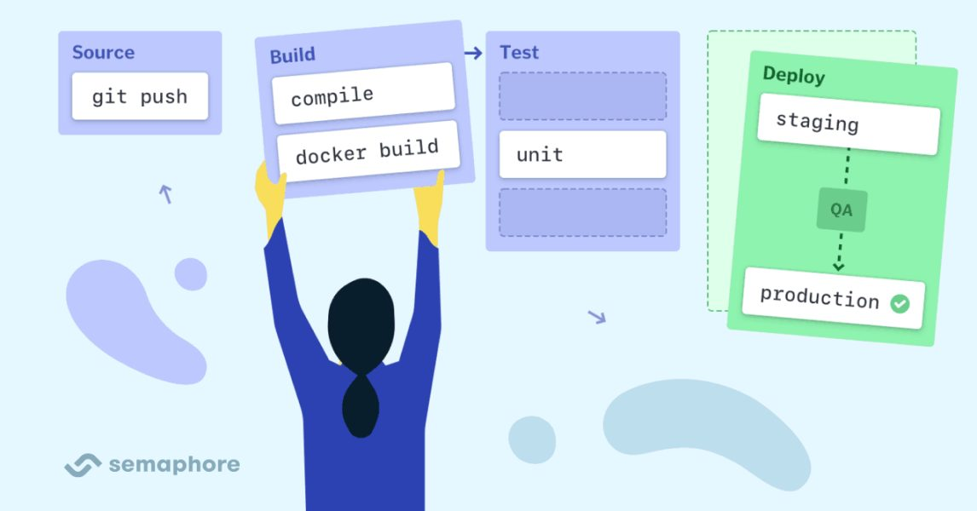
Deployment automation
Notes:
Another thing to help: Deplyoment Automation
Integrate build pipelines to workflow
Define pipelines to run all steps
- Build
- Test
- Release or Deploy
Integrate infrastructure changes if possible as well
GitOps: Integrate infrastructure changes to your pipelines

Slide 170
Deployment automation
Automated pipelines for build, test, release
Deploy fast and often
«Handle every commit on master as deployable»
Feedback-Loop gets faster
Notes:
We are lazy, we want automation
Create your pipelines to automate process
Define pipelines in code as well
Deploy fast and often, fail early
A friend of mine said: Handle every commit on master as deployable
Brings better devops mindset
Feedback loop gets faster a lot
Brings speed and efficiency

Slide 171
Deployment automation
API changes need to be categorized
Non-breaking changes deployed fast
Breaking changes need to deploy all dependent services
Communication is key
Notes:
Some insights or tips:
Categorize your changes impact on API
- Breaking / Non-breaking changes
Breaking changes change the way you can communicate with API
Non-breaking changes will not be felt from outside
When deploying single services be careful with breaking changes
Identify impact, deploy all impacted services
Communication between devs is key

Slide 172
Agenda - Day 2
8 fallacies of distributed computing
Cloud patterns
Continuous integration and delivery
Event driven architecture and messaging
Observability – Metrics and Tracing
Writing your own Quarkus extension

Slide 173
Reactive Messaging
«Framework for building event-driven, data streaming and event sourcing applications using CDI», smallrye.io
Notes:
Für Event-Driven, Event-Sourcing und Data-Streaming Apps wird in Quarkus das SmallRye Reactive Messaging Framework verwendet. Dies ist eine Implementation der Eclipse MicroProfile Spezifikation.
Event-Driven: Event gesteuerte Architektur
Event-Sourcing: Data wird in Events gehalten
Data-Streaming: Kontinuierlicher Flow von Daten

Slide 174

Reactive Messaging Concepts
Message, Payload, Metadata
Application receives, processes and send messages
Message is an envelop around payload
Messages can contain metadata (e.g tracing context)
Notes:
Metadaten ist ein Optional, da diese nicht zwingend vorhanden sein müssen.

Slide 175

Reactive Messaging Concepts
Channels and Streams
Messages transit on channels
Virtual destination (identified by name)
Notes:
Innerhalb der App fliessen die Messages auf Channels.
Channels sind virt. Destinationen, smallrye verbindet die einzelnen Komponenten mit Channels.

Slide 176

Reactive Messaging Concepts
Connectors
Connect to broker
Poll or write messages
Map messages to channels
Dedicated to a technology (e.g. Kafka)
Notes:
Sind:
- Bindeglied APP – Broker
- Technologie-Speziefisch
Tun:
- Beziehen/ Senden Message zu Broker
- Schreiben in od. Beziehen von spez. Channel
- Marshalling vom Payload
- Verarbeiten der Metadaten
- Acknowleadgment
Sind Nicht zwindend → in-memory → selbst verantwortlich für Source und Sink,

Slide 177
Reactive Messaging
Connector Support
Kafka Connector
AMQP Connector
MQTT Connector
HTTP Connector
Camel Connector (SmallRye Camel Quarkus)
In Memory (for testing)

Slide 178
Reactive Messaging Example
Application Class
/**
* A bean consuming data from the "prices" Kafka topic and applying some conversion.
* The result is pushed to the "my-data-stream" stream.
*/
@ApplicationScoped
public class PriceConverter {
private static final double CONVERSION_RATE = 0.88;
@Incoming("prices")
@Outgoing("my-data-stream")
public double process(int priceInUsd) {
return priceInUsd * CONVERSION_RATE;
}
}
Notes:
Consumer-Beispiel

Slide 179
Reactive Messaging Example
Application Configuration (Serializer/Deserializer properties omitted)
# Configure the SmallRye Kafka connector
kafka.bootstrap.servers=localhost:9092
# Configure the Kafka source (we read from it)
mp.messaging.incoming.prices.connector=smallrye-kafka
mp.messaging.incoming.prices.topic=prices-raw
# Configure the Kafka sink (we write to it)
mp.messaging.outgoing.my-data-stream.connector=smallrye-kafka
mp.messaging.outgoing.my-data-stream.topic=prices-converted
kafka address
connector type
channel
kafka topic
Notes:
Connector Config
- Channel ist ConfigKey für Connector und Topic

Slide 180
Reactive Messaging
Documentation
SmallRye Reactive Messaging
View supported Method Signatures
They affect the acknowledgement strategies
Notes:
- Connectoren im Detail beschrieben
- relevanten Konzepte wie bspw. Acknowleadgement-Strategien, backpressure ect.

Slide 181
Agenda - Day 2
8 fallacies of distributed computing
Cloud patterns
Continuous integration and delivery
Event driven architecture and messaging
Observability – Metrics and Tracing
Writing your own Quarkus extension
Serverless

Slide 182
Observability extends Monitoring
«Monitoring tells you whether a system is working, observability lets you ask why it is not working.», Baron Schwartz 2017
Proactive
Alerting
Monitoring
Metrics &
Dashboards
Observability
Reactive
Tracing

Slide 183
Why do we need it?
More complexity
More diverse problems
Runtime issues
Request path may vary
1:n communication
Monitoring: targets known problems
Tracing: Instrumentation for problems we dont know yet

Slide 184

Three pillars of observability
source: dynatrace.com

Slide 185
Metrics
number of orders created:23
number of failed invocations of /order:3
response time of /order:823ms
Capture system state at given time
Visualize and analyze metrics with dashboards
History might be useful
Send alerts based on metrics

Slide 186
Logs
2020-07-12 11:45:34 Transaction id 12398 failed on update
2020-09-23 19:23:11 POST /order - status:201 – response_ms:21
Collect logs centrally
Analyze logs in case of problem
What happens at this time
Find application misbehaviour and exceptions

Slide 187


Tracing - Terminology
Trace: Execution path through the system
  Acyclic graph of spans
Span: Logical unit of work
  Name, Start-Time and Duration
  Could be nested, ordered

Slide 188
Tracing
request with id 98183 took 62ms
- service a took 22ms
- service b took 40ms
Sample real requests
Find erroneous components
Find bottlenecks

Slide 189
Observability Example

Slide 190

Observability – Example
Logs
Centralized logs
Metrics
JVM Metrics Microservices
System metrics
Network metrics
Message Brokers
Storage
Duration of message processing
Alerts
Queue size
...

Slide 191

Observability – Example

Slide 192

Observability – Example
Alerting
Pod scaling

Slide 193


Observability – Example

Slide 194
Observability – Example
Slow
Fills up
Time to investigate ...
Log: what happend at that time?
Metrics: processing is slow
Metrics: network, system does not show any problems

Slide 195
Observability – Example
Results from Tracing
Huge amount of repeated spans
Three-fourths of time in foreach
«complex» calls db & services
Select n + 1 problem
Increasing size of data[] increases request count
processCalculations(Message message) {
Data[] data = message.data;
// handle data
data.foreach({
// complex
});
store(data);
}

Slide 196
Observability – Example
Optimization
Prefetch data once (as batch)
Less interaction in foreach
Code runs 10x faster
Increasing data[] does not increase request count
processCalculations(Message message) {
Data[] data = message.data;
// prefetch required data once
fetchData();
// handle data
data.foreach({
// less complex
});
store(data);
}

Slide 197
Agenda - Day 2
8 fallacies of distributed computing
Cloud patterns
Continuous integration and delivery
Event driven architecture and messaging
Observability – Metrics and Tracing
Writing your own Quarkus extension

Slide 198
Quarkus structure
Image source: Red Hat
Notes:
Quarkus core – add only extensions you need – extensions provide functionality
Write your own extensions!

Slide 199
Extensions
Extend Quarkus framework
  with custom functionality
  Adopting libraries or frameworks to the Quarkus world
Maven multi-module project
  Deployment
  Runtime
Notes:
Either something that you need (frequently) or write an extension to use a third party library with quarkus
Extensions have are built from 2 parts/ modules: Depoyment and Runtime.
You can do stuff at build time and provide functionality at runtime

Slide 200
Extensions
Adopting libraries or frameworks to the Quarkus world
Third party libraries might or might not work out of the box
Notes:
Third party libs might not work because of the quarkus model (remember day 1?)

Slide 201
Deployment Module
How to deploy the extension code
Processing done with @BuildSteps which run at build time
Has dependency to extension runtime module
Dev UI integration

Slide 202
Deployment Module - @BuildStep
Produce and consume BuildItems
Are ordered by dependencies
A BuildStep is run when all dependencies are available
Can record invocations by using recorders from runtime module

Slide 203
Deployment Module - @BuildStep
Example: Find classes ending with MessageConverter and register for CDI
Jandex Access → CombinedIndexBuildItem
Register additional beans for CDI → AdditionalBeanBuildItem
@BuildStep
void messageConvertersAsBean(CombinedIndexBuildItem index,
BuildProducer<AdditionalBeanBuildItem> additionalBeans) {
List<String> converters = index.getIndex().getKnownClasses().stream()
.filter(ci -> !Modifier.isAbstract(ci.flags()))
.map(ci -> ci.name().toString())
.filter(c -> c.startsWith("my.dependency.package."))
.filter(c -> c.endsWith("MessageConverter"))
.collect(Collectors.toList());
additionalBeans.produce(new AdditionalBeanBuildItem.Builder()
.addBeanClasses(converters)
.setUnremovable()
.setDefaultScope(DotNames.APPLICATION_SCOPED)
.build());
}
Notes:
At build time: get all classes in package «my.dependency.package» that end with «messageConverter» as a list of strings
Produce additionalBeans for all these classes at buidl time.

Slide 204
Deployment Module - @BuildStep
Example: Add an undertow servlet
Access to current LaunchMode of Quarkus → LaunchModeBuildItem
Access build configuration → Custom defined MyBuildConfig
Add Servlet → ServletBuildItem
@BuildStep
void createServlet(LaunchModeBuildItem mode,
MyExtConfig config,
BuildProducer<ServletBuildItem> servlets) {
if(mode.getLaunchMode().isDevOrTest() && config.enabled) {
servlets.produce(ServletBuildItem.builder(config.basePath, MyExtServlet.class.getName())
.addMapping(config.basePath)
.build();
}
}
Notes:
Servlet provides some information. In Techlab you will write an Appinfo Extension. The servlet provides the application info – in this code snippet, the servlet is created and mapped to your extensions basePath

Slide 205
Runtime Module
Runtime features (extension code, configuration)
Application depends on this extension module
Contains recorders
@Recorder
class HelloRecorder {
public void sayHello(String name) {
System.out.println("Hello" + name);
}
}
@BuildStep (deployment module)
@Record(RUNTIME_INIT)
@BuildStep
public void helloBuildStep(HelloRecorder recorder) {
recorder.sayHello("World");
}

Slide 206
Exposing Configuration
Extensions can expose configuration
  Remember different configuration phases
@ConfigRoot(name = "my-ext", phase = ConfigPhase.BUILD_TIME)
public final class MyExtConfig {
@ConfigItem(defaultValue = "true")
public boolean enabled;
@ConfigItem(defaultValue = "/myext")
public String basePath;
}
application.properties
quarkus.my-ext.enabled=false

Slide 207
Extension Resources
Writing your own extension
https://quarkus.io/guides/writing-extensions
Building my first extension
https://quarkus.io/guides/building-my-first-extension
How to write Quarkus extensions
https://peter.palaga.org/presentations/210407-quarkus-insights-how-to-write-quarkus-extensions
Quarkus core extensions
https://github.com/quarkusio/quarkus/tree/main/extensions
Quarkus community extensions (quarkiverse)
https://github.com/quarkiverse

Slide 209

Goodbye
Raffael Hertle
Senior Software Engineer
hertle@puzzle.ch
@g1raffi
Christof Lüthi
Kafka Messaging Engineer
luethi@puzzle.ch
@christofluethi

