Slide 1
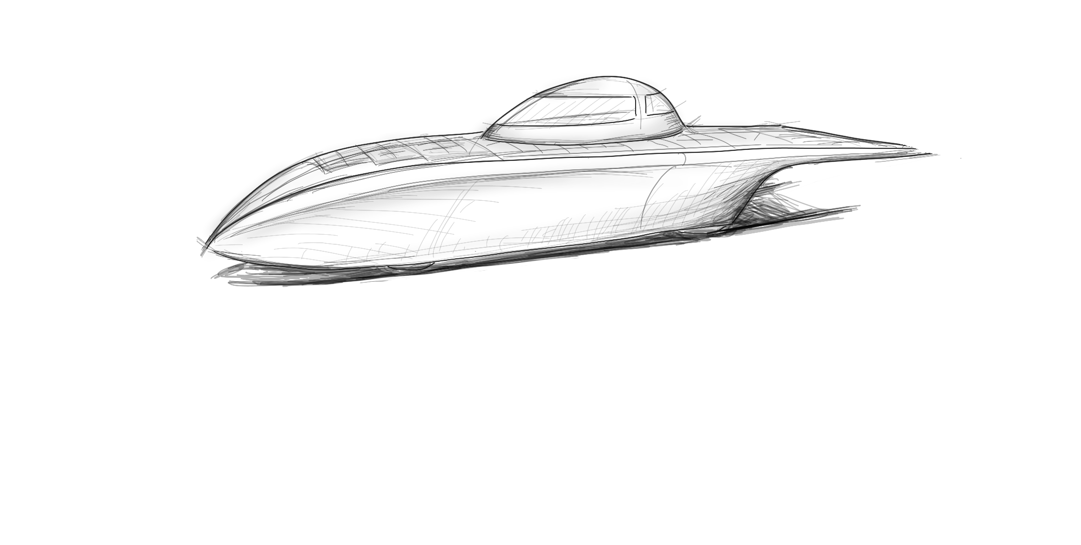
Update Presentation Simulation and Strategy Bachelor Thesis Giacomo Mastroddi

Slide 2
Problem Definition
Results
Components
Conclusion & Next Steps

Slide 3
Problem Definition

Slide 4
Rules
Driving time: 08:00 – 17:00
Recharge possibilities: from 15 min before sunrise and until 15 min after sunset
Safety stops at certain location: 30 min
Max allowed speed
Driver change
Max time to arrive at safety stops
Time domain
Space domain

Slide 5
Requirements & Goals
Robust
Stable
Simulation time as fast as possible
→ Finish the race
→ Minimize time to arrival, when subject to physical and meteorological constraint

Slide 6
Components

Slide 7
General Structure of the Simulation
Weather
Route
Vehicle
Parameters
Driver
Plant

Slide 8
Components Plant

Slide 9
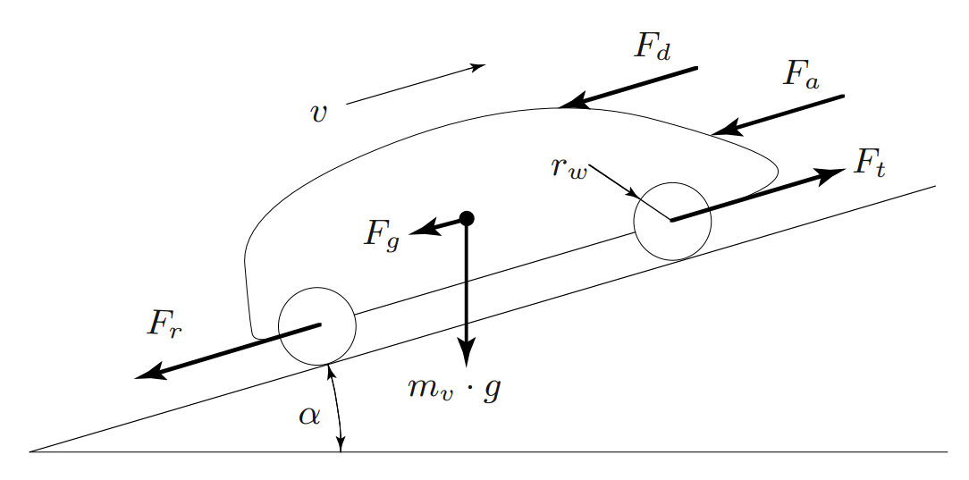
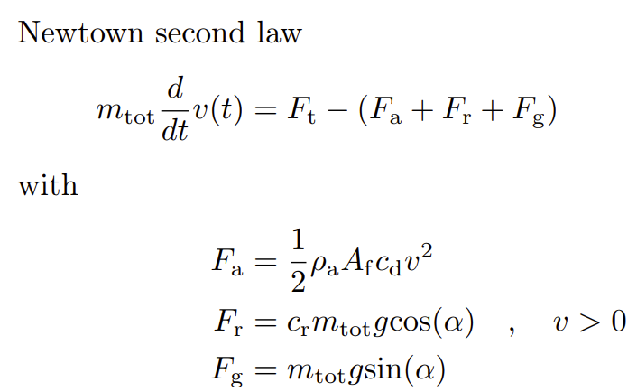
Longitudinal Vehicle Dynamics
Guzzella, Sciaretta - Vehicle Propulsion System

Slide 10
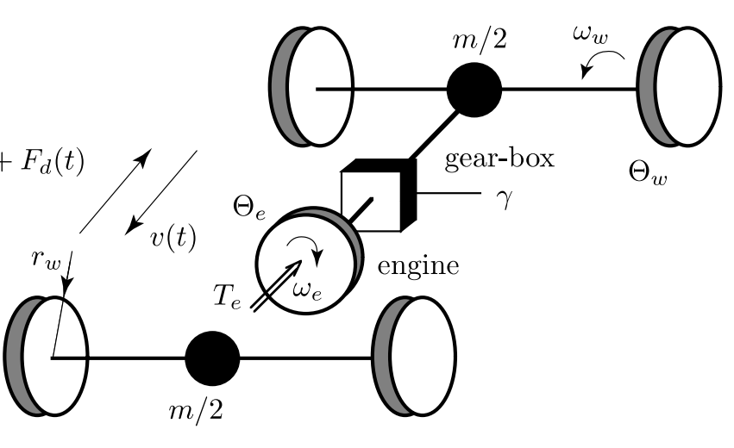
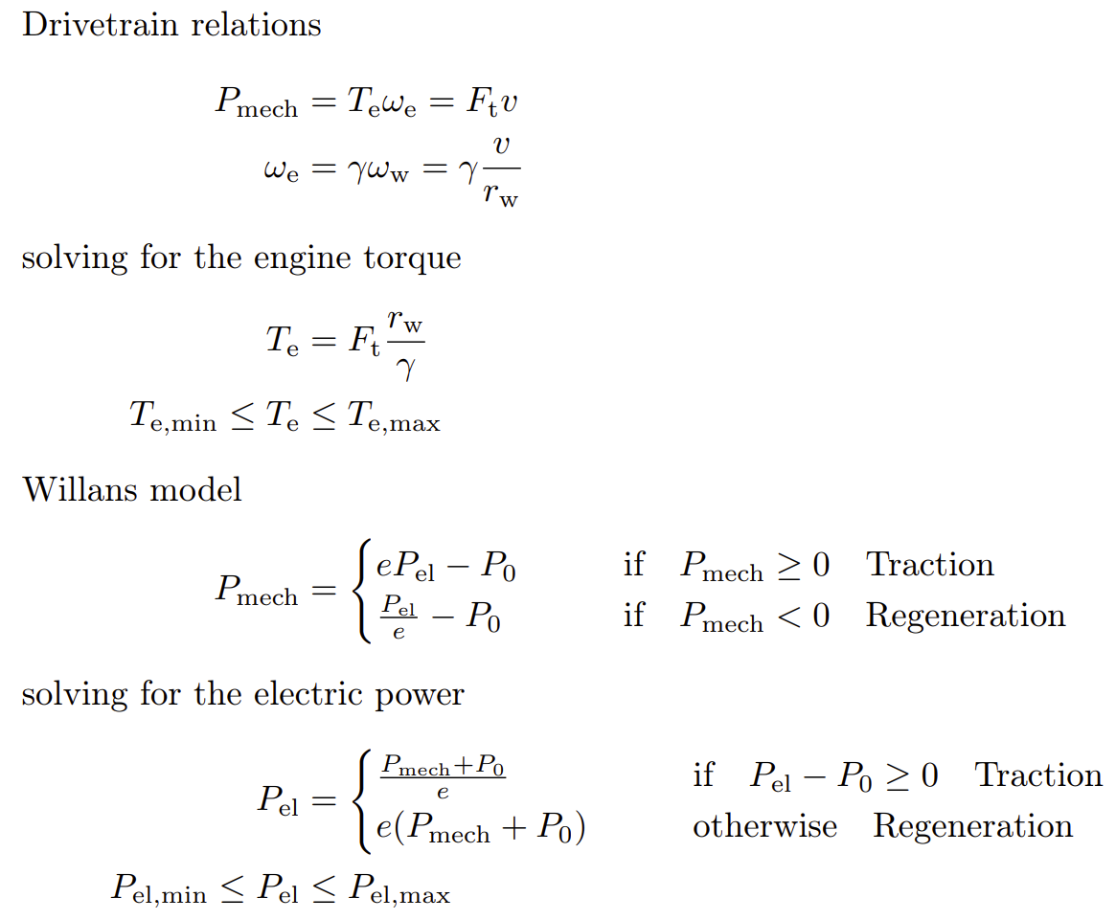
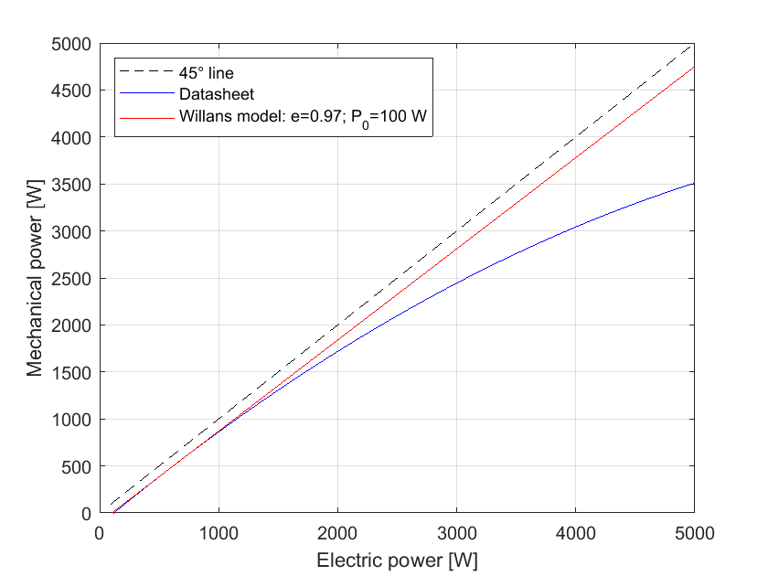
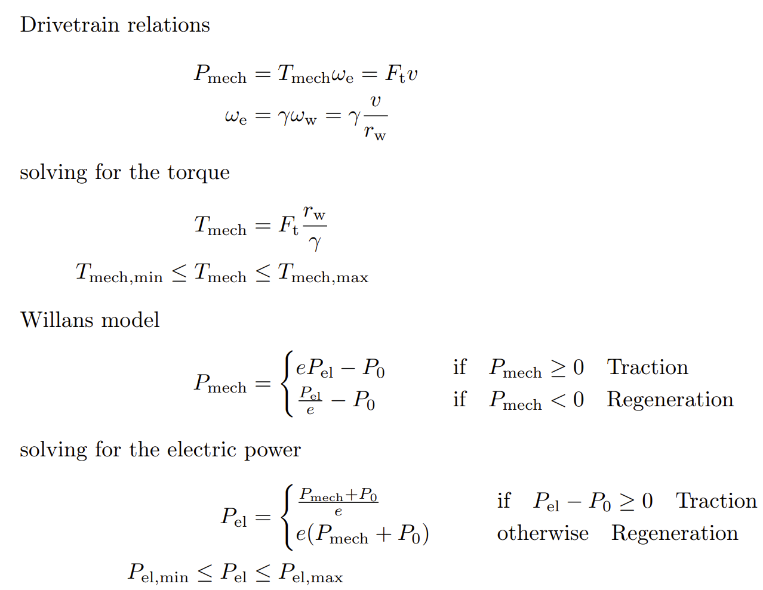
Electric Motor
Guzzella - System Modeling

Slide 11
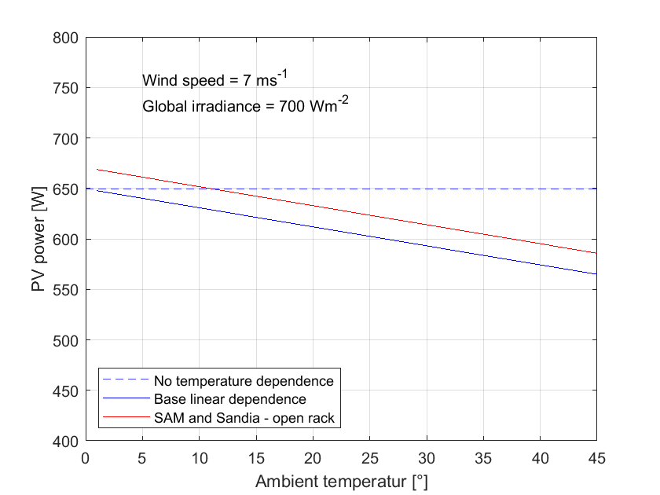
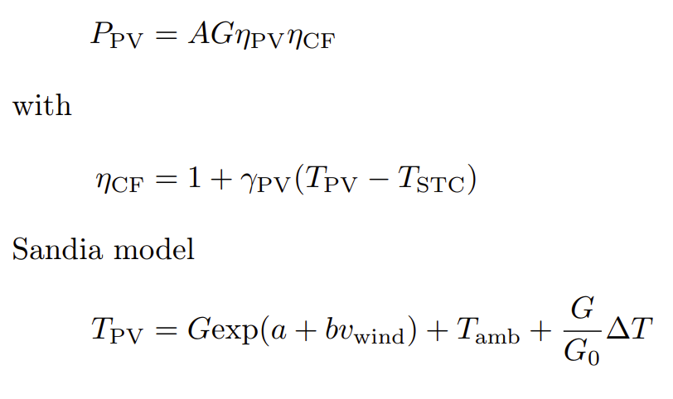
PV Module

Slide 12
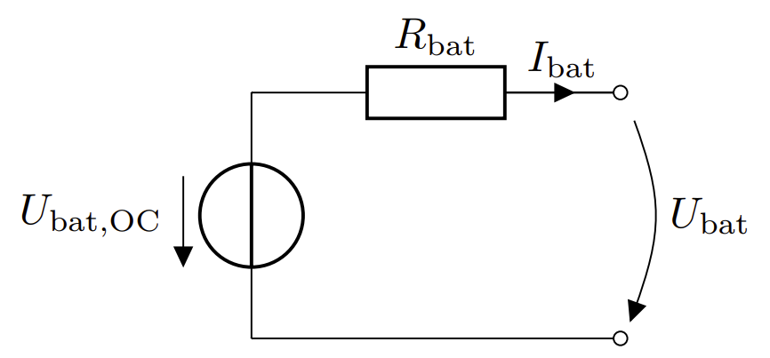
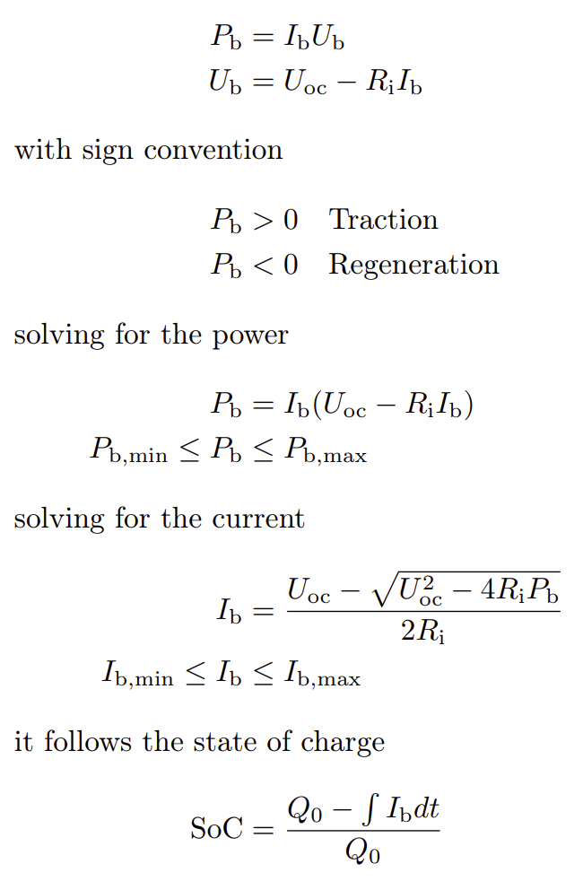
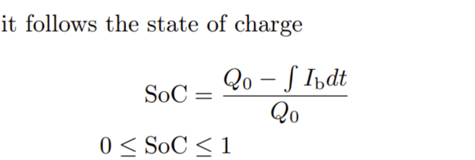
Battery Pack
2017 - Widmer - Trip-Wise Adaptive ECMS

Slide 13
Components Vehicle Parameters

Slide 14
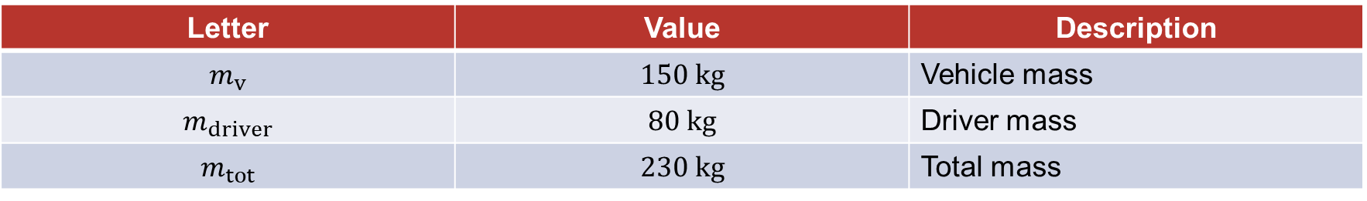
Structure
Letter | Value | Description
$$m_{v}$$ | $$150 kg$$ | Vehicle mass
$$m_{driver}$$ | $$80 kg$$ | Driver mass
$$m_{tot}$$ | $$230 kg$$ | Total mass

Slide 15
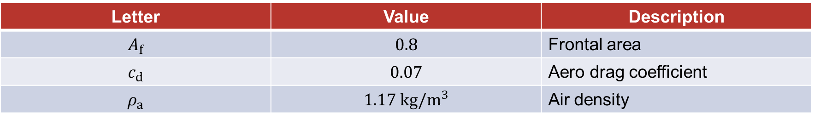
Aero
Letter | Value | Description
$$A_{f}$$ | $$0.8$$ | Frontal area
$$c_{d}$$ | $$0.07$$ | Aero drag coefficient
$$ρ_{a}$$ | $$1.17 kg/m^{3}$$ | Air density

Slide 16

Suspension
Letter | Value | Description
$$c_{r}$$ | $$0.003$$ | Rolling coefficient
$$r_{w}$$ | $$278.5 mm$$ | Wheel radius

Slide 17
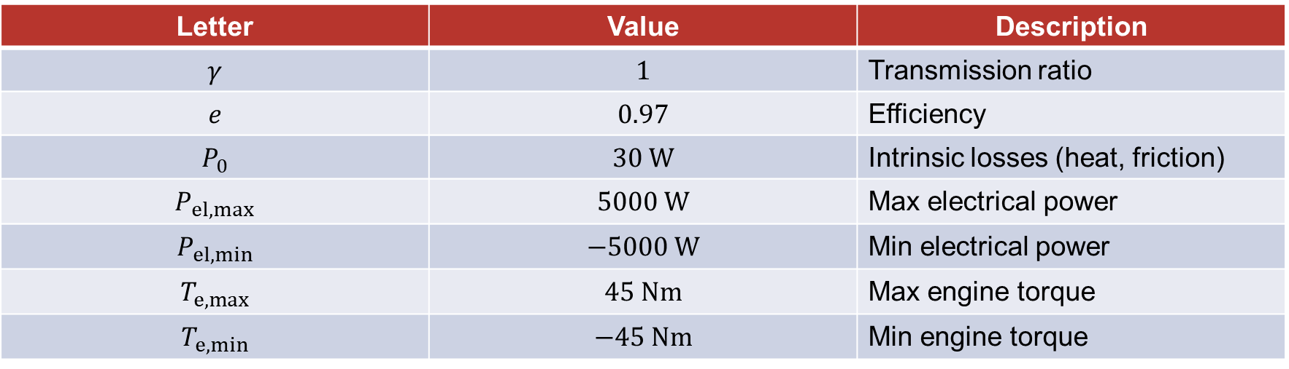
Motor
Letter | Value | Description
$$γ$$ | $$1$$ | Transmission ratio
$$e$$ | $$0.97$$ | Efficiency
$$P_{0}$$ | $$30 W$$ | Intrinsic losses (heat, friction)
$$P_{el,max}$$ | $$5000 W$$ | Max electrical power
$$P_{el,min}$$ | $$−5000 W$$ | Min electrical power
$$T_{e,max}$$ | $$45 Nm$$ | Max engine torque
$$T_{e,min}$$ | $$−45 Nm$$ | Min engine torque

Slide 18
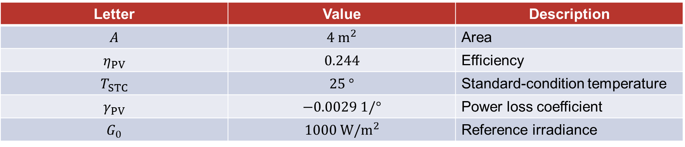
PV
Letter | Value | Description
$$A$$ | $$4 m^{2}$$ | Area
$$η_{PV}$$ | $$0.244$$ | Efficiency
$$T_{STC}$$ | $$25 °$$ | Standard-condition temperature
$$γ_{PV}$$ | $$−0.0029 1/°$$ | Power loss coefficient
$$G_{0}$$ | $$1000 W/m^{2}$$ | Reference irradiance

Slide 19
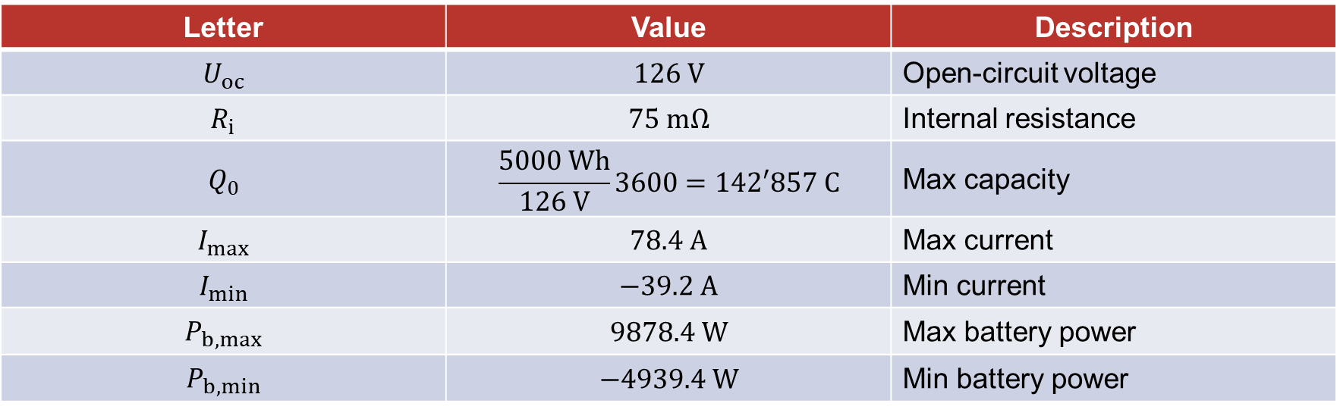
Battery
Letter | Value | Description
$$U_{oc}$$ | $$126 V$$ | Open-circuit voltage
$$R_{i}$$ | $$75 mΩ$$ | Internal resistance
$$Q_{0}$$ | $$\frac{5000 Wh}{126 V}3600=142′857 C$$ | Max capacity
$$I_{max}$$ | $$78.4 A$$ | Max current
$$I_{min}$$ | $$−39.2 A$$ | Min current
$$P_{b,max}$$ | $$9878.4 W$$ | Max battery power
$$P_{b,min}$$ | $$−4939.4 W$$ | Min battery power

Slide 20
Components Weather

Slide 21
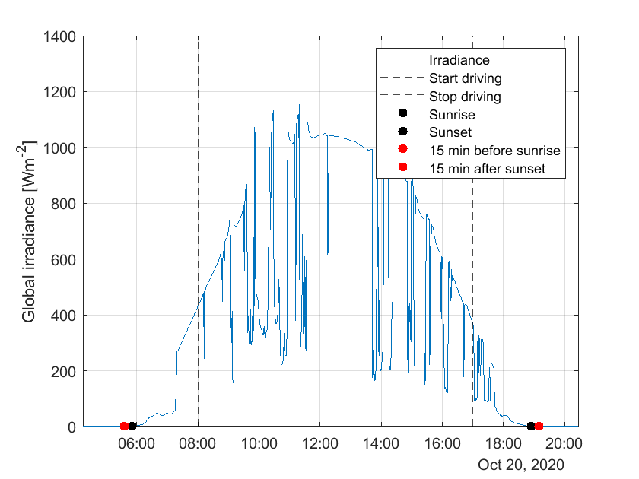
Irradiance
Time domain
Influence in the PV model

Slide 22
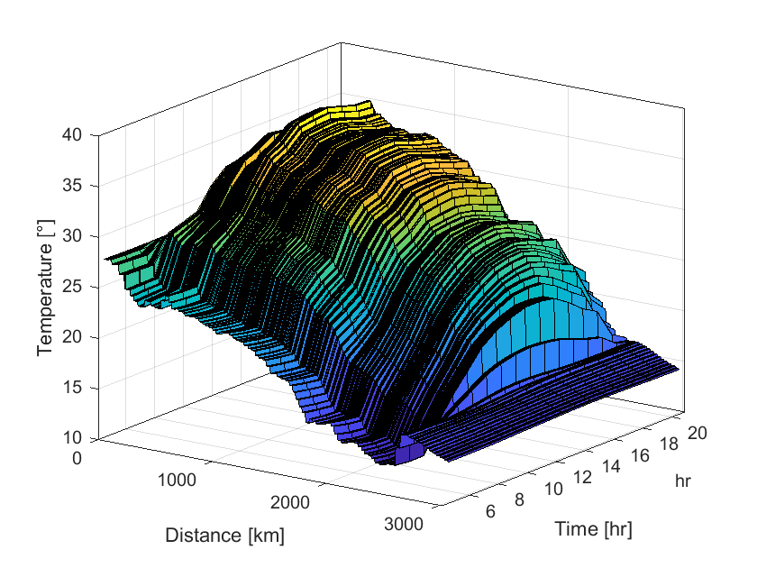
Temperature
Time and space domain
Influence in the PV model

Slide 23
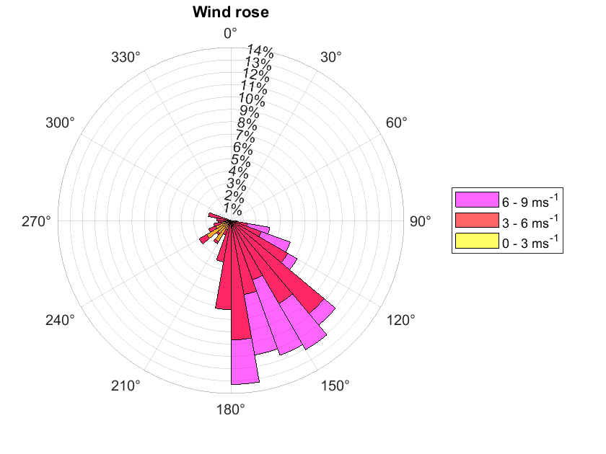
Wind
Time and space domain
Influence in the PV model: → front and side wind with velocity
Influence in the aero drag force: → front wind with velocity

Slide 24
Components Route

Slide 25
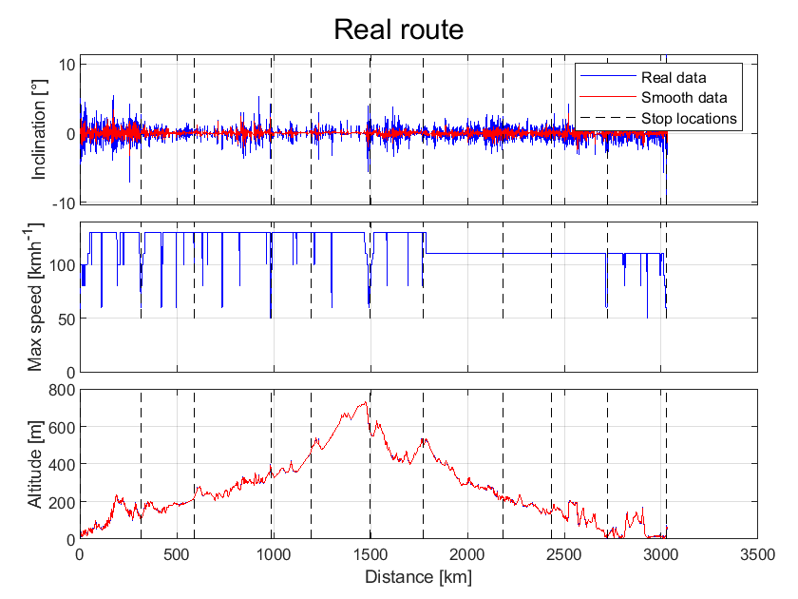
Inclination
Space domain
Influence in the rolling and uphill forces

Slide 26
Max Speed
Space domain
Constraint for the driver

Slide 27
Components Driver

Slide 28
Decision Maker
Position
Time
Decision
Maker
Controllers
Velocity
SoC

Slide 29
Controllers
Acceleration
PI controller on ramp velocity
Cruise
PI controller on velocity reference
Cascaded controller on velocity and SoC
Or
Deceleration
PI controller on ramp velocity

Slide 30
Results

Slide 31
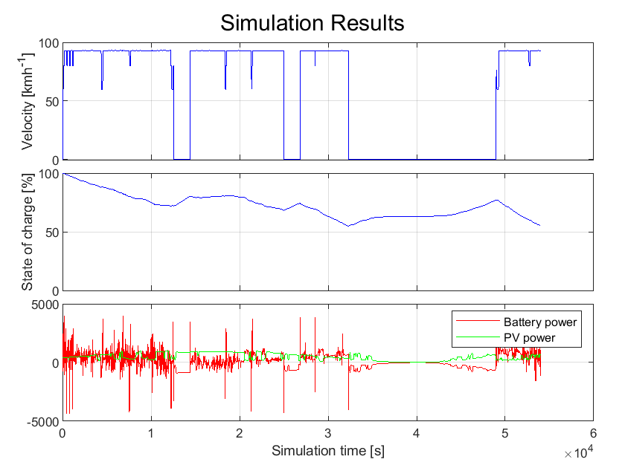
15 Hours Simulation

Slide 32
Conclusion & Next Steps

Slide 33
Energy Optimization
Barely finish the race
Real life race could be even worse
→ Strategy is important
→ Limited energy budget has to be optimized

