Slide 1



Predicting lithium-ion battery degradation using machine learning
Knowledge and solutions for a changing world
Advancing data-intensive discovery in all fields
Be boundless
UW DIRECT
BattDeg Team
https://github.com/ShrilakshmiB/BattDeg
Chintan Pathak(chintanp) Shrilakshmi Bonageri(ShrilakshmiB)
Guoyao Chen(lisboacgypt) Ge Gu(guge1996)
Chemical Engineering & eScience Institute

Slide 2
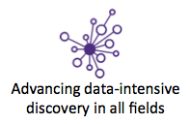


BattDeg
Predicting lithium-ion battery degradation using machine learning

Slide 3

Objectives
Perform a literature survey of data-science based methods of battery degradation prediction.
Collect all the battery cycling data.
Choose the features and machine learning technique to predict battery degradation for a particular type of battery.
Perform machine learning on the data using the chosen method
Deploy the solution as a web-service and create a web-UI.

Slide 4
Methodology
Collect battery cycling data for multiple chemistries, charge/discharge rates, DoDs, etc. to use a training data.
Train and test a machine learning model
Predict degradation for a different cell, given a few cycles of charge/discharge data. The charge/discharge rates can be different from the test data.

Slide 5
Data
>What data do we have right now?
>The source of the data:
1.Prognostics Center of NASA
(https://ti.arc.nasa.gov/tech/dash/groups/pcoe/prognostic-data-repository)
2.CALCE Battery Research Group
(https://web.calce.umd.edu/batteries/data.htm)
>Battery types:
>CS2,CX2,PL Samples.
>The type of file the data storage:
>Txt,xlsx,mat

Slide 6
Data
Briefly introduction of the data
•Features:
• Charging was carried out in a constant current (CC) mode at 1.5A until the battery voltage reached 4.2V and then continued in a constant voltage (CV) mode until the charge current dropped to 20mA.
• Discharge was carried out at a constant current (CC) level of 2A until the battery voltage fell to 2.7V, 2.5V, 2.2V and 2.5V for batteries 5 6 7 and 18 respectively.
• Impedance measurement was carried out through an electrochemical impedance spectroscopy (EIS) frequency sweep from 0.1Hz to 5kHz.
• The experiments were stopped when the batteries reached end-of-life (EOL) criteria, which was a 30% fade in rated capacity (from 2Ahr to 1.4Ahr).

Slide 7
Data
Adjusting and cleaning
Most of the data were storage in matlab profile,need to transfer it.
Plotting the data to eliminating some abnormal.
80% of data using on training mode+20% using on testing.

Slide 8
Package Review
The following packages were reviewed for the purpose of machine learning and deep learning :
Scikit-learn
TensorFlow
Keras
Theanos
Pytorch

Slide 9
Scikit-learn
PROS
Easy to learn and use
High level of abstraction.
Good for data mining or simple projects like data prediction on small or labelled sets.
CONS
Cannot run on an external hardware.
It can be used only for machine learning.

Slide 10
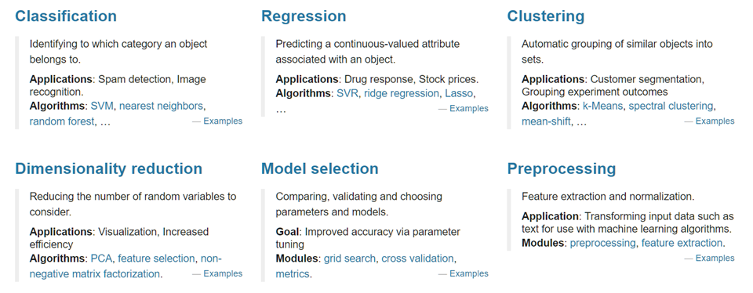
What can SKlearn do

Slide 11
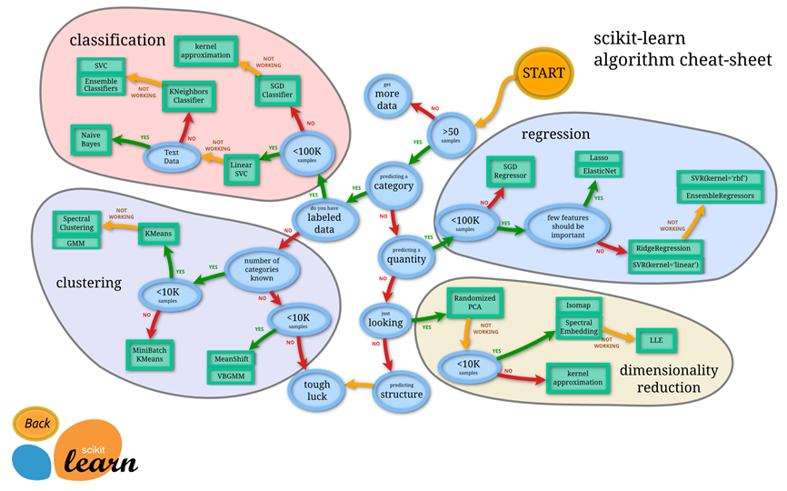

Slide 12
TensorFlow
PROS
Can be used for both machine learning and deep learning.
Good for large datasets and it can run on external hardware.
Contains several ready to use ML packages.
Provides more control, functionality and flexibility.
Special debugger.
CONS
Steep learning curve.

Slide 13
Keras
PROS
Keras is a high level API built on TensorFlow.
Can be used for both machine learning and deep learning.
Easy and fast neural network prototyping.
The ‘Model’ and ‘Sequential’ APIs are very powerful and can be used to easily build a neural network.
CONS
Steep learning curve when compared to Scikit-learn.
Less flexibility, functionality and control on the model when compared to TensorFlow.

Slide 14
PyTorch
PROS
Can be used for both machine learning and deep learning.
Easy to learn and use.
Can run on external flow.
Dynamic graphs.
CONS
Quite new, so it has a smaller community and fewer resources available online.

Slide 15
Theano
PROS
Can be used for both machine learning and deep learning.
High speed computation.
Can run on external hardware.
CONS
Advanced level of knowledge on machine learning is required.
Steep learning curve.
Low level API.

Slide 16
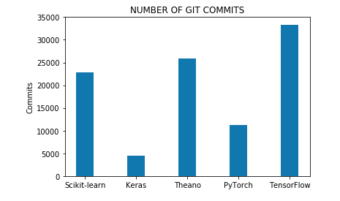
Comparing number of git commits

Slide 17
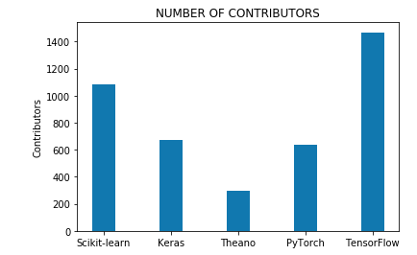
Comparing the number of contributors

