Slide 1
Open Health Data Visualization
Summer 2015
Midway Presentation and Demo

Slide 2
Motivation for Project
The New York State Department of Health wants to provide quality and price data to consumers through easy-to-use visualizations and tools.
The Department will need to integrate price data with quality data and other types of data so that consumers can understand the value they are receiving.

Slide 3
Summary of Project Scope
Test how DOH can connect more dynamically to the Health Data NY site
Demonstrate the re-creation of the existing eQARR online tool more efficiently
Demonstrate how eQARR can be improved by prototyping different types of visualizations
Increase understanding of the reusability and costs of this approach with other data sets

Slide 4
CTG’s Initial Activity
Work from User Stories developed at first meeting with DOH and CTG
Focus on main goals of project related to eQARR data and other data sets (CHIRS and SPARCS)

Slide 5
Two-Week Sprints
Understand the data
Address user stories related to “consumers comparing plans for quality”
Access data dynamically (SODA api)
Prototype flexible, user-friendly selection options
Prototype visualizations of the data
Gather questions for further exploration

Slide 6
eQARR Data
Objective
Understand how the dataset was organized hierarchically
Identify inconsistencies among the data and analyze possible roadblocks for comparisons
Process
Downloaded entire dataset from Health Data NY to Excel
Went through every payer mapping its content concerning “Domains”, “Sub Domains” and “Quality Measurements”
Tools
Mindmup.com

Slide 7
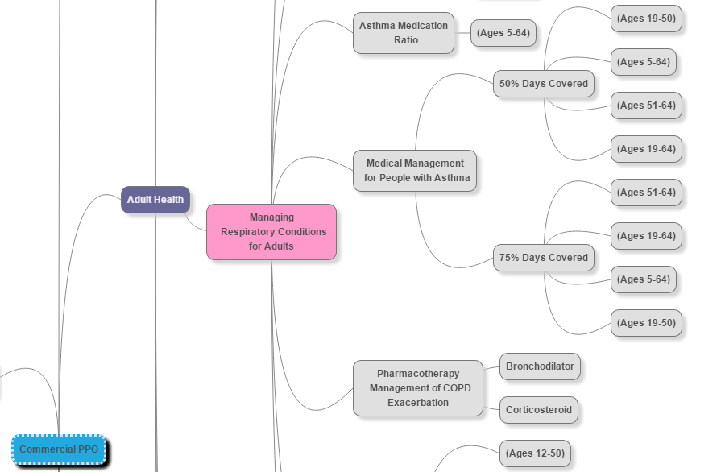
Mind Mapping Tool

Slide 8
CHIRS and SPARCS Data
Objective
Study the CHIRS and SPARCS datasets
Review the common relationships for comparing different health plans and services for users
Process
Review datasets on health.data.ny.gov from user interfaces and data source downloads
Tools
None

Slide 9
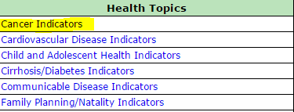
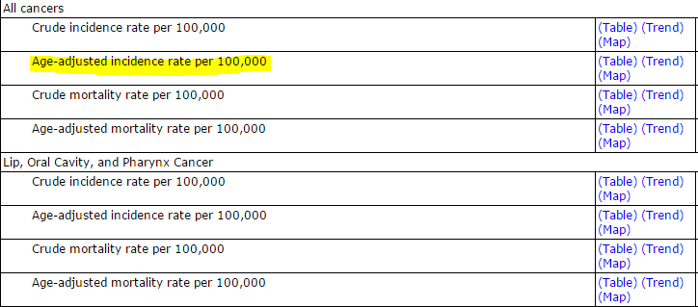
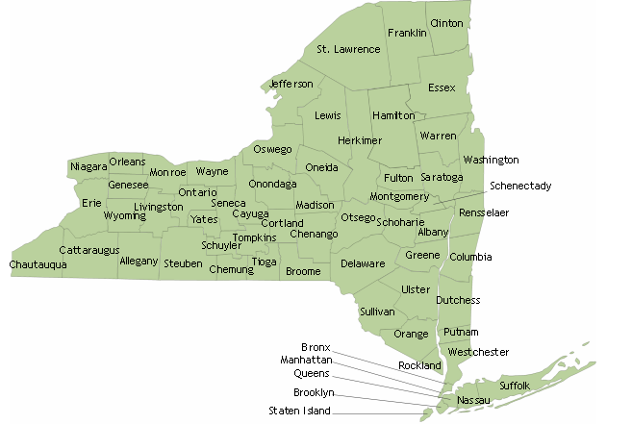
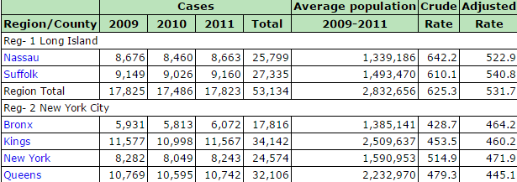
Health indicator data by counties

Slide 10
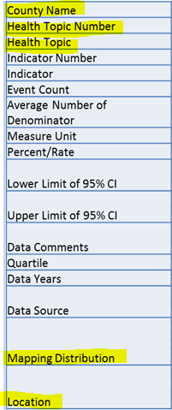
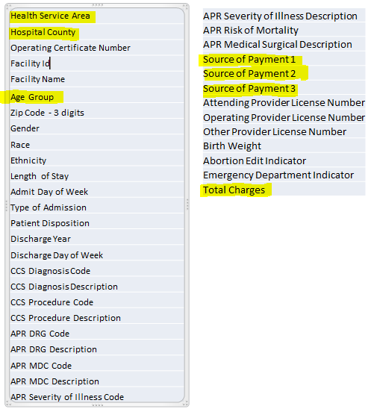
CHIRS & SPARCS Data
CHIRS
SPARCS

Slide 11
Dynamic Selection Tools
Objective
Provide a user-friendly interface to access the data
Process
Create mockups on paper
Research tools and methods for online samples of mockups
Create initial online samples
Test > Analyze > Enhance
Tools
CSS, Bootstrap (Framework), Javascript/jQuery

Slide 12
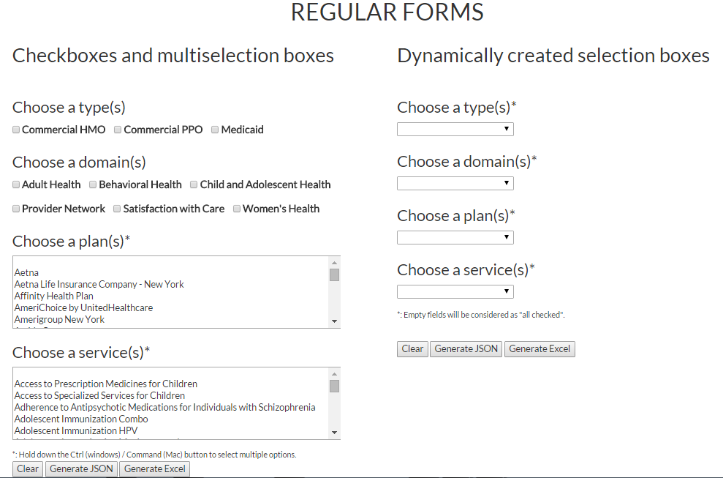
Dynamic Selection Tools

Slide 13
Dynamic Visualizations
Objective
Prototype better ways for users to see comparisons while using enhanced selection options
Process
Research and experiment with Tableau using eQARR data
Tools
Tableau

Slide 14
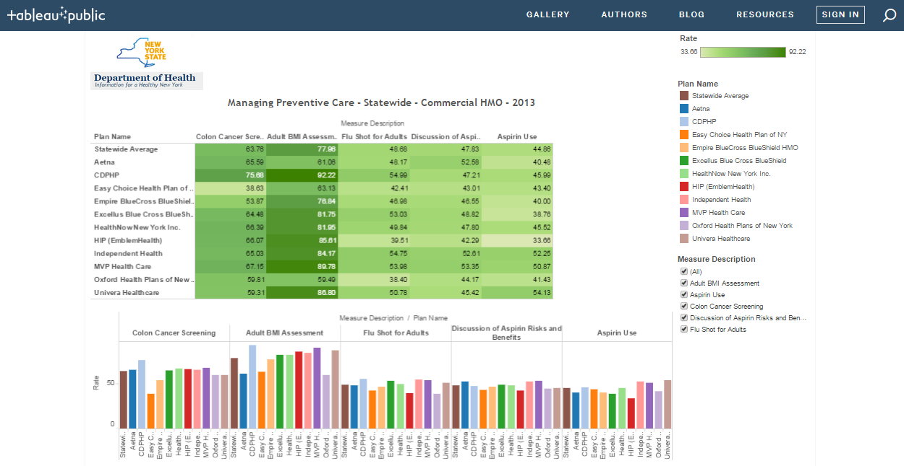
Dynamic Visualizations

Slide 15
Questions and Next Stops

