Slide 1
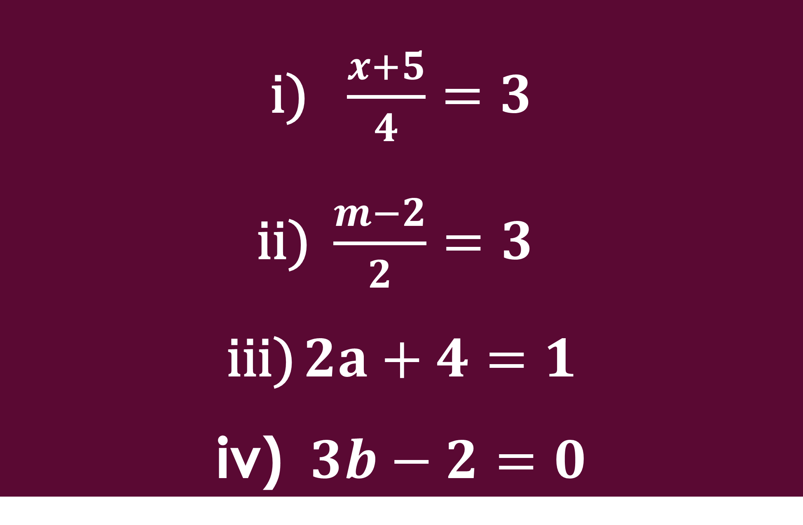
$\frac{x+5}{4}=3$
$\frac{m−2}{2}=3$
$2a+4=1$
$3b−2=0$
RESOLVA
MozEstuda

Slide 2

$$\frac{x+5}{4}=3$$
Polinomial
MozEstuda

Slide 3

$$\frac{m−2}{2}=3$$
Polinomial
MozEstuda

Slide 4

Polinomial
$$2a+4=1$$
MozEstuda

Slide 5

Polinomial
$$3b−2=0$$
MozEstuda

