Slide 1

Introduction to Digital Design
Week 8: Finite State Machines
Yao Zheng
Assistant Professor
University of Hawaiʻi at Mānoa
Department of Electrical Engineering
Notes:
Week 7: start sequential circuit. A few devices that are the fundamental building block of sequential circuits.

Slide 2
Overview
FSM model to capture sequential behavior
  FSM: describe timing behavior of sequential circuit.
  States, and transitions among states.
FSM as a Controller
  Controller-Datapath architecture.
  Controller design process.
  Convert FSM to a circuit.
  Convert a circuit to FSM.
Miscellaneous
  Common mistakes when capturing FSMs.
  Metastability
  Glitching
Notes:
Sequential circuit, the clever part, unyielding storage requirement.
SR latch
D Latch
Flip-Flop: edge sensitive
Clock
Register: multiple flip-flop

Slide 3
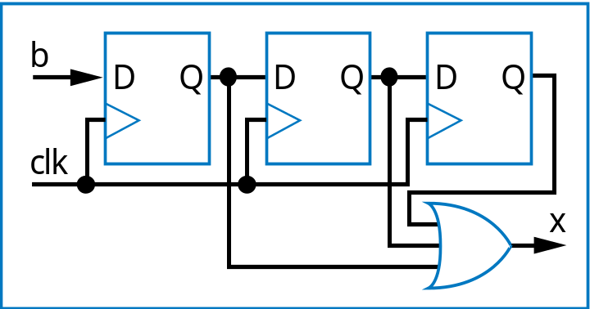
Finite-State Machines (FSMs) and Controllers
3.3
Want sequential circuit with particular behavior over time
Example: Laser timer
  Pushing button causes x=1 for exactly 3 clock cycles
    Precisely-timed laser pulse
  How? Let’s try three flip-flops
    b=1 gets stored in first D flip-flop
    Then 2nd flip-flop on next cycle, then 3rd flip-flop on next
    OR the three flip-flop outputs, so x should be 1 for three cycles
b
Controller
x
laser
clk
patient
0
0
1
a
1
Bad job – what if button pressed a second time during those 3 cycles?
a

Slide 4
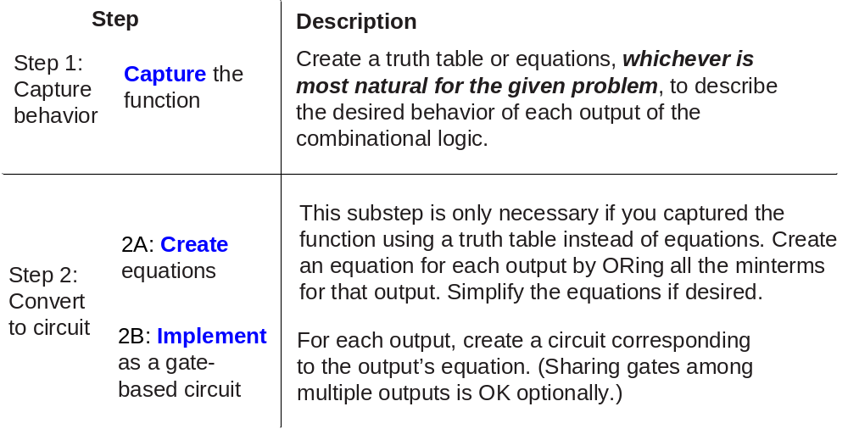
Need a Better Way to Design Sequential Circuits
Also bad because of ad hoc design process
  How create other sequential circuits?
Need
  A way to capture desired sequential behavior
  A way to convert such behavior to a sequential circuit
Like we had for designing combinational circuits

Slide 5
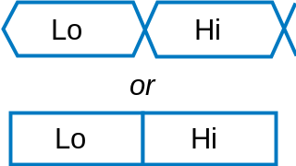
Capturing Sequential Circuit Behavior as FSM
Outputs
:
x
Finite-State Machine (FSM)
  Describes desired behavior of sequential circuit
    Akin to Boolean equations for combinational behavior
List states, and transitions among states
  Example: Toggle x every clock cycle
  Two states: “Lo” (x=0), and “Hi” (x=1)
  Transition from Lo to Hi, or Hi to Lo, on rising clock edge (clk^)
  Arrow points to initial state (when circuit first starts)
x=0
clk
^
x=1
Lo
Hi
clk
^
Lo
Hi
Lo
Hi
Lo
Hi
Lo
Hi
clk
cycle 1
cycle 2
cycle 3
cycle 4
state
Lo
Hi
Lo
Hi
Outputs
:
x
Depicting multi-bit or other info in a timing diagram
a

Slide 6
FSM Example: Three Cycles High System
Want 0, 1, 1, 1, 0, 1, 1, 1, ...
  For one clock cycle each
Capture as FSM
  Four states: 0, first 1, second 1, third 1
  Transition on rising clock edge to next state
Outputs
:
x
x=0
clk
^
x=1
clk
^
x=1
clk
^
x=1
Off
On1
On2
On3
clk
^
a
clk
State
Off
On1
On2
On3
Off
On1
On2
On3
Off
Outputs
:
x
a

Slide 7
Three-Cycles High System with Button Input
Four states
Wait in “Off” while b is 0 (b’*clk^)
When b is 1 (b*clk^), transition to On1
  Sets x=1
  Next two clock edges, transition to On2, then On3
So x=1 for three cycles after button pressed
Inputs:
b
Outputs:
x
x=0
clk
^
Off
b'*clk
^
b*clk
^
x=1
clk
^
x=1
clk
^
x=1
On1
On2
On3
clk
Inputs
:
b
State
Off
Off
Off
Off
Off
On1
On2
On3
Off
Outputs
:
x

Slide 8
FSM Simplification: Rising Clock Edges Implicit
Every edge ANDed with rising clock edge
What if we wanted a transition without a rising edge
    We don’t consider such asynchronous FSMs – less common, and advanced topic
    Only consider synchronous FSMs – rising edge on every transition
Inputs: b; Outputs: x
x=0
clk
^
O
ff
b’
*clk
^
b
*clk
^
x=1
clk
^
x=1
clk
^
x=1
On1
On2
On3
Inputs: b; Outputs: x
x=0
Off
b
’
a
b
x=1
x=1
x=1
Note: Transition with no associated condition thus transistions to next state on next clock cycle
On1
On2
On3

Slide 9
FSM Definition
FSM consists of
  Set of states
    Ex: {Off, On1, On2, On3}
  Set of inputs, set of outputs
    Ex: Inputs: {b}, Outputs: {x}
  Initial state
    Ex: “Off”
  Set of transitions
    Each with condition
    Describes next states
    Ex: Has 5 transitions
  Set of actions
    Sets outputs in each state
    Ex: x=0, x=1, x=1, and x=1
Inputs: b; Outputs: x
x=0
Off
b
’
b
x=1
x=1
x=1
On1
On2
On3
We often draw FSM graphically, known as state diagram
Can also use table (state table), or textual languages

Slide 10

FSM Example: Secure Car Key
Many new car keys include tiny computer chip
  When key turned, car’s computer (under engine hood) requests identifier from key
  Key transmits identifier
    Else, computer doesn’t start car
FSM
  Wait until computer requests ID (a=1)
  Transmit ID (in this case, 1 1 0 1)
Inputs: a; Outputs: r
Wait
r=0
a
a
’
K1
K2
K3
K4
r=1
r=1
r=0
r=1

Slide 11
FSM Example: Secure Car Key (cont.)
Nice feature of FSM
  Can evaluate output behavior for different input sequence
  Timing diagrams show states and output values for different input waveforms
I
nputs:
a
;
O
utputs:
r
W
ait
r=0
a
a
’
K1
K2
K3
K4
r=1
r=1
r=0
r=1
Q: Determine states and r value for given input waveform:
clk
clk
nputs
I
I
nputs
a
a
S
t
a
t
e
W
ait
W
ait
K1
K2
K3
K4
W
ait
W
ait
State
W
ait
W
ait
K1
K2
K3
K4
W
ait
K1
O
utputs
Output
a
r
r

Slide 12
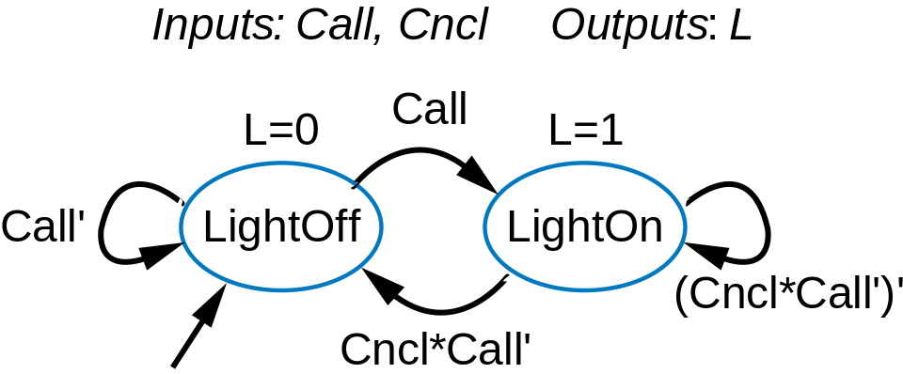
Ex: Earlier Flight-Attendant Call Button
Previously built using SR latch, then D flip-flop
Capture desired bit storage behavior using FSM instead
  Clear and precise description of desired behavior
  We’ll later convert to a circuit
Call
button
Blue light
Bit
Storage
Cancel
button

Slide 13
How To Capture Desired Behavior as FSM
List states
  Give meaningful names, show initial state
  Optionally add some transitions if they help
Create transitions
  For each state, define all possible transitions leaving that state.
Refine the FSM
  Execute the FSM mentally and make any needed improvements.

Slide 14
FSM Capture Example: Code Detector
Unlock door (u=1) only when buttons pressed in sequence:
  start, then red, blue, green, red
Input from each button: s, r, g, b
  Also, output a indicates that some colored button pressed
Capture as FSM
  List states
    Some transitions included
Start
s
1
u
Red
r
Code
Door
Green
g
detector
lock
Blue
b
a
a
Inputs:
s
,
r
,g,
b
,a
W
ait
f
or sta
r
t
b
utton
Outputs:
u
W
ait
u=0
s
s'
Sta
r
t
W
ait
f
or first colored
b
utton
u=0
a
ar
ab
ag
ar
Red1
Blue
Green
Red2
u=0
u=0
u=0
u=1

Slide 15
FSM Capture Example: Code Detector
Capture as FSM
  List states
  Create transitions
Start
s
u
Red
r
Code
Door
a
Green
g
detector
lock
Blue
b
a
Inputs:
s
,
r
,g,
b
,a
Outputs:
u
W
ait
u=0
a
s
s'
ar'
Sta
r
t
a'
u=0
ar
ab
ag
ar
Red1
Blue
Green
Red2
u=0
u=0
u=0
u=1

Slide 16
FSM Capture Example: Code Detector
Capture as FSM
  List states
  Create transitions
    Repeat for remaining states
  Refine FSM
    Mentally execute
    Works for normal sequence
    Check unusual cases
    All colored buttons pressed
      Door opens!
      Change conditions: other buttons NOT pressed also
Start
s
u
Red
r
Code
Door
a
Green
g
detector
lock
Blue
b
a
Inputs:
s
,
r
,g,
b
,a
Outputs:
u
W
ait
u=0
s
s'
ar'
ab'
ag'
ar'
Sta
r
t
a'
u=0
ar
ab
ag
ar
Red1
Blue
Green
Red2
a'
a'
a'
u=0
u=0
u=0
u=1

Slide 17
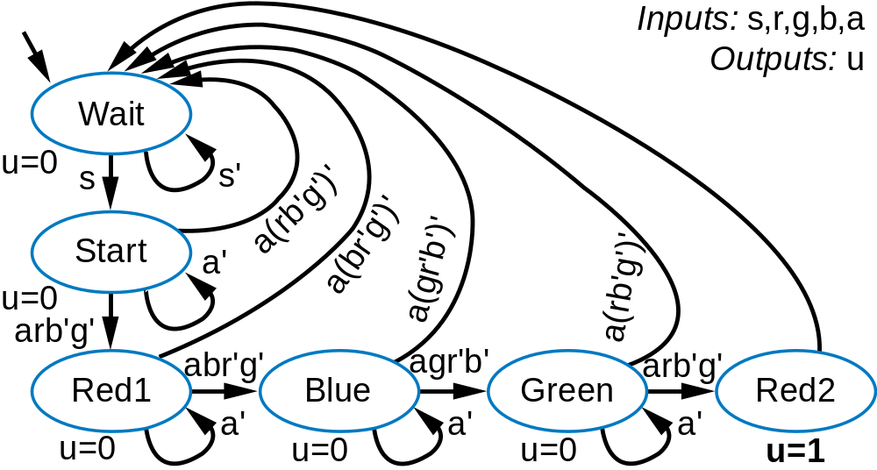
FSM Capture Example: Code Detector
Start
s
u
Red
r
Code
Door
a
Green
g
detector
lock
Blue
b
a

Slide 18
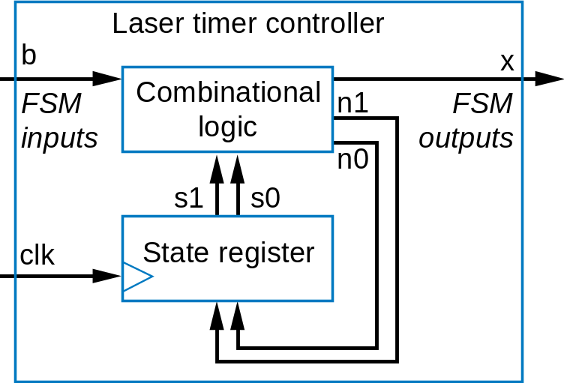
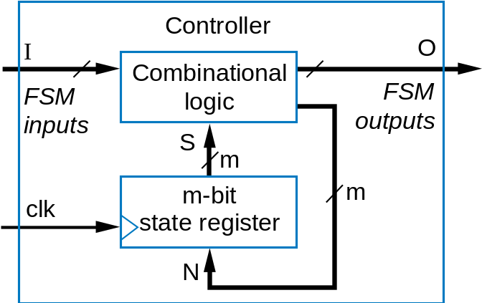
Controller Design
3.4
Laser timer FSM
Converting FSM to sequential circuit
  Circuit called controller
  Standard controller architecture
    State register stores encoding of current state
      e.g., Off:00, On1:01, On2:10, On3:11
    Combinational logic computes outputs and next state from inputs and current state
    Rising clock edge takes controller to next state
Inputs: b; Outputs: x
x=0
Off
b
’
b
x=1
x=1
x=1
On1
On2
On3
Controller for laser timer FSM
General form
a

Slide 19
Controller Design Process
Step
Description
Step 1:
Capture
behavior
Capture the FSM
Create an FSM that describes the desired behavior of the controller.
2A: Set up
architecture
Use state register of appropriate width and combinational logic. The logic’s inputs are the state register bits and the FSM inputs; outputs are next state bits and the FSM outputs.
2B: Encode
the states
Assign unique binary number (encoding) to each state. Usually use fewest bits, assign encoding to each state by counting up in binary.
Step 2:
Convert
to circuit
Translate FSM to truth table for combinational logic such that the logic will generate the outputs and next state signals for the given FSM. Ordering the inputs with state bits first makes the correspondence between the table and the FSM clear.
2C: Fill in
the truth table
2D: Implement
combinational logic
Implement the combinational logic using any method.

Slide 20
Controller Design: Laser Timer Example
Step 1: Capture the FSM
  Already done
Step 2A: Set up architecture
  2-bit state register (for 4 states)
  Input b, output x
  Next state signals n1, n0
Step 2B: Encode the states
  Any encoding with each state unique will work
Inputs: b; Outputs: x
x=0
00
b
’
O
ff
a
b
x=1
x=1
x=1
01
On1
10
On2
11
On3
FSM
inputs
b
x
FSM
outputs
Combinational
logic
n1
n0
s1
s0
a
clk
State register

Slide 21
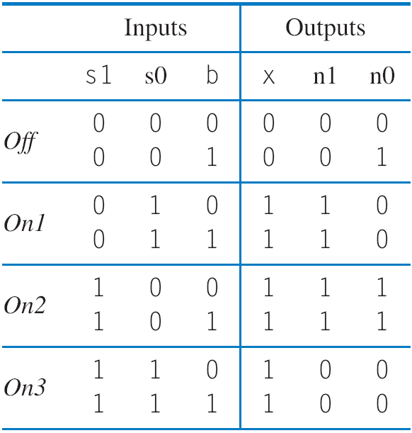
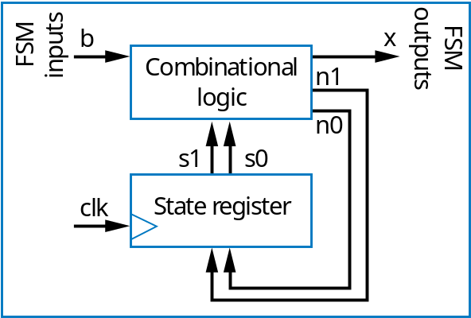
Controller Design: Laser Timer Example (cont)
Step 2C: Fill in truth table
Inputs: b; Outputs: x
x=0
00
b
’
O
ff
b
a
x=1
x=1
x=1
01
On1
10
On2
11
On3

Slide 22
Controller Design: Laser Timer Example (cont)
Step 2D: Implement combinational logic
a
x = s1 + s0 (note that x=1 if s1=1 or s0=1)
n1 = s1’s0b’ + s1’s0b + s1s0’b’ + s1s0’b
n1 = s1’s0 + s1s0’
n0 = s1’s0’b + s1s0’b’ + s1s0’b
n0 = s1’s0’b + s1s0’

Slide 23
Controller Design: Laser Timer Example (cont)
Step 2D: Implement combinational logic (cont)
Combinational Logic
b
x
n1
a
n0
s1
s0
clk
State register
x = s1 + s0
n1 = s1’s0 + s1s0’
n0 = s1’s0’b + s1s0’

Slide 24
Understanding the Controller’s Behavior
x=0
x=0
x=0
00
b
’
00
b
’
00
b
’
O
ff
O
ff
O
ff
b
x=1
x=1
x=1
b
x=1
x=1
x=1
b
x=1
x=1
x=1
01
On1
10
On2
11
On3
01
On1
10
On2
11
On3
01
On1
10
On2
11
On3
b
0
x
b
0
x
b
0
x
0
0
0
1
0
0
1
1
1
0
0
1
n1
n1
n1
0
0
1
a
0
0
0
0
1
0
n0
n0
n0
0
1
0
0
0
0
clk
s1
s0
clk
s1
s0
clk
s1
s0
0
0
0
0
0
1
0
0
0
1
1
0
clk
st
a
t
e=00
st
a
t
e=00
st
a
t
e=01
I
nputs:
b
O
utputs:
x

Slide 25
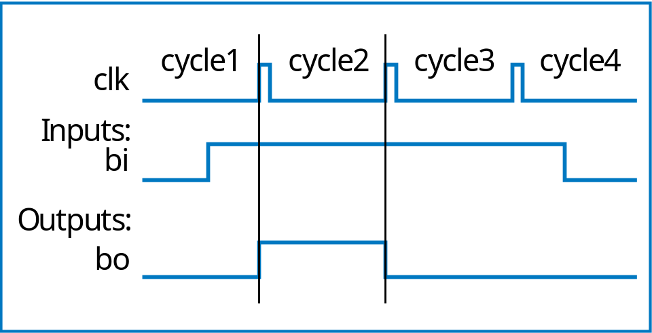
Controller Example:
Button Press Synchronizer
bi
Button press
synchronizer
controller
bo
Want simple sequential circuit that converts button press to single cycle duration, regardless of length of time that button was actually pressed
  We assumed such an ideal button press signal in earlier example, like the button in the laser timer controller

Slide 26
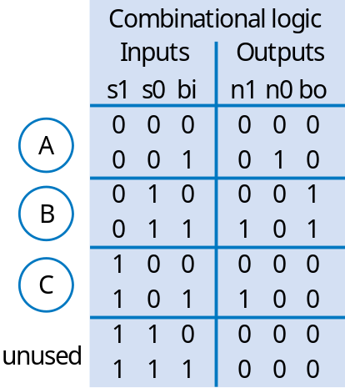
Controller Example:
Button Press Synchronizer (cont)
FSM inputs: bi; FSM outputs: bo
FSM
inputs
bi
bo
FSM
outputs
Step 2A: Set up architecture
Combinational
logic
bi
’
bi
n1
b
i
’
bi
’
n0
A
bi
B
bi
C
s1
s0
n1 = s1’s0bi + s1s0bi
n0 = s1’s0’bi
bo = s1’s0bi’ + s1’s0bi = s1s0
a
bo=0
bo=1
bo=0
clk
State register
Step 1: Capture FSM
Combinational logic
bo
bi
n1
FSM inputs: bi; FSM outputs: bo
bi
’
bi
n0
bi
’
bi
’
00
bi
01
bi
10
s1
s0
bo=0
bo=1
bo=0
State register
Step 2B: Encode states
clk
Step 2C: Fill in truth table
Step 2D: Implement combinational logic

Slide 27
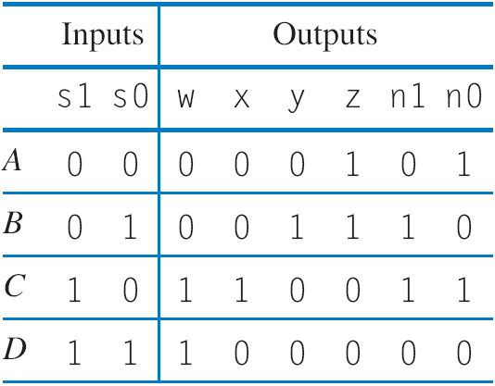
Controller Example: Sequence Generator
Want generate sequence 0001, 0011, 1100, 1000, (repeat)
  Each value for one clock cycle
  Common, e.g., to create pattern in 4 lights, or control magnets of a “stepper motor”
Inputs: none; Outputs: w,x,y,z
w
x
Inputs: none; Outputs: w,x,y,z
wxyz=0001
wxyz=1000
Combinational
logic
y
wxyz=0001
wxyz=1000
z
A
D
n1
A
00
D
11
n0
s1
s0
01
10
B
C
clk
State register
B
C
wxyz=0011
wxyz=1100
wxyz=0011
wxyz=1100
Step 1: Create FSM
Step 2A: Set up architecture
Step 2B: Encode states
w
w = s1
x = s1s0’
y = s1’s0
z = s1’
n1 = s1 xor s0
n0 = s0’
x
y
z
a
s1
s0
n0
n1
clk
State register
Step 2C: Fill in truth table
Step 2D: Implement combinational logic

Slide 28
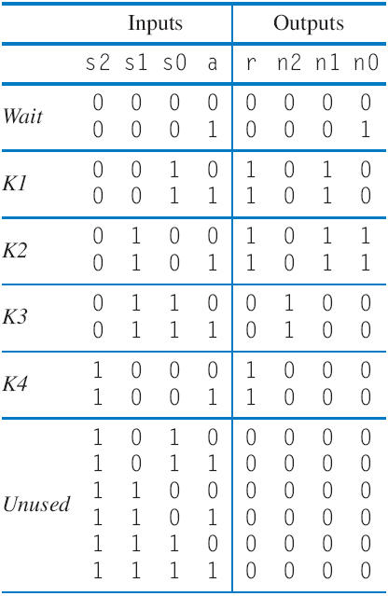
Controller Example: Secure Car Key
(from earlier example)
Inputs: a; Outputs: r
Wait
r=0
a
a
’
Step 1
K1
K2
K3
K4
a
r=1
r=1
r=0
r=1
a
r
Step 2A
Combinational
logic
n2
n1
n0
s2
s1
s0
clk
State register
nputs:
I
a
;
O
utputs:
r
000
r=0
a
’
a
Step 2B
001
010
011
100
r=1
r=1
r=0
r=1
Step 2C
We’ll omit Step 2D

Slide 29
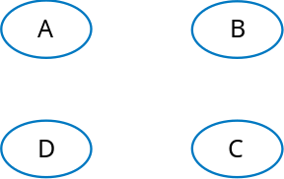
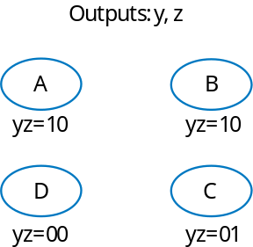
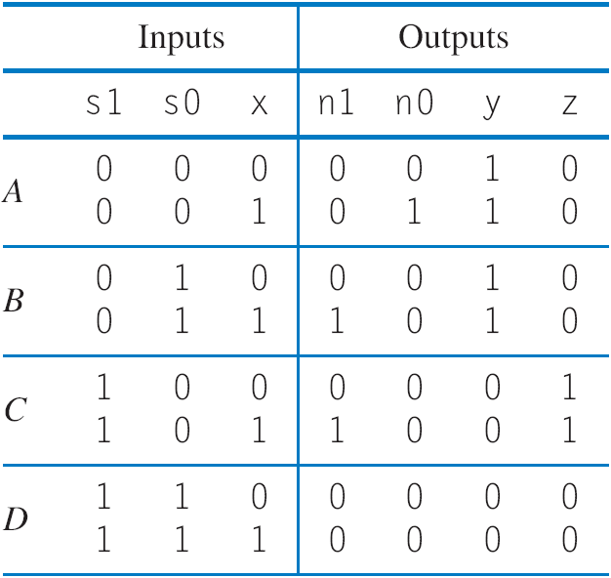
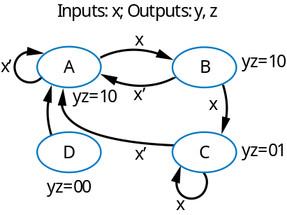
Converting a Circuit to FSM (Reverse Engineering)
2D: Circuit to eqns
  y=s1’
  z = s1s0’
  n1=(s1 xor s0)x
  n0=(s1’*s0’)x
2C: Truth table
Step 1: FSM (get from table)
What does this
circuit do?
a
states
x
y
z
states with outputs
n1
n0
s1
s0
clk
State register
Work backwards
2B: (Un)encode states
Pick any state names you want
states with outputs and transitions
2A: Set up arch – already done

Slide 30
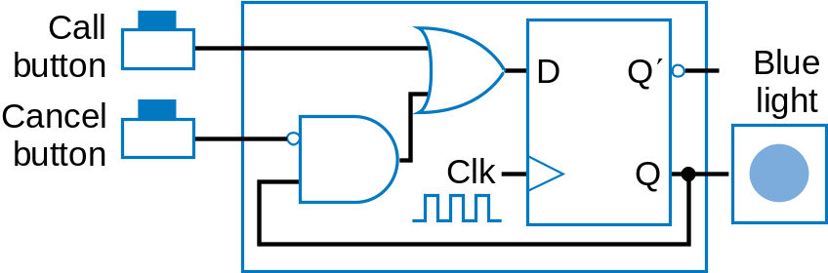
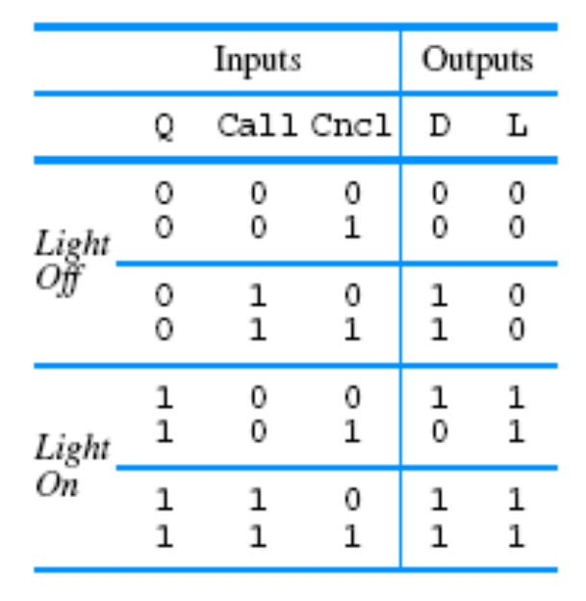
Reverse Engin. the D-flip-flop Flight Atten. Call Button
2C: Truth table
L
2B: (Un)encode states
2D: Circuit to eqns
  L = Q
  D = Cncl'Q + Call (next state)
Don’t let the way the circuit is drawn confuse you; the combinational logic is everything outside the register
2A: Set up arch (nothing to do)
Inputs
:
Call, Cncl Outputs
:
L
L=0
Call
L=1
Call'
LightOff
LightOn
Step 1: FSM (get from table)
Cncl'+Call
Call'*Cncl

Slide 31
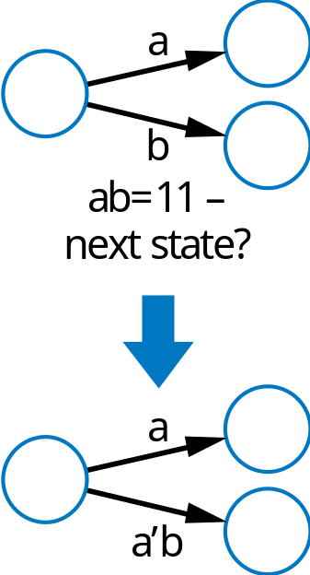
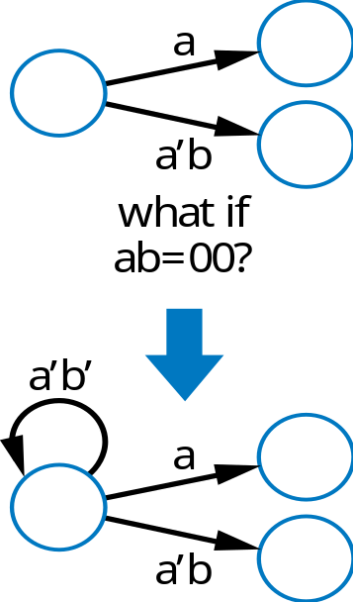
Common Mistakes when Capturing FSMs
Non-exclusive transitions
Incomplete transitions
a

Slide 32
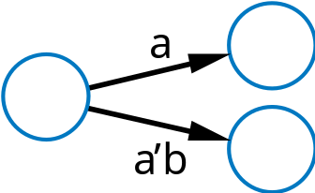
Verifying Correct Transition Properties
Can verify using Boolean algebra
  Only one condition true: AND of each condition pair (for transitions leaving a state) should equal 0 → proves pair can never simultaneously be true
  One condition true: OR of all conditions of transitions leaving a state) should equal 1 → proves at least one condition must be true
  Example
Answer:
a * a’b
= (a * a’) * b
= 0 * b
= 0
OK!
a
a + a’b
= a*(1+b) + a’b
= a + ab + a’b
= a + (a+a’)b
= a + b
Fails! Might not be 1 (i.e., a=0, b=0)
Q: For shown transitions, prove whether:
* Only one condition true (AND of each pair is always 0)
* One condition true (OR of all transitions is always 1)

Slide 33
Verifying transition properties
Recall code detector FSM
  We “fixed” a problem with the transition conditions
  Do the transitions obey the two required transition properties?
    Consider transitions of state Start, and the “only one true” property
Wait
u=0
s
’
a
s
Start
u=0
a
’
ar
ab
ag
ar
Red1
Blue
Green
Red2
u=0
a
’
u=0
a
’
u=0
a
’
u=1
ar * a’ a’ * a(r’+b+g) ar * a(r’+b+g)
= (a*a’)r = 0*r = (a’*a)*(r’+b+g) = 0*(r’+b+g) = (a*a)*r*(r’+b+g) = a*r*(r’+b+g)
= 0 = 0 = arr’+arb+arg
= 0 + arb+arg
= arb + arg
= ar(b+g)
Intuitively: press red and blue buttons at same time: conditions ar, and a(r’+b+g) will both be true. Which one should be taken?
Q: How to solve?
a
A: ar should be arb’g’
(likewise for ab, ag, ar)
Fails! Means that two of Start’s transitions could be true
Note: As evidence the pitfall is common,
we admit the mistake was not initially intentional.
A reviewer of an earlier edition of the book caught it.

Slide 34
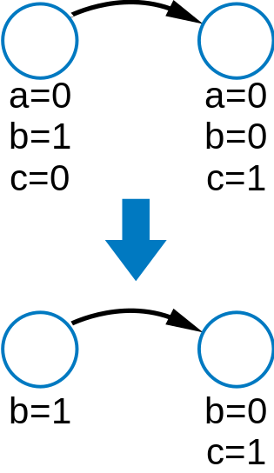
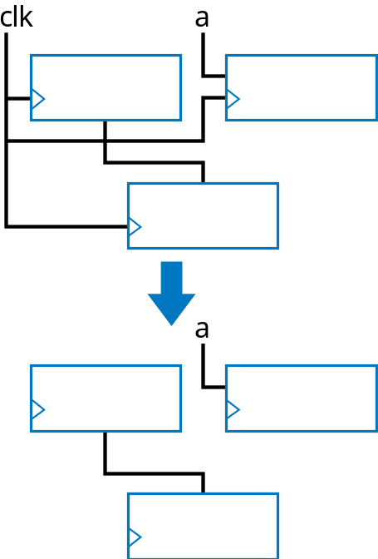
Simplifying Notations
FSMs
  Assume unassigned output implicitly assigned 0
Sequential circuits
  Assume unconnected clock inputs connected to same external clock
a

Slide 35
Mathematical Formalisms
Two formalisms to capture behavior thus far
  Boolean equations for combinational circuit design
  FSMs for sequential circuit design
Not necessary
  But tremendously beneficial
    Structured methodology
    Correct circuits
    Automated design, automated verification, many more advantages

Slide 36
More on Flip-Flops and Controllers
3.5
Non-ideal flip-flop behavior
  Can’t change flip-flop input too close to clock edge
  Setup time: time D must be stable before edge
    Else, stable value not present at internal latch
  Hold time: time D must be held stable after edge
    Else, new value doesn’t have time to loop around and stabilize in internal latch
clk
D
setup time
clk
Setup time violation
D
D latch
C
D
S
D
1
hold time
Q
′
S
C
2
u
Q
R
3
4
u
R
Q
′
7
Leads to oscillation!
Q
5
6

Slide 37
Metastability
clk
D
Violating setup/hold time can lead to bad situation
  Metastable state: Any flip-flop state other than stable 1 or 0
    Eventually settles to either, but we don’t know which
  For internal circuits, we can make sure to observe setup time
  But what if input is from external (asynchronous) source, e.g., button press?
Partial solution
  Insert synchronizer flip-flop for asynchronous input
    Special flip-flop with very small setup/hold time
setup time
violation
Q
metasta
b
le
state
ai
a
ai
synchroni
z
er

Slide 38
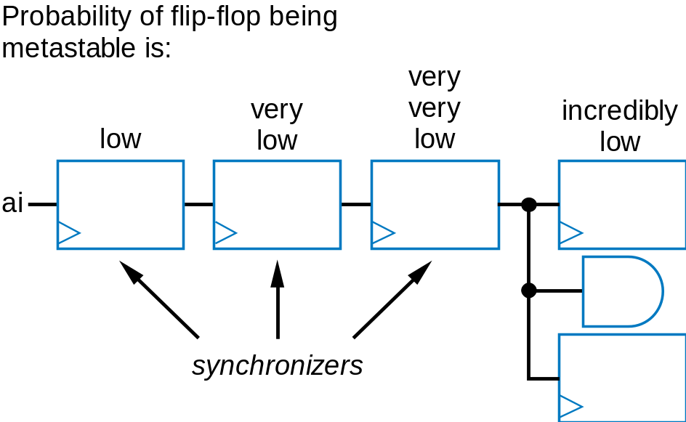
Metastability
Synchronizer flip-flop doesn’t completely prevent metastability
  But reduces probability of metastability in dozens/hundreds of internal flip-flops storing important values
  Adding more synchronizer flip-flops further reduces probability
    First ff likely stable before next clock; second ff very unlikely to have setup time violated
  Drawback: Change on input is delayed to internal flip-flops
    By three clock cycles in below circuit
a

Slide 39
Example of Reducing Metastability Probability
Recall earlier secure car key controller
Inputs: a; Outputs: r
a
Wait
r=0
a
a
’
Adding synchronizer flip-flop reduces metastability probability in state register, at expense of 1 cycle delay
K1
K2
K3
K4
r=1
r=1
r=0
r=1
a
r
outputs
O
r
iginal
D
a
r
FSM
Combinational
logic
n2
a
flip-flop
inputs
Combinational
n1
logic
n2
n0
n1
n0
s2
s1
s0
s2
s1
s0
clk
State register
clk
State register
a

Slide 40
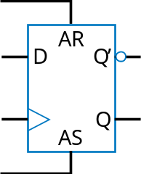
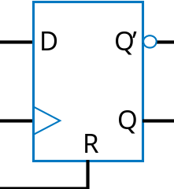
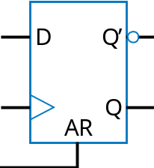
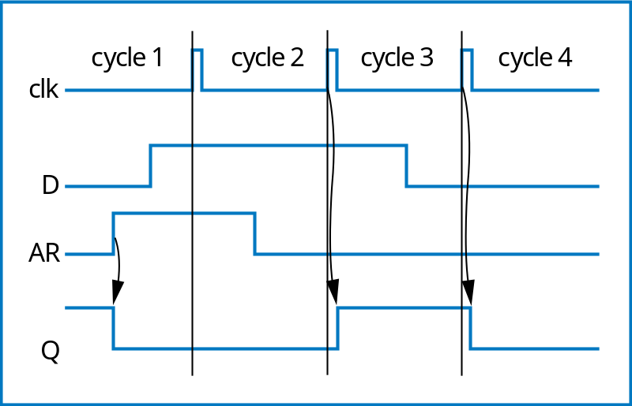
Flip-Flop Set and Reset Inputs
Some flip-flops have additional reset/set inputs
  Synchronous
    Synch. reset: Clears Q to 0 on next clock edge
    Synch. set: Sets Q to 1 on next clock edge
    Have priority over D input
  Asynchronous
    Asynch. reset: Clear Q to 0, independently of clock
      Example timing diagram shown
    Asynch. set: set Q to 1, indep. of clock

Slide 41
Initial State of a Controller
All our FSMs had initial state
  But our sequential circuits did not
  Can accomplish using flip-flops with reset/set inputs
    Shown circuit initializes flip-flops to 01
  Designer must ensure reset-controller input is 1 during power up of circuit
    By electronic circuit design
Inputs: x; Outputs: b
x=0
Off
b
’
b
x=1
x=1
x=1
On1
On2
On3
b
x
Combinational
logic
n1
n0
s1
s0
State register
clk
D
Q
’
D
Q
’
Controller with reset to initial state 01 (assuming state Off was encoded as 01).
R
Q
S
Q
reset
controller

Slide 42
Glitching
Glitch: Temporary values on outputs that appear soon after input changes, before stable new output values
Designer must determine whether glitching outputs may pose a problem
  If so, may consider adding flip-flops to outputs
    Delays output by one clock cycle, but may be OK
    Called registered output
b
x
xr
Combinational
D
n1
flip-flop
logic
n0
s1
s0
Laser timer controller with flip-flop to prevent glitches on x from unintentionally turning on laser
State register

Slide 43
Glitching
Alternative registered output approach, avoid 1 cycle delay:
  Add extra state register bit for each output
  Connect output directly to its bit
  No logic between state register flip-flop and output, hence no glitches
Inputs:
b
Outputs:
x
b
x
x=
0
Combinational
00
0
n1
Off
b
′
logic
n0
nx
b
s1
s0
sx
x=
1
x=
1
x=
1
01
1
On1
10
1
On2
11
1
On3
State register
But, uses more flip-flops, plus more logic to compute next state

Slide 44
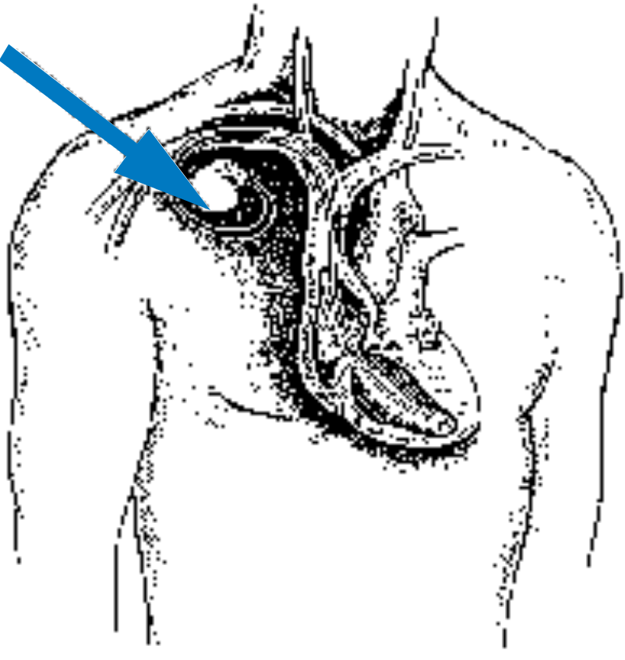
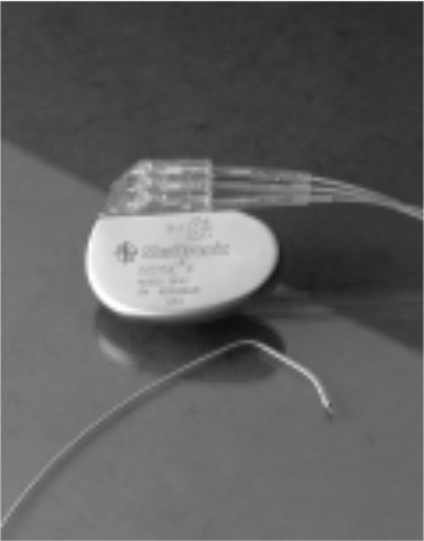
Product Profile: Pacemaker

Slide 45
Product Profile: Pacemaker
P
acema
k
er
Inputs
:
s
, z
Osc
Outputs
:
t, p
r
a
la
t=1
, p=0
s
′
′
Controller
r
v
lv
ResetTimer
s
z
p
t
z
W
ait
s
′
z
Timer
s
t=0
(counts d
o
wn
p=0
P
ace
p=1
from 0.8s)
t=0
Basic pacemaker

Slide 46
Product Profile: Pacemaker
P
acema
k
er
r
ight at
r
ium
Inputs
:
sa, za, s
v
, zv
Osc
Outputs
:
pa, ta, p
v
, tv
left at
r
ium
ta=1
sa
sa
′
*za
′
pa
ResetTimerA
Controller
sv
W
aitA
pv
sa
′
*za
sv
pa=1
ta
za
tv
zv
P
aceV
r
ight
left
sa
P
aceA
v
ent
r
icle
v
ent
r
icle
pv=1
sv
′
*zv
W
aitV
tv=1
TimerA
TimerV
ResetTimerV
sv
′
*zv
′
Atrioventricular pacemaker

Slide 47
Summary
FSM model to capture sequential behavior
  FSM: describe timing behavior of sequential circuit.
  States, and transitions among states.
FSM as a Controller
  Controller-Datapath architecture.
  Controller design process.
  Convert FSM to a circuit.
  Convert a circuit to FSM.
Miscellaneous
  Common mistakes when capturing FSMs.
  Metastability
  Glitching

