Slide 1
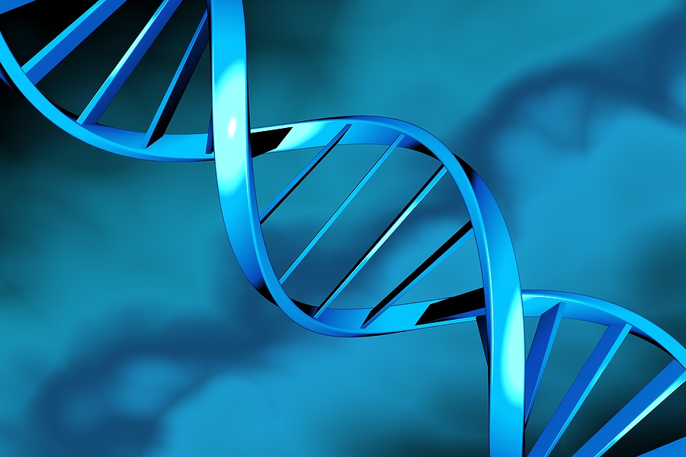
Simplifying Drug Research
Redbasin Networks

Slide 2
Elevator Pitch
Redbasin Networks provides software and services for simplifying cancer drug research

Slide 3
Redbasin Networks: Core Team
Engineering: 3 People
Biologists: 2 People
Sales: 1 Person
HR and Operations: 1 Person
Doctors: 2 People
Advisor: 1 Person

Slide 4
Target Customer
Our customers are researchers/research doctors
in Pharma/Biotech, Research and Treatment centers.

Slide 5
History & Opportunity
Process Driven
Genomic Era
Pre Genomic Era
Redbasin
Networks
Exploring the
Unknown
Product/Services
Offering
$100k –
Several Million
NextBio
Ingenuity
Exploring the known
Cost: $100k – Millions
Data Acquisition
Instrumentation
Lab Information
Management
System
(LIMS)
Lab Automation
System
(LAS)
3rd Generation
2nd Generation
I st Generation

Slide 6
Customer Pain Points
Investigative oncological processes missing
Deep insights of biology for drug R&D missing
Disease focus missing

Slide 7
Products & Services
Drug Investigation Study
Drug Resistance study
Drug Study
ADMET Study
Oncogene Behavior Study
Drug Biomarker Study
Population Feasibility Analysis
Patient Histology Research
Patient Pathology Analysis
Software Licensing
Drug Study Services
Related enzyme Study
Proteomics Study
Cell signaling Study
Ethnic subgroup Study
Biomarkers of PD/PK
Drug Efficacy
Ligand Binders Study
Enzymes Study
Signal Transduction
Epigenetic Study
Histone Modification
DNA Modification
(Methylation, Acetylation,
Ubiquitination)
Drug interaction study
( MDDI)

Slide 8
Patentable Technology
Pathway Genesis + 22 Algorithms

Slide 9
Drug Research (World Market): $60b
Source: Pharmaceutical Research & Manufacturers of America
World Market
Cancer Research Funds | Scientists/ Researchers | Physicians | IT Market | Cancer Universities/ Institutes | Bioscience companies
$10b | ~2,000,000 | 1,600,000 | $6b | ~200 | 42,000

Slide 10
Sales

Slide 11
Sales Strategy
Conferences, Bio Centers Life Science Associations Research & Academia Institutions
California 15,000 companies 100,000 Researchers
References from Customers KOL, Life Science Champions Invitation capabilities Recognition & Rewards
Viral Marketing via
Researchers, Partnerships, Press Coverage
Redbasin core team
Business with 250 Labs & Pharma
1500+ Life science connections
Source: Deloitte, Battelle, chi.org

Slide 12
Redbasin: Business Scalability A sweep through of 20% of content will yield us 80% of relationships. 80-20 advantage allows building a sustainable and scalable business
Cost
$10m
$4m
$2m
Content Relationships Diseases Market Size
1% 3% 3 (cancer types) $200m
5% 20% 10 (cancer types) $1b
10% 50% 2 Diseases $5b
20% 80% 5 Diseases $10b
$10b
Content
Relationships
Market Size
Diseases
$5b
80%
$1b
50%
20%
5 D
$200m
$500k
3%
2 D
10 C
20%
3 C
10%
1%
5%
Year 1 Year 2 Year 3 Year 4

Slide 13
We are seeking
$500K seed financing
Deliverables
Patent Filing
Version 1.0
Customer validation with 2 companies

Slide 14
Activities for Version 1.0
Data Engines
Gene Engine, Protein Engine, PDPK Engine, NCICancer Engine
PubMed Engine, Taxonomy Engine
Analysis Engine
Physiological and environmental models
Pathway Discovery Engine, Epigenetic Engine, Interaction Graph,
Enzyme, Ligand, Antibody, Drug efficacy, Oncogene, Drug interaction, Resistance, Biomarker, DNA, Cell Signaling, Histone, Patient Population, Proteomics
Cancer focus: Colorectal, Prostate
(Future focus : Leukemia, Breast, Lung Melanoma, Ovarian, Liver, Kidney)

