Slide 1
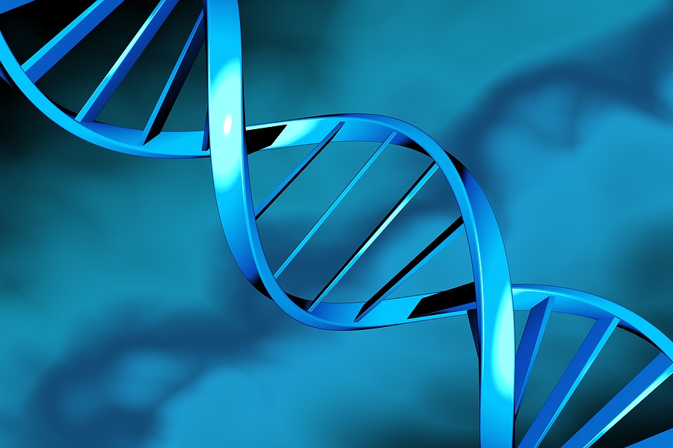
Simplifying Drug Research
Redbasin Networks

Slide 2
Introduction
Smitha Kulkarni Gudur, CEO
Manoj Joshi, CTO
Allan Grimes, VP Business
Neeta Potdar, VP HR & Admin
John Fernandez, Advisor

Slide 3
Redbasin Networks: Overview
Redbasin Networks provides a cloud based platform for cancer drug researchers in Pharma and Bio-tech.
Redbasin is a scalable technology and platform that allows Life Science researchers to gain insights about viable drug molecules and pathways.

Slide 4
Cancer Ecosystem Today
Drug Labs
FDA
EPA
Legal
Patients
Instrument vendors
Certification,
Approval
Biotech Labs
Insurance
Hospitals
Pharma
Contract Research Organization
CDC
Lab tests
Pub Med
Universities
Shipping

Slide 5
Good Data, Not Big Data!
Contextual Mining
Typical Instance – Contextual Slice
10m nodes
50m relationships
100m properties
Use case driven instances
225 dimensions

Slide 6
Cancer Market Research
1) 1.5m new cases in USA 2) 89m world wide deaths from 2005 – 2015
1) US Cancer spending $108b/yr 2) 10% of top 200 drugs cancer related, generate $1b/yr
Cancer Information Overload
Survey : Need Context relevance and personalization

Slide 7
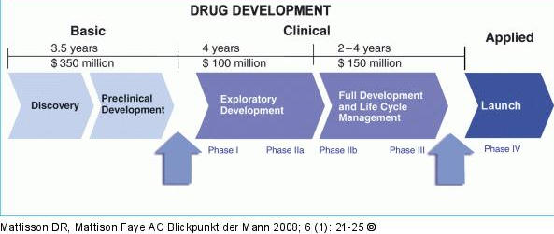
Typical Drug Life Cycle Costs

Slide 8
Redbasin Networks: Why Neo4j
Neo4j is a modern graph database
Very easy to use
Complex features that are used less often
have been dropped
High performance & scalability
Strong Java & REST Support

Slide 9
Why Not Go Relational?
Oncological meta-data is multi-dimensional
Pervasive joins are a drag on performance
Unpredictable schemas during mining
Temporality is difficult to represent

Slide 10
Comparing against other NoSQLs
Document stores like Mongo need excessive nesting.
Key value stores like Redis work for simple use cases
Hadoop supports high volume but not real time
Neo4j thrives on pervasive relationships like in Oncology

Slide 11
How does Redbasin use Neo4J?
Redbasin cloud connects to hundred’s of cancer data sources
Redbasin uses contextual mining to create dynamic graph model
We map Neo4j nodes, relationships, properties to Redbasin object model
We separate analytics from queries

Slide 12
How does Redbasin use Neo4J?
We have 225 oncology dimensions
Everything either a node or relationship or a property
We use indexes liberally

Slide 13
Node Index Example
IndexHits <Node> pNodeHits = drugIdIndex.get(DRUG_ID, drugConceptCode);
if (pNodeHits != null && pNodeHits.size() > 0) { // if node already exists
drugNode = pNodeHits.getSingle();
if (drugNode != null) {
if (!drugNode.hasProperty(DRUG_CONCEPT_CODE)) {
drugNode.setProperty(DRUG_CONCEPT_CODE, drugConceptCode);
}
if (!drugNode.hasProperty(BioEntityTypes.NODE_TYPE)) {
drugNode.setProperty(BioEntityTypes.NODE_TYPE, BioEntityTypes.RB_DRUG);
}
}
}

Slide 14
Neo4J Spring Data-isms
@Retention(RetentionPolicy.RUNTIME)
public @interface BioEntity {
public BioTypes bioType();
}
@Retention(RetentionPolicy.RUNTIME)
public @interface RelationshipEntity {
}

Slide 15
Neo4J Spring Data-isms
@Retention(RetentionPolicy.RUNTIME)
public @interface RelatedTo {
public Direction direction() default Direction.BOTH;
public BioRelTypes relType() default BioRelTypes.DEFAULT_RELATION;
public Class<?> elementClass() default Object.class;
public BioTypes endNodeBioType() default BioTypes.UNKNOWN;
public BioTypes startNodeBioType() default BioTypes.UNKNOWN;
}

Slide 16
Using Neo4J Rest API
public static String addNodeWithPropertyToIndex(String indexName, String value, Long nodeId, String key)
throws UnsupportedEncodingException,
MalformedURLException,
IOException,
UnknownHostException,
HttpException {
String uri = "http://" + Config.NEO_HOST + ":" + Config.NEO_PORT +
NeoURIRequests.ONLY_NODE_URI + nodeId;
String message =
"{"
+ "\"value\" :" + "\"" + value + "\","
+ "\"uri\" :" + "\"" + uri + "\","
+ "\"key\" :" + "\"" + key + "\""
+ "}";
return HttpPostUtil.postJson(NeoURIRequests.NODE_URI, indexName, message);
}

Slide 17
Redbasin vs Other BioModels
Redbasin | Other BioModels
Focused on Oncology | No focus on any specific Disease
Commercial drug research | Focused on academic knowledge
Information density is “infinite” | Information size is “infinite”
Temporality/pathway dependent | No time element
Hybrid vendor strategy | No co-existence scenario
One cloud for all Oncology | Typically downloadable software

Slide 18













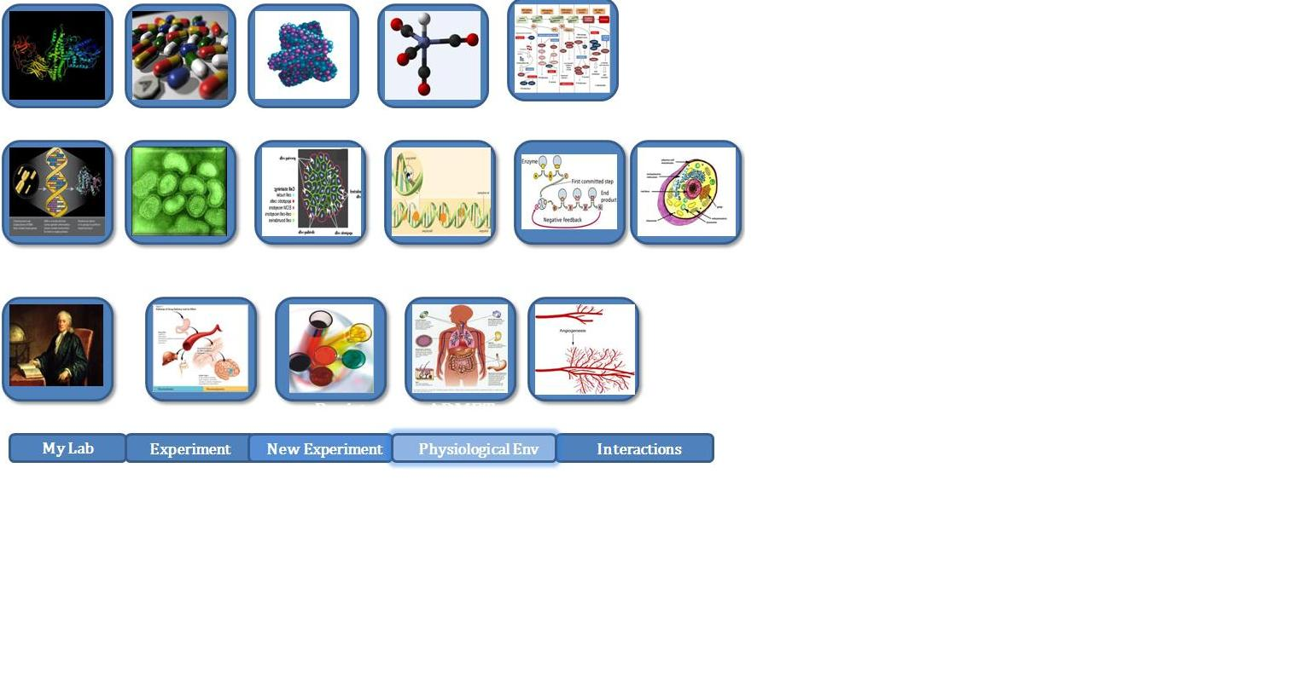
VEGF pathway generated
…Discovering VEGF interactions
EGFL7
α-EGFL7 Vascularization
VEGF
C-met
Notch
Drugs inhibit Notch
Coadmin
α-EGFL7
5-F-Uracil
VHL
hypoxia
tumor
H1F1α
up regulates VEGF, FGF
Avastin Drug
VEGF
FGF
Avastin
Sunitinib
VEGF ligand
inactivates
VEGFR
Tie2
FGFR
IGFR
TGFα-R
SLIT
VEGFR
PDGFR
endothelial cells
p13k
Src
FAK
MAPK
Smad2/3
PLC
pericyte
Akt
NoS
EKT1/2
proliferation
survival
vascular
permeability
migration
Vascular
guidance
drug
enzyme
protein
env
ligand

