Slide 1

Fuzzy Position Control Approach For An Autonomous Robot Controller Otonom Bir Robotun Bulanık Kontrollör Yaklaşımı ile Konum Kontrolü
MSc. Ali CETINKAYA
KTO Karatay University, Konya, Turkey
aalicetinkayaa@gmail.com
Prof.Dr. Novruz ALLAHVERDI
KTO Karatay University, Konya, Turkey
novruz.allahverdi@karatay.edu.tr
Kto karatay UNIVERSITY 2017 konya

Slide 2
Introduction
In This Study
fuzzy system is designed for autonomous robot controller
Arduino MEGA control board and Visual Studio 2015 C Sharp program
The fuzzy approach is compared with the traditional control method
KTO KARATAY UNIVERSITY 2017 KONYA

Slide 3
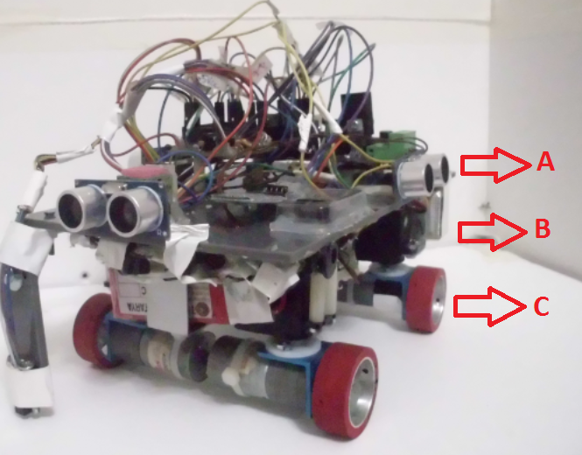
Introduction
Robot Components
A – Ultrasonic Sensors
B – Servo Motors
C – DC Motors
Fig. 1. Altu Robot Hardware
KTO KARATAY UNIVERSITY 2017 KONYA

Slide 4
Materials and Methods
Altu Robot Design
The robot body is made of a Plexiglass with a length of 140mm x 225mm and a thickness of 5mm as illustrated in Fig.1.
On the upper part of the body the following components can be found:
One wireless point (HC05).
Four ultrasonic sensors (H04).
One Schmitt trigger circuit (74HS14 ).
One microcontroller card (ATMEGA 2560).
One regulation circuit (LM2576-5V ).
KTO KARATAY UNIVERSITY 2017 KONYA

Slide 5
Materials and Methods
Altu Robot Design
On the lower part of the body:
One Li-Po battery (11.1V 800mA).
One Li-Po battery (7.4V 1050mA).
One DC motor driver card.
Four ON-OFF buttons and the charger section.
Four servo motors (12 V 500RPM).
Four silicon wheels;
One regulated circuit (7805 R 5V).
Two infrared sensors (QRD1114).
KTO KARATAY UNIVERSITY 2017 KONYA

Slide 6
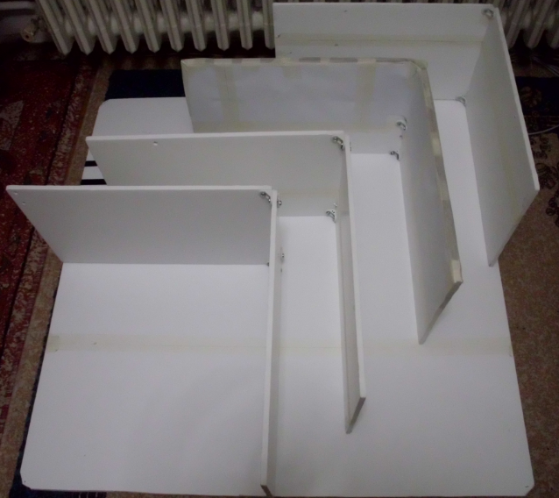
Materials and Methods
Robot Test Environment
Altu robot, the track is limited to 1m2 , and thus the sensor is suitable for this work. The track is made of strap and the edges of the track are covered by four L-shaped pieces.
Fig. 2. Altu Robot tracks limit
KTO KARATAY UNIVERSITY 2017 KONYA

Slide 7
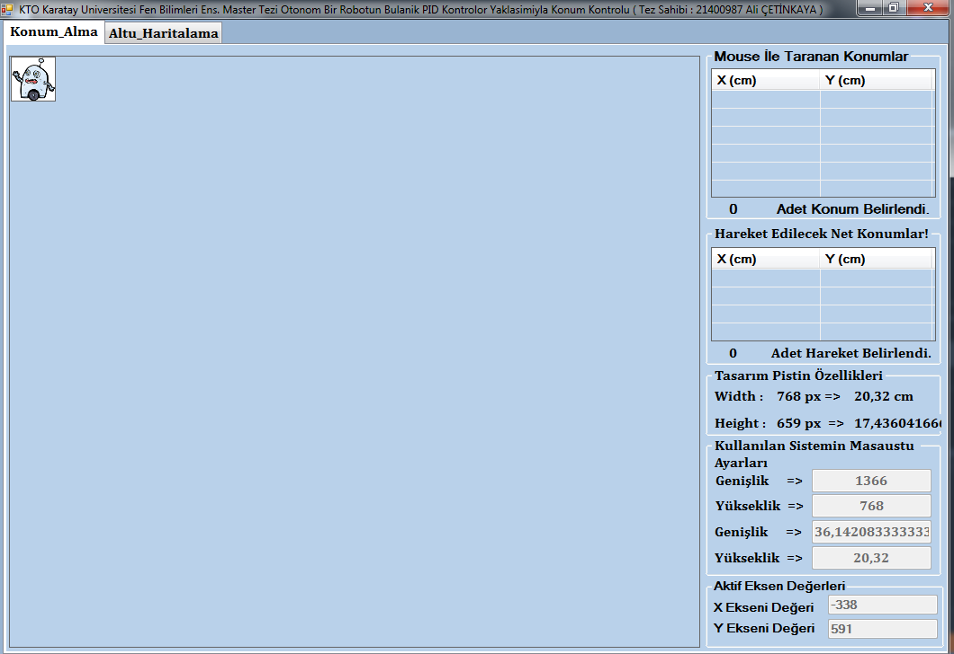
Materials and Methods
Visual Studio 2015 C Sharp program – Getting location
KTO KARATAY UNIVERSITY 2017 KONYA

Slide 8
Materials and Methods
Visual Studio 2015 C Sharp program - Mapping
KTO KARATAY UNIVERSITY 2017 KONYA

Slide 9
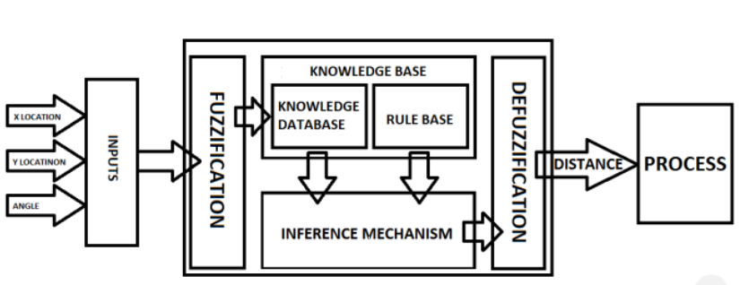
Materials and Methods
Fuzzy Control Approach
Fig. 3. Blok diagram of the fuzzy system.
KTO KARATAY UNIVERSITY 2017 KONYA

Slide 10
Materials and Methods >Mempersip
The block diagram od the fuzzy control system designed for this study is shown in Fig. 3.
The Fuzzy unit of Altu Robot consist of input and output variables, fuzzification, fuzzy inference and defuzzyfication units.
The input and output variables of the designed controller are:
X position (0 - 100 cm), Y position(0 - 100cm), Angle (0-90˚) and Distance (0 – 140 cm).

Slide 11
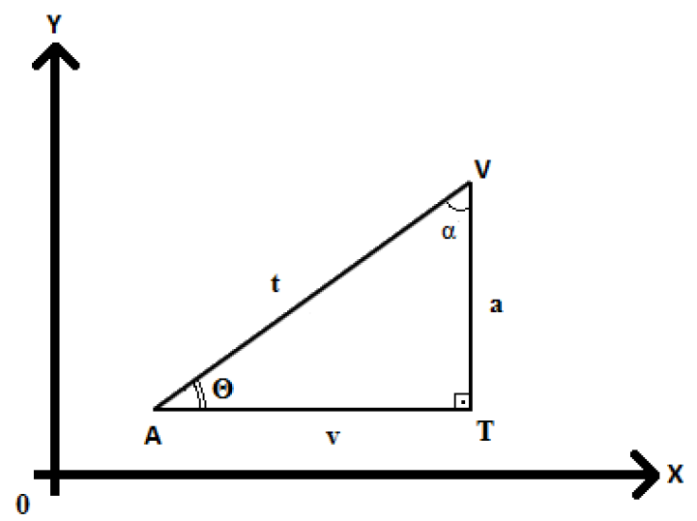
Materials and Methods
Control System – Calculate Distance
teta_acisi = 90 - (Math.Atan((konum_y_farki) / (konum_x_farki)) * 180 / Math.PI);
textBox_aci_gelen.Text = teta_acisi.ToString();
mesafe = Math.Sqrt(Math.Pow(konum_x_farki, 2) + Math.Pow(konum_y_farki, 2));
textBox_mesafe_hesaplanan.Text = mesafe.ToString();
KTO KARATAY UNIVERSITY 2017 KONYA

Slide 12
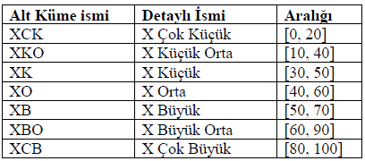
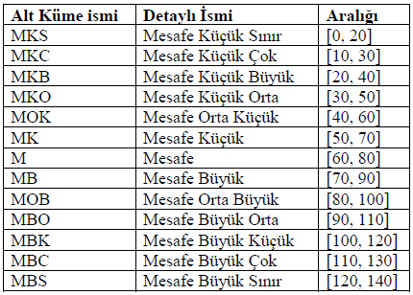
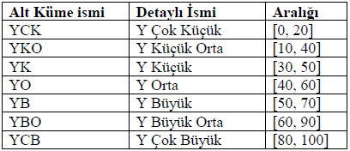
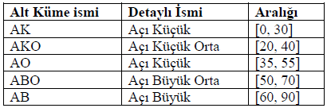
Materials and Methods
Fuzzification
X and Y are expressed separately using seven fuzzy subsets
The angle variable is expressed with five fuzzy subsests
The distance variable expressed with thirteen fuzzy subsests
KTO KARATAY UNIVERSITY 2017 KONYA

Slide 13
Materials and Methods
>Membership Processes
Graph of fuzzy input subsests of X position data
Graph of fuzzy input subsests of Y position data
Graph of fuzzy input subsests of Angle ϴ
Graph of fuzzy output subsests of Distance data
KTO KARATAY UNIVERSITY 2017 KONYA

Slide 14
Materials and Methods
Fuzzy Inference
Fuzzy rules are the most important part of fuzzy control. In this part, the Altu robot fuzzy knowledge base and decision making mechanism are created. There ara many techniques available for creating fuzzy inference.
In this study max-min (Mamdani) method is adopted.

Slide 15
Materyal ve Metot
Determination of Fuzzy Rules
Rule 1. If XCK,YCK ,and AK, then the distance value is MKS
….
Rule 71. If XO, YCK, and AB, then the distance value is MOK
….
Rule 141. If XCB, YCB, and AB, then the distance value is MBS
KTO KARATAY UNIVERSITY 2017 KONYA

Slide 16
Materials and Methods
Defuzzification
In this work, 141 fuzzy rules are defined that relate the verbal expression and the fuzzy expressions of each input and output variables.
There are several methods to do that transformation. In this work, the weight average method is used to identify the single and exact values
KTO KARATAY UNIVERSITY 2017 KONYA

Slide 17
Experimentals
ICAT’17 ISTANBUL

Slide 18
Experimentals

Slide 19
Experimentals

Slide 20
Experimentals
ICAT’17 ISTANBUL

Slide 21
Experimentals

Slide 22
Experimentals

Slide 23
Experimentals
ICAT’17 ISTANBUL

Slide 24
Experimentals
ICAT’17 ISTANBUL

Slide 25
Conclusions
In this study, the ”Fuzzy Approach” and the ”Traditional” methods for controlling the Altu robot autonomously have been designed and applied practically. Both methods have been tested and the results have been compared in the experiment section….
Acknowledgment
The authors thank the KTO Karatay University for supporting this work.
KTO KARATAY UNIVERSITY 2017 KONYA

Slide 26
Thank you… Contact Information: e_mail: aalicetinkayaa@gmail.com
KTO KARATAY UNIVERSITY 2017 KONYA

