Slide 1
Manager_dashboard
File created on: 10/13/2024 7:58:08 AM
Author: June Ramirez

Slide 2
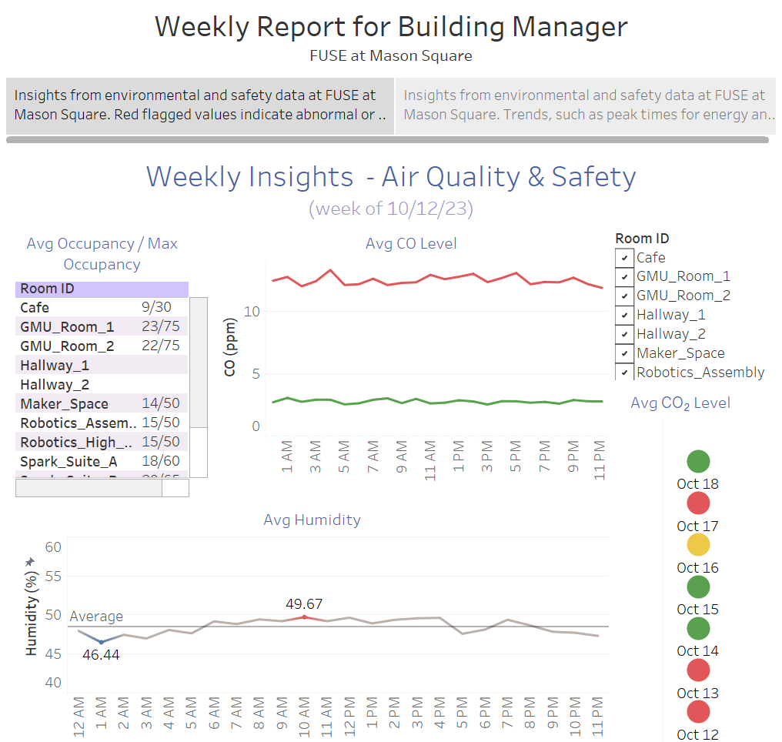

Slide 3
