Slide 1

Investment Strategy: Mortgage-Backed Securities
Significant Factors Impacting Sale Prices
Analysis and Presentation by Alonzo Gaither

Slide 2
Analysis Objectives
The purpose of this analysis is to determine if there are less widely considered attributes that will make a property more valuable compared to other well-maintained homes in sought after communities.
The attributes considered in the analysis are:
The materials that the exterior of the home are constructed of.
The shape of the lot containing the home.
The material used to construct any fencing outlining the property.
Notes:
Interior home improvements are intuitive contributors to home value. A multi-car garage, renovated kitchen, finished basement, and numerous full bathrooms are well known facets of a valuable home.
Finding property in a coveted locale is another obvious contributor to a higher sale price.

Slide 3
Analysis
The first step for each of the three analyses was to gather data on home attributes and sale prices. The data included 1461 homes and up to 80 data points for each home
The second step was to calculate descriptive statistics and illustrate frequency distribution using a histogram chart.
The next step was to conduct a t-test with the intent of determining whether the difference in average sale price supported a conclusion of higher value given one attribute over the other.
Notes:
For all three analyses, measures of central tendency and frequency distribution justified further exploration.
For all three analyses, measures of central tendency and frequency distribution justified further exploration.
Outlier values were removed so that the accuracy of the tests were not negatively impacted.

Slide 4
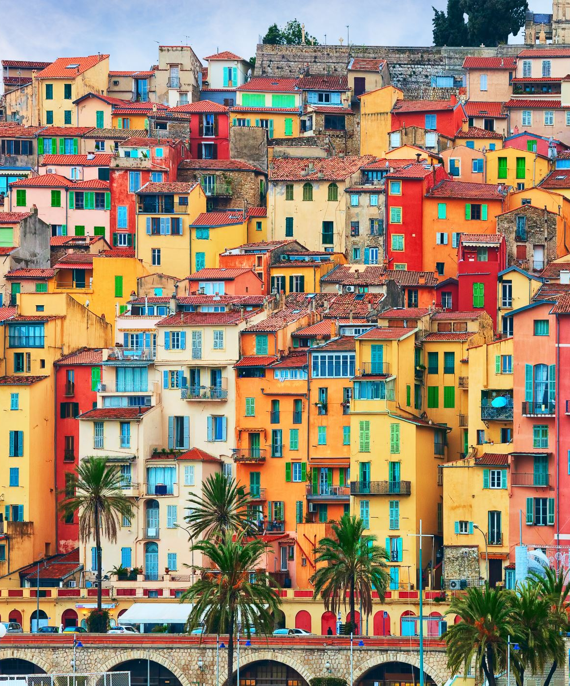
Hypothesis 1: Exterior
Null Hypothesis:
There is no significant difference between home sale prices for homes with a vinyl exterior and homes with non-vinyl exterior.
Alternative Hypothesis:
There is a significant difference between home sale prices for homes with a vinyl exterior and homes with non-vinyl exterior.

Slide 5
Conclusion 1: Exterior
Homes with vinyl exteriors have significantly higher average sales price than homes with non-vinyl exteriors.
As p (3.82251567636431E-49) is less than alpha (.05) reject the null hypothesis.

Slide 6
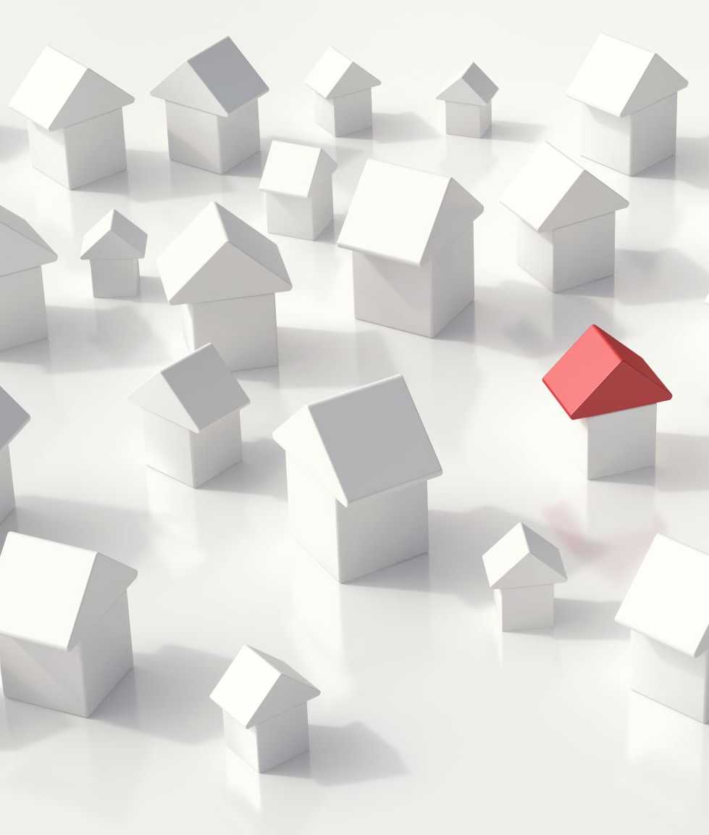
Hypothesis 2: Lot Shape
Null Hypothesis:
There is no significant difference between home sale prices for homes with regular lot shapes and homes with irregular lot shapes.
Alternative Hypothesis:
There is a significant difference between home sale prices for homes with regular lot shapes and homes with irregular lot shapes.

Slide 7
Conclusion 2: Lot Shape
Homes with irregular lot shapes have significantly higher average sale prices than homes with regular lot shapes.
As p (3.54872204463304E-38) is less than alpha (.05) reject the null hypothesis.

Slide 8
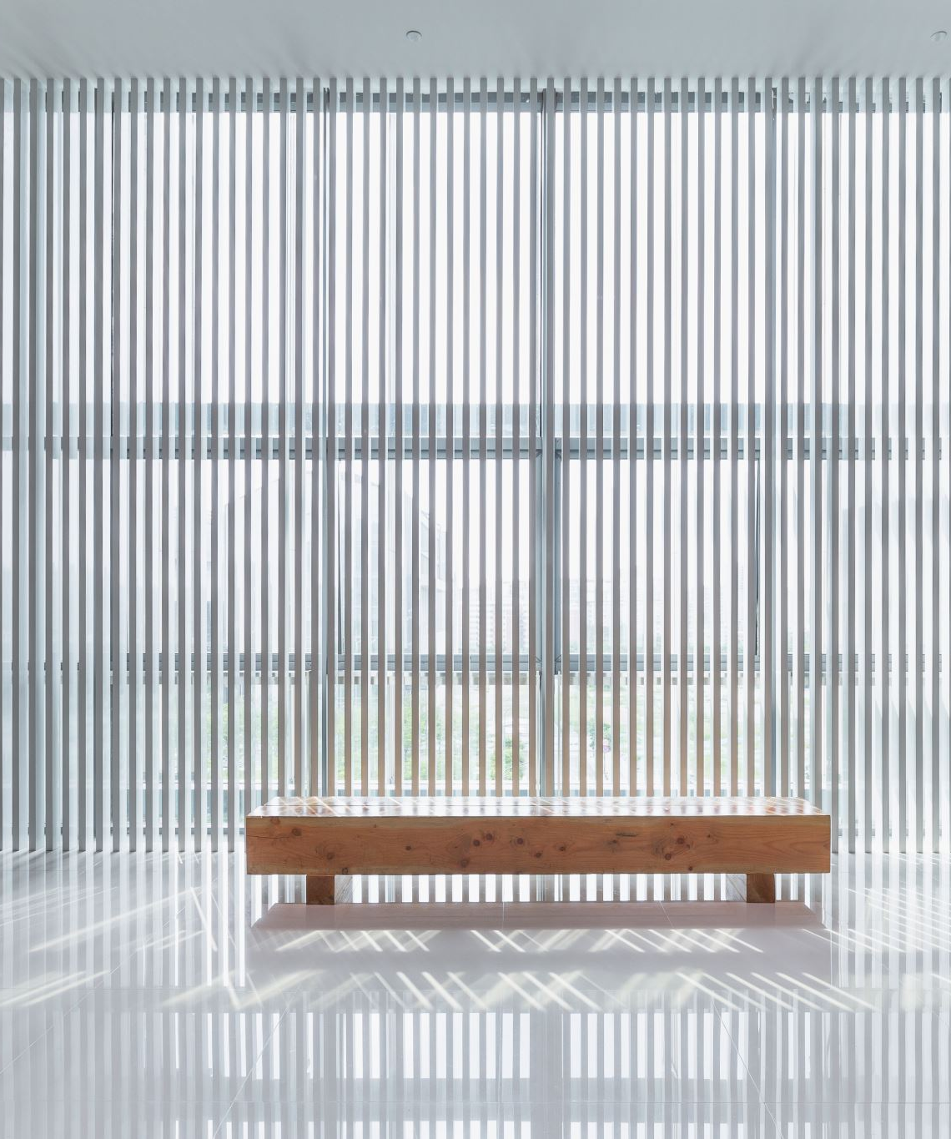
Hypothesis 3: Fencing
Null Hypothesis:
There is no significant difference between home sale prices for homes that have a privacy fence and homes that have wood and wire fencing.
Alternative Hypothesis:
There is a significant difference between home sale prices for homes that have a privacy fence and homes that have wood and wire fencing.

Slide 9
Conclusion 3: Fencing
Homes with a privacy fence have a significantly higher average sale price than homes with wood and wire fencing.
As p (.0012) is less than alpha (.05) reject the null hypothesis.

Slide 10

Investment Strategy Recommendations
An MBS can be a lucrative investment but comes with considerable risk. Finding the highest value properties can be a key risk abating tool. These recommendations will aid in identifying profitability in a saturated marketplace.
Look to invest in homes with vinyl exteriors. These homes will potentially sell for 33.3% more than homes with exteriors made of other materials.
Seek properties with irregular lot shapes. These could be 29% more valuable than properties with regular lot shapes.
Properties with privacy fencing may sell for up to 11.7% more than properties with wood or wire fences. By targeting these properties, the chances of a sizeable return are significantly increased.

