Slide 1
Lariat Fleet Analysis
Study Conducted By: Alonzo Gaither

Slide 2


Fleet Summary
Lariat’s fleet consists of:
73 makes
878 models
And 4000 total cars
In 2018 the fleet accommodated:
81,318 total trips
Across 50 different branches
In 22 states

Slide 3

Fleet Financial Data
Operating costs including annual expenses and insurance:
$2,756,390.72
Revenue generated:
$52,830,207.00
Net profit:
$50,073,816.28

Slide 4

Analysis Goals
General objectives:
Make smarter business decisions
Analyze the costs and revenue generated by fleet
Minimize costs and maximize revenue

Slide 5

Methodology
To uncover insights, Lariat’s fleet of 4000 cars was separated into 73 makes.
From there, the cars were separated into 8 different groups (octants) based on the profit generated per trip.
Profit per trip was used to organize car makes because it accounts for cost, revenue, and utility amongst the other makes in the fleet.
Tables for each octant account for the total number of cars for all makes, total costs, total revenue, and total profit.
Finally, an analysis was conducted to study the impact of redistributing the total number of cars per octant on total fleet costs, revenue, and profit.

Slide 6
Car Makes by Octant
Octant 1
Renault
MG
Geo
Spyker
McLaren
Citroen
Jensen
Alfa Romeo
Daihatsu
Octant 2
Holden
Lamborghini
Isuzu
Aston Martin
Lincoln
Bentley
Infiniti
Mitsubishi
Cadillac

Slide 7
Car Makes by Octant (continued)
Octant 3
Volkswagen
Daewoo
Nissan
Mercedes-Benz
Ford
Chevrolet
Morgan
Scion
Shelby
Octant 4
Lexus
Audi
Studebaker
Mercury
GMC
Pontiac
Suzuki
Aptera
Lotus

Slide 8
Car Makes by Octant (continued)
Octant 5
Mazda
Hyundai
Jeep
Toyota
Buick
Dodge
Subaru
Volvo
Honda
Octant 6
Acura
Land Rover
Ferrari
Porsche
Chrysler
BMW
Ram
Plymouth
Maserati

Slide 9
Car Makes by Octant (continued)
Octant 7
Hummer
Saturn
Kia
Austin
Panoz
Rolls-Royce
Oldsmobile
Jaguar
Saab
Octant 8
Tesla
Maybach
Eagle
Smart
MINI
Merkur
Hillman
Peugeot
Fiat
Corbin

Slide 10

Initial Insight
Redistributing the fleet by reducing the number of cars in one octant, either totally or in part, yielded little to no change in costs or revenue.
Therefore, the conclusion was drawn that in order to make worthwhile impacts on costs and revenue there would have to be more dramatic redistribution efforts.
From this initial insight the strategy of reducing the fleet to the car makes within 3 octants was derived.

Slide 11
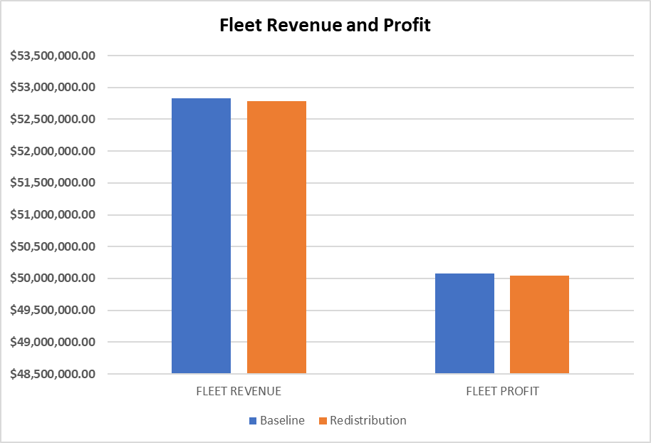
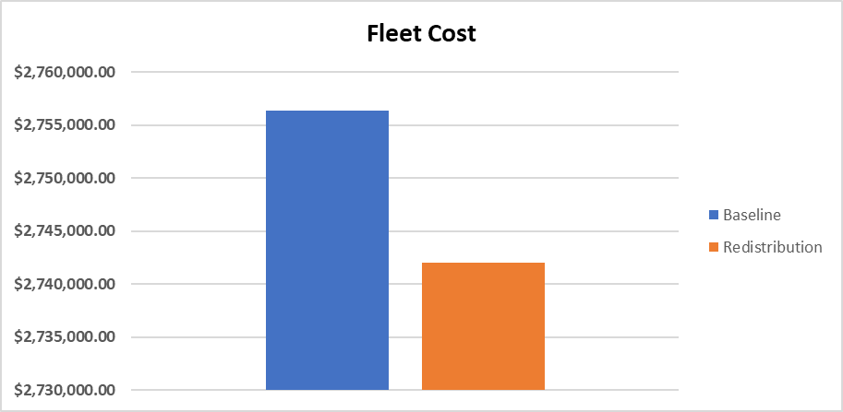
Strategy 1: Eliminate High-Cost Car Makes
Insight: Fleet redistribution that filters to minimize costs led to slight drops in fleet revenue and profitability.
1.04% drop in costs but .09% drop in revenue

Slide 12
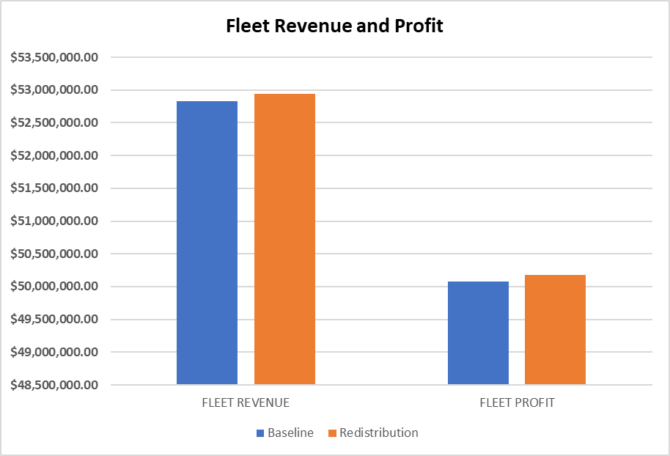
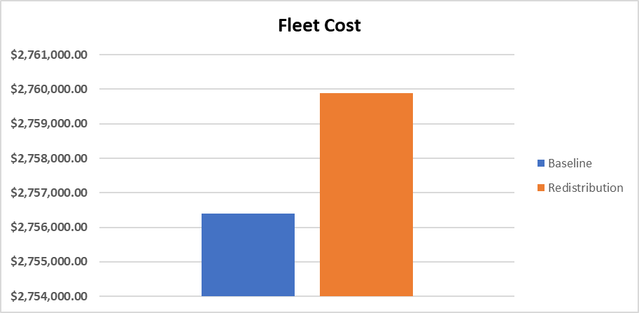
Strategy 2: Increase High-Revenue Car Makes
Insight: Fleet redistribution that filters to increase revenue led to relatively marginal increases in costs as well as profits.
.22% increase in profitability but .13% increase in costs

Slide 13
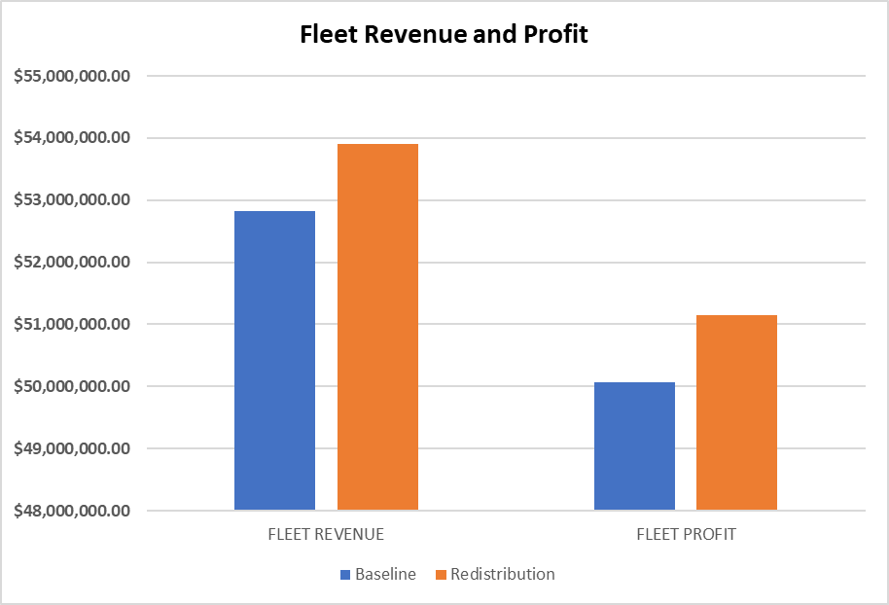
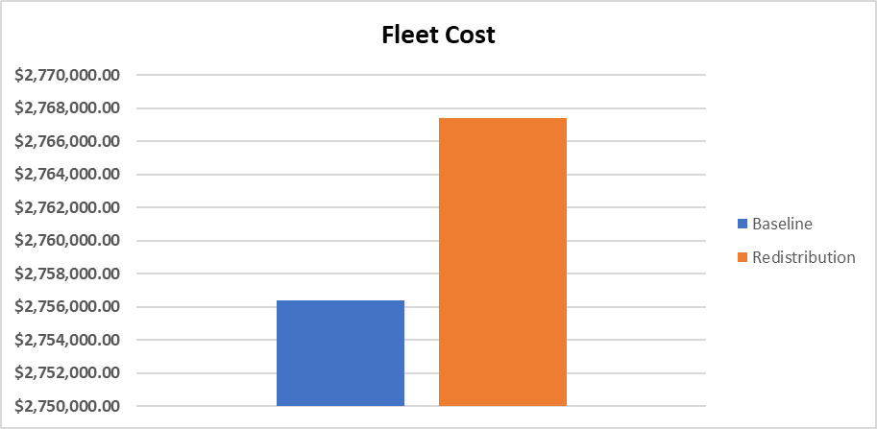
Strategy 3: Concentrate Fleet in High-Profit Car Makes
Insight: Fleet redistribution that filters to maximize profit led to a relatively small increase in costs but sharp increases in revenue and profitability.
Net cost increase of $11,003.82 and net profit gain of $1,070,559.22

Slide 14
Recommendation
Redistributing the fleet in order to maximize profits is the best strategy to update the efficiency of the fleet.
Although net costs will increase, the costs of the new fleet will be .54% of profit versus .55% of profit for the current fleet. The new fleet will produce a relative decrease in costs.
Fleet profitability and revenue will both increase by 1.02%.

Slide 15
Recommended Fleet
Group 1
833 Cars
Car Makes: Renault, MG, Geo, Spyker, McLaren, Citroen, Jensen, Alfa Romeo, Daihatsu
Group 2
1287 Cars
Car Makes: Holden, Lamborghini, Isuzu, Aston Martin, Lincoln, Bentley, Infiniti, Mitsubishi, Cadillac
Group 3
1880 Cars
Car Makes: Volkswagen, Daewoo, Nissan, Mercedes-Benz, Ford, Chevrolet, Morgan, Scion, Shelby

