Slide 1

Agile, Secure Cloud Applications @ UC Davis
Adam Getchell
acgetchell@ucdavis.edu
https://github.com/acgetchell
http://www.linkedin.com/in/adamgetchell
ucdotnet@ucdavis.edu
TIF Ignite Session
March 28, 2012
University of California Davis

Slide 2
Online Pre-Purchasing in 6 months

Slide 3
Online Pre-Purchasing in 6 months

Slide 4
What we’re doing Right
We are starting to listen to the demands of our customers – the “virtuous feedback loop”
We are starting to leverage the power of the web
We are starting to work together
We are starting to use known/good software engineering principles
“Central” systems are starting to understand that they provide consumable services to a wide range of applications and end users, and that they need to be flexible (= APIs and documentation)

Slide 5
What we’re doing Right
Agile development, Pre-Purchasing Steering Committee, UserVoice
HTML5, CSS, Javascript, RESTful web services
GitHub, code sprints, frequent meetings with clients (agile development)
Solid architecture, code review, test-driven development, continuous integration, instrumentation
Application Programming Interfaces, documentation

Slide 6
What we’re doing wrong
We think all Programmers are created equal

Slide 7
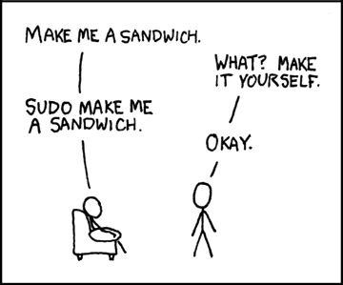
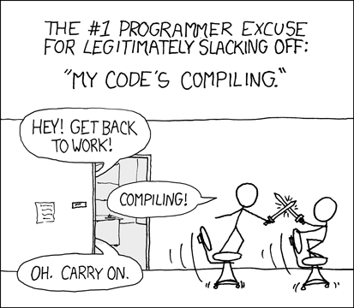
Programmer (noun): An organism that can turn caffeine and alcohol into code*
http://xkcd.com/149/
http://xkcd.com/303/
* http://uncyclopedia.wikia.com/wiki/Programmer

Slide 8
Picture of Applications Stack

Slide 9
What we’re doing wrong
Virtualization ≠ Cloud Services
-> DevOps = ??? (a combination of the above)

Slide 10
What we’re doing wrong
Authentication
CAS is UC Davis only, difficult for “post-PC” devices
Shibboleth is hard to setup, hard to use, narrow in scope
OAuth 2.0 is the rest of the web
Google, Facebook, major cloud providers
Why not UC?
Non-secured APIs (hint: OAuth 2.0)
Authorization

Slide 11
What we’re doing Wrong
Not Invented Here syndrome
We’re not Sharing enough! (i.e. useless language/tool debates, service catalogs)
= We are still working on the balance between central and departmental services

Slide 12
Let’s fix it together!
Adam Getchell
acgetchell@ucdavis.edu
https://github.com/acgetchell
http://www.linkedin.com/in/adamgetchell
ucdotnet@ucdavis.edu
TIF Ignite Session
March 28, 2012
University of California Davis

