Slide 1

Agile Software Development @ UC Davis
Adam Getchell
acgetchell@ucdavis.edu
https://github.com/acgetchell
http://www.linkedin.com/in/adamgetchell
ucdotnet@ucdavis.edu
TIF Ignite Session
March 28, 2012
University of California Davis

Slide 2
Requisites
Culture
Collaboration
Process
Cloud
Services

Slide 3
Culture
We are in a research institution whose output is academic publications – and yet, we do not apply the same processes of peer-review, independent verification, and publication to our software.
Publish!
We don’t even fully consult with the intended users of our software before we design it!
And we rarely get their input while we’re writing it!
Not Invented Here syndrome
Who fixes problems?
Peer Review!
= We are still working on the balance between central and departmental services
= Better Collaboration

Slide 4
Bug Fix costs
The longer a bug sits, the harder it is to fix*
Compiler errors trivial
A few days ago easier
Months ago???
The same applies to designing the application to begin with

Slide 5
Collaboration
Get Programmers to collaborate by project, not reporting relationship
We’re Not Sharing Enough! (i.e. useless language/tool debates, service catalogs)
It’s not about the language or tool
It’s about usable, actionable Software Development Standards!
And documentation (LP)
Comments are NOT sufficient documentation
Test cases are NOT “executable” documentation
Need to know Why something was done, not How
And a Service Catalog
Using well-known APIs (RESTFul, OAuth, etc.)
Publish/Peer Review on GitHub

Slide 6
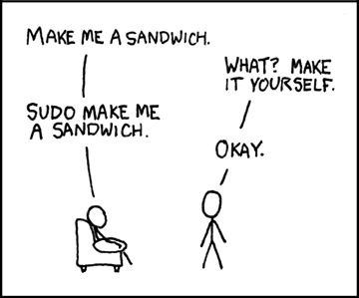
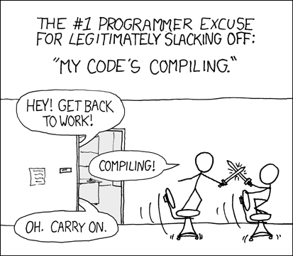
Programmer (noun): An organism that can turn caffeine and alcohol into code*
http://xkcd.com/149/
http://xkcd.com/303/
* http://uncyclopedia.wikia.com/wiki/Programmer
Notes:
Cloud first slide, continuous integration second

Slide 7
Process
The Joel (Spolsky) Test*:
Do you use source control?
Can you make a build in one step?
Do you make daily builds?
Do you have a bug database?
Do you fix bugs before writing new code
Do you have an up-to-date schedule
Do you have a spec?
Do programmers have quiet working conditions?
Do you use the best tools?
Do you have testers?
Do new candidates write code during interviews?
Do you do hallway usability testing?
* http://www.joelonsoftware.com/articles/fog0000000043.html

Slide 8
Cloud
Virtualization ≠ Cloud Services
-> DevOps = ??? (a combination of the above)
But see:
Ford, Bryan. “Icebergs in the Clouds: The Other Risks of Cloud Computing.” arXiv:1203.1979 (March 8, 2012). http://arxiv.org/abs/1203.1979.

Slide 9
PalletOps
From “Pallet: DevOps for the JVM”
@tbatchelli a.k.a. @disclojure
Clojure/West 2012
http://palletops.com/

Slide 10
Cloud

Slide 11
Cloud

Slide 12
Cloud

Slide 13
Cloud

Slide 14
Cloud

Slide 15
Cloud

Slide 16
Cloud

Slide 17
Cloud

Slide 18
Services
Why do we buy cloud computing from Amazon, an online bookstore?
Steve Yegge’s Google Platform* rant:
All teams expose their data and functionality through service interfaces
Teams must communicate with each other through these interfaces
There will be no other form of interprocess communication allowed: no direct linking, no direct reads of another team’s data store, no shared-memory model, no back doors whatsoever
It doesn’t matter what technology is used
All service interfaces, without exception, must be designed from the ground up to be externalizable.
Anyone who doesn’t do this will be fired
http://news.ycombinator.com/item?id=3101876

Slide 19
Services
Authentication
CAS is UC Davis only, difficult for “post-PC” devices
Shibboleth is hard to setup, hard to use, narrow in scope
OAuth 2.0 is the rest of the web
Google, Facebook, major cloud providers
Why not UC?
Non-secured APIs (hint: OAuth 2.0)
SOAP is insecure without a shared secret
With a shared secret, it’s difficult to mange
Authorization (API)
CatBert v4 is a web API for Authorization

Slide 20
Let’s fix it together!
Adam Getchell
acgetchell@ucdavis.edu
https://github.com/acgetchell
http://www.linkedin.com/in/adamgetchell
ucdotnet@ucdavis.edu
TIF Ignite Session
March 28, 2012
University of California Davis

