Slide 1

Agile, Secure Cloud Applications @ UC Davis
Adam Getchell
acgetchell@ucdavis.edu
https://github.com/acgetchell
http://www.linkedin.com/in/adamgetchell
ucdotnet@ucdavis.edu
TIF Ignite Session
March 28, 2012
University of California Davis

Slide 2
Online Pre-Purchasing in 7 months
(Show pretty graphcs on GitHub)

Slide 3
Online Pre-Purchasing in 7 months
Agile development using Trello for user stories, GitHub for source code management/collaboration, and TeamCity for Continuous Integration (and eventually, deployment!)
Battle-tested architecture using JavaScript front end (jQuery, knockout,) UCDArch (MVC, Nhibernate, CAS, etc) middle layer, SQL server backend, SOAP APIs
Cloud infrastructure using Ganeti, managed by CSE (Bill Broadley) and running in the DataCenter
UserVoice for feedback

Slide 4
What we’re doing Right
We are starting to listen to the demands of our customers – the “virtuous feedback loop”
We are starting to leverage the power of the web
We are starting to work together
We are starting to use known/good software engineering principles
“Central” systems are starting to understand that they provide consumable services to a wide range of applications and end users, and that they need to be flexible (= APIs and documentation)

Slide 5
What we’re doing Right
Agile development, Pre-Purchasing Steering Committee, UserVoice
HTML5, CSS, Javascript, RESTful web services
GitHub, code sprints, frequent meetings with clients (agile development)
Solid architecture, code review, test-driven development, continuous integration, instrumentation
Application Programming Interfaces, documentation

Slide 6
What we’re doing wrong
We think all Programmers are created equal

Slide 7
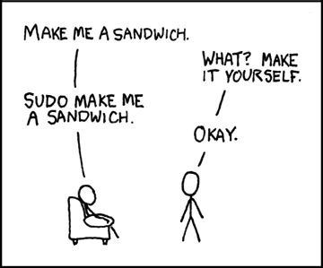
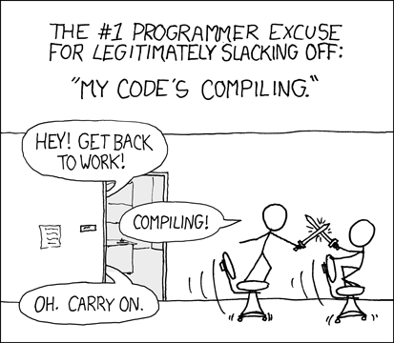
Programmer (noun): An organism that can turn caffeine and alcohol into code*
http://xkcd.com/149/
http://xkcd.com/303/
* http://uncyclopedia.wikia.com/wiki/Programmer

Slide 8
Picture of Applications Stack

Slide 9
What we’re doing wrong
Virtualization ≠ Cloud Services
-> DevOps = ??? (a combination of the above)

Slide 10
What we’re doing wrong
Authentication
CAS is UC Davis only, difficult for “post-PC” devices
Shibboleth is hard to setup, hard to use, narrow in scope
OAuth 2.0 is the rest of the web
Google, Facebook, major cloud providers
Why not UC?
Non-secured APIs (hint: OAuth 2.0)
SOAP is insecure without a shared secret
With a shared secret, it’s difficult to mange
Authorization (API)
CatBert v4 is a web API for Authorization

Slide 11
What we’re doing Wrong
Not Invented Here syndrome
We’re Not Sharing Enough! (i.e. useless language/tool debates, service catalogs)
It’s not about the language or tool
It’s about usable, actionable Software Development Standards!
And documentation (LP)
Comments are NOT sufficient documentation
Test cases are NOT “executable” documentation
Need to know Why something was done, not How
And a Service Catalog
Using well-known APIs (RESTFul, OAuth, etc.)
= We are still working on the balance between central and departmental services
= Better Collaboration

Slide 12
Let’s fix it together!
Adam Getchell
acgetchell@ucdavis.edu
https://github.com/acgetchell
http://www.linkedin.com/in/adamgetchell
ucdotnet@ucdavis.edu
TIF Ignite Session
March 28, 2012
University of California Davis

